Slide 1
THE NEW LOGISTICS OF KNOWLEDGE

Slide 2
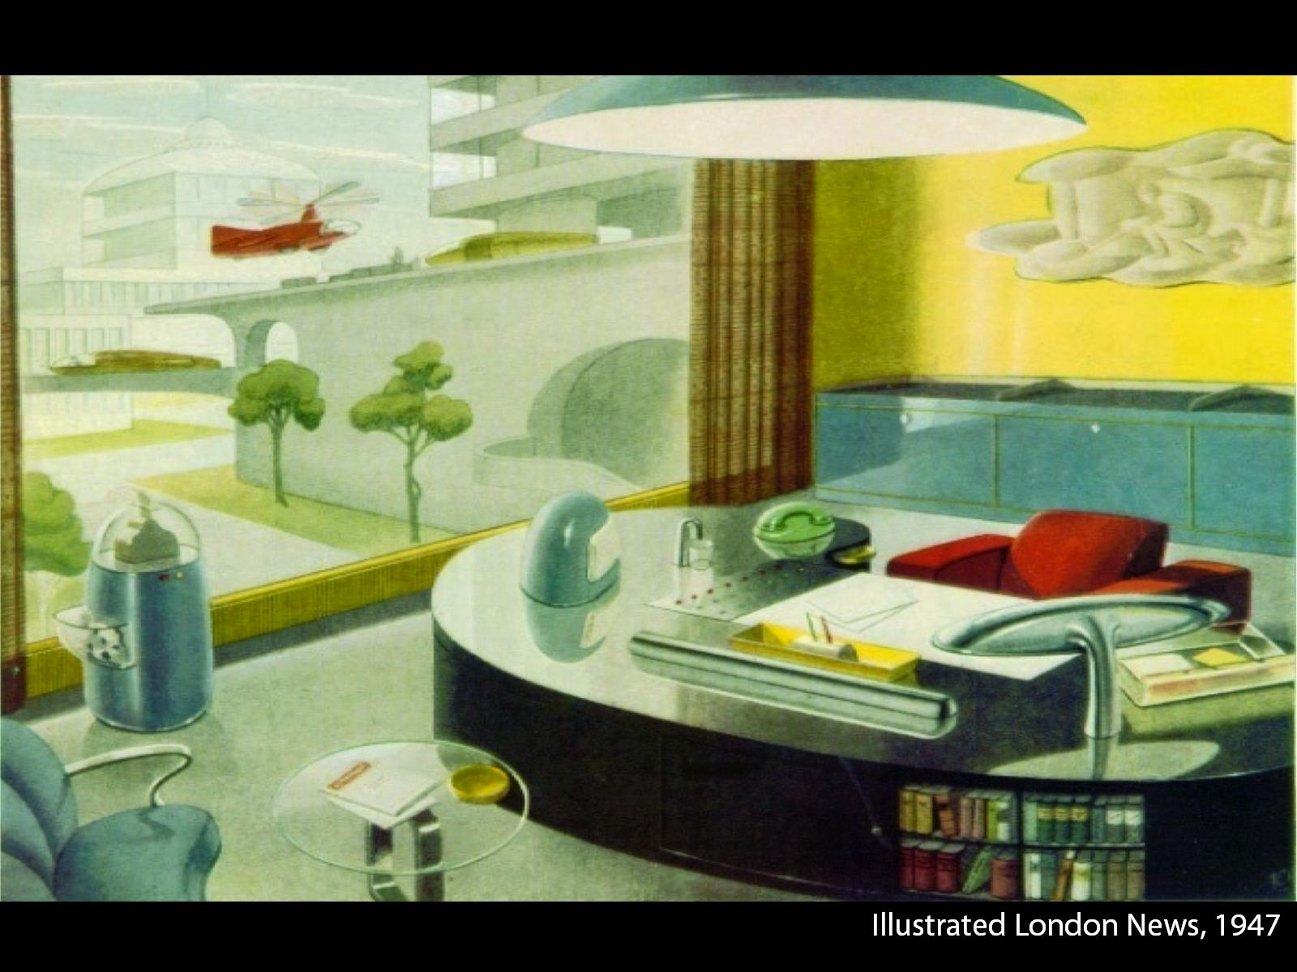

Slide 3
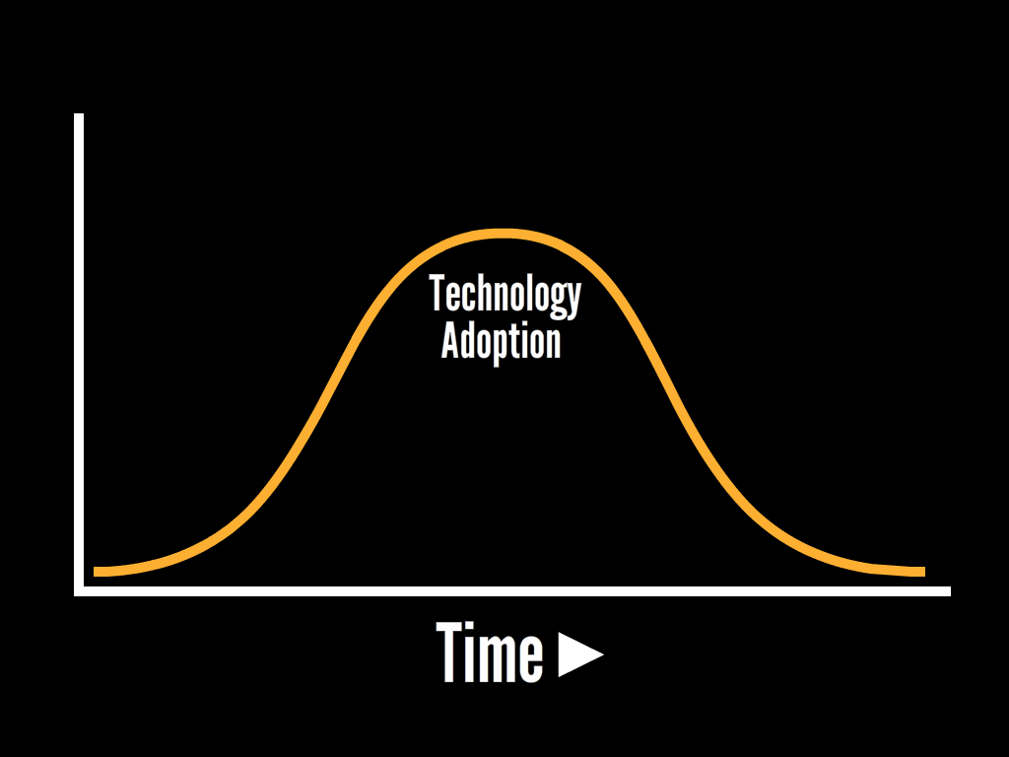
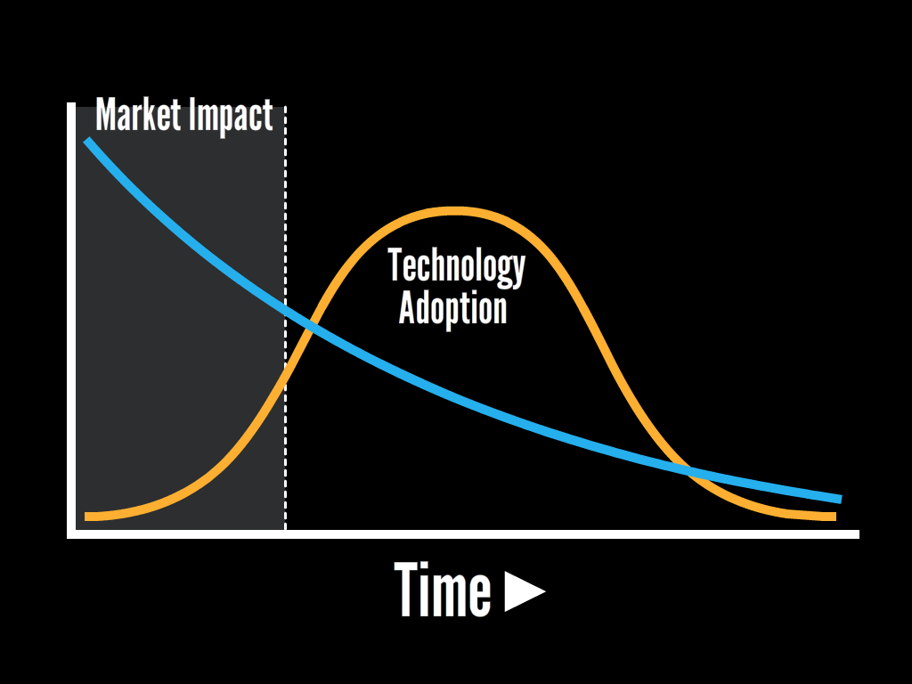
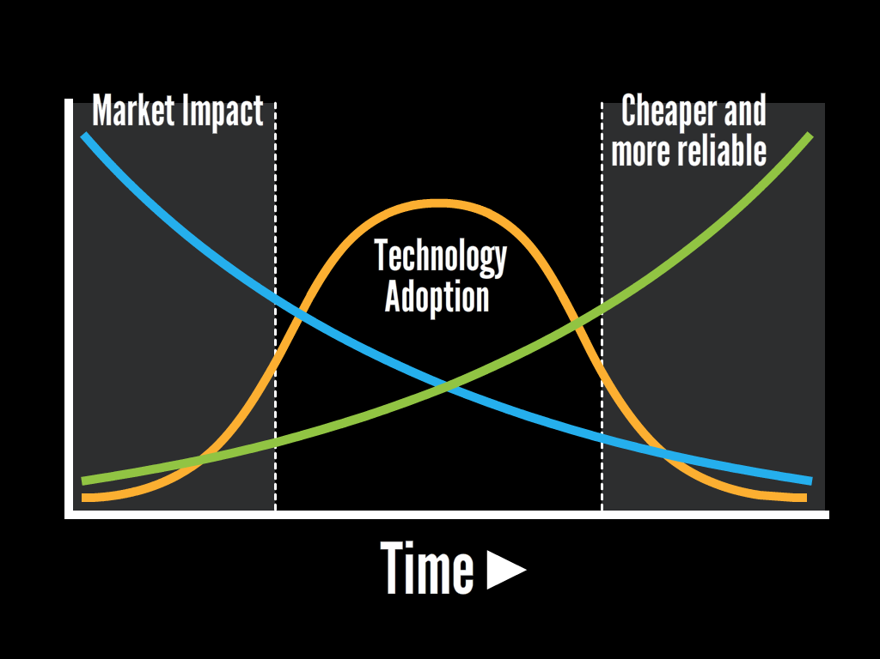

Slide 5
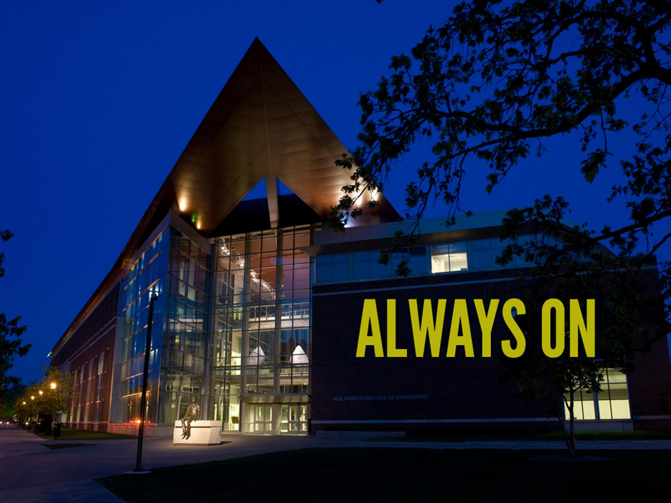

Slide 11
“The picture is a digital badge, a new type of credential being developed by some of the most prominent businesses and learning organizations in the world, including Purdue, Carnegie Mellon, the University of California, the Smithsonian,
Intel and Disney-Pixar.”
The New York Times, Show me your badge
November 2, 2012
http://www.purdue.edu/studio

