Slide 1
Publishing New Resources
HUBbub 2011
Sam Wilson
Notes:
*Introduction*
*Credibility statement*
*Attention getter*

Slide 2
Agenda
Types and Parameters
Access levels & privacy settings
Resource “classes”
Activity
Notes:
This is going to be a quick set of slides, with a longer interactive activity.
Mission statement: by the end of this presentation, you should be able to understand the settings around resources on the hub, create all of the standard resources, and properly set their access level.

Slide 3
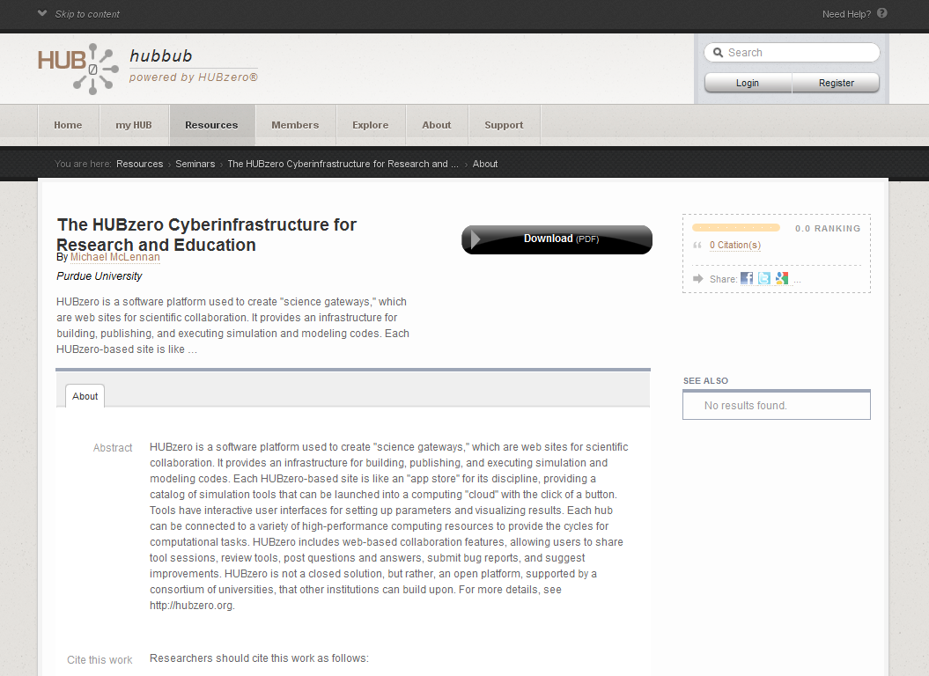
Hub Resources
What is a Hub resource?
Notes:
Hub resources are different than article pages (as discussed earlier) – these are/can be user submitted (as a hub admin, you’ll still want to know how to submit resources)
Hub resources have an “action” item (download document, launch tool, watch presentation, etc…)
Hub resources have reviews, stats, supporting docs, etc…
*Bring up a resource on the hub*

Slide 4
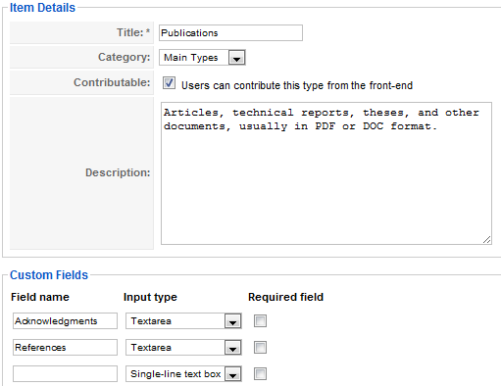
Hub Resources Continued…
Backend vs. frontend publication process
Resource “Types” settings
Setting which resource types are publishable via the frontend
Defining the fields available on a given resource type
Notes:
There are two ways to submit a resource… (at least from the administrator’s perspective)
You can customize which resources can be contributed by users from the frontend, and you can set what fields are available for those resources.
You can even rename or create new categories.
NOTE: NEVER rename/delete tool resource type! That is the only one that needs to stay the same.
*Demo Resources -> Types on backend & /contribute on the frontend with available types and fields*

Slide 5
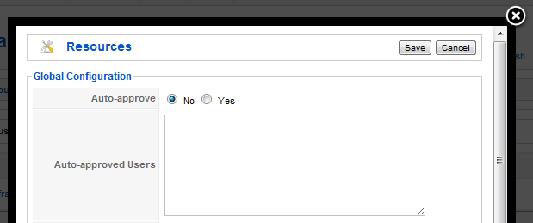
Resource “Parameters”
Resources – Global Configuration
Approving or auto-approving resources
Notes:
This parameter allows you to customize whether or not user submitted resources must be approved before showing up on the hub.
Leave it on “No” for now. Nikki will discuss this further during her talk on Daily Maintenance and Administrative tasks

Slide 6
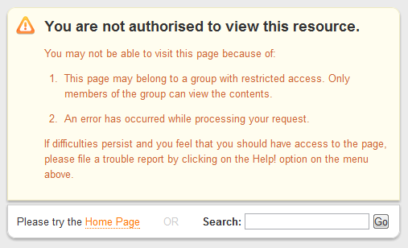
Access Levels / Privacy Settings
Public
Anyone may view/download the resource
Protected
Abstract is visible, files restricted to group members
Private
Only visible to group members
Notes:
NOTE: A resource doesn’t have to be protected or private to be associated with a group, but it does have to be associated with a group if it is protected of private.

Slide 7
Resource Classes
Standard resources
Standard resources include a teaching material, a download or a publication
Multimedia resources
A Multimedia resource is one made up of a Presenter or screen capture presentation
Multitier resources
Includes Courses, Series, and workshops
Tools
Online Simulation tools that run in the browser
Notes:
Standard resources usually have a download button (word doc, pdf file, etc.)
Multimedia resources usually have a play button, and a presentation pops open in a box (adobe breeze or captivate files).
Multitier resources usually have a view series or view course button, that in turn takes you to a list of associated/child resources.
Tools usually have a launch tool button.
NOTE: This isn’t necessarily how resources are classified on the hub, I just made this up to help keep them straight in my mind.
If you’re interested in Tools, be sure to check out the presentations from breakout session 3: Creating and Deploying Scientific Tools.
*This session is going to be more interactive. We’re going to just dive in and create a few resources*

Slide 8
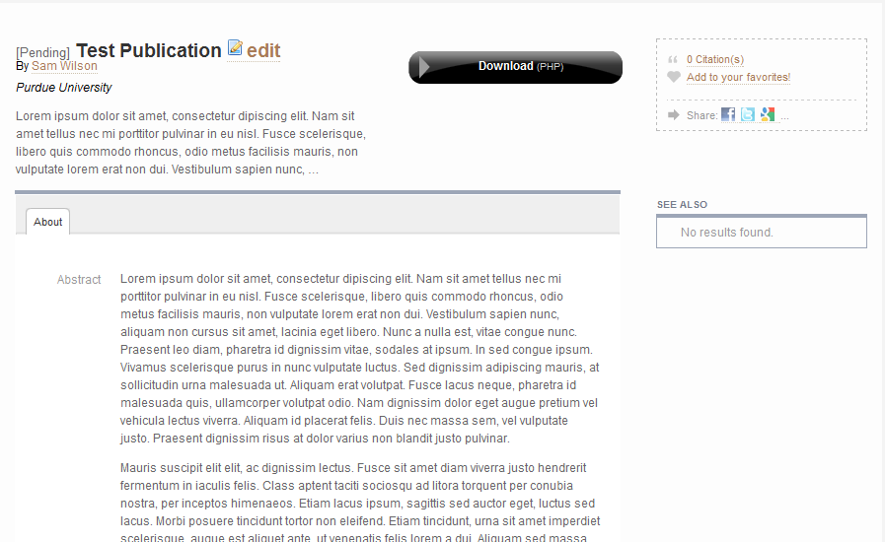
Activity Part I
Create a “Standard” resource from the frontend and make it private
Notes:
See “Solutions” handout for detailed instructions

Slide 9
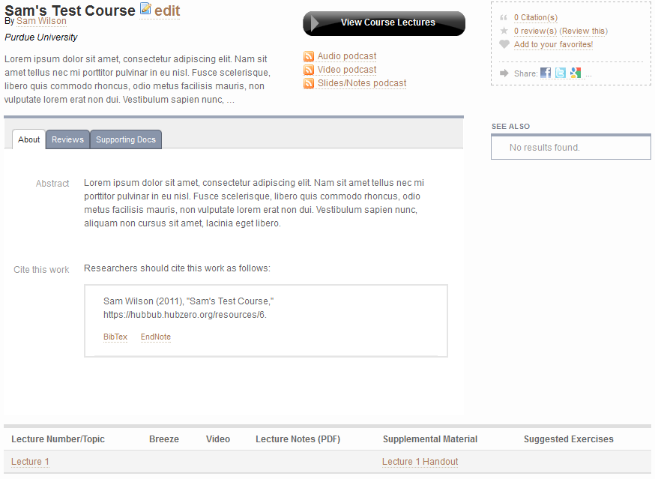
Activity Part II
Create a “Multitier” resource on the backend and make it public
Notes:
See “Solutions” handout for detailed instructions

Slide 10
Further help?
Existing documentation can be found here:
http://hubzero.org/documentation/1.0.0/managers/maintenance.resources
NOTE: scroll down for info on courses

