Slide 1
CyberSecurity for NEEShub:
Best-Practices and Lessons Learned
Gaspar Modelo-Howard
CyberSecurity Engineer
George E. Brown, Jr. Network for Earthquake Engineering Simulation

Slide 2
Need for Cyber-Security
Colaboratories
Trusted Repository
Earthquake / Tsunami
What should I pay attention to, regarding security, when using HUBzero software?

Slide 3
Agenda
NEES Project: What is it?
NEES Security Plan
Compliance
Hubzero Security “Out of the Box”
Additional Security Concerns
Security Assessments
Incidents
NEES Security in a Nutshell

Slide 4
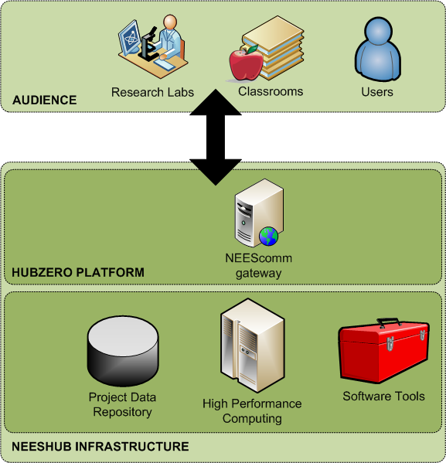
NEES Project: What is it?
Network of civil engineering experimental facilities aimed at facilitating research on mitigating the impact of earthquakes
14 research labs
+5,000 users from around the world

Slide 5
Security Plan
Describes a structured process to plan adequate, cost-effective security protection for NEES cyber infrastructure
Audience: NEES community
Sections
  Roles and Responsibilities
  Authentication and Authorization
  Privacy
  Incident Response
  Auditing
Updated annually

Slide 6
Compliance
Moving from NIST SP-800s to Trusted Digital Repositories and Audit Checklist (TRAC / ISO16363)
  Security section based on ISO/IEC 27001
Security requirements
  Security plan and implemented controls
  System roles and responsibilities
  Risk assessment procedures
  Disaster recovery and continuity plan

Slide 7
NEEShub Components Diagram
NEEShub
HubZero
Joomla!
MySQL
Open LDAP
Apache HTTP
PHP
Exim SMTP
Debian Linux

Slide 8
Hubzero Security (Out of the Box)
Group-based Access Control (Joomla/Hubzero)
Firewall (IPtables)
Single sign-on (LDAP)
Network Port restrictions
Input Validation for wiki entries
Captcha-based Ticketing system
Easy to include other security mechanisms
to protect against attacks (malware, password guessing, web-based vulnerabilities)

Slide 9
(Additional) Security Concerns
Malware Protection
Account cracking
Joomla/PHP-related vulnerabilities
Host and Network Monitoring

Slide 10
Malware Protection
ClamAV: free, cross-platform antivirus software tool-kit
  command-line scanner, scalable multi-threaded daemon, and automatic database update tool
Malware is ‘seasonal’, consider participating in the ClamAV Community Threat Tracking System
  www.clamav.net/lang/en/download/cvd/malware-stats/
Double check possible infected files
  www.virustotal.com
Beware of false positives and false negatives
Need protection for both servers and user computers

Slide 11
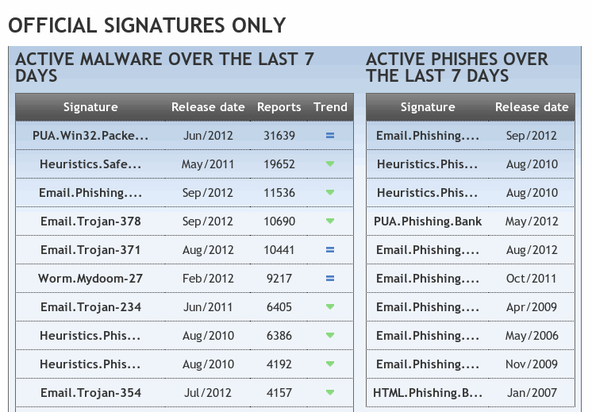
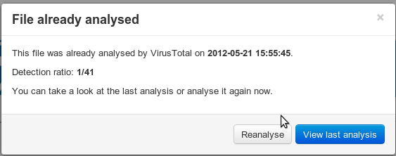
Malware
ClamAV Community Threat Tracking System
Virustotal.com

Slide 12
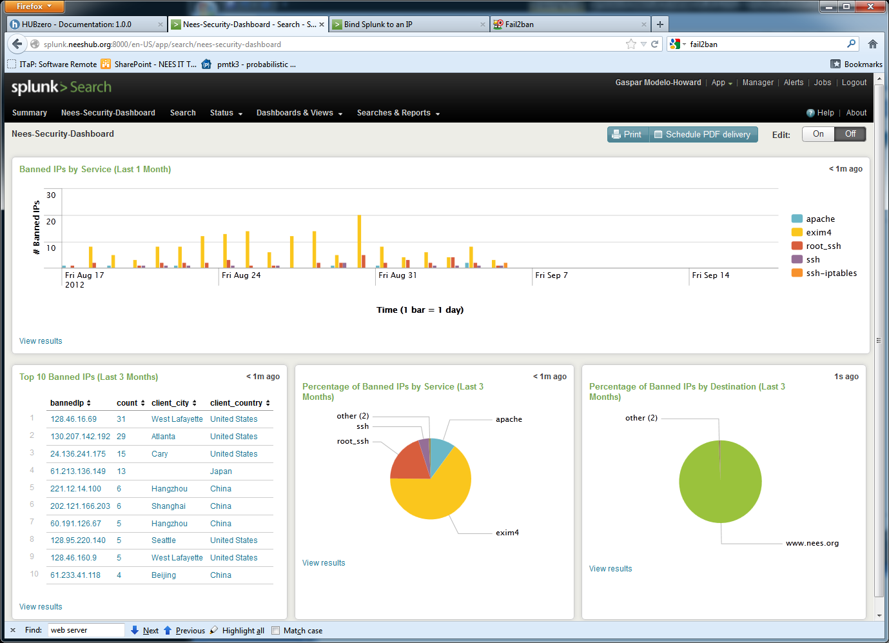
Account Cracking
Any Internet-facing service is constantly being probed
Fail2ban (www.fail2ban.org) scans log files and bans IP addresses that show too many password failures by updating firewall rules to reject the addresses for a specified amount of time

Slide 13
Joomla/PHP-related Vulnerabilities
OWASP PHP Top 5 Attack Vectors
  Remote Code Execution
  Cross-site scripting
  SQL injection
  PHP Configuration
  File system
OWASP Joomla Security Scanner
  Good introduction to Joomla! world of core and extensions (modules, components and plugins)
  Detects file inclusion, SQL injection, command execution vulnerabilities of a target Joomla! web site
  Searches for known vulnerabilities of Joomla! and its components: 611 vulnerability checks (Feb. 2, 2012)

Slide 14



Joomla/PHP-related Vulnerabilities
OWASP Zed Attack Proxy
  Penetration testing tool for finding vulnerabilities
  in web applications
  http://code.google.com/p/zaproxy
SQLmap
  Automates process to detect and exploit SQL injection flaws in web applications/databases
  Good detection accuracy (nice suite of heuristics)
hub
ZAP
browser
Testing System

Slide 15
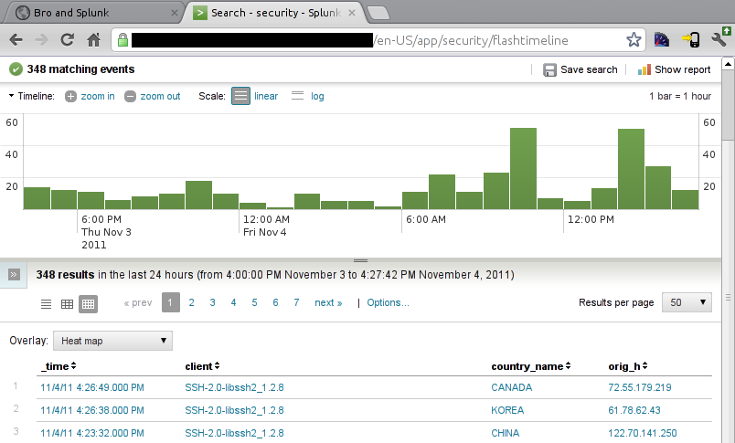
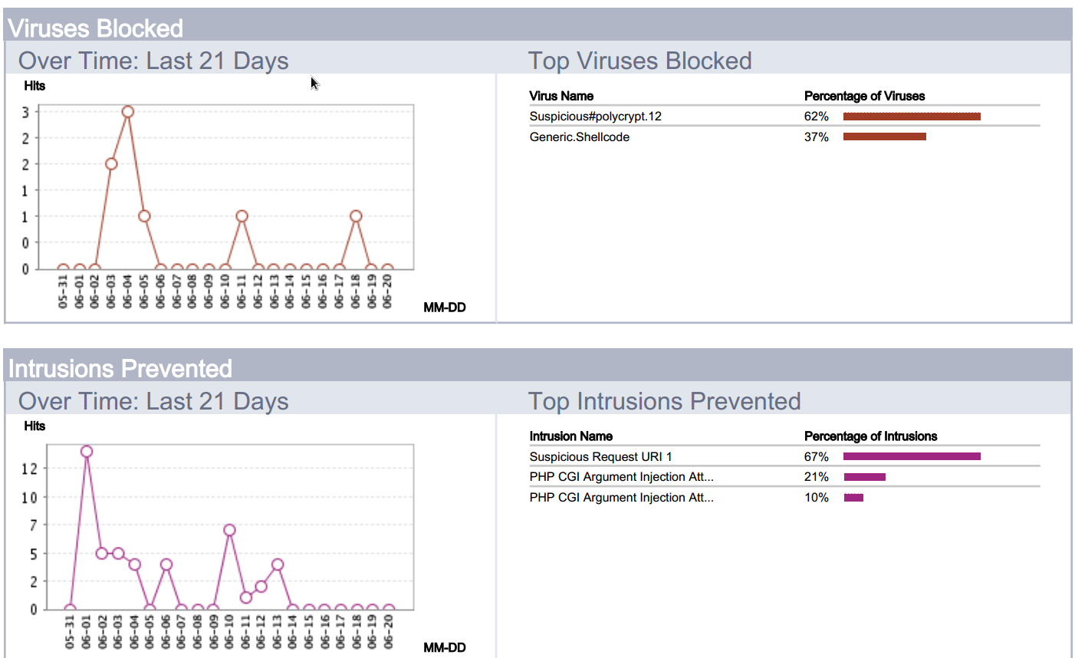
Host and Network Monitoring
Monitoring network traffic and file systems

Slide 16
Security Assessment
Two phases: Internet and Campus
  Testing for filtering implementations
Review of security policy compliance (Questionnaire)
Reviews of users and groups
Ports and vulnerabilities scanning
Attention to web applications and databases
Deployment of permanent scanner server
Usage of public resources
  Example: Google Safe Browsing

Slide 17
Incident: CVE-2010-4344
Vulnerability in Exim4 mailing software
  With specially crafted message, an attacker can corrupt the heap and execute arbitrary code with the privileges of the Exim daemon
  Window to patch: 24 hours
  Testing machines were taken offline, after attackers tried
  to install new binaries
  Corrupted machines were scrapped and then rebuilt
  No production machines were affected, thus no external users were affected
  As a precaution, NEEShub users were asked to reset their password
  Additional measures were implemented to protect environments
  Lesson Learned: protect the “Post Office”

Slide 18
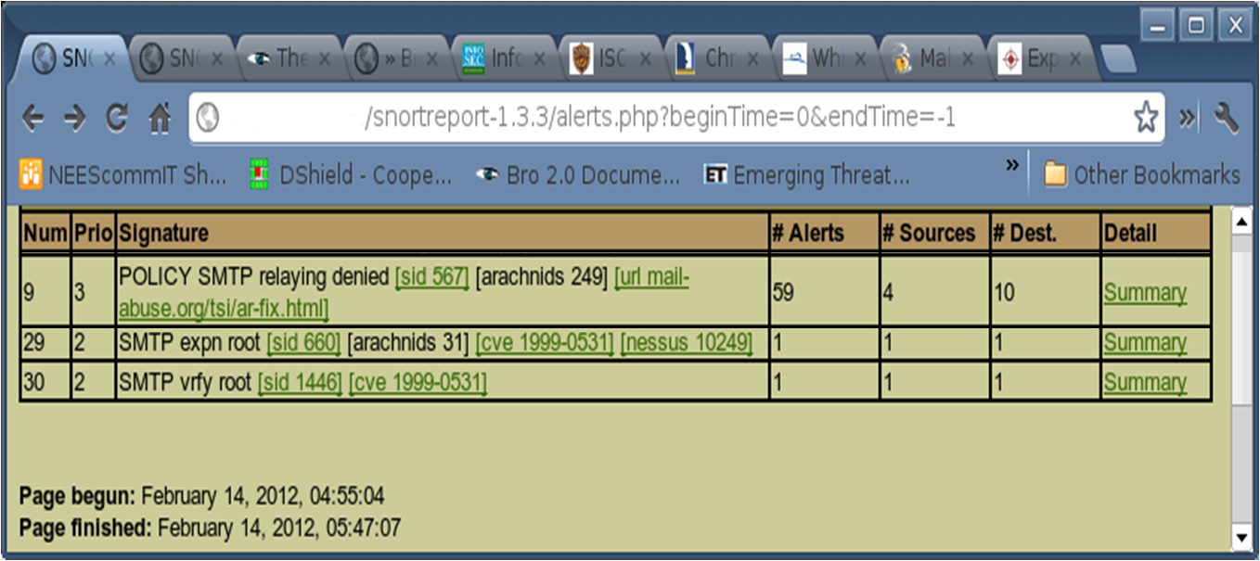
Intrusion Detection System (IDS)
Probing the mailing list server

Slide 19
Epilogue: NEES Security in a Nutshell
U.S. Federal Regulations (NIST)
NEES CyberSecurity Plan / University’s Security Policies
Access Control | Firewalls, access permissions (web servers, file servers and databases), VPN, separation of resources by environment (production, testing, development), file integrity checker
Authentication | user and group directory (LDAP)
Auditing | System logs, fail2ban
Others | security assessments, software patching, intrusion detection systems (IDS)

Slide 20
Acknowledgements
Pascal Meunier, HUBzero
Brian Rohler, NEEShub

