Slide 1
WaterHUB – Enabling hydrological exploration, modeling and collaboration
Venkatesh Merwade, Purdue University
Lan Zhao, Carol Song and Shandian Zhe
HUBbub 2012, Indianapolis, IN, Sep. 25, 2012.

Slide 2
Acknowledgements
National Science Foundation
Purdue Engineering
Collaborators
Ben Ruddell, Arizona State University
Anjaneyulu Yerramilli, Jackson State University

Slide 3
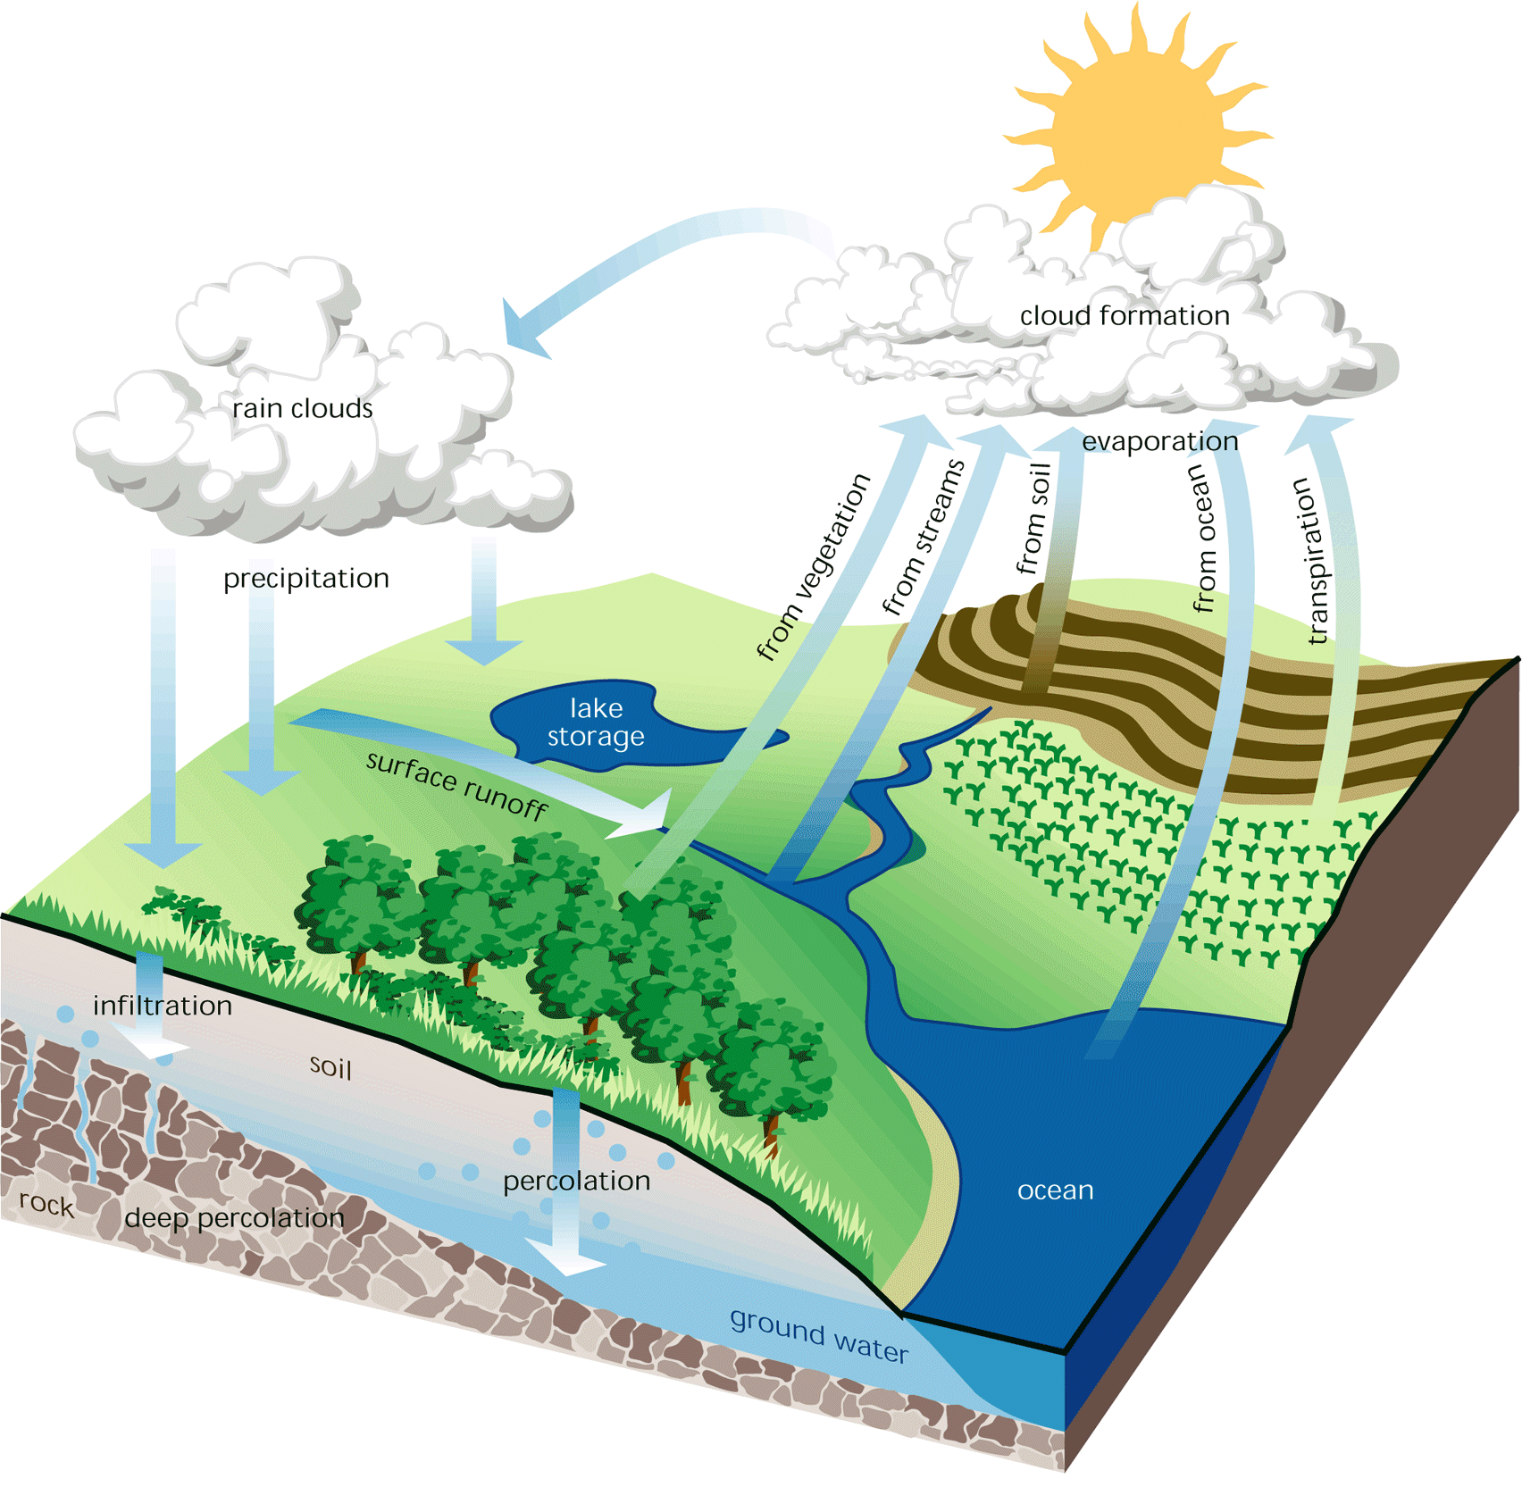
What is Hydrology?
Understanding and modeling of hydrologic cycle

Slide 4
Need of CI for Hydrology
Understanding hydrology requires data - access, sources, heterogeneity, temporal and spatial domains
Modeling requires computational tools –spatial and temporal scale, integration, applications
Hydrologic problems – complex and interconnected across disciplines

Slide 5
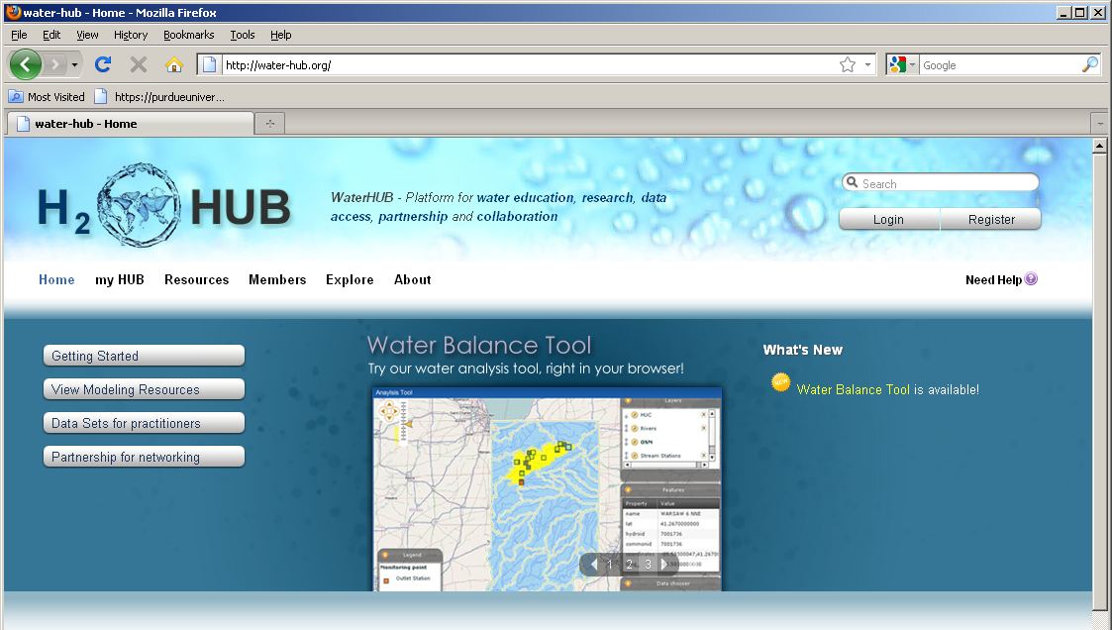
What is WaterHUB
Large scale geospatial data and modeling extensions
Geospatial services and middleware
TeraGrid/XSEDE computation/storage resources
Remote geospatial data providers (CUAHSI HIS, NCDC)
GIS software, community modeling tools
Notes:
Waterhub has the following built-in tools:
Interactive simulation tools
Online presentations
Mechanism for uploading resources
Tool development area
Content tagging
Wikis and Blogs
User groups for private collaboration
User support area
Usage statistics
Feedback mechanisms
Right now waterhub is in development phase and is not available to the public. It will be available at water-hub.org in september. If anyone is interested in beta testing, please let us know, and we will send you the link.

Slide 6
Architecture
GIS-enabled user interface
HUBzero Core
Geospatial Services
GeoServer
PostGIS
Apache
Joomla! CMS
GIS Data Sharing
Software
NCL
SWAT
Community Building Tools
GIS Data Processing
GDAL/OGR
Data
Content Contribution
VNC
Visualization
CUAHSI HIS
Data Transfer
NCDC Weather
Rappture Toolkit
MySQL
HPC
Metadata
Condor Pool
Education/Training
TeraGrid
Multi-scale
Modeling
Storage
Notes:
The CI system is a layered architecture that expands the HUBzero core software.
At the top is GIS-enabled highly-interactive user interface
The middleware layer is a set of GIS data and web services that interact with the backend resource layer
The resource layer includes geospatial data processing software, database, map server, remote data provider, and high performance computation and storage systems

Slide 7
Why WaterHUB for Hydrology
Connecting hydrologists : sharing of information, data and simulation tools
Connecting data and models: use of CUAHSI HIS web services for running hydrologic models
Connecting models and community: models created by one person/organization can be used by multiple entities
Connecting science and people: policy makers can use model outputs and other information on waterHUB for making decisions
Notes:
Because of its interactive environment it enables the following

Slide 8
WaterHUB for Hydrology Education
Understanding contemporary hydrologic issues need more than text book knowledge!
Water availability – change in watershed storage under various geographic and climatic settings
Water movement - Quantifying fluxes of carbon, water, energy, and nutrients across the land surface?
Human impacts – quantifying the impact of natural variability versus human actions on hydro-climatology
Notes:
Because of its interactive environment it enables the following

Slide 9
Hydrology Tools on WaterHUB
SWATShare – A tool for sharing Soil Water Assessment Tool (fluxes)
Water Balance – A tool for plotting inputs, outputs and losses from hydrologic system (storage)
Hydrology Exploration – a tool for exploring the role of land use change on hydrology (human impacts)

Slide 10
SWATShare Modeling Environment
Implementation
GIS interface using FLEX for rich UI and portability
Web services for metadata/data management, job submission, status tracking, visualization, and data transfer
Datamover: a secure FTP client that enables large data transfer
XSEDE computation and storage resources
PBS jobs at Steele for long running jobs
Condor jobs at Purdue for short jobs
Community account
Globus job submission

Slide 11
SWATShare Demo
www.water-hub.org

Slide 12
Hydrology Exploration Toolkit
Dynamic data retrieval from remote data resources via web service
Rainfall and radiation data at NCDC
Streamflow data at CUAHSI HIS
FLEX GIS client
PostGIS database
geoserver
Notes:
User interacts with a GIS web client implemented using FLEX
PostGIS database and geoserver are used for geospatial data management and rendering

Slide 13
Hydrology Exploration Toolkit Demo
https://drinet.hubzero.org/hydroexplorer

Slide 14
Summary and ongoing work
Three tools are developed that uses public domain data and computational tools to address hydrologic issues
These tools have potential to serve both research and educational audience in hydrology
Actual testing and assessment in classrooms will be done over the next two years

Slide 15
Thank you!
www.water-hub.org
Contact:
Venkatesh Merwade – vmerwade@purdue.edu
http://web.ics.purdue.edu/~vmerwade

