Slide 1
George E. Brown, Jr. Network for Earthquake Engineering Simulation
Windows Tools on NEEShub
Brian Rohler
Rajesh Thyagarajan
Hubbub 2012 IUPUI Conference Center, Indianapolis, IN
September 25th, 2012
Notes:
This is the title slide

Slide 2
What is NEES?
George E. Brown Jr. Network for Earthquake Engineering Simulation (NEES) is an NSF funded organization started Oct-2004
NEEShub started August of 2009
Focus on accelerating innovations in infrastructure design and construction practices to minimize damage during earthquakes or tsunamis
NEES network infrastructure
NEEScomm mgmt headquarters
14 Earthquake research facility sites
1 Tsunami research facility site
located at universities across the U.S.
Notes:
This is a content slide

Slide 3
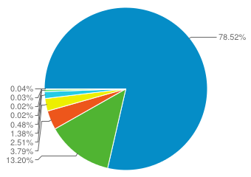
Why Develop for Windows Tools???
1. Windows 10,179 78.52%
2. Macintosh 1,711 13.20%
3. Linux 491 3.79%
4. iOS 326 2.51%
5. Android 179 1.38%
6. (not set) 62 0.48%
7. BlackBerry 5 0.04%
8. Chrome OS 4 0.03%
9. SymbianOS 3 0.02%
10. Windows Phone 2 0.02%
Taken from Google Analytics
on NEEShub
08/24/12 - 09/24/12
Notes:
This is a content slide

Slide 4
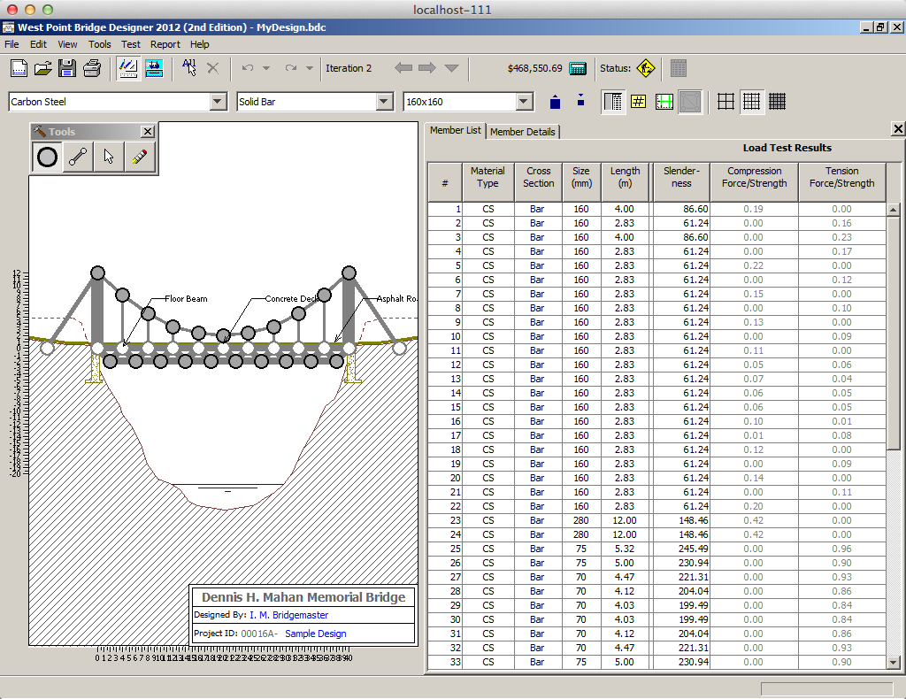
NEEShub Tools Types
Linux
Currently most tools are based off
of OpenSEES (earthquake simulation)
High Performance Computing
Submit (synchronous simulation processing)
Batchsubmit (asynchronous simulation processing)
Education, Outreach and Technology Tools
Windows
Visualization
Data Analysis
Notes:
This is a content slide

Slide 5
Evolution of Windows Tools
Date | Milestone
Aug-2009 | NEEShub goes “live”
May-2010 | Request for windows tools capability
Sep-2010 | Working “Proof of Concept”
Mar-2011 | Production Release 1.0
Mar-2012 | Added home directory access
Aug-2012 | Added second windows server
Notes:
This is a content slide

Slide 6
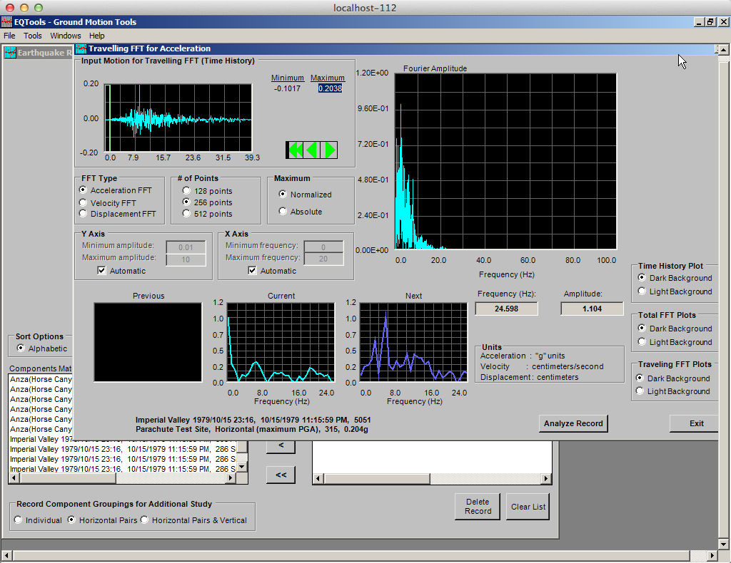
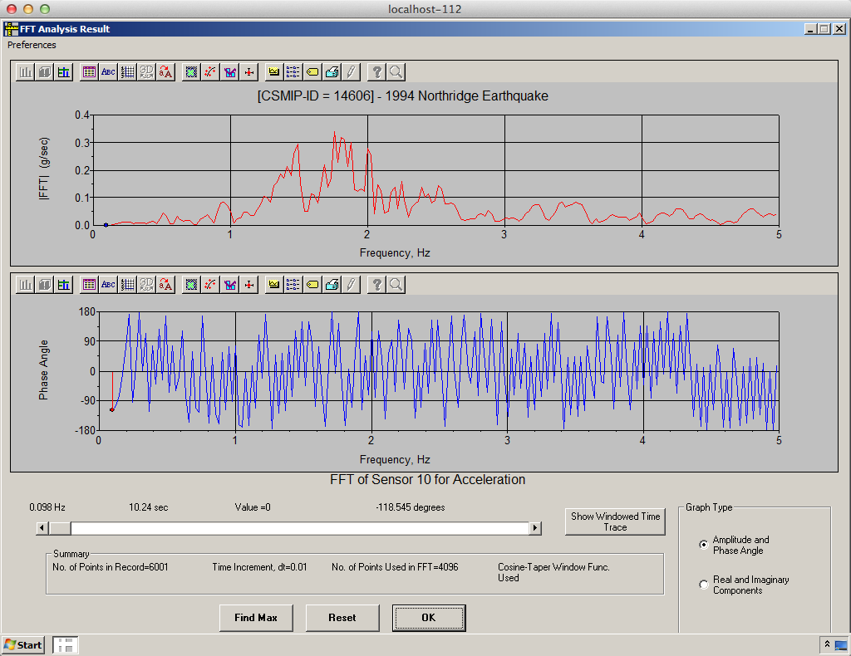
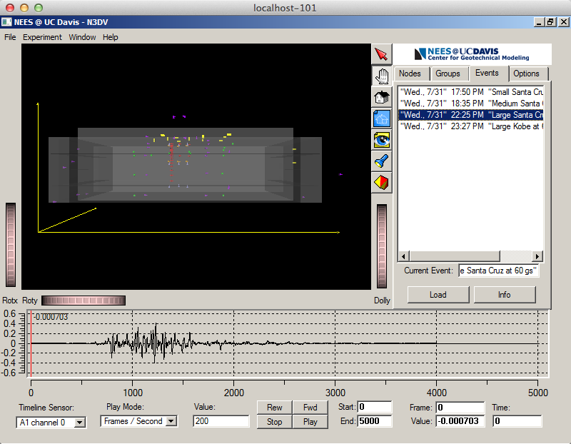
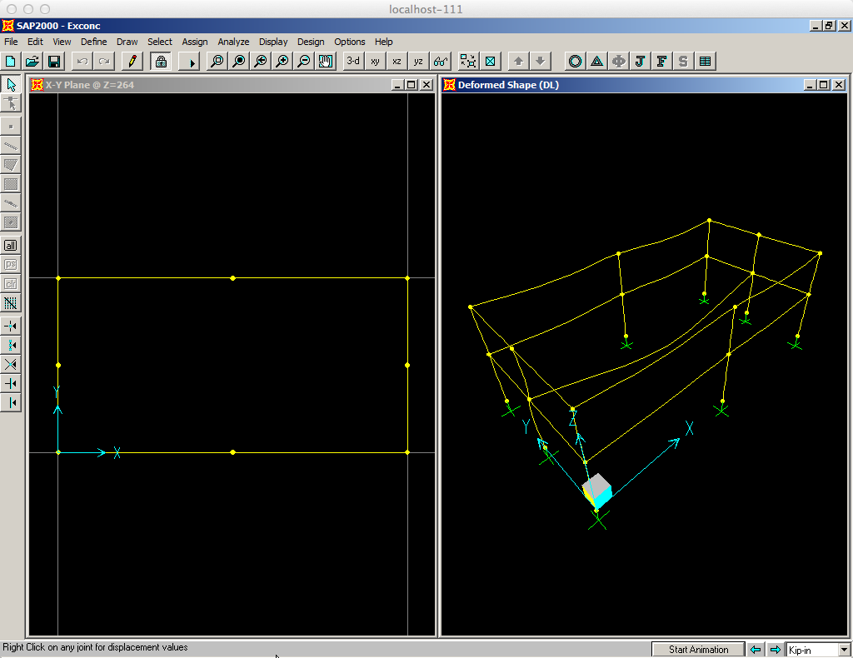
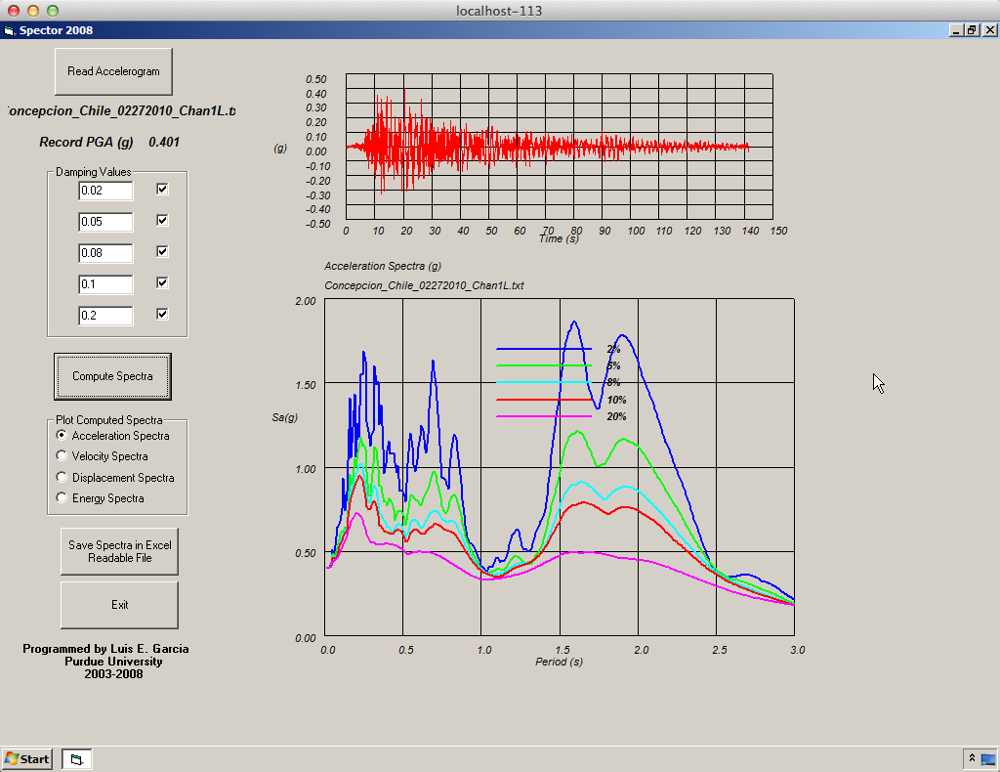
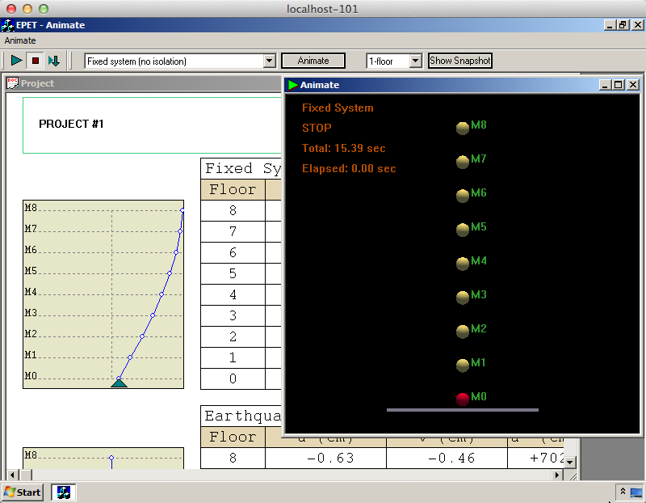
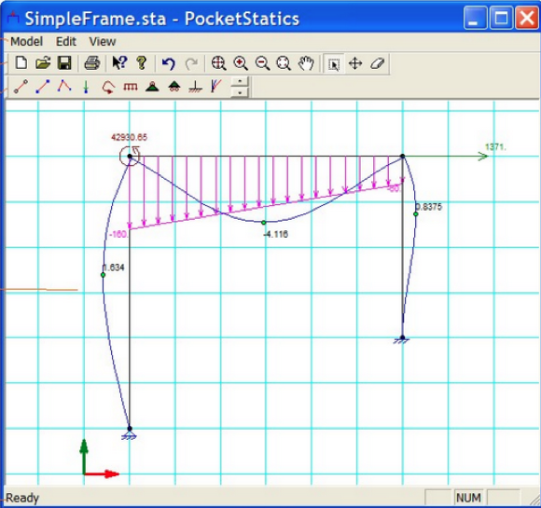
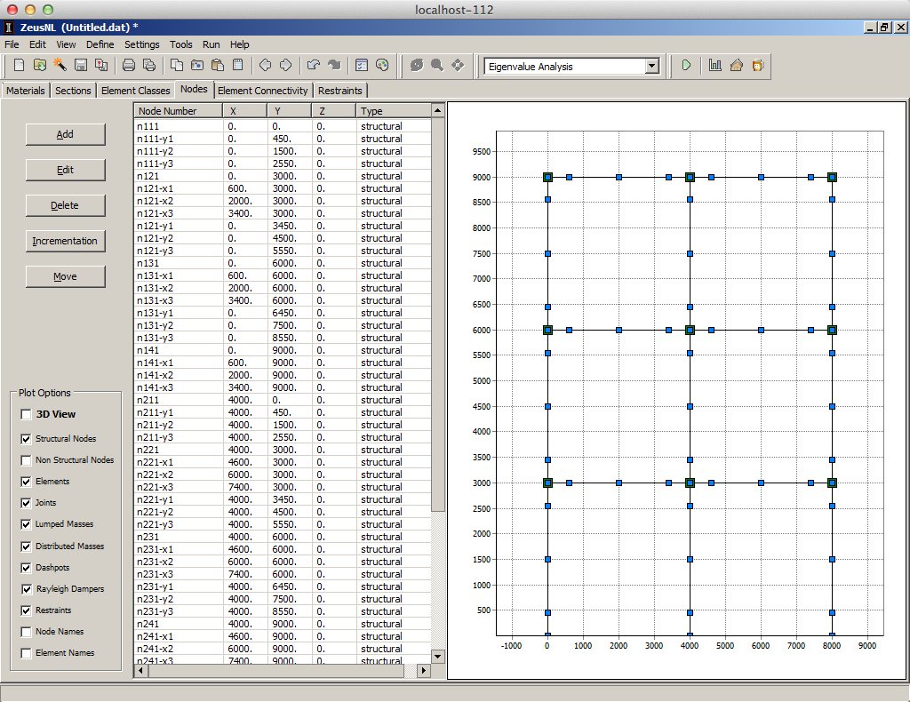
Windows Tools
CSMIP - Instrumented Building Response Analysis and 3D Visualization System
UCDavis – N3DV
West Point Bridge Design
Finley Charney - EqTools
Spector 2008
Earthquake Performance
Evaluation Tool
SAP 2000
Pocketstatics
ZeusNL
Notes:
This is a content slide

Slide 7
Windows Tools Software Requirements
Windows Server 2008 R2 Datacenter unlimited virtual licenses
Parallels Virtuozzo Container
Based off of OpenVZ-Linux
WinSSHd
TightVNC
Server
Cygwin
Socat
Python
Maxwell
Hubzero middleware
Filewatcher necessary for home directories
Linux “Samba”
installed on Linux Home directory server
Notes:
This is a content slide

Slide 8
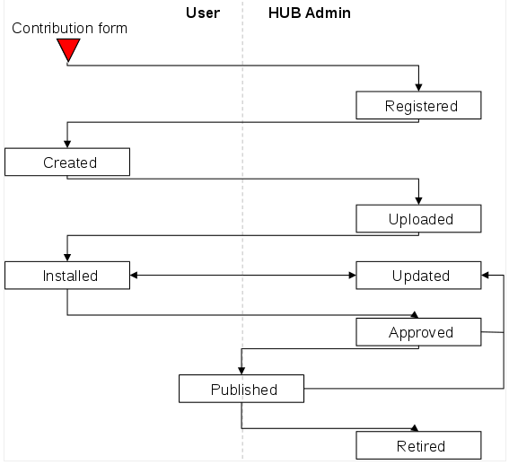
Hub Tool Contribution Process
Notes:
This is a content slide

Slide 9
Windows Tools Contribution Process
User registers new tool
User provides installation files
NEEScomm IT verifies if tool works properly
User uploads the source code to SVN (optional)
User develops the tool pages (About, Docs & Attachments, etc)
User verifies the tool works properly
NEEScomm IT makes necessary configuration changes
NEEScomm IT publishes and make tool available on the hub
Notes:
This is a content slide

Slide 10
Hub Tool Maxwell Diagram
Notes:
This is a content slide

Slide 11
Questions
Notes:
This is a content slide

