Slide 1
Usability Evaluation of a Research Repository and Collaboration Website For Human-animal Bond Researchers
Tao Zhang | Digital User Experience Specialist
Deborah J. Maron | Digital Repository Specialist
Christopher C. Charles | HABRI Central Project Manager
Purdue University Libraries

Slide 2
HABRI Central
  www.habricentral.org
  Built upon HUBzero platform.
  Open access resource hub and virtual community for research and collaboration into the relationships between humans and animals.
  Repository features
    Resources: a collection of locally stored text-based and multimedia resources
    Citations: a collection of bibliographic entries linked to third party resources
  Community features
    Forum, Questions & Answers, Wiki, Groups
    Events, Jobs

Slide 3
Metadata in HABRI CENTRAL
  Resources (“Repository” on HABRI Central)
    Metadata with an attached item
    Supports a variety of resource types (audiovisual, journal article, presentation (ppt, PDF, etc.)
    First customized fields of their kind in the hub; initialized the ‘custom fields’ that other hubs now have access to
  Citations (“Bibliography” on HABRI Central)
    Metadata without an attached item
    Fields linked in back-end to EndNote fields to support batch uploads from EndNote

Slide 4
Repository and Bibliography
  Initial Content of HABRI Central
  Resources (Repository)
    Ongoing process of mining different repositories for content
    Almost 300 items (journal articles, books, theses and dissertations) in the repository courtesy of librarian Debbie Maron at Purdue
  Citations (Bibliography)
    Databases have been mined and exported into EndNote
    EndNote fields are then ingested into HABRI Central
    12,000 citations to date by Gretchen Stephens at Purdue
  User Contribution
  HABRI Central’s future growth depends largely on contributions from human-animal bond researchers community
  User experience of content contribution is as important as information seeking and collaboration

Slide 5
Motivation
Initial user survey prior to launch
    Confirmed assumptions about potential users
    Features added:
      Indicating whether a resource is peer-reviewed
      Including abstract and other supplementary information where possible
  Usability evaluation focused on:
    Information seeking & content contribution
    Task performance
    Workflow

Slide 6
Method
7 graduate students (5 females & 2 males; post-hoc number) from veterinary medicine school at Purdue
All experienced with books and articles search and scholarly databases
Tasks
  Find a journal article.
  Submit a journal article to repository.
  Submit citation (bibliographic information) of a journal article to bibliography.
  Ask a question in Questions & Answers, join an interested group and post a message in that group’s discussion area.

Slide 7
Measures
Task successfulness
Whether help needed
Number of steps participants went through
Time to complete a task
Participants’ comments during each task
Observer notes
Participants’ usability ratings (System Usability Scale)

Slide 8
Results
 | Help Needed
 | Yes | No
Find an article | 1 | 6
Submit an article | 4 | 3
Submit a citation | 2 | 5
Ask a question | 2 | 5
 | # Steps of Path |  |  | Time (seconds)
 | Mean | Min | Max | Mean | Min | Max
Find an article | 10.4 | 6 | 15 | 132.7 | 78 | 184
Submit an article | 18.3 | 8 | 27 | 647.7 | 443 | 1065
Submit a citation | 7 | 5 | 11 | 215.3 | 136 | 296
Ask a question | 7 | 4 | 10 | 125.1 | 88 | 203

Slide 9
Usability Issues
Resources and citations are presented as two separate spaces
    Users are expected to submit resources
    Citations are initially batch imported by librarians
If a user wants to contribute his/her own papers …
  Upload resource
  Add citation for the resource

Slide 10
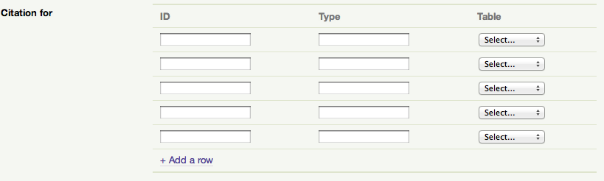
Current workflow

Slide 11
Suggested workflow

Slide 12
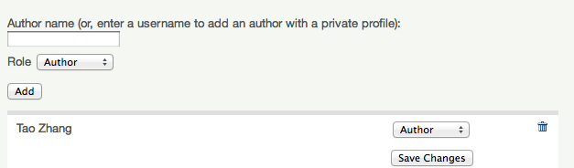
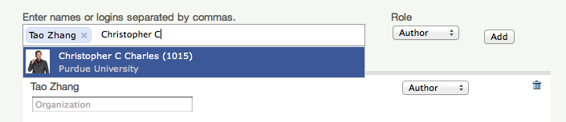
Usability Issues
Adding authors when submitting a resource
Participants spent longer time in this step than other steps
Previous design:
New design:

Slide 13
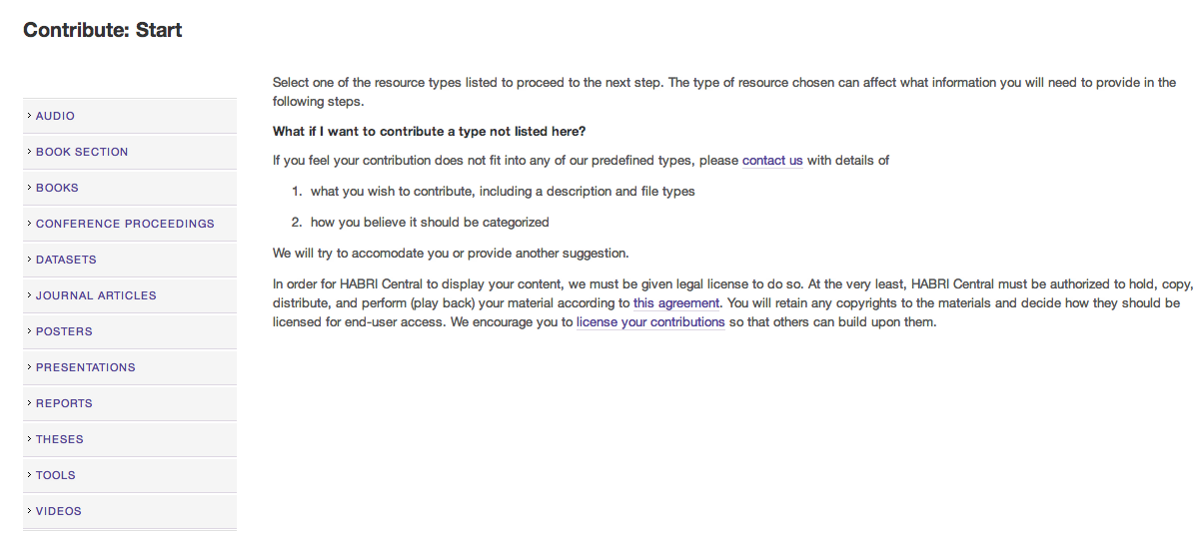
Usability issues
Select resource type when submitting a resource
Participants had difficulty finding out where to start and go to next step

Slide 14
Challenges
Continuously improve user interface and work flow
  A user-centered design process
Improve search functionality
  Search/filter results by topic, author
  Synonym handling
Preservation file formats, preservation mechanisms
Better collaboration platform for users: building GIS features into HABRI Central
Semantic ontology

Slide 15
User-centered design process

Slide 16
