Slide 1
The Upper Cumberland Rural STEM Initiative
Strategies and Challenges

Slide 2
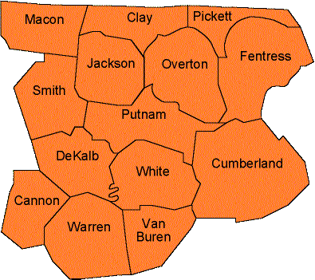
Upper Cumberland

Slide 3
$1.5 million grant
$500,000 to Oakley STEM Center
$1 million to Putnam County Schools
STEM Center to “create a hub to
Coordinate processes among the partner schools to create customizable lessons and experiences for classrooms
Document activities and results from the UCRSI
Create a platform to communicate and share best practices between teachers in partner schools”

Slide 4
Teachers
Professors
Professionals

Slide 5
Resources on the HUB
Ask other teachers / professors / professionals
Collaborate to create a new resource

Slide 7
Timeline

Slide 8
Challenges
Adoption

Slide 9
Challenges
User expectations
“I just stumbled on the Knowledge Base…and would never have guessed that this contained info on using the website! (I expected to find STEM-related literature.)”
“Questions and Answers seems like it would be teaching questions…but the comment, “Can't find an answer in our Knowledge Base or by Search?” implies to me it should relate to website questions, rather than teaching questions. ”

Slide 10
Challenges
User ease of entry
Added “Quick Start” link to front page
Reduced number of enabled features
Pre-made groups

Slide 11
We’re still just beginning our journey…
Resource contribution is low, but increasing
User growth steady, with surges as school systems join
Several groups with frequent activity

