Slide 1
Day-to-day Management
Sam Wilson
Hub Liaison

Slide 2
overview
Support tickets
putting out fires
Resources
building content
Wishes
dream a little
Abuse Reports
where to get a great deal on Vera Wang handbags…
Questions and Answers
community driven support

Slide 3
mission control (aka: the control panel)
Support tickets
User/Group info
Resources
Wishes
Did you know: the modules that show up here, and their position, are customizable!

Slide 4
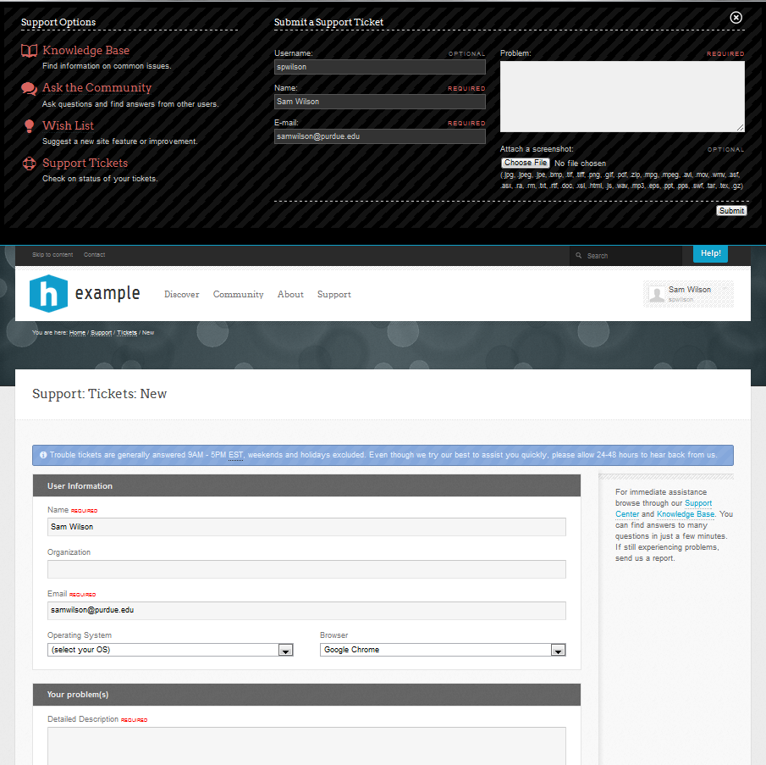
support tickets
Trouble/bug reports
“It doesn’t work like it should…”
not…
“I wish it…”
Usually require code or configuration changes
Drop down vs. new ticket page
Ticket drop down box
New ticket form

Slide 5
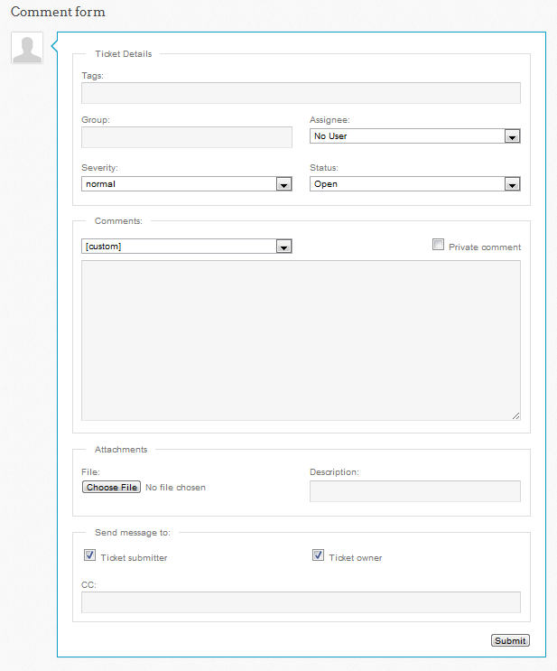
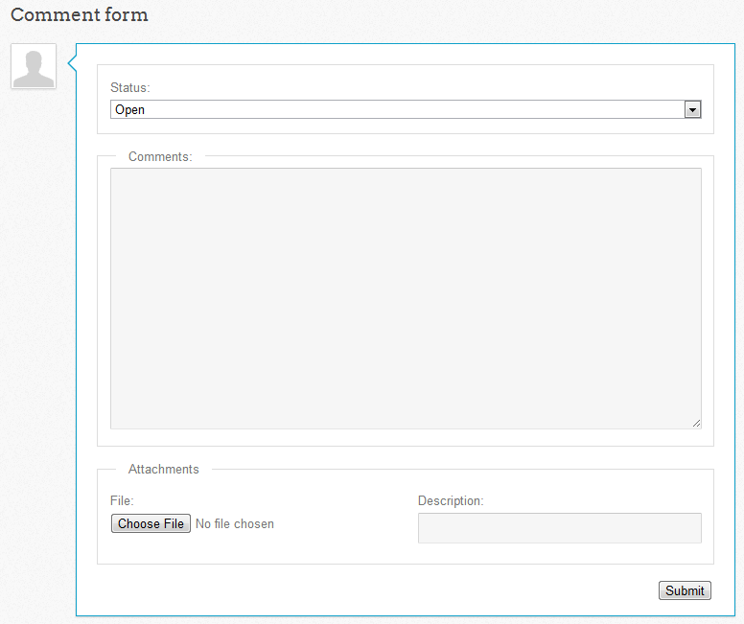
support tickets continued…
Support ACL
Admin view with
full privileges
Standard user view of
ticket they submitted

Slide 6
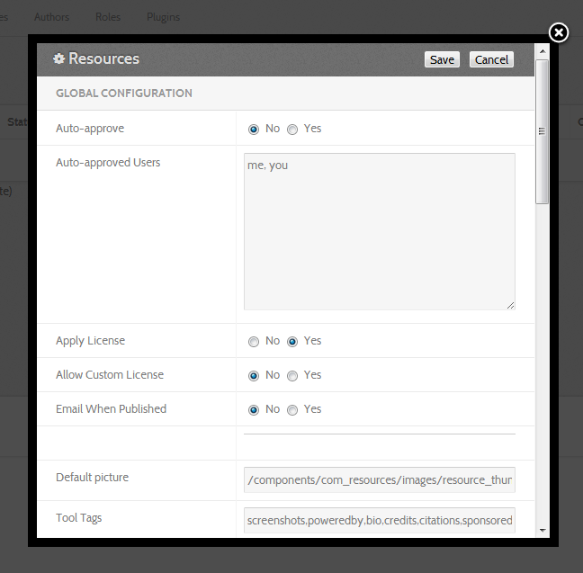
resources
What is a resource?
Configuration options
auto approve?
licenses
email notifications
global vs. individual
Contributors
Tags
Rating
Date
Metadata
Citation

Slide 7
resources continued…
Action
“at a glance”
Title
Navigation
Related
Metadata

Slide 8
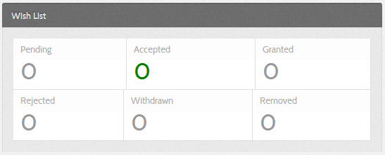
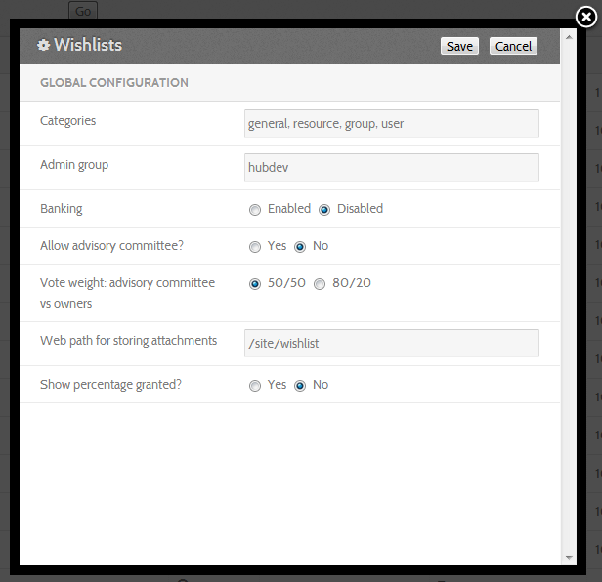
wishes
“Wouldn’t it be nice if…”
Site-wide, group, tool
Parameters
admin group
banking
advisory committee

Slide 9
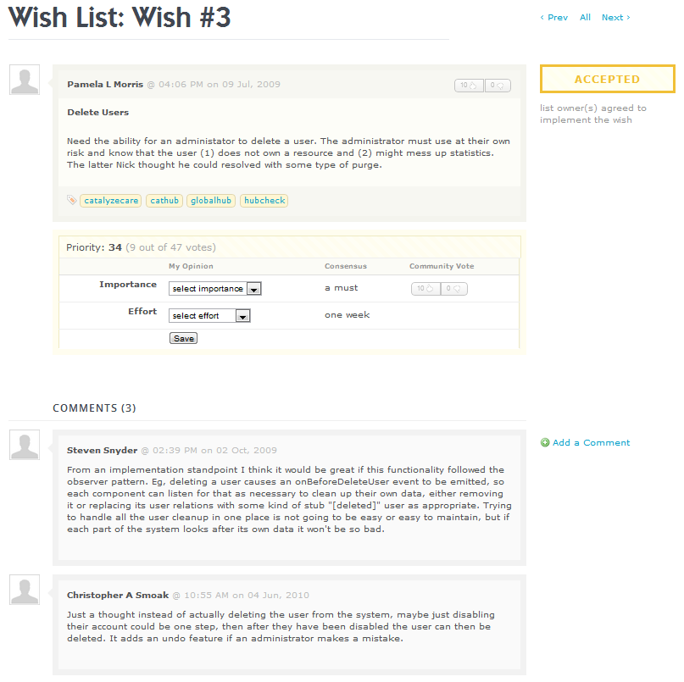
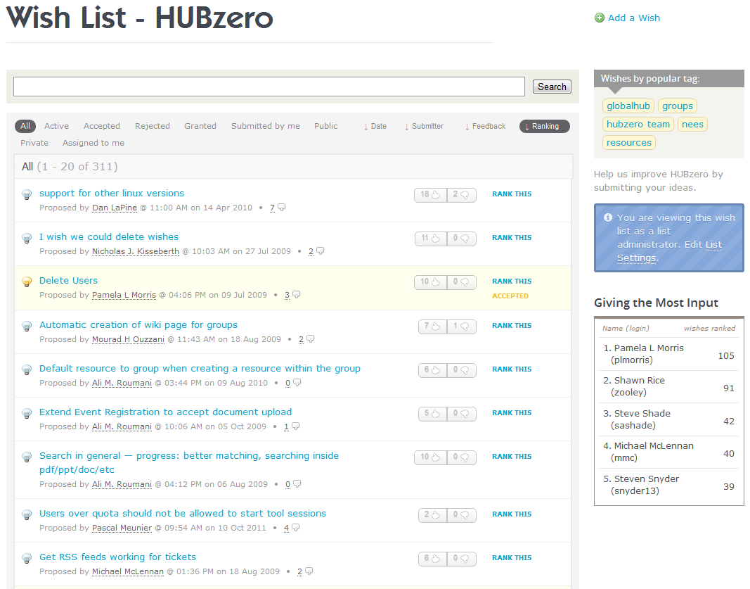
wishes continued…
Ranking
Comments

Slide 10
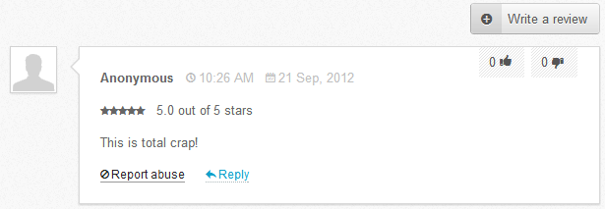
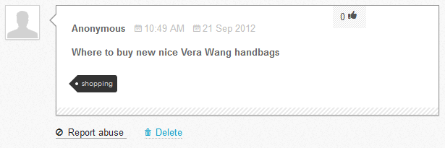
abuse reports
Reviews
Questions and Answers
General site comments

Slide 11
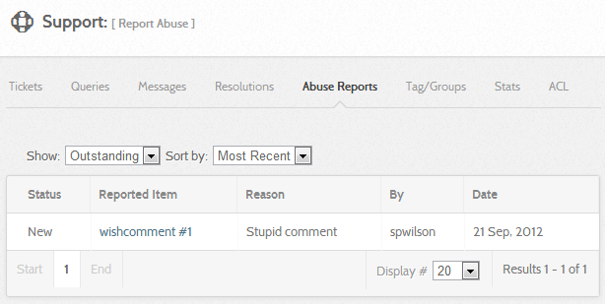
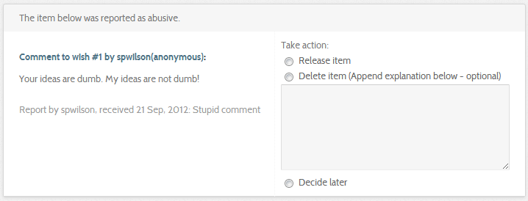
abuse reports continued…
Release item: no problem here – restore it
Delete Item: confirm as abusive – take it down
Decide Later: not sure – come back to it later

Slide 12
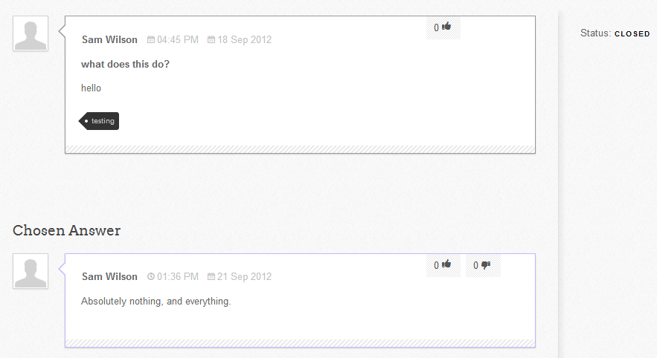
questions and answers
Like “StackOverflow”
Different from forums (not a dialog)
Typically a concrete question with a “best” answer

Slide 13
questions?

