Slide 1
Administrative Tasks
Sam Wilson
Hub Liaison

Slide 2
overview
Joomla! User Roles
why they do and don’t matter
Parameters/Configurations
where are they and what do they do
Knowledge Base (KB)
adding or removing KB content
Customizing hub content
using the Joomla! article manager
Proxy Creating Users
when (and when not to) proxy create users

Slide 3
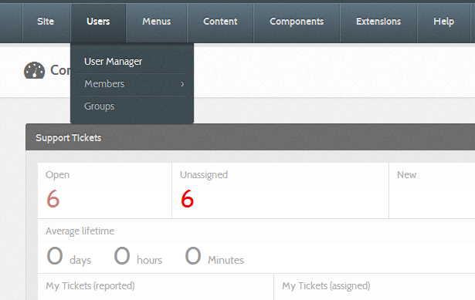
Joomla! user roles
The User Manager

Slide 4
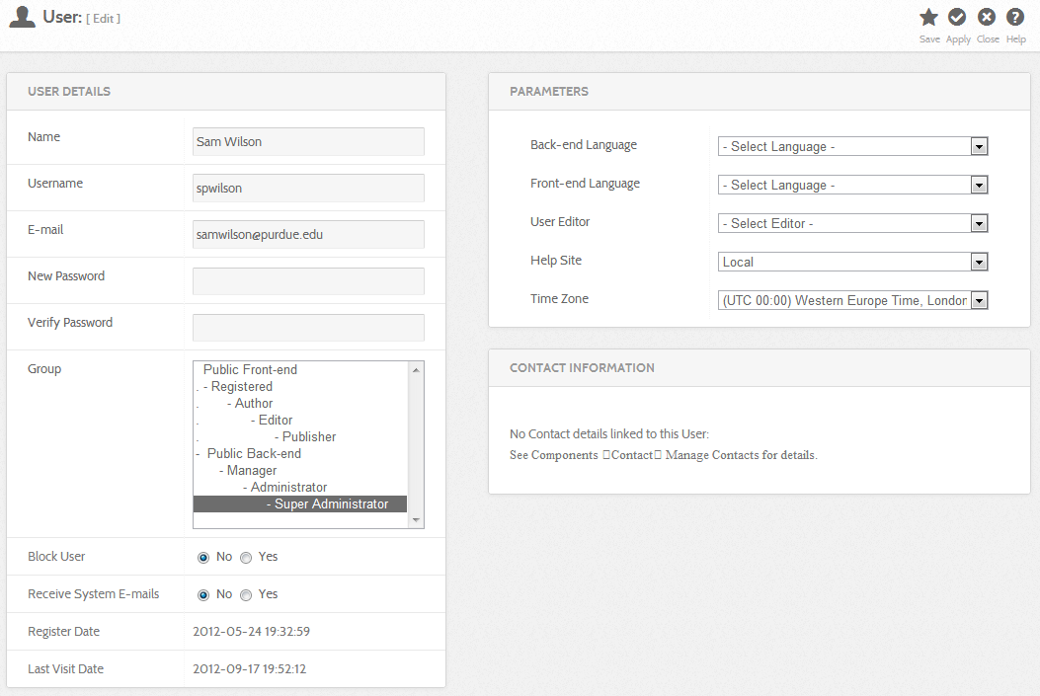
Joomla! user roles continued…

Slide 5
Joomla! user roles continued…
Task | Registered User | Super Administrator
Log in to the front end | ✔ | ✔
Log in to the backend (yourhub.org/administrator) |  | ✔
Modify other user’s profile |  | ✔
Contribute resources/topic pages | ✔ | ✔
Create and edit article pages and knowledge base entries |  | ✔
Create/manage own group | ✔ | ✔
Edit others’ groups |  | ✔
Submit tickets and comment to own ticket | ✔ | ✔
See all tickets and be a ticket assignee | ✔ (with ACL) | ✔
View [almost] ALL hub content |  | ✔

Slide 6
parameters
Global Parameters
settings across a whole component
often function like “defaults”
usually the answer to: “I wonder if I can change that?”
Individual Parameters
settings for a specific instance
override the global settings
not available for every global type parameter
ex: articles, members, groups, etc…

Slide 7
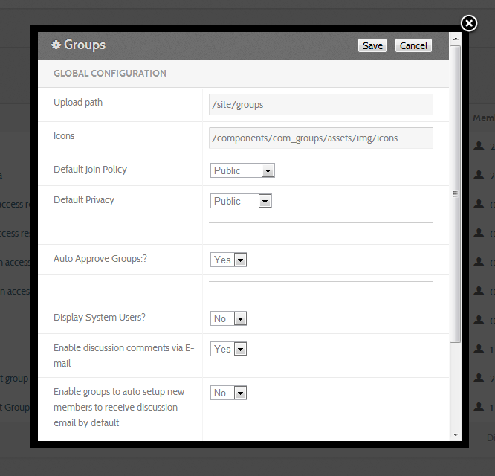
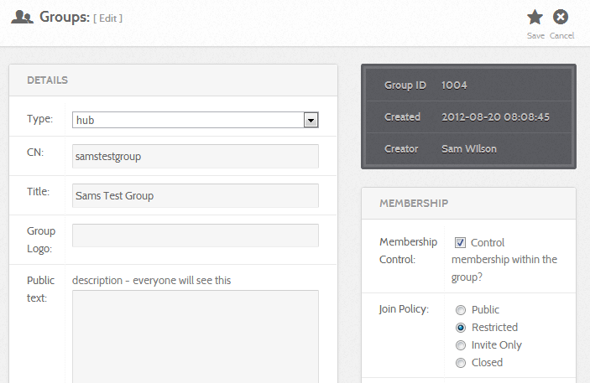
parameters continued…

Slide 8
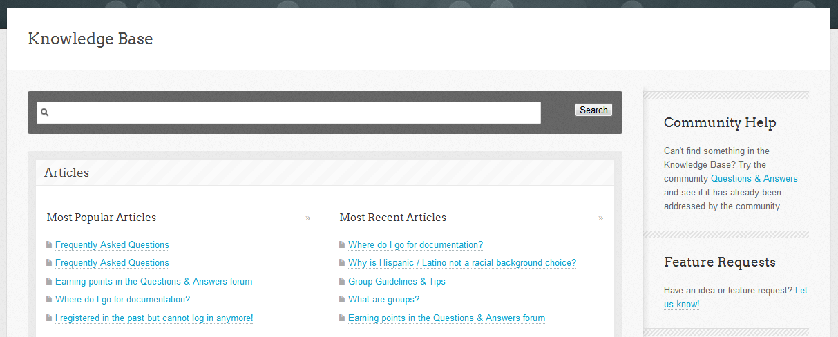
knowledge base
Knowledge base (KB)
static “faqs”
great to capture short answers you find yourself saying again and again
hub defaults + add your own

Slide 9
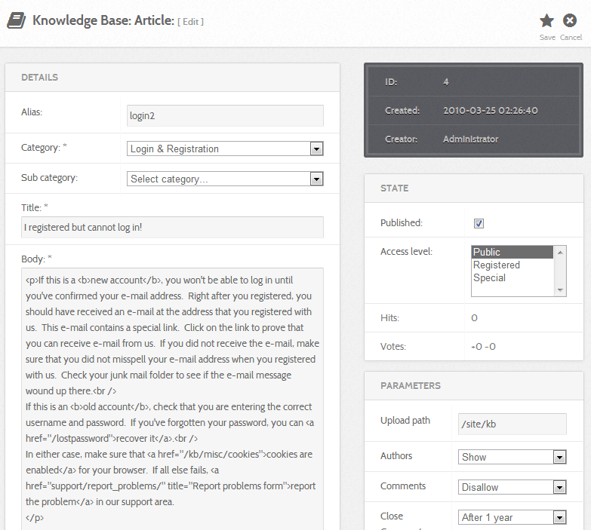
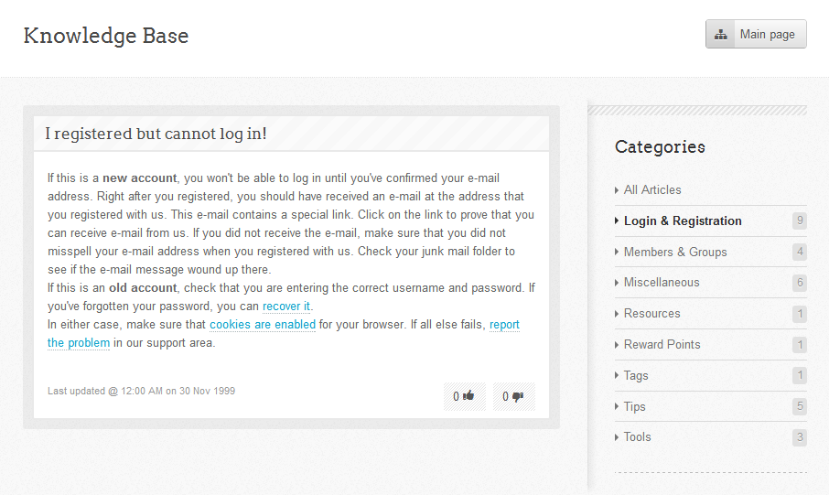
knowledge base continued…

Slide 10
customizing content
Joomla! article manager
customizable static content pages
can include HTML and modules
ex: about pages, home page, and more
sections, categories, and aliases
menus
check out the hubbub presentations from last year
http://hubzero.org/resources/385
Article parameters
global vs. individual: another example

Slide 11
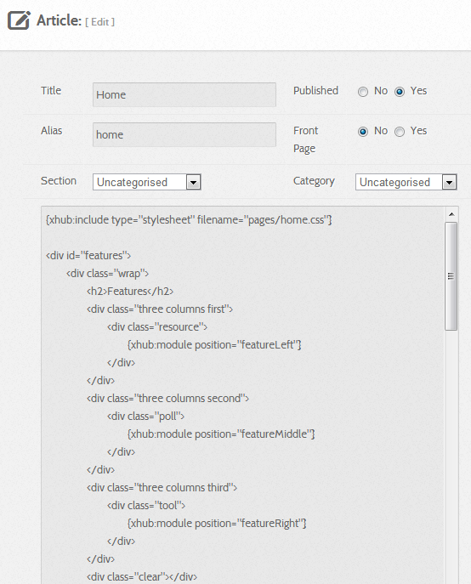
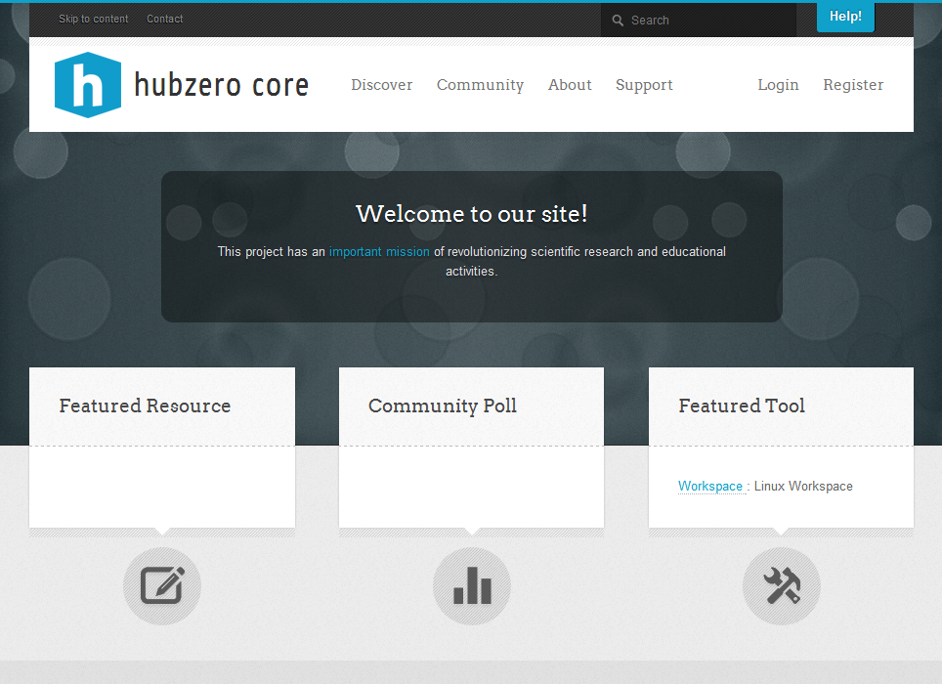
customizing content continued…

Slide 12
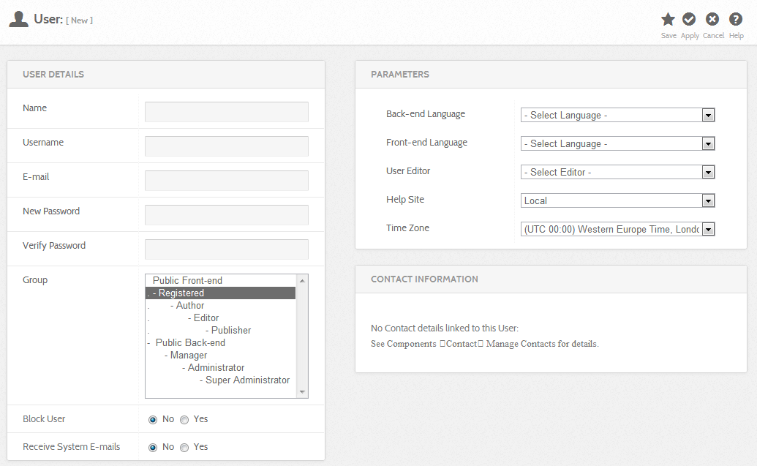
proxy creating users
Proxy creation
to do or not to do? – the pros and cons
why it used to matter, and why it doesn’t anymore

Slide 13
questions?

