Slide 1
Using the Purdue DB Technology to build simple on-demand data exploration tools
Michael Grobe
Pervasive Technology Institute
Indiana University

Slide 2
The general idea
This presentation describes some of the work that came out of our collaboration with Ann-Christine Catlin’s group at Purdue. The primary goal involved making data from Connie Weaver’s Nutrional Science Lab at Purdue available on the Indiana CTSI Hub using the tools developed by Ann-Christine’s group, which we took to calling the “Purdue database technology toolset.”
At the time we were working on this project, the Purdue database technology was focused around several tools that are very useful for collecting and displaying data, and therefore for building integrated data base interfaces:
Dbparse: allows users to upload CSV files to backend database tables
DataView: displays contents of backend database tables
Photo_Gallery and the Collections manager: maintains and displays
collections of images which may be displayed on-their-own
or from within DataView views
com_form: a component for building web-based forms for data
collection and display

Slide 3
The general idea (continued)
To use the DataViewer for data display, programmers simply prepare configuration files that identify database tables to be displayed, and define display appearance, including suitable plots.
However, for non-programming users, it seemed likely that a small set of ad hoc data exploration tools might be useful for getting a quick look at the data.
In particular, the following capabilities seem to constitute a basic package of capabilities:
- frequency tables,
- cross tabulations,
- simple correlations/regression plots, or
- simple correlation matrices.

Slide 4
The prototype and a question
The com_form and DataViewer components were used to provide a PROTOTYPE version of a new HubZero component that performs these functions (com_datashape).
com_form was used to build forms requesting and validating user input, and
com_dataview was used to display frequency charts and regression plots as directed at run-time. (Something of a mutation of the DataViewer model.)
So today’s presentation will:
illustrate how these components can be used together, and
help gauge user-interest in having such capabilities proceed
past the prototype phase.
(It will not however, provide a tutorial on actual coding techniques.)

Slide 5
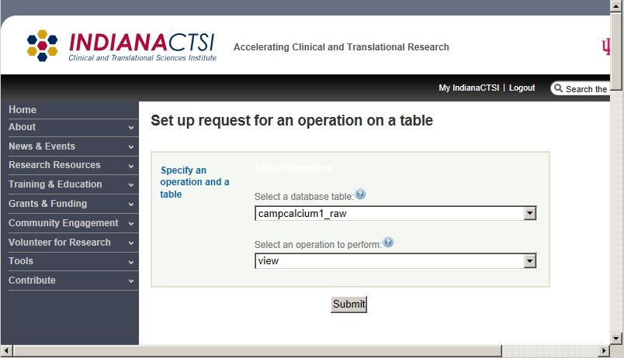
A starting form to create queries on the fly. (http://dev1.indianactsi.org/form?proj_id=menu&form_id=form0)

Slide 6
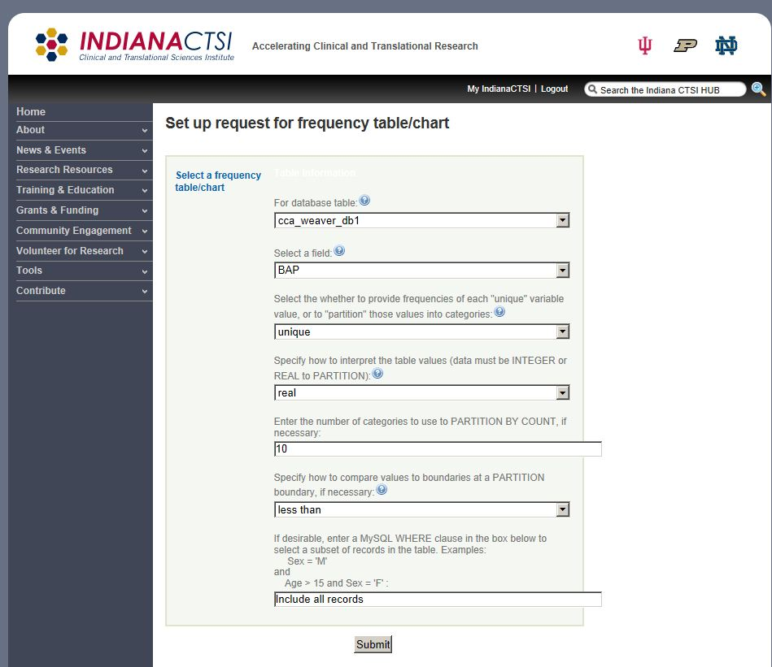
Request a frequency table/chart

Slide 7
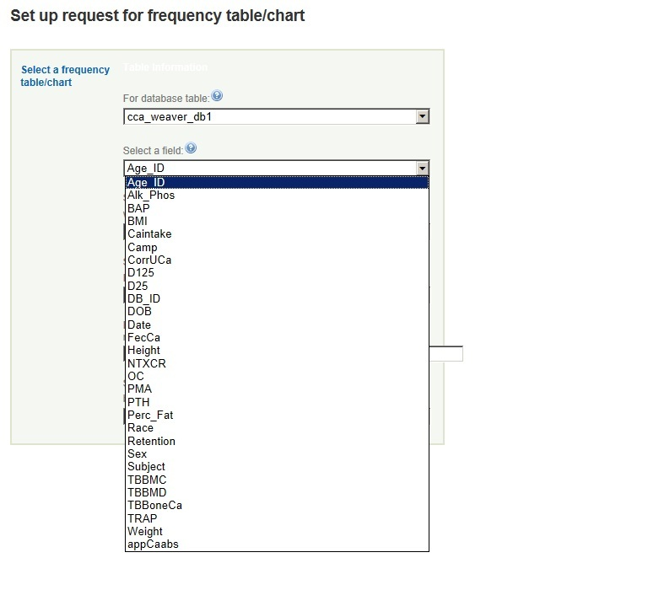
The field name pulldown menu

Slide 8
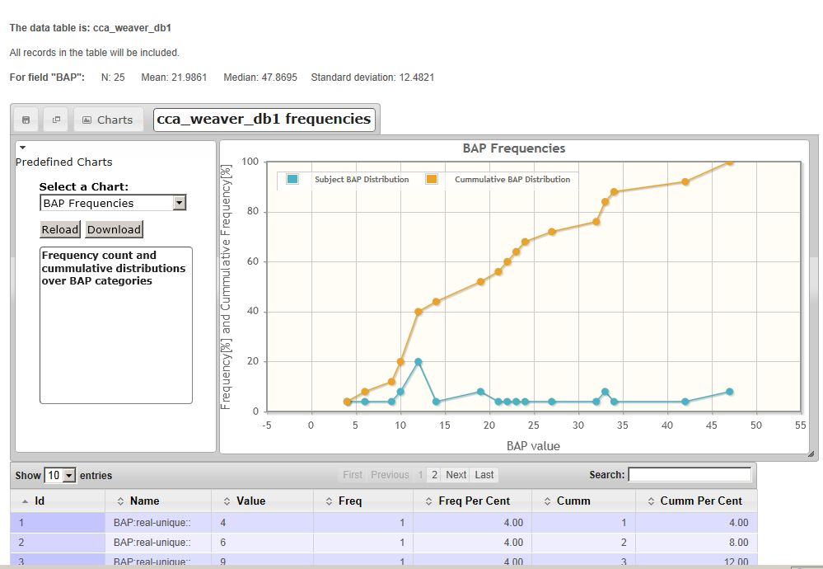
The resulting frequency chart

Slide 9
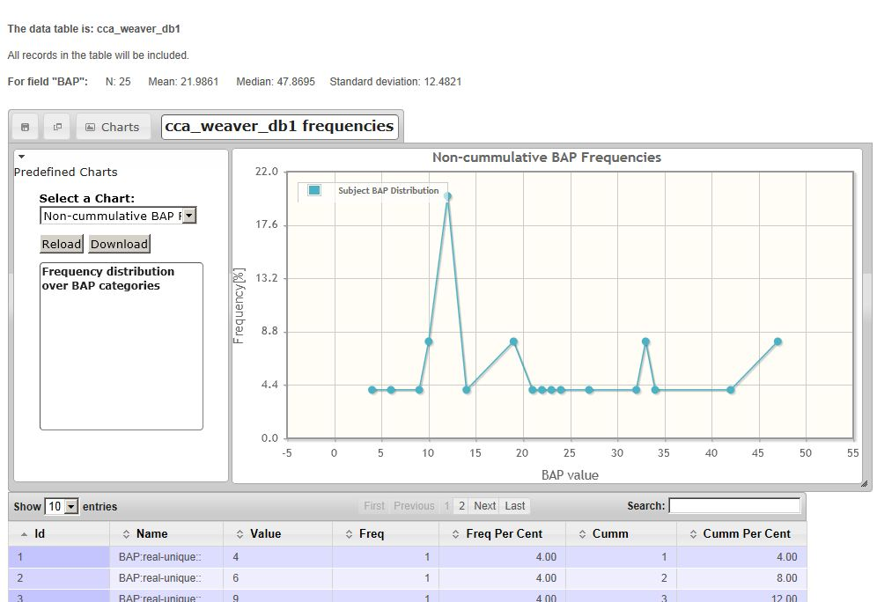
The cumulative frequency chart

Slide 10
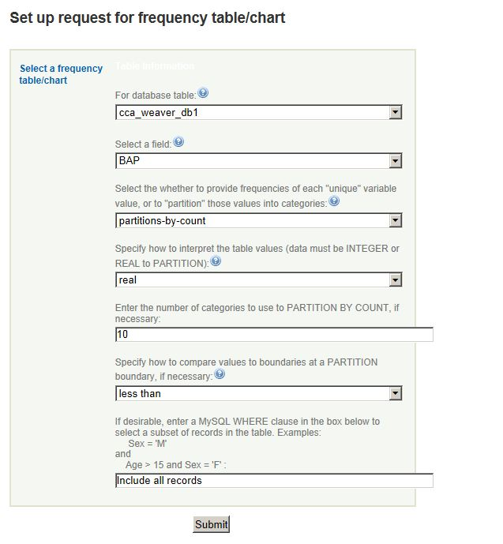
Request a chart of partitioned field values

Slide 11
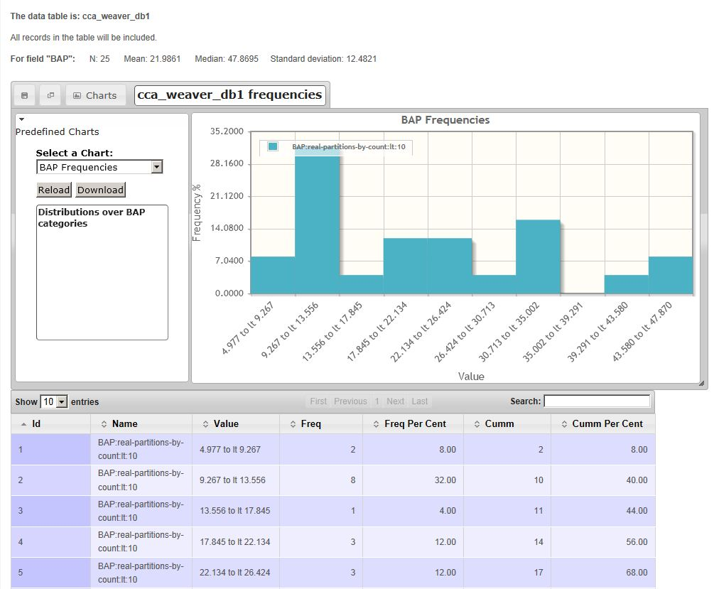
Resulting chart showing partition frequencies

Slide 12
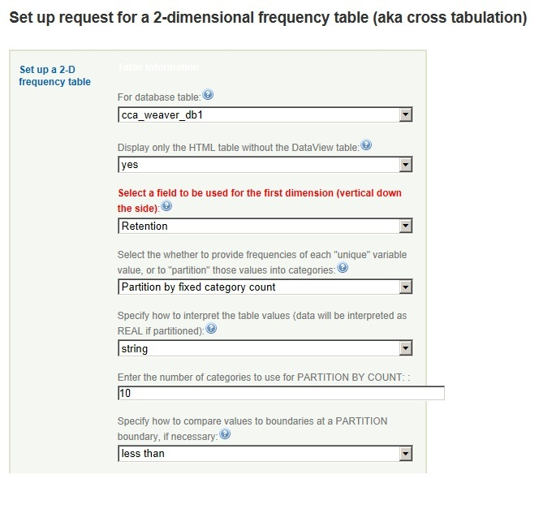
Cross tabulation on 10 partitions of 2 fields

Slide 13
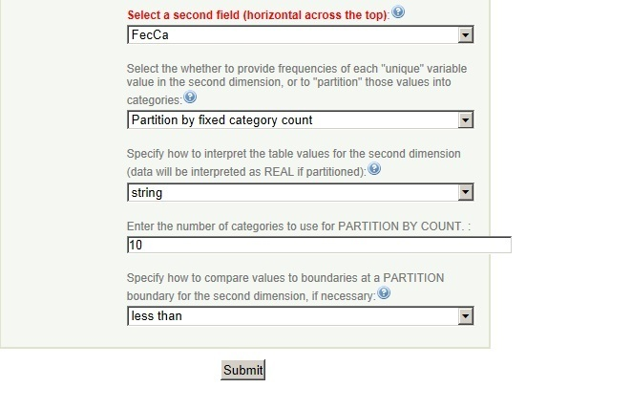
Cross tabulation (second half)

Slide 14
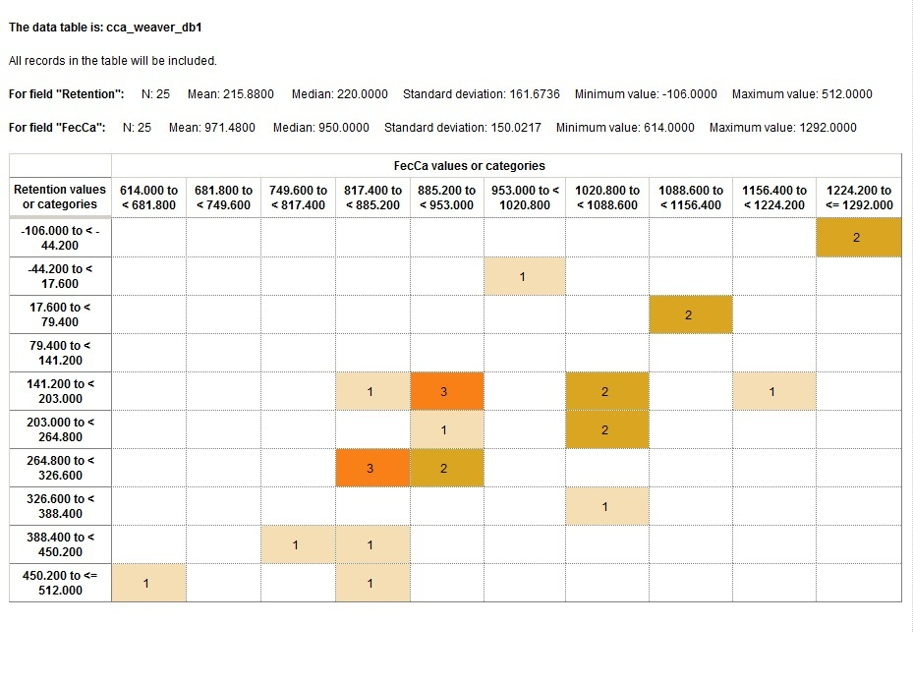
Resulting tabulation (10 partitions of each variable)

Slide 15
User specified partitions
Users may explicitly specify partitions.
In the next example, FecCa partitions were specified as:
700 | 800 | 900 | 1000 | 1100 | 1200
and the Retention partitions were specified as:
-200 | -100 | 0 | 100 | 200 | 300 | 400 | 500
Real partition values may be specified using either standard decimal notation or scientific notation; they must of course be in ascending order.
These are strict "partitions" rather than category "boundaries", so the first and last categories extend to negative or positive infinity, respectively; they are "unbounded", though that may not always be explicitly represented in the headers.

Slide 16
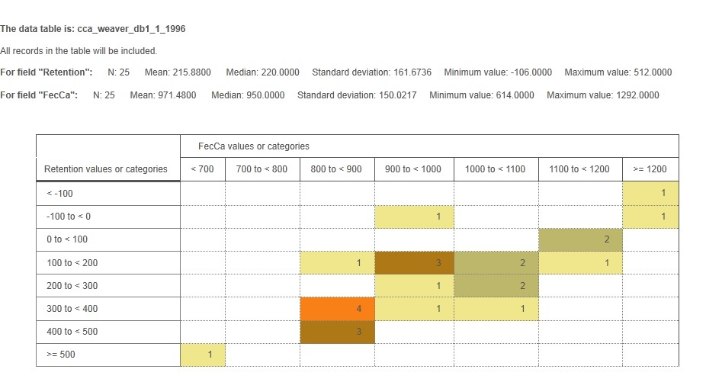
Resulting tabulation (user-defined partitions of each variable)

Slide 17
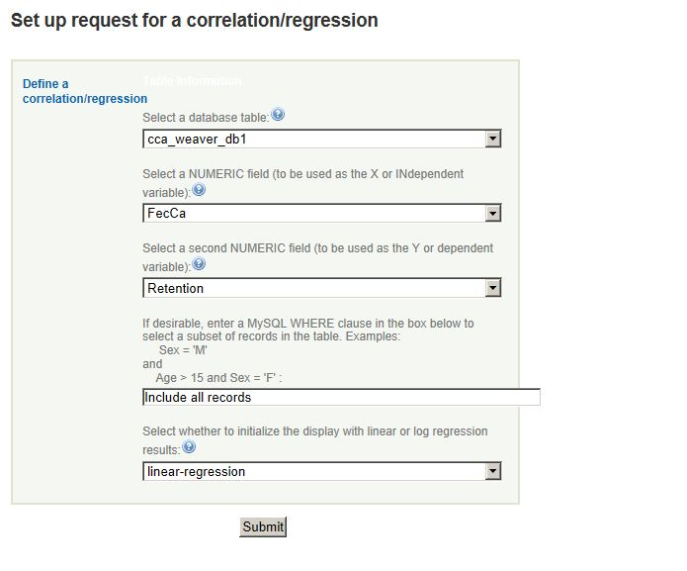
Request a simple correlation/regression

Slide 18
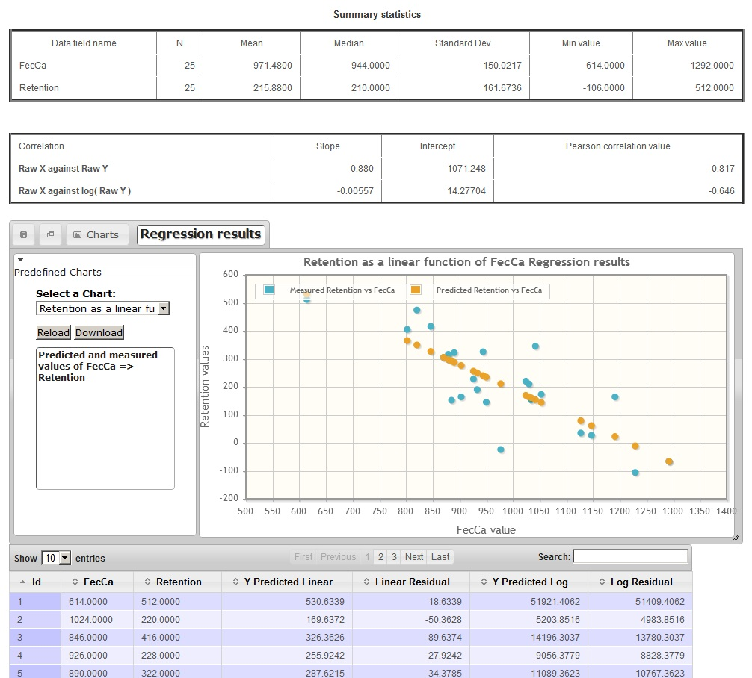
Resulting regression info

Slide 19
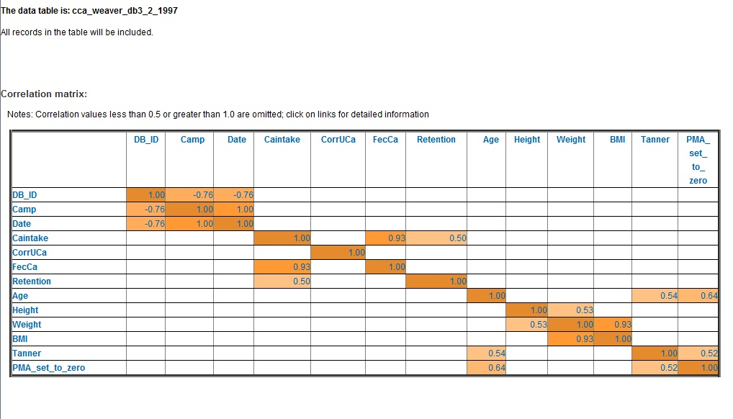
A correlation_matrix

Slide 20
Request user-defined displays via URLs
You can invoke these applications via statically coded URLs. These examples will only work (at present) if you are logged in to the target CTSI hub instance in the same browser.
Cross tablulate Retention with "Age category" (Teen or Adult) (1996) (show only the HTML table to avoid formatting imposed by the DataViewer display)
Cross tabulate Retention with "Age category" (Teen or Adult) (1996) (show BOTH the HTML and DataView tables)
Cross tabulate 10 Alk Phos categories with 10 Retention categories (HTML table only)
Cross tabulate unique Retention values with unique Retention values (both cases interpreted as integers) (HTML table only)
Retention cross-tabulated with FecCa (Fecal Calcium)
Age by Pre-specified Age Month categories (There are some missing Age values.)
Correlate and regress Retention as a function of Post Menarcheal age (1996)
Correlation matrix composed of all numeric fields in the table cca_weaver_db1_1_1996 showing only values greater than .5

Slide 21
Summary
Prototypes for 4 tools for (very) simple data exploration were built over 2 existing Purdue DB technology tools. (Correlation matrix tool can now run independently of the DataViewer.)
These provide on-demand frequency charts, cross-tabulations, and simple correlation/regression output.
These tools can help users get a “feel” for the data, but are not suitable for serious statistical analysis.
Can these tools be helpful in the Hub context?

Slide 22
Additional information
Tutorial: Setting up a spreadsheet for use with the cceHub DataViewer
Tutorial: Using the Web form component to build scripts to modify databases
Tutorial: Using the Web form and DataViewer components for to request user-specified frequency tables/charts, cross-tabs, and regressions
Putting a Joomla! component into SVN for the development cycle

