Slide 1
ISO 16363 & OAI-PMH
Purdue University Research Repository
By Neal Harmeyer, Amy Hatfield, and Brandon Beatty
Notes:
Good afternoon. I am Neal Harmeyer, digital archivist at Purdue University. Amy Hatfield, Metadata Specialist, and Brandon Beatty, Software Developer, and I will be speaking today in regards to our work behind-the-scenes to steward research datasets into the future.
Our colleague, Courtney Matthews, has described PURR and how it serves Purdue’s research community.
Once data is submitted into PURR, strategies must be in place to ensure this research is accessible and discoverable long-term.
Three components—preservation, metadata, and OAI-PMH—act in tandem to provide long-term access to research data. We will each talk about how we are applying these methodologies within PURR.

Slide 2
Preservation by neal harmeyer
Notes:
As the digital archivist on the PURR Project Team, I advise as to preservation best practices and create documentation regarding preservation tools and techniques.
I will discuss the digital preservation efforts within PURR designed to guide published datasets into the future.

Slide 3
Why Preserve?
Scholarly research necessitates ability to refer back, or build upon, previous work—without preservation, this becomes impossible over time.
Items accessible today are not guaranteed to be accessible tomorrow.
Obsolescence, technology failures, disasters, etc. can damage or destroy—effective preservation mitigates that eventuality.
Notes:
1. Physical back-ups are integral to the preservation process but not enough. A back-up won’t help you if the software used to operate or open a digital object is outmoded or the file itself cannot be read.

Slide 4
PURR Digital Preservation Policy
The PURR Digital Preservation Policy is a guiding document for the management of content within the repository.
The Policy states that a focused attention to preservation is an “essential component of PURR services as it enables long-term access, and as such it requires attention throughout the data management process.”
Development of long-term preservation strategies, strategic plans, and actions are taken from this foundational document.
  The Libraries is committed to preserving and maintaining all PURR content for at least a period of ten years after it is published within the repository.
Notes:
1. Purdue University Libraries is responsible for preserving content in PURR.
2. Purdue University supports the preservation of scholarship and information resources, which are found increasingly in a digital format.

Slide 5
From Policy to Trustworthiness
Via the mandate of the PURR Digital Preservation Policy, a robust preservation system must be implemented.
Stringent preservation planning should come from an internationally recognized standard.
ISO 16363, Audit and Certification of Trustworthy Digital Repositories, provides metrics designed to establish a functional and reliable digital preservation environment.
Notes:
For effective long-term preservation, we need to establish a systematic way of moving digital objects into future-friendly formats.
To that end, preservation polices have been created based upon these directives.

Slide 6
Documentation – Plan and Strategies
Preservation Strategic Plan
  Lays out overall objectives
  Lists imperative preservation activities
Preservation Strategies
  Determines specific strategies for preservation of digital objects
  Lists preservation actions necessary for long-term preservation and access
Notes:
Strategies include: format recognition, back-ups, fixity checks, format normalization and migration.
Migration is two-fold: physical migration to other physical media, as well as to an archival format during object life-cycle.
Preservation events are recorded in preservation metadata, which Amy will discuss at part of our presentation.

Slide 7
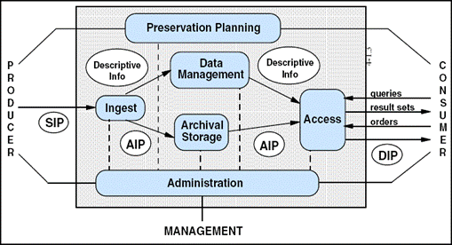
Documentation - OAIS Model
The Open Archival Information System (OAIS) Reference Model is a standard in digital preservation.
Various preservation planning aspects – ingest, data management, archival storage, and access – are modeled.
The goal is to create a trustworthy system from producer to consumer.
Notes:
Preservation planning and strategies are good high-level documents. The OAIS Model, seen here, is helpful for a more granular view of archival methodologies.
OAIS is also an international ISO standard. (ISO 14721)

Slide 8
Documentation – Fixity and Formats
Digital objects must undergo fixity checks on a regular basis.
  At ingest, a cryptographic hash is created for each object.
  On a set schedule, the current hash is compared to preservation hash to check fixity.
File formats must be determined and validated to ensure long-term preservation techniques are appropriately applied.
  Files are checked against a format registry database at submission.
  Preservation strategies and actions are determined by file format.
  Formats are normalized to archival standards.
As archival best practices change, preservation actions will change.
Notes:
1. Fixity is the property an object has when unchanged over time.
2. Variance in this hash indicates corruption or data loss and triggers replacement of the file.

Slide 9
Documentation – Information Packages
An information package is a group of digital objects within a preservation system.
There are three types of information packages.
  Submission Information Package (SIP)
    Delivered by producer and initiated when user creates a project
    Includes: digital object(s), descriptive information (metadata)
  Archival Information Package (AIP)
    Created from SIP
    Contains digital object(s) and Preservation Descriptive Information (more metadata)
  Dissemination Information Package (DIP)
    Derived from AIP
    Access piece for consumer upon request
Notes:
Taken from the OAIS Reference Model is the concept of information packages within a digital preservation system.
PDI includes preservation metadata such as: fixity, reference, context, provenance, and rights information.
AIP is wrapped together utilizing an instance of BagIt.
Now Amy will talk specifically about how the metadata associated with these digital objects is essential to their preservation and accessibility.

Slide 10
Metadata

Slide 11
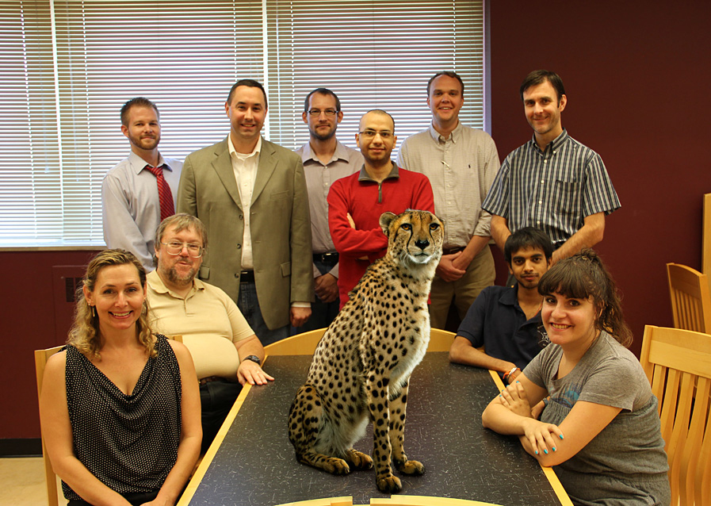
Amy Hatfield, MLS PURR Metadata
Puurrrrrrrrrrrrr……

Slide 13
Database population

Slide 14
Dublin Core

Slide 15
Qualified Dublin Core Schema dcterms name space
<dcterms:creator>Principle Author - Required</dcterms:creator>
<dcterms:contributor>Other Authors - Optional/Repeatable</dcterms:contributor>
<dcterms:date>Submission Timestamp (ISO 8601) - Required</dcterms:date>
<dcterms:description>Abstract - Currently Required/Repeatable</dcterms:description>
<dcterms:description>Synopsis - Currently Required/Repeatable</dcterms:description>
<dcterms:description>Notes - Currently Required/Repeatable</dcterms:description>
<dcterms:format>BagIt - Hard coded - Required</dcterms:format>
<dcterms:identifier>DOI - Required</dcterms:identifier>
<dcterms:publisher>Purdue University Research Repository - Hard coded - Required</dcterms:publisher>
<dcterms:rights>Information about rights held in and over the resource</dcterms:rights>
<dcterms:subject>Tags - Required/Repeatable</dcterms:subject>
<dcterms:title>Required</dcterms:title>
<dcterms:type>Dataset - Hard coded - Required</dcterms:type>

Slide 16
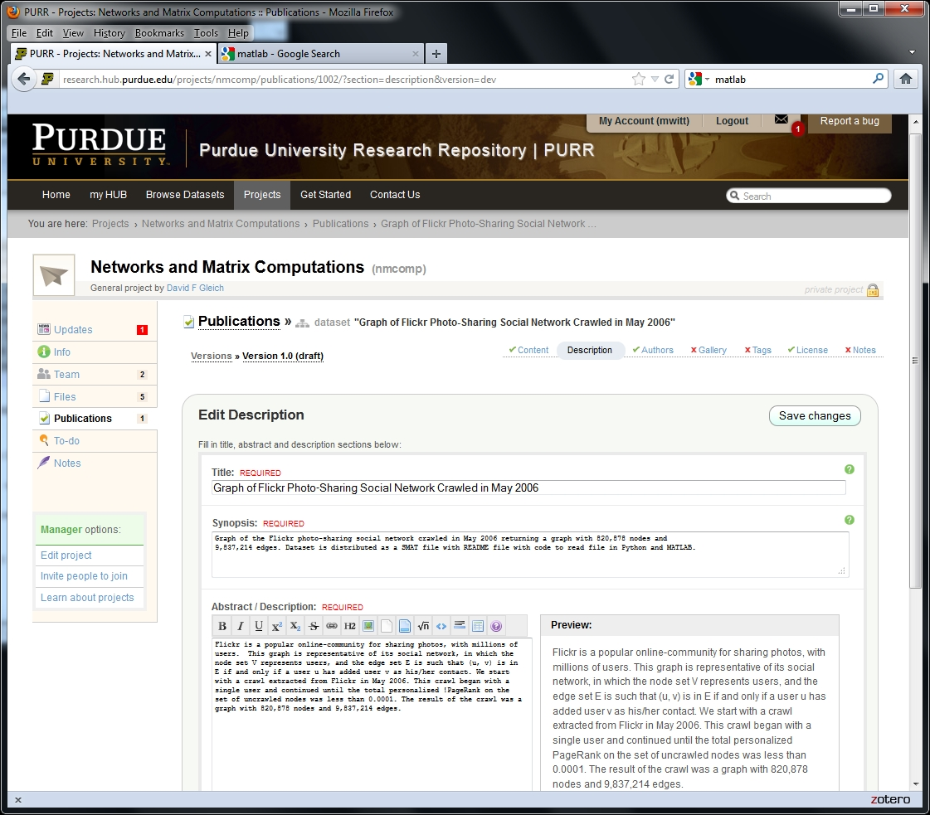
Implementation
<dcterms:title></dcterms:title>
<dcterms:description></dcterms:description>
<dcterms:description></dcterms:description>

Slide 17
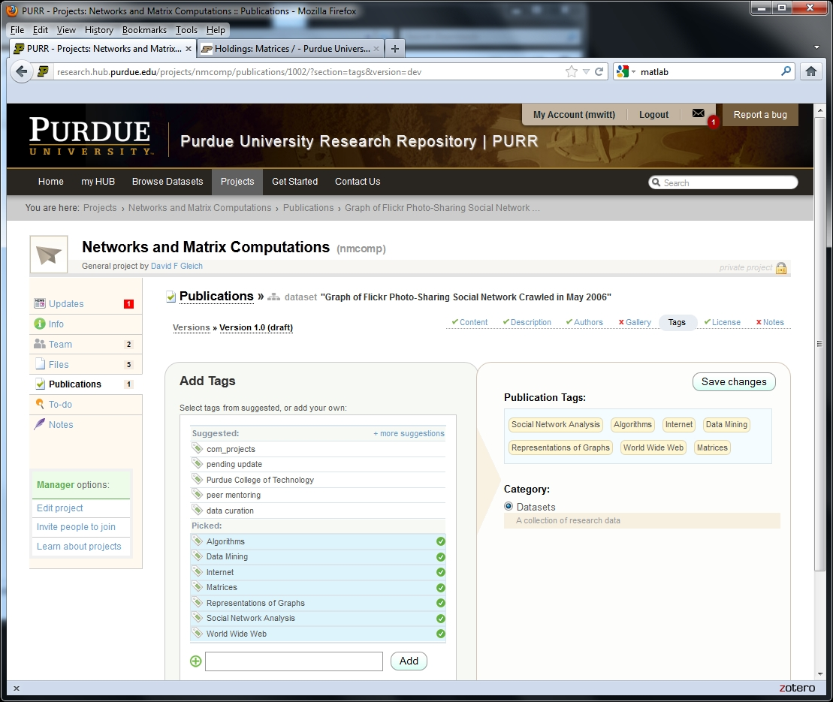
<dcterms:subject></dcterms:subject>

Slide 18
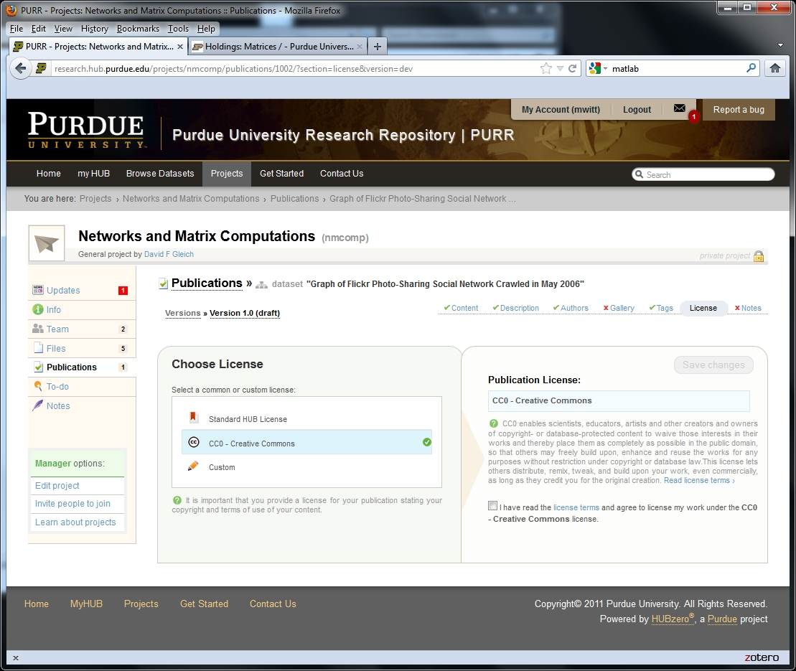
<dcterms:license></dcterms:license>

Slide 19
Metadata Encoding and Transmission Standard (METS) Wrapper
<dcterms:dcterms…
<dcterms:creator>Principle Author - Required</dcterms:creator>
<dcterms:contributor>Other Authors - Optional/Repeatable</dcterms:contributor>
<dcterms:date>Submission Timestamp - Required</dcterms:date>
<dcterms:desctiption>Abstract - Optional/Repeatable</dcterms:desctiption>
<dcterms:description>Synopsis - Optional/Repeatable</dcterms:description>
<dcterms:description>Notes - Optional/Repeatable</dcterms:description>
<dcterms:format>Bagit - Hard coded</dcterms:format>
<dcterms:identifier>DOI - Required</dcterms:identifier>
<dcterms:publisher>Purdue University Research Repository - Hard coded</dcterms:publisher>
<dcterms:rights>Information about rights held in and over the resource</dcterms:rights>
<dcterms:subject>Tags - Optional/Repeatable</dcterms:subject>
<dcterms:title>Required</dcterms:title>
<dcterms:type>Dataset - Hard coded</dcterms:type>
</dcterms:dcterms>
</mets:xmlData>
<mets:mets…
<mets:dmdSec ID="DC">
<mets:mdWrap MDTYPE="DC">
<mets:xmlData>
</mets:xmlData>
</mets:mdWrap>
</mets:dmdSec>
<mets:amdSec>
<mets:techMD ID="object1">
<mets:mdWrap MDTYPE="PREMIS:OBJECT">
<mets:xmlData>
</mets:xmlData>
</mets:mdWrap>
</mets:techMD>
<mets:digiprovMD ID="event1" >
<mets:mdWrap MDTYPE="PREMIS:EVENT">
<mets:xmlData>
</mets:xmlData>
</mets:mdWrap>
</mets:digiprovMD>
</mets:amdSec>
</mets:mets>
Dublin Core Terms

Slide 20
PREMIS Preservation Metadata
<premis:object xsi:type="premis:file" xsi:schemaLocation="info:lc/xmlns/premis-v2 http://www.loc.gov/standards/premis/v2/premis-v2-0.xsd">
<premis:objectIdentifier>
<premis:objectIdentifierType>CHECKSUM - Required</premis:objectIdentifierType>
<premis:objectIdentifierValue>Generated checksum</premis:objectIdentifierValue>
</premis:objectIdentifier>
<premis:preservationLevel>
<premis:preservationLevelValue>full</premis:preservationLevelValue>
<premis:preservationLevelDateAssigned>00000000
</premis:preservationLevelDateAssigned>
</premis:preservationLevel>
<premis:objectCharacteristics>
<premis:compositionLevel>0</premis:compositionLevel>
<premis:fixity>
<premis:messageDigestAlgorithm>Name of CHECKSUM algorithm</premis:messageDigestAlgorithm>
<premis:messageDigest>Generated checksum</premis:messageDigest>
<premis:messageDigestOriginator>PURR</premis:messageDigestOriginator>
</premis:fixity>
<premis:size>000000</premis:size>
<premis:format>
<premis:formatDesignation>
<premis:formatName>File format</premis:formatName>
<premis:formatVersion>If the format is versioned, formatVersion should be recorded. It can be either a numeric or chronological designation.</premis:formatVersion>
</premis:formatDesignation>
<premis:formatRegistry>
<premis:formatRegistryName>DROID or Unix Tools?</premis:formatRegistryName>
<premis:formatRegistryKey>(e.g., fmt/10)</premis:formatRegistryKey>
<premis:formatRegistryRole>specification</premis:formatRegistryRole>
</premis:formatRegistry>
</premis:format>
<mets:mets…
<mets:dmdSec ID="DC">
<mets:mdWrap MDTYPE="DC">
<mets:xmlData>
</mets:xmlData>
</mets:mdWrap>
</mets:dmdSec>
<mets:amdSec>
<mets:techMD ID="object1">
<mets:mdWrap MDTYPE="PREMIS:OBJECT">
<mets:xmlData>
</mets:xmlData>
</mets:mdWrap>
</mets:techMD>
<mets:digiprovMD ID="event1" >
<mets:mdWrap MDTYPE="PREMIS:EVENT">
<mets:xmlData>
</mets:xmlData>
</mets:mdWrap>
</mets:digiprovMD>
</mets:amdSec>
</mets:mets>
Administrative Metadata

Slide 21
<mets:mets…
<mets:dmdSec ID="DC">
<mets:mdWrap MDTYPE="DC">
<mets:xmlData>
</mets:xmlData>
</mets:mdWrap>
</mets:dmdSec>
<mets:amdSec>
<mets:techMD ID="object1">
<mets:mdWrap MDTYPE="PREMIS:OBJECT">
<mets:xmlData>
</mets:xmlData>
</mets:mdWrap>
</mets:techMD>
<mets:digiprovMD ID="event1" >
<mets:mdWrap MDTYPE="PREMIS:EVENT">
<mets:xmlData>
</mets:xmlData>
</mets:mdWrap>
</mets:digiprovMD>
</mets:amdSec>
</mets:mets>
<premis:creatingApplication>
<premis:creatingApplicationName>Software used to create the file. Repeatable for multiple software used.</premis:creatingApplicationName>
<premis:creatingApplicationVersion>Software version</premis:creatingApplicationVersion>
<premis:dateCreatedByApplication>00000000</premis:dateCreatedByApplication>
</premis:creatingApplication>
Technical Metadata

Slide 22
<mets:mets…
<mets:dmdSec ID="DC">
<mets:mdWrap MDTYPE="DC">
<mets:xmlData>
</mets:xmlData>
</mets:mdWrap>
</mets:dmdSec>
<mets:amdSec>
<mets:techMD ID="object1">
<mets:mdWrap MDTYPE="PREMIS:OBJECT">
<mets:xmlData>
</mets:xmlData>
</mets:mdWrap>
</mets:techMD>
<mets:digiprovMD ID="event1" >
<mets:mdWrap MDTYPE="PREMIS:EVENT">
<mets:xmlData>
</mets:xmlData>
</mets:mdWrap>
</mets:digiprovMD>
</mets:amdSec>
</mets:mets>
<premis:hardware>
<premis:hwName>Name of hardware</premis:hwName>
<premis:hwType>Processor</premis:hwType>
<premis:hwOtherInformation>(e.g., 60 mhz minimum)</premis:hwOtherInformation>
</premis:hardware>
<premis:hardware>
<premis:hwName>(e.g., 64 MB RAM)</premis:hwName>
<premis:hwType>Memory</premis:hwType>
<premis:hwOtherInformation>(e.g., 32 MB minimum)</premis:hwOtherInformation>
</premis:hardware>
<premis:environmentExtension>
<hardwareInformation/>
<softwareInformation/>
</premis:environmentExtension>
Technical Metadata

Slide 23
<mets:mets…
<mets:dmdSec ID="DC">
<mets:mdWrap MDTYPE="DC">
<mets:xmlData>
</mets:xmlData>
</mets:mdWrap>
</mets:dmdSec>
<mets:amdSec>
<mets:techMD ID="object1">
<mets:mdWrap MDTYPE="PREMIS:OBJECT">
<mets:xmlData>
</mets:xmlData>
</mets:mdWrap>
</mets:techMD>
<mets:digiprovMD ID="event1" >
<mets:mdWrap MDTYPE="PREMIS:EVENT">
<mets:xmlData>
</mets:xmlData>
</mets:mdWrap>
</mets:digiprovMD>
</mets:amdSec>
</mets:mets>
<premis:eventType>validation</premis:eventType>
<premis:eventDateTime>2006-06-06T00:00:00.001</premis:eventDateTime>
<premis:eventDetail>jhove1_1e - validation software</premis:eventDetail>
<premis:eventOutcomeInformation>
<premis:eventOutcome>successful</premis:eventOutcome>
<premis:eventOutcomeDetail>
<premis:eventOutcomeDetailNote>Well-formed and valid</premis:eventOutcomeDetailNote>
<premis:eventOutcomeDetailExtension>
<logfileInfo>
<in/>
<out/>
</logfileInfo>
</premis:eventOutcomeDetailExtension>
</premis:eventOutcomeDetail>
</premis:eventOutcomeInformation>
Provenance Metadata

Slide 24
<mets:mets…
<mets:dmdSec ID="DC">
<mets:mdWrap MDTYPE="DC">
<mets:xmlData>
</mets:xmlData>
</mets:mdWrap>
</mets:dmdSec>
<mets:amdSec>
<mets:techMD ID="object1">
<mets:mdWrap MDTYPE="PREMIS:OBJECT">
<mets:xmlData>
</mets:xmlData>
</mets:mdWrap>
</mets:techMD>
<mets:digiprovMD ID="event1" >
<mets:mdWrap MDTYPE="PREMIS:EVENT">
<mets:xmlData>
</mets:xmlData>
</mets:mdWrap>
</mets:digiprovMD>
</mets:amdSec>
</mets:mets>
<premis:eventType>ingestion</premis:eventType>
<premis:eventDateTime>2006-06-06T00:00:00.002</premis:eventDateTime>
<premis:eventDetail>Ingest tool/software (e.g., ingester1_0.exe)</premis:eventDetail>
<premis:eventOutcomeInformation>
<premis:eventOutcome>successful</premis:eventOutcome>
</premis:eventOutcomeInformation>
Provenance Metadata
<premis:eventType>migration</premis:eventType>
<premis:eventDateTime>2006-07-06T00:00:00.006</premis:eventDateTime>
<premis:eventDetail>Name of software used to migrate version (e.g., Adobe Acrobat v. 9) </premis:eventDetail>
<premis:eventOutcomeInformation>
<premis:eventOutcome>successful</premis:eventOutcome>
</premis:eventOutcomeInformation>

Slide 25
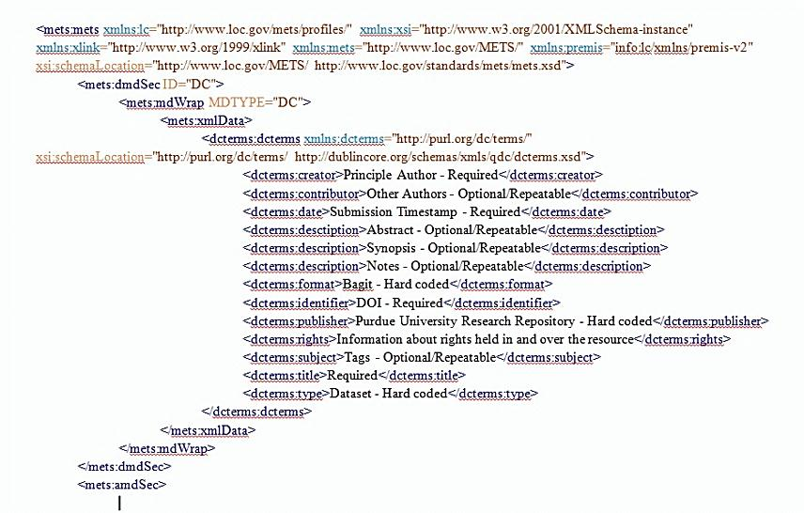



Archival Information Package (AIP)
Dissemination Information Package
(DIP)
PURR
Puuuurrrrrrrrrrr….

Slide 26
Dissemination Information Package (DIP)
Searchable – within PURR
Discoverable – through other systems…

Slide 27
OAI-PMH
Open Archives Initiative Protocol for Metadata Harvesting

Slide 28
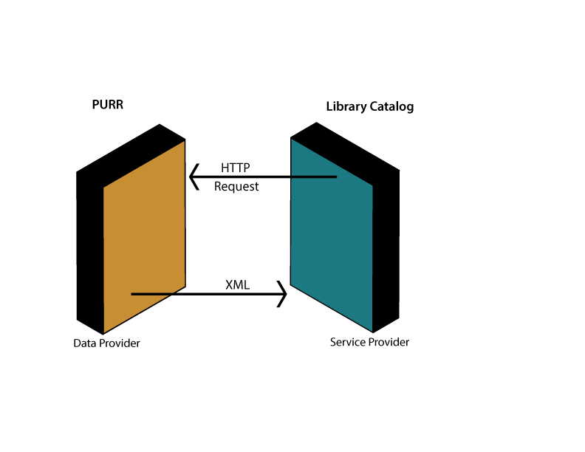
OAI-PMH
Open Archives Initiative Protocol for Metadata Harvesting
Application-independent framework based on metadata harvesting. There are two classes of participants in the OAI-PMH framework:
Data Providers administer systems that support the OAI-PMH as a means of exposing metadata; and
Service Providers use metadata harvested via the OAI-PMH as a basis for building value-added services.

Slide 29
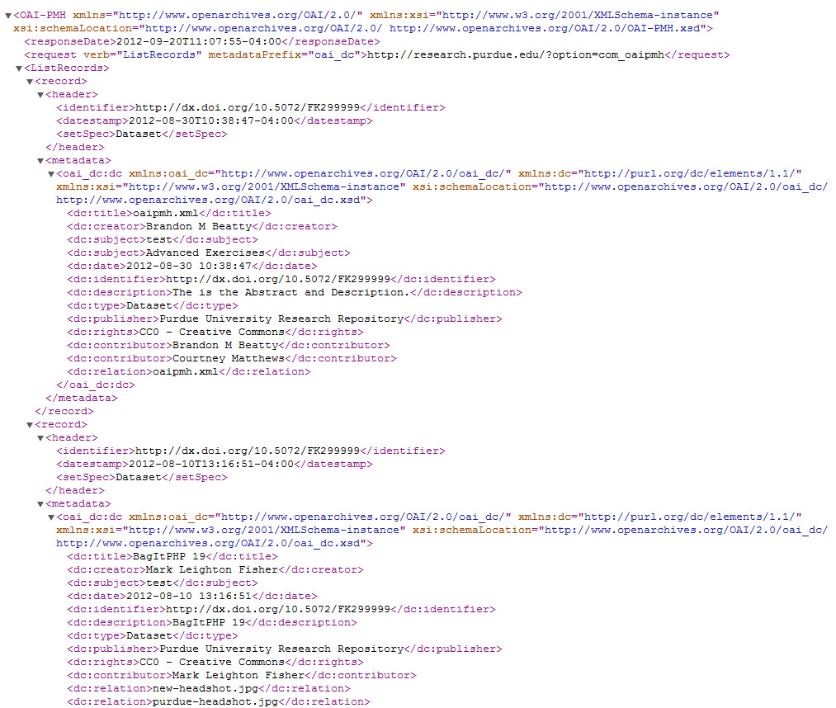
OAI-PMH XML Output
Hubname.org/?option=com_oaipmh&verb=ListRecords&metadataPrefix=oai_dc

Slide 30
Thank you
Neal Harmeyer – Digital Archivist – harmeyna@purdue.edu
Amy Hatfield – Metadata Specialist – hatfiea@purdue.edu
Brandon Beatty – PURR Software Developer – bbeatty@purdue.edu

