Slide 1
Cyberinfrastructure and Scientific Portals at Notre Dame
Jarek Nabrzyski
Center for Research Computing naber@nd.edu, http://crc.nd.edu

Slide 2
Center for Research Computing
Established in 2006, HPC operations and user support.
I arrived in 2009 to see that 7 staff members run HPC operations (~20 small clusters in ~20+ small cabinets/closets on campus, 250 users total)
My goal is to build a new model for the center
  Grow computational science
  Grow cyberinfrastructure development

Slide 3
Mission
The University of Notre Dame’s Center for Research Computing (CRC) engages in computational science, fosters multidisciplinary research and provides advanced computational tools and services. The CRC works to facilitate discoveries across science, engineering, arts, humanities, social sciences, business and other disciplines.

Slide 4
Vision
To become an internationally recognized multidisciplinary research computing center based upon our reputation for facilitating and accelerating discovery through effective and novel applications of cyberinfrastructure.

Slide 5
Jarek’s thoughts (May-August 2009):
“Nice vision, but how we get there?”
“What should we do first?”
“Users should tell us what they need…”
“HPC works fine, so let’s focus on CI Development…”
“We need PORTALS and other collaborative environments”
“We need good user support, and good, straight resource usage policies”
“We need CI and HPC teams working together”
“How do we fund all these with very limited resources?”
“What is available out there?
And so on…

Slide 6
Workflow
Take the risk and hire people first -> train people -> generate / bring projects -> assign people to projects and focus on getting more projects and more people -> etc...
-> if not successful then exit, i.e. quit ☺
Fortunately, we had many projects, mostly science gateway projects of various kinds and difficulty.

Slide 7
Cyberinfrastructure Group
15 programmers (and need more…)
7 computational scientists (and need more…)
ICE group (Interactive and Collaborative Environments) and Computational Frameworks Group
ICE heavily involved in portal/science gateways development
~30 different science gateways projects of various size since 2010

Slide 8
Old times … (oh, I miss them)
GridSphere Portlet Framework (abandoned, although used broadly worldwide)
VineToolkit (still exists)
  Tools (portal APIs) that connected users to bunch of grid / distributed infrastructures, including Globus, Condor, national grid infrastructures, etc.
No CMS though
LifeRay was a strong competitor (still doing well).

Slide 9
Today…
‘War’ between Joomla!, Drupal, Plone, WordPress… you name it…
Java, vs. Django vs. Ruby, etc.
Users very often have their pilot projects developed in “something”
Shall we let users decide? Shall we impose a solution/technology on them?
How do we build teams? Do we need to know all the web technologies or use just one or two? Is it a good investment?

Slide 10
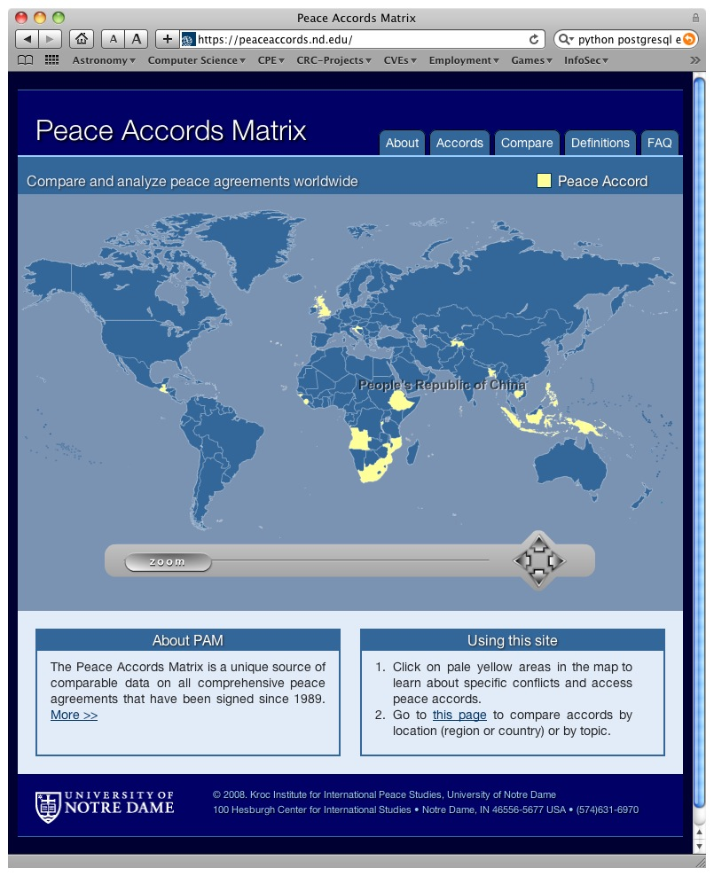
Peace Accords Matrix
The Peace Accords Matrix (PAM) project serves as a good example of how a Web technology can bridge the gap between researchers and their data. Here, the Kroc Institute for International Peace Studies engaged the CRC's ICE team to rapidly build a replacement for what was a malfunctioning and poorly designed Web/database system.
Although the original system required more than a year to build, the ICE team had one month to complete this project--nothing from the original project could be reused.

Slide 11
Varieties of Democracy (VoD)
Varieties of Democracy aims to produce better indicators of Democracy
Who: fifteen social scientists on three continents who work with hundreds of country experts and a truly global International Advisory Board.
VoD Home Page: http://v-dem.net

Slide 12
Varieties of Democracy (VoD)
Objectives
  Survey, measure, and visualize degrees and types of democracy around the world
  Support a global community of researchers and survey coders (500 to 600 registered users; 100 visitors a day)
  CMS capabilities including strong workflow for content management
  Small, inexpensive server footprint
Technology Choice
  Plone (version 4.1)
  PostgreSQL (version 8.4; currently storing 1.2 million rows)
  HighCharts (Javascript visualization library)

Slide 13
Varieties of Democracy (VoD)
Why Plone?
  Open source (GPL)
  Python-based (CRC is largely a Python shop!)
  Mature (first release in 2001)
  Deployment base in thousands (roughly 2,283 sites, according to Plone.org); government, academic, and private sector
  Robust CMS and workflow out-of-the-box
  Extensible/customizable through Zope

Slide 14
Varieties of Democracy (VoD)
Plone does deliver on its promises, but….
  Zope (Python-based Web application server) is Byzantine and very complex; significant learning curve
  Zope is its own universe; its approach is unlike any other Python Web environment
  Development workflow (e.g., development→ QA → production) is made more difficult with Zope, though not impossible

Slide 15
Varieties of Democracy (VoD)
Example Survey Dialog

Slide 16
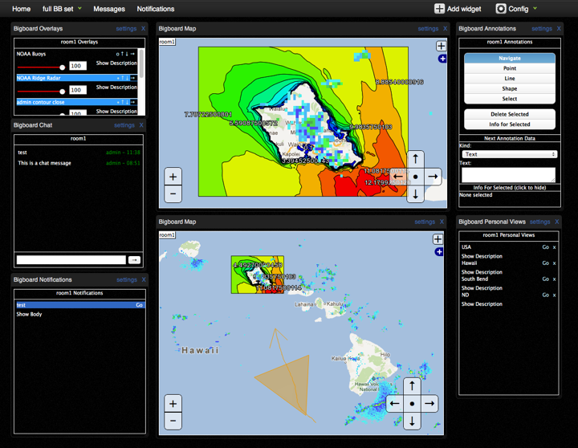
Cyber-Eye

Slide 17
Cyber-Eye Hurricane Situational Awareness Application
Objectives
  Platform to provide Situational Awareness with respect to Hurricane events
  Provide Geospatial modeling and information
  Provide a modular environment where custom Web 2.0 apps could be created
  Small, inexpensive server footprint
Technology Choice
  GeoAnalytics (http://geoanalytics.renci.org/)
  Django

Slide 18
Cyber-Eye
Why GeoAnalytics?
  Modular, lightweight framework for GIS
  Provides Python and Django integration
  Integrates mature tools (PostGIS, GeoDjango, OpenLayers, Grass)
  Provides attractive “BigBoard” Web 2.0 based GIS collaborative application

Slide 19
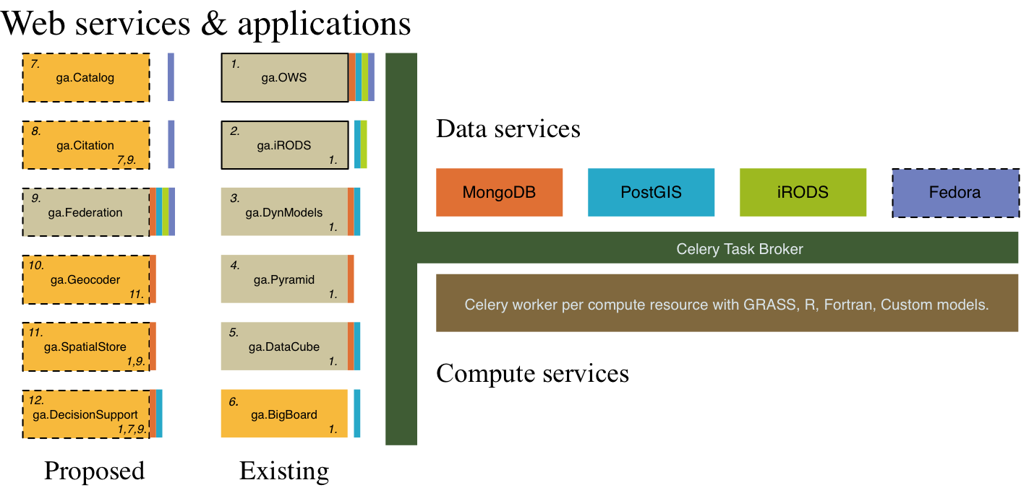
Geoanalytics (collaboration with RENCI)

Slide 20
SPACES - Niche Modeling Framework
Spatial Portal for Analysis of Change in Environment on Species

Slide 21
SPACES
A Modeling Framework to serve the niche modeling community by providing a dozen or so Species Distribution Model (SDM) algorithms alongside a vast amount of formatted spatial data available through user selection and integrated with projected climate scenarios, projected land-cover/land-use, and other non-climate data to capture all the attributes pertaining to the species' realized niche.
Utilizes open source software in combination with spatial and species information, remote sensing technologies, data- and knowledge-management tools, and other cyberinfrastructure components.
Provides the means to compare, contrast, and analyze output maps pertaining to different SDM algorithms using a raster output calculator, thereby allowing the comparison of the spatial extent of species' realized niches across multiple SDMs.

Slide 22
Features
Enables biologists to take advantage of massive quantities of spatial data while freeing them from the time-consuming, laborious, and error-prone conversion process.
Makes available many otherwise-inaccessible collections of spatial information.
Avoids duplicate storage of massive spatial datasets.
Provides a virtual high-performance computing facility to people from developing countries.
Builds documentation that is not currently available.
Creates and manages a platform for a virtual community.
Makes spatial data accessible in a format that is standardized with respect to spatial extent and resolution.
Permits the direct comparison of model results with respect to the spatial extents.

Slide 23
SPACES experiment
Species
Spatial
Layers

Slide 24
Select
SDM
algorithms

Slide 26
Results: SDM algorithm : Envelope Score

Slide 27
Results: SDM algorithm : Desktop GARP

Slide 28
Results: SDM algorithm : Environmental Distance

Slide 29
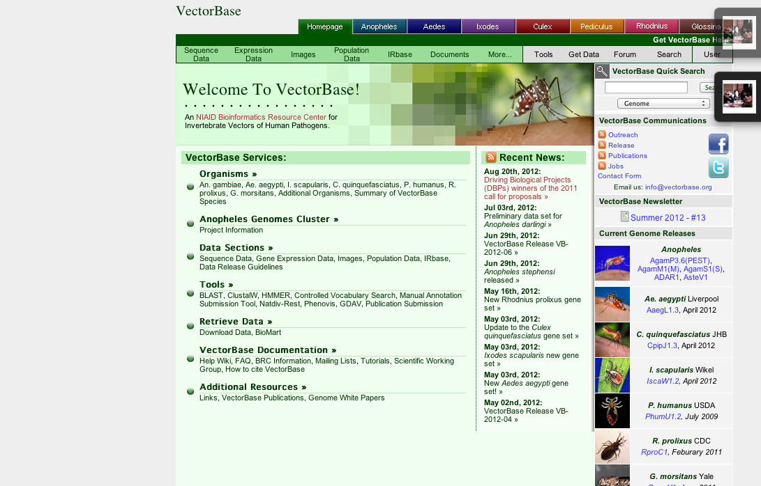

Slide 30
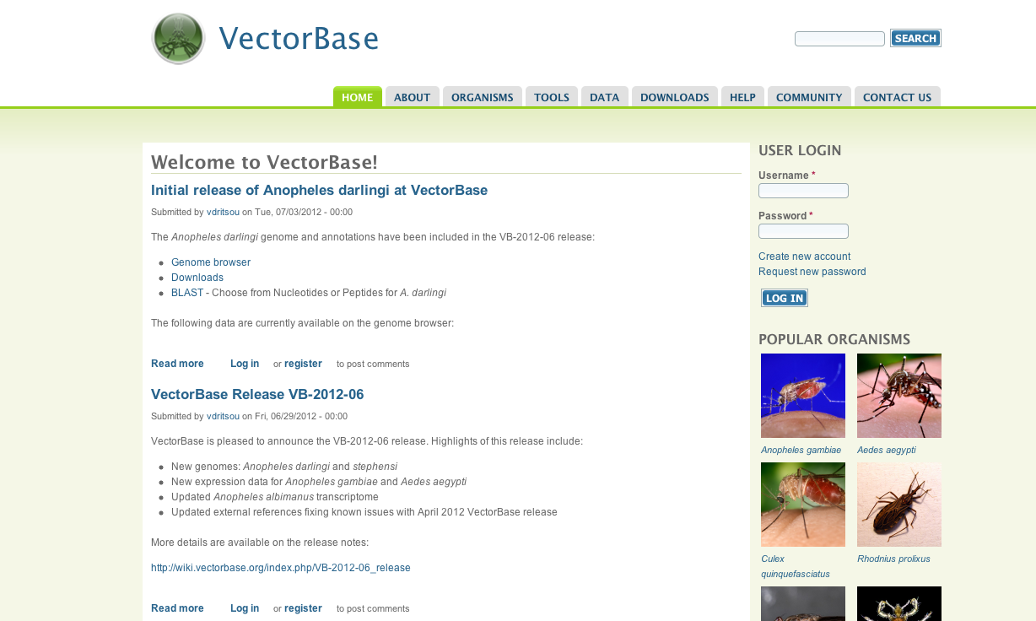

Slide 31
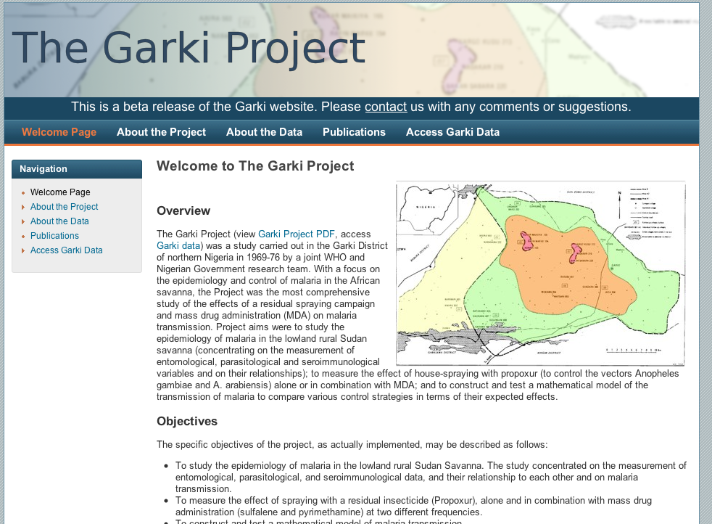
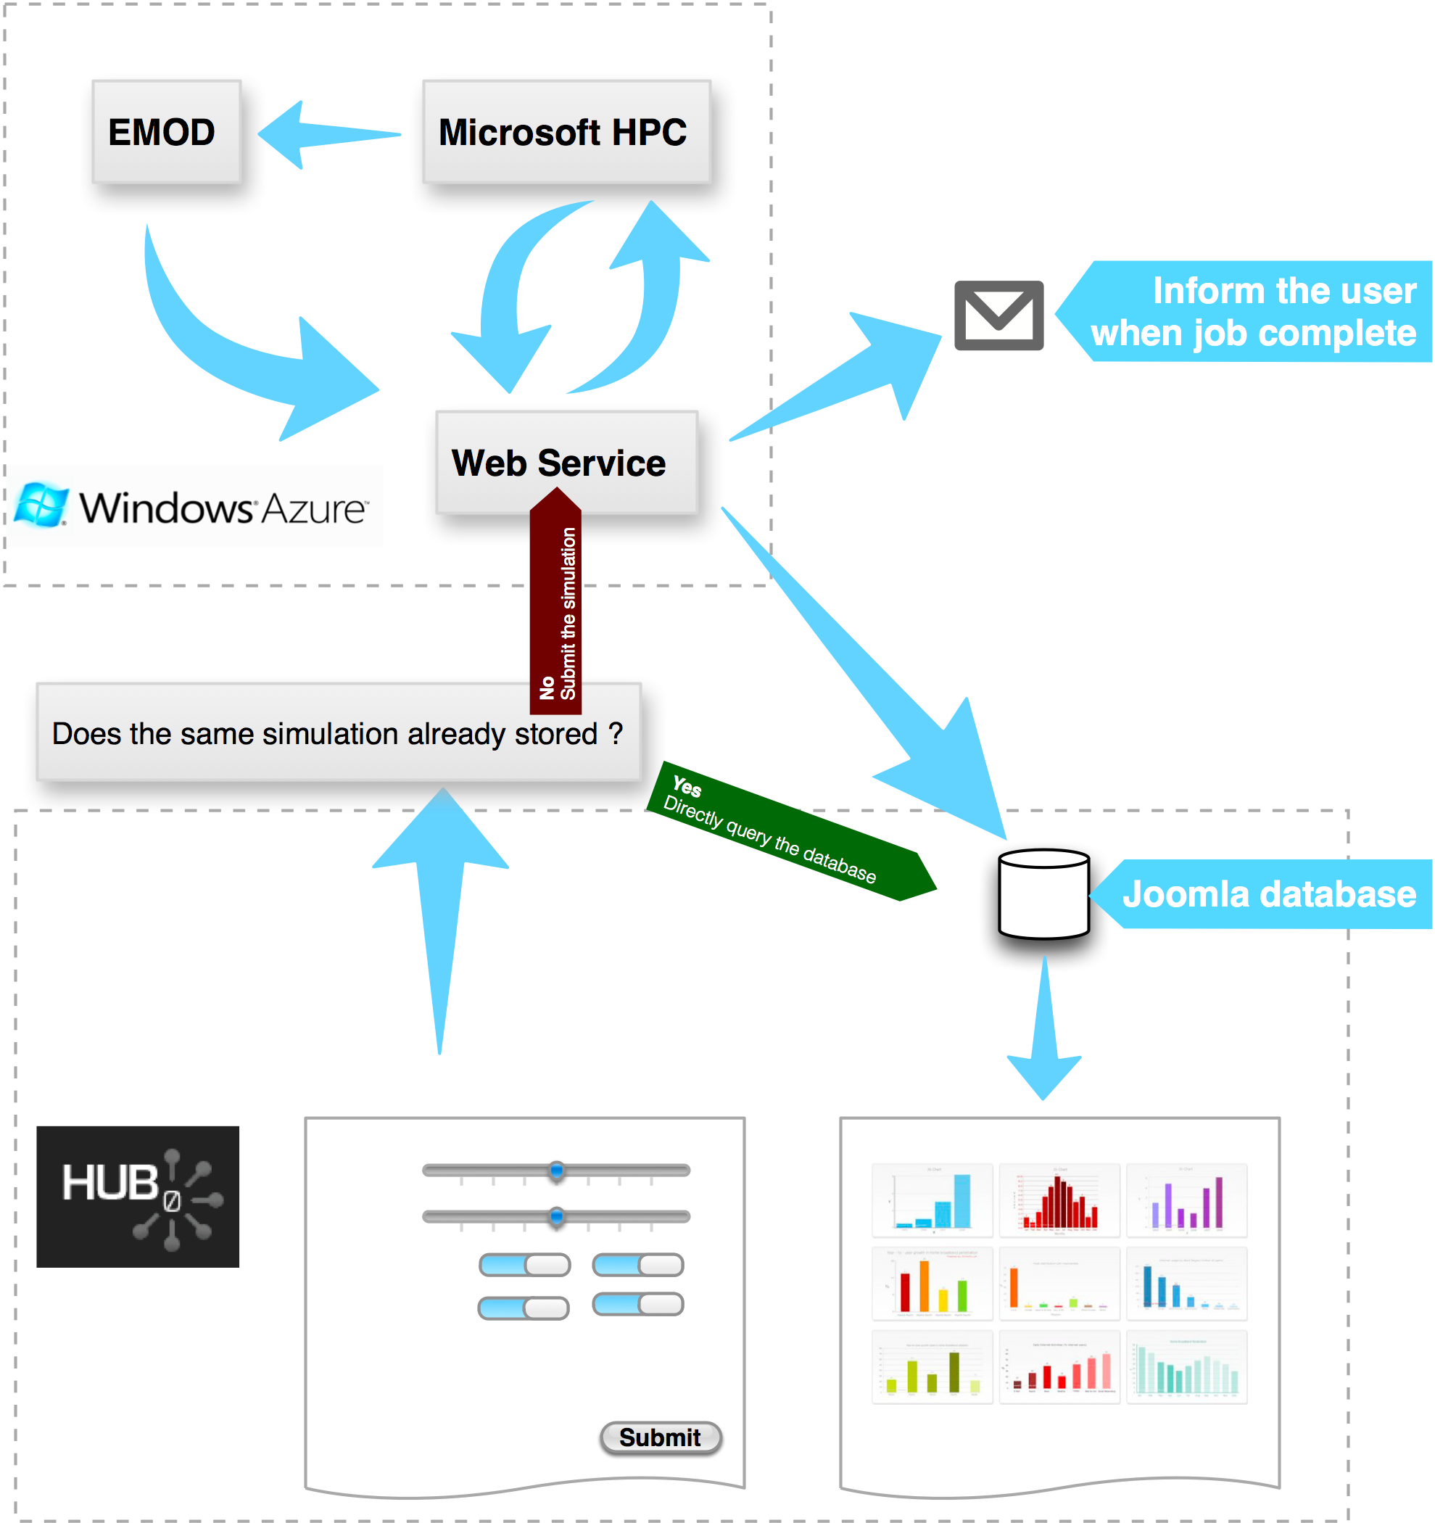
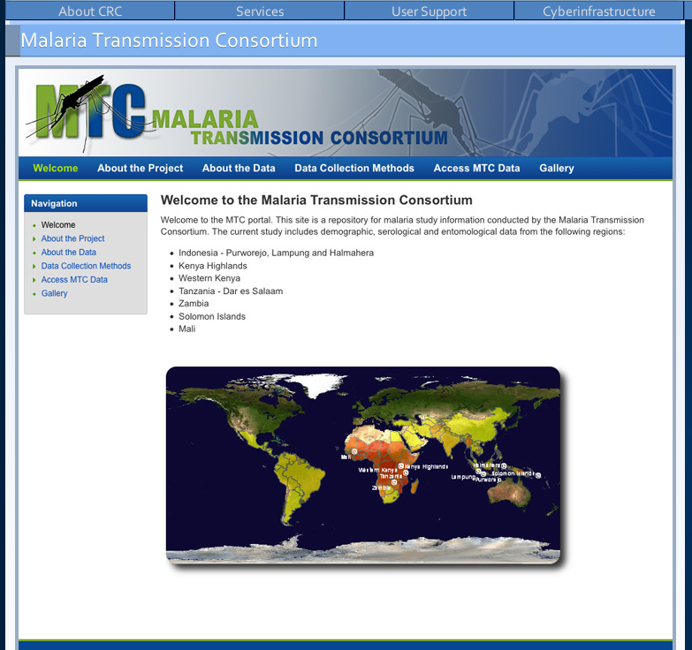
Malaria Projects at Notre Dame

Slide 32
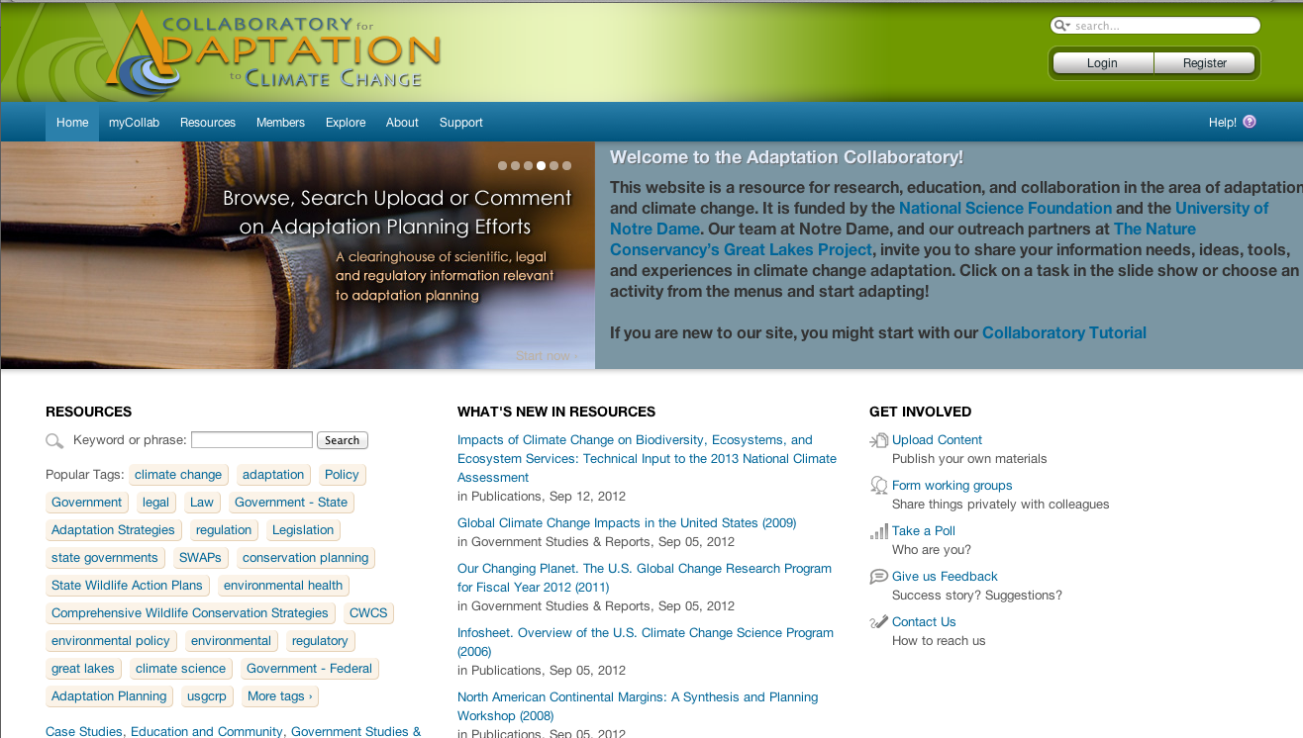

Slide 33
Collaboratory is a virtual organization relying on cyber infrastructure for data sharing and modeling, shared computational resources, networking, community building, expert advise and to pursue pioneering inter- disciplinary integration and sound policy development.

Slide 34
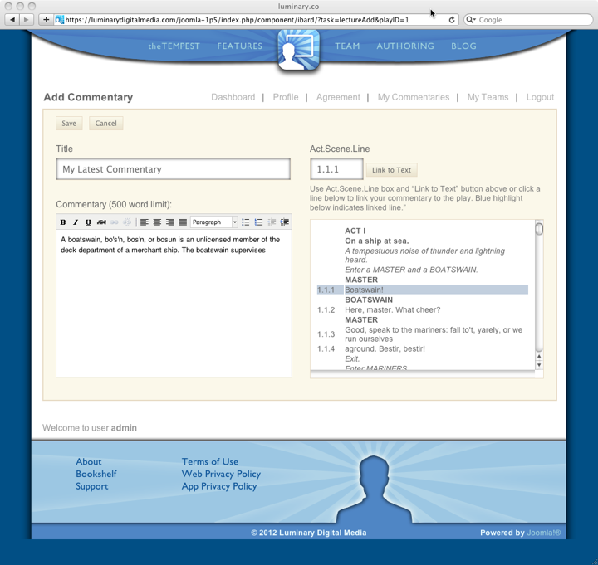
Tempest iOS Application
http://www.luminarydigitalmedia.com

Slide 35
Tempest iOS Application
Objectives
  Interactive, social networking eBook
  A platform for users to create and share commentary on text
  Tutorials and multimedia materials for app users
  Platform for users to create and share
  Small, inexpensive server footprint
Technology Choice
  Joomla!
  PostgreSQL

Slide 36
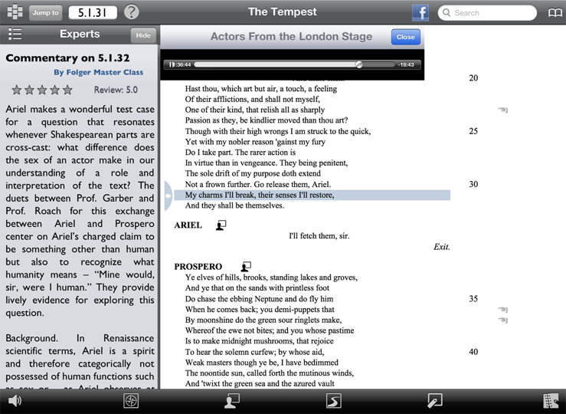
Tempest iOS Application

Slide 37
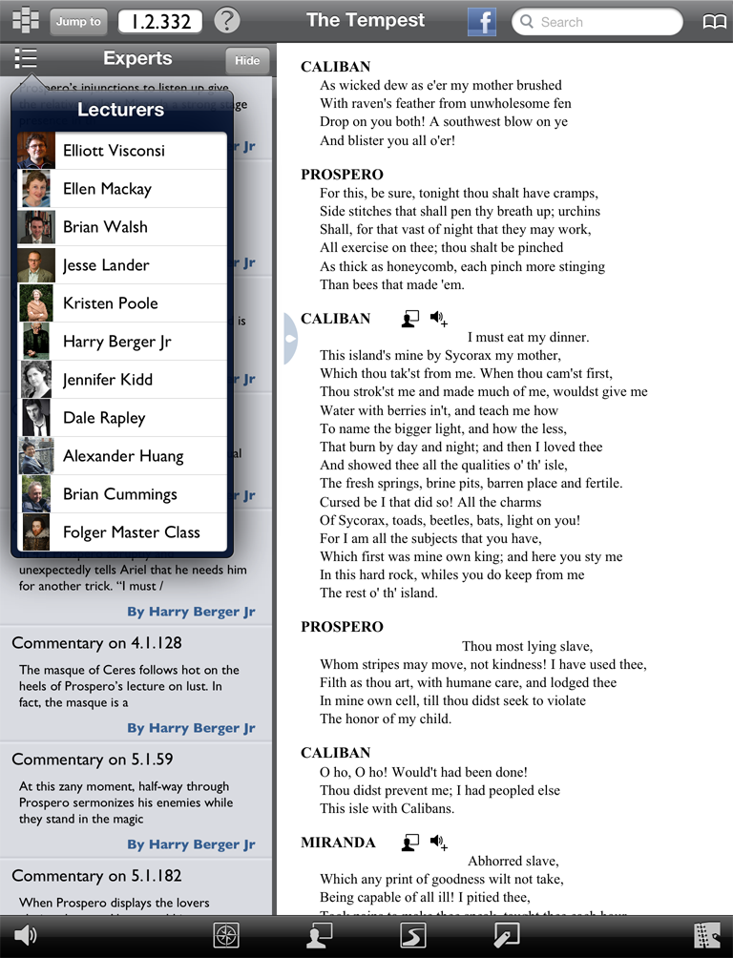
Much more than a digital book, The Tempest for iPad is designed for social reading, authoring, and sharing, for all readers from students to professional scholars.

Slide 38

Enjoy a full-length audio performance from the noted company Actors From the London Stage. Play text scrolls as you listen. Additional audio takes provide alternative performances of key passages.

Slide 39
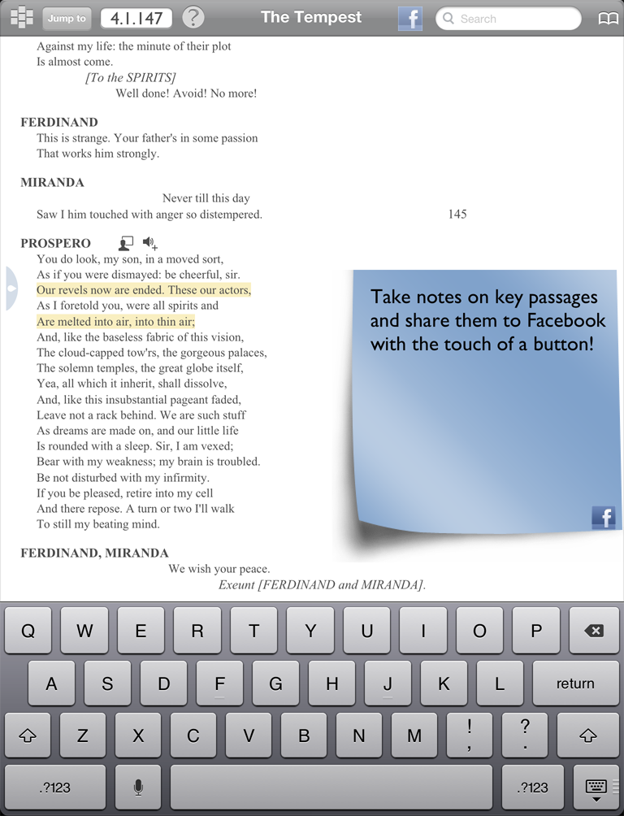
Share your notes immediately to a Facebook discussion group

Slide 40
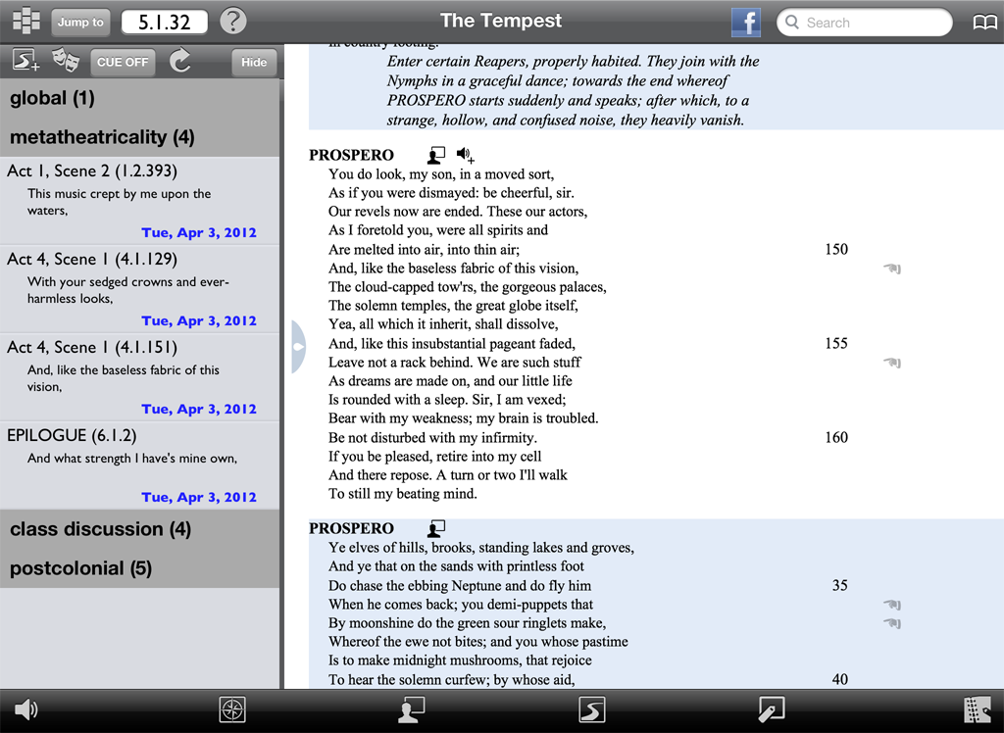
Create your own play text. Select key passages you like, annotate them, and share with friends, colleagues, and readers worldwide.

Slide 41
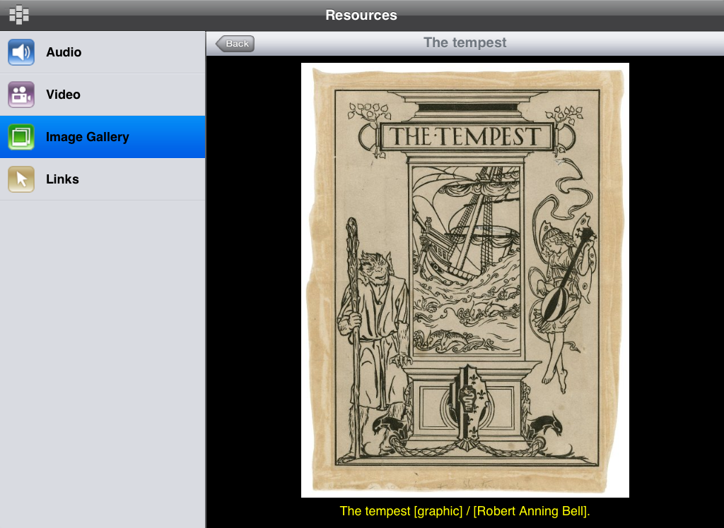
Illustrations, podcasts and video from The Folger Shakespeare Library's collection bring alive Renaissance English culture and theater.

Slide 42
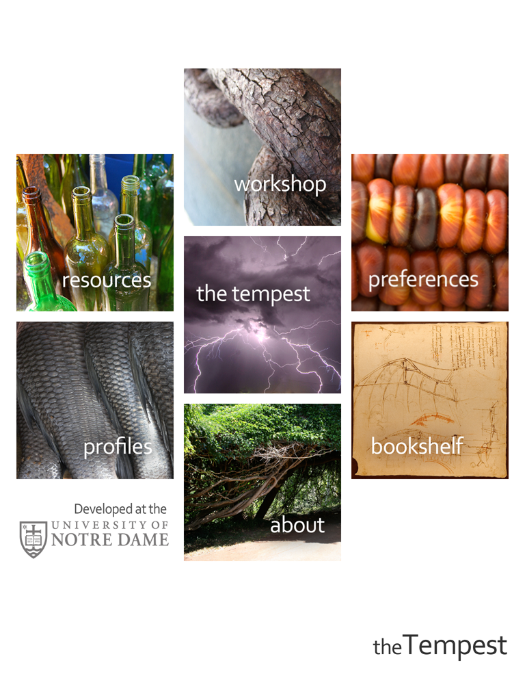
Customize your experience. Quiet when you need it, social when you want it.

Slide 43
Summary
Many lessons learned, many mistakes
  E.g. now need to integrate SPACES and COLLABORATORY, and it is not easy
To HUB or not to HUB? – very often asked question at the CRC
  If community building and collaborative tools are important – YES
  If just data access and sharing – not necessary, there are more lightweight solutions.
“You go to a war with the army you have”

Slide 44
Thank you!

