Slide 1
Science Gateways and their Democratization and Acceleration of Science
Nancy Wilkins-Diehr
wilkinsn@sdsc.edu

Slide 2
Gateways: A natural result of the impact of the internet on worldwide communication and information retrieval
Only 20 years since the release of Mosaic!
Implications on the conduct of science are still evolving
1980’s, Early gateways, National Center for Biotechnology Information BLAST server, search results sent by email, still a working portal today
1989 World Wide Web developed at CERN
1992 Mosaic web browser developed
1995 “International Protein Data Bank Enhanced by Computer Browser”
2004 TeraGrid project director Rick Stevens recognized growth in scientific portal development and proposed the Science Gateway Program
Today, Web 3.0 and programmatic exchange of data between web pages
Simultaneous explosion of digital information
Growing analysis needs in many, many scientific areas
Sensors, telescopes, satellites, digital images, video, genome sequencers
#1 machine on Top500 today over 10,000x more powerful than all combined entries on the first list in 1993

Slide 3
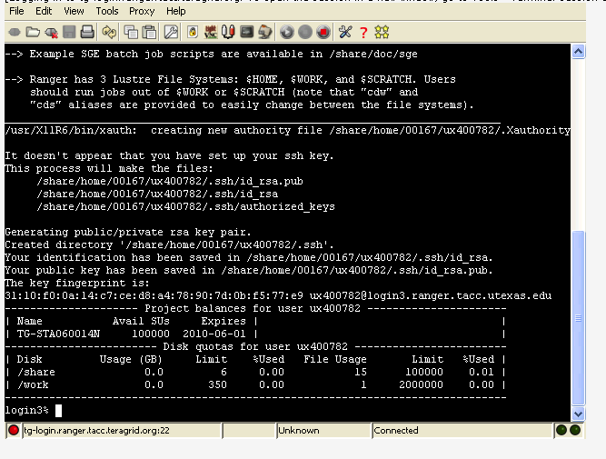
My experiences Science Gateways and high performance computing
Interfaces to supercomputers haven’t changed much in the last 20 years
vt100 in the 1980s and a login window on the Ranger system at TACC today

Slide 4
Why are gateways worth the effort?
=======
# Full path to executable
executable=/users/wilkinsn/tutorial/bin/mcell
# Working directory, where Condor-G will write
# its output and error files on the local machine.
initialdir=/users/wilkinsn/tutorial/exercise_3
# To set the working directory of the remote job, we
# specify it in this globus RSL, which will be appended
# to the RSL that Condor-G generates
globusrsl=(directory='/users/wilkinsn/tutorial/exercise_3')
# Arguments to pass to executable.
arguments=nmj_recon.main.mdl
# Condor-G can stage the executable
transfer_executable=false
# Specify the globus resource to execute the job
globusscheduler=tg-login1.sdsc.teragrid.org/jobmanager-pbs
# Condor has multiple universes, but Condor-G always uses globus
universe=globus
# Files to receive sdout and stderr.
output=condor.out
error=condor.err
# Specify the number of copies of the job to submit to the condor queue.
queue 1
#! /bin/sh
#PBS -q dque
#PBS -l nodes=1:ppn=2
#PBS -l walltime=00:02:00
#PBS -o pbs.out
#PBS -e pbs.err
#PBS -V
cd /users/wilkinsn/tutorial/exercise_3
../bin/mcell nmj_recon.main.mdl
Increasing range of expertise needed to tackle the most challenging scientific problems
How many details do you want each individual scientist to need to know?
PBS, RSL, Condor
Coupling multi-scale codes
Assembling data from multiple sources
Collaboration frameworks
+(
&(resourceManagerContact="tg-login1.sdsc.teragrid.org/jobmanager-pbs")
(executable="/users/birnbaum/tutorial/bin/mcell")
(arguments=nmj_recon.main.mdl)
(count=128)
(hostCount=10)
(maxtime=2)
(directory="/users/birnbaum/tutorial/exercise_3")
(stdout="/users/birnbaum/tutorial/exercise_3/globus.out")
(stderr="/users/birnbaum/tutorial/exercise_3/globus.err")
)

Slide 5
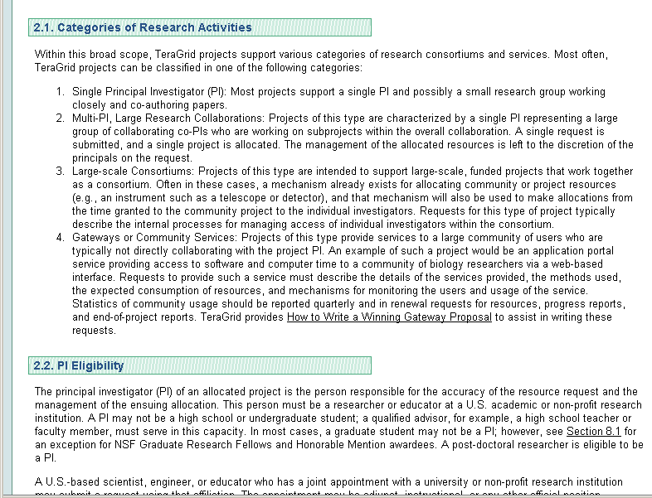
Did you know?
Supercomputers can be accessed through user-designed web interfaces as well as from the command line
In 2011 40% of TeraGrid users came through the web

Slide 6
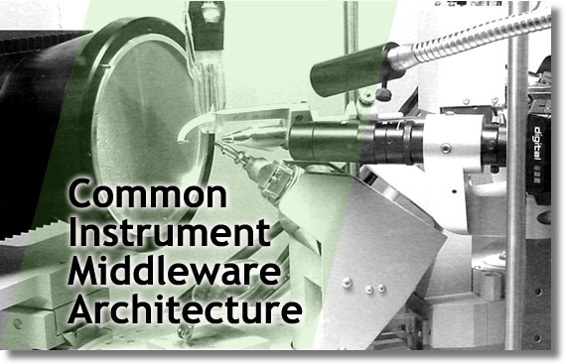
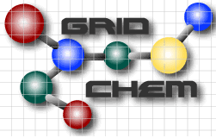
Today, there are approximately 35 gateways using XSEDE
Notes:
Most popular these days is CIPRES- Phylogeny (Mark Miller)

Slide 7
Cyberinfrastructure for Phylogenetic Research (CIPRES)
Most popular science gateway
~25% of all XSEDE users
In use on 6 continents
Cited in major journals (Cell, Nature, PNAS)
Used at major research institutions (Stanford, Harvard, Yale)
Used by 57 researchers for curriculum delivery
Used in 80% of EPSCoR states
Recently used by a 15-year-old high school student who won the Massachusetts state science fair with no support from gateway staff

Slide 8
http://www.phylo.org/tools/map.html
Notes:
Let’s see who’s using the system here
Actively pursuing European computing resources for the back end

Slide 9
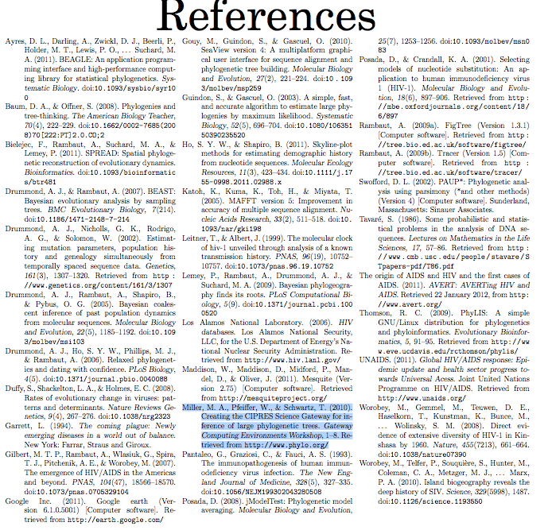
Arman Bilge, Lexington High School wins MA state science fair using CIPRES

Slide 10
CIPRES on NSF’s front page today!

Slide 11
CyberGIS Software Integration for Sustained Geospatial Innovation
Application of high-end cyberinfrastructure to GIS
Influence on multiple domains
Improved decision support
Spatial joins, layers of multiple datasets at different resolutions
Goal is core set of composable, interoperable, manageable, and reusable software elements
Collaborative geospatial problem solving environment

Slide 12
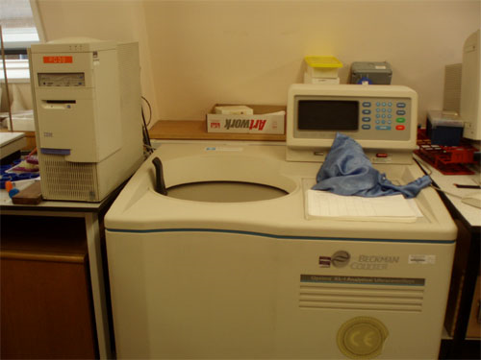
Analytical Ultracentrifugation: Emerging computational tool for the study of proteins
Samples from researchers all over the world
Some (Germany, Australia) have their own ultracentrifuges and use only the analysis capabilities, others send samples to UT to spin
Spin the samples at high speeds, learn about macromolecule properties
Monte Carlo simulations
Observations are electronically digitized and stored for further mathematical analysis
The Center for Analytical Ultracentrifugation of
Macromolecular Assemblies, UT Health Sciences,
Borries Demeler, PI
Source: Suresh Marru, IU

Slide 13
Ultrascan provides a comprehensive data analysis environment
Management of analytical ultracentrifugation data for single users or entire facilities
Support for storage, editing, sharing and analysis of data
HPC facilities used for 2-D spectrum analysis and genetic algorithm analysis
XSEDE
Technische University of Munich
Juelich Supercomputing Center
Portable graphical user interface
MySQL database backend for data management
Over 30 active institutions
Source: Suresh Marru, IU

Slide 14
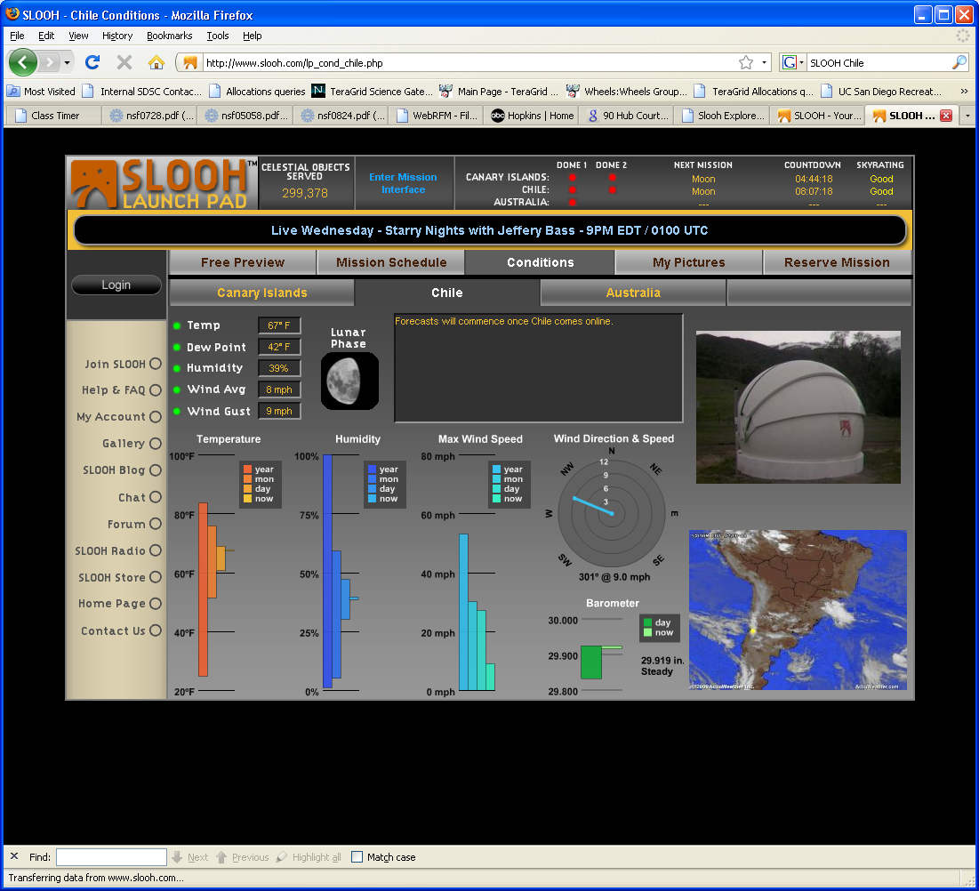
Gateways in the marketplace Kids control telescopes and share images
“In seconds my computer screen was transformed into a live telescopic view”
“Slooh's users include newbies and professional astronomers in 70 countries”
Observatories in the Canary Islands and Chile, Australia coming soon
5000 images/month since 2003
Increases public support for investment in these facilities

Slide 15
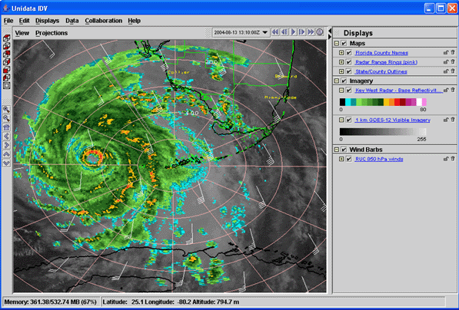
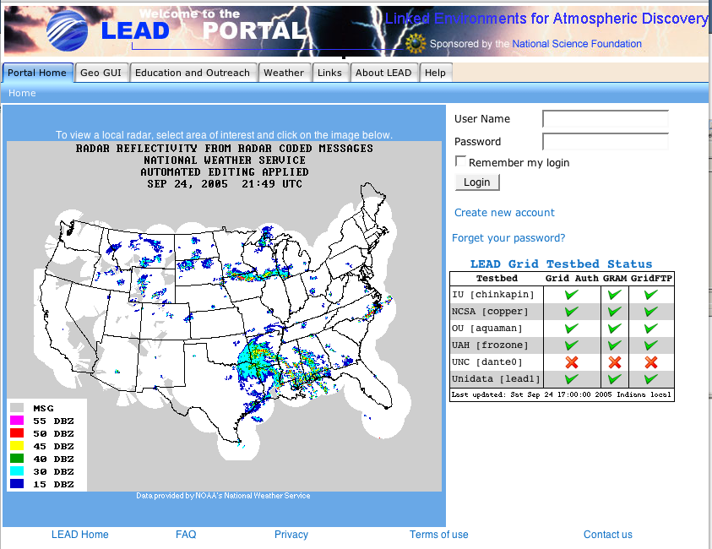
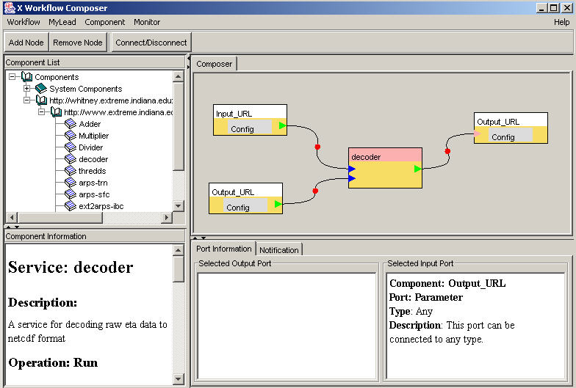
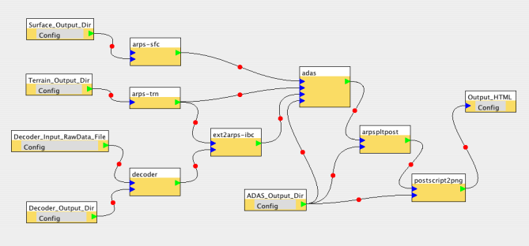
Linked Environments for Atmospheric Discovery LEAD
Providing tools that are needed to make accurate
predictions of tornados and hurricanes
Data exploration and Grid workflow

Slide 16
Social Informatics Data Grid Collaborative access to large, complex datasets
SIDGrid is unique among social science data archive projects
Streaming data which change over time
Voice, video, images (e.g. fMRI), text, numerical (e.g. heart rate, eye movement)
Investigate multiple datasets, collected at different time scales, simultaneously
Large data requirements
Sophisticated analysis tools
Especially valuable for multi-disciplinary course
Computer science, linguistics, psychology
http://www.ci.uchicago.edu/research/files/sidgrid.mov

Slide 17
Viewing multimodal data like a symphony conductor
“Music-score” display and synchronized playback of video and audio files
Pitch tracks
Text
Head nods, pause, gesture references
Central archive of multi-modal data, annotations, and analyses
Distributed annotation efforts by multiple researchers working on a common data set
History of updates
Computational tools
Distributed acoustic analysis using Praat
Statistical analysis using R
Matrix computations using Matlab and Octave
Source: Studying Discourse and Dialog with SIDGrid, Levow, 2008

Slide 18
Gateways democratize access to high end resources
Almost anyone can investigate scientific questions using high end resources
Not just those in high profile research groups
Gateways allow anyone with a web browser to explore
Foster new ideas, cross-disciplinary approaches
Encourage students to experiment
But used in production, too
Significant number of papers resulting from gateways, including GridChem, nanoHUB
Scientists can focus on challenging science problems rather than challenging infrastructure problems

Slide 19
Gateway Sustainability Study With Dr. Katherine Lawrence, U Michigan School of Information
Characteristics of short funding cycles
Build exciting prototypes with input from scientists
Work with early adopters to extend capabilities
Tools are publicized, more scientists interested
Funding ends
Scientists who invested their time to use new tools are disillusioned
Less likely to try something new again
Start again on new short-term project
Need to break this cycle
Small grant to look at characteristics of successful gateways and domain areas where a gateway could have a big impact
4 focus group meetings over 2 years
First 2 held June, 2010
Final 3 held June, 2011
www.sciencegateways.org

Slide 20
After reading stacks of reports, we wanted to capture our findings in a memorable way

Slide 21
These findings lead nicely into NSF’s Scientific Software Innovation Institutes (S2I2) program
Cyberinfrastructure Framework for the 21st Century Science and Engineering (CIF21) vision
Software as integral enabler of computation, experiment and theory
NSF expects that software investment will result in robust, reliable, usable, sustainable software infrastructure
S2I2 institutes are viewed as long-term hubs of excellence that serve communities of substantial size and disciplinary breadth

Slide 22
Science Gateway Institute
One of several 1-year conceptualization grants awarded this past summer
Collaboration involves
SDSC, Elizabeth City State, Indiana, Purdue, U Michigan, U Texas
Gathering community feedback on Institute offerings this year
Incubator service
Extended support services
Gateway forum
Gateway framework
Workforce development
Community engagement

Slide 23
Incubator Service
Assist with the entire lifecycle of a gateway:
Business plan development and review
Development environment, consulting, documentation and software recommendations
Software repositories
Software engineering facilities
Software assessment services
like Open Source Software Advisory Service, Apache assessment service, Software Sustainability Institute (UK)
Build-and-test facilities
Hosting service
Offering gateways expertise in the following areas:
Usability assessment
Licensing
Sustainability
Project management
Security

Slide 24
Extended Support
Peer-reviewed request process open to all
Institute staff assigned to a project for months, up to a year
Assist with gateway development
Teach research teams what it takes to build, enhance, operate, and maintain gateways after support ends

Slide 25
Gateway Forum
Gathering place for scientific web developers across NSF directorates, agencies, and international boundaries
Social forums, white papers, blogs, testimonials and user stories
Annual conference
Broad and engaging symposium series
Gateway training program
Synchronous and asynchronous, video tutorials
Best practices, case studies
Showcase of successful projects
Environment that enables continuous community feedback

Slide 26
Gateway Framework
Modular, layered approach
Supports community contributions
Grocery store approach allows developers to pick and choose the components they need
4 levels of architecture
Value-added services such as a publication channel for delivering content to a wider audience, information repositories for good design practices, and information/code samples for best practices in user-interface and user-experience design
Core web framework which includes hosted site creation and content management
Platform API to provide a cohesive set of RESTful web services upon which the previous two layers rely
Systems layer where the hardware and low-level middleware reside
Clouds and cloud services, HPC systems, grid middleware, data warehouses, databases, instrumentation, and distributed data stores

Slide 27
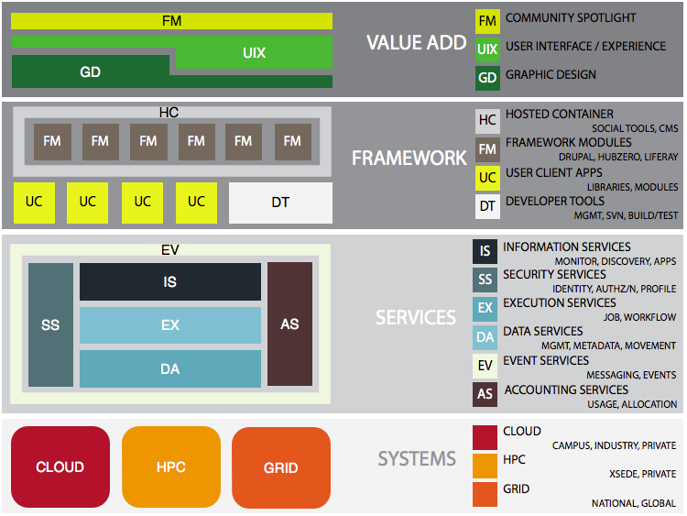
Figure 1. High-level architecture of software offerings and value-added services provided by the institute.

Slide 28
First community input session this afternoon!
Lightning talks highlighting gateways from 1:30-4, 5-5:30
Live polling and interactive session on what would be of value in an institute from 4-5
Hope to see some of you this afternoon
Thank you for your attention

