Slide 1
and the Rise of Social Machines
David De Roure

Slide 2
Workflow of Talk
The experiment that is myExperiment
Influences in the Research Ecosystem
The Rise of Social Machines

Slide 3
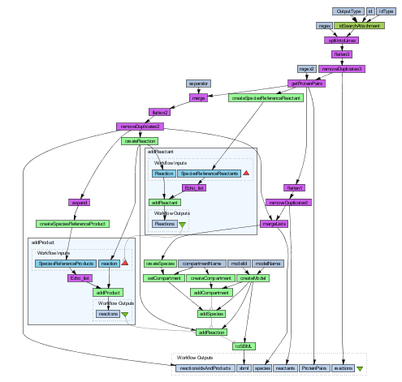

Slide 4
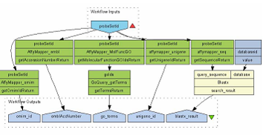
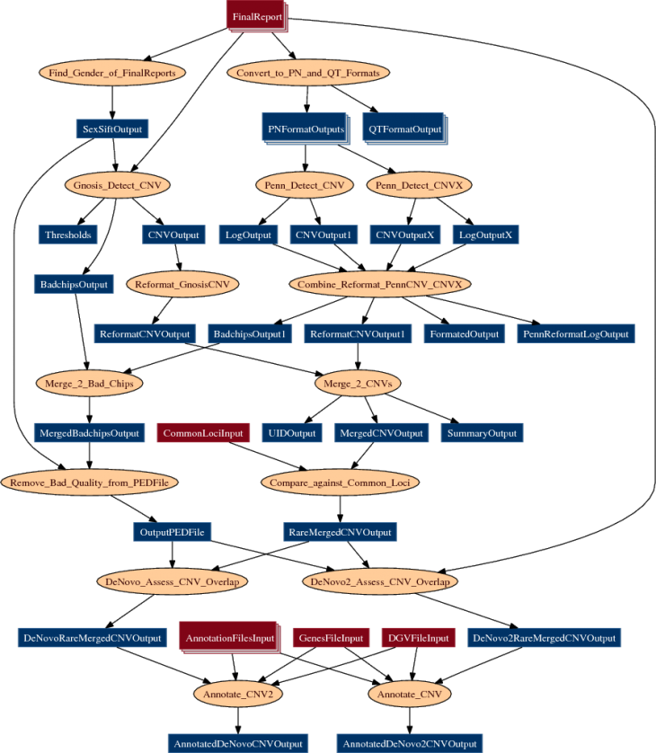
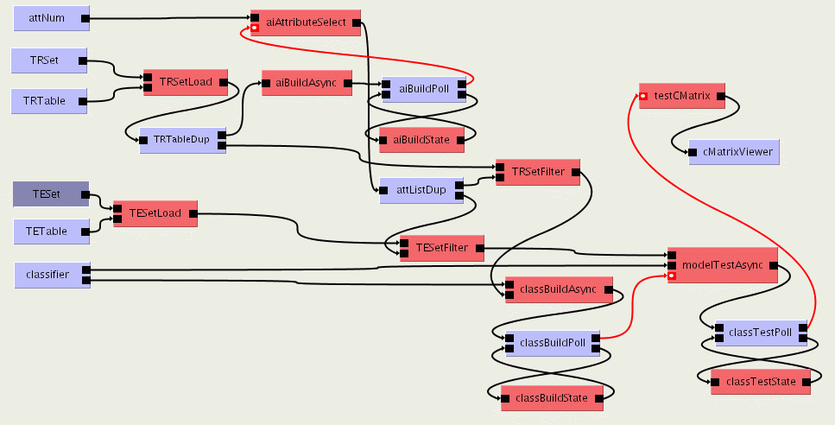
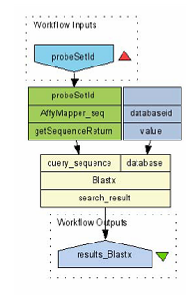
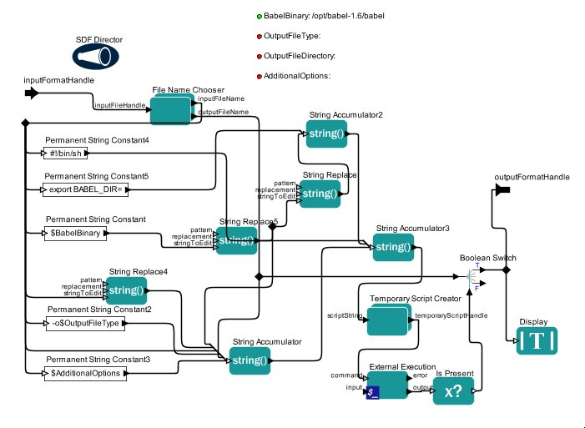
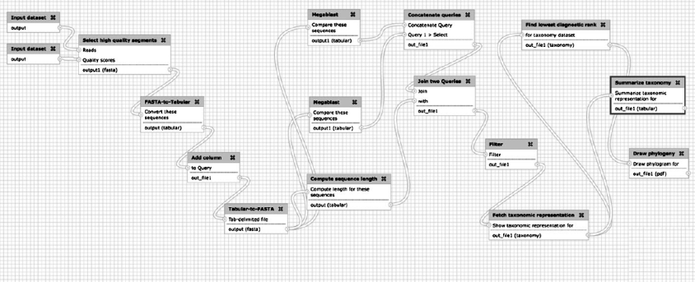
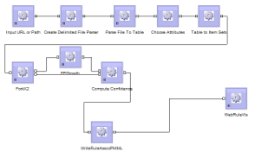
Trident
Triana
Kepler
Pegasus
BPEL
Meandre
Taverna
Galaxy
Notes:
4

Slide 5
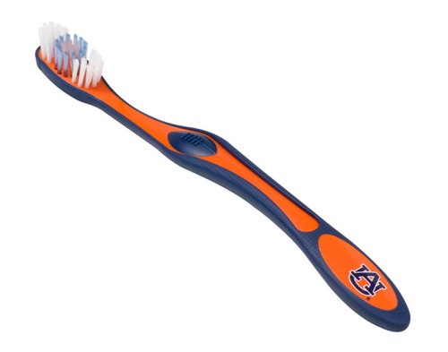
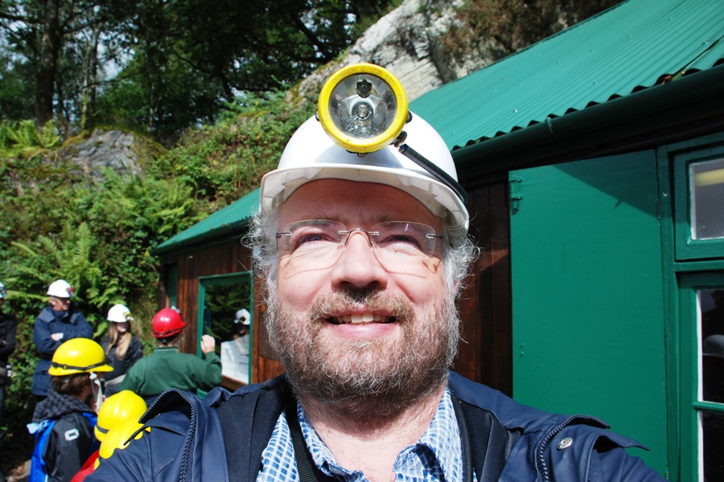
“A biologist would rather share their toothbrush than their gene name”
“Data mining: my data’s mine and your data’s mine”

Slide 7
too passé!
Not
Facebook
mySpace for scientists!
too open!

Slide 8
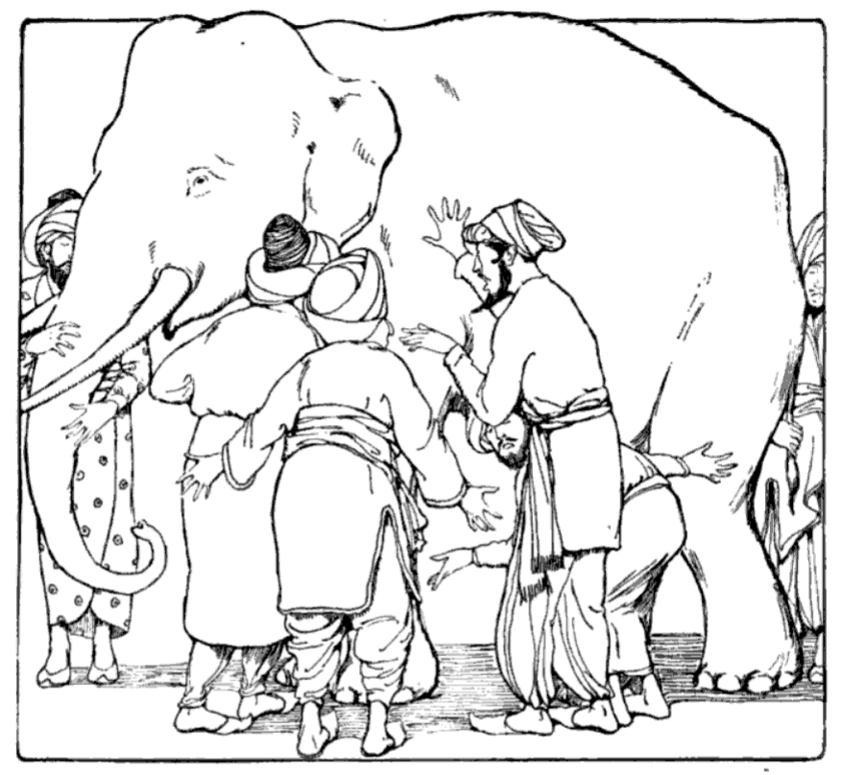
Researchers
Social Scientists
Social Networkers
Open Repositories
Developers

Slide 9
“Facebook for Scientists” ...but different to Facebook!
A repository of research methods
A community social network of people and things
A probe into researcher behaviour
A provocation in scholarly communication
Open source (BSD) Ruby on Rails app
REST and SPARQL interfaces, supports Linked Data
Influenced BioCatalogue, MethodBox and SysMO-SEEK
myExperiment has 300 groups, 2600 workflows and 260 packs

Slide 10
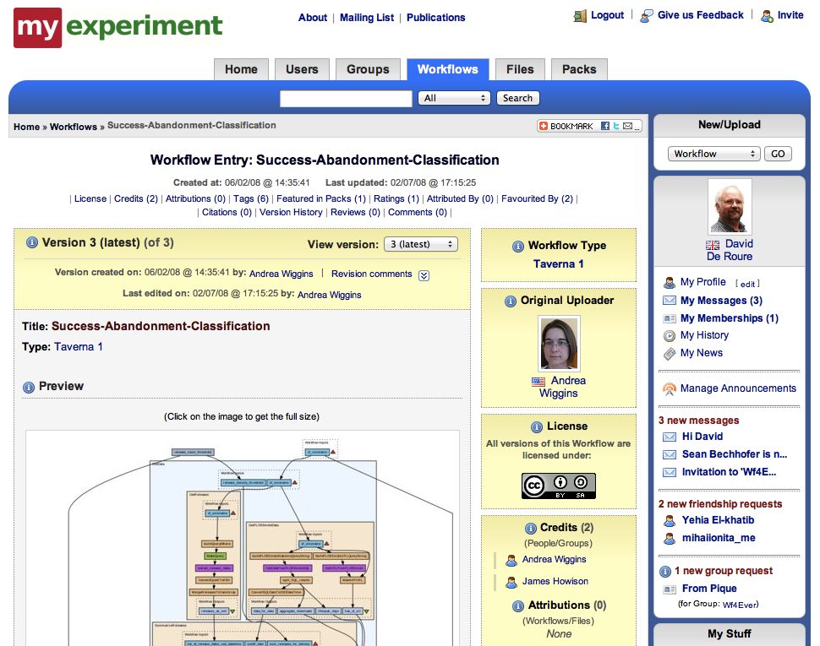
http://www.myexperiment.org/

Slide 11
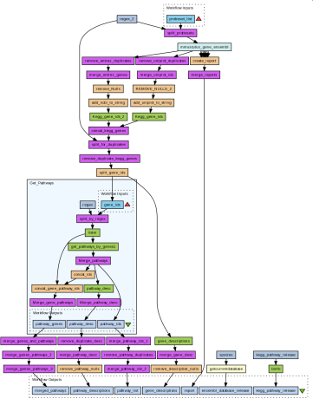
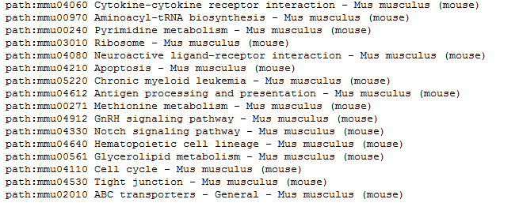
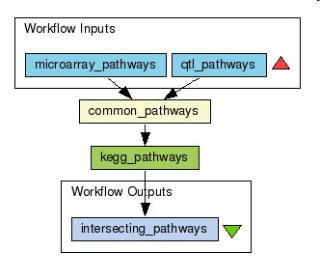
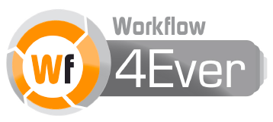
Paul’s Pack
Paul’s Research Object
Workflow 16
QTL
Results
produces
Included in
Published in
Included in
Feeds into
Logs
produces
Included in
Included in
Metadata
Slides
Paper
produces
Published in
Common pathways
Workflow 13
Results

Slide 12
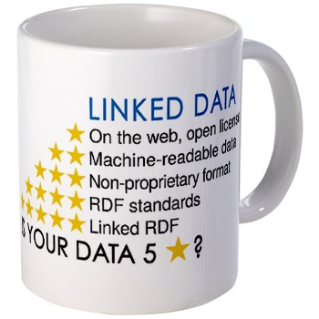
Linked Data support
rdf.myexperiment.org
Use URIs as names for things
Use HTTP URIs so that people can look up those names
When someone looks up a URI, provide useful information, using the standards (RDF*, SPARQL)
Include links to other URIs so that they can discover more things

Slide 13
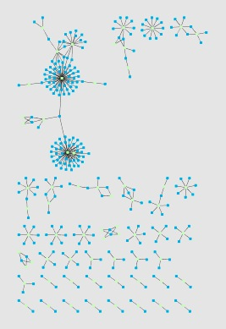
Sean Bechhofer
SELECT?wf ?uri
WHERE {
?wf mebase:has-current-version ?v.
?v mecomp:executes-dataflow ?d.
?d mecomp:has-component ?c.
?c rdf:type mecomp:WSDLProcessor.
?c mecomp:processor-uri ?uri.
}
SELECT?pack ?contrib
WHERE {
?pack rdf:type mepack:Pack.
?pack ore:aggregates ?contrib.
}

Slide 14
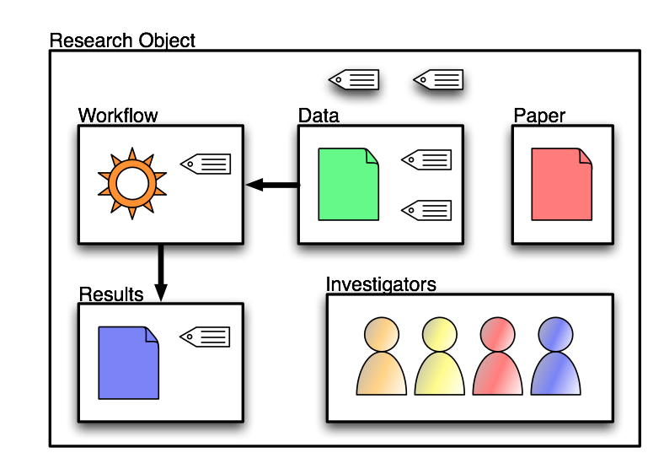
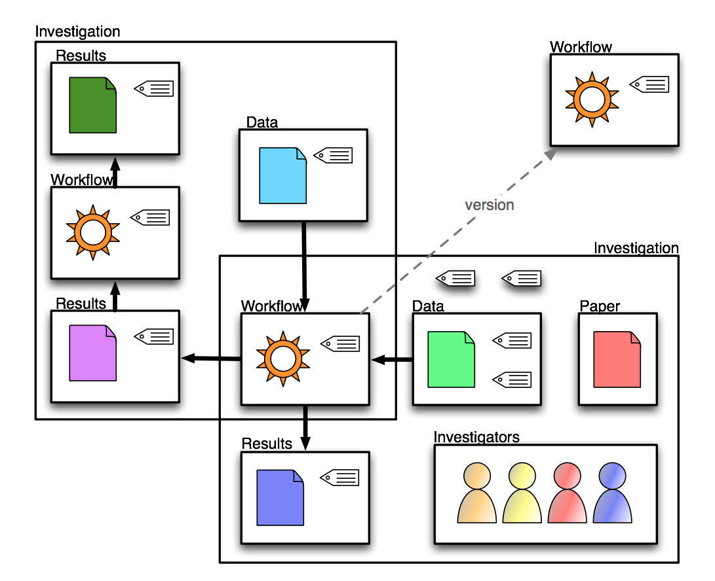
Research Objects Reproducibility, Integrated Publishing
Workflow
Provenance
Conservation & Preservation
Executable Publication
Human
Credit Tracking
Unit of Scholarship
Crowd management
Semantics
Acquisition & Publishing
Encoding, Encapsulation
& Annotation: OAI-ORE, AO…
Distributed
Third Party
Tenancy
Alien
Store
Carole Goble
Technical Objects
Social Objects

Slide 15
Product Family
www.mygrid.org.uk
The BioCatalogue Life Science Web Service Registry www.biocatalogue.org
MethodBox Browse datasets, shop for variables and share knowledge www.methodbox.org
SysMO-Seek Find, share and exchange Data, Models and Processes www.sysmo-db.org

Slide 16
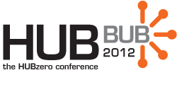
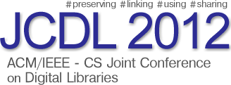
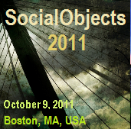
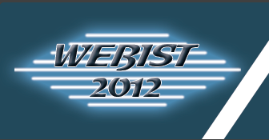

Slide 17
methods
data

Slide 18
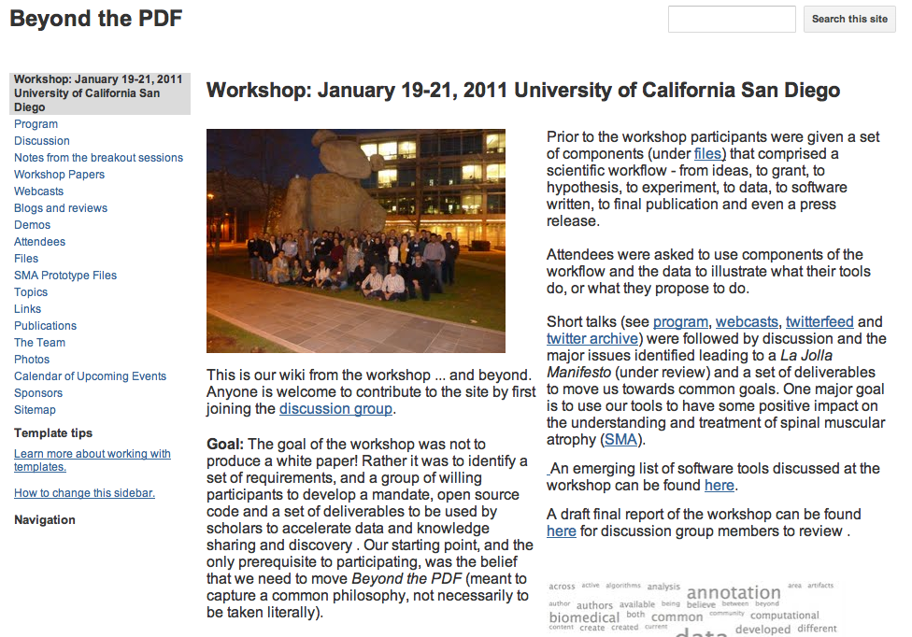
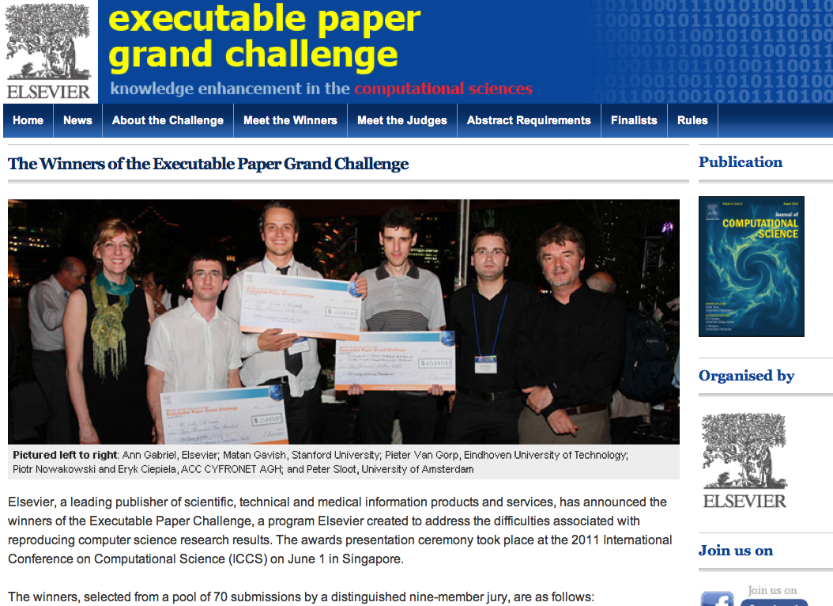
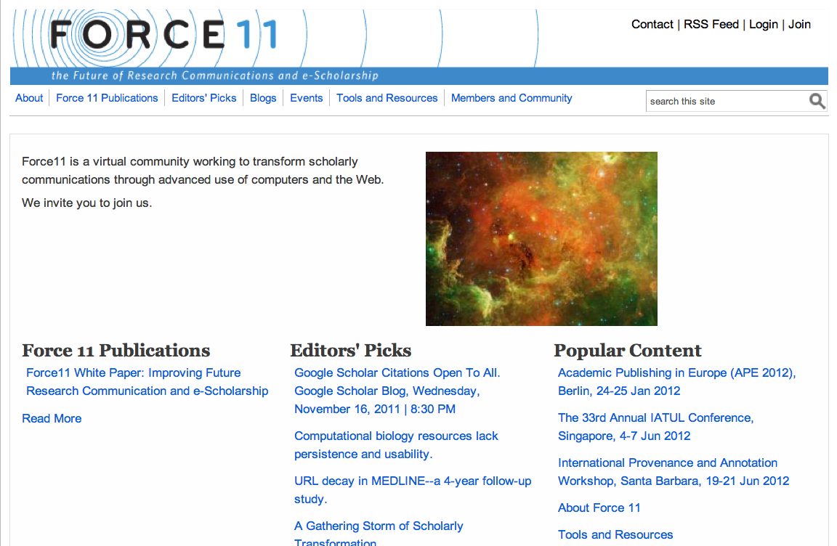
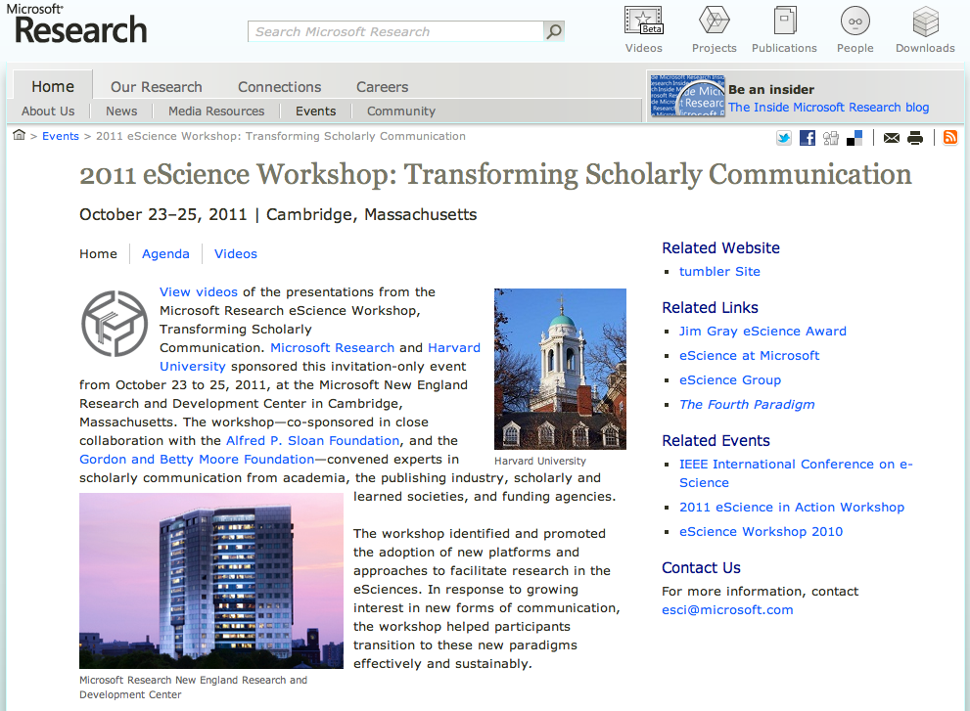
http://force11.org/

Slide 19
The R dimensions
Reusable. The key tenet of Research Objects is to support the sharing and reuse of data, methods and processes.
Repurposeable. Reuse may also involve the reuse of constituent parts of the Research Object.
Repeatable. There should be sufficient information in a Research Object to be able to repeat the study, perhaps years later.
Reproducible. A third party can start with the same inputs and methods and see if a prior result can be confirmed.
Replayable. Studies might involve single investigations that happen in milliseconds or protracted processes that take years.
Referenceable. If research objects are to augment or replace traditional publication methods, then they must be referenceable or citeable.
Revealable. Third parties must be able to audit the steps performed in the research in order to be convinced of the validity of results.
Respectful. Explicit representations of the provenance, lineage and flow of intellectual property.
Replacing the Paper: The Twelve Rs of the e-Research Record” on http://blogs.nature.com/eresearch/

Slide 20
Research Record
repeat
repeat
Machine
paper
Machine
REPRODUCE
paper
software
software
software
Machine
Machine
Software
REPRODUCE OR REPEAT?
paper
workflow
workflow
software
wf
software
Machine
Machine
Software
blogs.nature.com/eresearch/

Slide 21
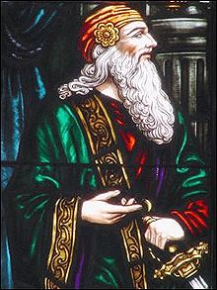
The Executable Thesis
new data
executable thesis
PhD Student
new results

Slide 22
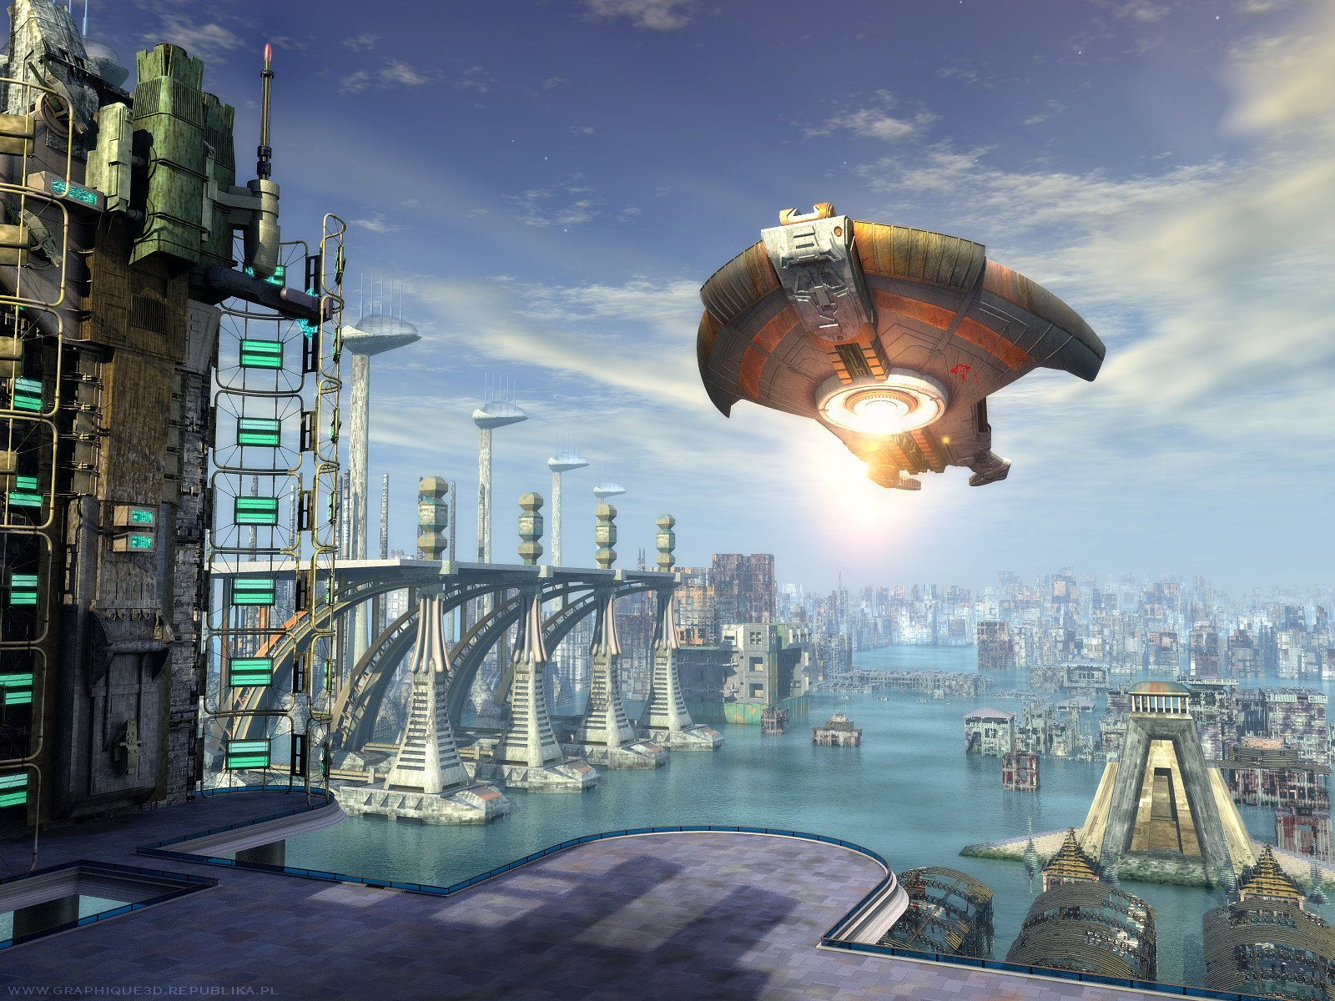
Notifications and automatic re-runs
Autonomic
Curation
Self-repair
New research?
Machines are users too

Slide 23
A Big Picture
cyberinfrastructure
Big Data
Big Compute
Conventional
Computation
The Future!
Social
Networking
More machines
online science
More people
Notes:
Big Data and Big Compute and Big Society!
Look at astronomy for example
Different rates of progress along axes – one futurological theory says we need a lot more machine to assist because machines scale further than people

Slide 24
The Order of Social Machines
Real life is and must be full of all kinds of social constraint – the very processes from which society arises. Computers can help if we use them to create abstract social machines on the Web: processes in which the people do the creative work and the machine does the administration… The stage is set for an evolutionary growth of new social engines.
Berners-Lee, Weaving the Web, 1999

Slide 25
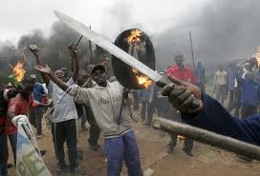
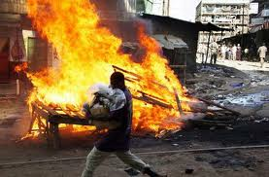
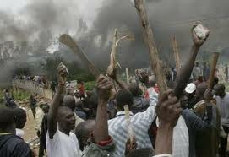
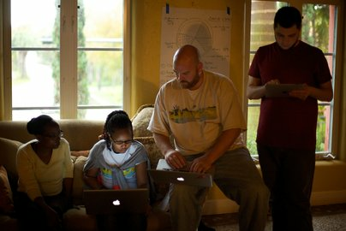
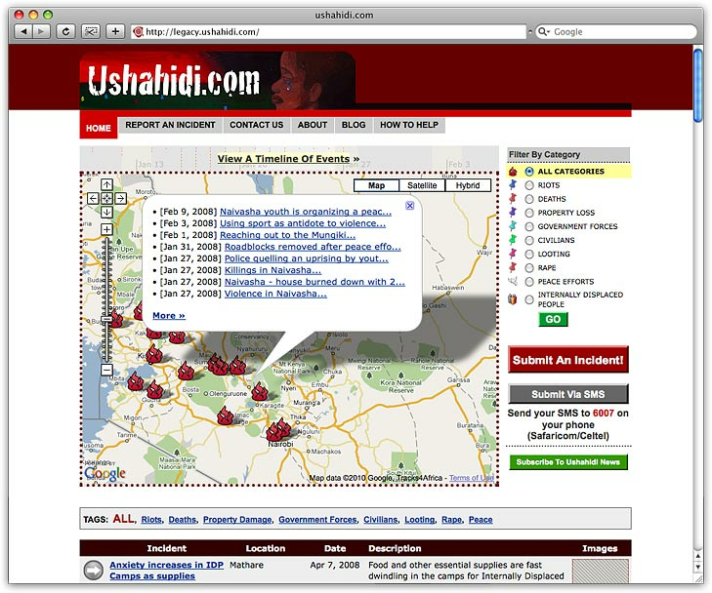
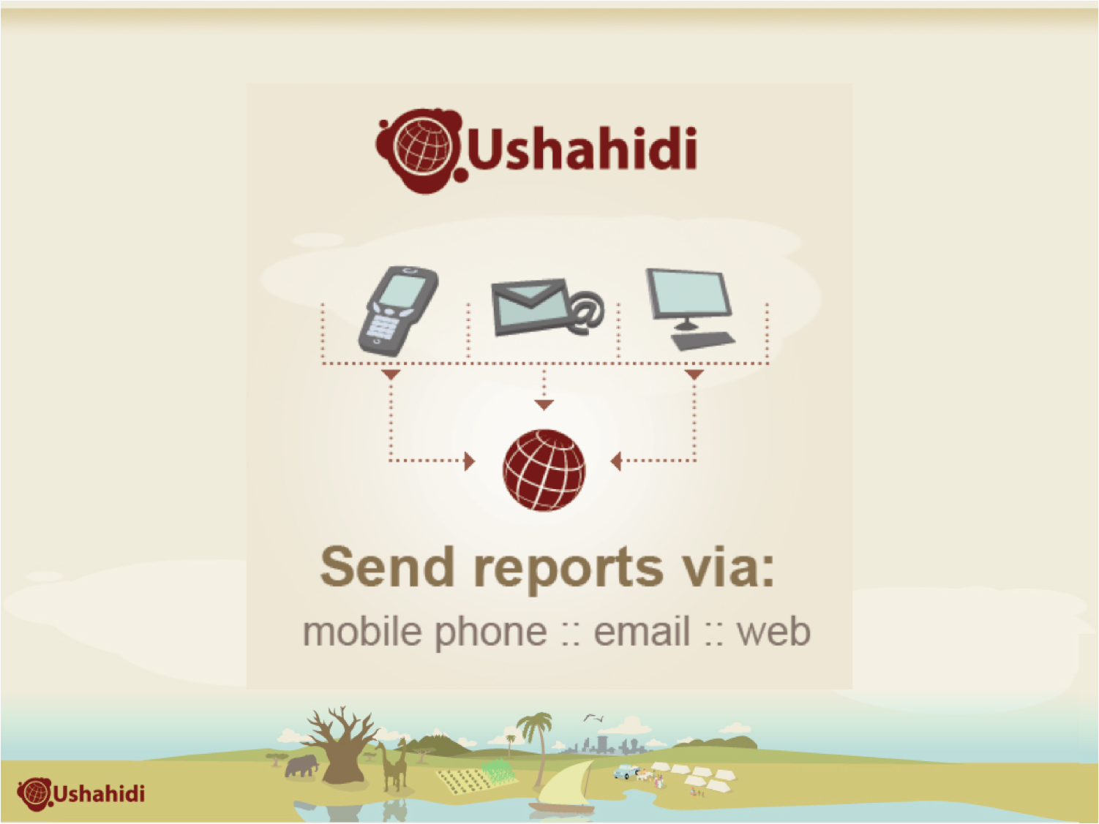
An Example Social Machine
The Kenyan election on the 27th December 2007
wave of riots, killings and turmoil
African blogger Erik Hersman read a post by another blogger Ory Okolloh
Resulted in Ushahidi…
“Nobody Knows Everything, but Everyone Knows Something.”
Local observers to submit reports using the Web or SMS messages from mobile phones

Slide 26
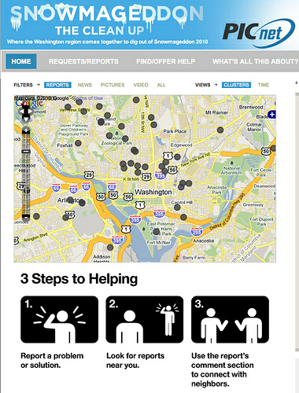
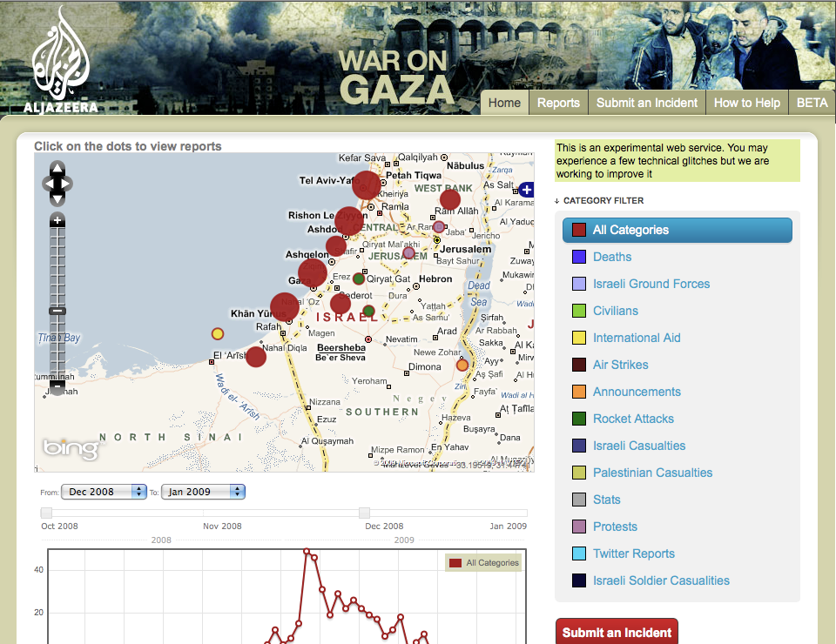
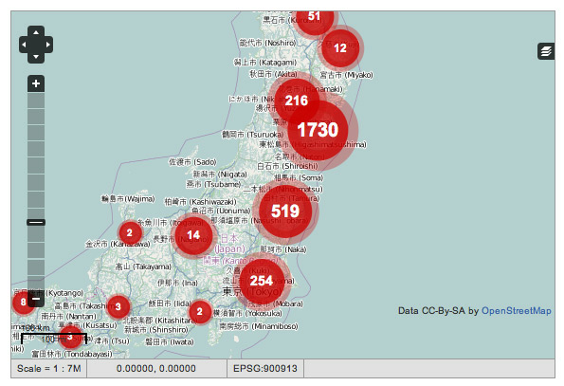
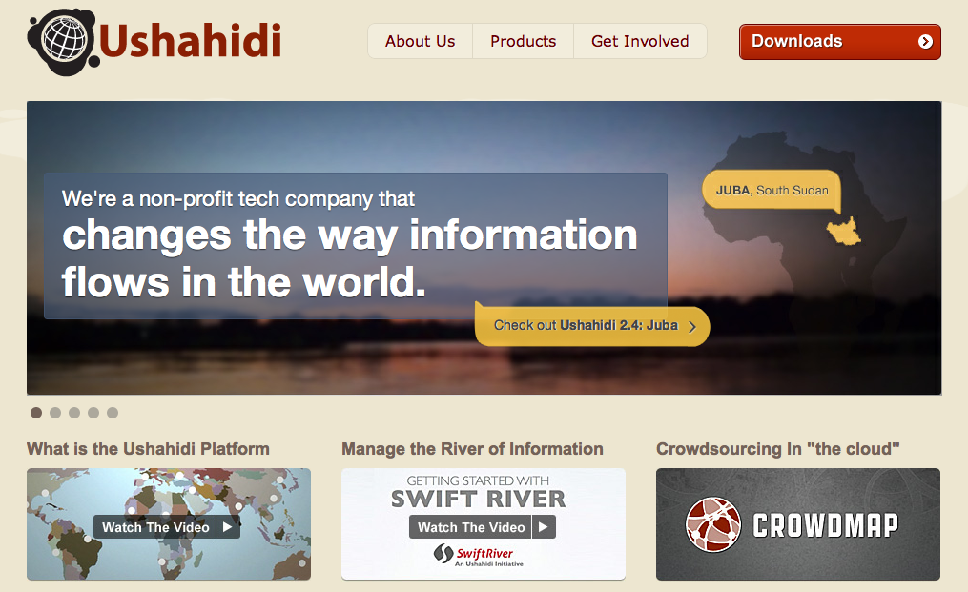
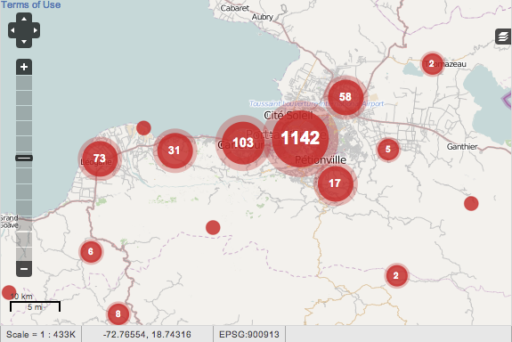
Ushahidi Variants
Washington Snowmageddon
Port au Prince Haiti
Japan Fukashima
Middle East Gaza

Slide 27
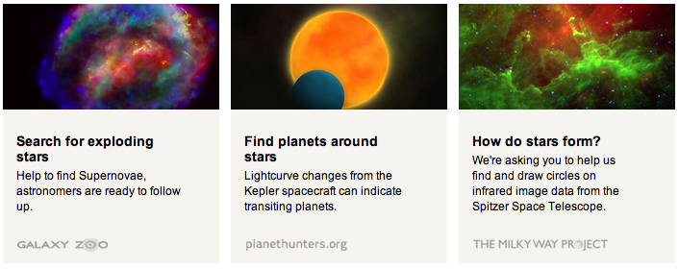
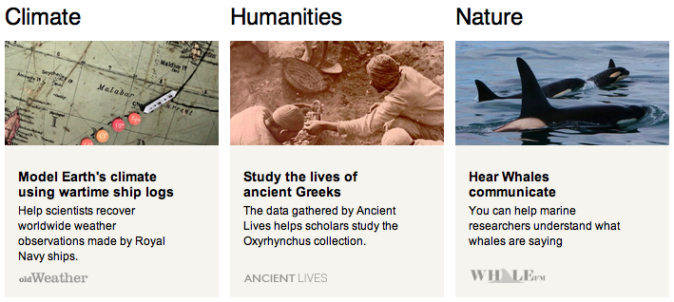

Slide 28
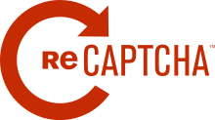
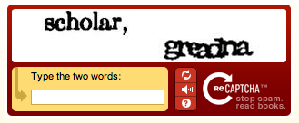
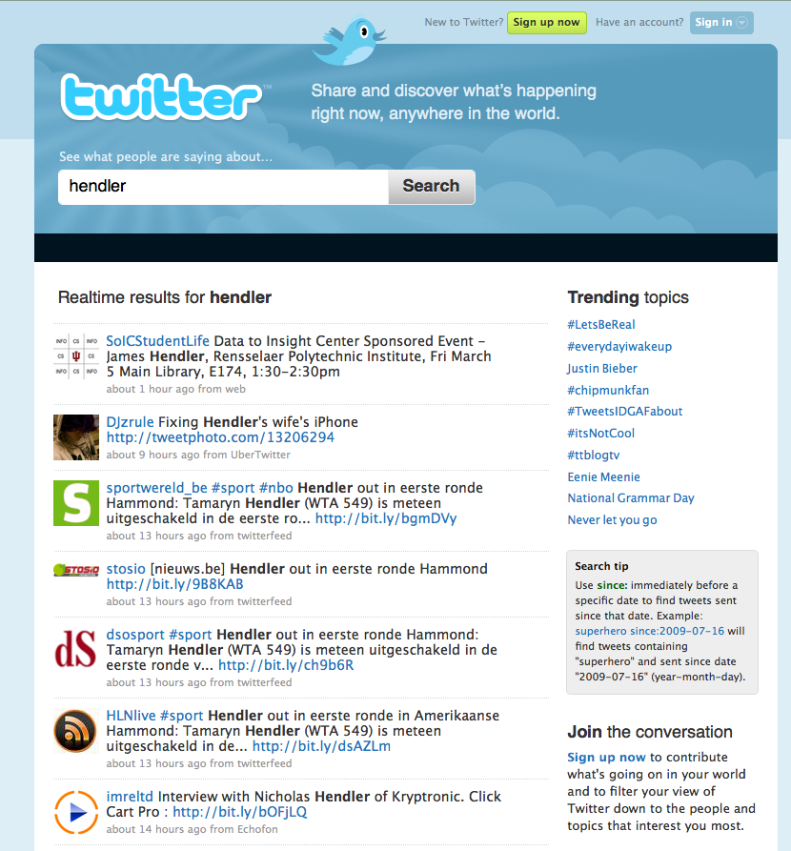
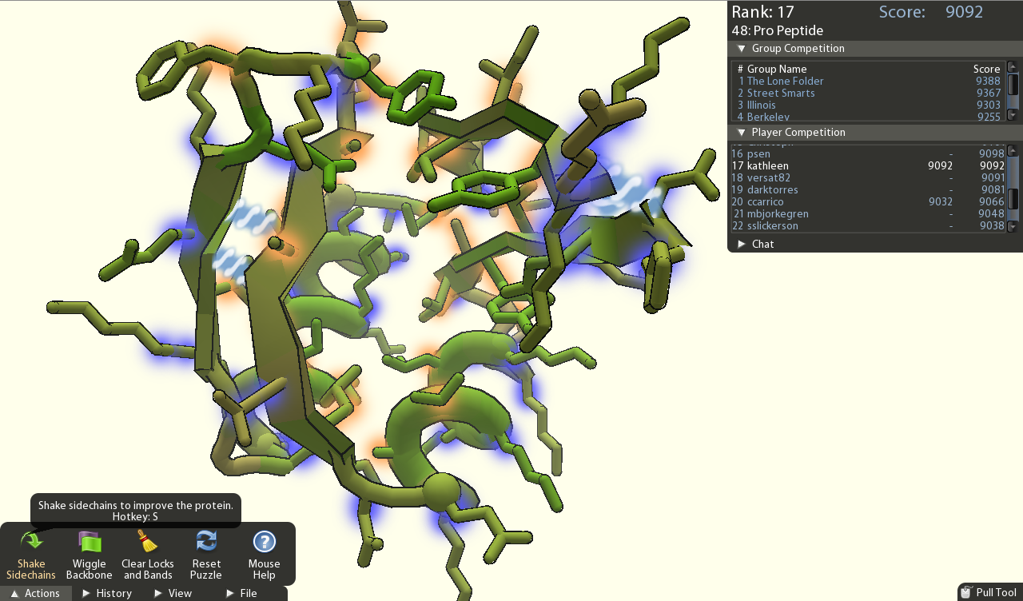
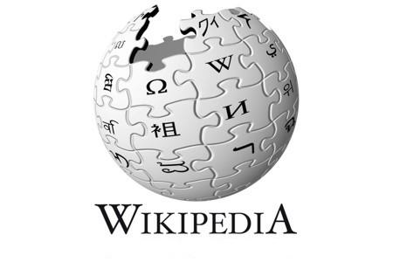
Some other machines?

Slide 29
Dimensions
Number of people
Number of machines
Scale of data
Varieties of data
Type of machine problem solving
Type of human problem solving
Empowering of individuals, groups, crowds
Time criticality
Extent of wide area communication
Need for urgent mobilization
Specification of goal state

Slide 30
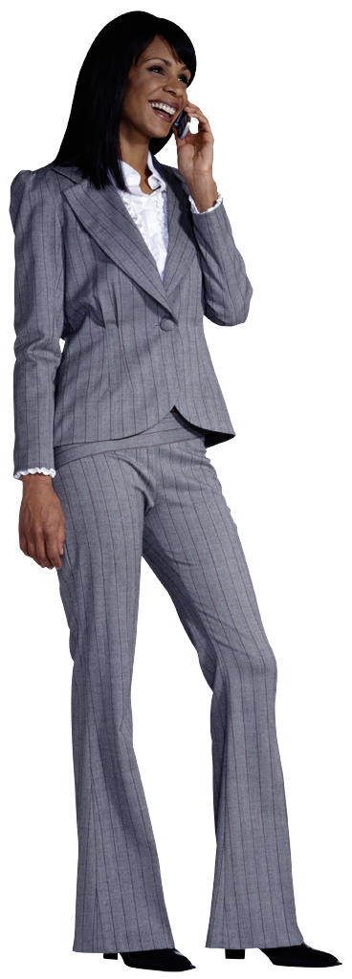
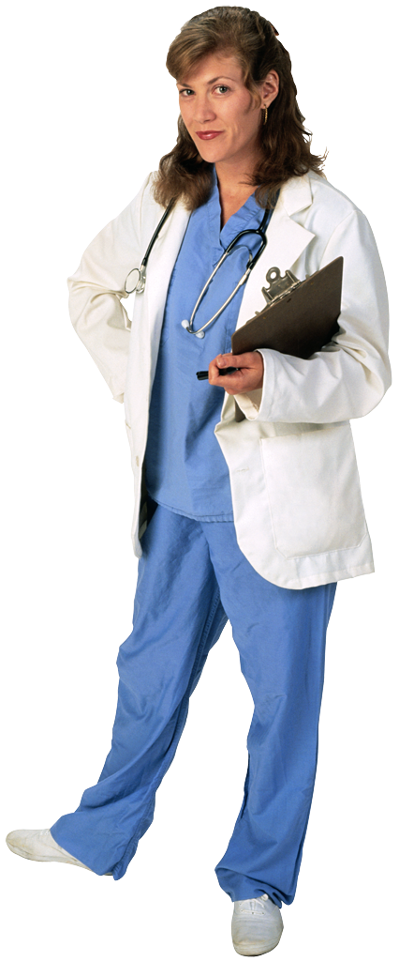
Building a Social Machine
Virtual World
(Network of
social interactions)
Model of social interaction
Design and
Composition
Participation and
Data supply
Physical World
(people and devices)

Slide 31
hubzero
A platform for creating social machines
A community of builders and users
Machine assisted human problem solving
Future quadrant and moving up

Slide 33
The users of a website, the website, and the interactions between them, together form our fundamental notion of a “machine”

Slide 34
Discussion
myExperiment
Workflows as social objects
Research Objects are emerging
Reproduce, Reconstruct
Curate, Preserve
HUBzero is a Social Machine platform
Noshir Contractor has commenced analysis!

Slide 36
Links
myExperiment project wiki http://wiki.myexperiment.org/
Workflow Forever project (Wf4Ever) http://www.wf4ever-project.org/
Future of Research Communication (FORCE11) http://force11.org/
Web Science http://webscience.org/
hubzero http://hubzero.org/

Slide 37
D. De Roure, C. Goble and R. Stevens. The Design and Realisation of the myExperiment Virtual Research Environment for Social Sharing of Workflows Future Generation Computer Systems 25, pp. 561-567.
S. Bechhofer, I. Buchan, D De Roure et al. Why linked data is not enough for scientists, Future Generation Computer Systems
D. De Roure, David and C. Goble, Anchors in Shifting Sand: the Primacy of Method in the Web of Data. WebSci10, April 26-27th, 2010, Raleigh, NC, US.
D. De Roure, S. Bechhofer, C. Goble and D. Newman, Scientific Social Objects, 1st International Workshop on Social Object Networks (SocialObjects 2011).
D. De Roure, K. Belhajjame, P. Missier, P. et al Towards the preservation of scientific workflows. 8th International Conference on Preservation of Digital Objects (iPRES 2011).
Carole A. Goble, David De Roure and Sean Bechhofer Accelerating scientists’ knowledge turns. Will be available at www.springerlink.com
Khalid Belhajjame, Oscar Corcho, Daniel Garijo et al Workflow-Centric Research Objects: First Class Citizens in Scholarly Discourse, SePublica2012 at ESWC2012, Greece, May 2012
Kevin R. Page, Ben Fields, David De Roure et al Reuse, Remix, Repeat: The Workflows of MIR, 13th International Society for Music Information Retrieval Conference (ISMIR 2012) Porto, Portugal, October 8th-12th, 2012
Jun Zhao, Jose Manuel Gomez-Perezy, Khalid Belhajjame et al, Why Workflows Break - Understanding and Combating Decay in Taverna Workflows, eScience 2012, Chicago, October 2012

Slide 38
david.deroure@oerc.ox.ac.uk
www.oerc.ox.ac.uk/people/dder
www.scilogs.com/eresearch
@dder
www.myexperiment.org/packs/335
www.slideshare.net/davidderoure/myexperiment-and-the-rise-of-social-machines

