Slide 1
Managing Workflows Within HUBzero: How to Use Pegasus to Execute Computational Pipelines
Ewa Deelman
USC Information Sciences Institute
Acknowledgement:
Steven Clark, Derrick Kearney, Michael McLennan (HUBzero)
Frank McKenna (OpenSees)
Gideon Juve, Gaurang Mehta, Mats Rynge, Karan Vahi (Pegasus)

Slide 2
Outline
Introduction to Pegasus and workflows
HUB Integration
Rappture and Pegasus
Submit command and Pegasus
Example: OpenSEES / NEESHub
Future directions

Slide 3
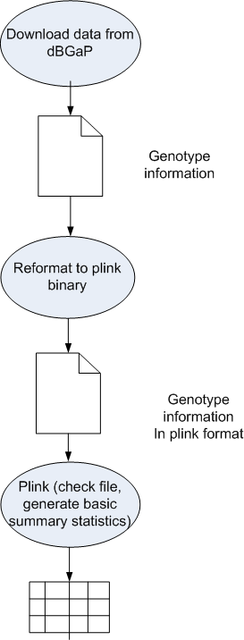
Computational workflows
Help express multi-step computations in a declarative way
Can support automation, minimize human involvement
Makes analyses easier to run
Can be high-level and portable across execution platforms
Keep track of provenance to support reproducibility
Foster collaboration—code and data sharing

Slide 4
Workflow Management
You may want to use different resources within a workflow or over time
Need a high-level workflow specification
Need a planning capability to map from high-level to executable workflow
Need to manage the task dependencies
Need to manage the execution of tasks on the remote resources
Need to provide scalability, performance, reliability

Slide 5
Our Approach
Analysis Representation
Support a declarative representation for the workflow (dataflow)
Represent the workflow structure as a Directed Acyclic Graph (DAG) in a resource-independent way
Use recursion to achieve scalability
System (Plan for the resources, Execute the Plan, Manage tasks)
Layered architecture, each layer is responsible for a particular function (Pegasus Planner, DAGMan, Condor schedd)
Mask errors at different levels of the system
Modular, composed of well-defined components, where different components can be swapped in
Use and adapt existing graph and other relevant algorithms
Can be embedded into

Slide 6
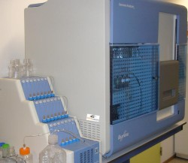
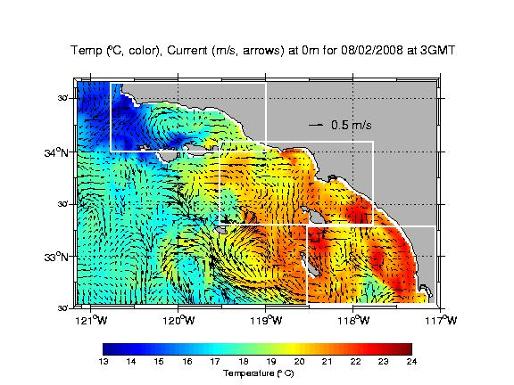
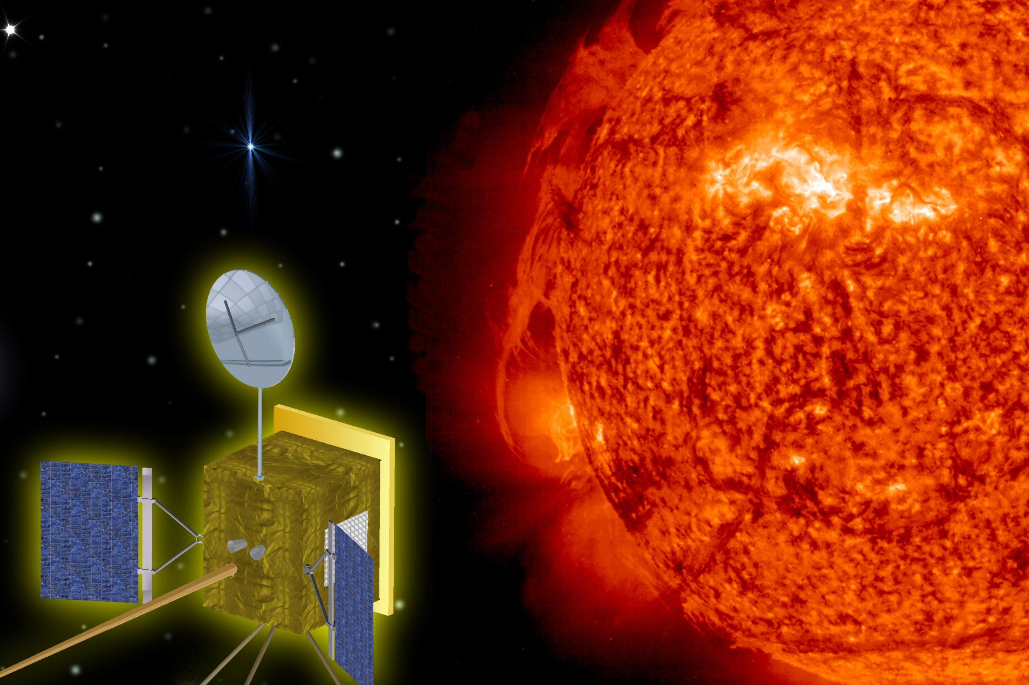
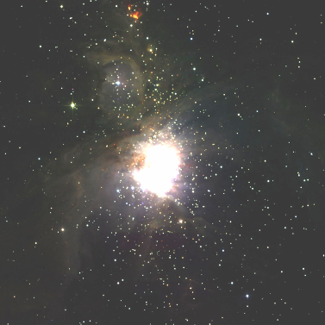
Pegasus Workflow Management System (est. 2001)
A collaboration with University of Wisconsin Madison
Used by a number of applications in a variety of domains
Provides reliability—can retry computations from the point of failure
Provides scalability—can handle large data and many computations (kbytes-TB of data, 1-10⁶ tasks)
Optimizes workflows for performance
Automatically captures provenance information
Runs workflows on distributed resources: laptop, campus cluster, Grids (DiaGrid, OSG, XSEDE), Clouds (FutureGrid, EC2, etc..)
http://pegasus.isi.edu

Slide 7
Planning Process
Assume data may be distributed in the Environment
Assume you may want to use local and/or remote resources
Pegasus needs information about the environment
data, executables, execution and data storage sites
Pegasus generates an executable workflow
Data transfer protocols
Gridftp, Condor I/O, HTTP, scp, S3, iRods, SRM, FDT (partial)
Scheduling to interfaces
Local, Gram, Condor, Condor-C (for remote Condor pools), via Condor Glideins – PBS, LSF, SGE

Slide 8
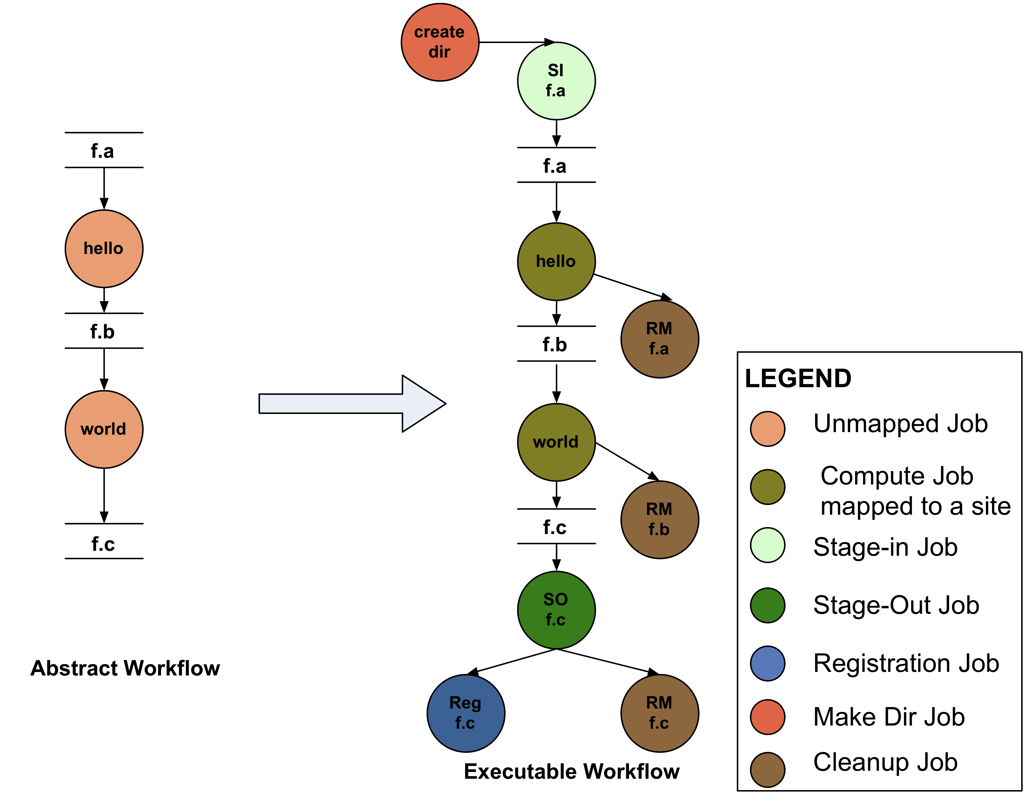
Generating executable workflows
(DAX)
APIs for workflow specification
(DAX---
DAG in XML)
Java, Perl, Python

Slide 9
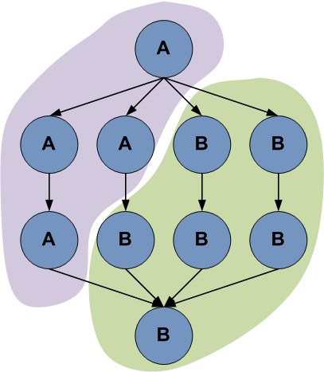
Advanced features
Performs data reuse
Registers data in data catalogs
Manages storage—deletes data no longer needed
Can cluster tasks together for performance
Can manage complex data architectures (shared and non-shared filesystem, distributed data sources)
Different execution modes which leverage different computing architectures (Condor pools, HPC resources, etc..)

Slide 10
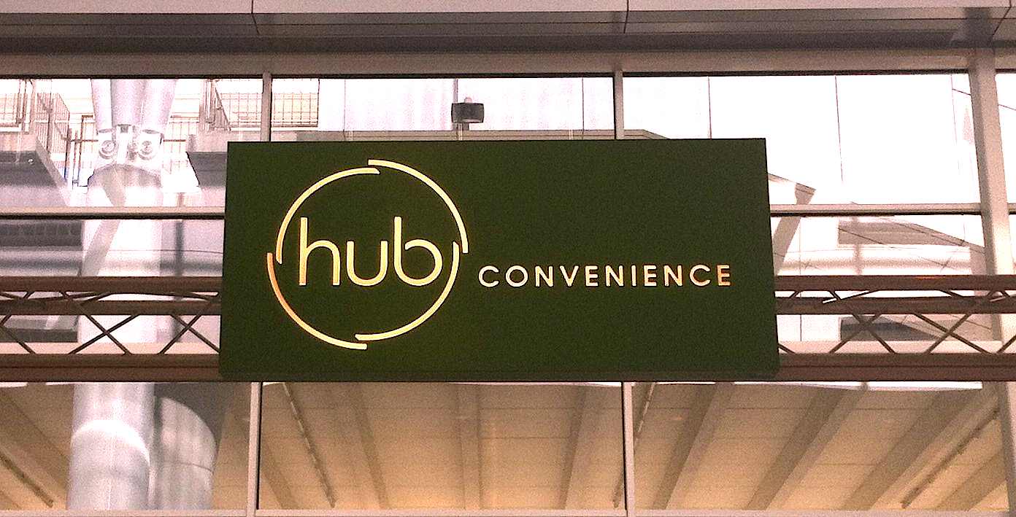
HUBzero Integration Pegasus with

Slide 11
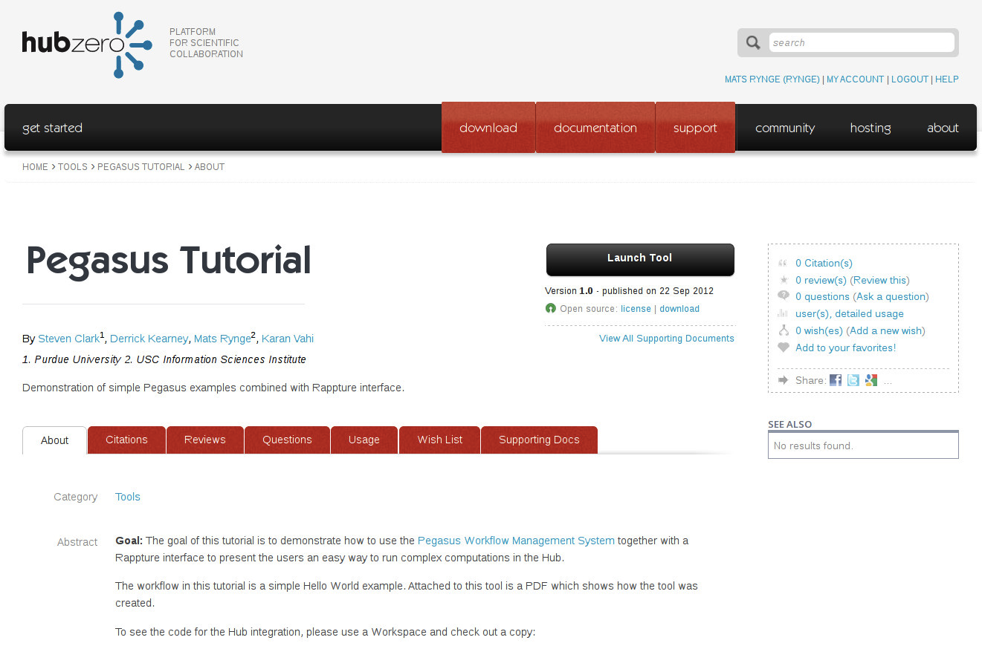
https://hubzero/resources/pegtut

Slide 12
Benefits of Pegasus for HUB Users
Provides Support for Complex Computations
Can connect the existing HUB models into larger computations
Portability / Reuse
User created workflows can easily be run in different environments without alteration (today DiaGrid, OSG)
Performance
The Pegasus mapper can reorder, group, and prioritize tasks in order to increase the overall workflow performance.
Scalability
Pegasus can easily scale both the size of the workflow, and the resources that the workflow is distributed over.
Notes:
Kent changed 080501 – removed period

Slide 13
Benefits of Pegasus for HUB Users
Provenance
Performance and provenance data is collected in a database, and the data can be summaries with tools such as pegasus-statistics, pegasus-plots, or directly with SQL queries.
Reliability
Jobs and data transfers are automatically retried in case of failures. Debugging tools such as pegasus-analyzer helps the user to debug the workflow in case of non-recoverable failures.
Notes:
Kent changed 080501 – removed period

Slide 14
Pegasus in HUBzero
Pegasus as a backend to the submit command
Pegasus workflows composed in Rappture
Build workflow within Rappture
Have Rappture collect inputs, call a workflow generator, and collect outputs
Pegasus Tutorial tool now available in HUBzero
http://hubzero.org/tools/pegtut
Session that includes Pegasus on Tuesday 1:30 – 5:30
Room 206 #2 Creating and Deploying Scientific Tools (part 2)
“… Scientific Workflows with Pegasus” by George Howlett & Derrick Kearney, Purdue University
Acknowledgements: Steven Clark and Derrick Kearney, Purdue University

Slide 15
Abstract Workflow (DAX)
Data and transformation info
Submit host
Pegasus Workflow Management System
Laptop
Campus Clusters
Grid Clusters
Clouds
Site info
Performance Database
Execution Info

Slide 16
Use of Pegasus with Submit Command
Used by Rappture interface to submit the workflow
Submits the workflow through Pegasus to
OSG
DIAGRID
Prepares the site catalog and other configuration files for Pegasus
Uses pegasus-status to track the workflow
Generates statistics and report about job failures using pegasus tools.
Acknowledgements: Steven Clark and Derrick Kearney, Purdue University

Slide 17
Data and transformation info
Hub
Abstract Workflow (DAX)
Submit host
Site info
Pegasus Workflow Management System
Laptop
Campus Clusters
Grid Clusters
Clouds
Performance Database
Execution Info

Slide 18
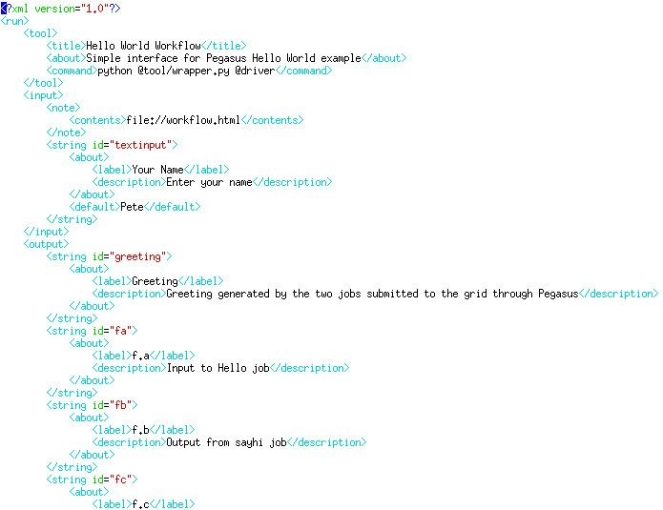
Rappture (data definitions)
Pegasus Workflows in the HUB
Tool description
Calls an external DAX generator
Inputs
Outputs
Acknowledgements: Steven Clark and Derrick Kearney, Purdue University

Slide 19
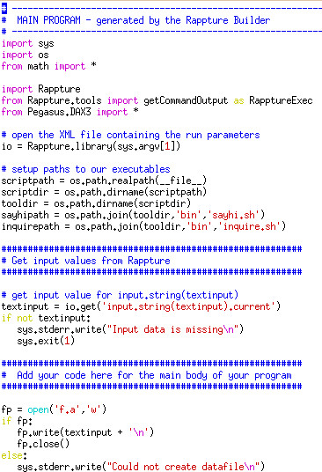
wrapper.py
Pegasus Workflows in the HUB
Python script
Collects the data from the Rappture interface
Generates the DAX
Runs the workflow
Presents the outputs to Rappture
Acknowledgements: Steven Clark and Derrick Kearney, Purdue University

Slide 20
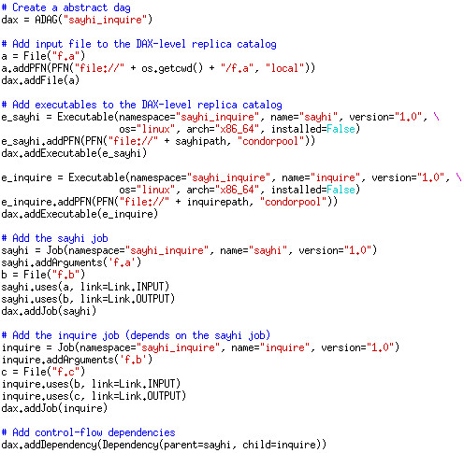
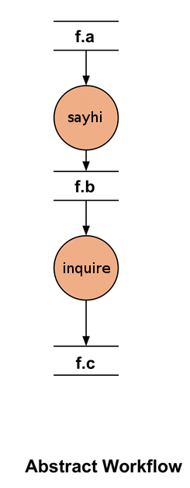
Workflow generation
Acknowledgements: Steven Clark and Derrick Kearney, Purdue University

Slide 21
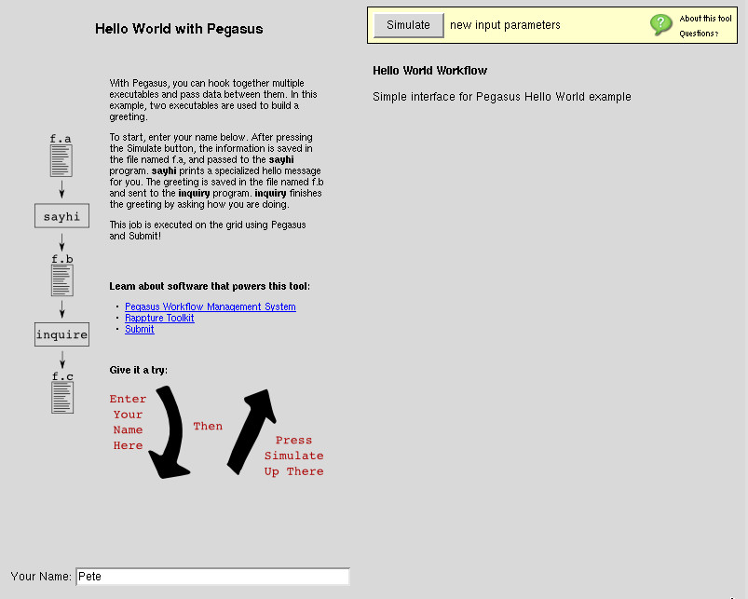
User provides inputs to the workflow and clicks the “Submit” button
Acknowledgements: Steven Clark and Derrick Kearney, Purdue University

Slide 22
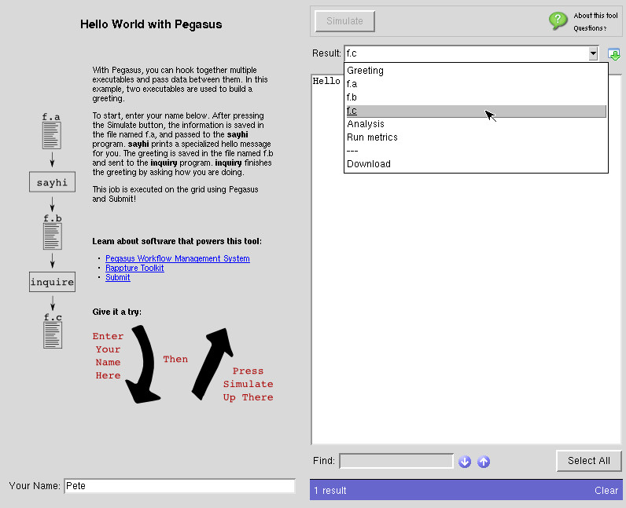
Workflow has completed. Outputs are available for browsing/downloading
Acknowledgements: Steven Clark and Derrick Kearney, Purdue University

Slide 23
OpenSEES / NEEShub

Slide 24
The OpenSeesLab tool: http://nees.org/resources/tools/openseeslab
Is a suite of Simulation Tools powered by OpenSees for:
Submitting OpenSees scripts to NEEShub resources
Educating students and practicing engineers
Acknowledgements: Frank McKenna from UC Berkeley

Slide 25
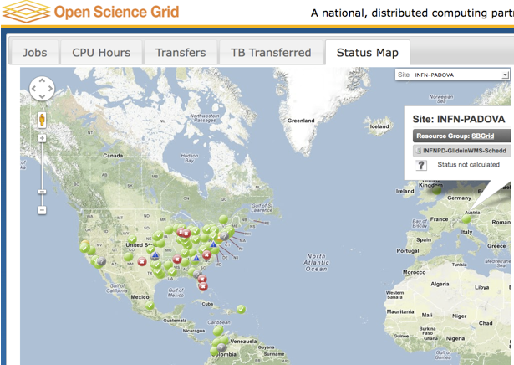
Rappture
Rappture implementation in TCL
calls out to an external Python DAX generator.
OpenSees
Matlab
OpenSees
Matlab
OpenSees
OpenSees uses Pegasus to run on Open Science Grid
Matlab is used to
generate random
material properties
10’s to 1000’s of OpenSees Simulations
Matlab is used to process the results and generate figures
Pegasus is Responsible for moving the data from the NEEShub to the OSG, orchestrating the workflow and returning the results to NEEShub.
Acknowledgements: Frank McKenna from UC Berkeley

Slide 26
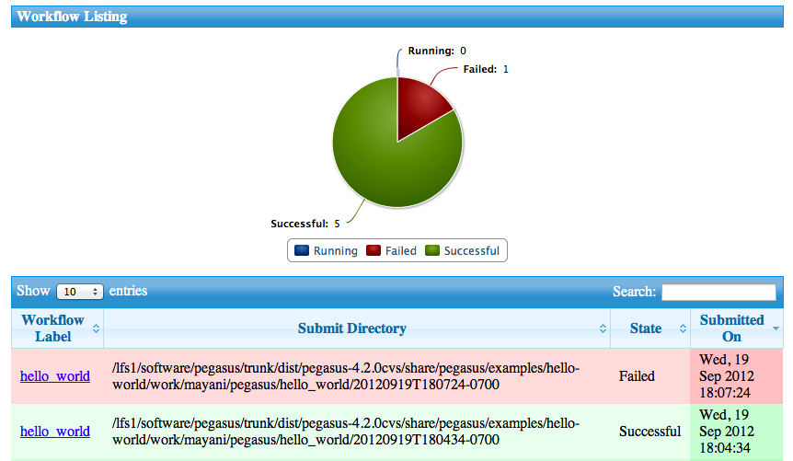
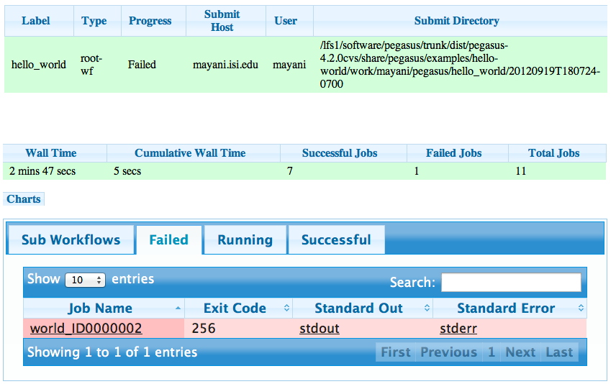
Future Directions
Submit to manage parameter sweep computations (now only on HUBzer0)
Web-based monitoring

Slide 27
Benefits of workflows in the HUB
Support for complex applications/ builds on existing domain tools
Clean separations for users/developers/operator
User: Nice high level interface via Rappture
Tool developer: Only has to build/provide a description of the workflow (DAX)
Hub operator: Ties the Hub to an existing distributed computing infrastructure (DiaGrid, OSG, …)
The Hub and Pegasus handle low level details
Job scheduling to various execution environments
Data staging in a distributed environment
Job retries
Workflow analysis
Support for large workflows

Slide 28
Benefits of the HUB to Pegasus
Provides a nice, easy to use interface to Pegasus workflows
Broadens the user base
Improves the software based on user’s feedback
Drives innovation—new deployment scenarios, use cases
I look forward to a continued collaboration

Slide 29
Further Information
Session that includes Pegasus on Tuesday 1:30 – 5:30
Room 206 #2 Creating and Deploying Scientific Tools (part 2)
“… Scientific Workflows with Pegasus” by George Howlett & Derrick Kearney, Purdue University
Pegasus Tutorial on the HUB
https://hubzero.org/tools/pegtut
General Pegasus Information http://pegasus.isi.edu
Pegasus in a VM—allows you to develop DAXes
http://pegasus.isi.edu/downloads
We are happy to help!
Support mailing lists pegasus-support@isi.edu pegasus-users@isi.edu,, pegasus-announce@isi.edu
Contact me deelman@isi.edu
Big Thank You to the HUBzero and OpenSees teams!

