Slide 1
Manufacturing an America Built to Last
Thomas R. Kurfess, Ph.D., P.E.
Assistant Director for Advanced Manufacturing
White House Office of Science & Technology Policy
Hubzero Keynote
September 24, 2012
Notes:
Good afternoon, and other greetings.

Slide 2
Why Manufacturing Matters
Conducts 70% of US R&D, 90% of patents issued
Close connection between R&D, design, and manufacturing
Health of industrial commons (know how, process engineering capability, workforce skills, suppliers)
Manufacturing multiplier ($1.40 for $1 of manufacturing output)
Critical for national security

Slide 3
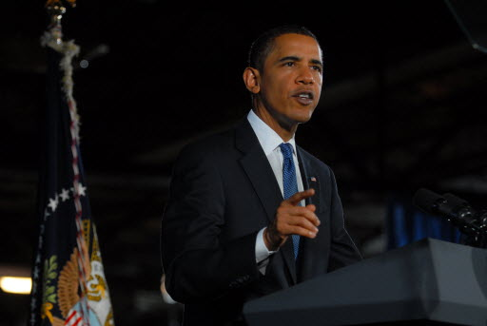
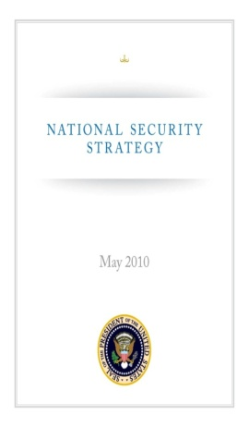
S&T as Presidential Priority
“Reaffirming America’s role as the global engine of scientific discovery and technological innovation has never been more critical. …Our renewed commitment to science and technology … will help us protect our citizens and advance U.S. national security priorities.”
–National Security Strategy, May 2010
Notes:
3
Prototype developed within three years of original concept
Device requires no energy supply

Slide 4
Manufacturing Economic Impact
Manufacturing drives jobs throughout the economy, including in services
Source: U.S. Department of Commerce, Bureau of Economic Analysis
Notes:
manufacturing has the highest multiplier effect on employment with more than 6.8 million jobs in sectors outside of manufacturing.

Slide 5
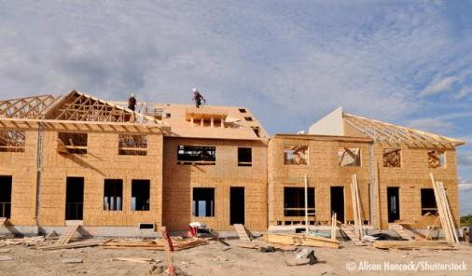
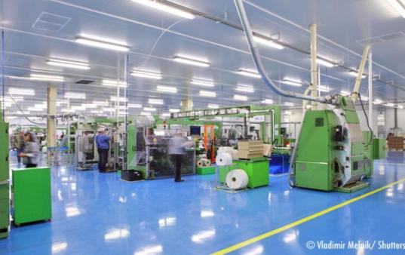

A Plant’s Economic Impact – supporting services
Manufacturing also has an important jobs impact in the local economy
Notes:
WILL EDIT –
Opening a new manufacturing plant can have a tremendous impact on the local economy. “Build it and they will come.” In this case, the “they” is a horde of new jobs and new workers. They may need other things like new schools, new roads, … Note, the arrows do not go the other way.
This is why States focus economic development efforts on tradeable sectors like manufacturing

Slide 6
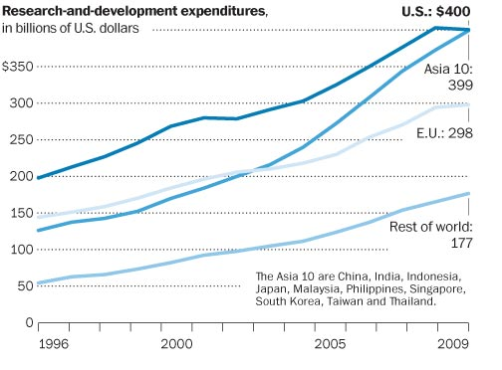
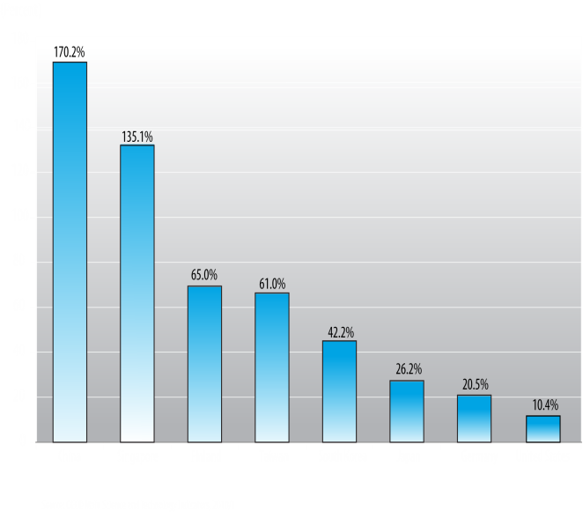
National investment in R&D
U.S. still out-invests the world…
… but others are catching up
Global R&D investments
Change in R&D Intensity (‘95-’08)
Notes:
However, many of our competitors have been changing up in absolute dollars. Asia, in fact, is on par with us.

Slide 7
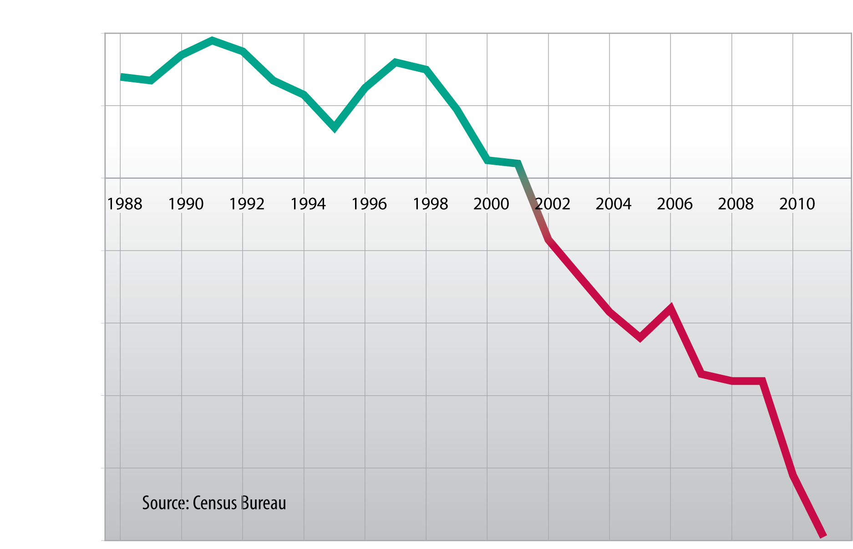
What is different in the past decade?
U.S. Trade Balance for Advanced Technology Products
Notes:
Starting in the beginning of this decade, for the first time in modern history, we have a negative trade balance in advanced manufactured products. In fact, as shown in the next slide, several technologies and product families are gone for good.
These are products which are US strengths – products not offshored chasing lower labor costs. Labor is a small component of these products…n

Slide 8
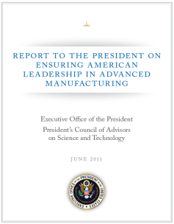
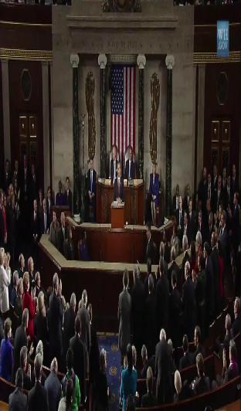
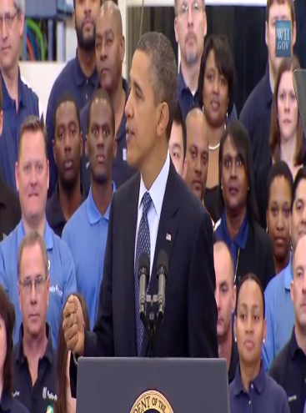
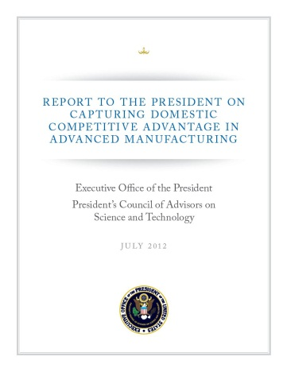
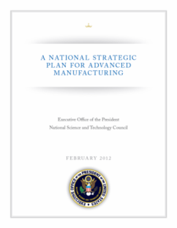
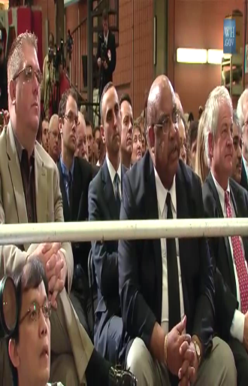
Adv. Mfg. Initiative Developments
June 2011
Jan
2012
Feb
2012
March
2012
July
2012
Notes:
JM note – use timeline to describe key milestones:
PCAST, Presidents Council of Advisors on Science and Technology, Report on Ensuring Advanced Manufacturing
State of the Union
NTSC Strategic Plan for Advanced Manufacturing
Announcement of NNMI at Rolls Royce in Crosspoint, Petersburg, VA, March 9

Slide 9
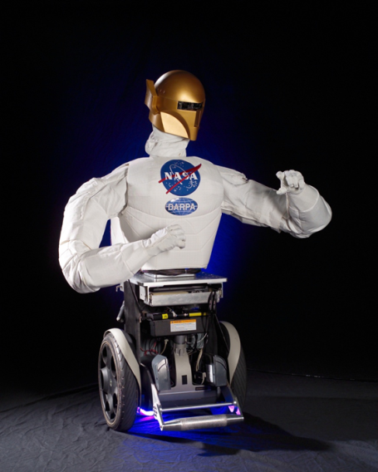
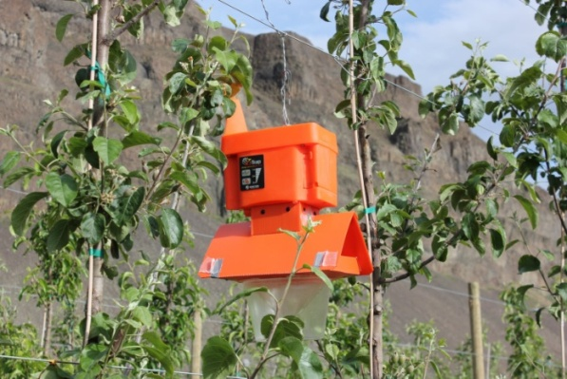

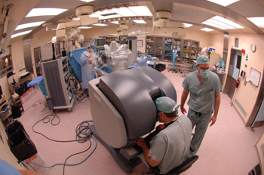
National Robotics Initiative (NRI)
The realization of co-robots acting in direct support of individuals and groups…manufacturing, exploration, discovery, agriculture, security, …..
USDA
THEMES
Fundamental research
Controls and dynamical systems
Computational models of human cognition
Application-inspired topics
Micro- and nano-robotics, neuro-robotics, humanoid robotics, & networked multi-robot team
Understanding of the long term social, behavioral and economic implications of co-robots across all areas of human activity
Use of co-robots for STEM learning
NRL
NIH

Slide 10
NRI: The Application Space
Co-Defender
Services
Co-Inhabitant
Security
Logistics
Monitoring
Inspection
Robust
Intelligent
Robot
Initiatives
Multi-agency SBIR
DURIP
Prizes & Competitions
Multi-agency RFP – over 700 proposals received
Manufacture & Automation Macro
HR
Interface
Intelligent
Transportation
Manufacture & Automation
Micro/Nano
Unmanned
Vehicles
Medical
Surgery
Rehab
Orthotics
Prosthetics
Co-Explorer
Co-Worker
Notes:
Conceived as robots that work beside, or cooperatively, with people in areas such as manufacturing, space and undersea exploration, healthcare and rehabilitation, military and homeland surveillance and security, education and training, and safe driving.
In contrast to current systems that use limited-reasoning strategies or address problems in narrow contexts, developing co-robot systems will be characterized by their flexibility, resourcefulness, use of a variety of modeling or reasoning approaches, and use of real-world data in real time, demonstrating a level of intelligence and adaptability seen in humans and animals.

Slide 11
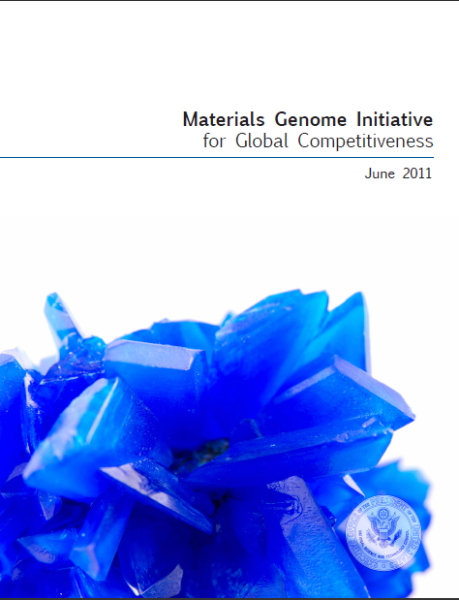
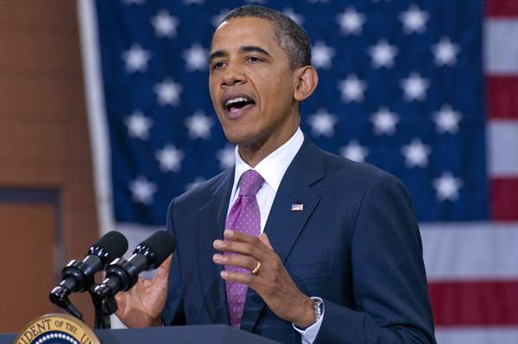
Materials Genome Initiative
Goal: Decrease the time-to-market by 50 %
“To help businesses discover, develop, and deploy new materials twice as fast, we’re launching what we call the Materials Genome Initiative. The invention of silicon circuits and lithium ion batteries made computers and iPods and iPads possible, but it took years to get those technologies from the drawing board to the market place. We can do it faster.”
-President Obama, Carnegie Mellon University, June 2011
Initiatives
Develop a Materials Innovation Infrastructure
Achieve National goals in energy, security, and human welfare with advanced materials
Equipping the next generation materials workforce
Themes
Incentivizing open paradigms of sharing & access of tools
Facilitating the development of innovation ecosystems & access to all stakeholders
Driving innovative techniques across computation, informatics & experimentation
Catalyzing shift in culture across the entire materials continuum & scaling the movement

Slide 12
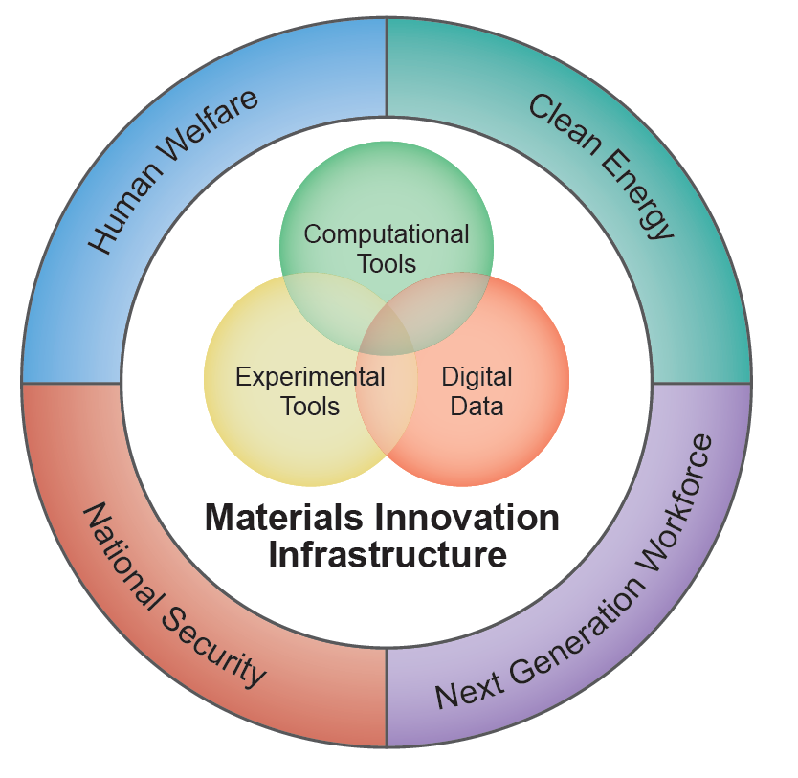
The Materials Genome Initiative
Goal: to decrease the time-to-market for advanced materials by over 50%
Develop an innovation infrastructure for materials deployment
Achieve National goals in energy, security, and human welfare
Prepare the next generation workforce
Notes:
As part of the Advanced Manufacturing Partnership, President Obama unveiled the “Materials Genome Initiative,” a multi-agency research initiative designed to reduce the time to develop new materials by at least 50 percent. Currently, it can take 10-20 years to move a new material from discovery to commercialization. The Initiative will develop in innovation infrastructure to accelerate materials deployment, use advanced materials to achieve national goals, and prepare a next generation workforce to continue the movement.

Slide 13
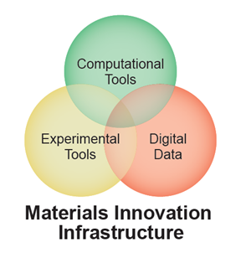
New Paradigms for Materials Deployment
Open access to data
Predictive modeling of materials behavior
High-throughput experimental tools
Unified design and manufacturing
Notes:
The innovation infrastructure developed through this initiative will consist of three elements: open access to digital data, computational tools to model materials behavior, and high-throughput experimental tools. The result will be accelerated materials deployment due to increased collaboration between design and manufacturing in the materials design process.

Slide 14


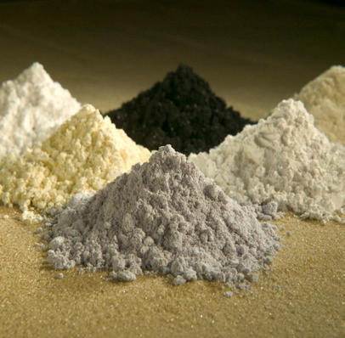
Potential Outcomes
Lightweight alloys
  New alloys for car chassis that will reduce America’s dependence on oil
Protective materials
  Better armor and helmet material to prevent brain injury in soldiers and civilians
Critical materials substitutes
  Substitutes for critical materials such as rare earth elements which jeopardize the U.S. economy
Battery anodes
  Batteries with dramatically higher energy density for increased lifespan

Slide 15


BIG DATA
“The future of computing is not just big iron. It’s big data.” Tom Kalil, Deputy Director of the White House Office of Science and Technology Policy
March 29th – agencies announce $200 million in additional investments in R&D related to Big Data
NSF and NIH joint solicitation
DARPA XDATA program
DOD “Data to Decision” initiative
Accelerate “data to knowledge to
action.”

Slide 16
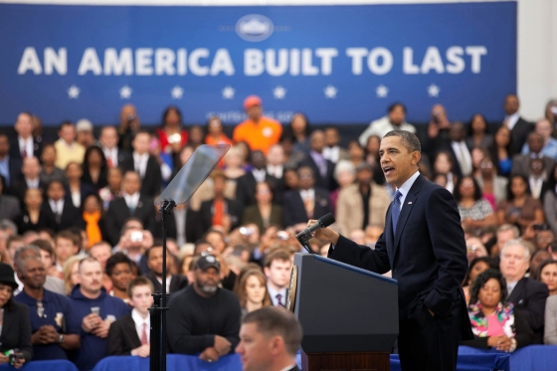
National Network for Manufacturing Innovation
$1 billion FY13 proposal:
“institutes of manufacturing excellence where some of our most advanced engineering schools and our most innovative manufacturers collaborate on new ideas, new technology, new methods, new processes.”
-President Obama, Rolls-Royce Crosspointe, Petersburg, VA, March 9, 2012
$30 million FY12 pilot - DoD pilot on ManTech - focused on additive metal, composites, & direct write electronics
President Obama at Rolls-Royce Crosspointe, Petersburg, VA, March 9, 2012

Slide 17
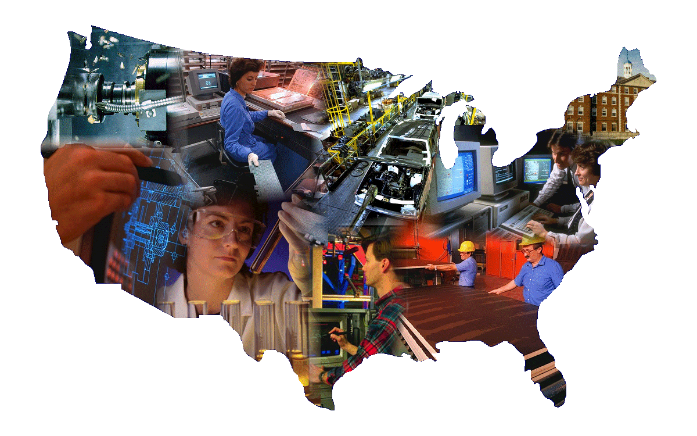
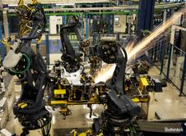
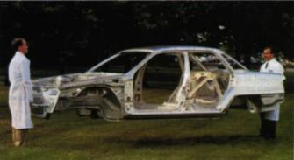


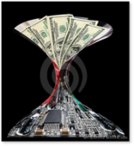



IMI Mission
$1B
Bridge the gap between basic research and product development
Create shared infrastructure (particularly for smaller manufacturers)
Create world-class environment for education and training
Foster regional “hubs”
Notes:
2) Institute Mission
Serve as manufacturing technology/business/education hub
Integrate capabilities and facilities to address cross-cutting manufacturing challenges
Focus on advanced manufacturing opportunities to expand industrial production in the United States via sustainable competitive advantages
IMI activities may include
Applied research and demonstration projects that reduce the cost and risk of commercializing new technologies or solve industrial problems
Education and training at all levels for workforce development
Development of innovative methodologies and practices for supply chain integration
Engagement with small and medium-sized manufacturing enterprises (SMEs).
$1B investment from U.S.

Slide 18
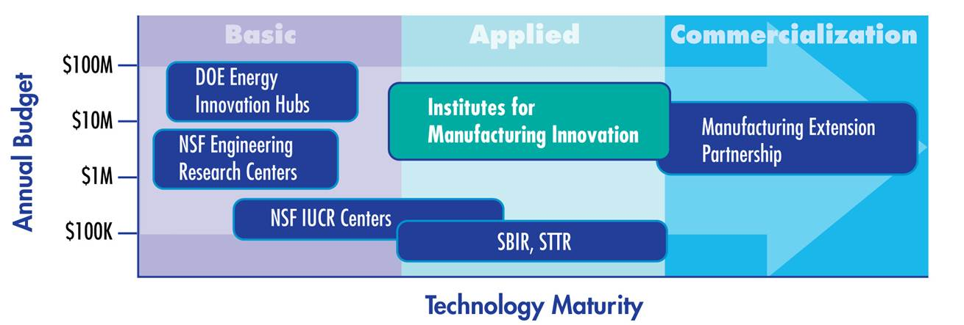
Focus on Scale Up–Missing Middle
Basic science
Largely government funded
Commercialization
private sector owned/funded
Notes:
1) Technology
Each Institute chartered to have unique, well-defined technology focus
Example focus may be an advanced material, a manufacturing process, an enabling technology, or an industry sector.
Addresses industrially-relevant challenges with clearly defined outputs
Focus on applied research, scale-up, commercialization (TRL 4-7)
Can do contract R&D but Federal funding of activities limited to pre-competitive
Provides structural bridge in the “missing middle” problem noted by PCAST

Slide 19
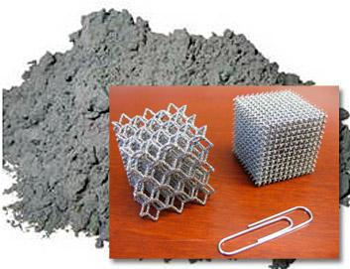
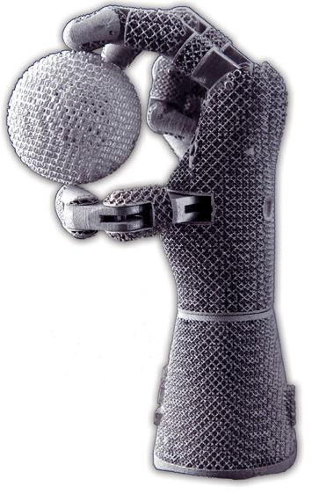





2012 Pilot Manufacturing Institute on
Additive Manufacturing
April 13
May 8
May 16
August 16
SN
Industry Day
$30 M
BAA
Notes:
2012 Pilot
DOD led joint Pilot RFI
Public Announcement released from Air Force Research Laboratory (AFRL) April 13th.
See manufacturing.gov for links, Questions: NNMI2012@wpafb.af.mil
Issue joint Broad Agency Announcement (BAA) around May 15, 2012
$45M collective initial investment by DOD, DOE, DOC, NASA and NSF
Industry Day for proposers, anticipated on or about May 22, 2012
Anticipated Awards Date: Mid August, 2012:

Slide 20
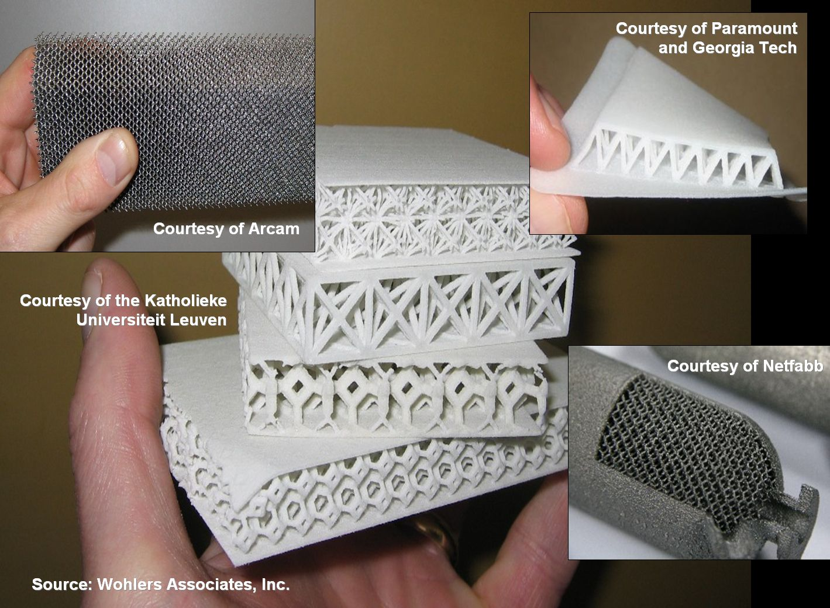
Lightweight / High Strength Structures
Notes:
Lightweight, but very strong structures.

Slide 21
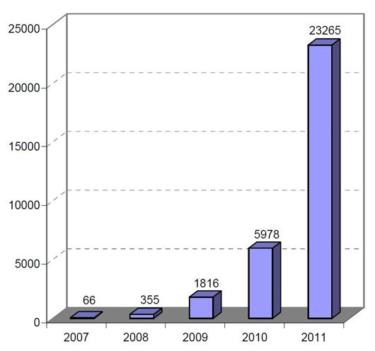
Unit Sales Growth of Personal 3D Printers
Source: Wohlers Report 2012
Notes:
Recent unit sales growth of personal 3D printers (priced at under $5,000). Chart was published in the April 21, 2012 issue of The Economist.

Slide 22
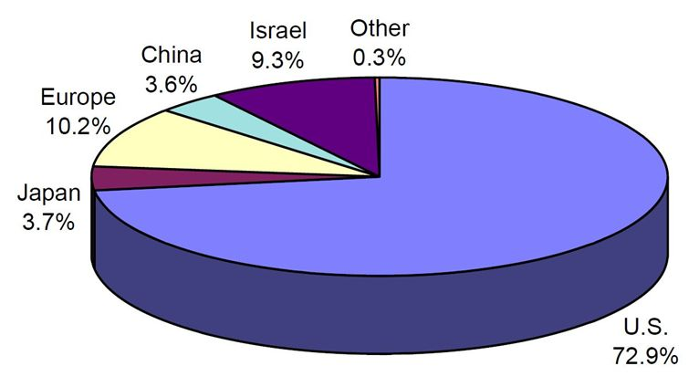
Number of Industrial AM Systems Sold from Each Geographic Region
Source: Wohlers Report 2012
Notes:
Cumulative total number of industrial AM systems sold from each geographic region from 1988 through 2011. U.S. system manufacturers are responsible for about 73% of all industrial AM machines sold worldwide.

Slide 23
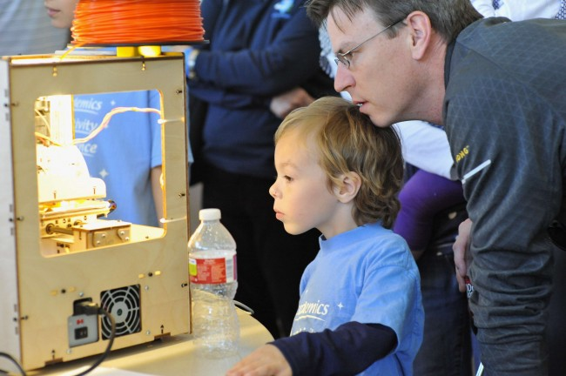
STEM Education Potential of 3-D Printing

Slide 24
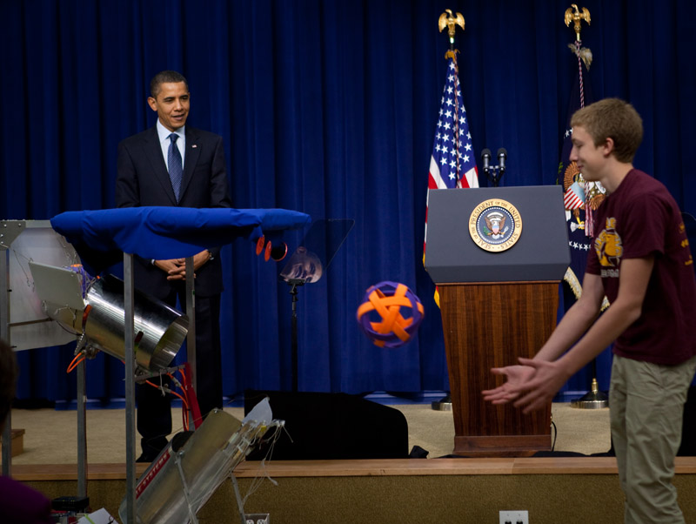
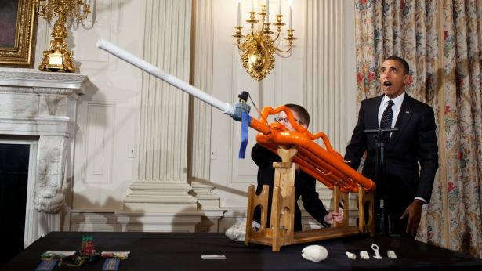
Encouraging Careers in STEM
The President’s "Educate to Innovate“ initiative is leveraging private-sector partners to get students excited about STEM subjects.
  FIRST students many more times likely to major and pursue careers in science and engineering
“Technology shifts and increasing investments in advanced manufacturing are creating
a great demand for STEM-
capable students worldwide.”
- Paula Davis, President,
Alcoa Foundation
White House, November 2009
White House Science Fair, Feb 2012

Slide 25
Global Wellbeing
Wealth creation
Sustainability / efficiency
Enabling SME’s
National well being
Secured international leadership
The United States of America
  Manufacturing
  Automotive
The World
“In times of change, learners inherit the earth; while the learned find themselves beautifully equipped to deal with a world that no longer exists.” (Eric Hoffer 1902-1983)
Notes:
Kuka KR 1000 Titan

Slide 26
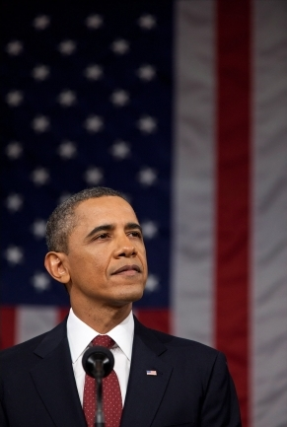
“Think about the America within our reach: A country that leads the world in educating its people. An America that attracts a new generation of high-tech manufacturing and high-paying jobs. A future where we’re in control of our own energy, and our security and prosperity aren’t so tied to unstable parts of the world. An economy built to last, where hard work pays off, and responsibility is rewarded.”
- President Barack Obama
January 24, 2012

