Slide 1
Transforming Healthcare Delivery Through Communities HUBbub, April 6, 2011 3:00 – 3:30 p.m.

Slide 2
A growing field
Healthcare delivery, healthcare engineering, healthcare systems research (etc.)
The challenges we see
Right care, right patient, right time
Fragmentation, variation

Slide 3
“We need a hub…”
How can we create a better healthcare system?
Researchers/universities, professional organizations, research companies, QIOs, etc.
Enable collaboration:
Aligning stakeholders (think vertical integration)
Multi-site trials and validation

Slide 4
Toward a better healthcare system
Online collaboration to transform healthcare delivery.
Develop research and educational tools and materials in healthcare delivery.
Provides a free and open place for researchers to share data sets, develop and pilot tools, and collaborate on projects.
Provides a place for the outcomes of such projects to be disseminated to researchers, practitioners, and patients.

Slide 5
How We Use Communities
Some types of tools are not “owned”
May not be publicly available
Not the source of published work
Tools and data are secured through HUB groups
Some research content is not public-facing
Tools are not the results; they are the method
Results may be in the form of case studies, policy and practice recommendations, and to a lesser extent, research publications.
Tools and data may have finite lifetimes

Slide 6
How We Use Communities
Data is often shared across institutions
Motivations
User agreements
Community participants are diverse
Researchers and practitioners
Interplay of RQs and practice, policy
“Closing the Loop”

Slide 7
Community Example 1: Preventing Hospital Readmissions
Researchers at multiple universities sharing
Data from several hospital systems
De-identified data and secured on separate server
Three tools for data exploration and visualization
Technical discussion with tool developers
Data analysis plans
Manuscripts in progress

Slide 8
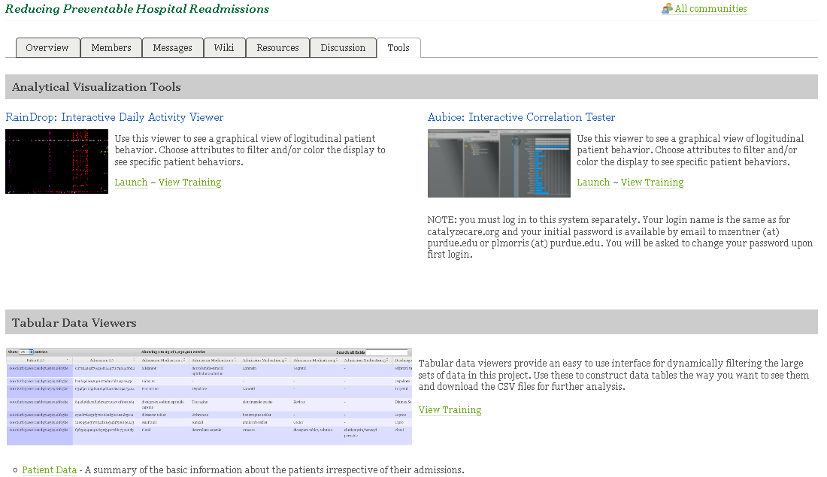
Readmissions Community Tools

Slide 9
Challenges
Few HUB resources…the Dropbox problem
Work in progress…by multiple parties
Not well-suited to HUB resources
“Tools” are not really HUB resources
Future HIPAA compliance
No “push” of data from groups

Slide 10
Community Example 2: Infusion Pump Informatics
Healthcare systems sharing:
Access to a tool that visually presents data
Data from “smart” medication infusion pumps
Compare my data to others
Ease of use
Pharmacy medication profiles
Participation in technical discussions
Wish list for tool improvements
Best practices for patient safety

Slide 11
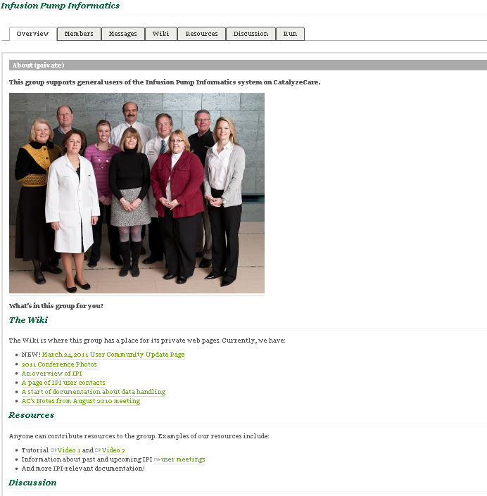
Infusion Pump Informatics Community

Slide 12
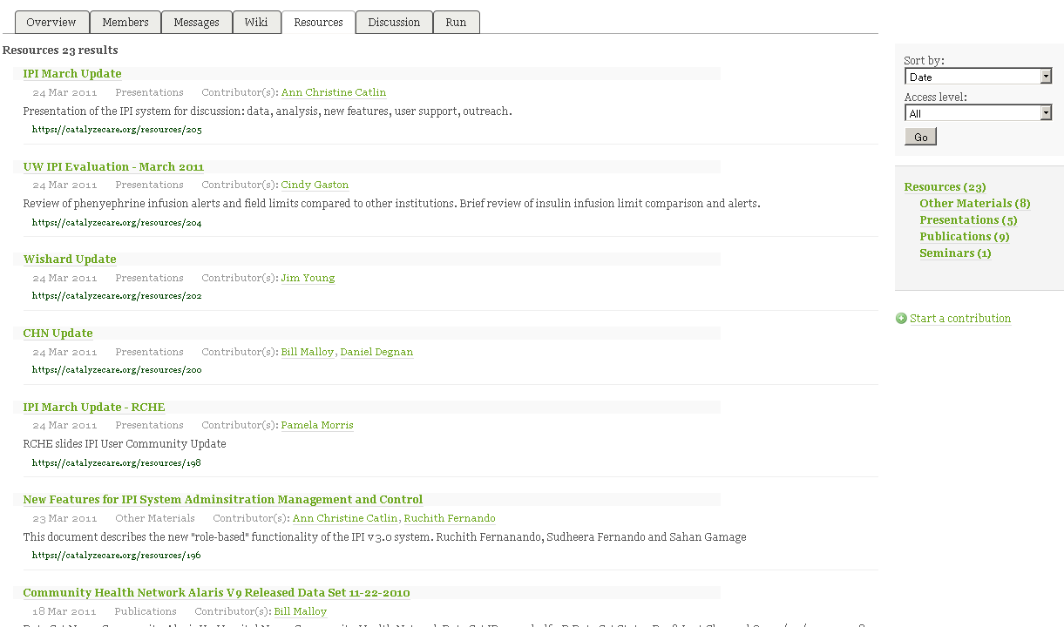
IPI Community Resources
Agendas and Minutes
Institution Reports
Development Updates
Technical Documentation
Data Sets

Slide 13
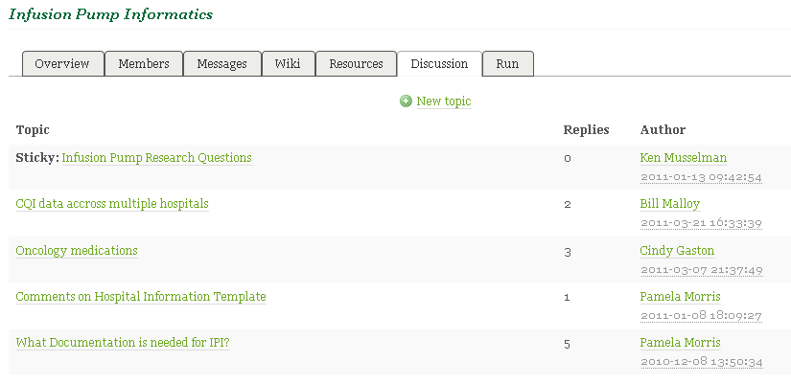
IPI Community Discussions

Slide 14
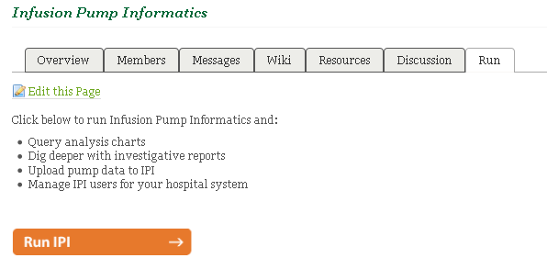
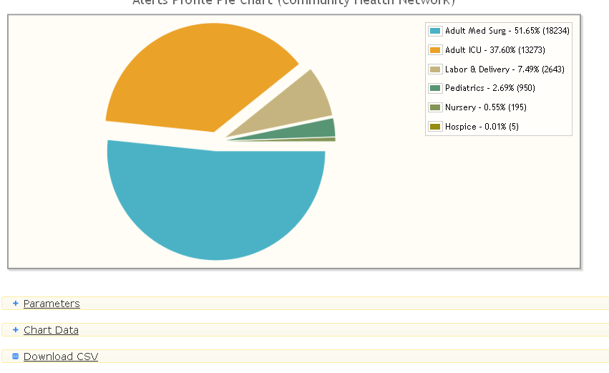
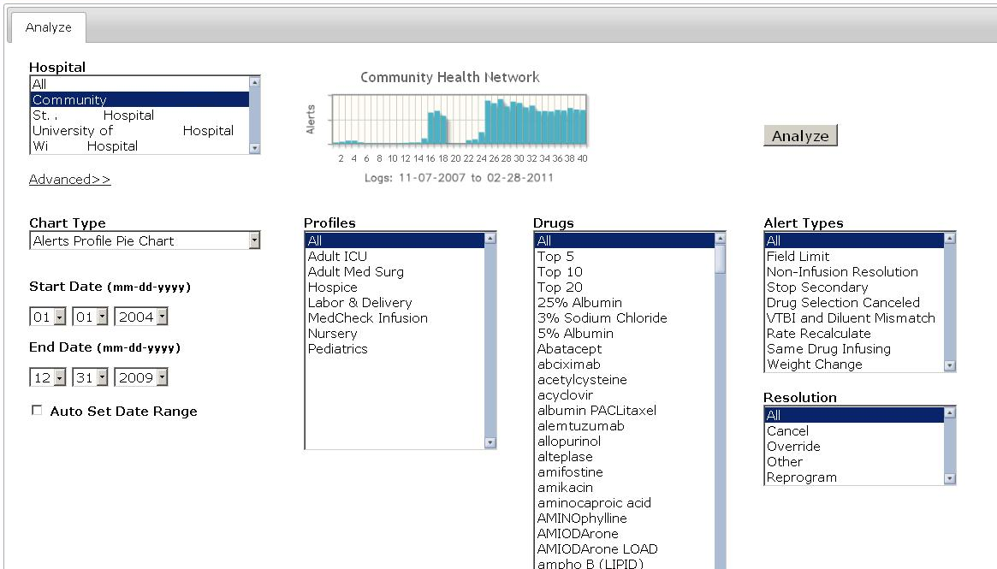
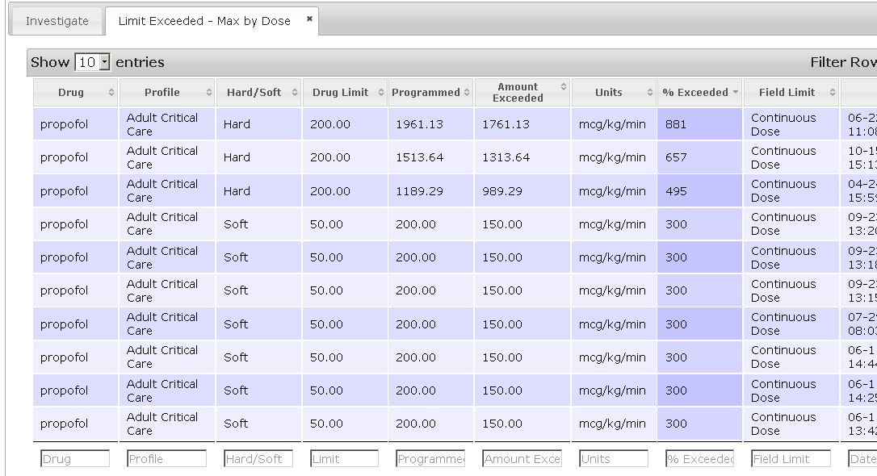
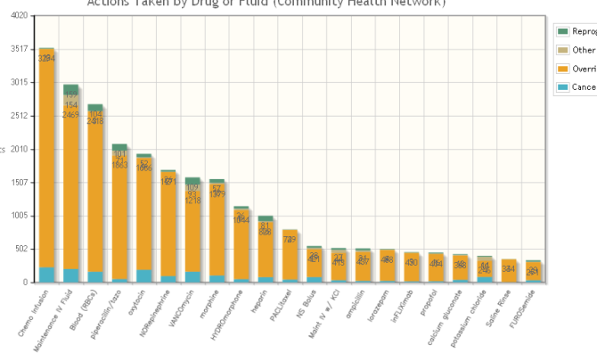
IPI Community Tool
Hospital 1
Hospital 2
Hospital 3

Slide 15
Community: Lessons Learned
Ease of use is key
Audience is not necessarily technically savvy
Straightforward vocabulary
No code
?
?

Slide 16
Community: Lessons Learned
Need for compelling reason to access group
Tool access or data access
Key documentation
Access to tool developers (discussion board)
…And a reason to return
Not once-and-done
Use feedback, currency, fresh data, new members, and growth of diversity in membership

