Slide 1
Cyberinfrastructure for Regenerative Personalized Medicine:
The Vision and Challenges
Sangtae Kim
Morgridge Institute for Research
Presentation at HUBbub2011 (Indianapolis), Apr. 6, 2011

Slide 2
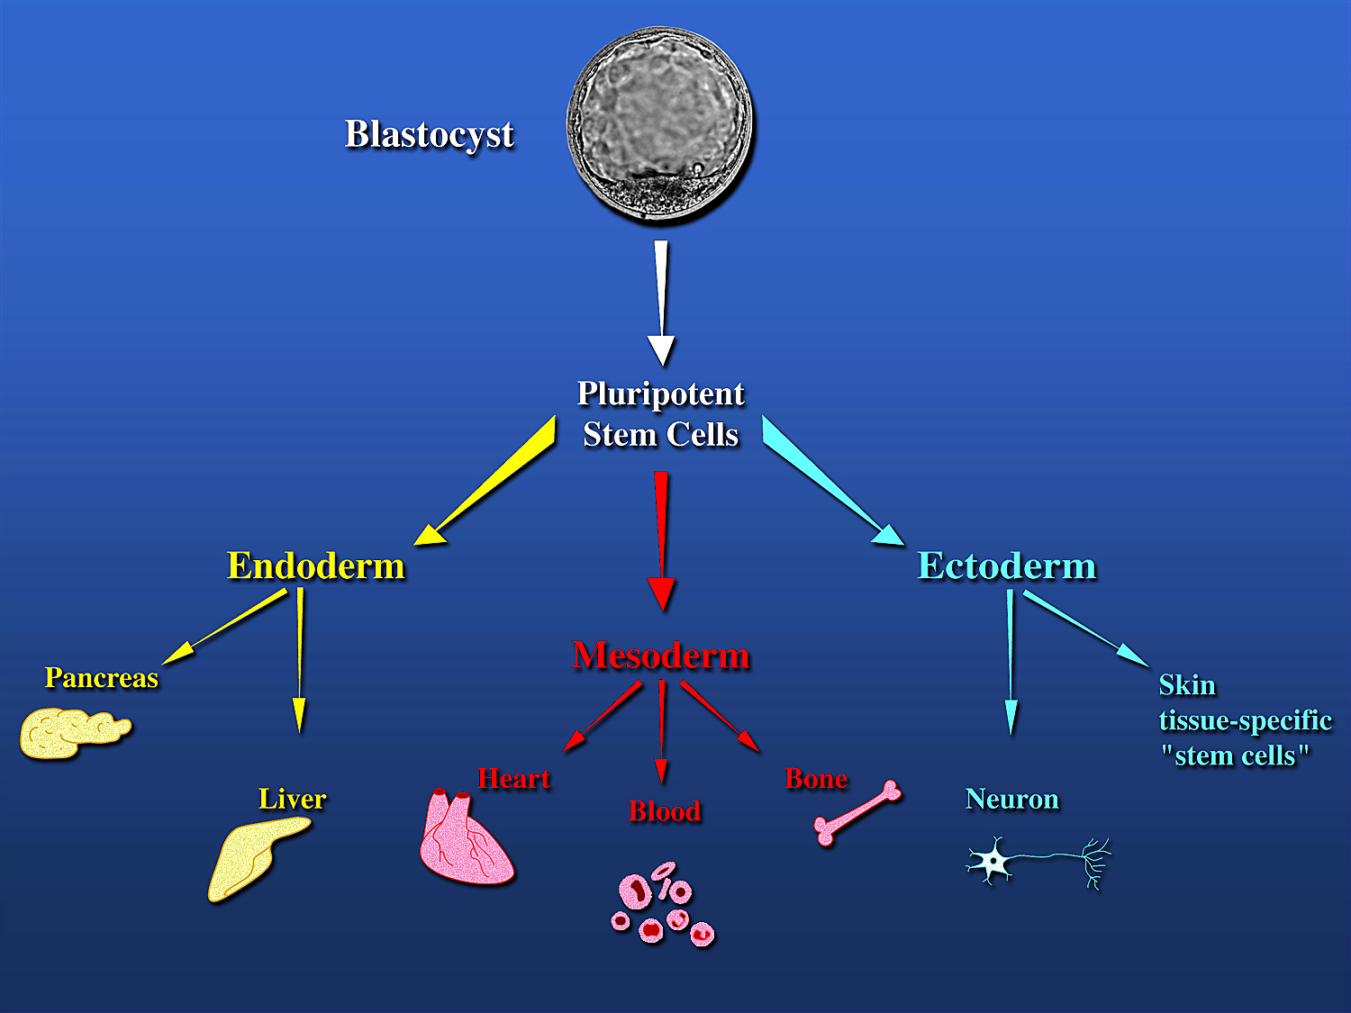
Differentiation Potential of Stem Cells
Slide courtesy of R. Shevde

Slide 4
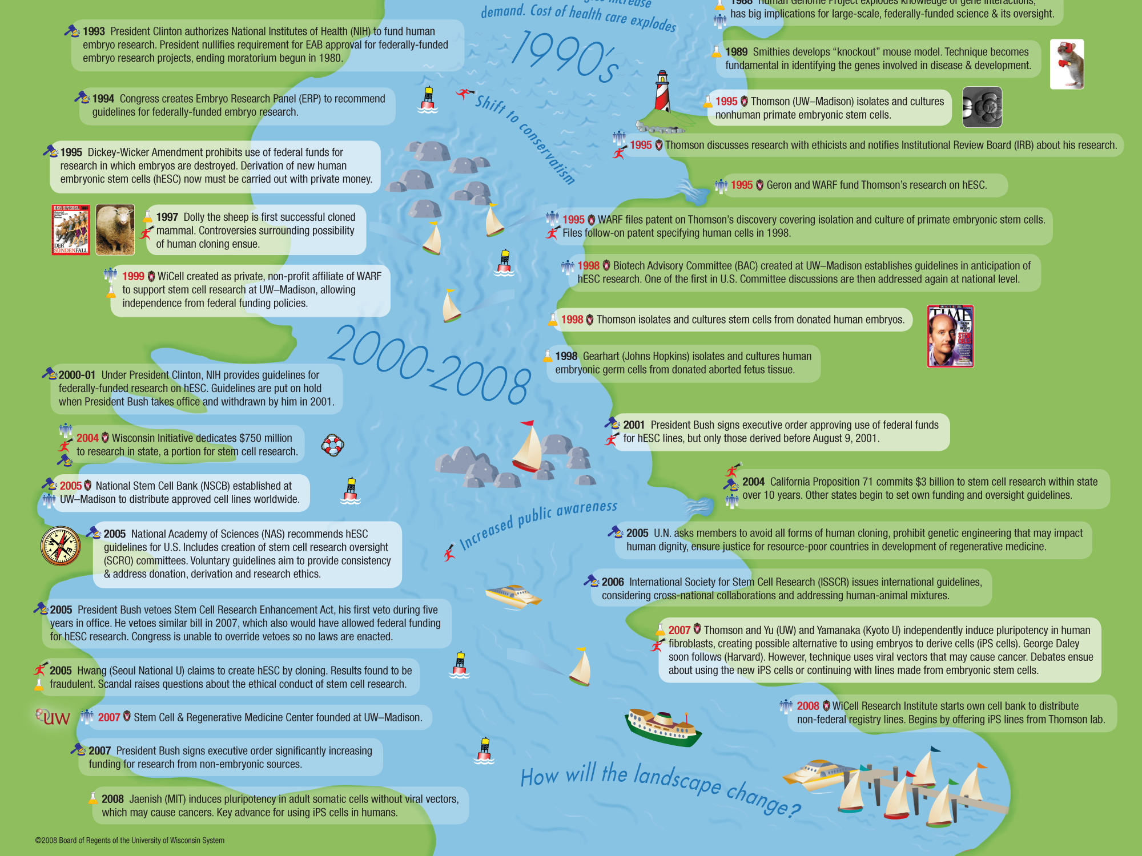

Slide 5
Human Embryonic Stem Cells, 1998
“The development of cell lines that may produce almost every tissue of the human body is an unprecedented scientific breakthrough. It is not too unrealistic to say that this research has the potential to revolutionize the practice of medicine and improve the quality and length of life”.
NIH Director Harold Varmus
Before the United States Senate Subcommittee on Labor, Health, and Human Services, Education and Related Agencies, December 2, 1998.
The Isolation of Human Embryonic Stem Cells was listed among the most significant scientific advances of 1998 in Science, Time, The London Times, and Discover Magazine, and was featured in Science’s “Breakthrough of the Year” in 1999.

Slide 6
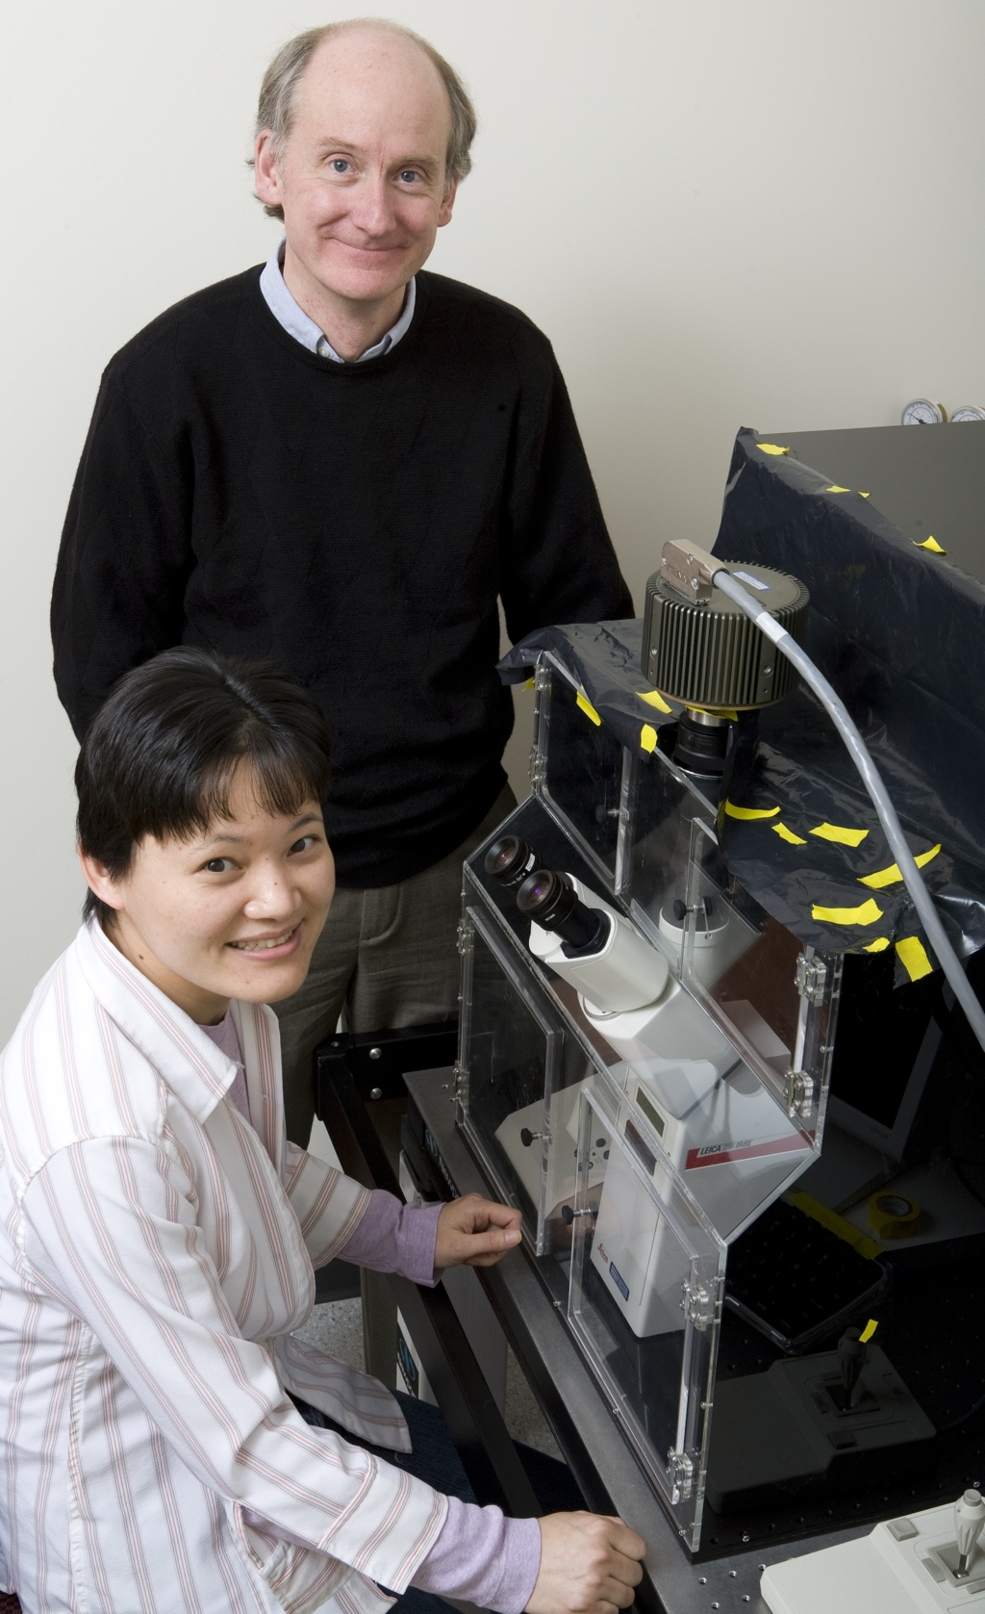
Human iPS Cells, 2007

Slide 7
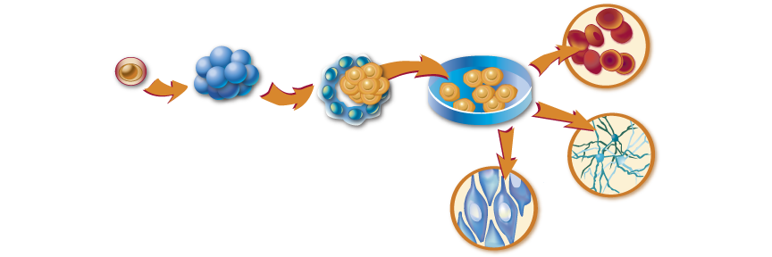
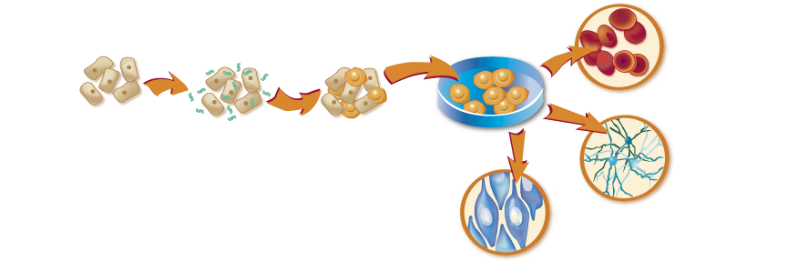
Blood Cells
EXISTING METHOD
Inner Stem
Cell Mass
Cultured Undifferentiated
Stem Cells
In Vitro Fertilized Egg
Neural Cells
Blastocyst Stage
(5-7 days old)
Muscle Cells
NEW METHOD
Blood Cells
Skin Cells are exposed to viruses, each carrying one to four critical genes.
Cultured Undifferentiated
Stem Cells
Adult Skin Cells
Neural Cells
Cells that absorb all four genes are converted to stem cells.
Muscle Cells

Slide 8
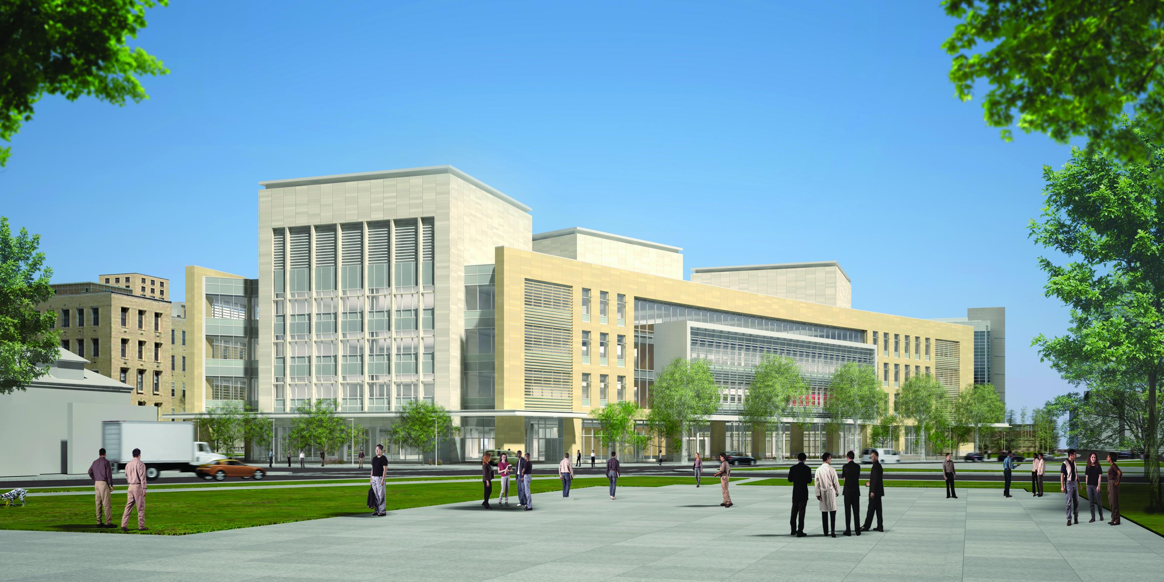
^{Twin institutes under one roof} ^{on the UW-Madison campus}
Notes:
This is an artists rendering of what the building will look like from the outside when completed.

Slide 9
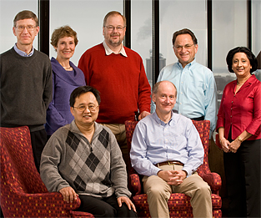
MIR Discovery to Delivery Team
Susan Millar
education research
Rock Mackie
medical devices
Miron Livny, CTO
Paul Ahlquist
virology/oncology
Rupa Shevde
outreach experiences
Sang Kim
pharma-informatics
Jamie Thomson
regenerative biology

Slide 10
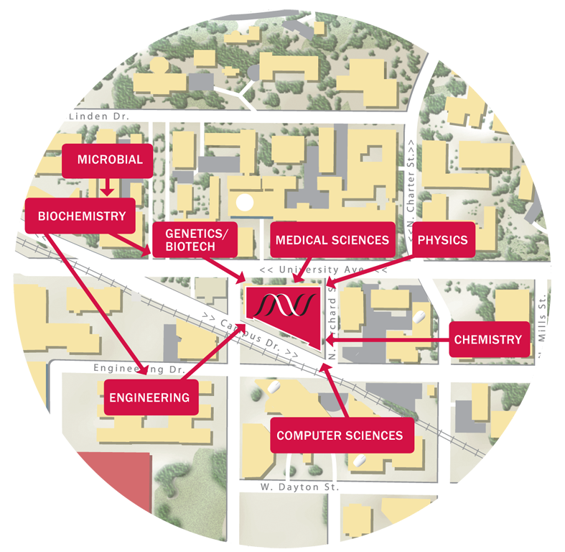
At center of campus science sites

Slide 11
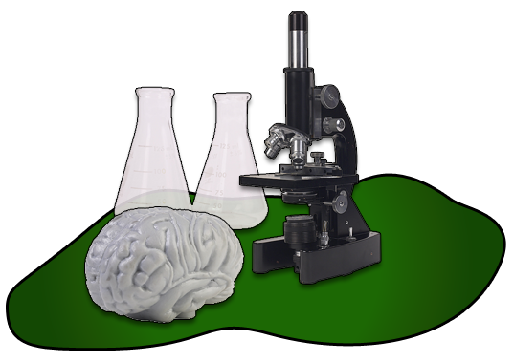
UW/WARF History: Discovery to Delivery
Delivery
Discovery

Slide 12
Global Reality: the Past Decade
Universities’ IP portfolios
decline in market value
Longer, riskier path

Slide 13
MIR Vision: Discovery to Delivery
IP portfolio grows in
value, responding to market forces

Slide 14
Commercial Program Profile

Slide 15
Stem Cell Therapeutic Applications
Immediate Applications
Diabetes
Cardiovascular Disease
Autoimmune Disease
Alzheimer’s Disease
Parkinson’s Disease
Spinal Cord Injury
Other Applications
Osteoperosis
Cancer
Burns and Skin Grafts
Notes:
Diabetes and cardiovascular diseases are predicted to be highly amenable for stem cell intervention. Indeed, most research in stem cells has focused on pancreatic islet cells.
Major therapeutic areas are Autoimmune, Cardiovascular, and Neurological

Slide 16
Stem Cell Therapeutics Market
Market expected to reach $11.5B by 2015
50% growth rate over next ten years
116 companies involved in stem cell therapy
Need data provenance from the start – long before the clinical phases!
Source: MedMarket Diligence, MII News, Global Industry Analysts, TFG Analysis
Notes:
Potential U.S. Patient Populations for Cell-Based Therapies:
Cardiovascular disease 70 million
Autoimmune disease 50 million
Diabetes 18 million
Osteoporosis 10 million
Cancer 10 million
Alzheimer’s disease 4.5 million
Parkinson’s disease 1 million
Burns (severe) 1.1 million
Spinal-cord injuries 0.25 million
Birth defects 0.15 million/year

Slide 17
WiCell Process
Computer System Scope
Stem Cell Banking
(from Customer)
WiCell
Bank
Stem Cell Request
(to Customer)
Stem Cell Derivation
(Passage 1-WiCell)
Stem Cell Development
(Passage n-WiCell)
Cyto
Testing
Test Requests
(to Customer)
Mat’l
Inventory
Vendor Supplies
(reagents, etc.)
QA Testing

Slide 18
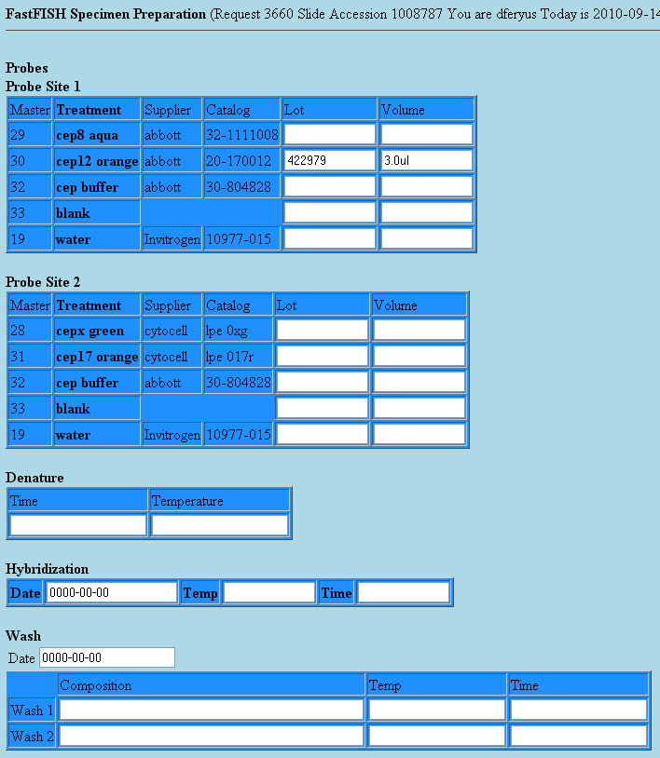
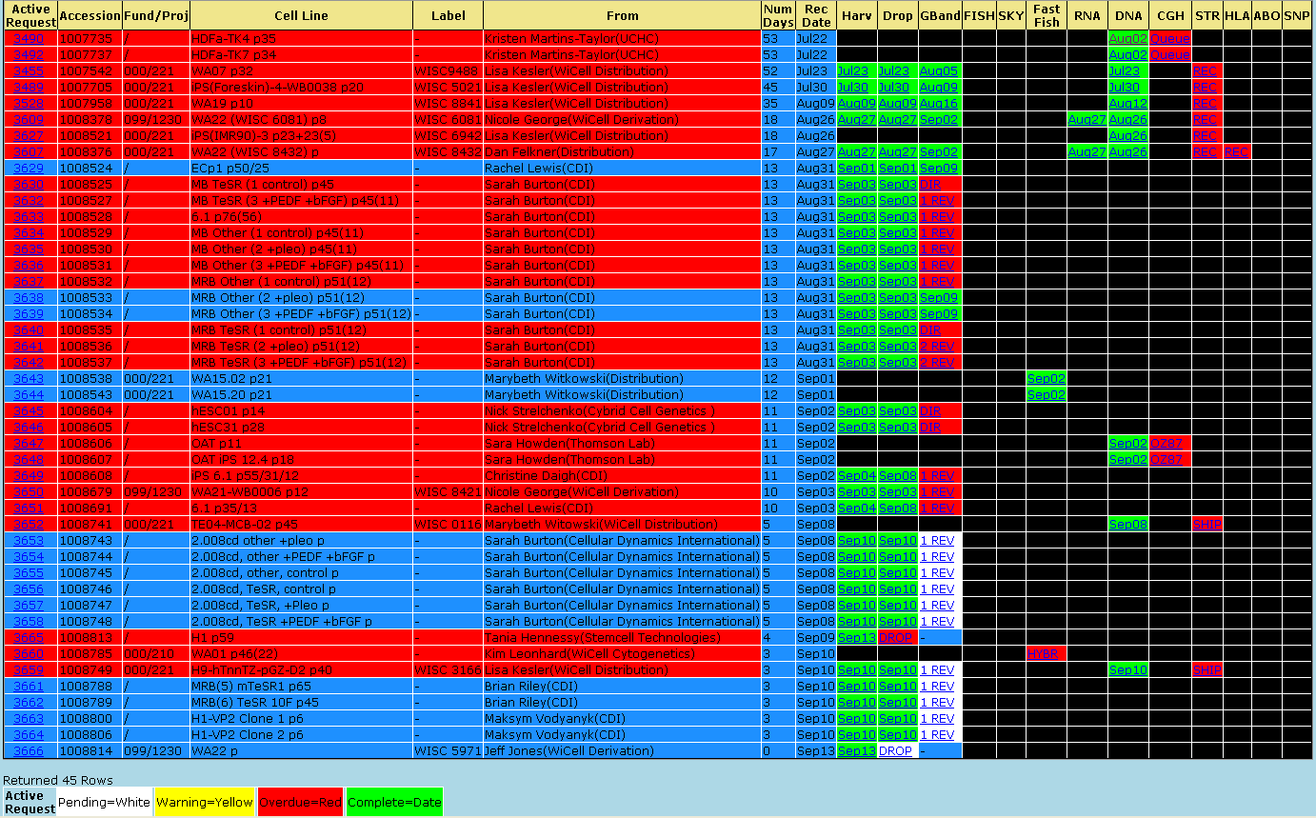
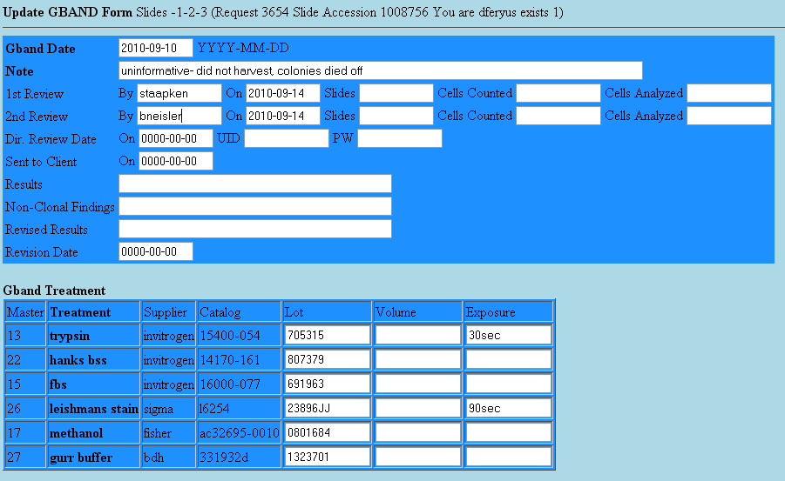
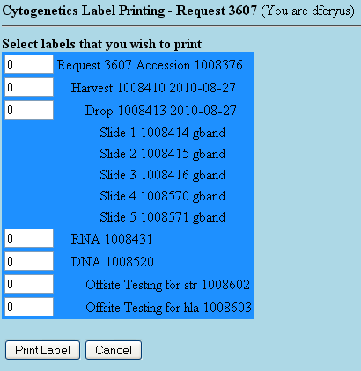
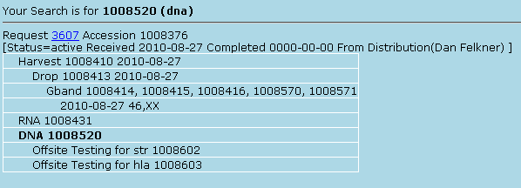
CytoGenetics Database (Dave Feryus)
Warnings are given for test steps
And warnings are also given for review steps
Generally, 1 or 2 days passes between steps before the overdue warning shows
All activities linked to specific activity page
All product given specific accession number, and label with barcode
10 day turn around is the Cytogenetics goal (from receipt of material)
From WiCell, UW, or an outside lab
Provides stem cell material to be tested
In a variety of ways
(Gband, FISH, SKY, FastFish, CGH, STR, Etc.)
A Request to WiCell Cytogenetics Testing Lab

Slide 19
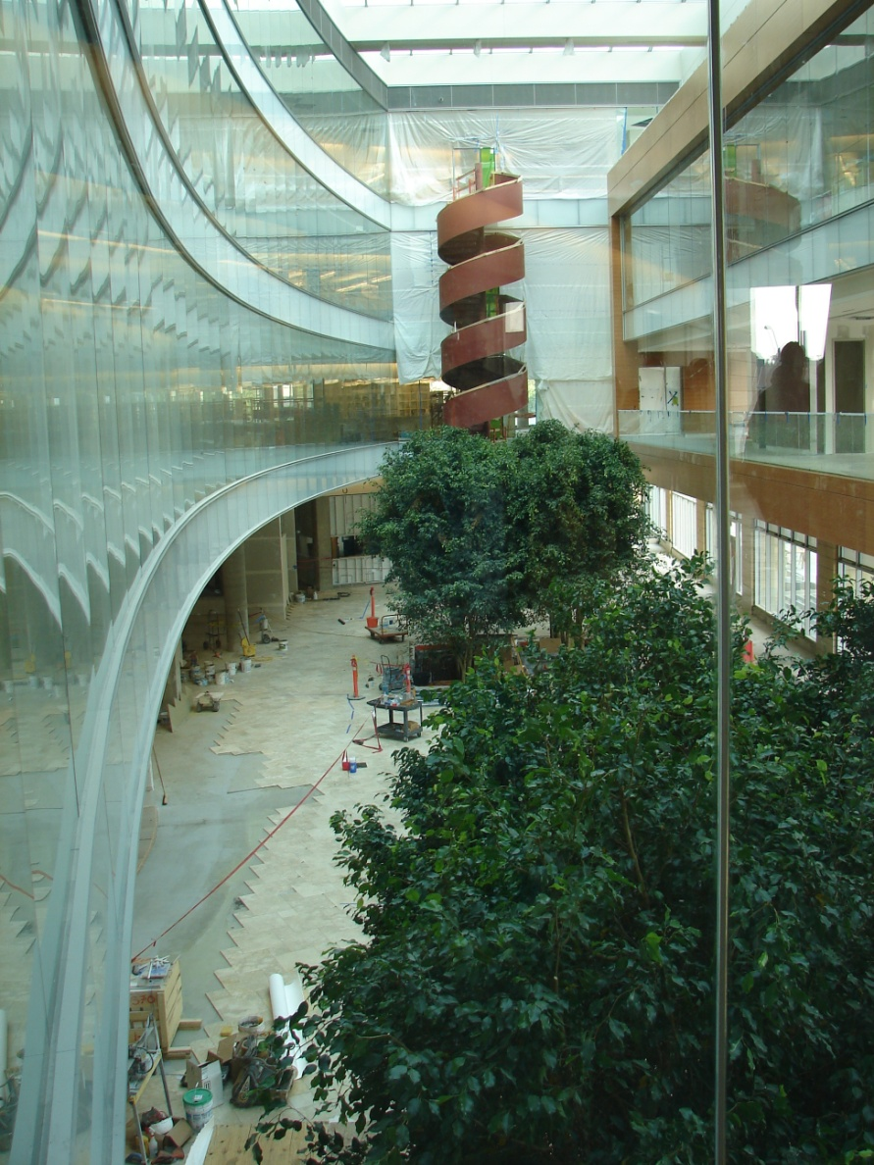
Discovery Regenerative Biology, Virology
Delivery Medical Devices, Pharmaceutical Informatics
Personalized – Provenance
Questions or Comments?

Slide 20
Morgridge Institute Mission
Accelerating Discovery to Delivery
to Improve Human Health
Move biomedical discoveries from benchtops of researchers to bedsides of patients . . . from point of discovery to application
Impact society through new treatments, tools and scientific insight
Scientific Areas
Discovery Regenerative Biology, Virology
Delivery Medical Devices, Pharmaceutical Informatics

Slide 21
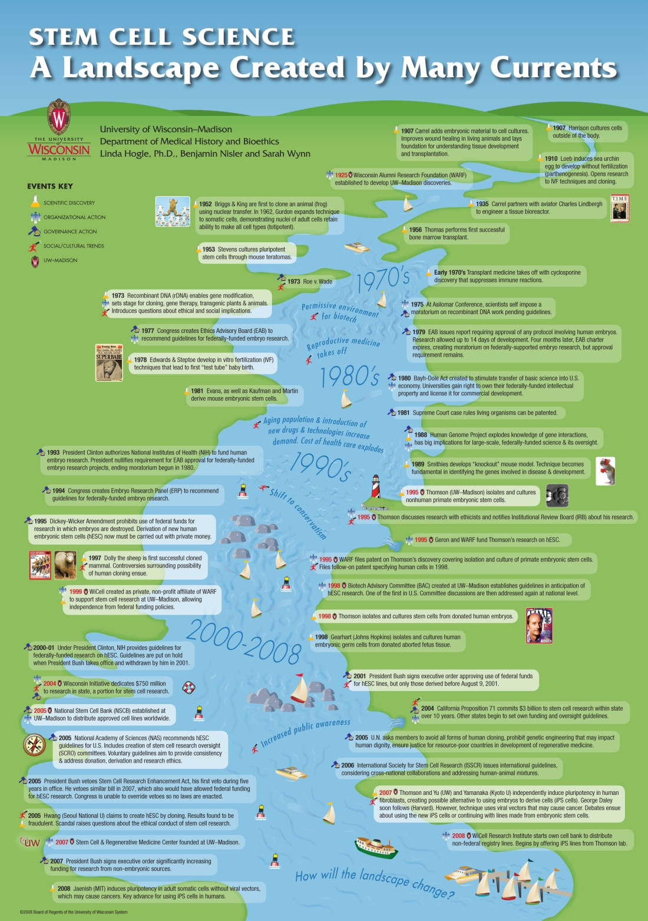

Slide 22
Stem Cell Research Tools
Cell Culture Media
ADME/Toxicology
Cryopreservation
Drug Discovery Assays
Karyotyping
hESC Characterization Kits
Gene Expression Systems
Differentiated Cell Characterization Kits
Notes:
Needs:
Isolation & characterization tools
Differentiation tools
Cell expansion reagents
ADME/Tox
Stem cell mobilizers
AnorMED (AOM; Vancouver)
Mozobil: mobilizing SC from bone marrow
Acquired by Millenium for $512 million
Predictive toxicology
Cellular Dynamics International (WI)
Cellartis (Sweden)
Vistagen (CA)
Biomarker Discovery
Stemina Biomarker Discovery (WI)
Reagents and assays
Invitrogen
Chemicon
Cambrex
Small molecule HTS screening
Curis:
Neurotrophic factors identified using ES cells
US$5 million Spinal Muscular Atrophy Foundation
Stem Cell Sciences (UK)

Slide 23
Stem Cell Diagnostics
Least developed market
Will require enabling technologies (e.g. cost effective cell culture)
Will compete with genetic and molecular diagnostics
Promising applications in personalized medicine

