Slide 1
CLEERhub: Using an Online Collaborative Workspace as a Cognitive Tool

Slide 2
Collaborators on this Project
Natasha Perova, Purdue University
Qaiser H. Malik, Purdue University
Ruth Streveler, Purdue University

Slide 3
CLEERhub.org Mission
Create a virtual community of practice building on the NSF CCLI project COLLABORATIVE RESEARCH: Expanding and sustaining research capacity in engineering and technology, while building on successful programs for faculty and graduate students [NSF DUE 0817461]

Slide 4
How Does a Hub Differ From a Website?
CLEERhub is an environment in which researchers, educators, and students can access tools and share information.
We define a “hub” as a web-based collaboration environment with the following features:
  User groups for public and private collaboration
  Webinars, online presentations, seminars and workshops
  Mechanism for uploading and sharing resources
  Access to course lectures and materials online
  Postings of news and events
  Wikis and blogs
  Document archive
  Content tagging

Slide 5
Theoretical Perspective
CLEERHub.org is a digital habitat with the mission to address the continued need for developing engineering education researchers

Slide 6
Digital Habitat
Digital habitat
  refers to the portion of the community’s habitat that is enabled by a configuration of technologies
  a dynamic mutually defining relationship that depends on the learning of the community
  reflects the practices that members have developed to take advantage of the technology available and thus experience this technology as a “place” for a community
A digital habitat is an experience of place enabled by technology Wenger et al. (2009). Digital Habitats: Stewarding technology for communities. Portland, OR: CPsquare

Slide 7
Framework for Social Web Design
Situated learning theory: learning is an act of social participation in communities of practice (Lave and Wenger 1991).
“People learn in all contexts of activity, not because they are internalizing knowledge, culture, and expertise as isolated individuals, but because they are part of shared cultural systems and are engaged in collective social action.” (p.14)

Slide 9
Collaboration Space: Groups
To facilitate the online group research collaboration, CLEERhub integrated Wiki document for shared co-editing, Resources page for listing relevant literature information and Discussion

Slide 10
Pilot Study Overview
In the fall of 2010 we conducted a Pilot Study to test the feasibility of using CLEERhub.org platform for supporting teams collaboration for students enrolled in an undergraduate semester-long Contemporary Science and Innovation course designed for non-science majors.
Participants
  24 undergraduate students
  Ages ranged from 19 to 22 years old
  Majors: accounting, marketing, advertisement, english, sociology, theater, finance, government and public relations

Slide 11
Pilot Study Overview
Course Structure
  In the first half, students explore the topics of energy, sustainability and the role of technology and engineering design process in the scientific advances.
  In the second half, students work collaboratively on projects.
  In the fall of 2010, students had to design hands-on educational experiments to explore energy-related topics. Six teams were working on the topics of their selection, including wind energy, solar energy, potential and kinetic energy, and energy efficiency.
To support student’s teamwork and collaboration, CLEERhub.org was recommended as an online workspace.

Slide 12
Measures
Internet Usage Survey:
  The focus of the updated survey is to investigate to what extent students use internet technologies, such as skype, twitter, facebook, social bookmarking tools, podcasts, etc., for personal use, classes and work if applicable. This survey originally was developed by HUBzero.
CLEERhub Usage Survey:
  Was designed to collect students’ feedback about their experiences using CLEERhub online space for their project work. More specifically questions included were: How frequently students used CLEERhub? How they used CLEERhub? What features did they find most or least helpful.

Slide 13
The Internet Usage Survey
For personal communication tasks, these preliminary results show that students favor facebook as the primary Web 2.0 tool (80 % frequent usage), and do not use as actively the other resources.
  For example, only 12% said they used Twitter frequently, and 28% used it occasionally. For Podcasts and Blogs, only 4% of participants indicated frequent usage, and 68% and 60% correspondently never used these tools. 20% of students indicated frequent and 16% occasional use of Wiki pages.
In Academic usage category, students do not rely as much on Web 2.0 tools. For occasional usage, Facebook leads with 40%, Blogs have 32%, and 20% use Wikis.
The reasons for heavy reliance on facebook in personal and academic spheres could be in better familiarity with interface, easier usability features, or the nature of tasks that don’t require integration of other online tools.

Slide 14
CLEERhub Usage Survey
Students who indicated using CLEERhub rarely explained that “it was easier to send group e-mails” and “CLEERhub was not needed for any other classes”.

Slide 15
Use Of Other Technologies For Class Project

Slide 16
CLEERhub Usage Results

Slide 17
CLEERhub Usage Results
Most useful features of using CLEERhub.org
  “being able to have a place where everyone could edit one document without having to constantly e-mail each other updates”.
  “I found it very useful how the entire group can log into the same website and edit something that every student can see”.
  “The Wiki page was the most useful since by editing our work we could work sometimes without meeting and contribute to the project by your own way since sometimes we couldn't meet because of the different time schedules we had”.
  “CLEERhub was most useful for being able to share information online without having to get together outside of class time.”

Slide 18
CLEERhub Usage Results
Least useful features of CLEERhub.org
  having to update the wiki page all the time
  having a lot of additional options that were confusing. “the discussion board was not helpful since most of the time we try to discuss in person what we wanted to achieve for the project.”
  “the format of the wiki page was hard to use because it was in codes, and not easy to use if you were not a computer genius. The wiki page should be set up more like a blog that is easily editable.”

Slide 19
CLEERhub Usage Results
Overall participants found helpful co-editing features of Wiki documents, easy accessibility of the online workspace for all members of the group, easy sharing of information online and the opportunity to continue group work outside the classroom without the need to meet in person.

Slide 20
Resulting Questions to Consider
How can we better support communication, collaboration and coordination in CLEERhub online groups?
How can we better support CLEERhub group thinking process?

Slide 21
Supporting Communication, Collaboration and Coordination
“To communicate, collaborate, and coordinate people must share a vast amount of information or mutual knowledge. Groups try and achieve common ground across conversational exchanges, related activities, and broader interactions that occur over long time periods.” Neale, Carroll, & Rosson (2004)
Integration of a tracked text chat feature as part of CLEERhub workspace to encourage and document group communication

Slide 22
Online Workspace Design
How can we better support CLEERhub group thinking process?
  Often when students are working in teams on science or engineering projects, their initial collaborative workflow is based on group meetings, production of a document with initial ideas for problem solution, e-mail exchanges of this document for refinement of main points, and sometimes use of text messaging for scheduling/organization purposes.

Slide 23
  Introduce brainstorming tool
Incorporate interface similar to Purdue University’s hotseat application in order to:
Provide better support to the ideas generation phase through fluid proposal and rating of concepts to all group members.
Allow users to stay connected to the group project at any time with preexisting social-networking software with which they are already familiar

Slide 24
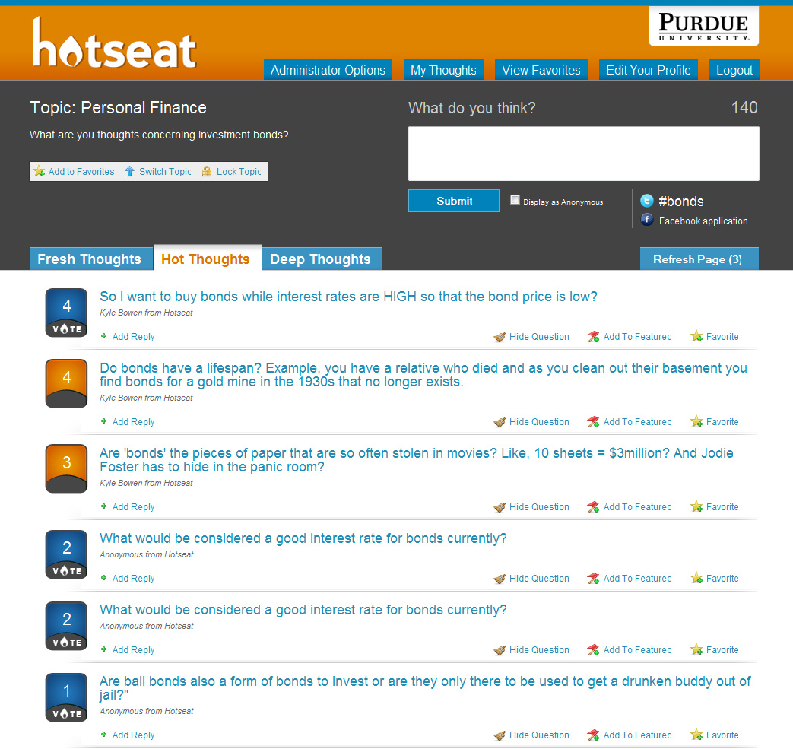
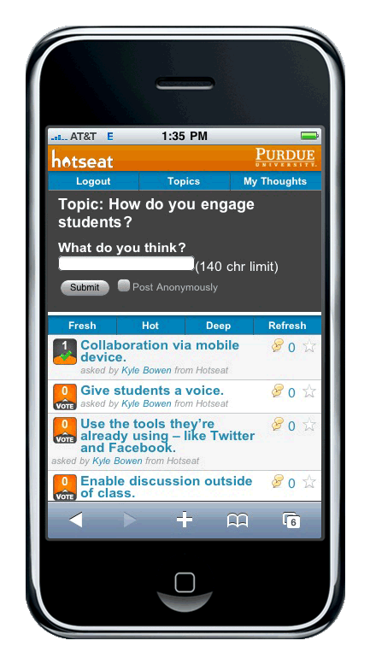

Slide 25
Important Points…
Neomillenial “always-on” students are expecting interactive and engaging course materials as part of their learning process
Affordances of web blogs, wikis, podcasting, social bookmarking, and social networking sites have created opportunities for “interconnectedness, content creation and interactivity” where students can not only acquire knowledge but also co-construct knowledge with their peers, teachers and experts in the field. Greenhow, C., Robelia, B., & Hughes, J. (2009). Baird, D. E., & Fisher, M. (2005).
Need to focus on how to meaningfully integrate online social media tools that would support different student learning styles and narrow the “digital disconnect” between learners and educators Levin et al. (2002).

Slide 26
References
Baird, D. E., & Fisher, M. (2005). Neomillenial user experience design strategies: Utilizing social networking media to support “always on” learning styles. Journal of Educational Technology, 34(1), 5–32.
Greenhow, C., Robelia, B., & Hughes, J. (2009). Learning, Teaching, and Scholarship in Digital Age. Educational Researcher, 38.
Smith, K., Sheppard, S., Johnson, D., & Johnson, R. 2005. Pedagogies of engagement: classroom-based Practices. Journal of Engineering Education, 94(1), 87-101.
Lemke, C., Coughlin, E., Garcia, L., Reifsneider, D., & Baas, J. (2009). Leadership for
Web 2.0 in Education: Promise and Reality. Culver City, CA: Metiri Group. Commissioned by CoSN through support from the John D. and Catherine T. MacArthur Foundation.
Levin, D., Arafeh, S., Lenhart, A., & Rainie, L. (2002). The digital disconnect: The widening gap between Internet-savvy students and their schools. Washington, DC: Pew Internet and American Life Project. Retrieved October 1, 2008, from http://www.pewinternet.org/PPF/r/67/report_display.asp

Slide 27
Acknowledgments
CLEERhub team
COLLABORATIVE RESEARCH: Expanding and sustaining research capacity in engineering and technology, while building on successful programs for faculty and graduate students [NSF DUE 0817461]

Slide 28
Contact Information
Natasha Perova, Purdue University nperova@purdue.edu
Qaiser H. Malik, Purdue University malikqai@purdue.edu
Ruth Streveler, Purdue University rastreve@purdue.edu

