Slide 1
Success Criteria for Establishing a Thriving HUBzero Based Site: A Model for Science 2.0
Lynn K. Zentner, Gerhard Klimeck, George B. Adams III, and Krishna P.C. Madhavan

Slide 2
nanoHUB Fast Facts
nanoHUB - the world’s largest nanotechnology user facility
Over 170,000 users annually
Over 2300 resources
Full courses, lectures, and workshops
Downloads, animations, podcasts
Nearly 200 simulation programs (tools)

Slide 3
The Vision for a Science Gateway
Employ
Fundamental Science
Engineering
Drive
Basic Research
Invention
Facilitate
Applied Research
Innovation
IMPACT
The transition from basic to applied research is not as simple as it sounds…

Slide 4
When it all works together…
Users
Developers
CI Operation
Vibrant and Impactful VO

Slide 5
7 Criteria
for Successful
Science Gateways

Slide 6
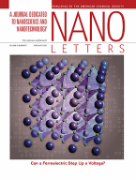
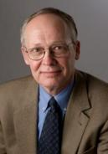
1. Outstanding Science
Basic research – invention
“What the world wants”
Meets the needs of a broad community
Leveraged research
7 NCN sites – each with a research focus
Partnerships with industry

Slide 7
2. Commitment to Dissemination
Buy in from the faculty community
Faculty willing to give it away free
Lead by example - NCN
44 faculty
7 site leads
23 post docs
106 grad students
38 undergrads
19 SURF/REU undergrads
Some faculty may ask – “What is the payoff?”
Taking the lead in content generation and deployment

Slide 8
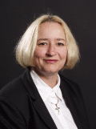
Faculty Incentives
Dragica Vasileska
Tool Usage ≈ reading papers
16 tools è Over 10,000 users!
è 115 citations
Proof of Impact -
Great in Proposals

Slide 9
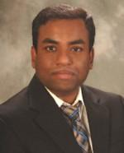
Next Generation Faculty
Shaikh Ahmed
7,703 users
14 tools
Post Doc
at Purdue
Faculty at
SIUC
Infused nanoHUB into existing classes
Built a new nanoelectronics curriculum
Used nanoHUB for research
Early Tenure Promotion

Slide 10
3. Understand Users
Eliminate software installation
Not allowed or no experience or no time
Understand experience and time constraints
No Manuals
Experience should be like using a rental car
Minimize learning curve
No time in already busy schedule
Immediate access & instant feedback
Visualize and compare results

Slide 11
Technology
Technology for Dissemination - underlying platform
Simple and utterly dependable
nanoHUB – 99.6% uptime last year
Funds dedicated to operation
Technology Transfer Process
NCN – Dedicated site leads at associated sites
Facilitate content creation and provide support
Recruit contributors

Slide 12
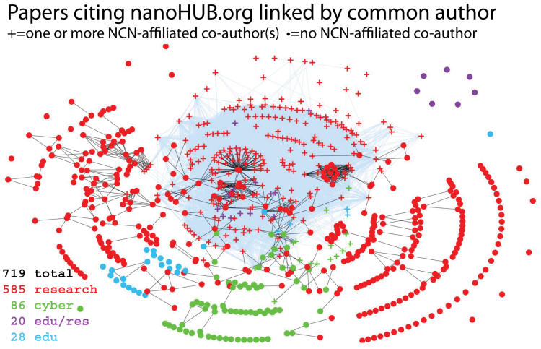
6. Open Assessment/Incentives
Gather, understand, disseminate stats
Access
Use
Impact
Measure impact of HUB – citations
Quality – secondary citations
Incentivize participation with usage stats
e.g., Vasileska & Ahmed
Are we meeting our goal?
Science & Engineering Invention Innovation

Slide 13
7. Business Model
What’s the next step?
Continued research – sustained academic funding
Product development – real business plans
Success at all 7 criteria
A thriving and vibrant science gateway –
Science 2.0

