Slide 1
Home Page Customization
HUBbub 2011
Sam Wilson
Notes:
*Introduction*
*Credibility statement*
*Attention getter*
*Open up hub, give quick orientation to Joomla and the home page*

Slide 2
Agenda
The “Home” Article Page
Template positions
Modules
Sliding Panes
Activity
Notes:
Mission statement: by the end of this presentation, you should be able to modify the home page to include a range of static and dynamic content provided by the use of HTML and modules.

Slide 3
Anatomy of the “Home” Page
Main Menu
“Welcome” Module -
Custom HTML module
Sliding Panes + Article Pages
“Home” Article Page
“Footer” Module -
Custom HTML module
Notes:
*Show frontend/backend comparison*
Home page customization is really just an extension of what we covered last session.
The home page is an article page that combines the use of modules and HTML to incorporate static and dynamic content!
The home page also includes other modules to allow for backend editing of content (remember, no code editing!)

Slide 4
The “Home” Article Page
What can it include?
Using the “xHUB” tag
{xhub:include type=”stylesheet” filename=”home.css”}
{xhub:include type=”script” filename=”resources.js”
component=”com_resources”}
{xhub:module position=”test”}
Notes:
Actually, all articles can include these tags.
You can include a stylesheet for custom styling, a JavaScript file for fancy animation, or a module for dynamic content
Also, the xHUB tag plugin must be installed and enabled for these to work

Slide 5
“Home” Page Continued…
What else can it include?
HTML
i.e. you’re not limited to modules
CSS
Styles from home.css or “included” style sheet can be referenced in your article pages
Notes:
The home page doesn’t have to be solely modules, you can put HTML in there and style using the included home style sheet, or even another, custom created style sheet.
NOTE: I prefer to put my home page HTML in a “Custom HTML” module for organization as opposed to directly in the home article page…I’ll show you how to do this later.

Slide 6
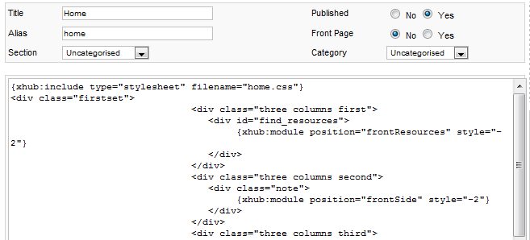
Template Positions
Helpful Hint: Locating positions
myhub.org/?tp=1
Those positions on the home article page
Using the Joomla! article manager
Notes:
*Demo ?tp=1 and finding positions*
*Flip to home article page on backend*
You can also create a new position and then manually type that position into the module position field (i.e. you’re not limited by what you see in the module position field).

Slide 7
Template Positions Continued…
Adding modules to those positions
Using the Joomla! Module Manager
Finding an existing module
Search by position or module type
Adding a new module
STEP 1:
Find your module and assign it to a new or existing position
STEP 2:
Add the xhub tag with that new/existing position to an article page
STEP 3:
Go to that page on the front-end and see your dynamic content in action
Notes:
Once you know what positions are available, or recently added to the home page, you can transition to the Joomla module manager on the backend to add a module to that position.
Or, if you know the position, and there’s already a module there, you can filter the list of modules on the backend by position or module type.
NOTE: adding a new module is more like instantiating an existing module, rather than creating a brand new one. It’s like selecting from a template and filling in your own custom information.
*Show module manager on the joomla backend*

Slide 8
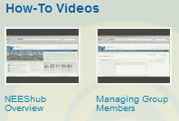
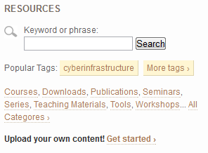
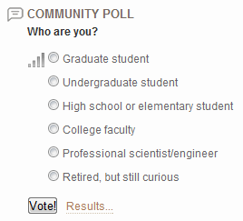
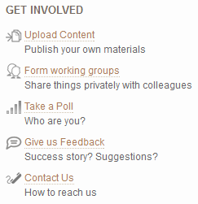
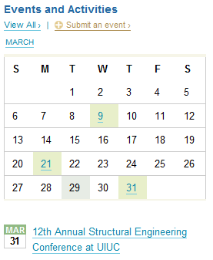
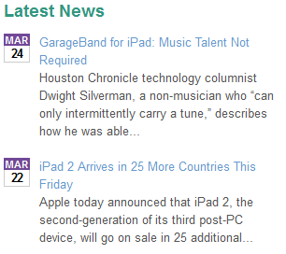
Zoo of Modules
Custom HTML
Welcome Module
Footer
News/Announcements
Featured
YouTube Feed
Latest Events
Notes:
These are just a few examples.
Guess what! Custom HTML modules also work for the MyHub page! Just give it the position “myhub”.

Slide 9
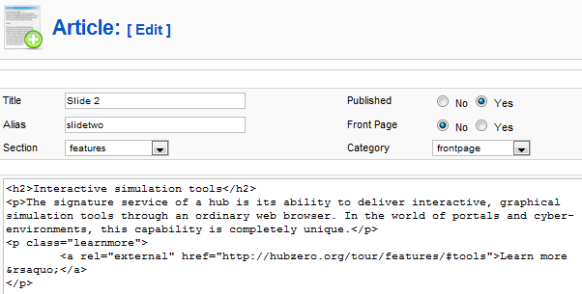
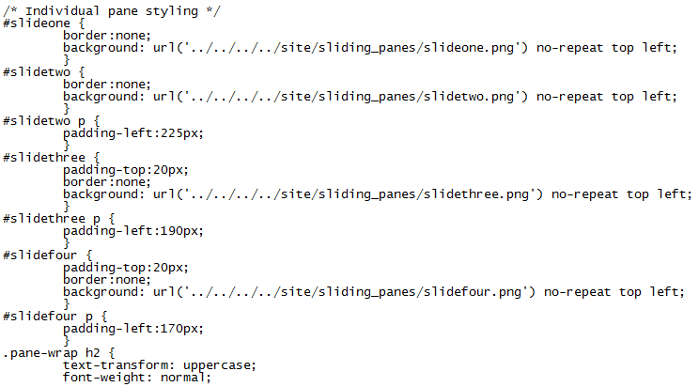
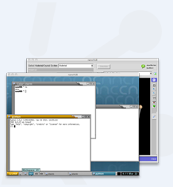
Sliding Panes
Sliding Panes = Article Pages + CSS + Images
Notes:
This is probably the trickiest thing we’ll touch on today.
Because of it’s complexity, and lack of complete admin interface, HUBzero is willing to help hosted hubs create this content.
But, if you’re using the open source, or you just like a challenge, I’m happy to help on a one-on-one basic if someone is interested in doing this for themselves.

Slide 10
Sliding Panes Continued…
Hints:
Text can be in the images, or in an article page
Article page must be assigned to the appropriate section and category
Article page alias should be the CSS class that identifies the background image being used
Images are defined in mod_sliding_panes.css
You’ll need SFTP access to add your images
Documentation: http://hubzero.org/documentation/1.0.0/managers/articles.homepage/
Notes:
Sliding panes documentation isn’t up yet, but I’ve got it written and am working on posting it.

Slide 11
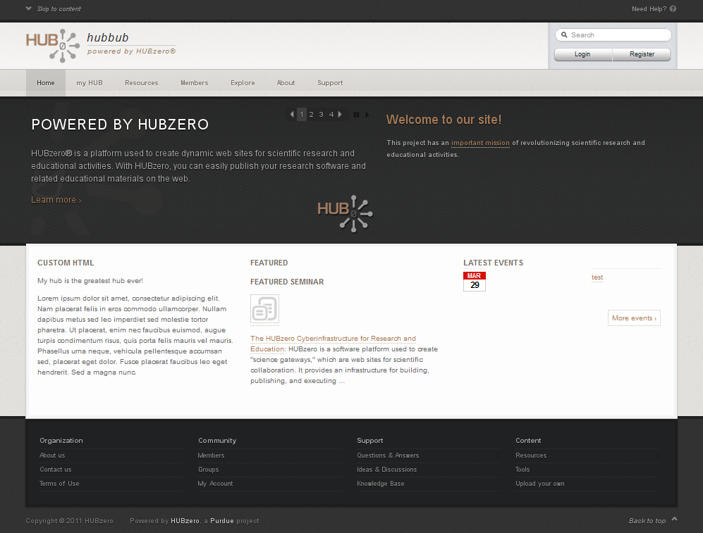
Activity
Modify your default Home page to go from…
This This
Notes:
And, ff there’s extra time, we’ll customize the Welcome module and the footer.

Slide 12
Activity Continued…
Steps
Modify the home article page and add the following positions
Add three positions: homeLeft, homeMiddle, and homeRight positions in a three column layout
Find the modules that you want to add, and assign them to those positions
Add a custom module, a featured module, and a latest events module
Notes:
See “Solutions” handout for detailed instructions
*If there’s extra time, customize the Welcome module and the footer*

Slide 13
Further help?
Existing documentation can be found here:
http://hubzero.org/documentation/1.0.0/managers/articles.homepage
http://hubzero.org/documentation/1.0.0/managers/extensions.modules

