Slide 1
Hub Content Customization
HUBbub 2011
Sam Wilson
Notes:
*Introduction*
*Credibility statement*
*Attention getter*
Who all here, is familiar with HUBzero/Joomla? Joomla is the CMS that HUBzero is built on.
We’ll start with a quick overview/orientation to Joomla.
Why use Joomla? It’s got a backend web interface for managing the hub (so you don’t have to get into the code).

Slide 2
Agenda
Article Pages
What are they for?
Sections, categories and URLs
Images
Menus
Menus vs. Menu items
Combining the two: Article pages + Menus
Activity
Notes:
Mission statement: by the time we’re finished here this afternoon, you should be able to create article pages, understand how URLs are formed, and add a menu to organize your article pages.
Let’s go!

Slide 3
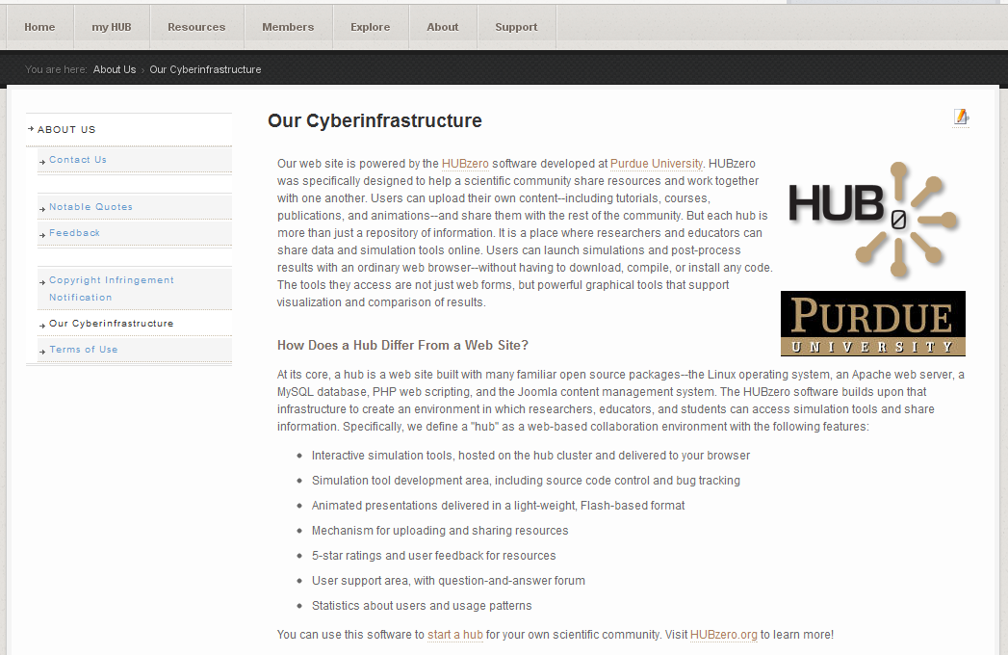
Article Pages
What’s an article page and what’s it for?
A single page on the hub
Great for displaying static content
Notes:
Article pages are a single page on the hub used for displaying content.
They are admin created and editable through the backend (non-user submitted, as is the case with resources).
While they are great for displaying static content, you can add modules to them for dynamic content as well.
*Flip to demo hub for example*

Slide 4
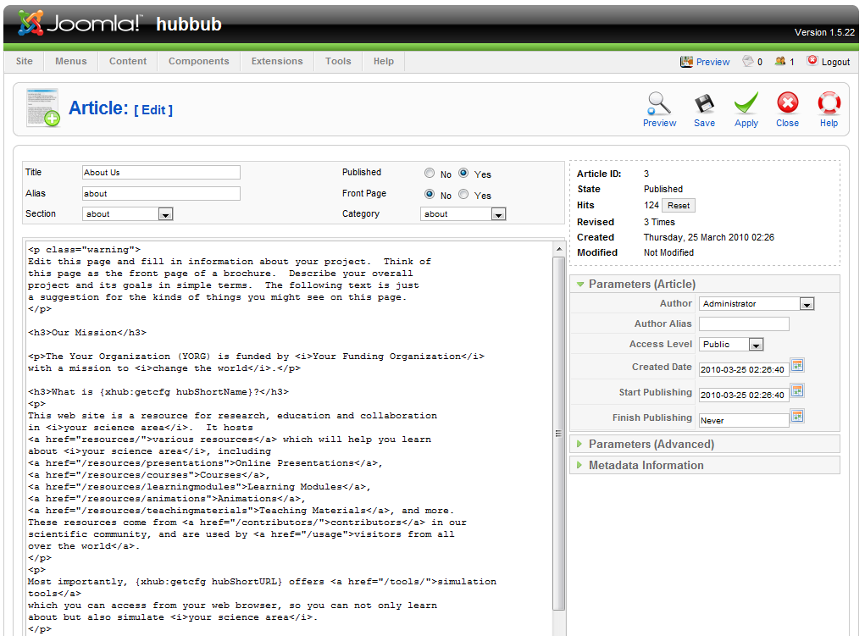
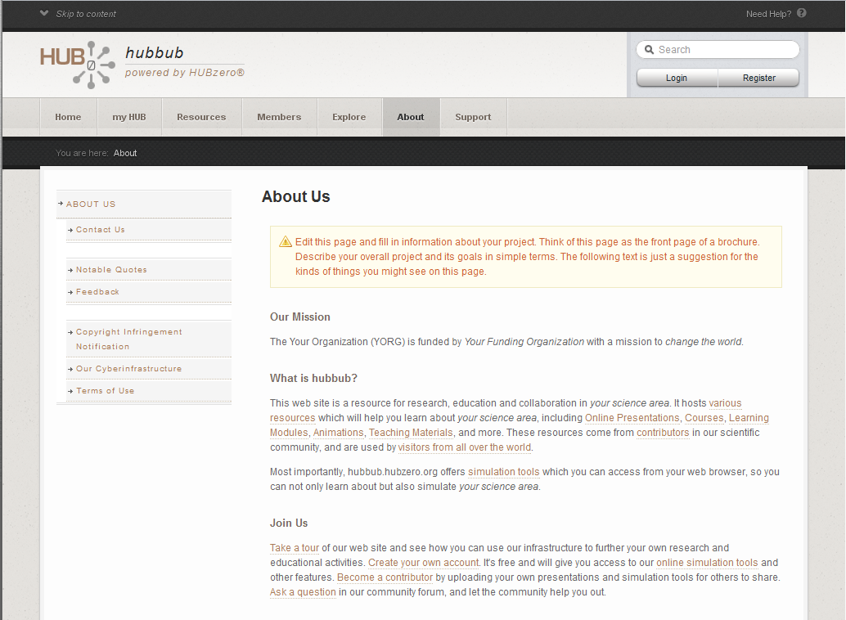
Article Pages Continued…
On the back-end
On the front-end
=
Notes:
You input your text, images, modules, etc. on the backend, and can then view that content on the front-end
*Flip to demo hub for example, make a change, and show that change reflected on the front-end*
NOTE: Global configuration – WYSIWYG vs. HTML text editing on the backend (look under the global configuration settings on the backend)
*Demo settings change and explain potential problems associated with the WYSIWWYG editor*

Slide 5
Article Pages Continued…
Sections
First level organizer for articles
Categories
Second level organizer for article
Examples:
myhub.org/section1/category1/article1
If “section name = category name” then…
myhub.org/samename/article1
Notes:
Sections and categories form an organizational tree for your articles.
This organization helps when finding those articles in the article manager on the backend, and work to form the URL of the article on the frontend
NOTE: We’ll bring up URLs again when we talk about menu structure

Slide 6
Article Pages Continued…
Aliases & URLs
An alias lets you define a unique identifier for your article (Joomla! will make one if you don’t)
Example
myhub.org/section1/category1/alias
Also, if the alias, section name, and category name are all the same, then…
myhub.org/samename
Notes:
When creating an article, it’s best to add your own alias (often an abbreviated, but distinct version of the article title).
If you don’t add an alias, Joomla will create one for you, and it will be your article title minus the spaces (often not the best URL for users on the frontend).
For your really important pages, that you want to be easily accessible (our “About” page in the slide), you can use the same section, category, and alias to create a short and succinct URL
NOTE: avoid using the “-” character in your article aliases

Slide 7
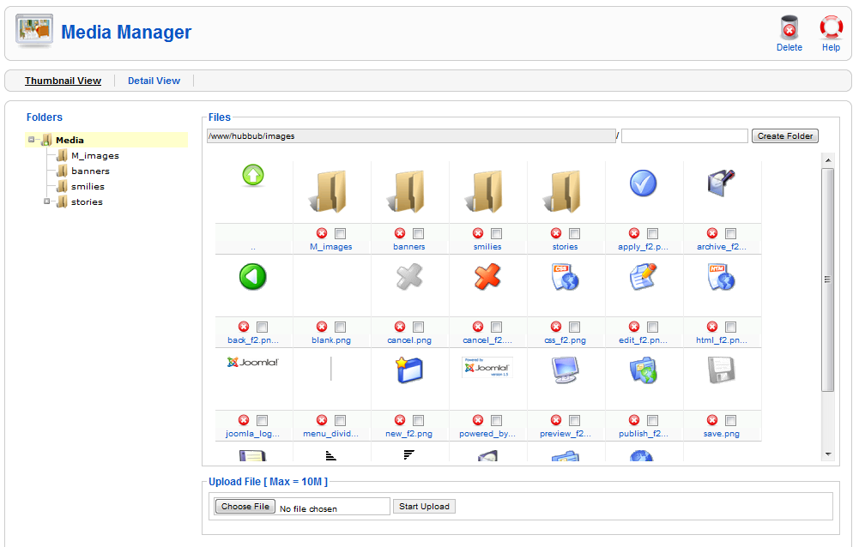
Article Pages Continued…
Adding Images
Adding images to the hub
Site -> Media Manager
Adding images to your article
Look for the Image icon
Notes:
Often times you’ll want to add images to your articles.
All you have to do is add them to the hub via the media manager.
Then, just use the Image button under the Article text box for help creating the HTML img tag
*NOTE about global configuration media settings*
*Demo the media manager and the image button on the article page*

Slide 8
Menus
On the home page
Main menu
Sub-menus
Setting a menu item’s “Parent Item”
Notes:
Menus help with navigation and organization on your hub.
The most obvious instance is the home page.
Menus also have a hierarchy used for organization and display.

Slide 9
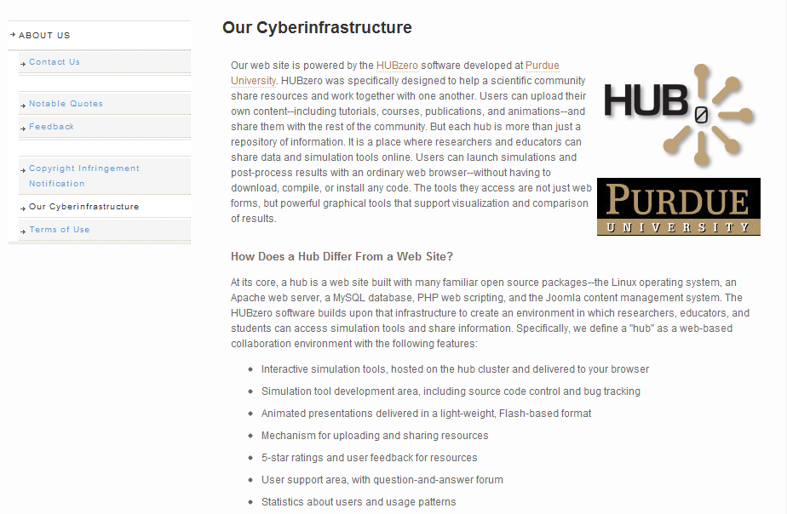
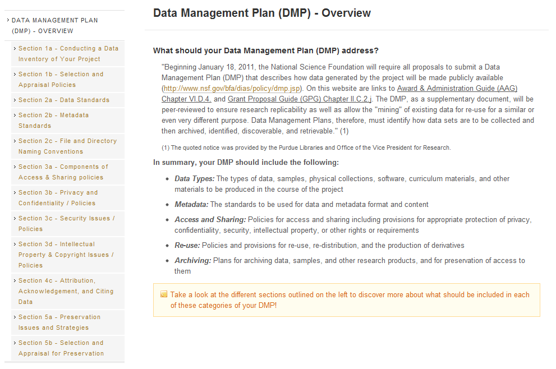
Menus Continued…
On article pages
Content Pages
About Pages
Notes:
You can also use menus on your article pages.
This allows you to group related articles in an easy to create, easy to navigate way.
Two examples are shown in the slide.
NOTE: Don’t delete the default menu (used in new code for routing)

Slide 10
Menus Continued…
Menu vs. menu item
Menu is a related group of menu items
Menu item types
Examples:
Article – points to a specific article
Component – points to a component page
External Link – points to a URL
Etc…
Notes:
Just to keep things clear…
*Give visual demo of menu manger*

Slide 11
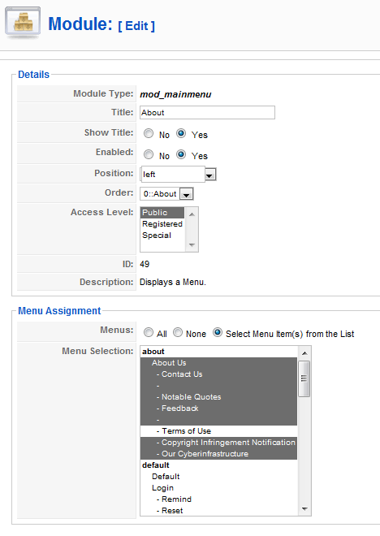
Menus Continued…
Displaying a menu on an article page?
Find/create a “menu” module
Assigning it to article pages
Notes:
So how do you actually create the menu?
Once you’ve added the menu items, you create a “menu” module.
Then, you assign that module to display on all of the article pages that you want to group together with your menu.
The other cool thing about menus is it also helps with navigation/URL
What might be “/test1/test2/test3” (section/category/article) on the backend, can become “/test1” through the use of a menu alias!
*Demo menu alias at work*

Slide 12
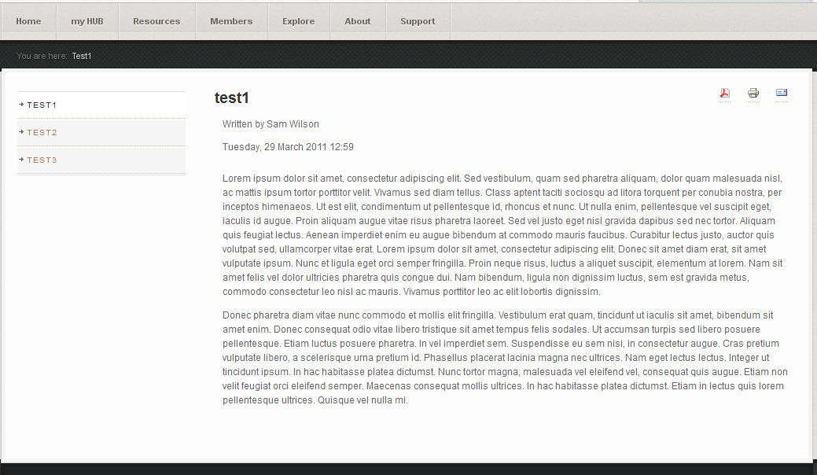
Activity
Create a group of article pages, organized by a menu on the left, as seen below

Slide 13
Activity Continued…
Steps
Create a new section and category
Create two or three test articles and assign them to that newly created section and category
Create a new menu and menu items for those articles
Create a new menu module and position it on those article pages
Notes:
See “Solutions” handout for detailed instructions

Slide 14
Further help?
Existing documentation can be found here:
http://hubzero.org/documentation/1.0.0/managers/articles
http://hubzero.org/documentation/1.0.0/managers/articles.sections
http://hubzero.org/documentation/1.0.0/managers/articles.editing
http://hubzero.org/documentation/1.0.0/managers/articles.urls
http://hubzero.org/documentation/1.0.0/managers/articles.menus

