Slide 1
NCN / nanoHUB.org Overview
Gerhard Klimeck
Director
Network for Computational Nanotechnology (NCN)
Electrical and Computer Engineering
gekco@purdue.edu

Slide 2
How to have impact with research?
Traditional solutions – driven by researchers:
  Publish in peer reviewed journals
  Patents
  Formation of small companies
Mandated by NSF, NIH and others –
driven by agencies:
  Outreach programs – broader Impact
    local schools, web pages,
  Knowledge Transfer Processes
    Typically think: Patents and lawyers
=> here is a different model !

Slide 3
Knowledge Transfer Issues
Customers
Immediate
Peer Researcher
Local
Students
Remote
Students
Other
Researchers
Public
Courses
Textbooks
Knowledge
IP
Publication
Web Content
Problems:
Research confined to small stove pipe
LONG path from research to student knowledge
Web content decoupled from the whole process
=> usually stale
No technology to share
Data and Sim. Tools
No technology to share research seminars easily
No incentives for researchers
Seminar
REALLY
Information
Data
Tools
Instruments
Sim. Tools
Research
Team
Modeling&Simulation
Experiments
Theory
3

Slide 4
nanoHUB approach to Cyber-Enabled KT
Customers
Immediate
Peer Researcher
Local
Students
Remote
Students
Other
Researchers
Public
Courses
Textbooks
Knowledge
IP
Publication
Web Content
Impact:
Use in education
Research recognition
Rapid dissemination
Fresh and timely Web Content
Solutions:
Technology to share
Data and Simulation Tools
Technology to share research seminars easily
Technology to share classes easily
Incentives for researchers
nanoHUB.org
Cyberinfrastructure
Seminar
Information
Data
Tools
Instruments
Sim. Tools
Research
Team
Modeling&Simulation
Experiments
Theory
4
Notes:
4

Slide 5
Science Gateway Essentials
Connection to outstanding science
  Leaders in the field, outstanding content
Commitment to making the gateway useful to a broad community
  Look outward – not inward
  Find people that have content “now” without much funding
  Fund content development – NOT ONLY research
Utterly dependable gateway operation
  Fund the operations and continued development!
Low-cost and rapid content adaptation and deployment to gateway
  Need infrastructure to manage content generation
  Does not come by itself => Fund content development
Publicly available assessment and usage data
  Be committed to showing all your data!
  Critical to the incentive system!

Slide 6





























Investments
NCN@University - Partnerships
NU-CRC
(Collaborative Research in Chemistry)
NU-MRSEC
(Materials Research Center)
Budget:
$3.6M NSF Budget
$1.0M Cost Share
$5.1M Associated Research
process – student registration
measure content contributions.

Slide 7


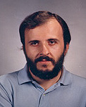


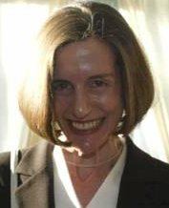
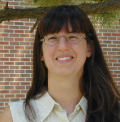

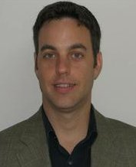


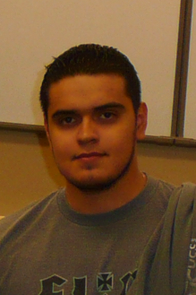

Investments
NCN@University - Site Leads
N. Sobh
U. Ravaioli
B. Tejerina
J. Grossman
J. Neaton
T. Seideman
S Black
B. Haley
A. Strachan
V. Gavrilenko
G. Lush
I. Coronado
J. Cychosz

Slide 8
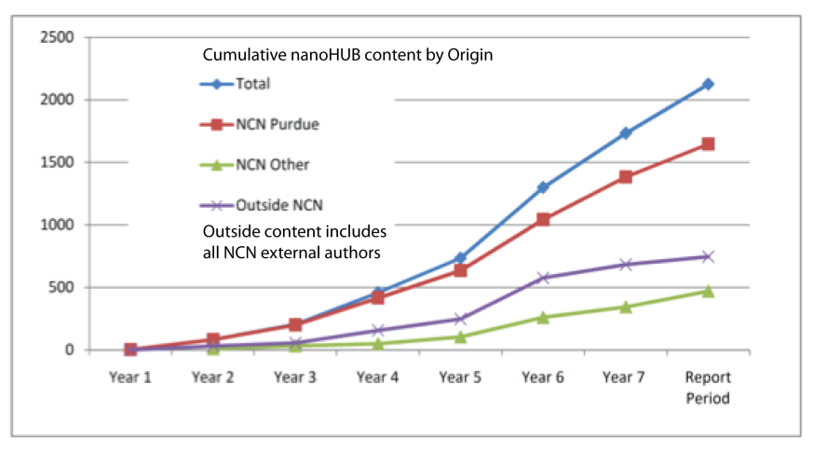
Site Leads Management:
Direct and Indirect Investments
Primary Investments: “harvesting and reseeding” of nanoHUB content
(Venture capital analogy – valley of death)
driven by strategic plans
Research Investments: 1) Simulation Driven Research Initiative
2) Cost-shared students
Associated research appears opportunity driven
Driven by strategic plans
Leaders write proposals with NCN leverage and commitment
=> Symbiosis
N. Sobh
U. Ravaioli
B. Tejerina
J. Grossman
J. Neaton
T. Seideman
NCN Budget:
$3.6M NSF Budget
$1.0M Cost Share
$5.1M Associated Research
S Black
B. Haley
A. Strachan
V. Gavrilenko
G. Lush
I. Coronado
J. Cychosz

Slide 9
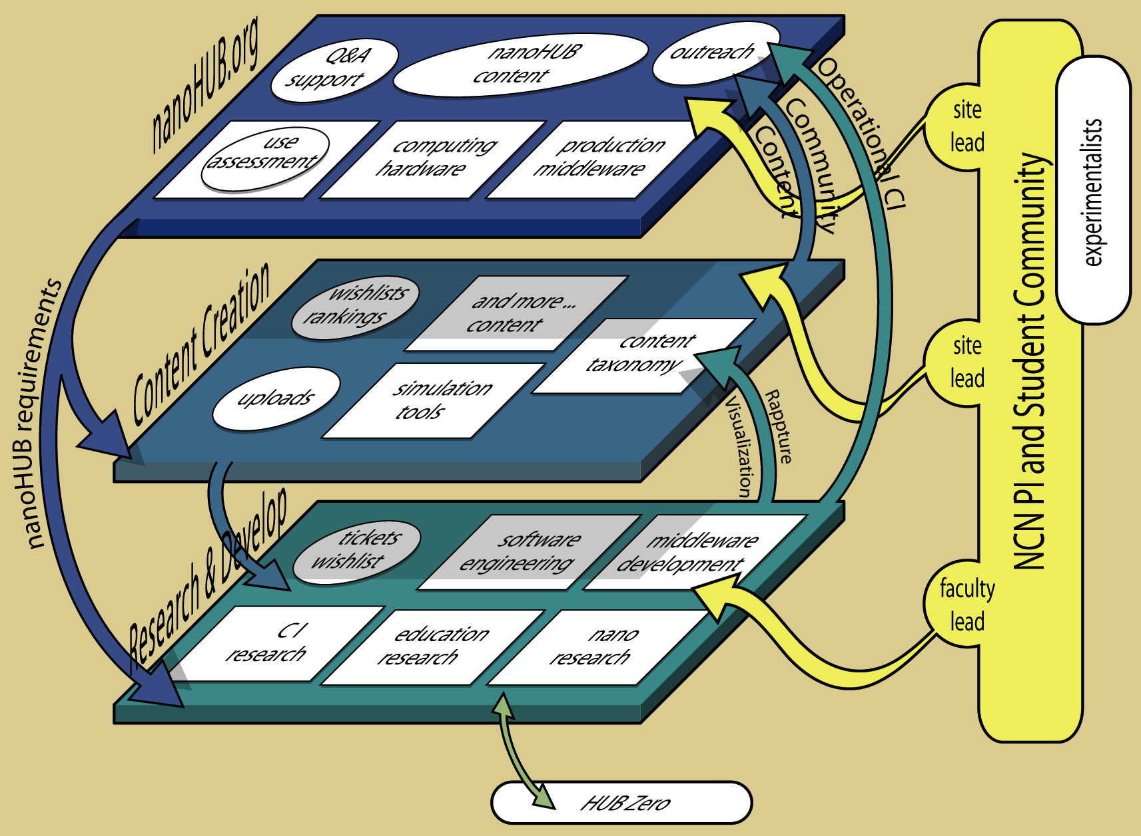
NCN core operations
$200k Ops
$80 Mkt
$750k Ed/out
22%
$1,420k
30%
$400k+$450k
research
18%
$800k HUBzero
17%

Slide 10
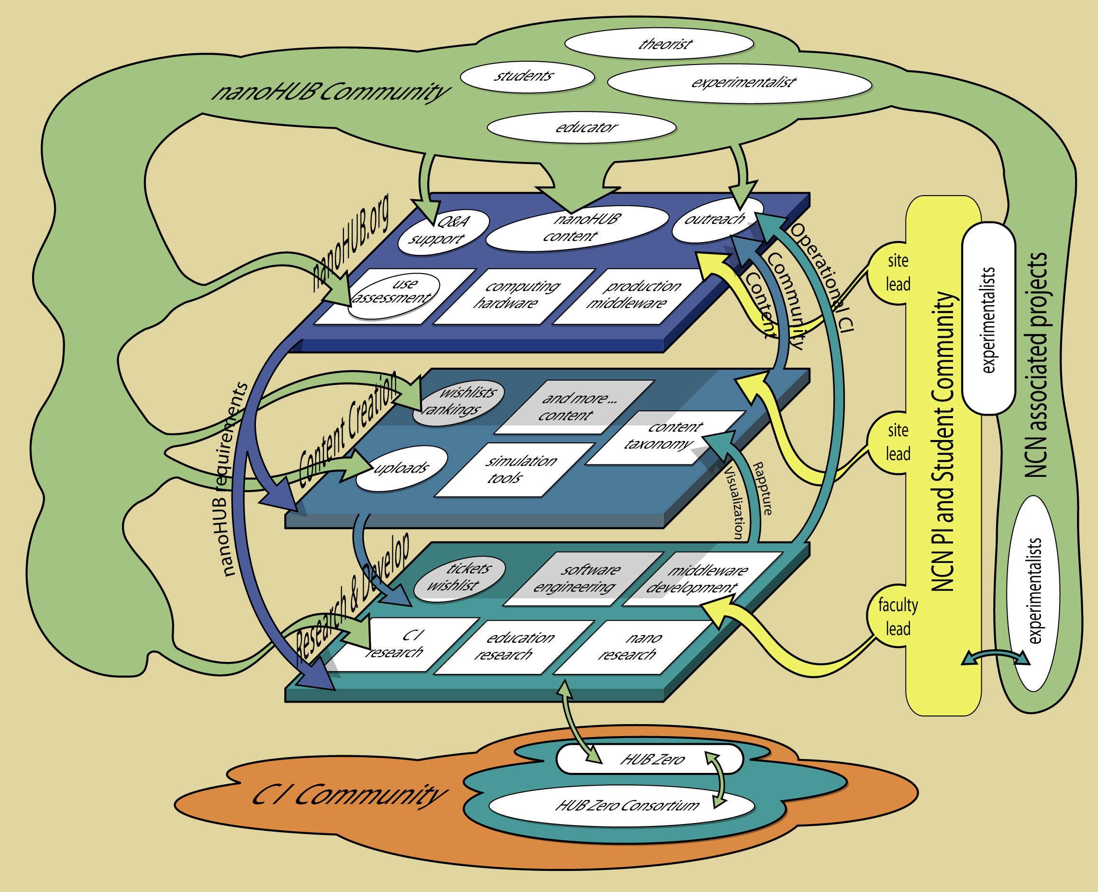
NCN core operations

Slide 11
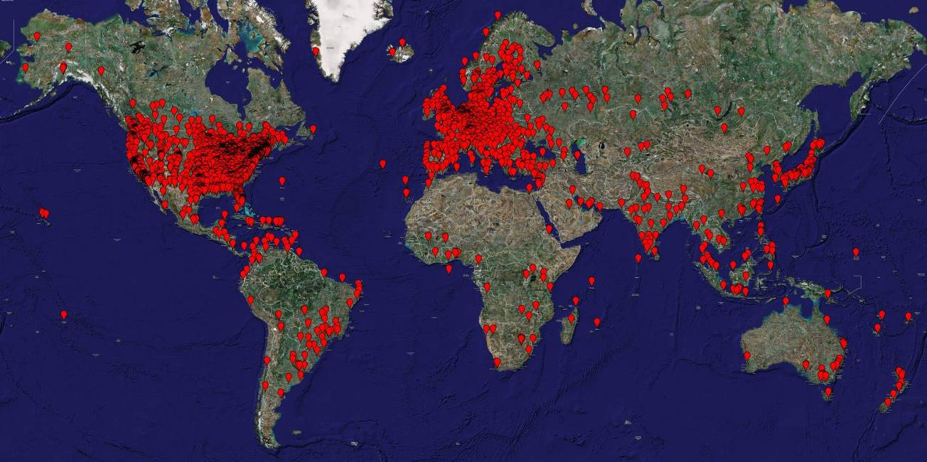
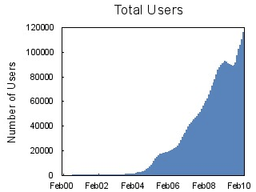
nanoHUB – Cyberinfrastructure of the Future
Serving 110,000 users today
>110,000 unique users last 12 months, 172 Countries
>8,300 users ran >360,000 simulations
Users at all Top 50 Engineering Schools
17% of all .edu institutions in the U.S.
>116 classes at >90 institutions in 2009
575 citations in the literature
System uptime > 99.7% (<20 hours downtime)
nanoHUB.org has as much traffic at www.purdue.edu
11
11

Slide 12

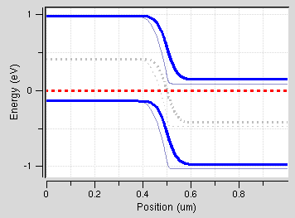
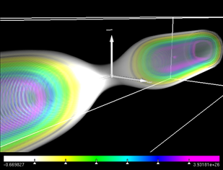
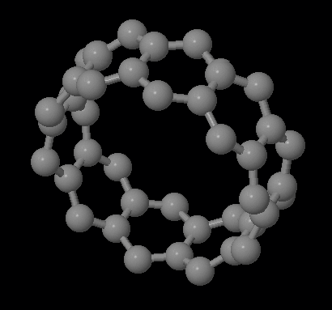
Student/
Faculty/
Developer
Friendly!
Free Account
Integrated
Visualization
No
Installation!

Slide 13
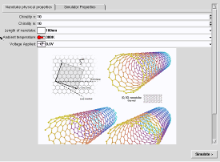
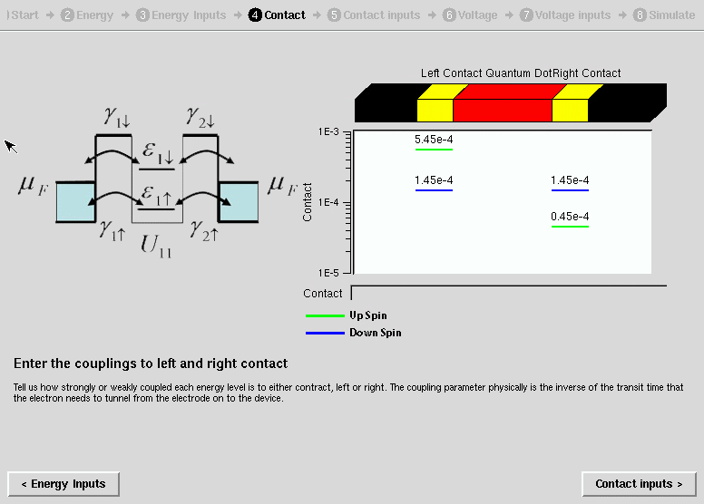
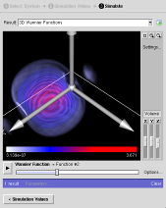

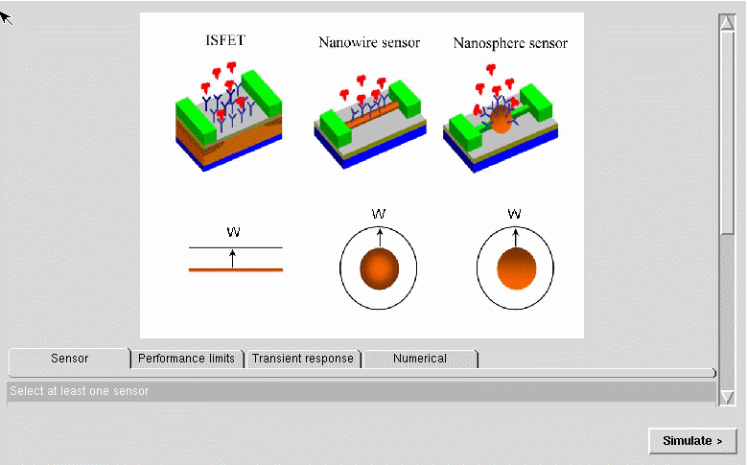
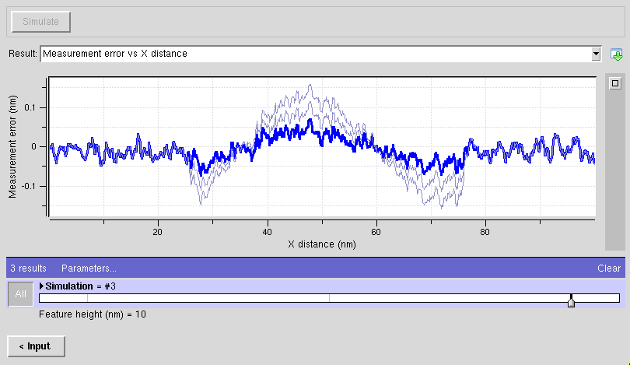
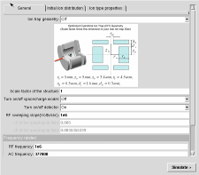
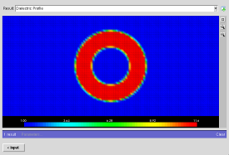
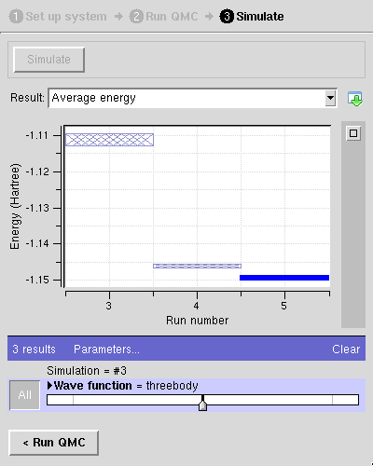
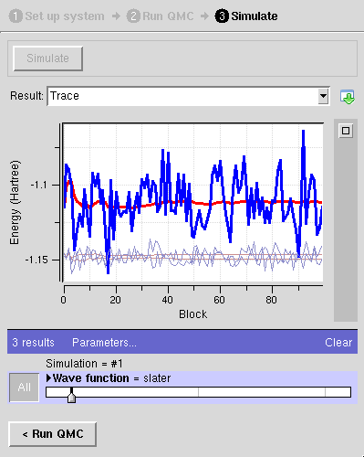
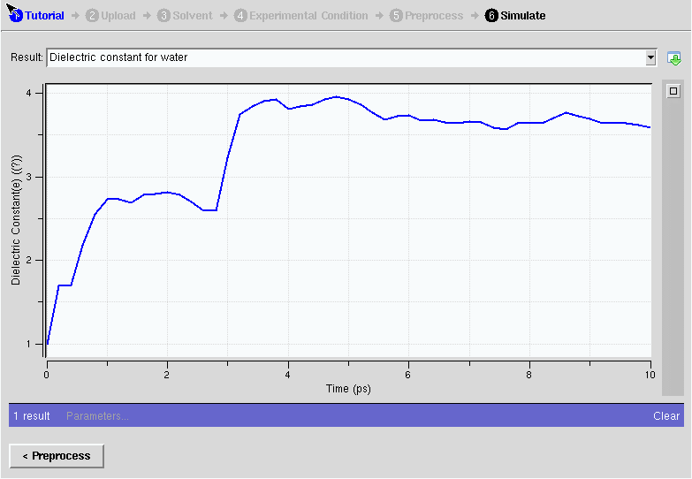
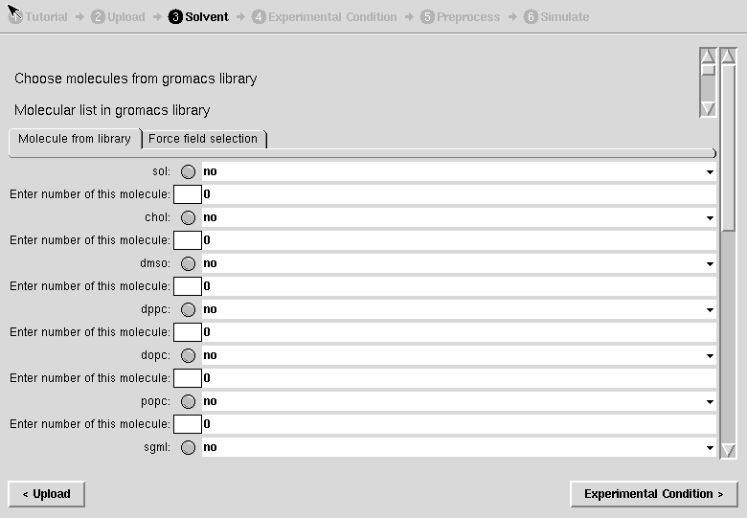
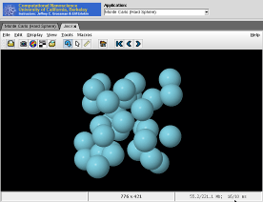
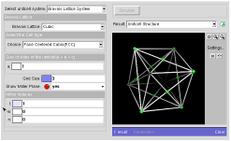
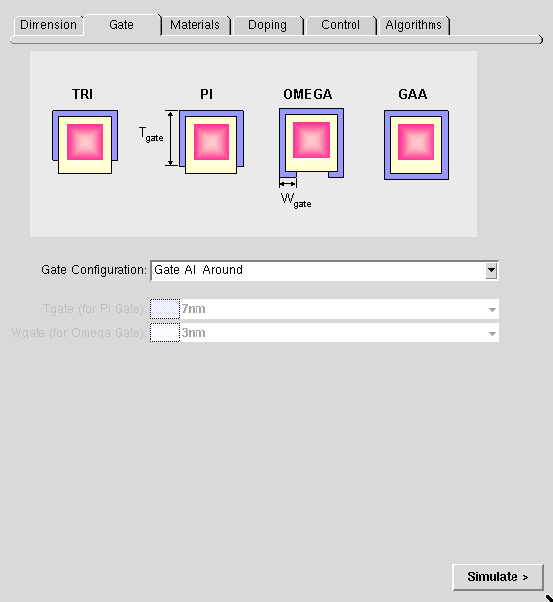
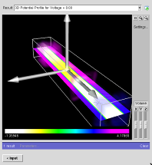
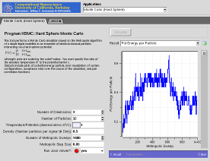
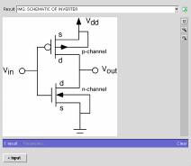
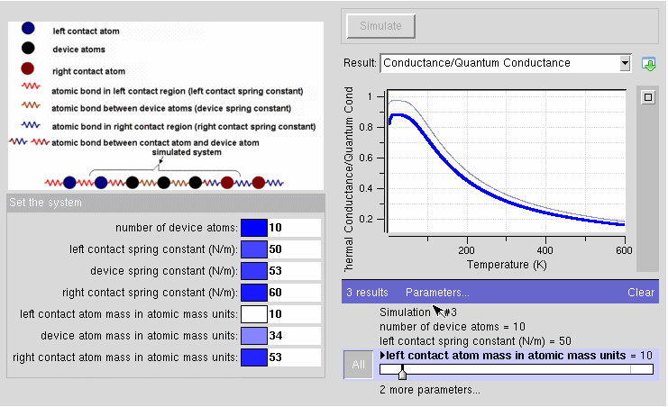
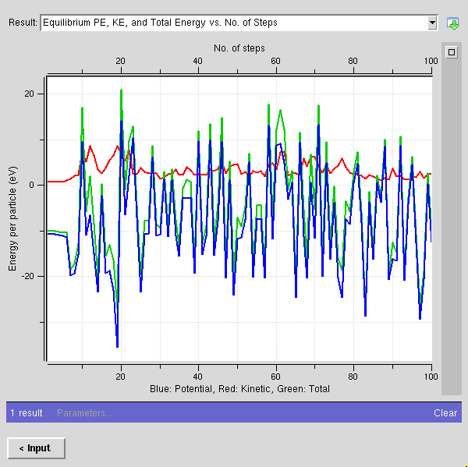
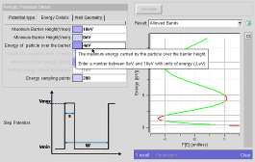
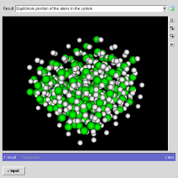
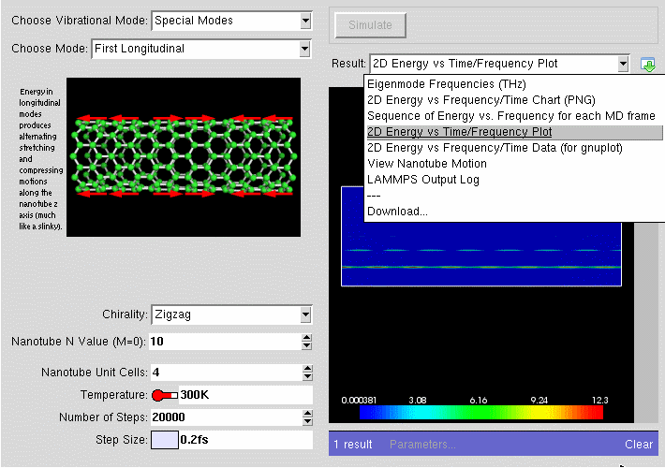
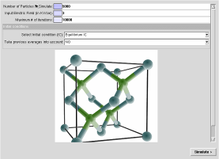
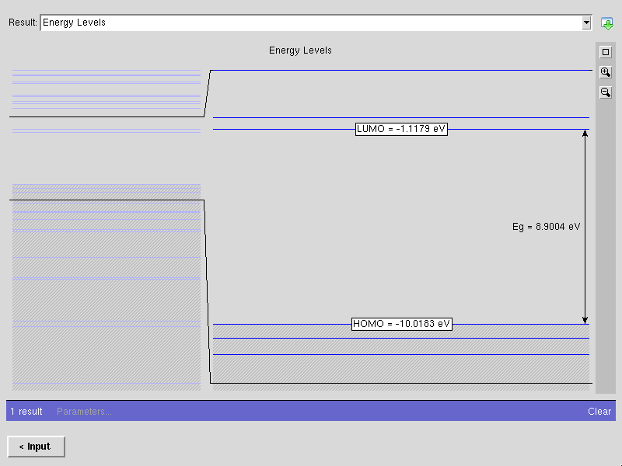
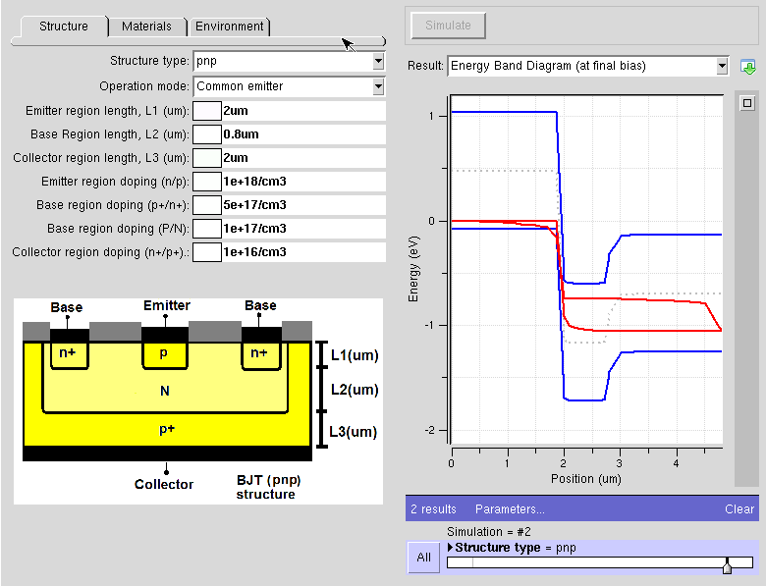
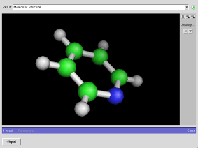
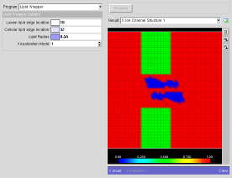
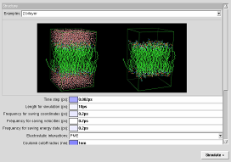
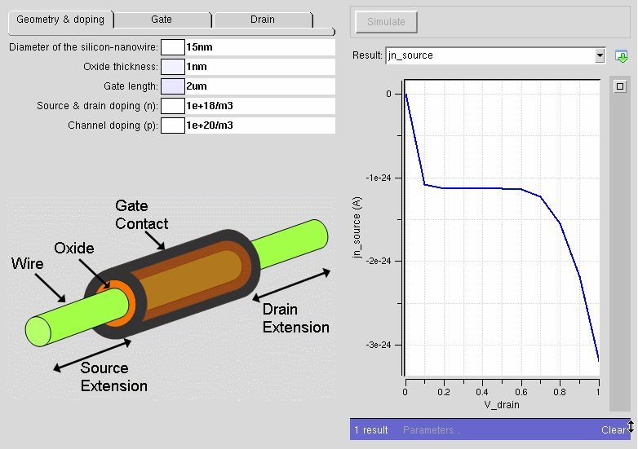
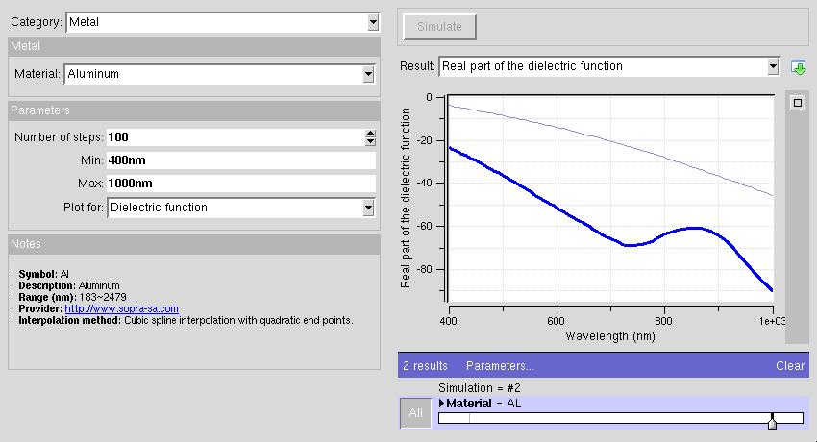
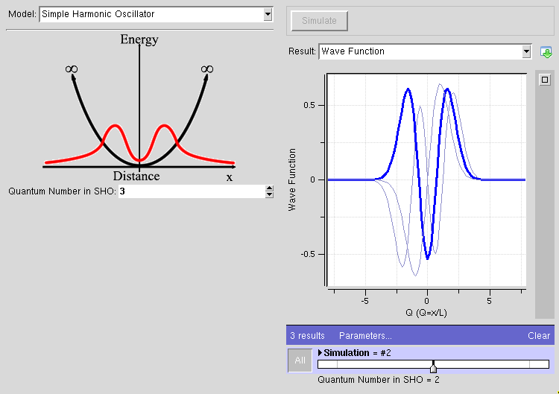
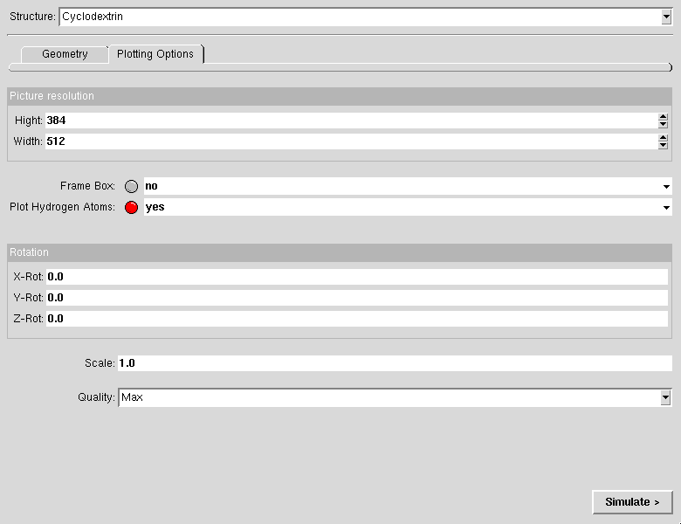
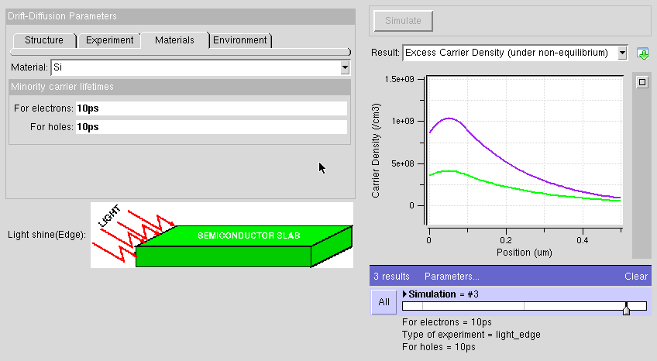
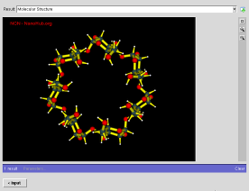
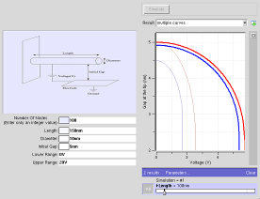
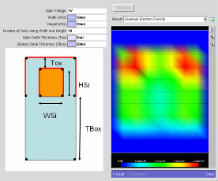
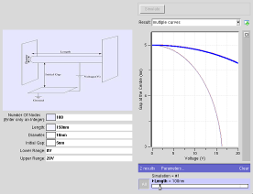




Over 160 tools online!
and >50 in preparation at nanoFORGE.org
13

Slide 14






Typical Web-based Simulations
Started at Purdue 1995 with PUNCH:
  Enabled researchers and students to access real simulation codes
  traditionally 800 users annually.
Typical usability is marginal
Codes are typically out-of-synch with web version
The OLD static GUI
Form sheet input
Batch submission
Output in some file
Visualize a gif image
Other output file
Visualize gif image
Typical Questions:
What was my input?
Did I enter things right?
Symptoms of:
No VISUAL feedback.
Not interactive.

Slide 15


Dual Use in Research and Education
Rappture version Feb 06
TCAD simulations using SCHRED [15] or ISE, …., were used to support our analysis and compute the inversion carrier profiles in the devices.
371 Users
Last 12 months
Effect of channel positioning on the 1∕ f noise in silicon-on-insulator metal-oxide-semiconductor
M von Haartman, M Oestling,
Journal of Applied Physics, 2007 - link.aip.org...
Same behavior across all similar converted tools
User’s don’t have to download/install software

Slide 16


nanoHUB Use in Research
16

Slide 17
NCN - an Infrastructure and Research Network nanoHUB Use in Research
17
17

Slide 18

NCN - an Infrastructure and Research Network nanoHUB Use by Experimentalists
18
18

Slide 19

NCN - an Infrastructure and Research Network
Citations for Tool Authors!
An incentive for
tool authors
19
19

Slide 20


Tool Usage is like reading papers!
Building an incentive system
20

Slide 21
nanoHUB – Cyberinfrastructure of the Future
Serving >110,000 users today
>110,000 unique users last 12 months, 172 Countries
>8,300 users ran >360,000 simulations
Users at all Top 50 Engineering Schools
17% of all .edu institutions in the U.S.
>116 classes at >90 institutions in 2009
575 citations in the literature
System uptime > 99.7% (<20 hours downtime)
nanoHUB.org has as much traffic at www.purdue.edu
21
21

Slide 22



nanoHUB – Cyberinfrastructure of the Future
Serving >110,000 users today
>110,000 unique users last 12 months, 172 Countries
>8,300 users ran >360,000 simulations
Users at all Top 50 Engineering Schools
17% of all .edu institutions in the U.S.
>116 classes at >90 institutions in 2009
575 citations in the literature
System uptime > 99.7% (<20 hours downtime)
nanoHUB.org has as much traffic at www.purdue.edu
22
22

Slide 23
Science Gateway Essentials
Connection to outstanding science
  Leaders in the field, outstanding content
Commitment to making the gateway useful to a broad community
  Look outward – not inward
  Find people that have content “now” without much funding
  Fund content development – NOT ONLY research
Utterly dependable gateway operation
  Fund the operations and continued development!
Low-cost and rapid content adaptation and deployment to gateway
  Need infrastructure to manage content generation
  Does not come by itself => Fund content development
Publicly available assessment and usage data
  Be committed to showing all your data!
  Critical to the incentive system!

