Slide 1
Technology Stewardship: Listening, Interacting and Leading
LEARNING ALLIANCES
JOHN DAVID SMITH
Coaching communities, their leaders and their sponsors
about technologies, politics and learning
Notes:
Hub Zero audience profile
Geeky: individually supporting a platform & collectively launching an open-source collaboration platform
Science background: science communities, many hosted in universities
Demographic, median age: 35, 70% males
Intro: John Smith has been a community leader and technology steward for many years. He also writes, speaks, and teaches about the intersection of technology, community and learning. His recent book, Digital Habitats with Etienne Wenger and Nancy White introduces the concept of technology stewardship, which is the topic of his talk today.

Slide 2
Help or coach?
Configure?
Select?

Slide 3
Technology Stewardship defined
Daily support
Community Experience
Technology Experience
Configure
Select
Increasing the learning capability of a community…
Notes:
Beyond tech support for one tool
Techne-mentor idea in Mimi Ito’s Hanging Out, Messing Around, and Geeking Out: Kids Living and Learning With New Media
Many people saying, “Oh, I’m a technology steward!”

Slide 4
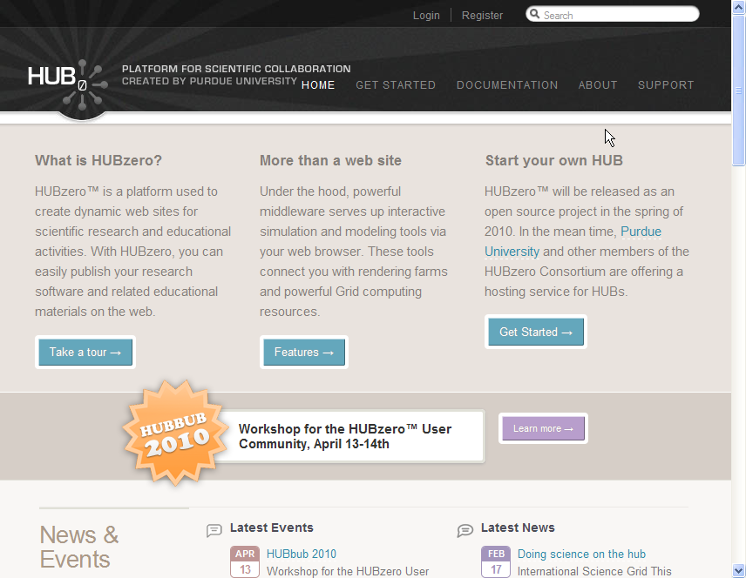
HubZero

Slide 5
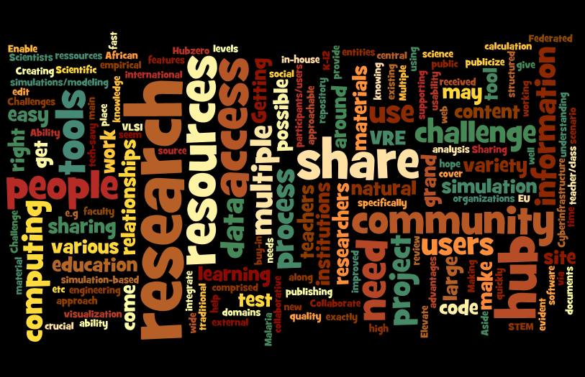
Your grand challenge

Slide 6
Tech STEWARDSHIP
LISTENING
LEADERSHIP
Notes:
My goals:
Talk about what I think technology steward does and how that might map to your work
A listening strategy to shape your work as technology steward
an argument that supporting an increase in learning capability of a community (including the Hub community) is a kind of leadership

Slide 7
An example of stewardship
Example:
Technology stewardship at an annual meeting of non-profit leaders

Slide 8
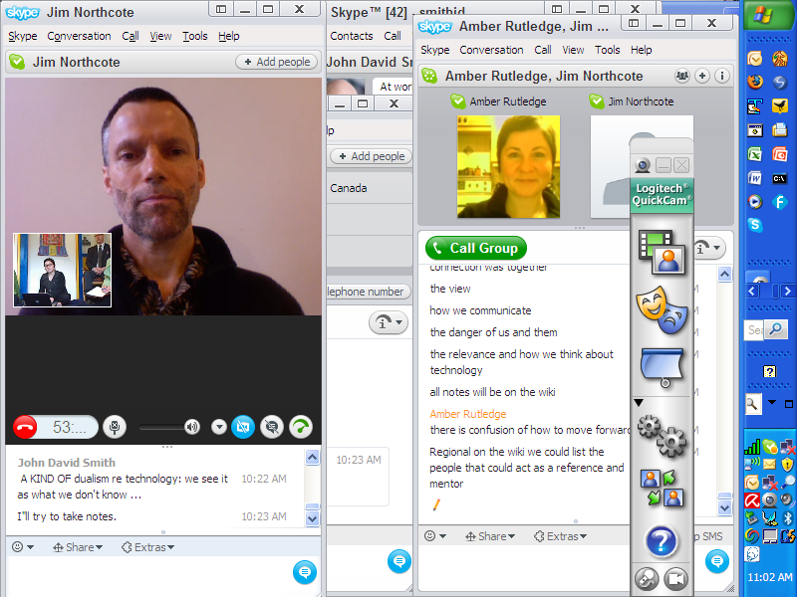
Notes:
Story: This screen-shot captures a moment at a recent face-to-face conference that I organized for a regional association of educational non-profits. It’s had an annual meeting for several years. I went to some length to include the guy on the left from Nelson BC for one of the sessions because of what he could bring to the meeting. Someone to the left from where I was sitting was pointing videocam at whoever was speaking at the moment (see the little picture of what the guy in Nelson was seeing). Three of us who were in the room took notes in the Skype chat on the right side of the screen. After the session I used the Skype time stamps to merge two chats to produce notes for the session.
We’ll come back to this as an example of trying to do several things to a mostly face-to-face meeting at once:
Trying to bring a remote member of the group into the conversation because I thought his views were important for everyone to hear. Conversely, it was important for him to hear what was being said in our meeting. We could hear him clearly when he spoke and he could hear us pretty well most of the time.
We were making the meeting more self-documenting by taking notes together in a Skype chat. The chat format automatically interleaved our note-taking, letting us take turns and letting us see when nobody was writing down what was being said.
I was also getting everyone to share meeting notes and hand-outs on a wiki, which is behind the scenes in this screen-shot.
I had introduced and practiced this style of note-taking in one-to-one sessions with they guy from Nelson and 2 other key partners in the session so it was only one more step of integration to do it all at once.
Adoption of the idea that verbal report-backs are for the overview, but all the extra detail goes on the wiki seemed easy for people to understand. There were many spontaneous references to using the wiki and to the distinction between the summary and the detail
Presence of mind to capture a screen-shot

Slide 9
Technology stewardship in practice

Slide 10
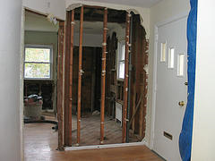
Chief change agent facet
Community launch
Tool choice, acquisition, introduction, replacement and integration
Continual software maintenance

Slide 11
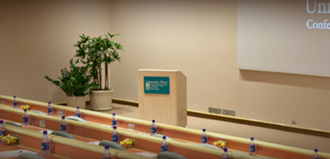
Chief ethnographer facet
Understanding community culture
Patterns of participation and interaction
Outsider and insider perspectives
Tool use conventions, neglect, and mix
Appetite for change
Memory practices
Seeing the ordinary as strange
Notes:
Story: Taking notes at the NW NP conference.

Slide 12
Chief bottle washer facet
Daily life
Do myriad technology chores
Support events, new people, tool integration
Spread good practice
Support skunk-works
Mentoring other tech stewards
Importance of being involved

Slide 13
Key concept: Focus on your community’s digital habitat

Slide 14
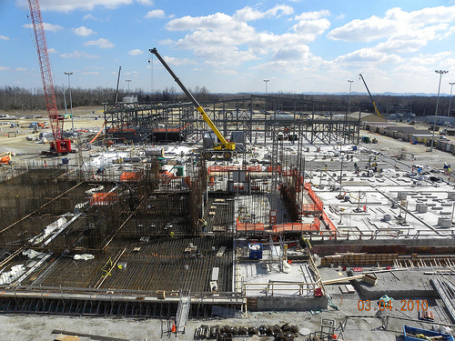
Your community’s digital habitat
Includes many platforms
Is more than the “official” habitat
Is the totality of tools and how they’re used
Is invisible without
using the tools as vantage point
being aware of what a tool might hide
Won’t stop evolving
as your community evolves
as technology resources evolve
Notes:
We use the term “configuration” in the book.

Slide 15
Key concept: technical AND social skills– to increase learning capabilities

Slide 16
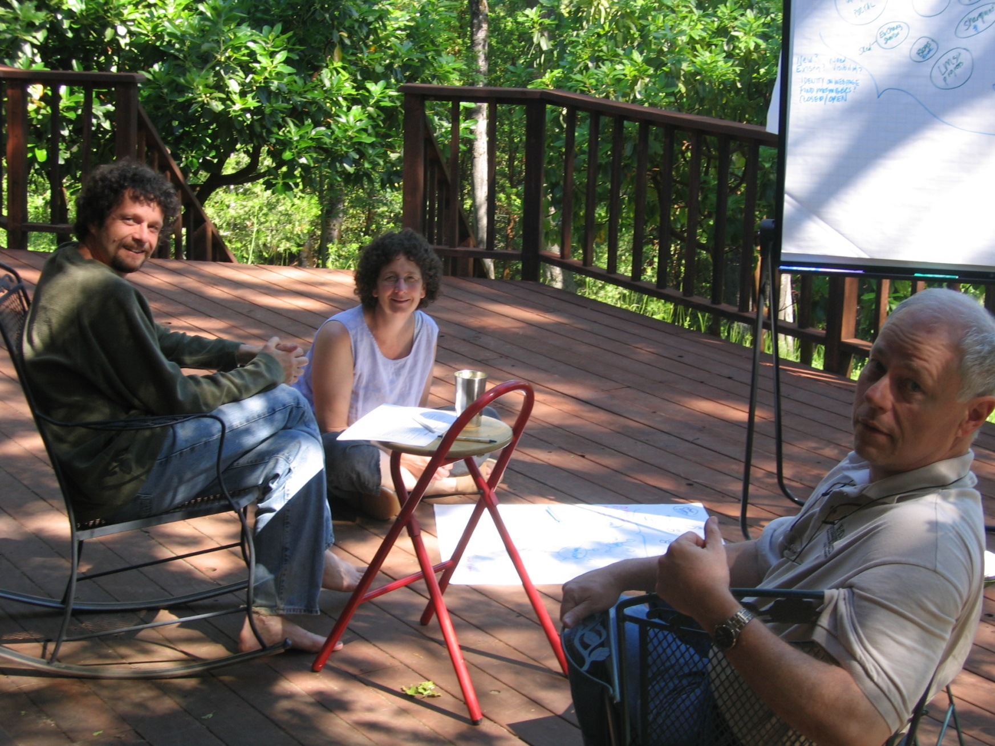
context
Learn at work
“Update” a report?
Practice working and writing at a distance – for 5+ years
Notes:
The three of us met to work on the book face-to-face only 2 times. Rest our collaboration was all at a distance. A lot of Skype sessions. We could write a book on all of the different tactics we used to work together.

Slide 17
The logic
Change and variance of
Technologies
Communities
Interactions of the two
Observing our own communities and practices
Notes:
Started out just “updating the tech report”
What would be useful and not out-of-date immediately?
Existing conversations seemed to be about separate topics
Tools
Facilitation
KM
Leadership

Slide 18
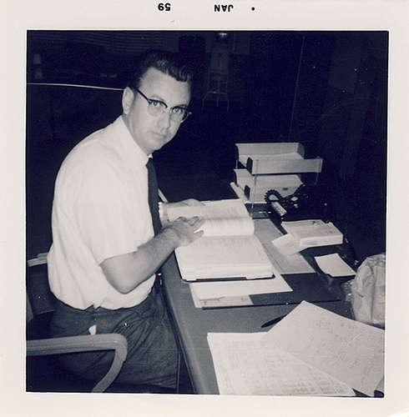
In practice
Done collectively?
Part time?
Insider vs. outsider?
Your background
Technology?
Facilitation?
Science?
Others?
Notes:
Story: when friends started reading early drafts of the book and would say, “Oh, that’s me! I’ve been doing that all along, I just didn’t have a name for it!” we knew we were on to something. Naming it makes a difference.
Find the tech stewarding work:
Who’s involved & how?
What are they doing and how do they do it?
Go beyond single tool or technology
Needed:
Social SONAR
Technology SONAR

Slide 19
Key concept: Learn by doing – as we go

Slide 20
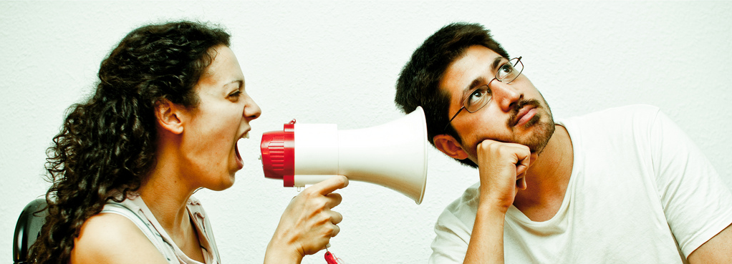
How do we learn?
Listening
It’s not as easy as it sounds…

Slide 21
for what?
Community – Who’s present? Influential? New? Absent?
Domain – The main topic? The group identity? Known puzzles?
Practice – Legitimate practice? What’s proof? How do people gather?
COMMUNITY
DOMAIN
PRACTICE
Learning capability
Applies to individual hubs and Hubzero?
Notes:
All of these are:
Emergent, change over time
Interact with each other in profound ways
Are shaped by technology
every tool gives access to some, leaves others out
technology affects a community’s practice in the field and in the way it can be together
technology affects domain indirectly through practice and through community
All three elements are seen through the technologies at your disposal

Slide 22
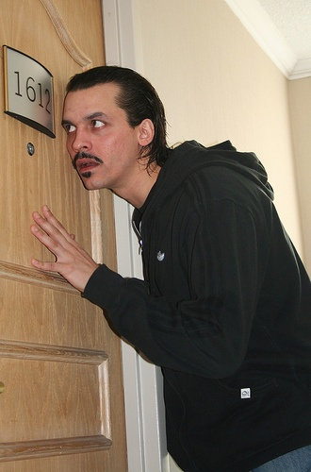
where?
Where are the listening posts?
Email lists, forums and chats
Web analytics
Twitter hashtags
Google alerts
Coffee — real or virtual
Notes:
Jac2, and other genetic markers as listening posts. member’s name.
What are some unique listening posts that matter in your communities?

Slide 23
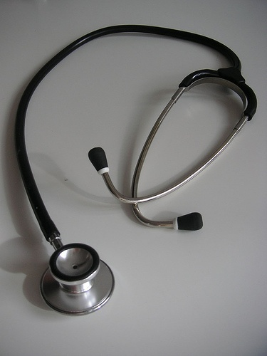
How well?
Listening and its absence
Been listened to?
Asked the right questions?
Evidence of listening
Getting the meaning of it
Note taking for later
Notes:
Listening is an emergent and situated activity. Your mother taught you how to do it. Your job as tech steward will challenge you to do it better.
What if I hadn’t noticed the conversations over on the other CPsquare platform?

Slide 24
Community needs with technology implications

Slide 25
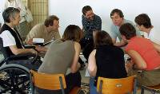
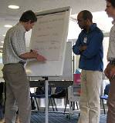
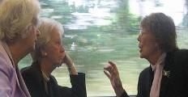
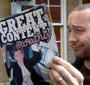
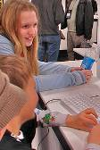
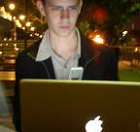
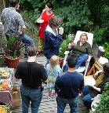
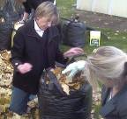
L
Listening for orientations…
… meetings
… open-ended conversation
… projects
… content publishing
Community activities oriented to …
… access to
expertise
… individual
participation
… relationships
… community
cultivation
… context
Digital Habitats, Chapter 6
© 2009 Wenger, White, and Smith
Notes:
25
The CPD model focuses on what communities have in common. This model focuses on different styles. Began by looking at clusters of tools, ended up realizing that these are styles with technology and other implications.

Slide 26
L
NW NP Leadership group
… meetings
… open-ended conversation
… projects
… content publishing
Community activities oriented to …
… access to
expertise
… individual
participation
… relationships
… community
cultivation
… context
Digital Habitats, Chapter 6
© 2009 Wenger, White, and Smith
Notes:
26
Meetings and access to expertise were important in the early days of CPsquare. But open-ended conversation forced the move to Web Crossing.
Are the models you can run on one of your hubs a publication? A project? Access to expertise?

Slide 27
L
HUBzero orientations?
… meetings
… open-ended conversation
… projects
… content publishing
Community activities oriented to …
… access to
expertise
… individual
participation
… relationships
… community
cultivation
… context
Digital Habitats, Chapter 6
© 2009 Wenger, White, and Smith
Notes:
27
Meetings and access to expertise were important in the early days of CPsquare. But open-ended conversation forced the move to Web Crossing.
Are the models you can run on one of your hubs a publication? A project? Access to expertise?

Slide 28
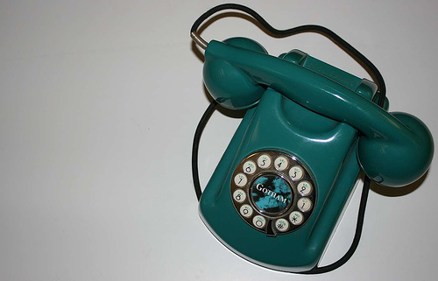
Polarities – mapping the habitat
Synchronous Asynchronous
Phone
Participation Reification
Phone
Individual Group
Phone
Notes:
Polarities as a way to describe the social affordances of a tool. They are also useful for describing the social needs of a community that a tool might meet. They can be used as a frame to make adjustments in both technology and practice.

Slide 29
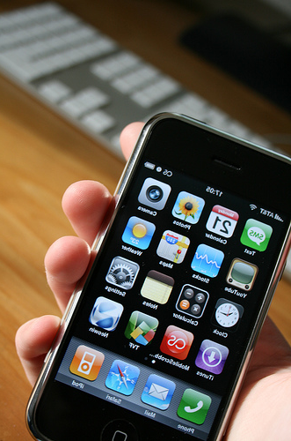
Polarities – mapping the habitat
Synchronous Asynchronous
Phone
Voice-mail
Participation Reification
Phone
Recordings
Individual Group
Phone
Phone Bridge
Notes:
Polarities as a way to describe the social affordances of a tool. They are also useful for describing the social needs of a community that a tool might meet. They can be used as a frame to make adjustments in both technology and practice.

Slide 30
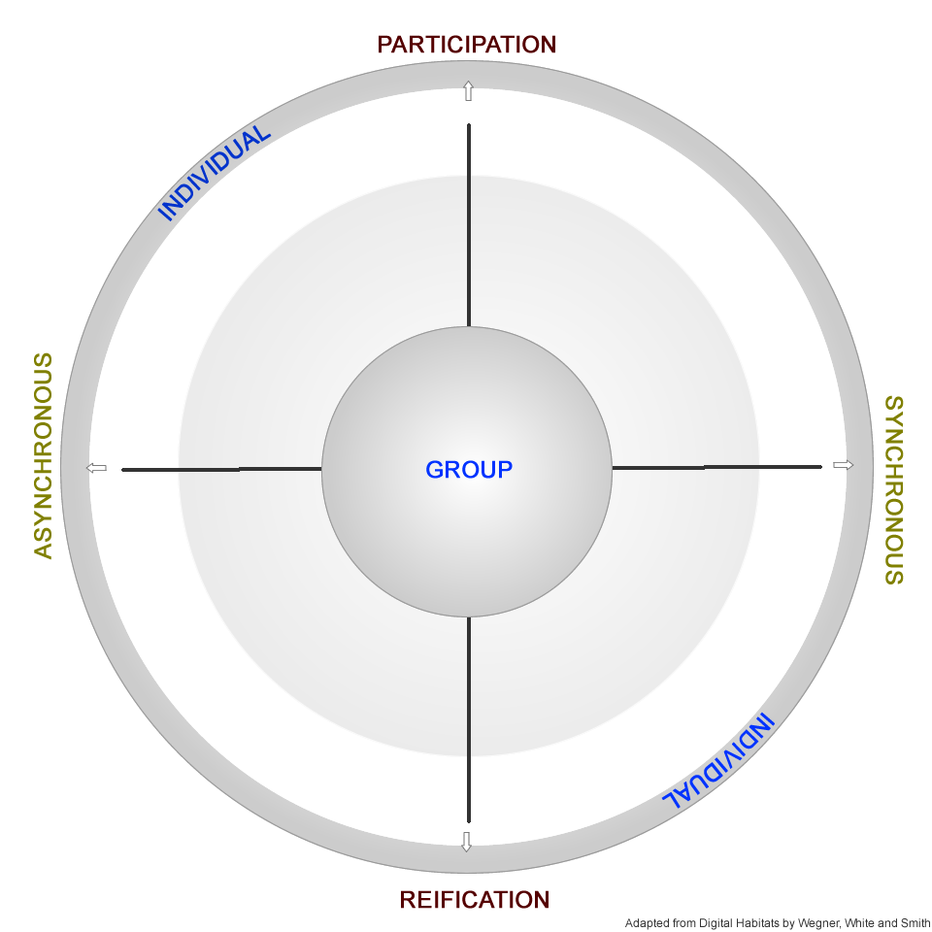
TECHNOLOGY LANDSCAPE
Skype example
Polarities in 3 dimensions
Tool vs. platform
Tool affordance vs. social use
video
Skype?
phone
chats
transcripts
alerts
Tech landscape, Chapter 4, p 60
Notes:
Have you ever noticed that to answer an incoming video or audio call on Skype when you’re already on a call means you have to put the first call on hold? Chat is different: you can have two or three simultaneous chats going on at the same time and just bounce between them. Skype video and audio calls are different from each other, too, because video is one-to-one, but you can conference up to 9 people who are on Skype or on a regular phone.
Exploiting the underlying geometry of tools like Skype is what technology stewards do to support people being and learning together. I’m going to use Skype as an example several times in this talk to bring out some of the issues that we face as technology stewards.
An essential part of my digital habitat
Many tools
A community platform
Why not the hub platform?
I would be superficial
Making the ordinary strange and the strange ordinary…
Why Skype?
Skype has become more & more of a community platform
Skype becomes part of the habitat of John’s communities
Mini-tour of a community tool: Skype as a platform for community
Integration, feature/tool/platform/configuration model
Polarities
Perpetual chat
Polarities Rhythm: one calls for the other, balancing.
Mini-tour of a community tool: Skype as a platform for community
Integration, feature/tool/platform/configuration model
Polarities
What is tool integration from a community’s perspective?
Your community’s configuration as the domain
The most leaky part of a community: phone, IM
Skype was the place we do not speak of on our other platforms
Skype has become more & more of a community platform
Skype becomes part of the habitat of John’s communities
listening post, integrated into other habitats
o drill down:
o phone / conference call hijincks
wasting minutes

Slide 31
Recognizing & supporting tech stewardship work

Slide 32
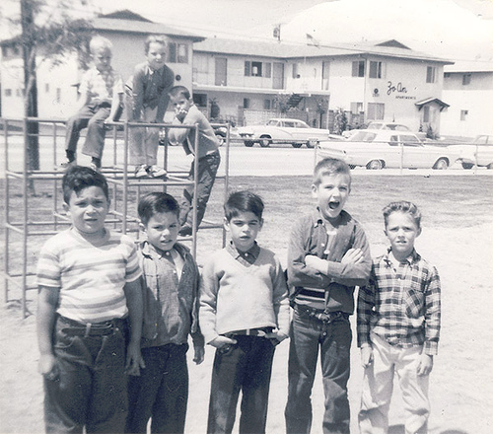
Tech stewardship is needed
“Community-sized” challenges:
Technical
Social
Interactions
Many hubs and an emerging tech steward community
Why call it leadership?
Notes:
Back and forth between your learning and the community’s learning

Slide 33
By identifying technologies that serve community needs we enhance learning capabilities

Slide 34
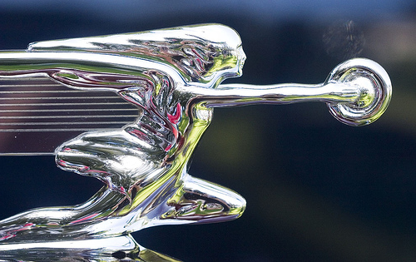
A Learning agenda
Guiding platform evolution
Hub platform races digital habitat
Leveraging positive deviance
A hub: a community service or a community of practice?
Notes:
Interaction within the Hubbub community as leadership

Slide 35
A Learning agenda
Coordinating levels of stewardship
Morphing a project into a community
Limits of “eating own dog food”
Understanding stewardship
Notes:
Interaction within the Hubbub community as leadership

Slide 36
Key concept: your learning agenda matters

Slide 37
CONCLUSION
Tech STEWARDSHIP: serving community inquiry
LISTENING:
understanding what’s working
LEADERSHIP:
further enabling learning capabilities
Notes:
My goals:
Talk about what I think technology steward does and how that maps to your job
Strategies for defining the scope and focus as it emerges
A listening strategy to shape your work as technology steward
A vocabulary for learning from and with other tech stewards in your community

Slide 38
Our conversation continues
Today’s talk, coffee, lunch
Upcoming HUB clinics
TechnologyForCommunities.com
CPsquare.org/wiki
Twibes, etc.
Tech steward communities of practice

Slide 39
Take notes!
Save screen-shots!
COMPARE!

Slide 40
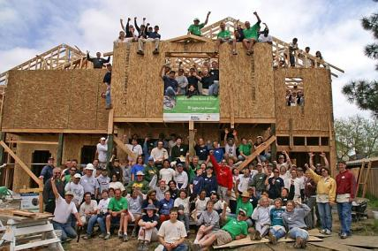
PHOTO CREDITS
http://www.flickr.com/photos/32099449@N00/424284363 doing dishes
http://www.flickr.com/photos/tranchis/3708549622/ bullhorn love
http://www.flickr.com/photos/slworking/539250589/sizes/o/in/photostream/ Kitchen renovation
http://www.flickr.com/photos/8490322@N08/1510205578 Refrigerator contents
http://www.flickr.com/photos/chaimzvi/12380818/sizes/l/ renovation remodel
http://www.flickr.com/photos/8462762@N07/2314400543 listener
http://www.flickr.com/photos/39388148@N04/4443414548 chemical plant
http://www.flickr.com/photos/stephenliveshere/425100210/ green phone
http://www.flickr.com/photos/williamhook/2431704208/ iPhone
http://www.flickr.com/photos/49767059@N00/290427121 stethoscope
http://www.flickr.com/photos/82312837@N00/1133303891 bw 50’s worker
http://www.flickr.com/photos/thomashawk/200447754/sizes/m/ car hood ornament
http://www.flickr.com/photos/82312837@N00/2183919173 boys on playground

Slide 41
LEARNING ALLIANCES
John David Smith
503. 963. 8229
John.Smith@LearningAlliances.net
http://LearningAlliances.net
Skype and Twitter: smithjd

Slide 42
Questions? Comments?

