Slide 1


RWater –A HUBZero Tool for K-12 Hydrology Education
Adnan Rajib
PhD Student
Venkatesh Merwade
Associate Professor
Lyles School of Civil Engineering, Purdue University
HUBbub 2014, Indianapolis

Slide 2


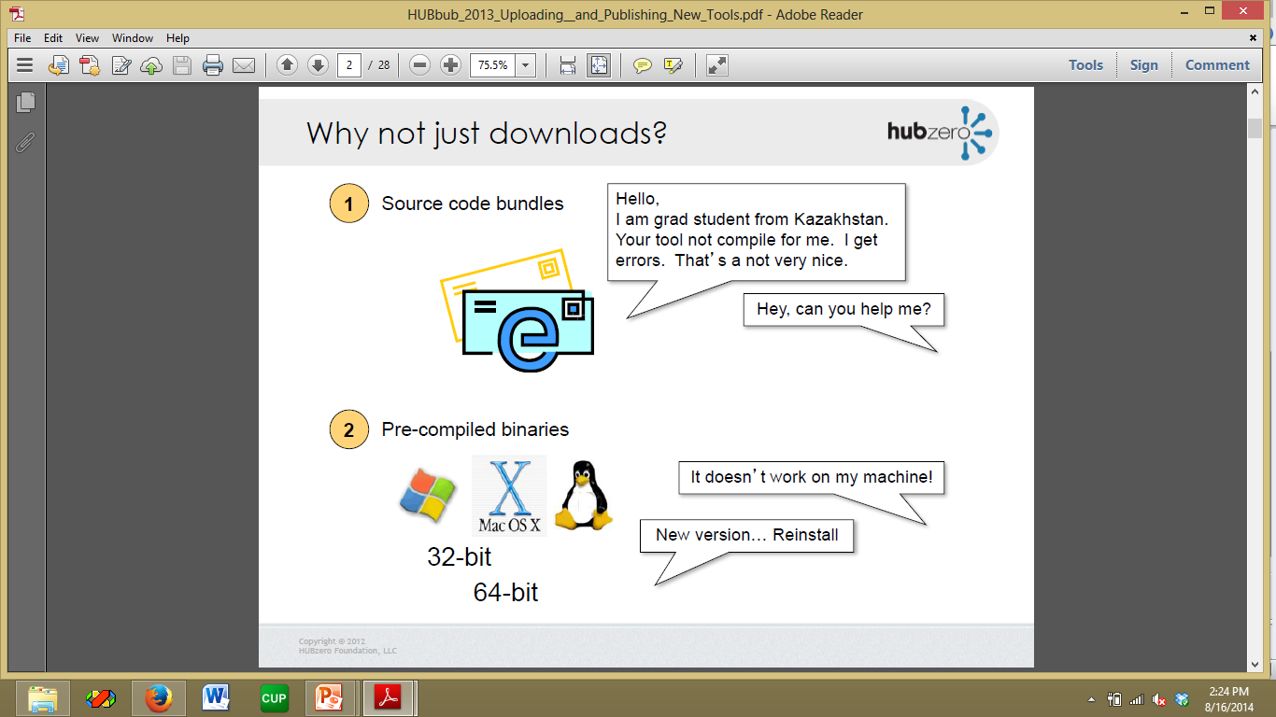
Motivation
How can we enhance students’ ability to analyze the
‘cause-and-effect’ relations in hydrologic processes?
Relating classroom concepts with real observations
Interpreting real-time events from real locations
Data extraction
Not emphasizing on data post-processing
Visualization
Not concentrating on how to create a plot
Interpretation
Focus on the science part
User-friendly tool-kit
Platform independent
Scalable

Slide 3
RWater:
Design for Classroom Teaching
It pulls streamflow data directly from the USGS website
  Only required information: time period and location ID
  Does not require any data post-processing
Following the data-driven modules, students can write/modify R scripts to create visualizations
Those visualizations allow users to understand the cause and effect relationships in hydrology
  Making it interesting and practical
Total 7 learning modules
  Contain both hypothetical and real-time examples
  Each module has a short quiz to evaluate students’ learning

Slide 4
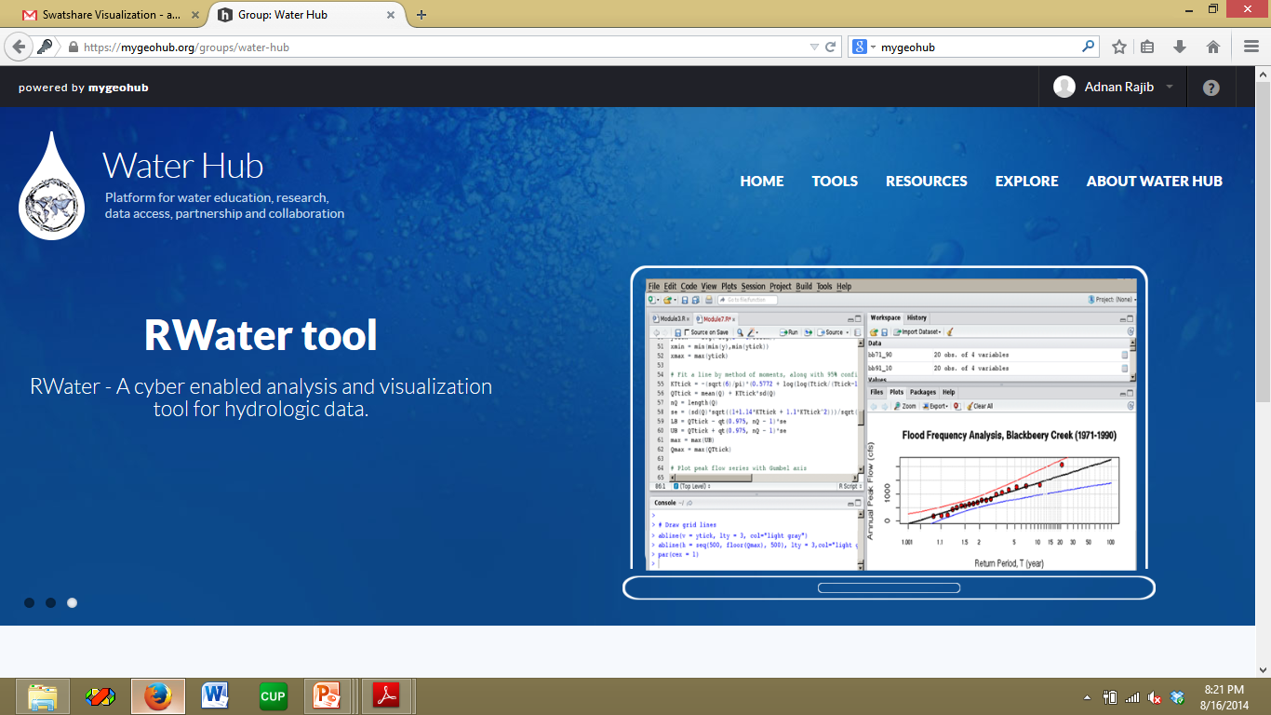
Introducing RWater
https://mygeohub.org/tools/rwater
Runs in a self contained environment on Purdue’s cyber-infrastructure (WaterHUB)
  Does not require any installation any software
  Does not store anything on user’s computer
  All you need is a Java compatible browser

Slide 5
RWater Interface
https://mygeohub.org/tools/rwater
Notes:
Flood Frequency Analysis

Slide 6
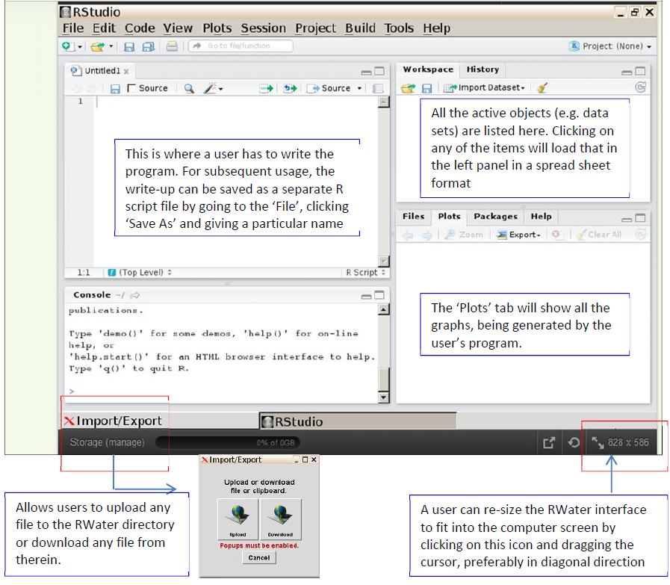

Slide 7
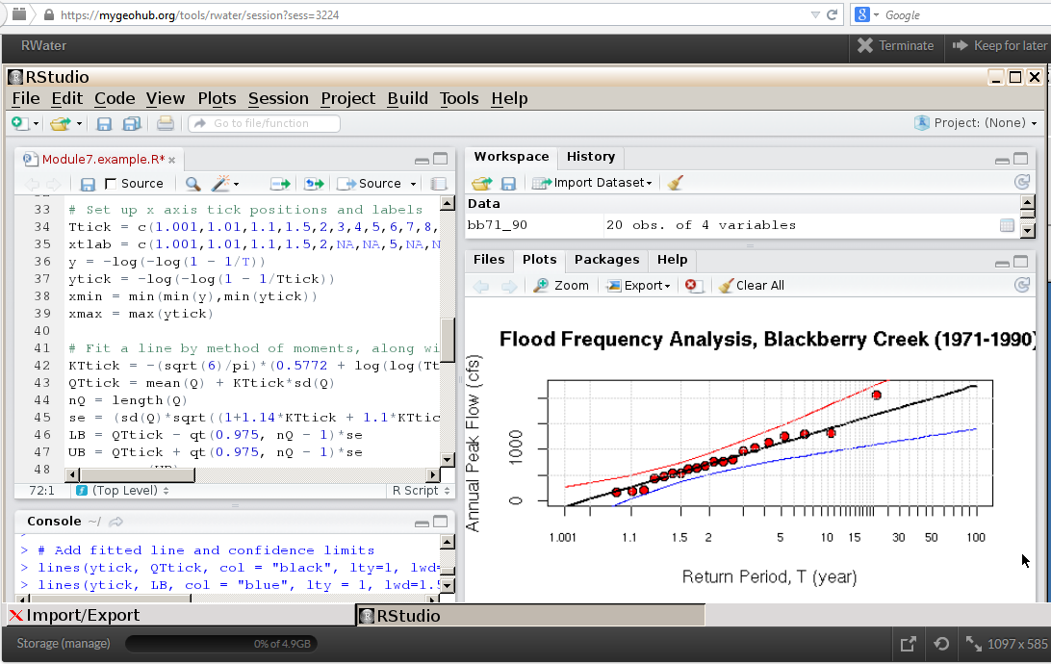
Sample Rwater Project

Slide 8
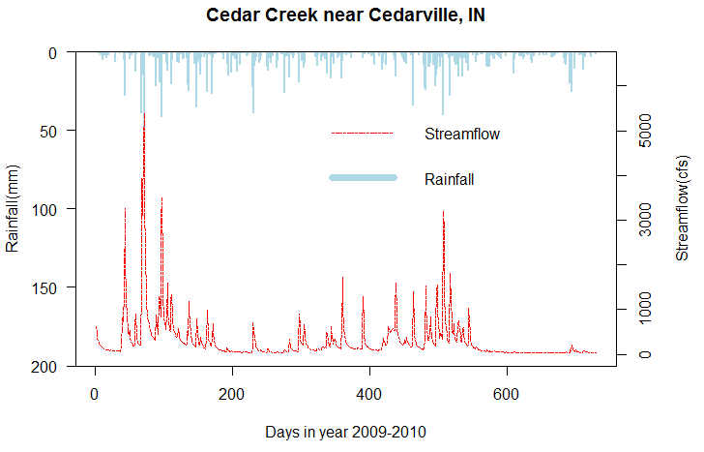
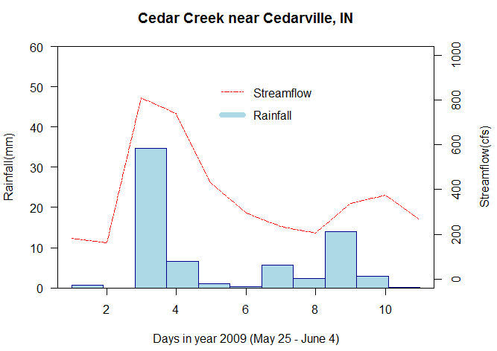
Science from RWater
Understanding Rainfall-Streamflow Relationship
Example for Cedar Creek, IN
?
?
High intensity
RWater Example
Real-time data for Cedar Creek, IN
Low intensity

Slide 9
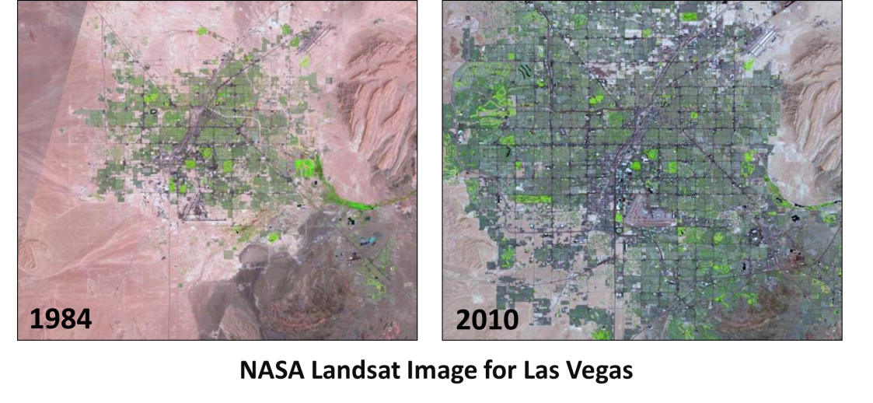
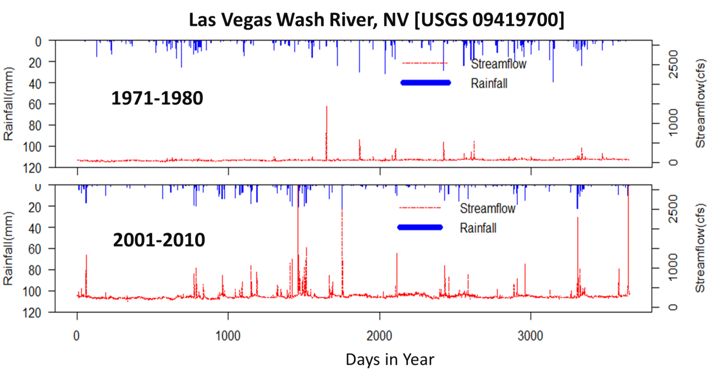
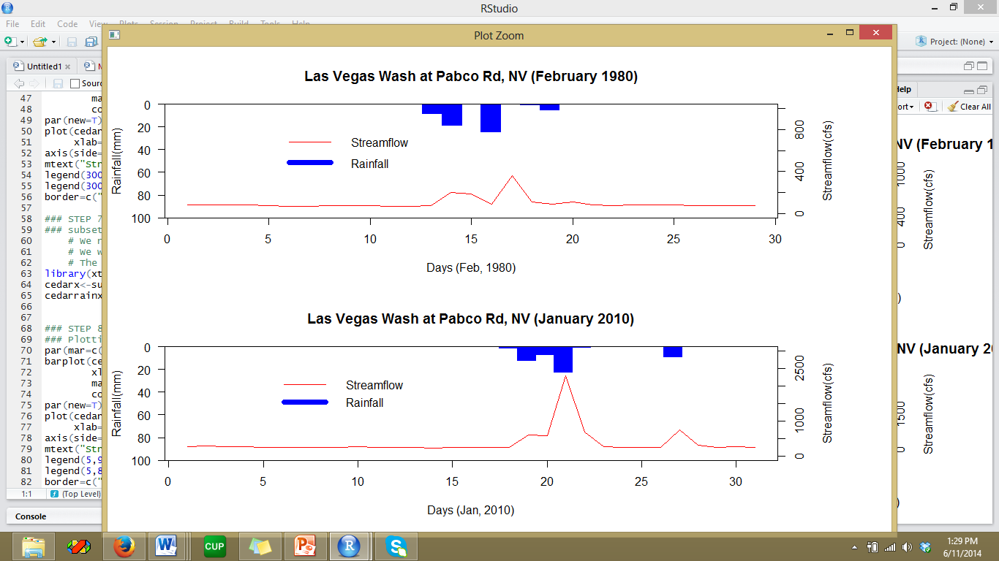
Science from RWater
Streamflow Response with Landuse Change
Example for Las Vegas, NV
https://earthengine.google.org/#intro/LasVegas
More frequent extreme event in recent times!
February 1980
Higher Peak Discharge and
shorter Lag Time!
January 2010
Days in Month

Slide 10
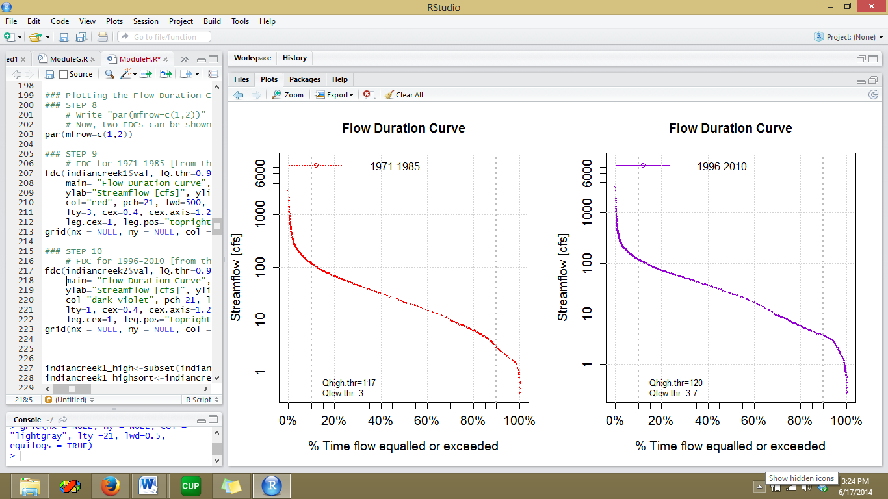
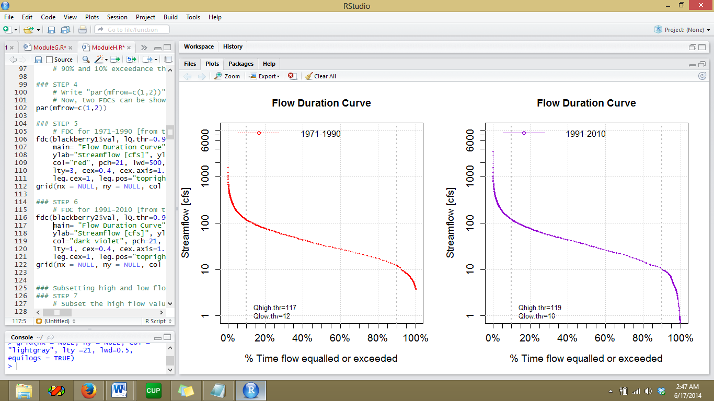
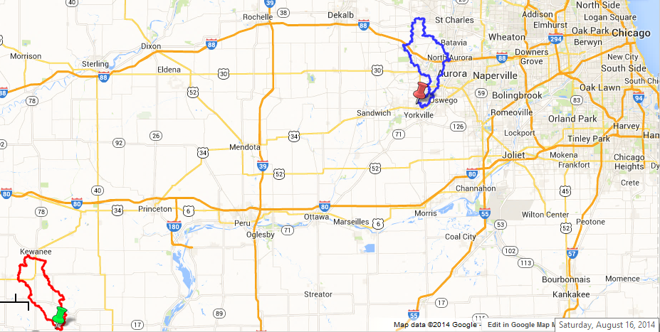

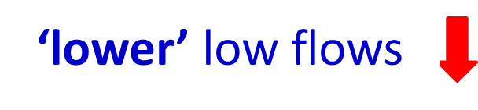
Science from RWater
Trending Urbanization by Flow Duration Curve
Example for Chicago area
1971-1990
1971-1990
Blackberry Creek [USGS 05551700]
Two adjacent watersheds near Chicago area
Objective: Analyze streamflow data and comment on possible trend of LU change
Method: Flow Duration Curve?
1991-2010
1991-2010
Indian Creek [USGS 05568800]

Slide 11
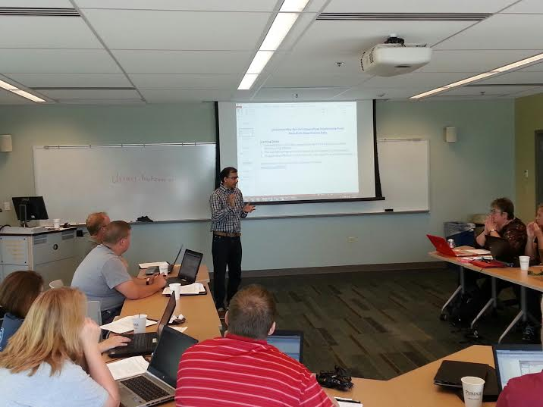
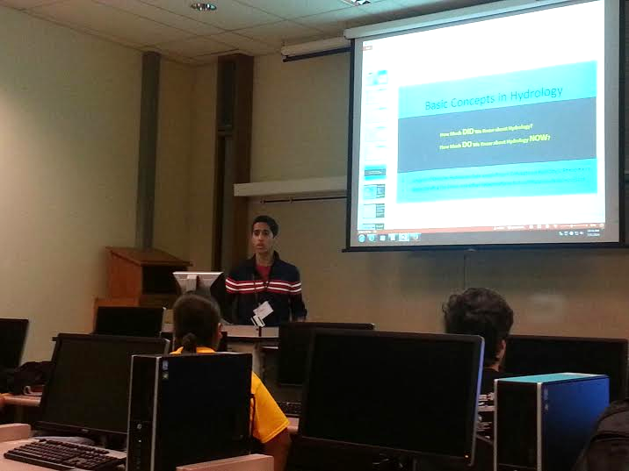
Student-Teacher Evaluation
Summer Residential Program,
College of Education, Purdue University
29 June – 12 July, 2014
Total 7 High School Students (9-12 Grade)
RWater Teacher’s Workshop,
Lyles School of Civil Engineering, Purdue University
17 – 18 July, 2014
Total 20 Middle and High School Teachers
Notes:
Flood Frequency Analysis

Slide 12
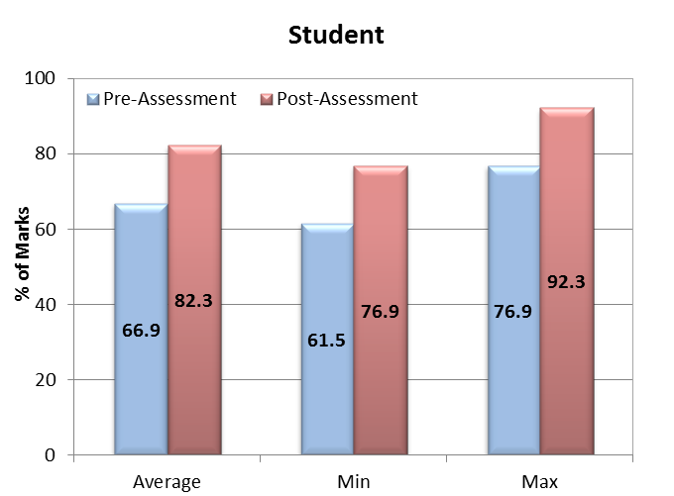
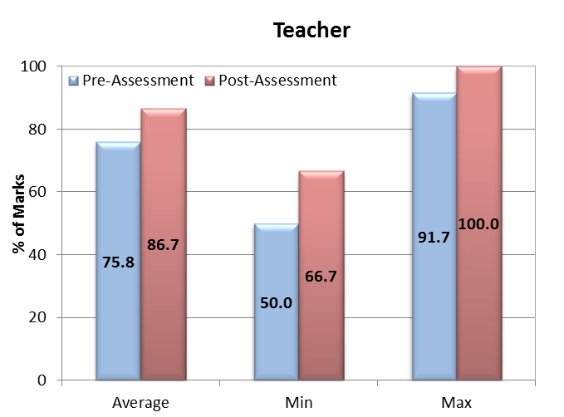
Student-Teacher Evaluation
Survey Results
Testing the improvement in users’ hydrologic understanding
Pre/Post Assessment
Notes:
Flood Frequency Analysis

Slide 13
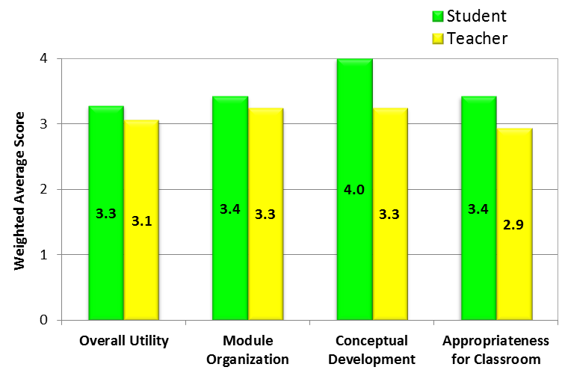
Student-Teacher Evaluation
Survey Results
User opinion on RWater’s Utility
Post Assessment
Evaluation
Criteria
Notes:
Flood Frequency Analysis

Slide 14
Future Work
Addition of a conceptual rainfall-runoff model with opportunities of high performance calibration
    Making RWater a comprehensive modeling and analysis tool
Testing RWater for upper undergraduate/graduate class
    Making RWater applicable from K-12 to the graduate level
Creating a database with RWater class projects from participating schools/universities all over United States.
    This will record hydrologic assessments over the real locations across the country, being done by the students.

Slide 15
Thank You!
Tool link: https://mygeohub.org/tools/rwater
Modules: https://web.ics.purdue.edu/~vmerwade/rwater
Questions ?
Contacts:
Adnan Rajib: adnanrajib@purdue.edu
Venkatesh Merwade: vmerwade@purdue.edu

