Slide 1
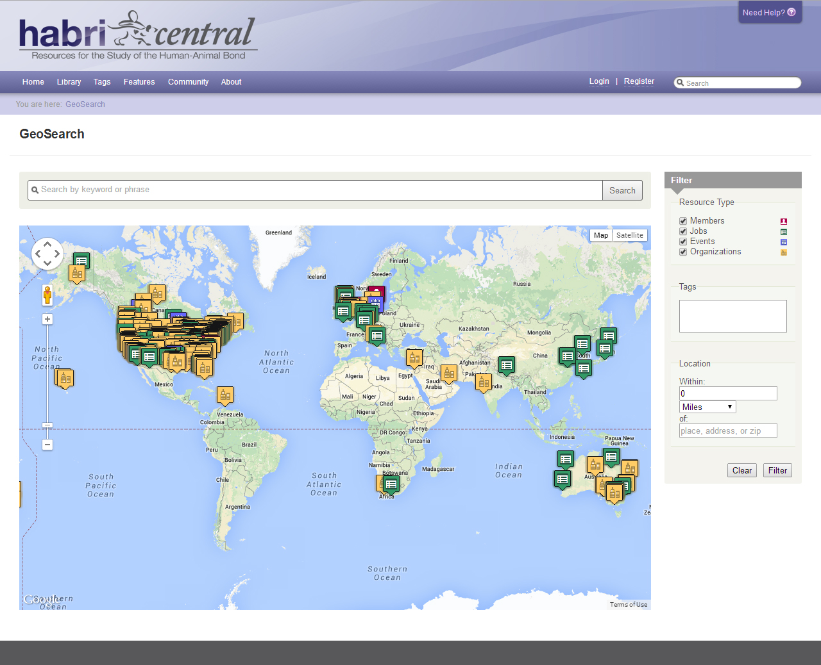
Brandon M. Beatty
Web Designer & Developer
Tao Zhang
Digital User Experience Specialist
Purdue University Libraries
Nicole Kong
GIS Specialist
Purdue University Libraries
Christopher Charles
Project Manager
HABRI Central
A Geospatial
Search Component
for HUBzero
HUBbub 2014

Slide 2

HABRI Central
www.habricentral.org
Built upon HUBzero platform
Open access resource hub and community for research on the relationship between humans and animals
Library of audio, video, documents, articles, and datasets
Community features
  Forum, Groups, Wiki
  Events, Jobs, Members
Intro

Slide 3
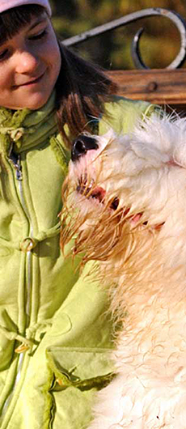
Motivation
Users expect to find information near specific locations
  Events
  Jobs
  Organizations
Build better user community – member information on a map is more engaging than a list
Visualizing information
  Distribution of members, events, and jobs
  Distribution of specialties (veterinary medicine, psychology, sociology, etc.)
Intro

Slide 4

GEO Search
Use member profile information, events, jobs, and resources contributed by users
  Geocode user location information in member profile using Google Maps API
  Geocode new entry on-the-fly
  Users can also manually input location information
Map displays all information on startup
  Users use search to narrow down information items on map
  Search within a radius of a location
Search scope
  Members, Jobs, Events, Organizations
  Tags
Design
Notes:
We used Google Maps API instead of a dedicated ArcGIS server, because we wanted to develop a HUBzero component that is easy to deploy and does not require access to special GIS software.

Slide 5
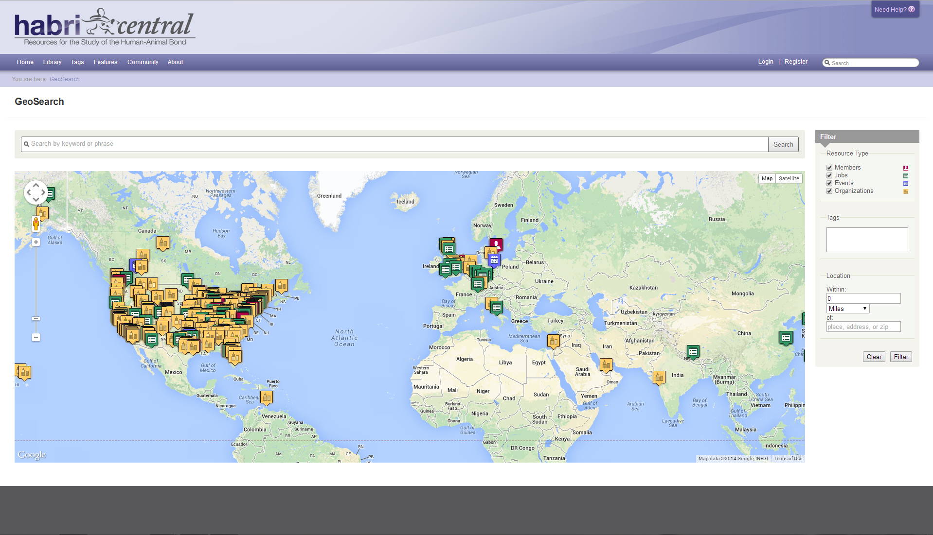
https://habricentral.org/geosearch
The Interface
Notes:
Google maps API with filter sidebar. Initially had list view under map.

Slide 6
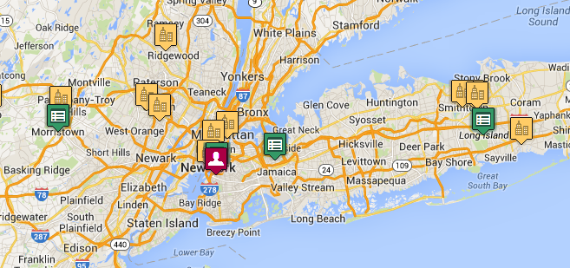
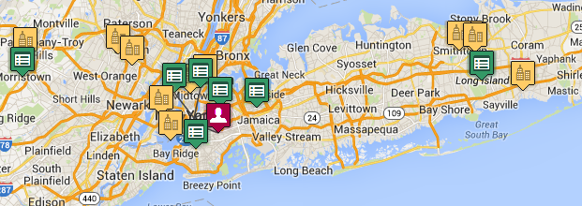
Map Display
Notes:
We used a JavaScript class Spiderfy to aggregate icons that are in the same location when the map is zoomed out. When the user clicks on the aggregated icon, we show the individual icons connected to the same location point on the map.

Slide 7
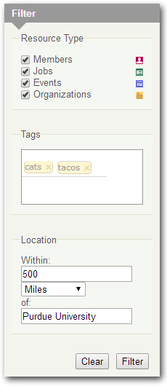
Resource Type
Narrow down results to at least one category
HUBzero Tags
Add one or more associated tags
Tag search is inclusive (“AND”)
Location
Define search radius in miles or kilometers
Enter a name of place, location, or zip
Filter Results
Notes:
Is inclusive the right word? Location is geocoded on-the-fly, distance is calculated…

Slide 8

Spherical Law of Cosines
$R * ACOS(COS(RADIANS($lat1)) * COS(RADIANS(lat2)) * COS(RADIANS(lng2) - RADIANS($lng1)) + SIN(RADIANS($lat1)) * SIN(RADIANS(lat2)))
$R = 6371 kilometers
3956 miles
$lat1, $lng1 = center of place, location, or zip
Distance between Lat/Long points
Notes:
Formula for MySQL query with PHP. Lat2 & lng2 come from database. SLoC can be accurate up to a few meters.

Slide 9
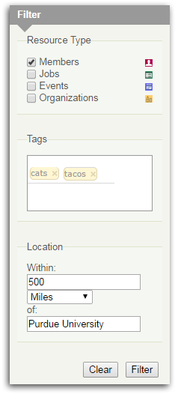
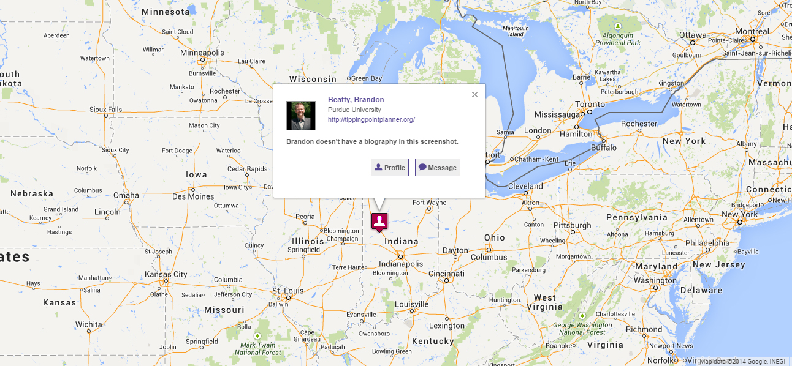
Filter Results
Notes:
Discuss narrowed down results and pop-up window details.

Slide 10

Summary
Initial user feedback
  Information overview and visualization
  Discovery tool
  Easier to connect with other users with similar interests
Users more willing to contribute information to HABRI Central
  Demographic information
  Tags
GeoSearch as a HUBzero component
Results
Notes:
As a summary, here are the things we have learned and completed so far.
First, we have collected some initial user feedback regarding the GeoSearch on HABRI Central. Some users think the GeoSearch is a tool for information overview and visualization, and they use the tool to get a sense of the distribution of researchers of particular topics. Other users use the GeoSearch to search for events or jobs near their locations. They found it easier to see events, jobs, or even peer researchers on the map.
Second, by implementing the GeoSearch, we have also managed to collect more demographic information from the users. Particularly, users are more willing to add tags to their profiles, partly because they feel that it is good to be seen on the map when others are searching for tags.
Finally, we have implemented the GeoSearch as a HUBzero component. So it should be easy for other hubs to implement a similar GeoSearch feature for their resources.

