Slide 1
{Fez} a Hatrack for your Metadata
Sam Wilson & Nathan Denny
HUBbub – Sep. 30, 2014
Notes:
Introductions – Sam and Nathan
Wife teaches presentational speaking…good presentations have attention getters with appropriate relevance statements.
In that vein, let me explain why you should care about Fez

Slide 2
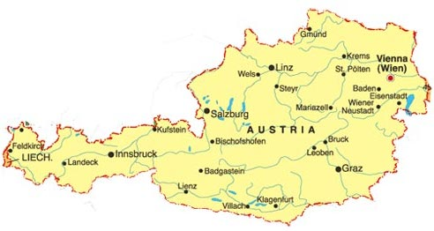
{why should you care?}
{Fez}
Notes:
* Therefore, as exhibited by your mere presence at HUBbub2014, you are interested in Fez

Slide 3
{what is it?}
Arbitrary metadata
Data provenance
Hub data
Tool/Rappture output
Project publication
Client and/or server
Notes:
Background for initiative over the last 6 months
Built a working prototype
The metadata itself isn’t necessarily my area of expertise
Arbitrary JSON data describing dataset/file in a domain agnostic manner
Hub could be client and/or server

Slide 4
{how would you use it?}
Generate a dataset (or any sort of file)
Publish to your primary fez repository
Describe it with your arbitrary metadata
Share your dataset will a colleague
Colleague wonders about some details of file
They query fez for metadata
Lather, rinse, repeat

Slide 5
{who’s doing something like it?}
Open Annotation Standard
W3C Specification
Interoperable web-based framework
http://www.openannotation.org/spec/core/
iRODS
Metadata catalog
Rules engine
https://irods.org/
Notes:
I’m not the expert on these projects
“The Open Annotation Core Data Model specifies an interoperable framework for creating associations between related resources, annotations, using a methodology that conforms to the Architecture of the World Wide Web. Open Annotations can easily be shared between platforms, with sufficient richness of expression to satisfy complex requirements while remaining simple enough to also allow for the most common use cases, such as attaching a piece of text to a single web resource.”
Just a standard…not a client.
iRODS enables data discovery using a metadata catalog that describes every file, every directory, and every storage resource in the data grid.
iRODS automates data workflows, with a rules engine that permits any action to be initiated by any trigger on any server or client in the grid.
iRODS enables secure collaboration, so users only need to log in to their home grid to access data hosted on a remote grid.
iRODS implements data virtualization, allowing access to distributed storage assets under a unified namespace, and freeing organizations from getting locked in to single-vendor storage solutions.
Complexity? Barriers to entry?

Slide 6
{where are we today?}
Client
Command line utility
Identify
Publish
Describe
Query
Server
RESTful API
Web based explorer

Slide 7
{where are we going tomorrow?}
Security
Authenticity of metadata publisher
Automatic provenance generation
Not just metadata, but data provenance
Automatic hub integration
Publication triggers
Multi-institutional horizontal distribution
Preferred server with DNS-style hierarchy
Metadata discovery
Searching arbitrary metadata in a structured manner
Notes:
Make reference to Materials Infrastructure presentation from Monday – data provenance and metadata

Slide 8
{questions?}

