Slide 1

Broadening Access to Geospatial Capabilities
Carol Song, Larry Biehl, Rosen Center for Advanced Computing
Venkatesh Merwade, School of Civil Engineering
Nelson Villoria, Agriculture Economics & Center for Global Trade Analysis
Purdue University
HUBbub 2014
Notes:
- brief overview of project
- brief overview of HUBzero and why the need for geospatial capabilities inside HUBzero
- brief overview of architecture
- current collaborations with other projects
- potential areas of collaboration
- data publishing
- linking other data sources to HUB tools
- providing APIs for accessing HUB tools

Slide 2
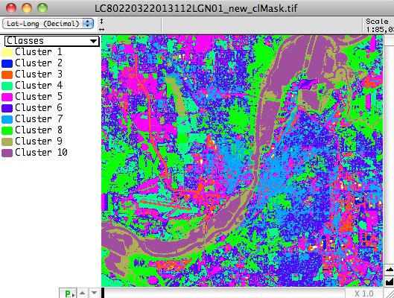
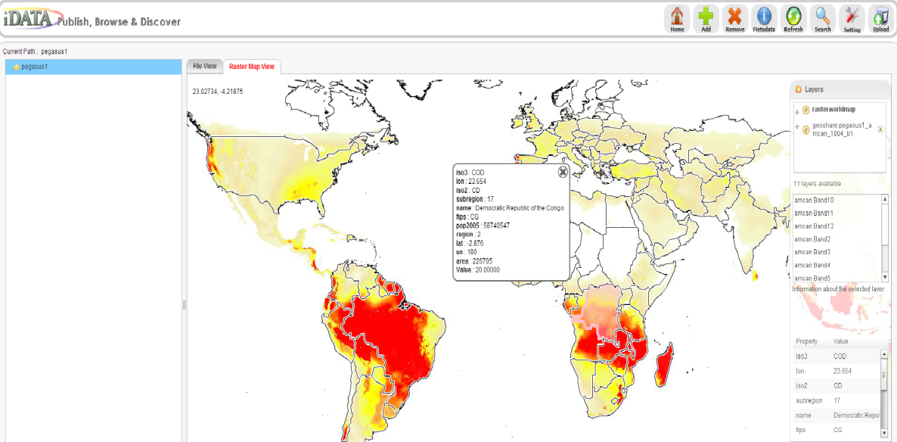
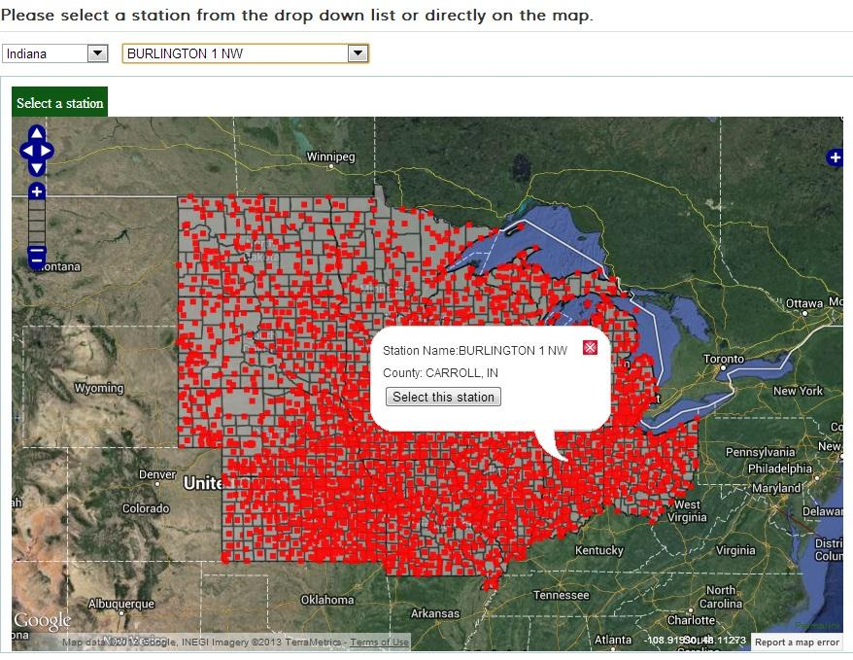
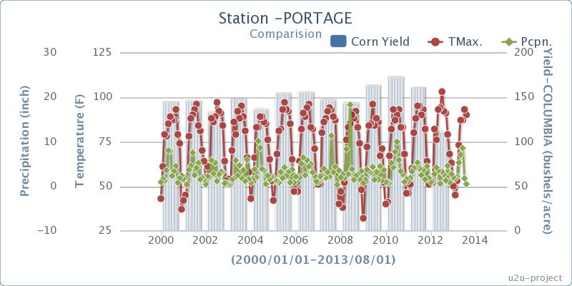
Driving Use Cases
Easy deployment of geospatial tools

Slide 3
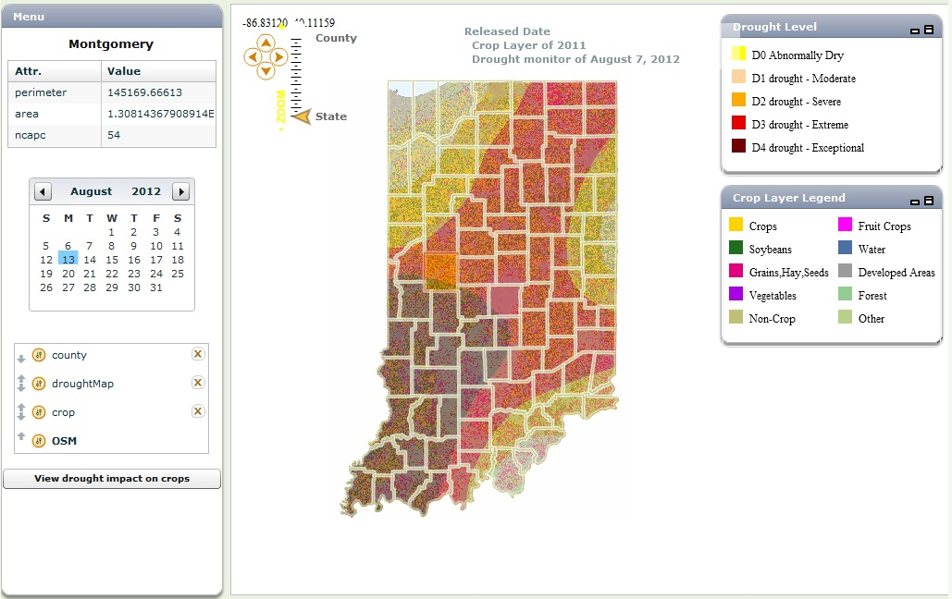
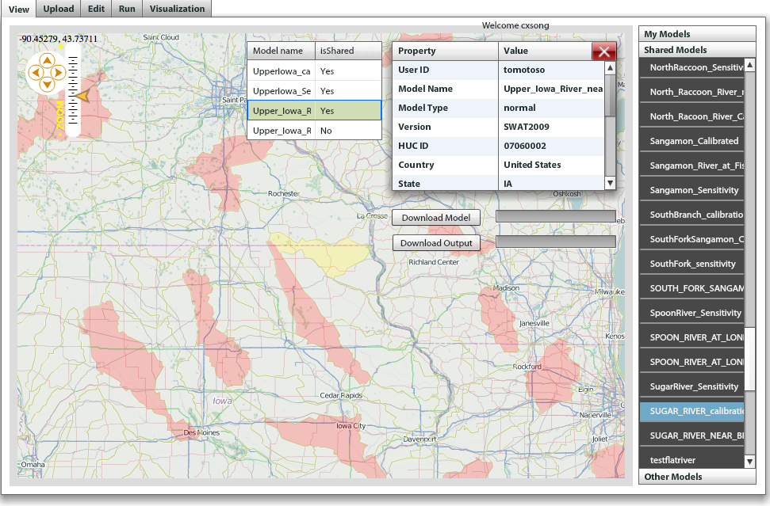
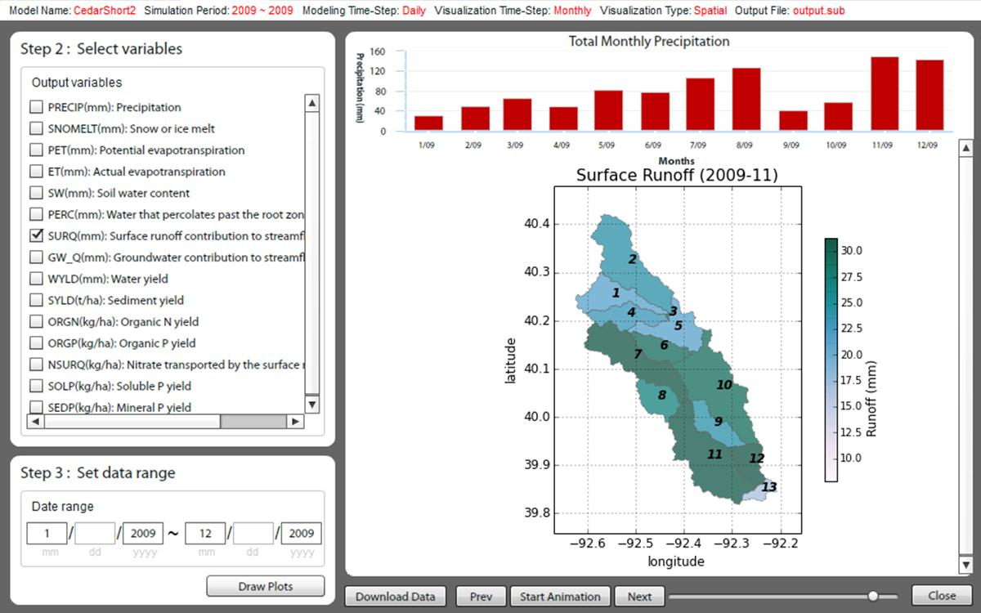
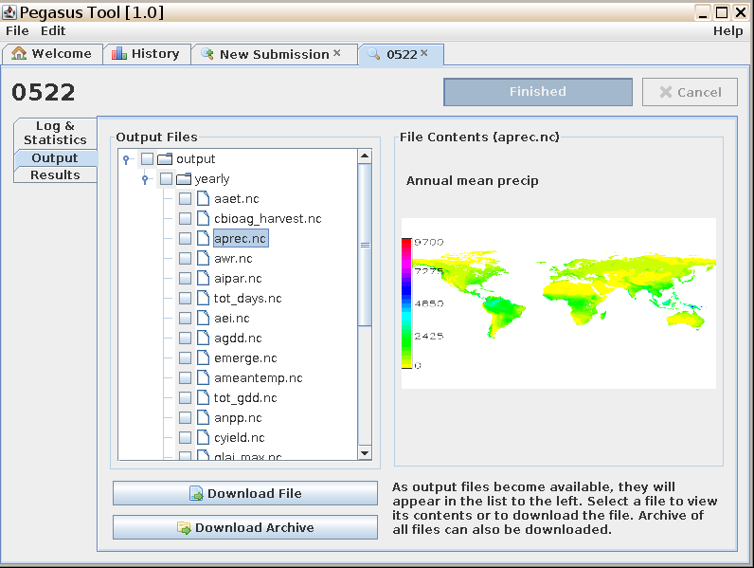
Driving example
Multi-scale and multi-disciplinary data and modeling for addressing hydrologic and ag economic issues

Slide 4
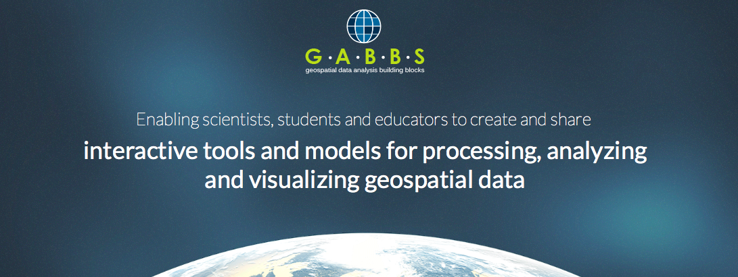
Overarching goal:
Making it easy for scientists to share geospatial data and tools
Reach broader user community
  Anyone can create an online app and share
  Anyone can share geospatial data
Notes:
Building for self service (DIY)
Leverage successful software
Develop building blocks

Slide 5
Outcome
The rapid tool development library RAPPTURE will support
  geo-referenced data objects (maps, images, etc)
  Easy way to share geospatial data, both in raw data, and visually and interactively
  Easy way to share interactive tools that uses, and produces geospatial data
Tool builder that supports geospatial data to further lower the barrier of creating interactive online tools
Service interfaces to upload and share geospatial and other types of data in HUBzero
Service interfaces to link tools and data
Geospatial capabilities as part of core HUBzero open source release

Slide 6
Funding
A National Science Foundation grant
Data Infrastructure Building Blocks (DIBBs) program
GABBs: 1 of 4 implementation awards in 2013
$4.5M, 4 years (10/2013 – 9/2017)
Collaboration with other DIBBs and DataNet awards

Slide 7
Team (11+)
Carol Song, PI & Project Director
Larry Biehl (image processing and visualization)
Venkatesh Merwade (hydrologic modeling and data, apps)
Nelson Villoria (global geospatial data, applications)
Betsy Hillery (project manager)
Michael McLennan (HUBzero architect)
Rob Campbell (sr developer, data component)
Leif Delgass (sr developer, visualization)
George Howlett (sr developer, RAPPTURE extension)
Lan Zhao (research scientist, geospatial applications, data management)
Rajesh Kalyanam (spatial processing, management)
Graduate students in scientific domains

Slide 8
Building on prior work
HUBzero (Rappture, graphics rendering, collaborative tools)
iData (tool for self service data sharing and management)
Multispec (tool for analyzing multispectral/hyperspectral image data)
Geospatial hub projects (DRINET, Geoshare, WaterHUB, U2U etc)
Leveraging software developed elsewhere
  iRODS
  Globus data transfer

Slide 9

HUBzero
Web Server
Visualization Server
GeoRenderer
Geospatial Joomla Tools
GDAL/OGR
GEOS
OSG/osgEarth
Community Data Space
Data Services
Workspace Container
WMS/WFS/WCS/WMTS
Metadata Catalog
Rappture Toolkit
Discover
Geospatial Rappture Tools
Data Manager
Image Processing API
Manage
Non-spatial Files
Retrieve
Process
SOAP/REST/WMS/WFS/WCS/WMTS
Core API
Data tables
Transfer
Geospatial Mapping API
Raster Maps
Annotate
Publish
Vector Maps
Visualize
Data publishing API
iRODS
MySQL
PostGIS
Map Rendering Server
XD
Condor
Campus Grid

Slide 10
Challenges
Dealing with large and complex (often non-standard) data sets
Peculiarity in data
Extending the existing RAPPTURE model to support the new requirements of geospatial data and interactivity
Map and image rendering in hub VM workspace
Service interfaces
Linking data – tools

Slide 11
What’s to come?
New Super Hub for your geospatial needs
Demonstration video

