Slide 1
Cybersecurity for Cyberinfrastructure…
and Science!
Von Welch (PI)
Susan Sons (HUBzero Engagement Lead)
Hubbub 2014
30 September 2014
trustedci.org

Slide 2
NSF Cyberinfrastructure
Image credit: Alan Blatecky/NSF

Slide 3
NSF Cyberinfrastructure
NSF CI Project
Cloud
HTC
Science DMZ
Portals
HPC
Instruments
PCs/Mobile
HPN
Satellite Links
Science Data
Servers
HPSS
Commodity Unique

Slide 4
NSF Cyberinfrastructure
NSF CI Project
Cloud
HTC
Science DMZ
Portals
HPC
Instruments
PCs/Mobile
HPN
Satellite Links
Science Data
Servers
HPSS
Commodity Unique

Slide 5
Science!
Requirements, Risks
Distributed Scientific Community
NSF CI Project
Multiple Universities and/or Research Orgs
(IT and policies)
CI, R&E, and Commercial Services
CI and Open Source Software
R&E Networks
Services, Risks, Policies
…

Slide 6
So, what is cybersecurity for NSF science?

Slide 7
Cybersecurity Historically: Technology
Firewalls, IDS, encryption, logs, passwords, etc.

Slide 8
Cybersecurity Contemporarily
Cybersecurity supports an organization’s mission by managing risks to information assets.

Slide 9
Translating to NSF projects...
Cybersecurity manages risks to the performance and integrity of computational science.

Slide 10
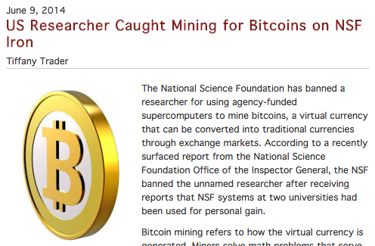
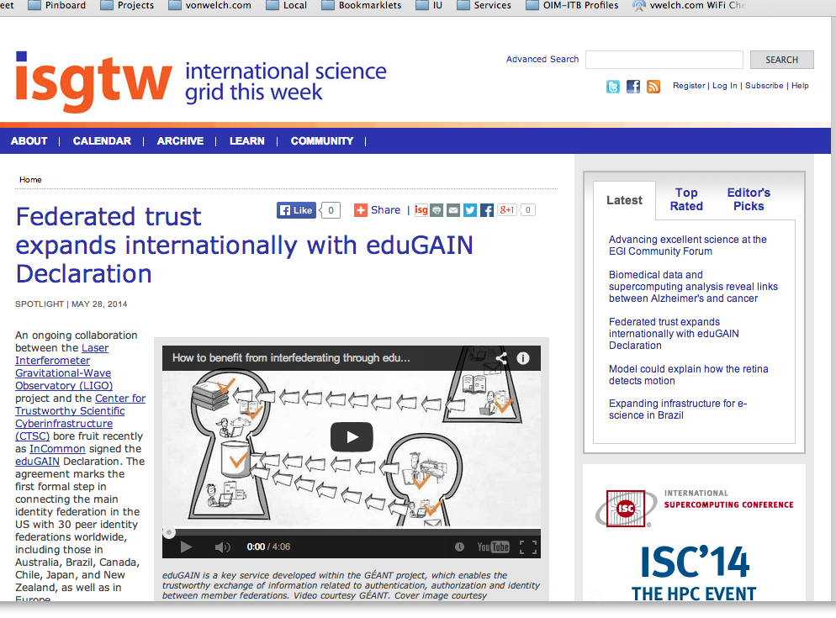
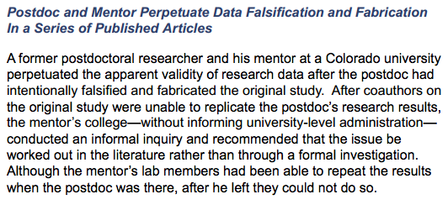
Risks...
http://www.hpcwire.com/2014/06/09/us-researcher-caught-mining-bitcoins-nsf-iron/
http://www.nsf.gov/pubs/2014/oig14002/oig14002.pdf
http://www.isgtw.org/spotlight/federated-trust-expands-internationally-edugain-declaration

Slide 11
Center for Trustworthy Cyberinfrastructure
The goal of CTSC is to provide the NSF community with a coherent understanding of cybersecurity, it’s importance to computational science, and the resources to achieve and maintain an appropriate cybersecurity program.

Slide 12
CTSC Activities
Engagements
LIGO, SciGAP, IceCube, Pegasus, CC-NIE peer review, DKIST, LTERNO, DataONE, SEAD, CyberGIS, HUBzero, Globus….
Education, Outreach and Training
Guide to Developing Cybersecurity Programs for NSF Science and Engineering Projects, Securing Commodity IT in Scientific CI Projects Baseline Controls and Best Practices, Training for CI professionals.
Leadership
Organized 2013, 2014 & 2015 Cybersecurity Summits for Large Facilities and CI, Incident response, IdM Best Practices.

Slide 13
CTSC and HUBzero Engagement

Slide 14
HUBzero and cybersecurity
Used by 60+ communities, some with 10s or 100s of thousands of users.
Export control (ITAR) and HIPAA compliance requirements.
HUBzero approached CTSC to assess and improve their cybersecurity.

Slide 15
HUBzero/CTSC “Cybercheckup”
Initial week-long “cybercheckup” of existing HUBzero cybersecurity program.
Finding was a mature, robust cybersecurity program.
Identified places for improvement and further review: better documented physical security, use of two-factor authentication, access control, disaster/incident response plan, and vulnerability scan handling.

Slide 16
In-depth Review
Web Server Security Model
Covers security measures--both technological and procedural--implemented by the HUBzero operations team.
Disaster Recovery Plan
Covers operational safeguards that ensure resiliency in case of a major failure, such as a hub hardware failure, and procedures for doing recovery operations.

Slide 17
New Initiatives: Formalizing Procedures
CMS Security Model
Codifies the design of access control and other security features of HUBzero’s CMS software for program longevity and so that they can be reviewed and improved upon.
Vulnerability Management
Formalizing the procedures for managing vulnerabilities discovered both in the CMS software and in HUBzero’s operations environment.

Slide 18
Guide to Developing Cybersecurity Programs for NSF Science and Engineering Projects
http://trustedci.org/guide
Basis for CTSC evaluation.
Will be extended with vulnerability management as part of HUBzero engagement.

Slide 19
Thank You
trustedci.org
@TrustedCI
We thank the National Science Foundation (grant 1234408) for supporting our work.
The views and conclusions contained herein are those of the author and should not be interpreted as necessarily representing the official policies or endorsements, either expressed or implied, of the NSF.

