Slide 1
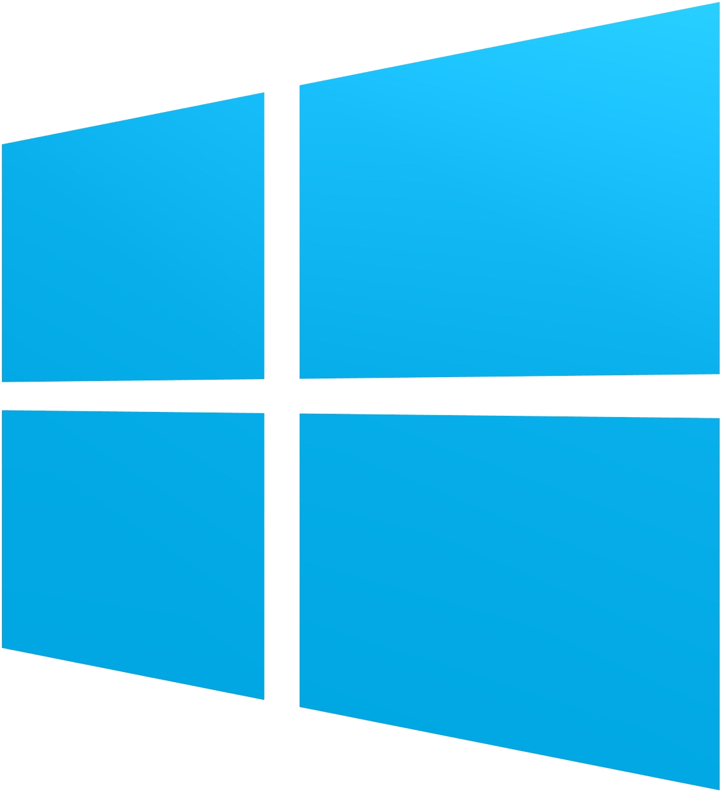
A Multi OS Hub Approach:
Integrating the Windows Operating System Into the Hub
By Christopher J. Nuland
Windows
Linux

Slide 2
About Me
Graduated from Purdue University with a BS in Computer Science, 2012
Focused in information systems and virtualization
Development Manager of cdmHub (IN3) since 2013
Live in West Lafayette, IN, with my wife, Melissa
Chris and Melissa
Nuland

Slide 3
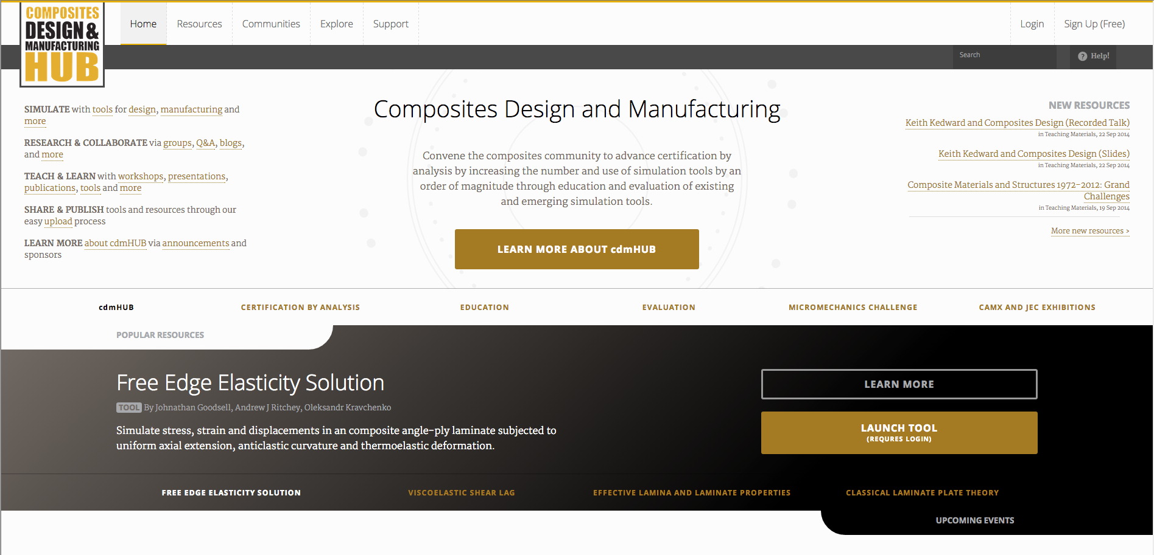
cdmHub.org

Slide 4
Challenges for cdmHub
Drop Java integration for running tools
Integrate HTML5 for running tools
Implement a backend system that is scalable
Address industry related security concerns
Implement a system that can run both Linux and Windows tools

Slide 5
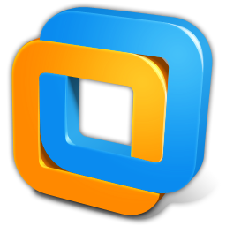
Technology
Guacamole (HTML5)
VMWare (Windows Support)

Slide 6
Pistachio Library
Backend tool system built around VMWare
Uses Guacamole code for displaying tools (HTML5)
Removes the need for separate graphics server
Allows for future scaleability
Addresses some security concerns
Pistachio Alpha
Version 0.5
Release Date
Late November 2014

Slide 7
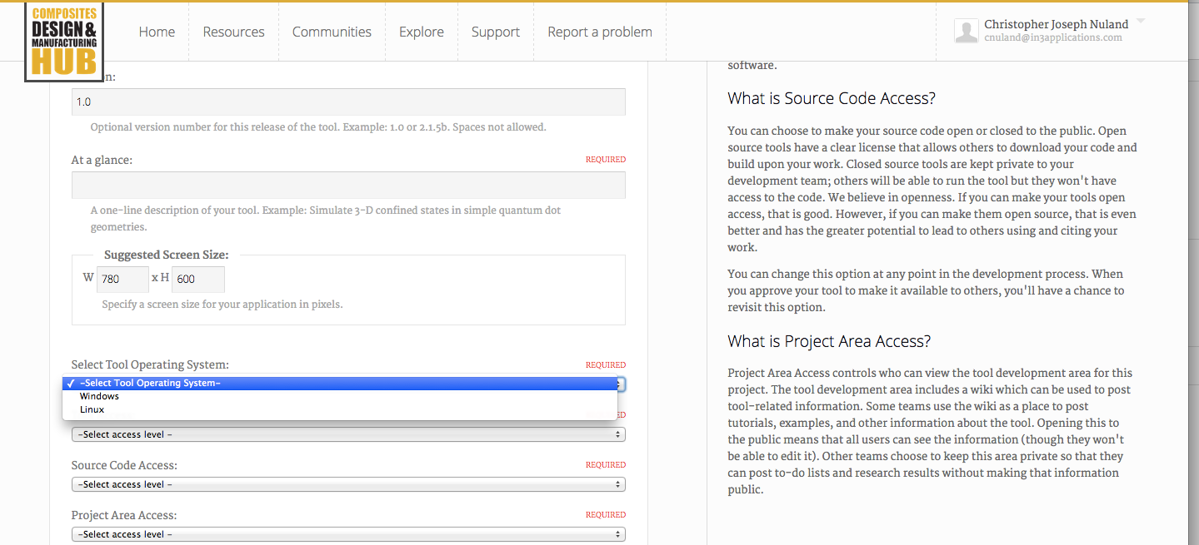
Tool Upload Process
For the average user the upload process remains mostly the same

Slide 8
Pros
Allows cdmHub to run both Windows and Linux based tools
Can move tools between servers more easily (scalability)
Can more easily secure a single session
Faster graphic card response time
More easily guarantee resources for a session

Slide 9
Cons
More expensive compared to the open source HubZero system
HubZero running Pistachio | Open Source HubZero
20 Linux Sessions | 100+ Linux Sessions
3 Linux Windows Sessions
Windows and VMware License Fees | No Licence Fees
1 Server | 4 Servers
$1,000 per/month (SingleHop) | $1,000 per/month (SingleHop)

Slide 10
Live Demo

Slide 11
Future
Implement more cloud based technology into Pistachio
Allow for local servers to create “MicroHubs”
Add virtual desktop features for more work collaboration
Release open source version of software

Slide 12
Conclusion
Christopher J Nuland
cnuland@in3applications.com
in3applications.com

