Slide 1
INSuRE HUBbub 2014
Courtney Falk PhD Student
Lauren Stuart PhD Student

Slide 2
INSuRE
Information Security Research and Education (INSuRE)
Began as an National Science Foundation (NSF) Early Concept Grants for Exploratory Research (EAGER) grant
Collaborative, inter-disciplinary research into information security
Leverage expertise across institutions, and across time frames
Notes:
The last bullet point also includes generating data.

Slide 3
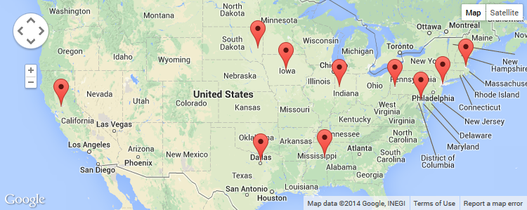
CAE-R
INSuRE is a network between Centers for Academic Excellence in Information Assurance Research (CAE-Rs)
The CAE-R program is administered by the Department of Homeland Security (DHS) and the National Security Agency (NSA)
Currently there are 10 participating CAE-R institutions

Slide 4
Courses
Courses are one part of the larger project
Teach students both information security and research methodology
Students are given real-world research problems from the partner organizations (NSA, Sandia, PNNL)
Teams of 2-4 students select a topic, do basic scientific research, write a report
Research should continue across semesters (one such project now)
Research should be usable across institutions
Notes:
Give examples of some topics.

Slide 5
Features Used
File versioning
Every team from every university keeps their deliverables in the same directory structure
Wiki
Common research findings
Data/corpora sharing
Discussions
Clarification/collaboration

Slide 6
Wish List
An INSuRE tool of our very own
Build a student project into a useful, interactive tool that is run on the Purdue University Research Repository (PURR)
Integrated/federated authentication
Chat/messaging for future inter-institutional teams

Slide 7
Thanks
Michael Witt, Purdue Libraries
Victor Piotrowski, NSF
Lisa Zilinski and Line Pouchard, Purdue
Melissa Dark, Purdue PI

