Slide 1

NanoElectronic Modeling with the NEMO toolkit on nanoHUB
Jim Fonseca
Network for Computational Nanotechnology (NCN)
Purdue University
jfonseca@purdue.edu

Slide 2
Overview
nanoHUB
Nanoelectronics modeling
NEMO5 engine
NEMO-powered nanoHUB tools
Best practices

Slide 3
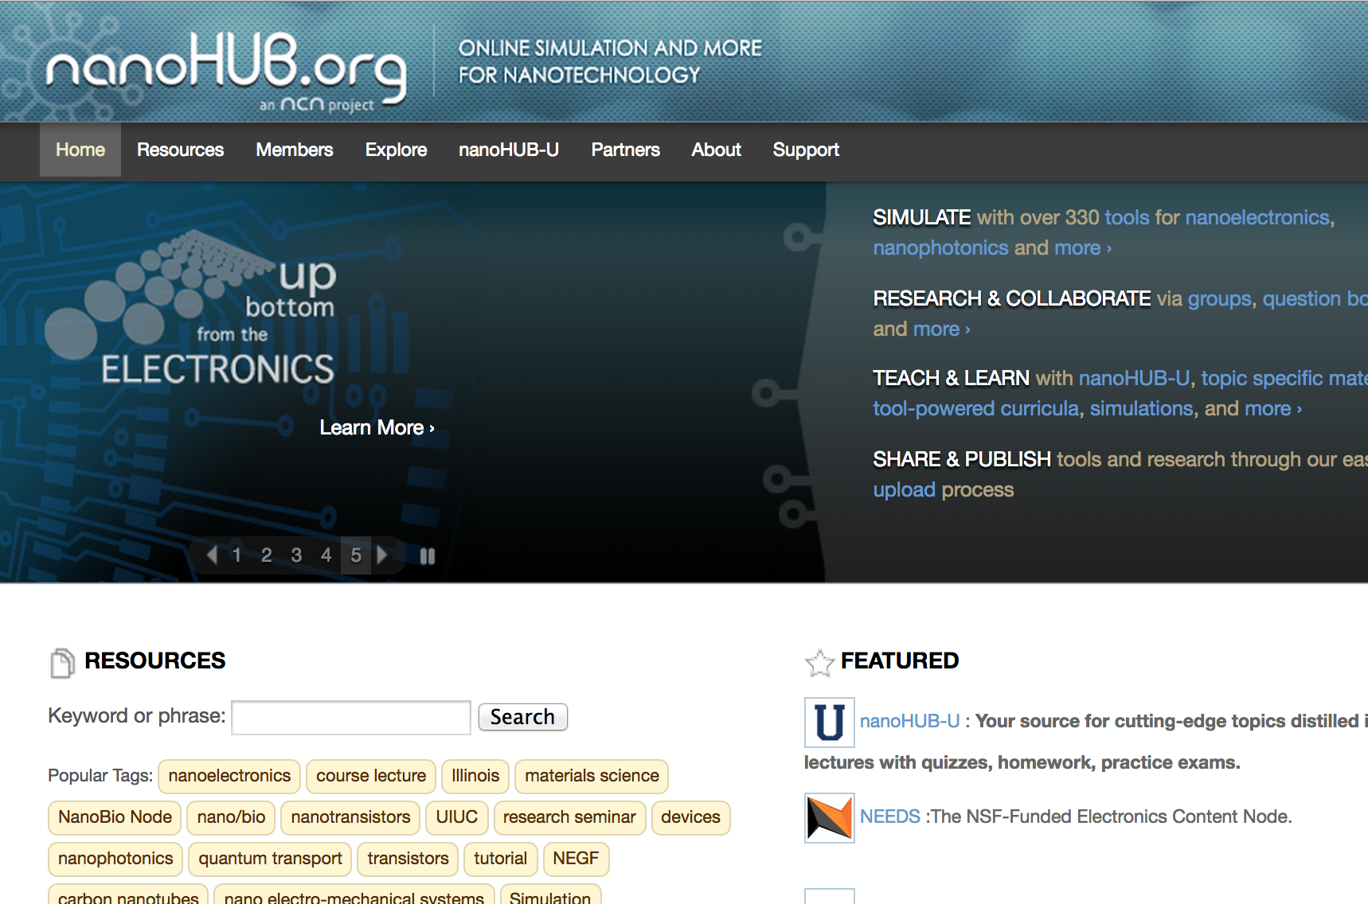
nanoHUB.org
330,000 annual users
330 simulation tools
  Nanoelectronics, nanophotonics, materials science, molecular electronics, carbon-based systems, Microelectromechanical systems
4,200 resources (video lectures, presentations, tutorials, etc.)
nanoHUB-U (online courses)
  Nanoscale transistors (Prof. Mark Lundstrom)
  Fundamentals of Nanoelectronics (Prof. Supriyo Datta)
  From Atoms to Materials: Predictive Theory and Simulations (Prof. Alejandro Strachan)
  Principles of Electronic Nanobiosensors (Prof. Ashraf Alam)

Slide 4
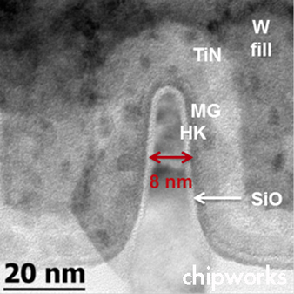
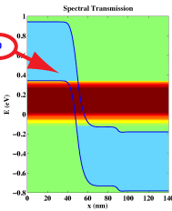
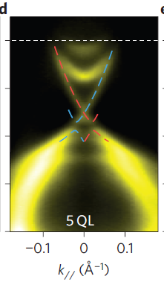
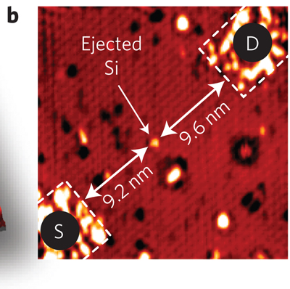
Nanoelectronics Today
$300 billion semiconductor industry
International Technology Roadmap for Semiconductors (ITRS)
Moore’s Law
Countable number of atoms
Quantum effects
Devices (transistors)
  Smaller, faster, more energy efficient
  Designs, materials
Band-to-band tunneling
Topological insulators
Single atom transistors
IEEE Elec. Dev. Lett. 30, 602 (2009)
Nature Physics 6, 584 (2010)
Nature Nanotechnology 7, 242 (2012)
http://www.chipworks.com/media/wpmu/uploads/blogs.dir/2/files/2012/08/Intel22nmPMOSfin.jpg

Slide 5

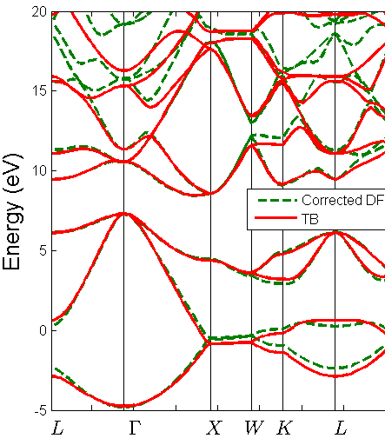
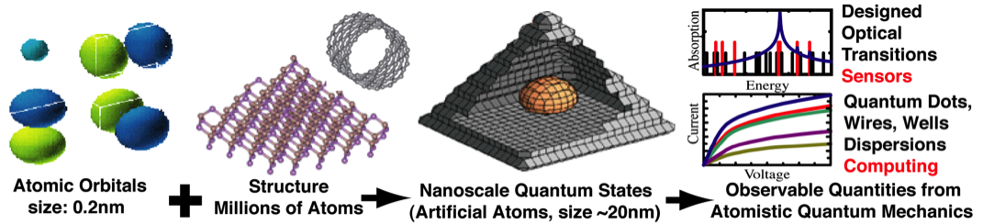
NEMO5 - Bridging the Scales
From Ab-Initio to Realistic Devices
Ab-Initio
TCAD
Goal:
• Device performance with realistic extent, heterostructures, fields, etc. for new / unknown materials
Problems:
• Need ab-initio to explore new material properties
• Ab-initio cannot model non-equilibrium.
• TCAD lacks real material physics
Approach:
Ab-initio:
  Bulk constituents
  Small ideal superlattices
Map ab-initio to tight binding (binaries and superlattices)
Current flow in ideal structures
Study devices perturbed by:
  Large applied biases
  Disorder
  Phonons

Slide 6
NEMO5 (on nanoHUB)
NEMO5
  Academic and industrial use
  Free for academic use
  ~30 developers currently
  500,000 lines of code
    C++, python
    3rd party libraries
  Input files 100s to 1000s of lines
  3 ways to use NEMO5
    Distribution and support group on nanoHUB
      Source code available
      nanoHUB workspace → Purdue’s RCAC clusters
    nanoHUB tools
...
solver {
name = QTBM:bands_source_mode_contact
type = Schroedinger
iterator {
set {
active_regions = (1,2,3)
allow_reinit_k_points = true
automatic_threshold = true
charge_model = electron_hole
convergence_limit = 1.e-10
cutoff_distance_to_bandedge = 0.05
domain = source_mode_contact
eigen_values_solver = krylovschur
job_list = (assemble_H,passivate_H, calculate_band_structure)
k_degeneracy = 1
...
}
}
}
solver {
name = QTBM:bands_drain_mode_contact
type = Schroedinger
...

Slide 7
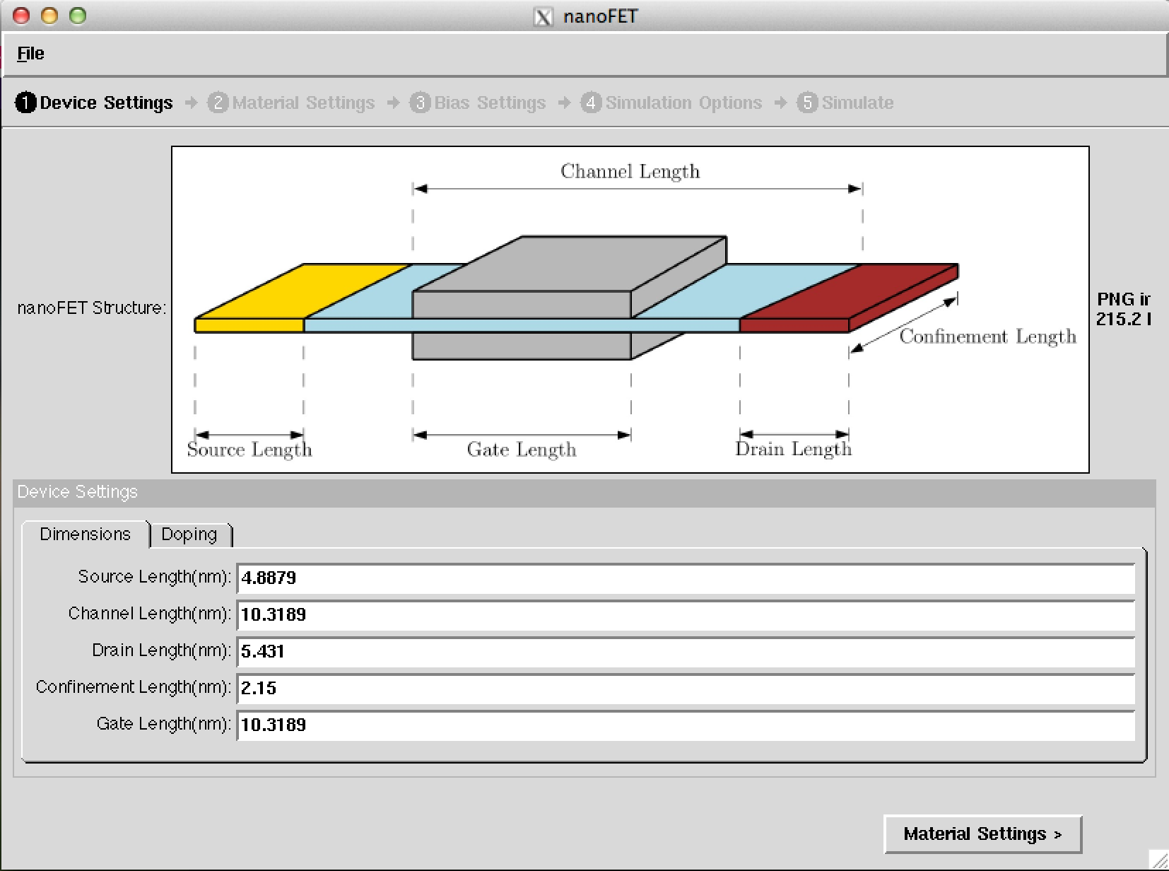
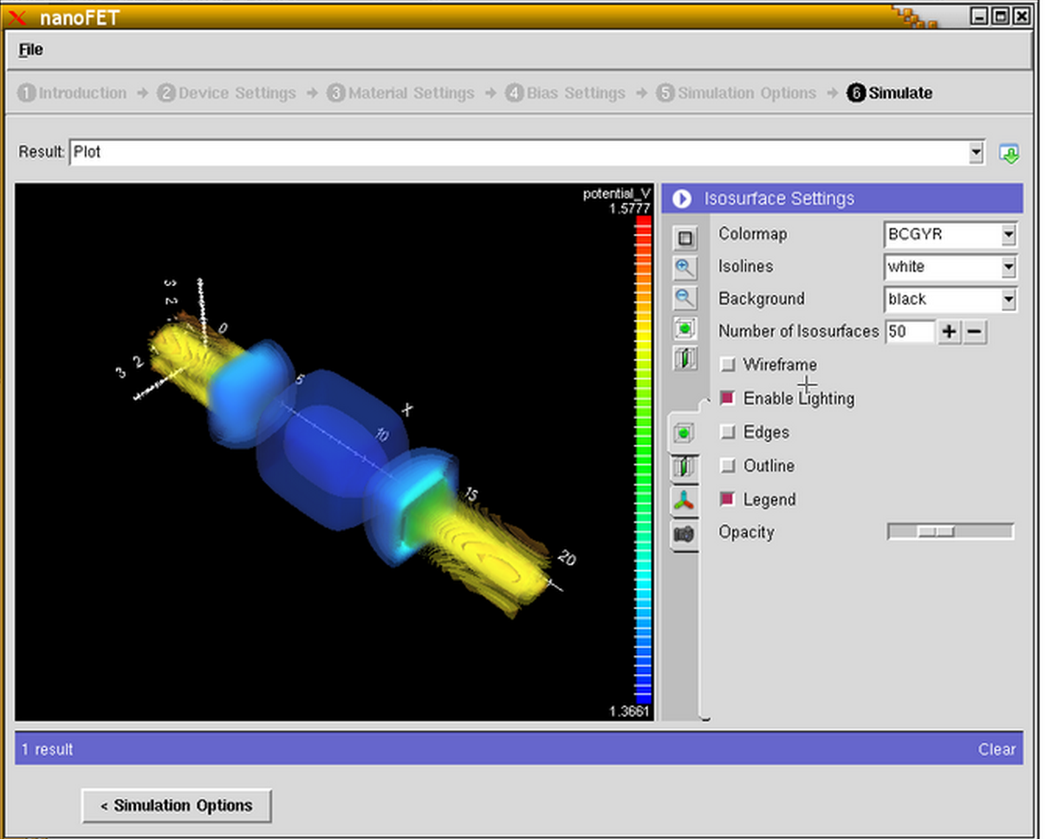
NEMO5 on nanoHUB.org
OMEN/NEMO5-based nanoHUB tools
  Brillouin Zone Viewer
    Crystal theory
  Crystal Viewer
    Visualize crystals, design your own
  Bandstructure Lab
    Semiconductor fundamentals
  1dhetero
    Poisson-Schroedinger Solver for 1 dimensional heterostructures
  RTDNEGF –
    Calculate current through resonant tunneling diodes
  Quantum Dot Lab
    Eigenstates (energy levels) of particle in a box system
  nanoFET
    Calculate transport properties of transistors
    NEMO5 powered version of OMENwire, OMEN_FET
  ITRS tool OMEN/PADRE/NEMO5 powered - (coming soon)

Slide 8
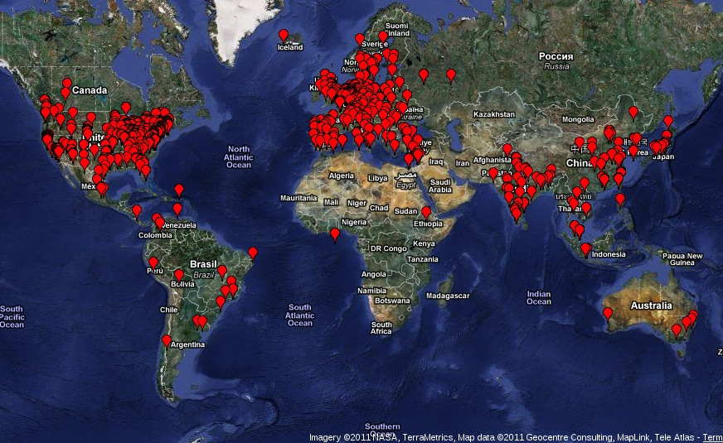

NEMO5 nanoHUB Usage
Include one cool breakthrough image
NEMO Powered Tools
  >18,000 Users
  >350,000 Simulation Runs
  >3,400 students in classroom
Notes:
8

Slide 9
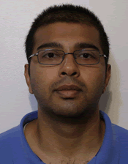
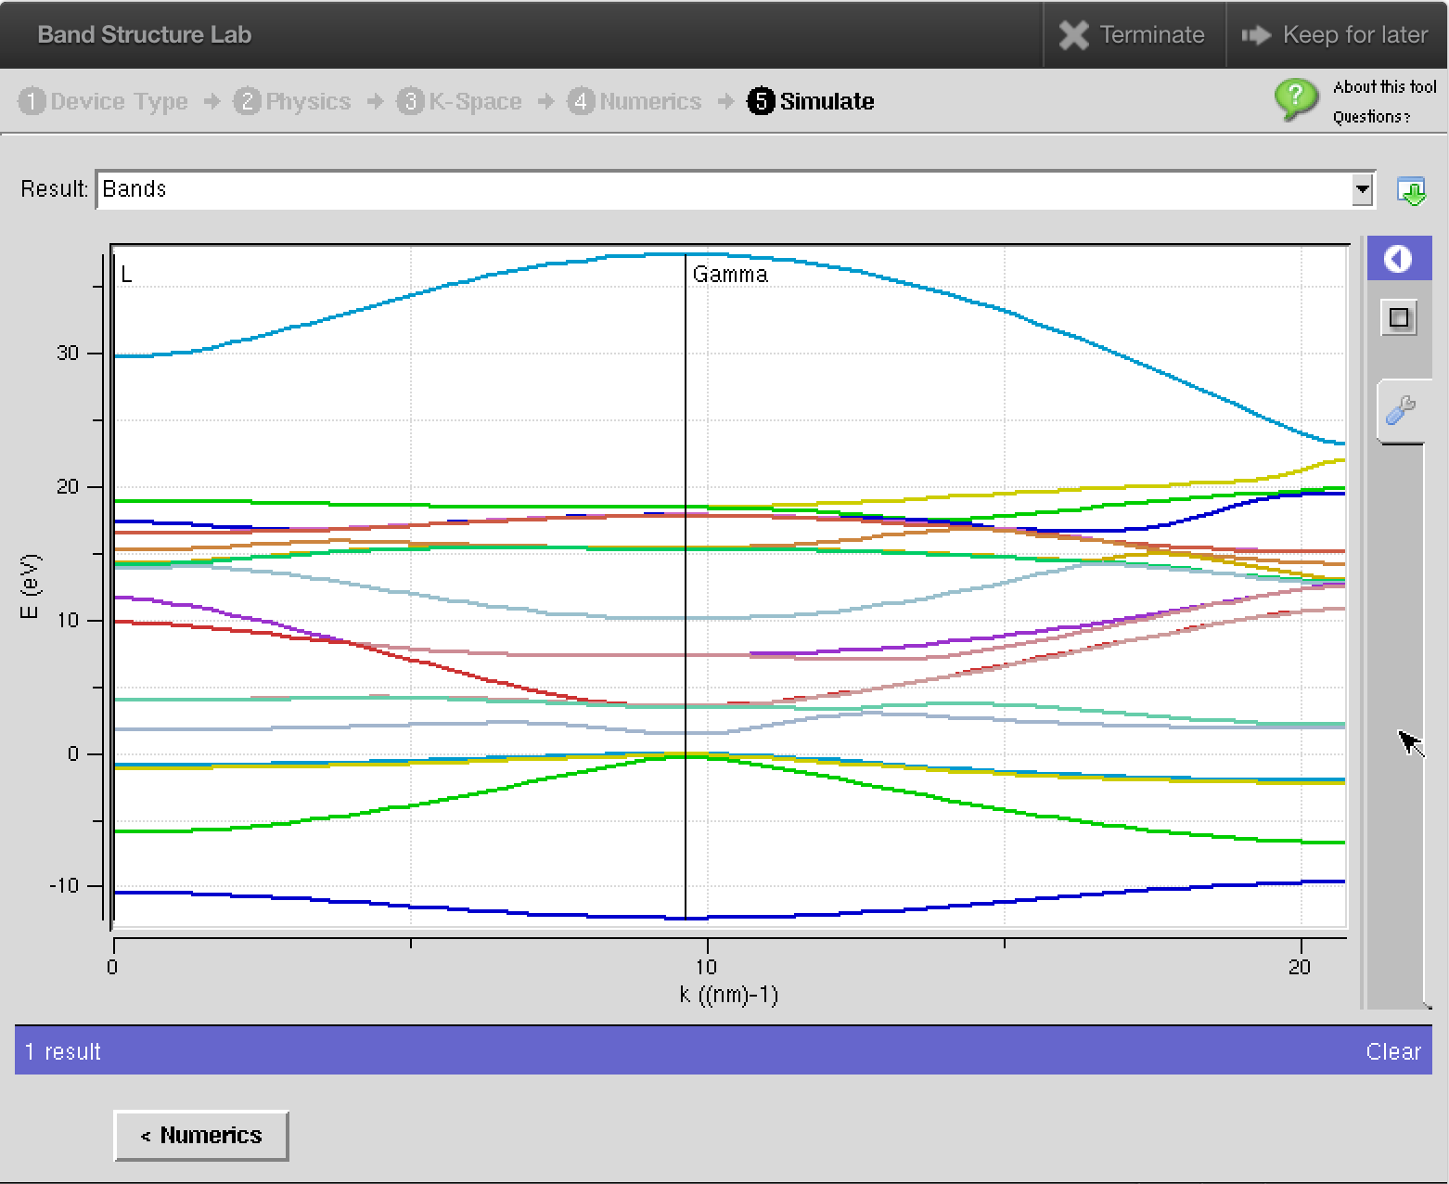
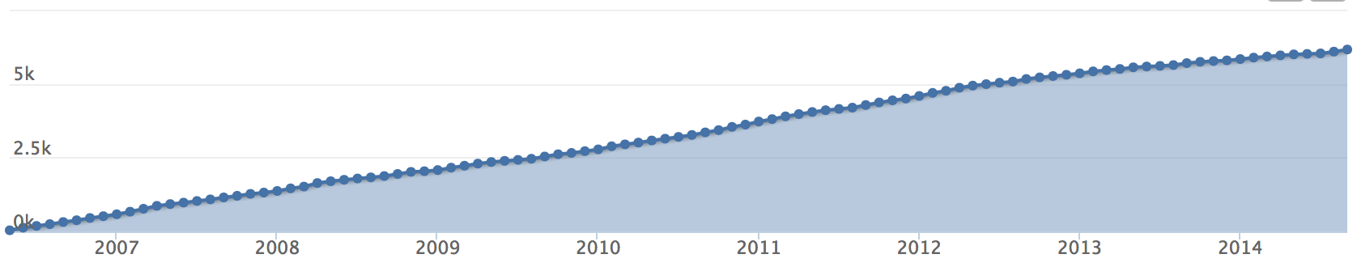
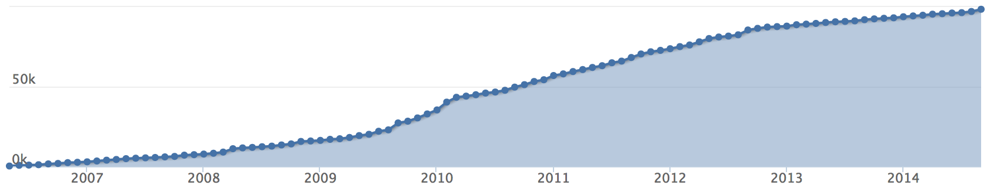
Bandstructure Lab
Computes the electronic and phonon structure of various materials in the spatial configuration of bulk, quantum wells, and wires
Various materials (Si, Ge, GaAs, etc. )
NEMO5 development --
Samik Mukherjee
6,000 Users
~100k
Simulation Runs
2007
2014

Slide 10
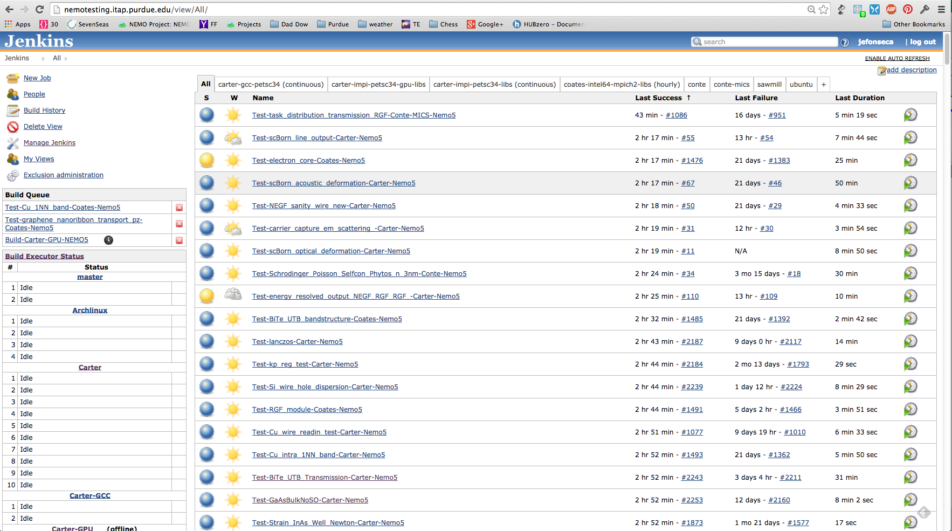
Tool Development Timeline and Testing
1.0
2.0
3.0
MATLAB
OMEN
NEMO5
‘06
‘07
‘08
‘09
‘10
‘11
‘12
‘13
‘14
~100 svn commits of Bandstructure Lab
~9200 commits of NEMO5 during development
Jenkins
  http://jenkins-ci.org/
  Continuous integration and testing system
  Alerts developers / owners
    Validity
    performance
12 bandstructure lab regression tests
Notes:
NEMO5 development work from July 2012 until Feb 2013 for publication.
Activation energy
~2000 commits from n5 dev start to 3.0 publication

Slide 11
Best Practices
Multiple, noncurrent developers
  Testing
  activation Energy
Development Guide and Resources
  Linux
  SVN
  NEMO5
  nanoHUB
  Rappture
  Wrapper code
    Tcl, C
  HPC systems

Slide 12




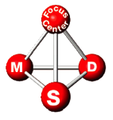


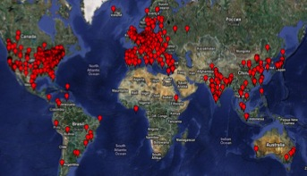


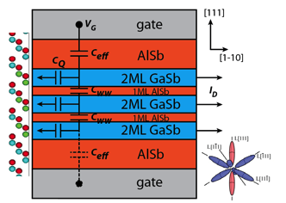
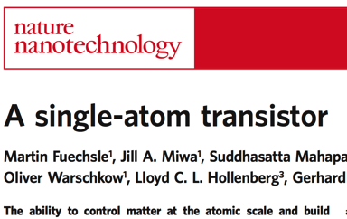

NEMO Agenda, Funding, and Leverage
Industrial Use
Tunneling Transistors
GaN, MoS₂
Intel Samsung
TSMC Philips
Industrial
Development
Contacts, HEMTs
NSF-NCN
18,000 users
NSF-OCI
NSF-NEB
Quantum Computing
Peta-Scale Computing
Notes:
TI contact at intel Ravi Pilarisetty

Slide 13
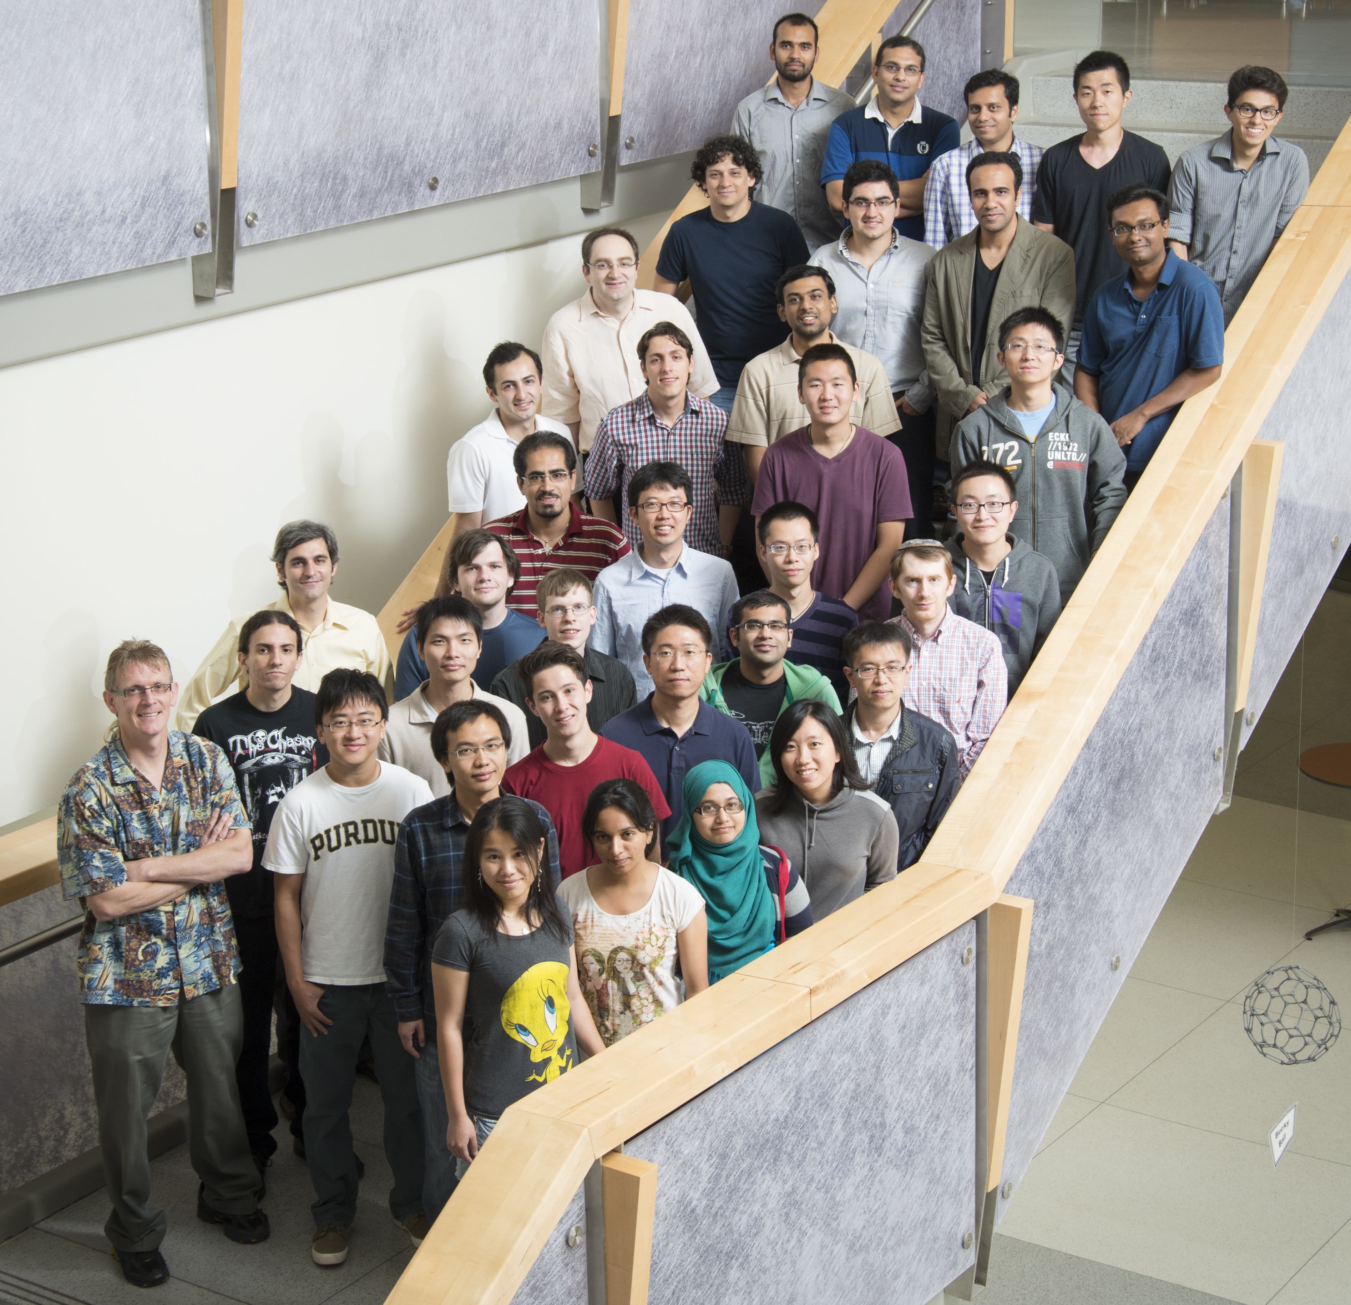
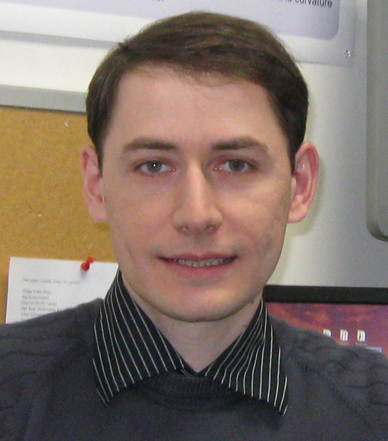
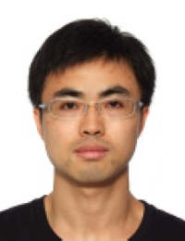
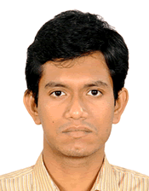


iNEMO Group
PI: Gerhard Klimeck
3 Research Faculty: Tillmann Kubis, Michael Povolotskyi, Rajib Rahman
Research Scientist: Jim Fonseca
2 Postdocs: Bozidar Novakovic, Jun Huang
Students: Kyle Aitken, Tarek Ameen, Yamini Bansal, James Charles, Chin-Yi Chen, Fan Chen, Yuanchu (Fabio) Chen, Rifat Ferdous, Jun Zhe Geng, Yu He, Yuling Hsueh, Jun Huang, Hesameddin Ilatikhameneh, Zhengping Jiang, Daniel Lemus, Pengyu Long, Daniel Mejia Padilla, Kai Miao, Samik Mukherjee, Ahmed kamal Reza, Santiago Rubiano, Harshad Sahasrabudhe, Mehdi Salmani Jelodar, Prasad Sarangapani, Saima Sharmin, Yaohua Tan, Yui Hong Tan, Archana Tankasala, Daniel Valencia Hoyos, KuangChung Wang, Yu Wang, Evan Wilson
SURF Students: Josef Borga, Woody Gilbertson, Kevin Margatan, Vincent Ntarugera, Travis Shepherd, Zach Schaffter

