Slide 1
The Use of Super Groups to Support AAU and the STEM Undergraduate Education Initiative
Hubbub 2014
Ann Bessenbacher
Discovery Learning Research Center
Purdue University

Slide 2
Overview
Background of STEMEdhub
AAU (Association of American Universities) STEM Education Initiative
AAU Super Groups

Slide 3
Background of STEMEdhub
Created April 2011
Shared project/group funding model
Participants register and participate for free
One hub manager with many group administrators
Users: Education Researchers, K-12 Educators, Public

Slide 4
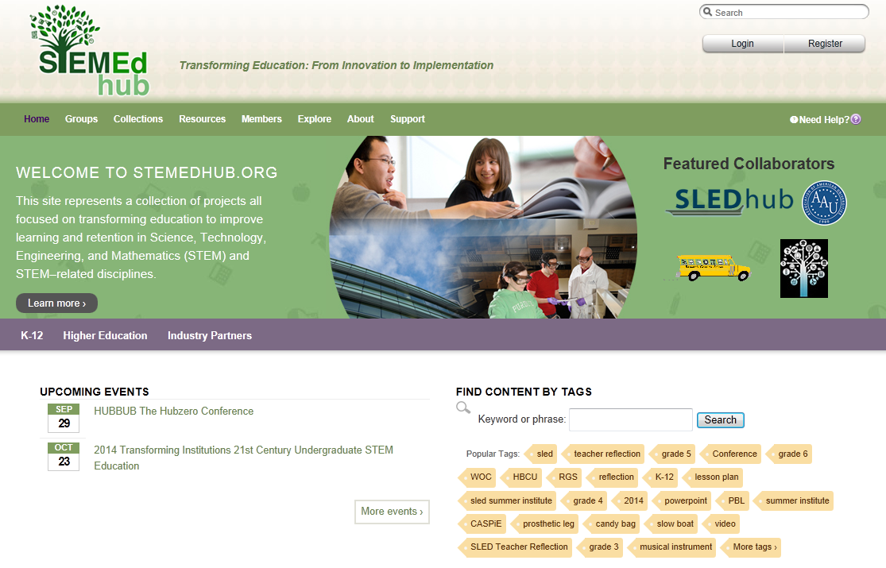
Background of STEMEdhub
1200+
Users
800+
Resources
40+ Groups

Slide 5
AAU Association of American Universities
AAU is a nonprofit organization of 62 member universities in the US and Canada
Launched a 5 year initiative to improve the quality of undergraduate STEM Education
Effort is based on existing research to influence the culture of STEM departments at AAU universities focused on first-year and sophomore levels

Slide 6
Goals of AAU’s STEM Education Initiative
Develop an effective analytical framework for assessing and improving the quality of STEM teaching and learning
Support AAU STEM project sites – 8 seed funded laboratories
Explore means that institutions and departments can use to improve STEM teaching and learning
Work with federal research agencies to develop means of recognizing, rewarding, and promoting efforts to improve undergraduate learning
Develop effective means for sharing information
Notes:
1Develop an effective analytical framework for assessing and improving the quality of STEM teaching and learning
2Support AAU STEM project sites at a subset of AAU universities
to implement the framework, and develop a broader network of
AAU universities committed to implementing STEM teaching
and learning reforms;
3 Explore means that institutions and departments can use to
train, recognize, and reward faculty members who want to improve
the quality of their STEM teaching;
4 Work with federal research agencies to develop means
of recognizing, rewarding, and promoting efforts to improve
undergraduate learning; and
5 Develop effective means for sharing information about
promising and effective undergraduate STEM education programs,
approaches, methods, and pedagogies.

Slide 7
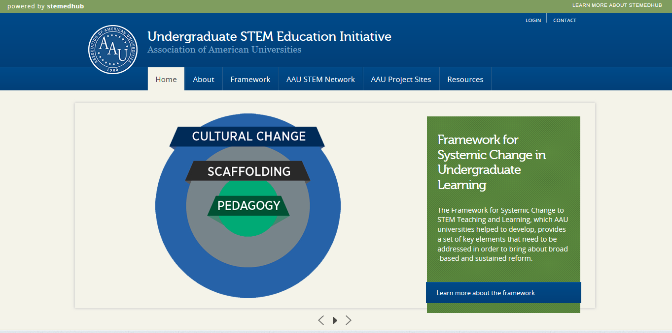
AAU Group
Serve as a collaboration network of STEM Education Researchers
Showcase examples of innovative institutional efforts from both project sites and other member sites
Sustain dialogues on systemic change across AAU member campuses

Slide 8
AAU Group
Main group at http://www.aau.edu/stem
Designed to coordinate in colors with both the AAU website and STEMEdhub
Simple navigation menu: Home – About – Framework -AAU STEM Network – AAU Project Sites – Resources
Repeated slider designs on three pages that both myself and the AAU staff can update and manage
Embedded videos, data chart slider, and twitter feed

Slide 9
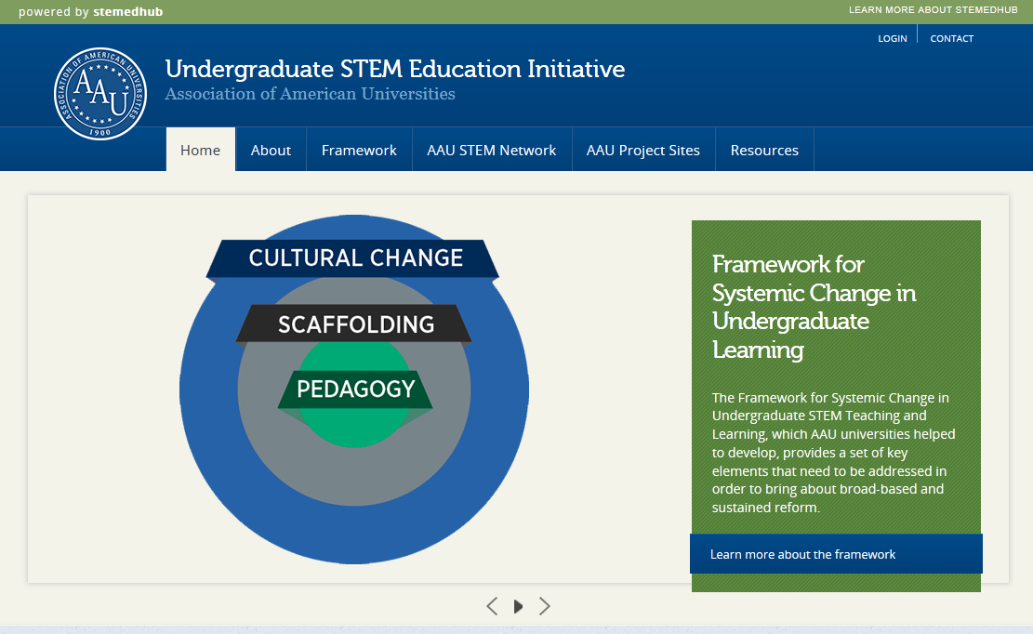
AAU Group – Home Page

Slide 10
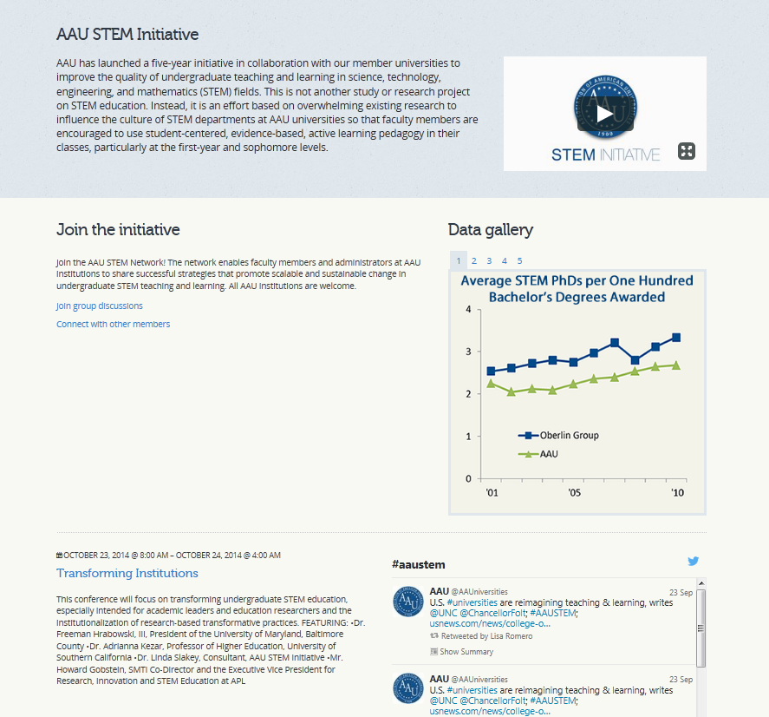
AAU Group –Home Page Cont’d

Slide 11
AAU Group Framework
Notes:
Interactive database of STEM Education Reforms
Institutions upload and edit their reform efforts through an online Qualtrics survey form
Efforts displayed through a graphical online interface
Users select a category box and the reform efforts are displayed below
Additional filters available on the right
Boxes change size based on the filters selected to visually show the impact of the filters selected
Displayed efforts have links to their group pages along with effort summary

Slide 12
AAU Group Framework Filters

Slide 13
AAU Framework Efforts

Slide 14
AAU STEM Network Page

Slide 15
AAU Project Sites Page

Slide 16
AAU Resources

Slide 17
AAU Group Members
AAU Project Sites were required to participate in the AAU group as a part of their seed funding.
AAU Member Institution points of contact were invited to join the AAU group as well as all AAU Conference Participants
Points of contact are made managers of their individual institution groups, invite members to join their group and those participants are made members of the AAU group.

Slide 18
AAU Institution Super Groups
Notes:
Each institution that submits an effort gets an individual super group
Base institution super group template based on AAU group template
Additional Qualtrics form to submit institution group customizations
Reform effort photos for slider
Institution logo
Institution description
Contact information
Member list and forum
Custom section: current events, link to another site, twitter feed or video

Slide 19
Thank you
Ilya Shunko- Hubzero Designer
Emily Miller – AAU STEM Initiative Project Director
Matt Stephen – AAU STEM Initiative Project Assistant

