Slide 1
THE NEW LOGISTICS OF KNOWLEDGE
PUTTING THE “I” BACK IN CIO: BIG DATA, BIG CHANGES
Dr. Gerry McCartney
Vice President for Information Technology and System CIO
Oesterle Professor of Information Technology

Slide 2
Institutional Data Analytics Platform (IDAP)

Slide 4
CHANGING CUSTOMER EXPECTATIONS
Traditional Business Model
Outcome Business Model
Sell It to Me
Let Me Try It
Install It for Me
Manage It for Me
Fix It for Me
Drive My Full Adoption
Optimize It for Me
Guarantee My Business
Outcome

Slide 6
KEY ATTRIBUTES OF
OUTCOME DRIVEN ORGANIZATION
Hyper-Aware
Predictive
Agile
Monitor customer behaviors in real time
Identify competitive changes
Balance innovation against calculated risks
Sense the location, status & context of company assets, customers
Anticipate market transitions
Optimize performance of assets, operations
Proactively address emerging security threats
Prioritize investment based on greatest impact
Measure progress constantly
Respond faster than rivals
Fail fast if necessary
Foster disruptive innovation
Respond to rapidly evolving threats
Flex methodology & process

Slide 7
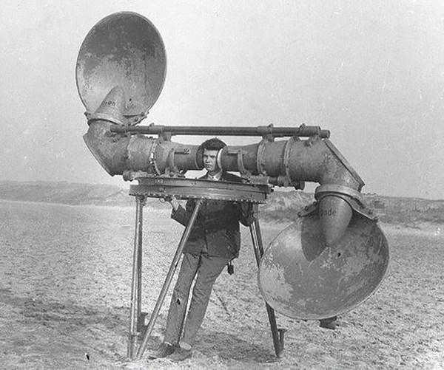

Slide 8
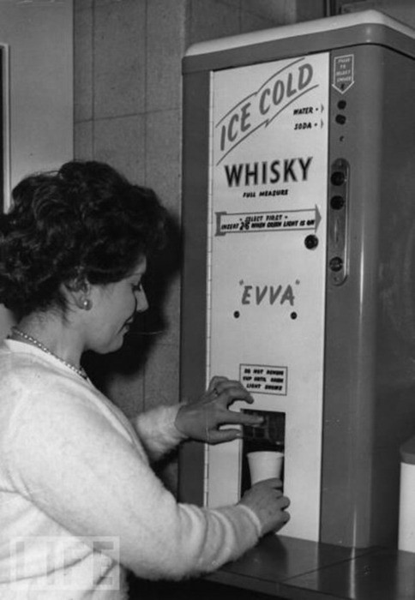

Slide 9
PUTTING THE “I” BACK IN CIO
@gerrymccartney

