Slide 1
HUBbub 2014
The HUBzero Conference
#hubbub2014 @hubzeroplatform
hubzero

Slide 2
State of the Hub: 2014
Michael McLennan, Ph.D. Director, HUBzero® Platform for Scientific Collaboration Purdue University mmclennan@purdue.edu

Slide 3
?
Why are
we here?

Slide 5
60+ Hubs for many disciplines
visitors users
705,725 330,939 nanoHUB.org
364,304 118,016 nees.org
63,487 32,236 pharmaHUB.org
62,495 5,492 HABRIcentral.org
53,507 13,487 vhub.org
49,559 23,168 GlobalHUB.org
47,972 6,976 ciHUB.org
47,085 12,788 cceHUB.org
46,083 5,166 PURR
45,833 5,473 iemhub.org
45,176 9,069 molecularHUB.org
41,048 8,078 StemEdHub.org
~1,800,000 visitors total

Slide 6
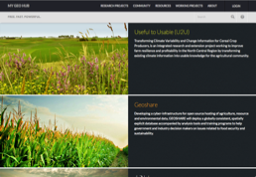
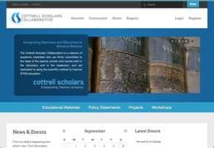
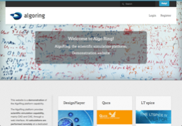
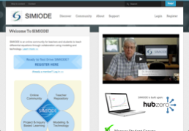
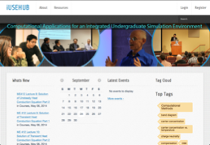
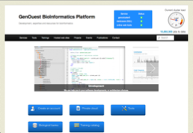
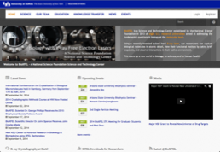
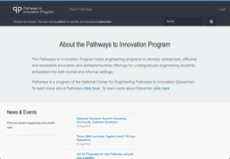
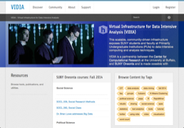
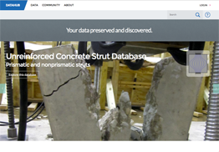
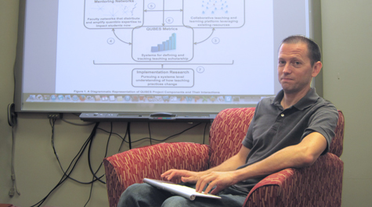
19 New Hubs
QUBES project
Drew LaMar
And more on the way…

Slide 7
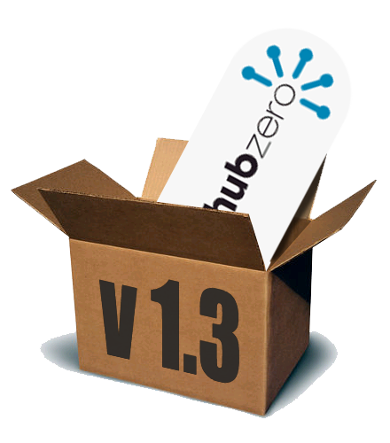
80+ improvements
CKEditor – WYSIWYG text
Collections Interface
Course preview mode
Course certificates
Data curation framework
Recurring events
New member dashboard
file restore in projects
Gravatars and Identicons
“Find This” plug-in
Simplified login page
Drag to create calendar event
PDF for Wiki pages
Video transcripts
New administrator dashboard
New Web APIs
Stronger password hashing
http://hubzero.org/download
VMware virtual machine images
Debian packages
RedHat packages
NEW!

Slide 8
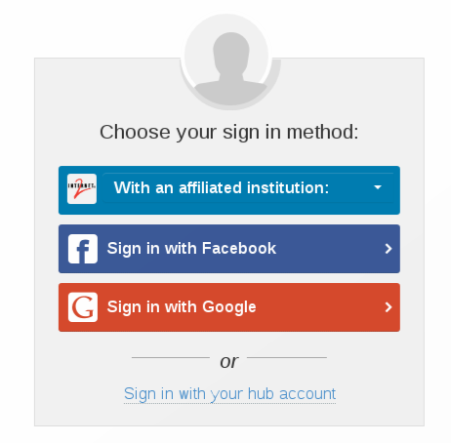
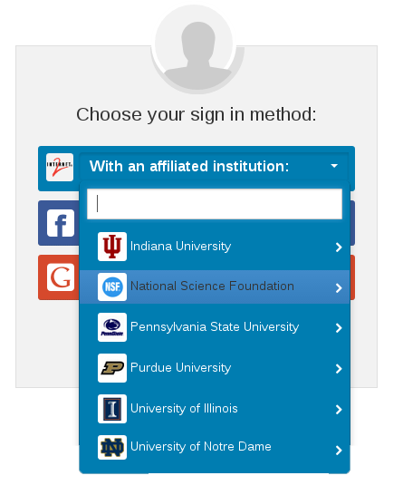
InCommon Authentication
Serves 7.8 million end users
Shibboleth-based authentication
Log in with your institutional account
More trust for InCommon users
Add-on pack for HUBzero
https://hubzero.org/documentation/1.3.0/installation/addons.shibboleth

Slide 9
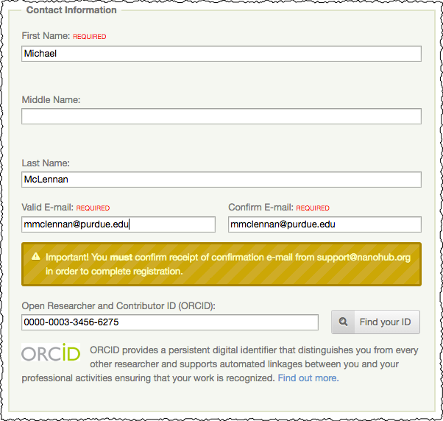
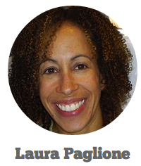
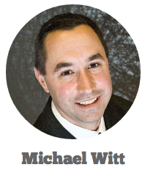
ORCID Integration
Associate your ORCID with your hub profile
Attach your ORCID to digital publications produced on the hub
Find related publications elsewhere

Slide 10
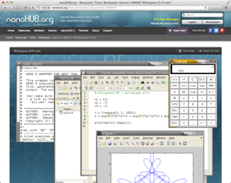
RedCloud
Subscription-based cloud computing
Supports parallel MATLAB runs
Integrated into HUBzero
Hub

Slide 11
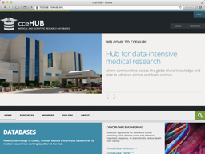
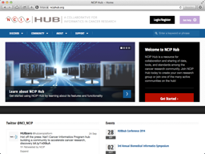
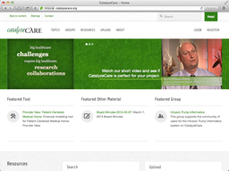
Cybersecurity
HIPAA
FISMA
CTSC CyberCheckup, April 2014
41 good practices
3 things to consider
6 areas for improvement:
2-factor authentication for admins
Better documentation for physical security
Starting a deeper engagement:
Improve policies for vulnerability management
Look for any gaps in access control model
trustedci.org

Slide 12
Running HUBzero on Amazon
Let Amazon be your web host
First release: Social hub (no tools)
$0.03/hour + machine charges
Proceeds go to HUBzero Foundation

Slide 13
Thanks to our Sponsors
Corporate Sponsors

Slide 14
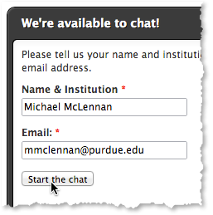
Join the HUBzero Foundation
$5,000 to join
20 hours of tech support
Discounts for additional support
Discounts for HUBbub and events
Helps to fund HUBbub and Hub Hero Challenge events
Instant Help during normal business hours
https://hubzero.org/about/foundation

Slide 15
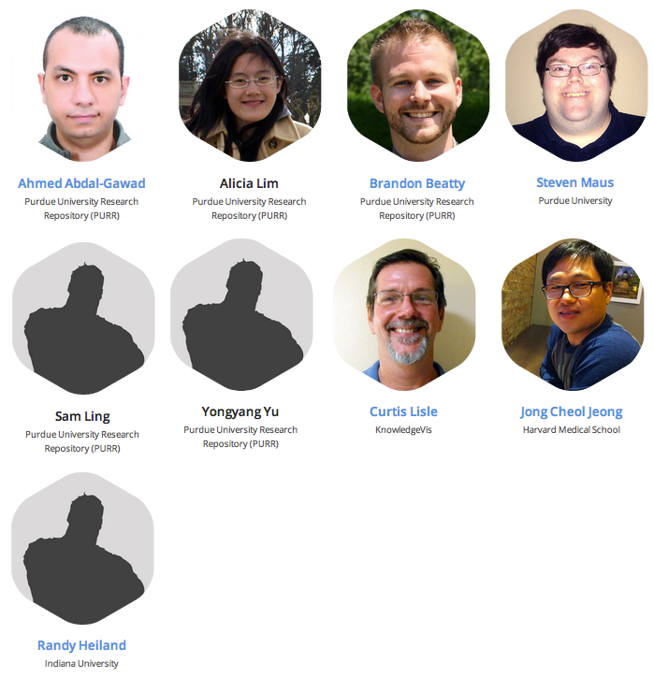
Hub Heroes
Anyone who has…
Contributed core code
Participated in challenge
Register Today!
Find out more:
http://hubzero.org/hubhero

Slide 16
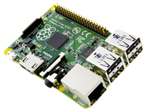
HUBbub 2014 Agenda
Monday
Tuesday
Wednesday
Plenary Session
Gerry McCartney, Andy Burnett, Ishwar Chandramouliswaran, Charles Ward, David Lifka
Plenary Session
Victoria Stodden, Laura Paglione, Abani Patra, Von Welch
Hub Hero
Challenge
Hub Users’ Meeting
Lunch
Lunch
HUBzero: Applications
and Experiences
Geospatial Capabilities
Web Dev Training Part I
Tool Dev Training Part I
Web Dev Training Part II
Tool Dev Training Part II
WIN!
Raspberry Pi
Computer
Banquet Dinner
Gameshow

