Slide 1
Courses Component: HUBzero Support for
Online Education
Emily Kayser
Hub Liaison, HUBzero® Platform for Online Collaboration
Purdue University

Slide 2


Where did this come from?
September 2011
May 2012
http://nanohub.org/u
http://purduenext.purdue.edu
25 courses covering mechanical
engr, electrical/computer engr,
computer science, chemical engr,
business systems, liberal arts
7 five-week courses
focused on nanotechnology
Notes:
We began developing our Courses Component, our course management system, to support the growing demand for digital learning on the hub.
Currently using our Courses component is being utilized by – nanoHUB, which has created Nanohub-U. PurdueNExT is another hub utilizing our Courses system.
The HUBzero platform is the underlying technology that powers this initiative and allows learners to watch video lectures, test concepts through visualization and computation, submit homework, take tests, and interact with other students and the professor all within the single environment and without downloading or purchasing software.

Slide 3
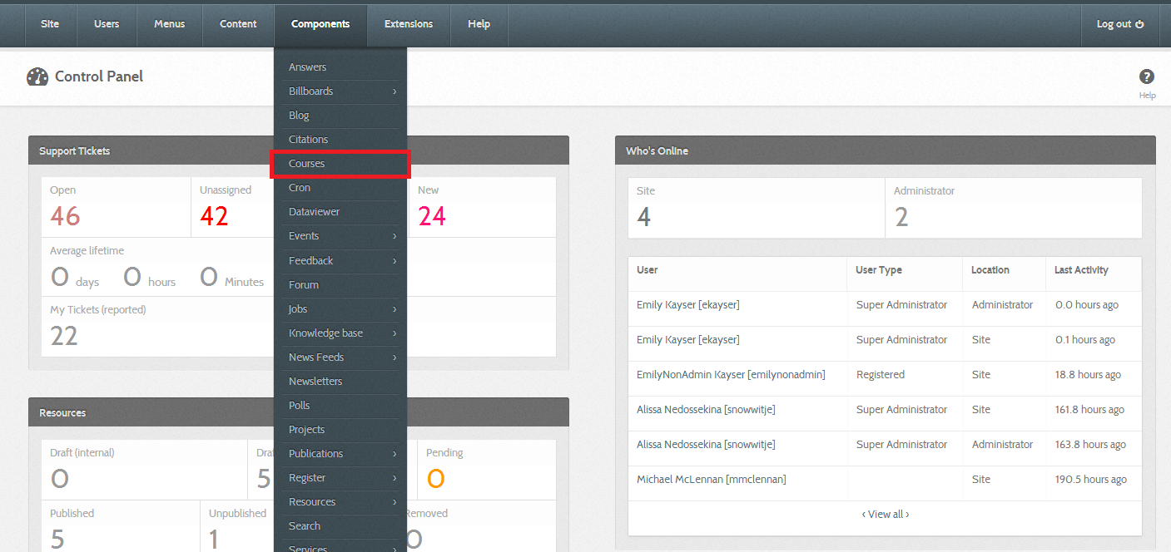
Create a course
Notes:
At the moment, only administrators on the hub can create a course. Navigate to Courses on the backend.

Slide 4
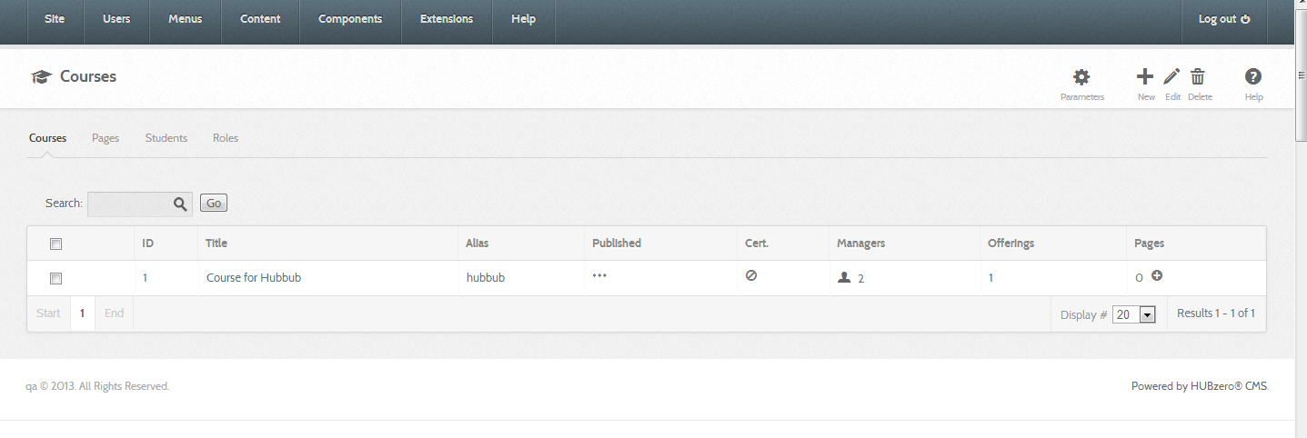

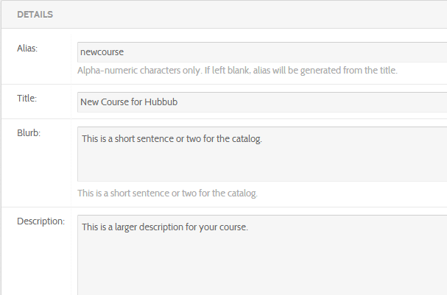

Creating a Course
Name for URL
Title of Course
Short description for the course catalog
Full Description

Slide 5
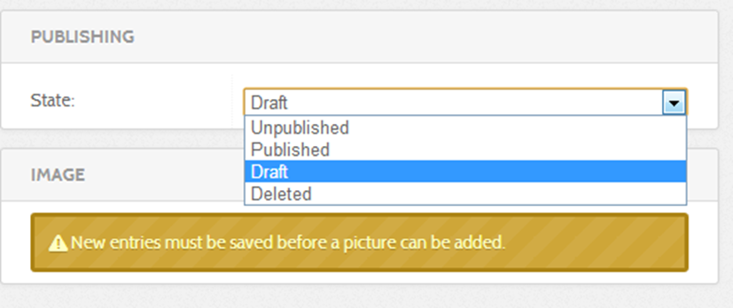

Publishing Options for a Course
Unpublished – Does not appear on frontend
Published – Available for students to enroll
Draft – Managers and Instructors are able to access on the frontend
Deleted – Course has been deleted, but will still remain on the backend
Notes:
You must save/apply changes to the course before adding a course logo or course level instructors/managers.

Slide 6
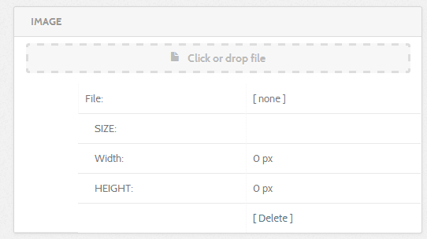
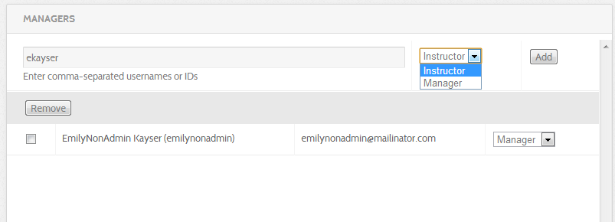
Adding a logo + Course managers and instructors
Notes:
Instructor or Manager

Slide 7
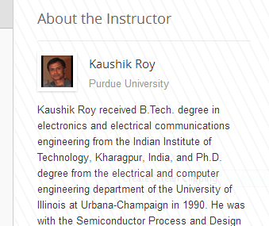
Course Roles
Course Instructor – Shows on the Course Overview page
Course Manager – Same access as the Course Instructor, but does not show in the overview
Section Instructor/Manager – Able to manage discussion threads in their section, but not able to upload or change content.
Notes:
Course content controlled at the Offering level– Only Course level instructors/managers can edit offering content/access Course Builder

Slide 8
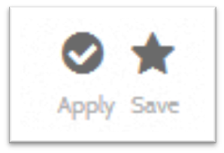
Adding Course managers and instructors
Notes:
Instructor or Manager

Slide 9
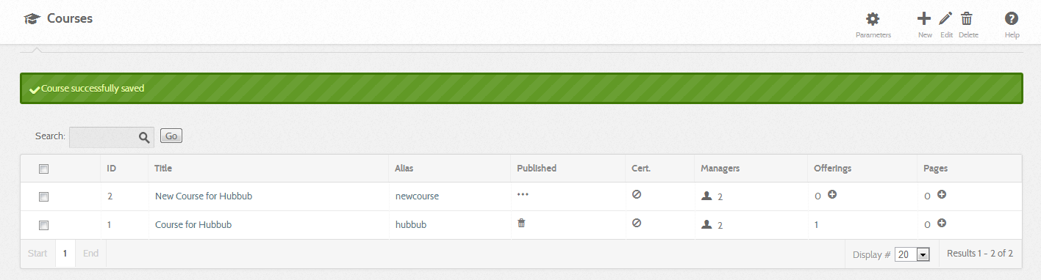
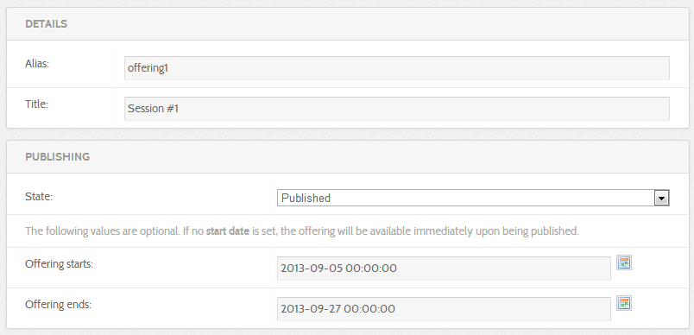
Create a Course Offering
Name for URL
Title of Offering
Publishing option
Offering Start and End Dates
Notes:
Think of offerings as versions of the course. If any content in the course changes, such as updated homeworks or tests, a new offering will be created.
After filling in info -- Click Save. A Default section is automatically created.

Slide 10




Supports Local Sections
Instructor(s) and
Teaching Assistants
Course
Offering
Spring 2012
Offering
Fall 2013
Section
Leaders
Section
Purdue
Section
IIT-Bombay
Section
Self-paced
Sections
have
different
schedules
Students
Notes:
Sections are created under offerings. Sections can have different schedules, and can take place at different times. For example, one 5 week section might take place in late fall, and another in early spring. Sections can also be self-paced, or scheduled by certain dates.

Slide 11
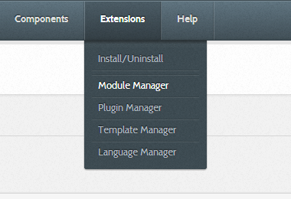
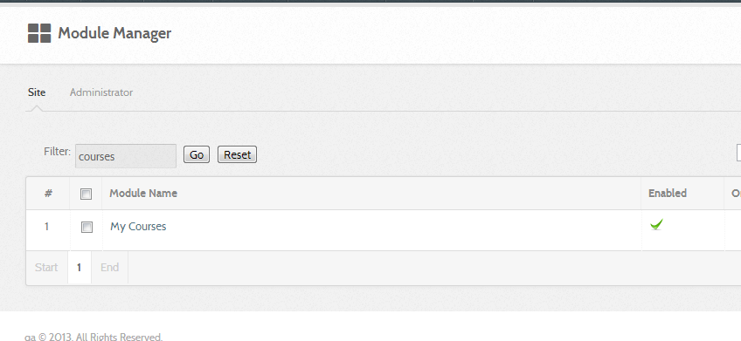

Add My Courses Module to Dashboard

Slide 12

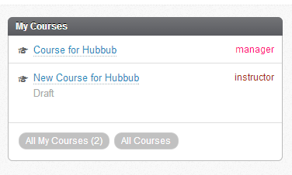
Adding My Courses Module
Notes:
Click on the title to view your course.

Slide 13
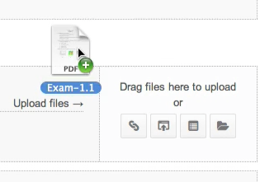
Instructor Experience
Drag-and-drop course builder
Monitor student progress
Latest discussion posts
Support for TAs and moderators
Notes:
Instructors have a slightly different interface than that of students. Instructors and course managers are able to drag-and-drop assets in the Course Builder in order to set up Courses. They can see a progress tab which allows them to monitor student progress.
They can also view and reply to the latest discussion posts from their Dashboard. When an instructor comments, they have an “Instructor” label to help students identify them.
There is also functional support for TA’s and moderators.

Slide 14
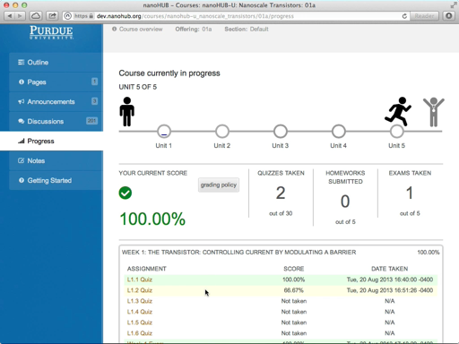
Student Experience
~20 min lecture videos
Self-test quizzes
Multiple choice exams
Homework with simulation tools
Discussion forums
Earn badges and certificates
Notes:
When you take one of our courses, you will watch lectures taught by world-class professors, learn at your own pace, test your knowledge, and reinforce concepts through interactive exercises. Every course is created based on a syllabus and presented online using an ordered, easy-to-follow framework. As the course progresses, students have access to all the notes, instructor lectures and discussions they’ve engaged in up to that point, as well as all the course materials. And the dialogue and interaction extends beyond classmates; For many courses, Professors are actively involved in online classroom discussions and available to answer questions.
Students can view prerecorded video lectures, take quizzes and multiple choice exams, complete homework with simulation tools, and finally earn badges and certificates. Courses involve hands-on learning through interactive, web-based tools that allow students to explore equations, execute computational models, analyze data, and visualize results.
Students have the unique opportunity to interact with the instructor and classmates via the discussion forum from anywhere in the world with internet access. The instructor will be available to answer questions and post additional materials as necessary. Some instructors may also hold electronic office hours and 'discuss' or 'work-out' the homework solutions.

Slide 15

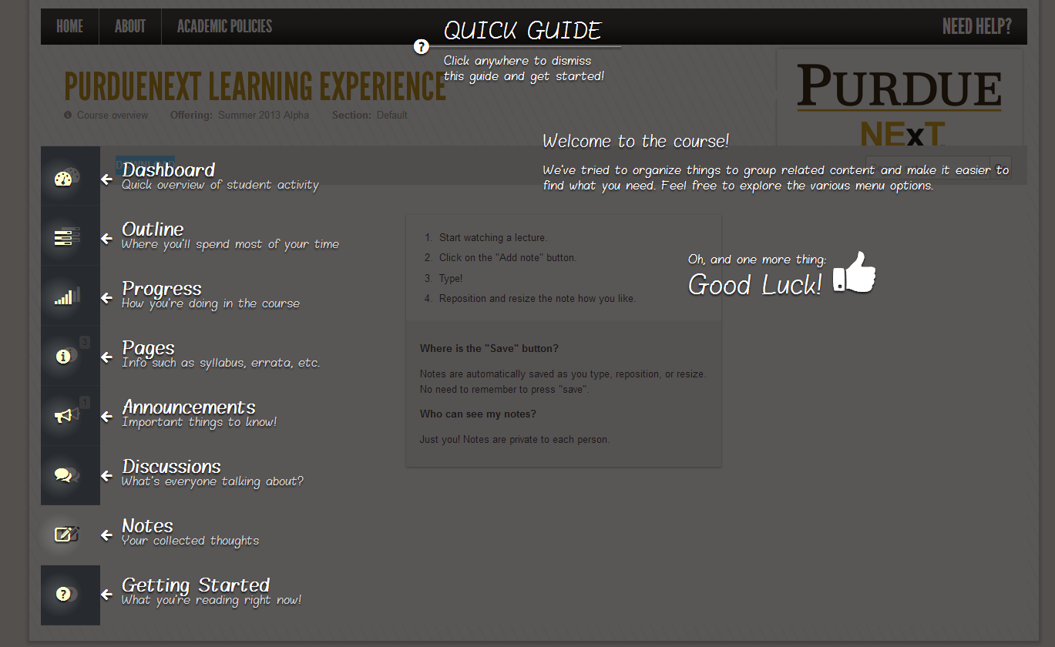
Quick Quide
Notes:
Instructor Dashboard – Quick Overview of Student Activity
Outline – Where you’ll spend more of your time – Building the course ;)
Progress – How your students are doing in the course
Pages – Info such as syllabus, errata, etc.
Announcements – Important things to Know
Discussions – What’s everyone talking about?
Notes – Your collected thoughts on lectures
Getting Started – Clicking this tab will bring back the overview page in case a user would like to view it again after they have clicked to remove it.

