Slide 1
Newsletters Component
Emily Kayser
Hub Liaison, HUBzero® Platform for Online Collaboration
Purdue University

Slide 2
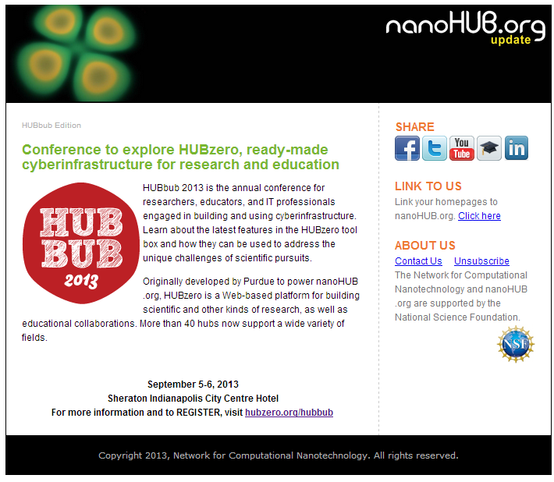
Newsletters on the HUB
Recent Activities
Upcoming Events
Updates
Featured Resources
New Features
Featured Members
Social Media Links
Notes:
Newsletters are an helpful and informative way to send updates about your hub to your users. Information such as upcoming events, featured members or resources, news, and much more can be shared through newsletters. The Newsletters Component allows hub administrators to create and manage newsletters and mailing lists.

Slide 3
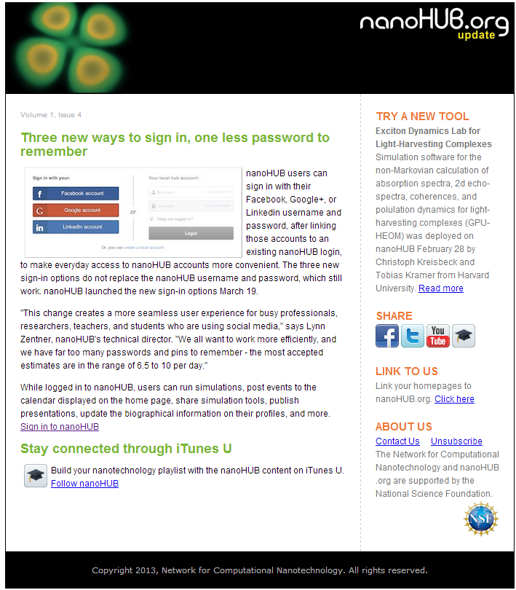
This presentation will demonstrate:
Subscribing to a Mailing List
Uploading a Newsletter from the backend
Creating a Mailing List
Adding users to a Mailing List
Check newsletter mailing stats
Tracking sent newsletters

Slide 4
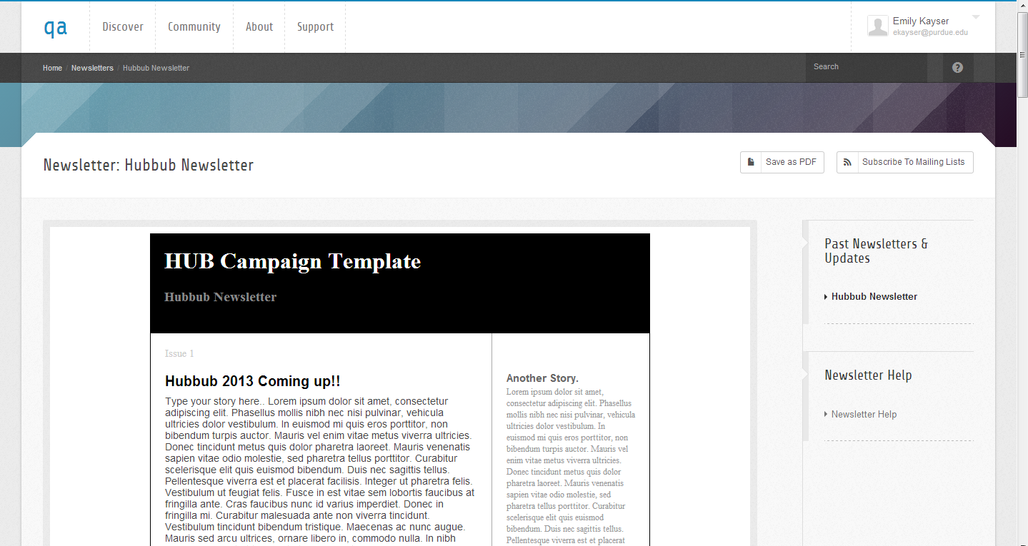
Newsletters on the Frontend
Notes:
Save as PDF – downloads the newsletter
Subscribe to Mailing list – Users able to choose from a list of public mailing lists
Past Newsletters and Updates – See past newsletters

Slide 5
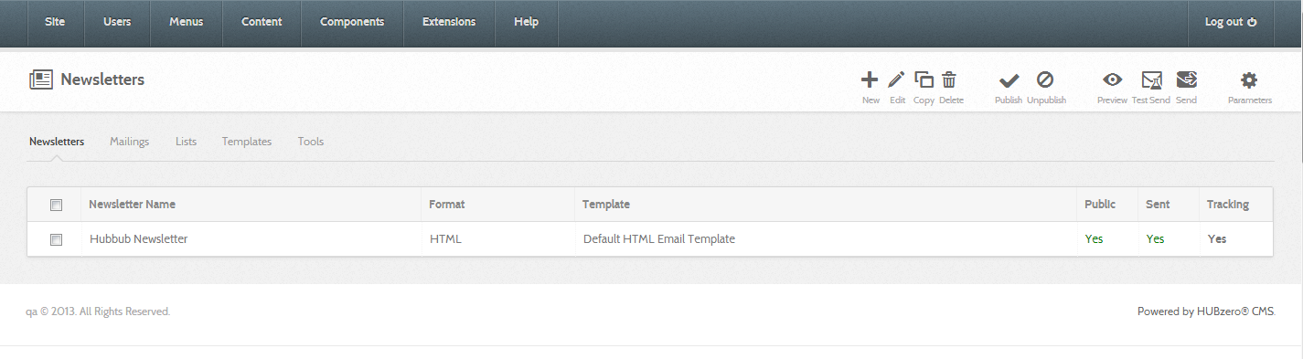

Newsletters on the Backend
Create, Edit, Publish, and Send Newsletters
Notes:
Emails are sent by cron jobs – Only 25 emails sent at a time. This helps avoid spam blockers.
From email and reply to email can be set in Options/Parameters. Filling in these emails upon creation of a newsletter will override these default settings.

Slide 6
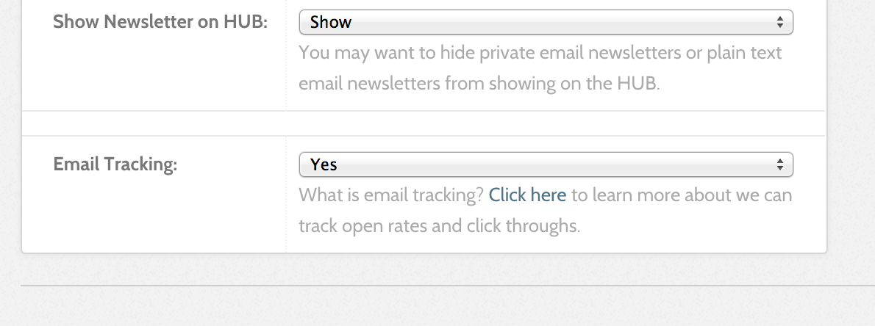
Email Tracking
Notes:
With Newsletters, Email tracking is available.
When the HUB sends out an email newsletter, we embed a tiny invisible image at the bottom of the email message. This image sometimes called a "Tracker" or "Web Beacon" is unique to each newsletter mailing.
When the newsletter is opened by a recipient, this "Tracker" is downloaded from our server and we count that as a 'open'.
We also track your newsletter clicks by directing the links in your newsletters to a central location, where we are able to capture that click, and then redirect the user to their final and desired destination.
By default is email tracking is set to 'on', but you can choose to turn off newsletter tracking at any time.

Slide 7

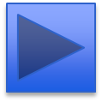
Newsletter Demo
Notes:
The Newsletters component functions mostly from the backend. – We will begin our demo there.
I will also show how to view the Newsletters on the front-end, and how to subscribe to a mailing list.

