Slide 1
Collections- Pinterest for Hubs The STEMEdhub.org use of Collections
Hubbub 2013
Ann Bessenbacher
Discovery Learning Research Center
Purdue University

Slide 2
Overview
Background of STEMEdhub
The basics of Collections
Collections on STEMEdhub

Slide 3
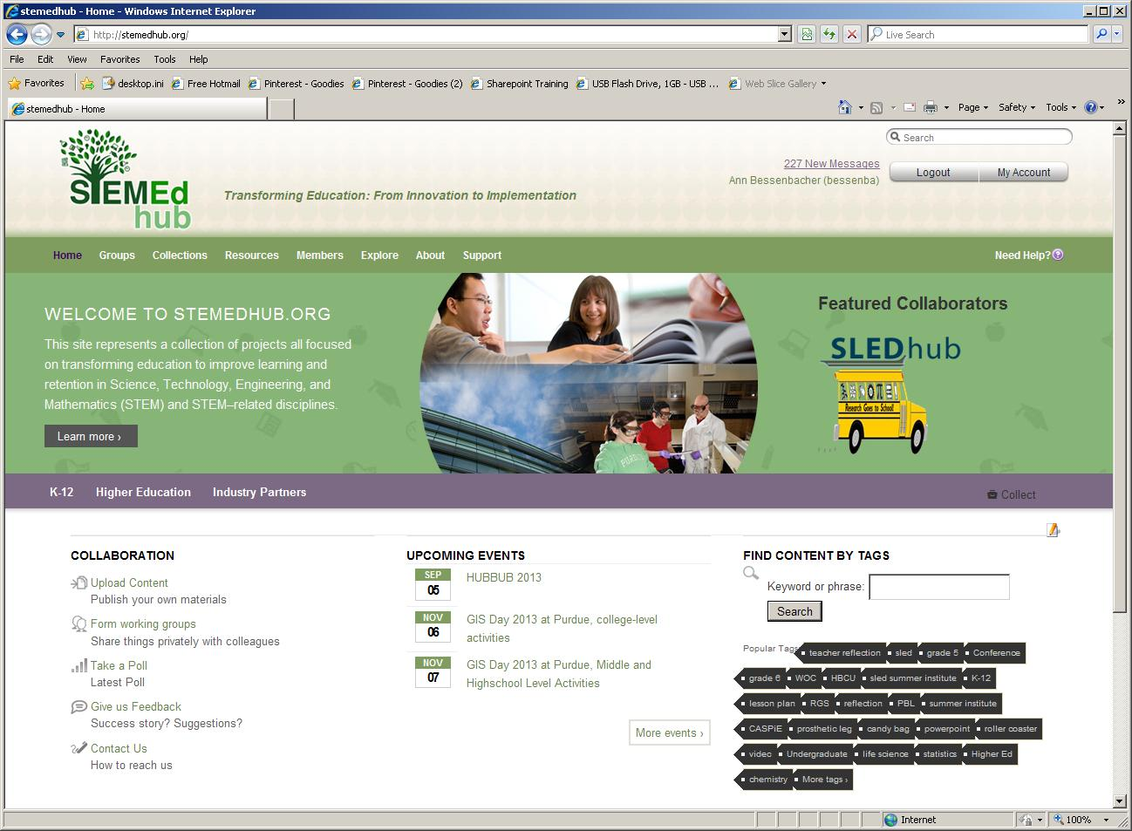
Background of STEMEdhub
600
Resources
690 Users
30 Groups
Notes:
Brings together researchers in STEM disciplines with teachers through Projects and groups.
- Broad focus on STEM (Science, Technology, Engineering and Math) education at all levels of education.

Slide 4
Background of STEMEdhub
Created April 2011
Shared project/group funding model
Participants register and participate for free
One hub administrator/technology steward with many group administrators
Notes:
shared funding model that ensures the continued life of projects past the end of their funding, and enables a quick start without the large expense of starting and establishing a new hub.
Individual participants register and participate for free including the ability to: contribute and track their own publications, join and participate in multiple user groups, and download and rate resources found on the hub.
One hub administrator/technology steward with many group administrators

Slide 5
Background of STEMEdhub
Users:
K-12 Teachers
Undergraduate Professors/Researchers
Education Researchers
Problem:
Share information easily and quickly
Informally publish information

Slide 6
The Basics of Collections
Collections
Notes:
Collections looks similar to Pinterest.

Slide 7
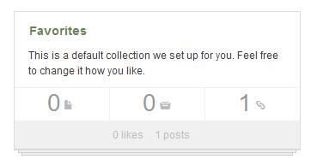
The Basics of Collections
Collections exist on two levels:
Personal
default favorites
public or private
Groups
defaults to security level of group collection tab
configurable between manager and member control
Notes:
Collections can be created personally in your dashboard or in a group.
All users on the hub automatically have a favorite group by default to collect their favorite pages, resources and collections on the hub.

Slide 8
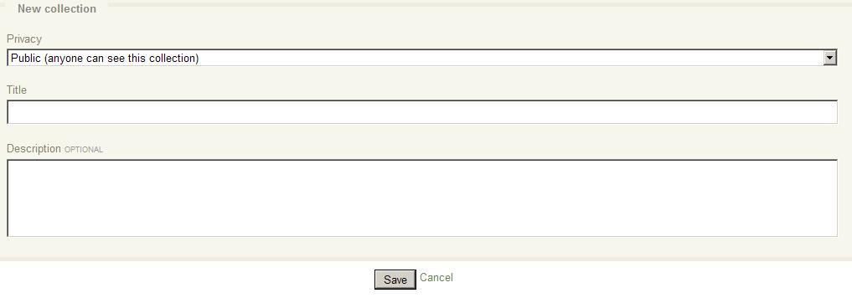
The Basics of Collections
Collection – Folder/Container
First: create the collection
Notes:
First you create a collection which is equivalent to a folder or container.

Slide 9
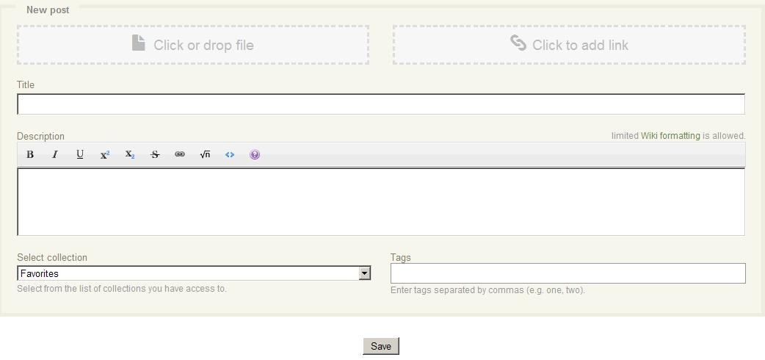
The Basics of Collections
Collection – Folder/Container
Second: create a post of images, videos, links or other documents
Notes:
Once you have your collection created you can create new posts to add images, videos, links or other documents to your collection.

Slide 10
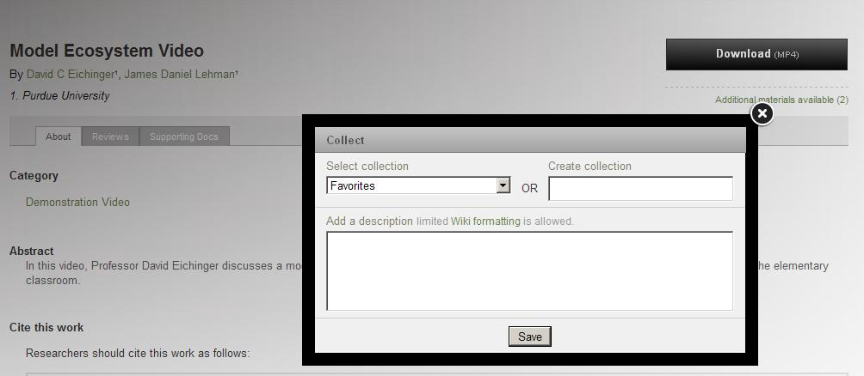
The Basics of Collections
Collection – Folder/Container
Third: collect resources or other collections to add to your collection

Slide 11
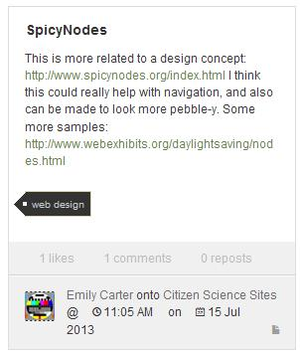
The Basics of Collections
Group and personal posts have:
Likes
Comments
Reposts (denotes that this post has been collected)
Notes:
You can like, comment and collect other posts. When you view a post it will tell you how many likes, comments and reposts it has.
You can not like your own post.
Simply click on the comment button to view all comments.

Slide 12
The Basics of Collections
Follow – all or current collection
Notes:
You can follow other personal or group collections. When you follow someone, their posts show up in your live feed. You can follow all of someone’s collections or just the ones you like best.

Slide 13
The Basics of Collections
Or be followed

Slide 14
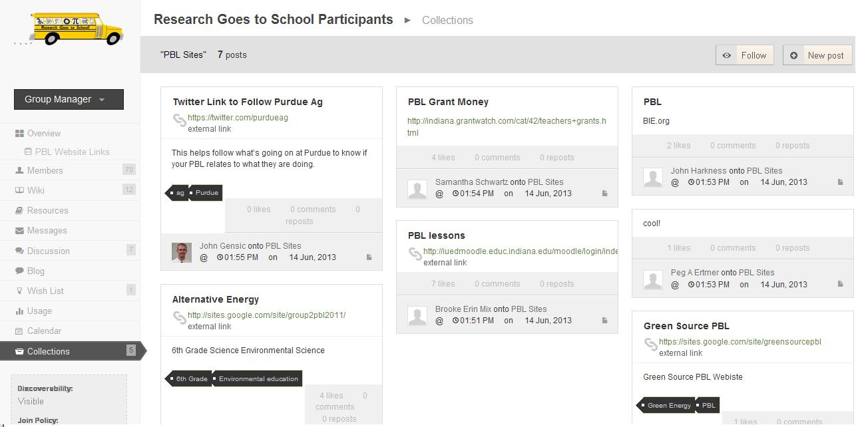
Collections on STEMEdhub
Used to make it easy for participants to share information.
Notes:
- Teachers are used to one-step procedures for uploading documents and the multiple steps required on the hub take too long.
Licensing agreements are wordy and teachers are reluctant to agree to them.
The traditional method for organizing resources for download make it difficult to find

Slide 15
Collections on STEMEdhub
Informal Project Management-
Used to share and comment on links and documents
Easy viewing of graphics without downloading
Description available with a quick glance
Easy to use for younger audiences

Slide 16
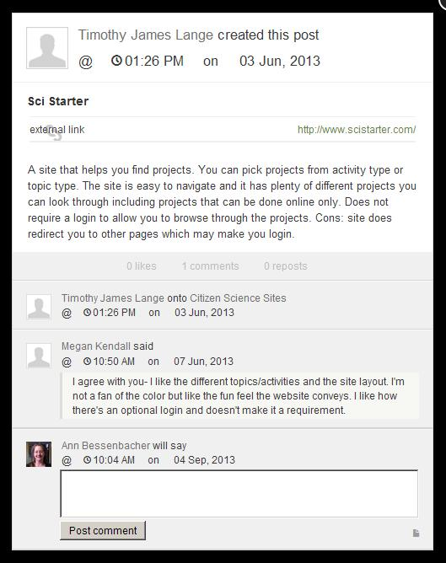
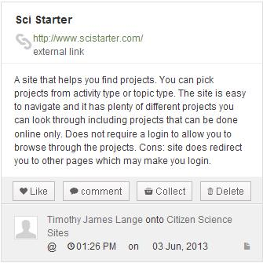
Collections on STEMEdhub
Used to share and comment on links and documents
Notes:
I used collections extensively this summer with our Ripple project.
Ripple is a project we are working on to build a citizen science group on STEMEdhub.org
Worked with undergraduate students who liked the quick and ease of uploading and sharing documents through collections.
Easier and quicker to use than projects.

Slide 17
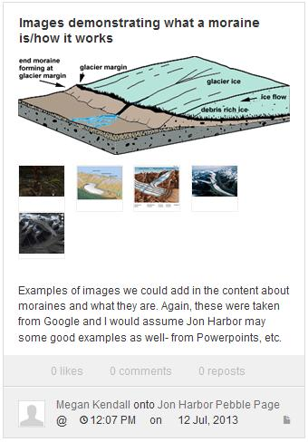
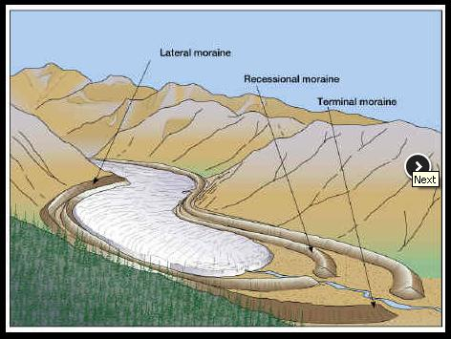
Collections on STEMEdhub
Easy viewing of graphics without downloading

Slide 18
Thank you
Shawn Rice - Hubzero
Erich Huebner – Hubzero
Mike McLennan – Hubzero

