Slide 1
Creating a Bibliography and Taxonomy within HubZero:
A HABRI Central Case Study
Gretchen Stephens & Jane Kinkus Yatcilla
Purdue University Libraries
Notes:
Thank you!
This afternoon, Jane Yatcilla and I will present how a bibliography and taxonomy is being created within HABRI Central, a digital hub for the human-animal bond research community, and how the librarian investigators within this project are contributing to it.

Slide 2
Research Partnership
Collaboration [2009]:
College of Veterinary Medicine (PVM)
Purdue University Libraries, and
Purdue University Press
Project Investigators:
Dr. Alan Beck [HAB Expert]
Charles Watkinson [PU Press]
Christopher Charles [Project Manager]
Gretchen Stephens [Bibliographer]
Jane Yatcilla [Taxonomy]
Mark Newton, Deborah Maron, & now Marcy Wilhelm-South [Digital Repository]
Felicia Trembath [Graduate Assistant]
Grant funding [2010]:
Human Animal Bond Research Initiative Foundation (HABRI)
Notes:
This research collaboration began in 2009 between the College of Veterinary Medicine, the Purdue University Libraries, and the Purdue University Press.
Project investigators, Dr. Alan Beck, Director of the Center of the Human-Animal Bond at Purdue, and Charles Watkinson, Head of the Purdue University Press, brought in Raym Crow, senior consultant from SPARC, for an environmental and financial stability scan to ascertain the viability of the proposed project.
Based on his report, a funding proposal was submitted to the newly-formed Human Animal Bond Research Initiative Foundation, a non-profit industry initiative that soon attracted additional industry and foundation members.
The first grant funded by HABRI is now known as “HABRI Central: Resources for the study of the human-animal bond.”

Slide 3
HABRI Central Structure
Project design:
Bibliography
Repository
Online Publishing Venue
Digital Community Hub
Two advisory boards to insure scholarly independence:
Management Advisory Board:
Individuals involved in academia, medicine, industry, and other areas of related to human- animal interaction
Discuss issues that affect the operation and sustainability of HABRI Central.
Editorial Board:
Experts and professionals from various fields related to human-animal interaction
Advise on the scope of the site’s content and oversee the review process for any original publications.
Notes:
The project design for HABRI Central focuses on four interrelated online resources:
A bibliography to compile the published and unpublished literature in this highly interdisciplinary field
A repository of open access resources and materials available with publisher permission
An online publishing venue for original scholarship
A digital community hub to facilitate research and collaboration and to encourage scholar and public interaction
Two advisory boards were established in the center’s management structure to insure scholarly independence.

Slide 4
Developing the Bibliography
Agree upon HAB journals to index comprehensively
Identify key topics within scope of the project
Create “value added” features
Add peer-viewed and evidenced-based tags to articles
Index book sections in key HAB books
Add citations for Editorial Board’s publications
Find earlier bibliographies in the field for inclusion
Select databases to search, prioritize retrieval, & save results to EndNote X5 for final edit before uploading.
Notes:
Development of the bibliography began with:
Agreeing on key HAB journals to index comprehensively
Identifying key topics, such as animal-assisted therapy or pet loss, as in scope
And clarifying that broader topics, such as animal behavior or animal rights , although relevant to human-animal bond are already well indexed elsewhere and will not be comprehensively indexed here.
Next we created “valued added’ features:
Adding peer-reviewed and evidenced-based tags to articles
Indexing book chapters and sections from key HAB books
Then we added citations to all Editorial Board members’ publications
And identified earlier bibliographies in the field for later inclusion
In order to strategically build the bibliography:
We select and prioritize relevant databases to search, focusing on current scientific literature first, and then
Save search results into Endnote X5 for final edit before uploading into the hub using a specially formatted export file.

Slide 5
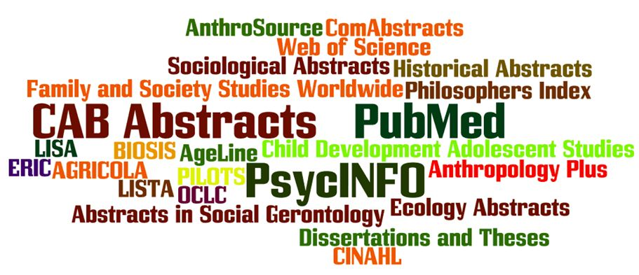
Databases Being Covered
Notes:
Selected databases being covered in HABRI Central are highlighted in this wordle.
To date, the most productive databases have been CAB Abstracts and PubMed, but equally interesting are the citations have been obtained from some of the small and more specialized databases, such as Abstracts in Social Gerontology and Published International Literature on Traumatic Stress (PILOTS )

Slide 6
HABRI Central Bibliography
16,700+ citations identified to date [1909-2013]
14+ databases searched
1,800+ journals with one or more relevant articles
1,300+ peer-reviewed journals with one or more relevant articles
1,980 book chapters and encyclopedia sections indexed
550 theses and dissertations identified [1915-2013]
Notes:
Currently, the HABRI Central bibliography features:
Some 16,700 citations from more than 14 databases.
That includes one or more relevant articles from over 1,800 journals
Of which, 1,300 are peer-review journals
In addition, 1,900 books chapters and encyclopedia sections have been indexed for the bibliography, and
550 theses and dissertations have also been added.

Slide 7
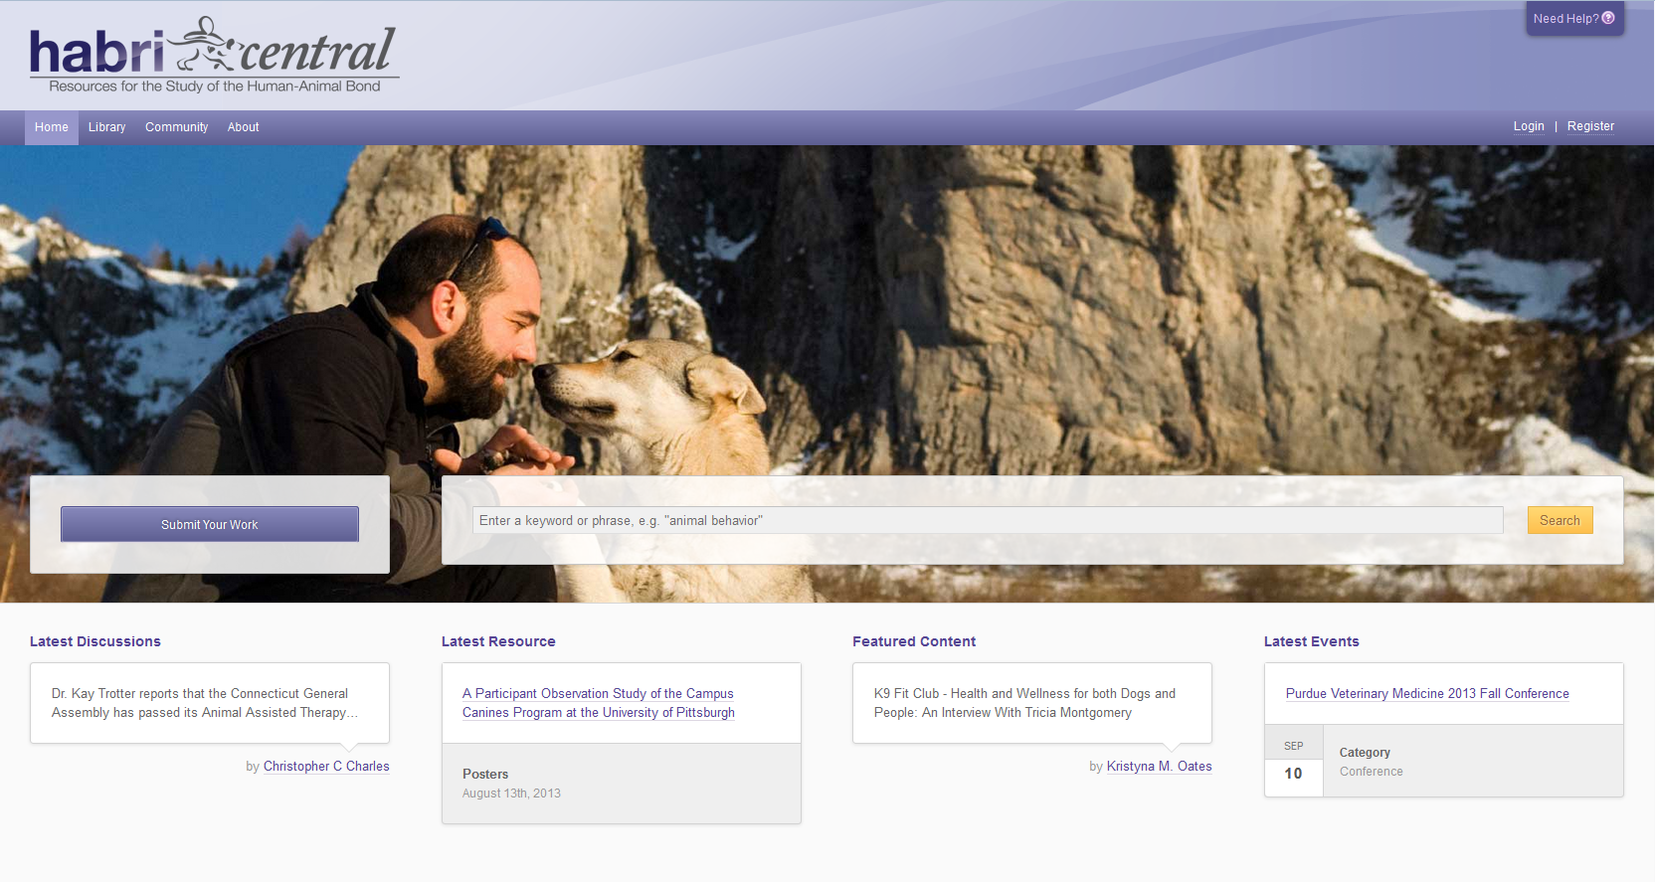
Notes:
Within HABRI Central, the new Hubgraph component of HubZero allows website users to access all resources via a single search box.
For example: If I entered “pet loss” into the search box,

Slide 8
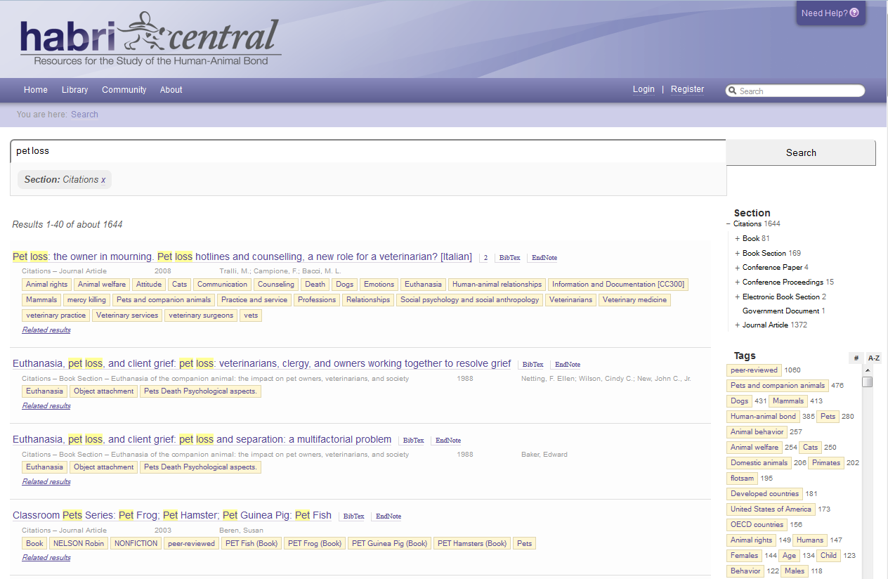
Notes:
Search results according to Section are:
1644 citations (in the bibliography)
33 events
2 groups
1 knowledge base article
10 members (interested in the topic)
151 resources (in the repository)
If I selected only “Citations”, I would see the 1644 citations from the bibliography on “pet loss”

Slide 9
Notes:
Within those citations on “pet loss,” there are 80 books, 160 book sections/chapters, etc. as well as 1300 journal articles.

Slide 10
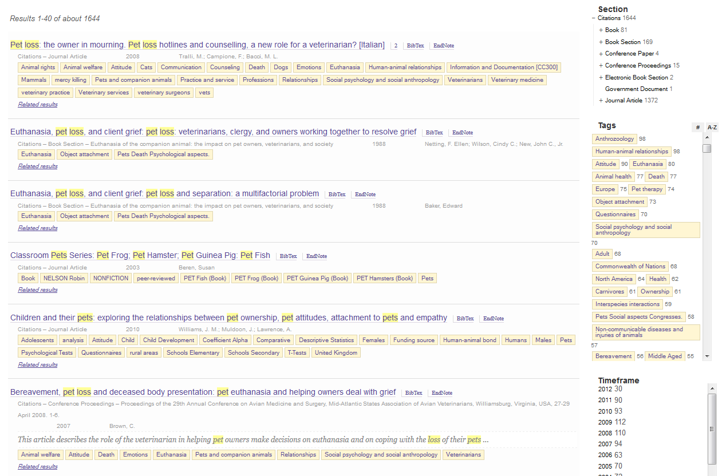
Notes:
In addition, you can see:
The most common Tags relevant to the topic, and
The Timeframe or publication years of available items, and thus you can limit by either as desired.
Selecting an individual title from this search, allows one to drill down to a single citation

Slide 11
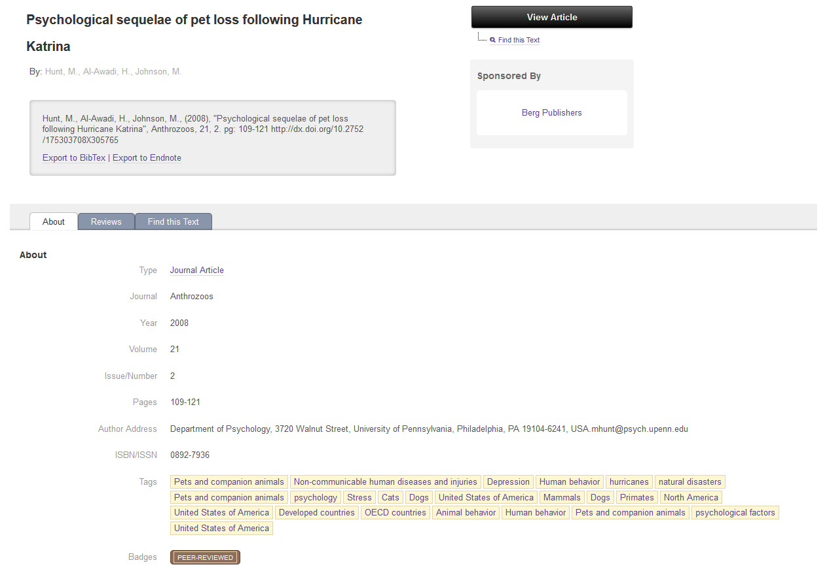
Notes:
In this single citation, you see a grey box with basic bibliography citation for the journal article with options to export it into either BibTex or EndNote bibliographic management software.
You can also find additional information such as the author’s address and a badge indicating the article is peer-reviewed.
In the upper right hand side of the screen, note that the citation is “sponsored” by Berg Publishers - meaning that we have sought and received permission from Berg to make the full text of this article available as seen in the “View Article” button

Slide 12
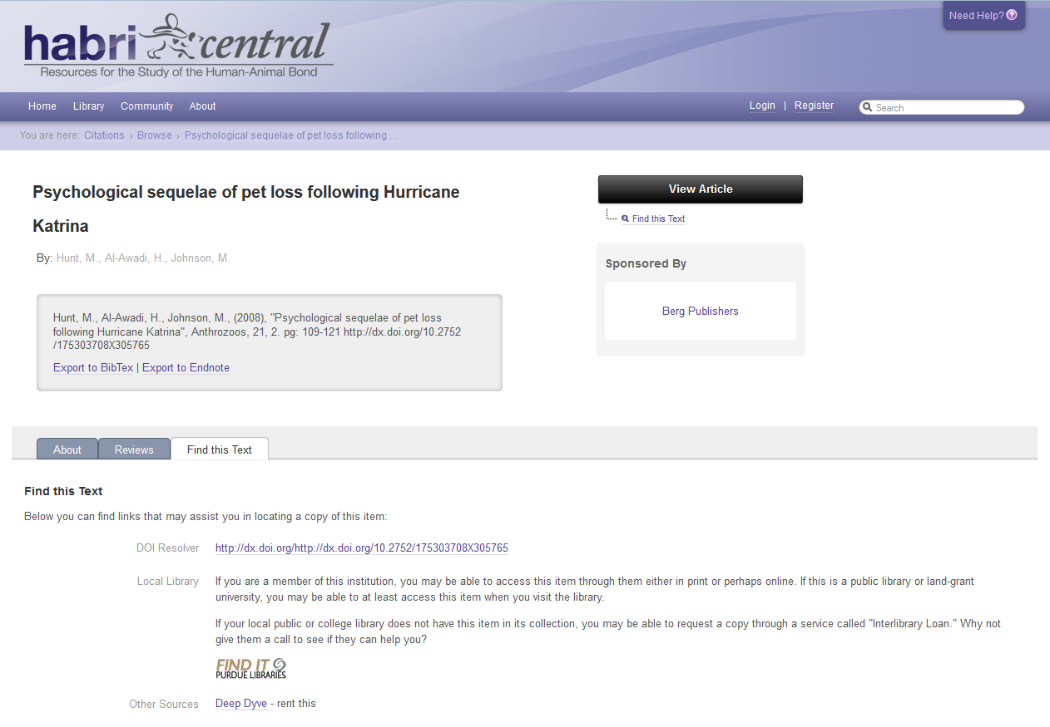
Notes:
If the article were not directly available from the publisher, the black button would read “Find this Text” and one would be guided to:
a DOI Resolver for the article (if available)
a link to a local university library link resolver,
a reminder that copies of the article could be requested via Interlibrary Loan through a local public or college library, or
or a link to information on how to rent the article through the online Deep Dyve service.

Slide 13
HABRI Central Repository
Develop repository for published and unpublished material relevant to human-animal bond via the basic resources feature of HubZero
Identify open access material for inclusion
Contact publishers to obtain permission to include selected HAB resources
Standardize metadata fields within bibliography and repository and edit EndNote X5 export component appropriately
Pursue merger of the bibliography & repository within HABRI Central
Notes:
In addition to the bibliography, HABRI Central is developing a repository using the basic resource feature of HubZero.
Over the past three years, a digital repository specialist (librarian) has been working to:
Identify open access materials (journal articles, theses, etc.) for inclusion in the repository
Contact publishers seeking permission to include abstracts, as well a selected group of HAB titles or articles in our site,
Collaborating with the bibliographer, to standardize metadata fields used within both the bibliography and repository.
We are continuing to explore with HubZero developers the possible merger of the bibliography and the repository components within HABRI Central
Now, Jane will update you on the taxonomy!

Slide 14
Creating a Taxonomy
Define the scope of a very INTERDISCIPLINARY field of research
Work with a growing collection of citations in bibliography
Look to subject experts, editorial board for input
Notes:
From the beginning, a priority of the HABRI Central project has been to create a taxonomy that defines the breadth of the interdisciplinary field of human-animal bond research.
It was initially conceived that terms from this taxonomy would be used to pre-poplulate the tags used to describe both citations in the bibliography, as well as any other works that community members might upload.
I started out doing typical taxonomy exercises, like sorting stacks of card with hand-written terms gathered from multiple searches in databases that Gretchen was planning to use.
Something that I was not expecting was that as Gretchen uploaded article citations into the bibliography, thousands of subject headings and keywords were pulled in from various databases like PubMed, CAB Abstracts, creating a morass of tags that represent many similar concepts but use different phrases, spellings, and formats.
The result is that multiple citations in our bibliography may be well aligned subject-wise, but they will not necessarily be tagged similarly because of their disparate origins.

Slide 15
Notes:
Here you can see the kinds of topics to be covered by the taxonomy.
As you can imagine, there is no agreed-upon language for human-animal bond research in disparate disciplines such as veterinary medicine and…sociology. Or anthropology, or geriatrics, or traumatic stress research.
As Gretchen uploaded large files of citations, my job became more of a “tag-wrangler” in that I needed to impose some sort of order on the tagging system, rather than systematically create a taxonomy.

Slide 16
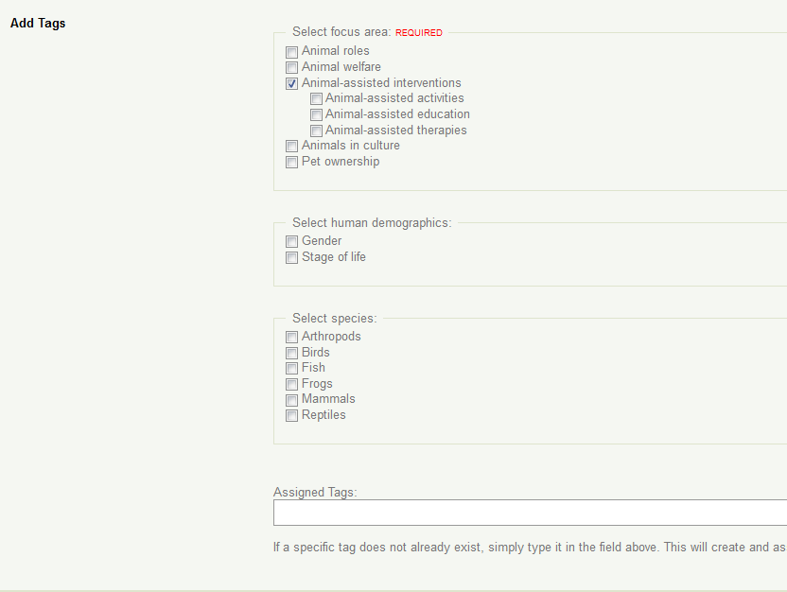
Notes:
Here you can see the beginning of the taxonomy as used in the tagging phase of resource upload. Users are required to select at least one of the broad focus areas. Choosing a sub-focus area, human demographic information, or animal species are optional.

Slide 17
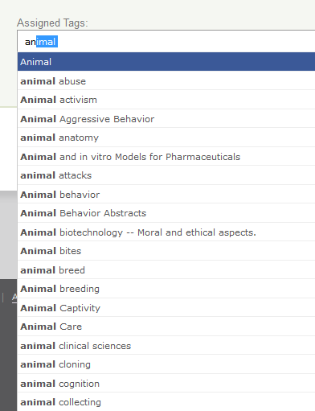
Notes:
When adding additional tags, the user is prompted with the auto-suggest list. Developers have suggested that when our taxonomy is more fleshed out, we could float the official taxonomic terms higher on the list, increasing the likelihood that users select from them.

Slide 18
Some Development Work
Requested that the “alias” function become prospective in addition to retrospective--i.e., for the tag relationship to persist.
When this was done, tag merging became synonymous with tag aliasing, and both functions are persistent.
Notes:
As we have worked on the HABRI Central hub, we requested that the tag alias function be made prospective in addition to retrospective. At the beginning of our project tag aliasing applied only to records that were already in HABRI Central. New resources or bibliography items could repopulate the tags with an undesirable term. So, tag aliasing was made persistent and permanent.

Slide 19
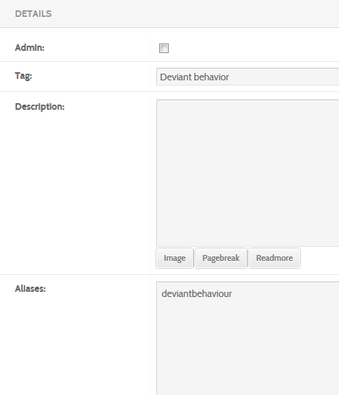
Notes:
Here you can see a useful way to implement permanent aliasing—to prioritize a particular spelling of a term. Here the American spelling of “behavior” is chosen over the British spelling.

Slide 21
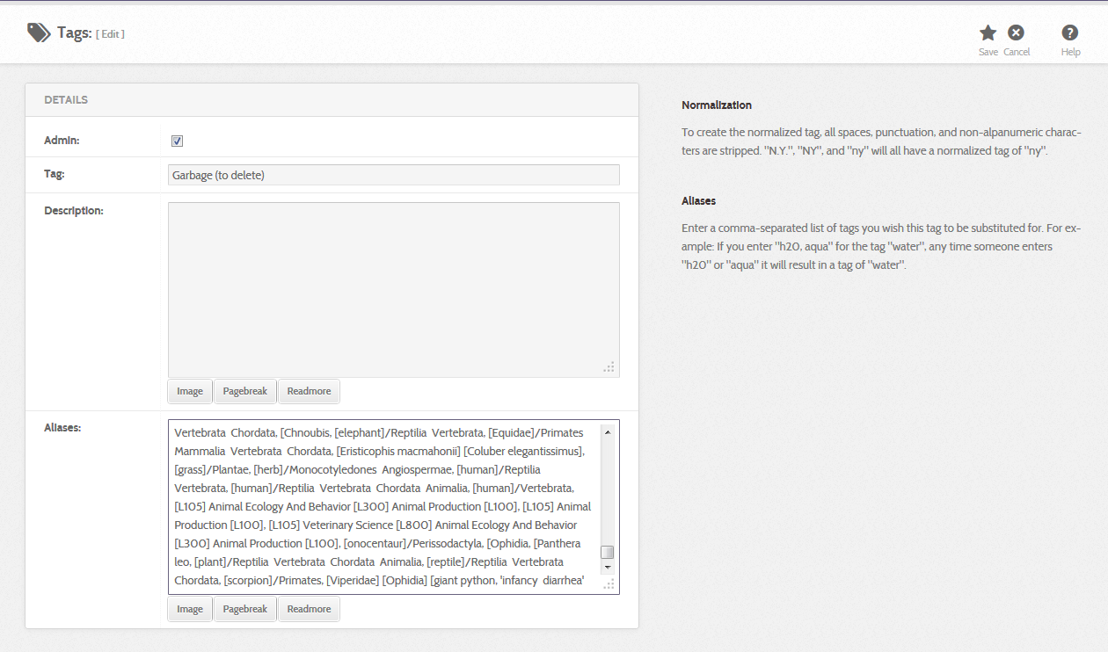
Notes:
A clever way to permanently hide undesirable tags is to alias them to an administrative tag that is never shown on the front end. For example, we have a “garbage” tag that effectively hides over a thousand terms from end-user view.

Slide 22
Additional Considerations
Aliasing permanently breaks the link between the original tag from the tagged record. Is it worth it to have developers make aliasing un-doable?
Is there room for both a controlled vocabulary (taxonomy, ontology) and free-form end-user tagging?
Notes:
One problem we have encountered with tag aliasing is that it cannot be undone. We can envision situations in which we want to make alterations to existing tag aliases; our team needs to decide if it is worth it to request developers make tag aliasing un-doable.
We are also mulling over the extent to which users are permitted to add new tags during resource upload. Is there room for both free form tagging and use of a controlled vocabulary, or will adoption of a controlled vocabulary override end-user tagging?

Slide 23
Challenges
Reconcile a controlled vocabulary (taxonomy or ontology) with an unregulated tag system
HUBzero was not developed to make use of a taxonomy
Work toward harmoniously resolving these two issues
Notes:
As you know, HUBzero uses a tagging system that permits any content contributor to tag resources in any way they desire. We have implemented auto-suggest to guide users to select terms already in existence. Another enhancement we have introduced to HABRI Central is the ability to permanently alias tags to a preferred term, which has helped a lot with tag organization.
When we approached the HUBzero developers about how a taxonomy could be implemented in a hub, we learned that HUBzero was not designed to make use of a taxonomy to organize content the way some other sites have been (for example, think of amazon.com with its faceted searching and suggested items). Therefore, it was easy to shift our focus from pure taxonomy creation to the more practical task of imposing order on a chaotic set of tags.
Further, Gretchen has encountered the use of confusing acronyms like PET and CAT in diverse areas of study, which slows searching considerably.

Slide 24
HABRI Central: A Work In Progress
Continued HABRI funding is anticipated for the next two years.
Bibliography to add HAB citations from liberal arts journals while keeping scientific literature current
Exploring further funding to model the creation of interdisciplinary taxonomies
Notes:
When our initial grant expires at the end of fiscal year 2014, we are looking forward to another two years of funding from the HABRI Foundation.
Gretchen continues to build the bibliography, keeping the scientific citations current as she begins adding content from the liberal arts.
I continue to work on both tag wrangling as well as taxonomy, and our group is exploring the potential for future grant work on how to build interdisciplinary taxonomies.

Slide 25
Questions?

