Slide 1
George E. Brown, Jr. Network for Earthquake Engineering Simulation
Publication of Research Data in the NEEShub
Stanislav Pejša, NEEScomm Data Curator
HUBbub 2013 Indianapolis, IN 2013-09-06
This work is licensed under a Creative Commons Attribution 3.0 Unported License.
Notes:
This is the title slide

Slide 2
Why Publish Data?
Sharing data can be a source of recognition
Incentivizing affect on promotion
A tool for research assessment
Can increase the citation rate
Other possible use of resources
Fosters responsible scholarship
Strengthening open science
Global access
Protection against fraud
Efficiency in use of scientific resources
Enables new discoveries – multiple perspectives
Costas, R., Meijer, I., Zahedi, Z. and Wouters, P. (2013). The Value of Research Data - Metrics for datasets from a cultural and technical point of view. A Knowledge Exchange Report, available from www.knowledge-exchange.info/datametrics
Notes:
Costas, R., Meijer, I., Zahedi, Z. and Wouters, P. (2013). The Value of Research Data - Metrics for datasets from a cultural and technical point of view. A Knowledge Exchange Report, available from www.knowledge-exchange.info/datametrics

Slide 3
But Also …
The White House wants you to do it…
The Administration is committed to ensuring that, … the direct results of federally funded scientific research are made available to and useful for the public, industry, and the scientific community. Such results include peer-reviewed publications and digital data.
OSTP (February 22, 2013 ): Memorandum for the Heads of the Executive Departments and Agencies. http://www.whitehouse.gov/sites/default/files/microsites/ostp/ostp_public_access_memo_2013.pdf
Notes:
This is a content slide

Slide 4
Because …
The White House wants you to do it… Because…
Policies that mobilize these publications and data for re-use through preservation and broader public access also maximize the impact and accountability of the Federal research investment. These policies will accelerate scientific breakthroughs and innovation, promote entrepreneurship, and enhance economic growth and job creation.
OSTP (February 22, 2013 ): Memorandum for the Heads of the Executive Departments and Agencies. http://www.whitehouse.gov/sites/default/files/microsites/ostp/ostp_public_access_memo_2013.pdf
Notes:
This is a content slide

Slide 5
…And Is Doing It
Executive Order -- Making Open and Machine Readable the New Default for Government Information
To promote continued job growth, Government efficiency, and the social good that can be gained from opening Government data to the public, the default state of new and modernized Government information resources shall be open and machine readable. Government information shall be managed as an asset throughout its life cycle to promote interoperability and openness, and, wherever possible and legally permissible, to ensure that data are released to the public in ways that make the data easy to find, accessible, and usable.
The White House. Office of the Press Secretary (May 09, 2013). Executive Order -- Making Open and Machine Readable the New Default for Government Information. http://www.whitehouse.gov/sites/default/files/microsites/ostp/ostp_public_access_memo_2013.pdf
Notes:
This is a content slide

Slide 6
G8 also Wants You to Do It
…
7) We, the G8, agree that open data are an untapped resource with huge potential to encourage the building of stronger, more interconnected societies that better meet the needs of our citizens and allow innovation and prosperity to flourish.
8) We therefore agree to follow a set of principles that will be the foundation for access to, and the release and re-use of, data made available by G8 governments. They are:
Open Data by Default
Quality and Quantity
Useable by All
Releasing Data for Improved Governance
Releasing Data for Innovation
G8 Open Data Charter and Technical Annex (2013, 18 June). https://www.gov.uk/government/publications/ open-data-charter/g8-open-data-charter-and-technical-annex
Notes:
This is a content slide

Slide 7
DCC Curation Life-Cycle Model
Data
Digital objects
Full Lifecycle Actions
Description and Representation information
Preservation planning
Community watch and participation
Curate and Preserve
Sequential actions
Conceptualise
Create or receive
Appraise and select
Ingest
Preservation action
Store
Access, use, re-use
Transform
Occasional actions
Dispose
Reappraise
Migrate
http://www.dcc.ac.uk/resources/curation-lifecycle-model
Notes:
This is a content slide

Slide 8
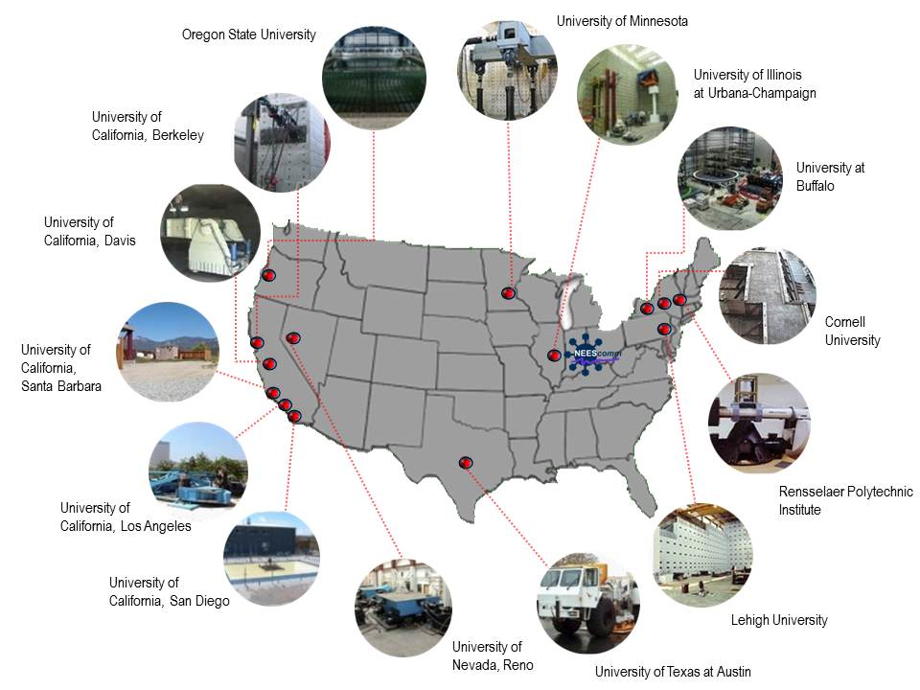
What Is NEES?
14 engineering laboratories
Shake Tables
University at Buffalo
UC San Diego
UN, Reno
Tsunami Wave Basin
OSU
Geotechnical Centrifuges
RPI
UC Davis
Field Experiments
UC Los Angeles
UC Santa Barbara
UT at Austin
Large Scale Laboratories
Cornell University
Lehigh University
UC Berkeley
UIUC
UM, Twin City
Notes:
This is a content slide

Slide 9
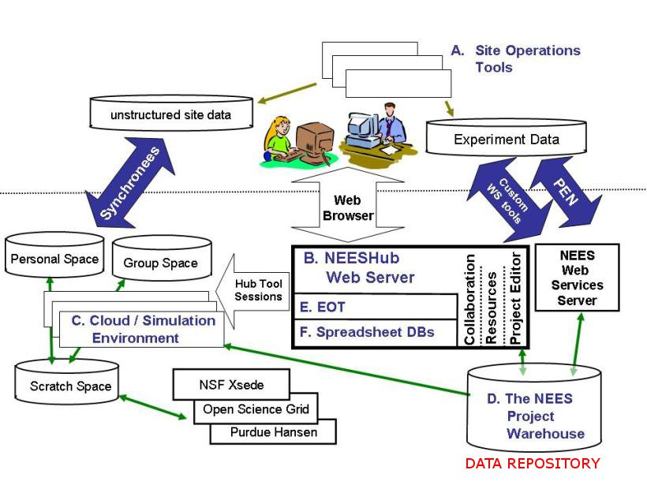
Cyberinfrastructure at NEES
NEES cyberinfrastructure:
Site Operations Tools
The NEEShub Web Server
Cloud / Simulation Environment
The Project Warehouse - NEES Data Repository
Education, Outreach, and Training (EOT)
Notes:
This is a content slide

Slide 10
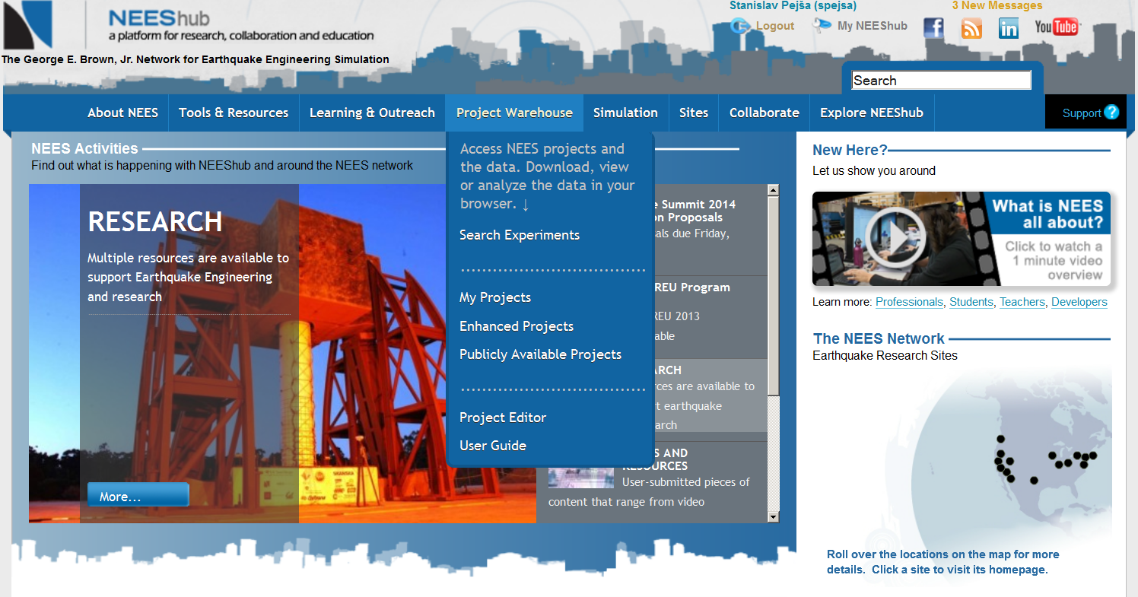
NEEShub - www.nees.org
Notes:
This is a content slide

Slide 11
Data Archiving at NEES
Who
research team, site personnel, curator, NEEScomm
What
sensor measurements
sensor calibrations
observations
analyses
numerical simulations
reports (including publications and presentations)
When
Dates are stated in the Data Sharing and Archiving Policies (1 month, 6 moths, 12 months)
For as long as the data are useful ~ indefinitely ~ for 20 years
Where
Project Warehouse http://nees.org/warehouse/welcome
Why
increases researcher’s impact
saves work, time, money
facilitates knowledge transfer
maintained authenticity and integrity of data
good practice
advances research
Notes:
This is a content slide

Slide 12
What kind of data?
diverse
shared facilities, not always practices
research domain
structural engineering
geotechnical engineering
geophysical research
material engineering
tsunami research
type of data
experimental
observational
computational
increasingly complex
number of sensors
interdisciplinarity
experimenting with computational modeling
Notes:
This is a content slide

Slide 13
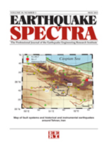
Data Publication in NEEShub
All recently curated experiments
Have assigned DOI
Have improved metadata that facilitate discovery
Datasets are considered published information products and NSF now allows listing information products in researchers' bio sketches. "Acceptable products must be citable and accessible including but not limited to publications, data sets, software, patents, and copyright"
http://www.nsf.gov/pubs/policydocs/pappguide/nsf13001/gpg_2.jsp#IIC2fic
The Earthquake Spectra journal is accepting a new type of manuscript called Data Papers.
Peer-reviewed papers that describe datasets of interest to the earthquake community
Data must be publically available with a Digit Object Identifier (DOI)
Submit soon for the inaugural issue of Data Papers
http://earthquakespectra.org/page/data_papers
Notes:
This is a content slide

Slide 14
Citation and Attribution
Recommended citation format
Researcher 1, Researcher 2, Researcher 3 (YYYY), “Experiment Title” Network for Earthquake Engineering Simulation (distributor), Dataset, DOI:10.4231/D3SQ8QH1F
Users of the data are expected to cite the data sets they used in the recommended format as shown above and also include an acknowledgement to the NEES Data Repository.
To acknowledge the NEEShub Data Repository:
The facilities of the George E. Brown Network for Earthquake Engineering Simulation (NEES) Data Repository were used for access to data and metadata used in this study (https://nees.org/warehouse/welcome). The NEES Data Repository is funded through the National Science Foundation and specifically the CMMI Directorate through the National Science Foundation under Cooperative Agreement Number CMMI-0927178
Notes:
This is a content slide

Slide 15
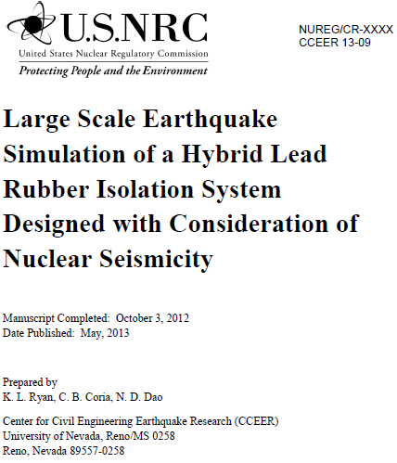
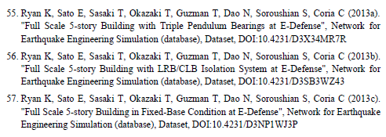
DOI – Digital Object Identifier
Date | # of issued DOIs
2012-06 | 6
2012-09 | 11
2012-12 | 19
2013-03 | 85
2013-06 | 374
Notes:
This is a content slide

Slide 16
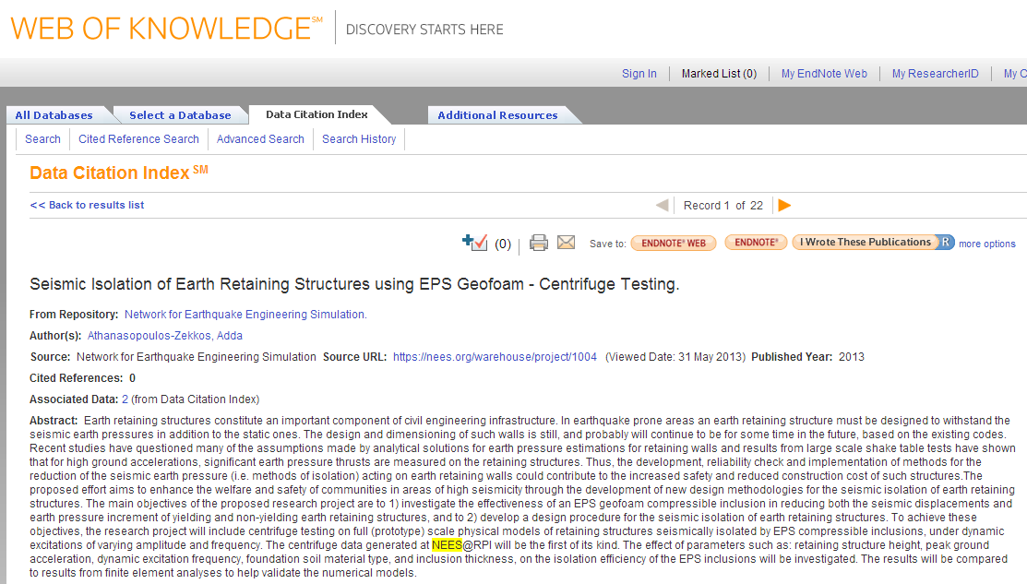
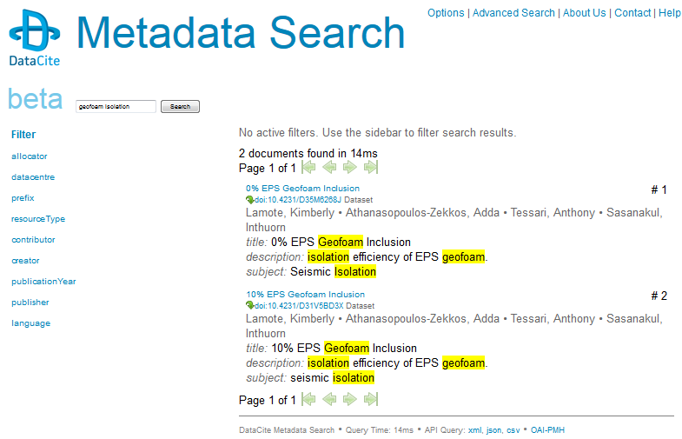
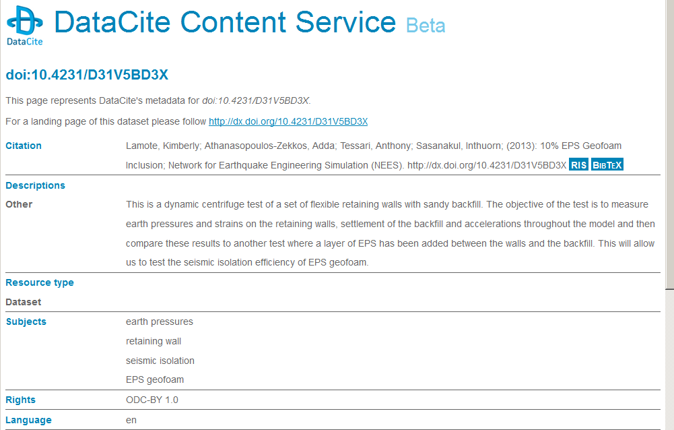
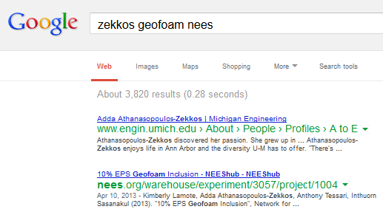
Exposure of EE Research Data
Notes:
This is a content slide

Slide 17
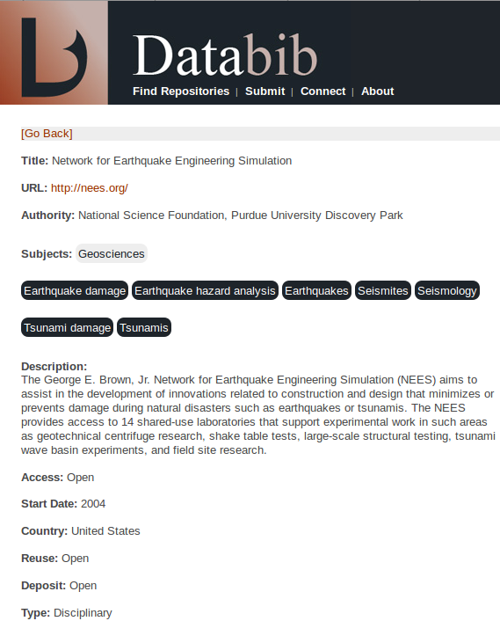
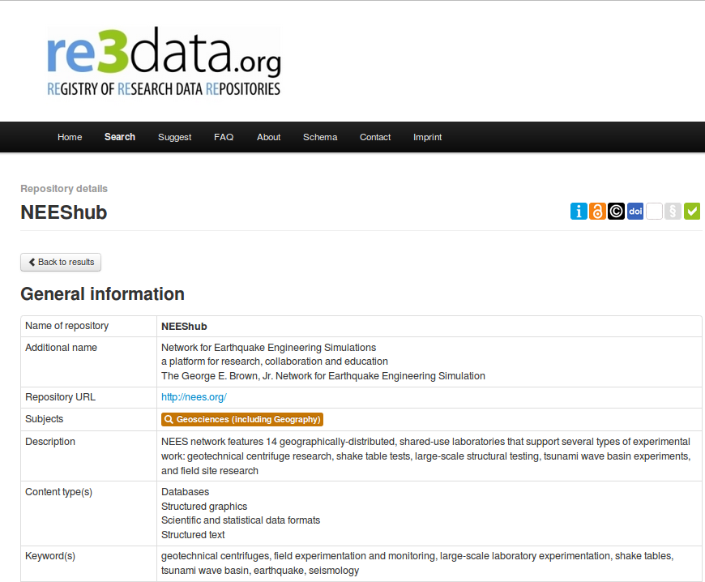
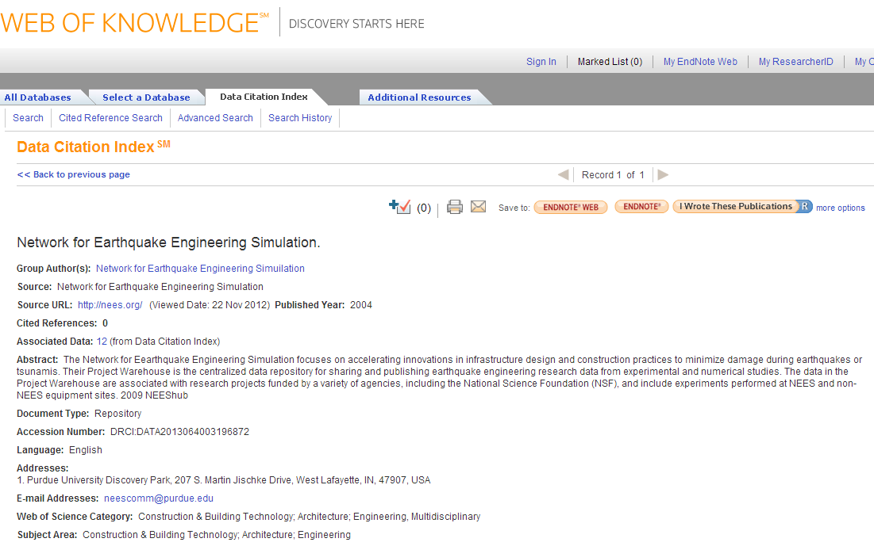
Repository for EE Data
Notes:
This is a content slide

Slide 18
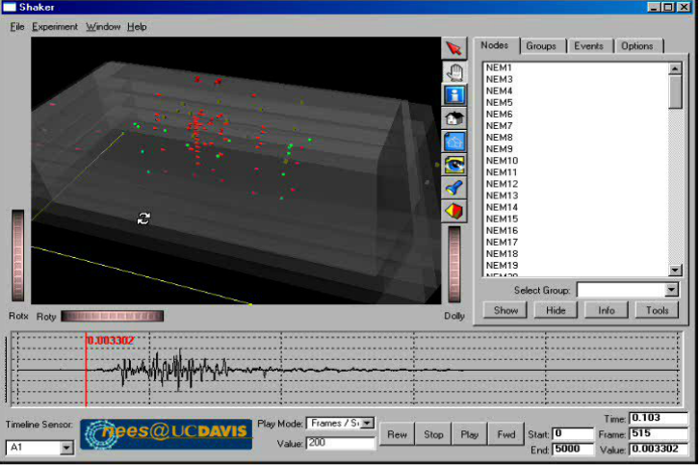
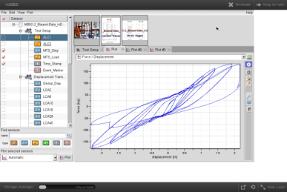
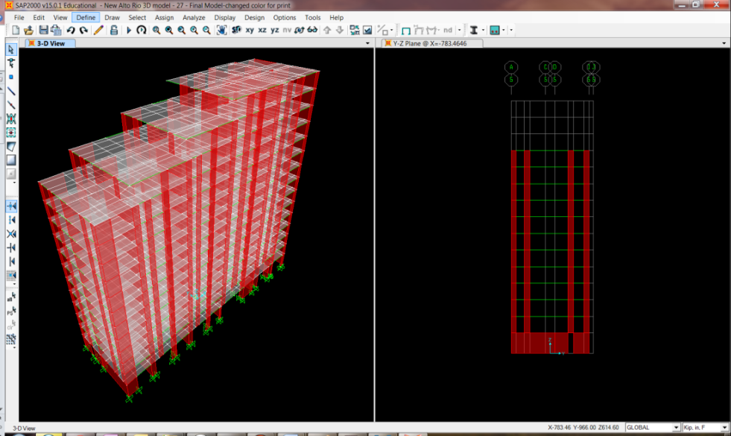
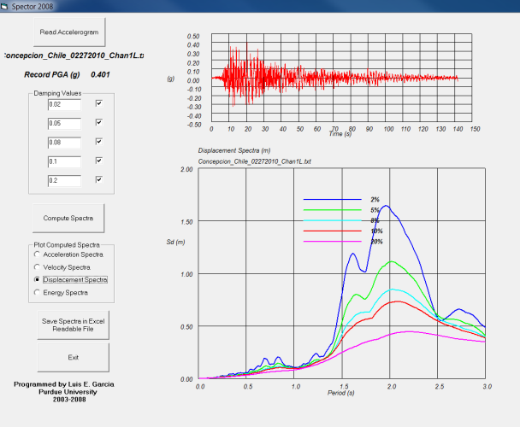
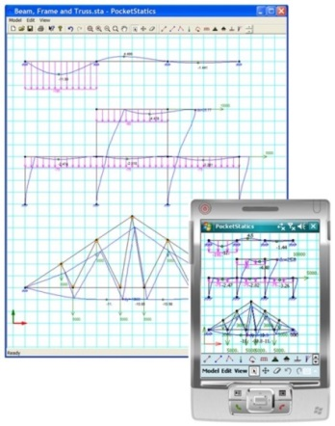
Visualisation
N3DV
inDEED
SAP 2000
Pocketstatics
Spector 2008
Notes:
This is a content slide

Slide 19
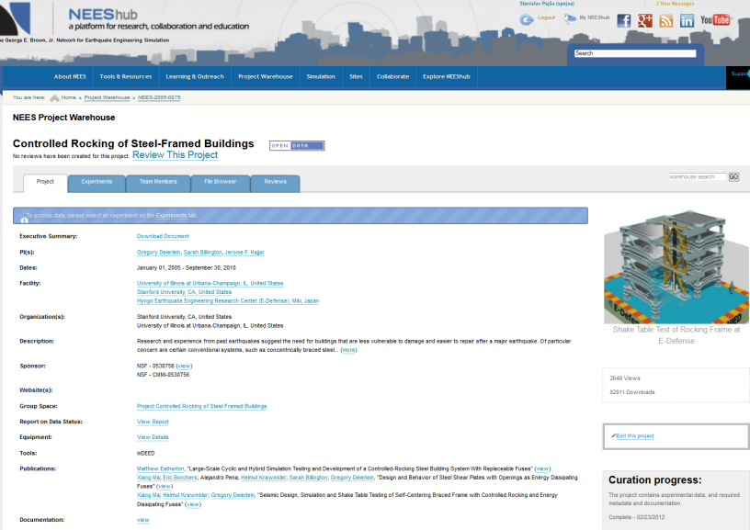
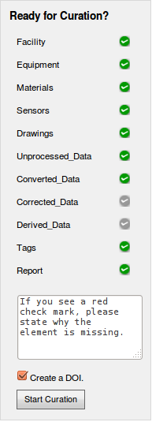
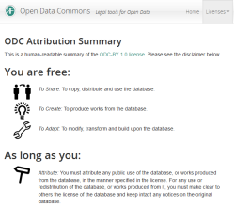
Curated Experiment
Notes:
This is a content slide

Slide 20
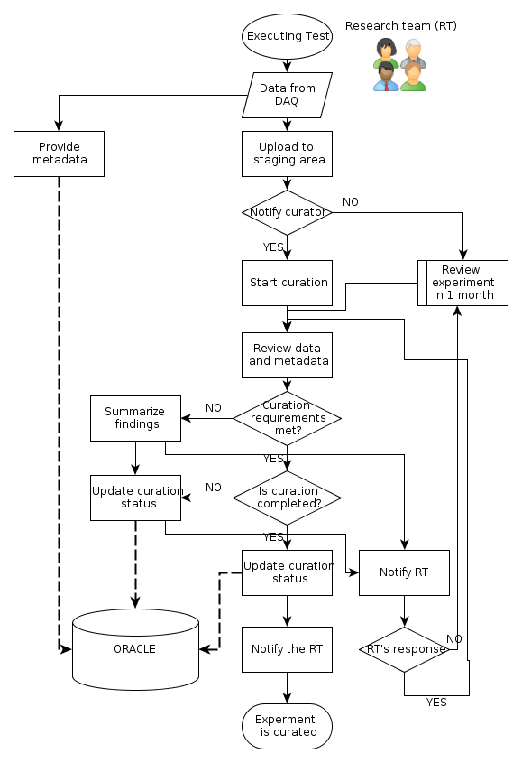
Curation Workflow
curation is a process
starts early
"exit" interview
data upload
reminders
data review
experiment review
copyright compliance
preservation
DOI assignment
Notes:
This is a content slide

Slide 21
Curation as Quality Assurance
Content
dependent on human monitoring
Metadata
Completeness
Based on standards and requirements
On the level of research hierarchy
Timeline
Technical
machine-actionable
Formats
Interoperability
Accessibility
Preservability
File integrity
Notes:
This is a content slide

Slide 22
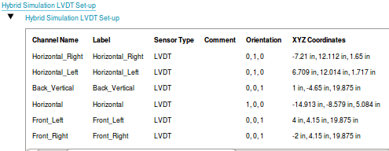
Understandable data
Metadata need to be:
meaningful
purposeful
consistent
accurate
predictable
"standardized"
Relationship among:
Instrumentation plan
Sensor metadata
Data
Notes:
This is a content slide

Slide 23
Content - Metadata
Names of researchers
Affiliated organization
Description
Title
Dates
Testing facility
Equipment
Material properties
Type of test
Proper location
Adequate file format
Sensors
Notes:
Different metadata are collected through variety of controlled vocabulary instruments

Slide 24
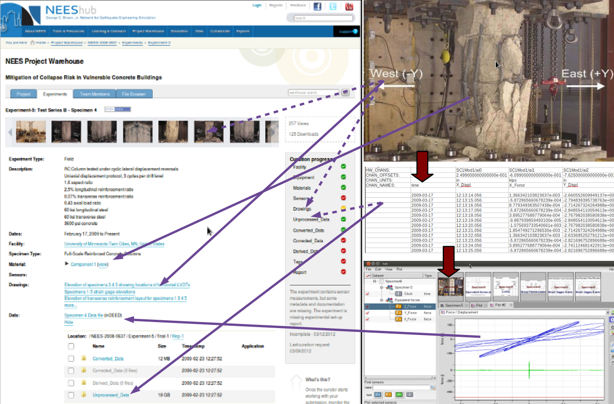
Access and re-use
Testing
project 637
Collected sensor measurements
Visualisation
Notes:
This is a picture slide

Slide 25
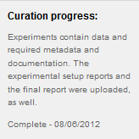
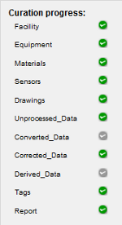
Curation - Path to SWAMP
Straightforward (relatively)
Way to
Authorship
Merit and
Publication
Notes:
This is a content slide

Slide 26
Thank you.
Questions?
Comments?
Standa Pejša - spejsa@purdue.edu
NEEScomm Data Curator
Network for Earthquake Engineering Simulation
Notes:
This is a content slide

Slide 27
NEEScomm Data Goals
Aligned with NSF Data Management Plan (DMP) requirements*
All research data and documentation will be archived
Archived data will be of high quality
Archived data will be accessible and shareable
Archived data will be re-usable
Archived data will be preserved
NEEScomm Data Sharing and Archiving Policies, https://nees.org/resources/2811
* http://www.nsf.gov/pubs/policydocs/pappguide/nsf11001/gpg_2.jsp#dmp
Notes:
This is a content slide

