Slide 1
Use of Hierarchical Keywords for Easy Data Management on HUBzero
HUBbub Conference 2013
Gaurav Nanda, Jonathan Tan, Peter Auyeung, Bill Gaskill,
Chris Smoak, Mark Lehto School of Industrial Engineering, Purdue University

Slide 2
Reliability Tools as Resources
Failure Mode Effects and Criticality Analysis (FMECA)
Analyzes failures of a system through failure modes, then identifies causes and effects, detection procedures and corrective actions for each failure mode.
Reliability Growth Analysis
Uses Logistics to model various developmental data such as time-to-failure, discrete (success/failure) and reliability values at different times or stages
Shakedown Testing
Records results of equipment testing during development or installation
Functional Block Diagram
Used for process planning by describing all the input and output relations.

Slide 3
HUBzero
Implementation Challenges
Collecting data from people
Getting owner’s consent before publishing
Selecting good quality resources for publishing
Interfacing HUBzero with other Software/Groupware
Access Control of the files
Selection of server to host HUBzero
Maintaining security of the HUBzero server

Slide 4
HUBzero
Implementation Summary
Automated the process of acquiring, publishing and sharing data.
Linked HUBzero with existing software in the organization.
Developed new navigational features on HUBzero to improve search and review process.
Semi-automated keyword assignment based on the content of the RE tool file

Slide 5
HUBzero
Customizations
Sophisticated search mechanisms using metadata.
Multiple views of the information
Different navigation layouts (Tag Browser, Lists, Filters)
Automated tagging based on content
Social networking features of reviews and comment
Automated Keyword assignment for each RE tool usage

Slide 6
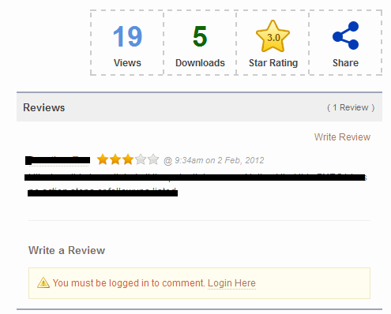
HUBzero
Customizations
Navigation Made Easy
Customization done to provide quick summary of the quality and popularity of a resource

Slide 7
Keywords/Tags
Keywords summarize a document concisely and give a high-level description of the document’s content.
Use in Knowledge Management
Content Organization
Content Discovery
Widely used in WEB 2.0
Ontologies have been proven to be good additions to knowledge management systems:
CoMMA(Corporate Memory Management through Agents)
FRODO (a Framework for Distributed Organizational Memories)

Slide 8
Keyword Extraction
Different Approaches
User Centered: uses historical tagging behavior of the user
Need a large user group, Vague meaning issue
Document Centered: uses document content
Keyword Assignment
Controlled vocabulary of terms
Keyword Extraction
Linguistics: Lexical analysis, Syntactic analysis
Machine Learning: naïve Bayes, Support Vector etc.
Simple Statistics: n-gram, word frequency, term frequency*inverse document frequency etc. Better for RE data since it doesn’t require proper sentence structure or training cases.

Slide 9
Keyword Extraction
Steps Involved
Read and parse reviewed RE tool files
Count the file specific and overall word frequencies
Calculate the file and global scores and normalize them
Recommend a set of keywords to the administrator for each file based on the criteria
Administrator to select the final set of keywords for a file and publish them to HUBzero
System to recommend a set of possible global keywords
Administrator to choose global keywords and publish them to HUBzero

Slide 10
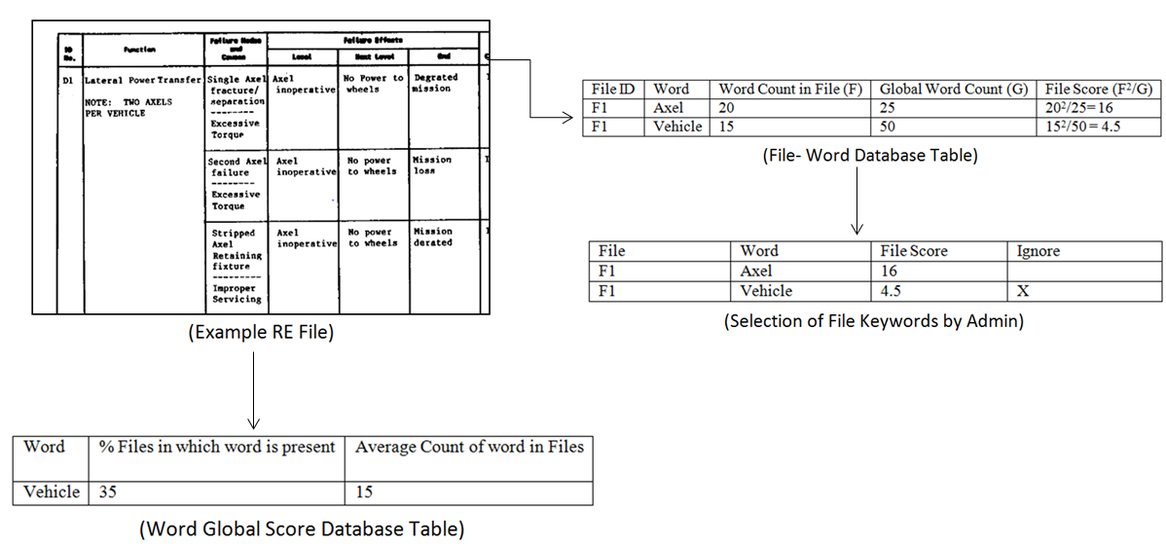
Keyword Extraction
File Keywords: Represent specific content of an RE file
Global/Popular Keywords: Represent a group of RE files
Both type of keywords displayed in order of decreasing scores

Slide 11
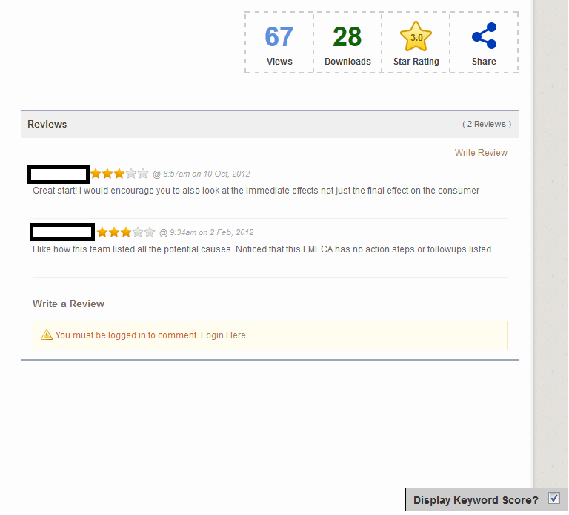
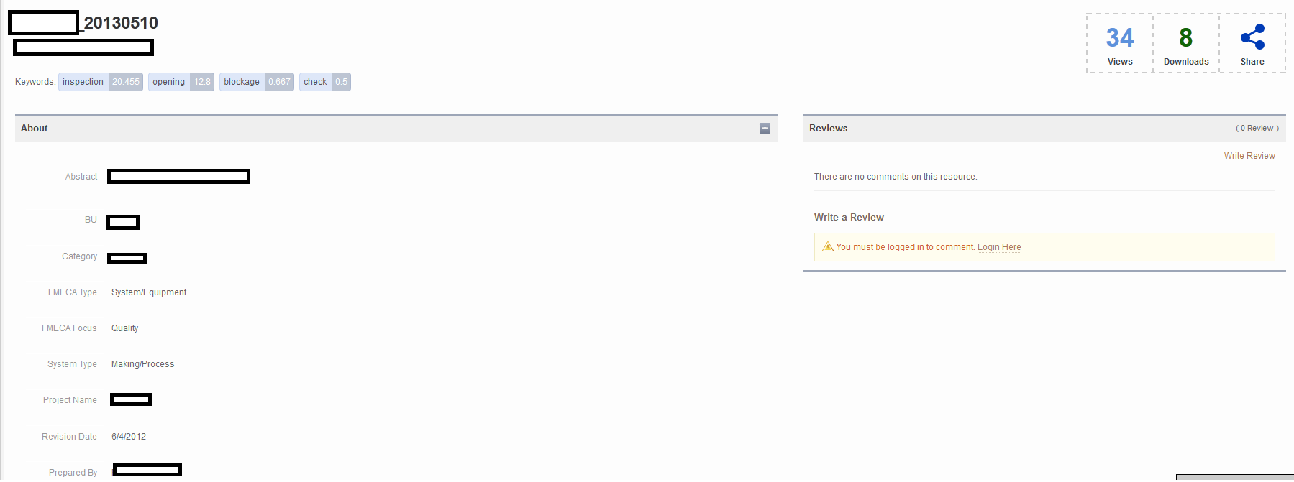
Keywords Display
Keywords on HUBzero Resource Page

Slide 12
Keywords Display
Keywords on HUBzero Resource List Page

Slide 13
Future Work
Implementation of more sophisticated algorithms for keyword assignment to handle complexities such as misspellings, synonyms etc.
Prepare training dataset with growing number of RE tool files and use data mining techniques.
Compare the results of different methods for keyword assignment.
Perform usability analysis to check if users are finding the keywords helpful for browsing.

Slide 14
Thank You
Questions?

