Slide 1
Databases at the Hub Now you can Create them yourself!
Ann Christine Catlin
HUBbub 2013

Slide 2
Sudheera Fernando
Sumudinie Fernando
Ruchith Fernando
Ruwan Gamage
Nabeel Yoosef

Slide 3
What is a Hub database?
How are Hub database created?
Some customized databases
Creating your own Hub databases

Slide 4
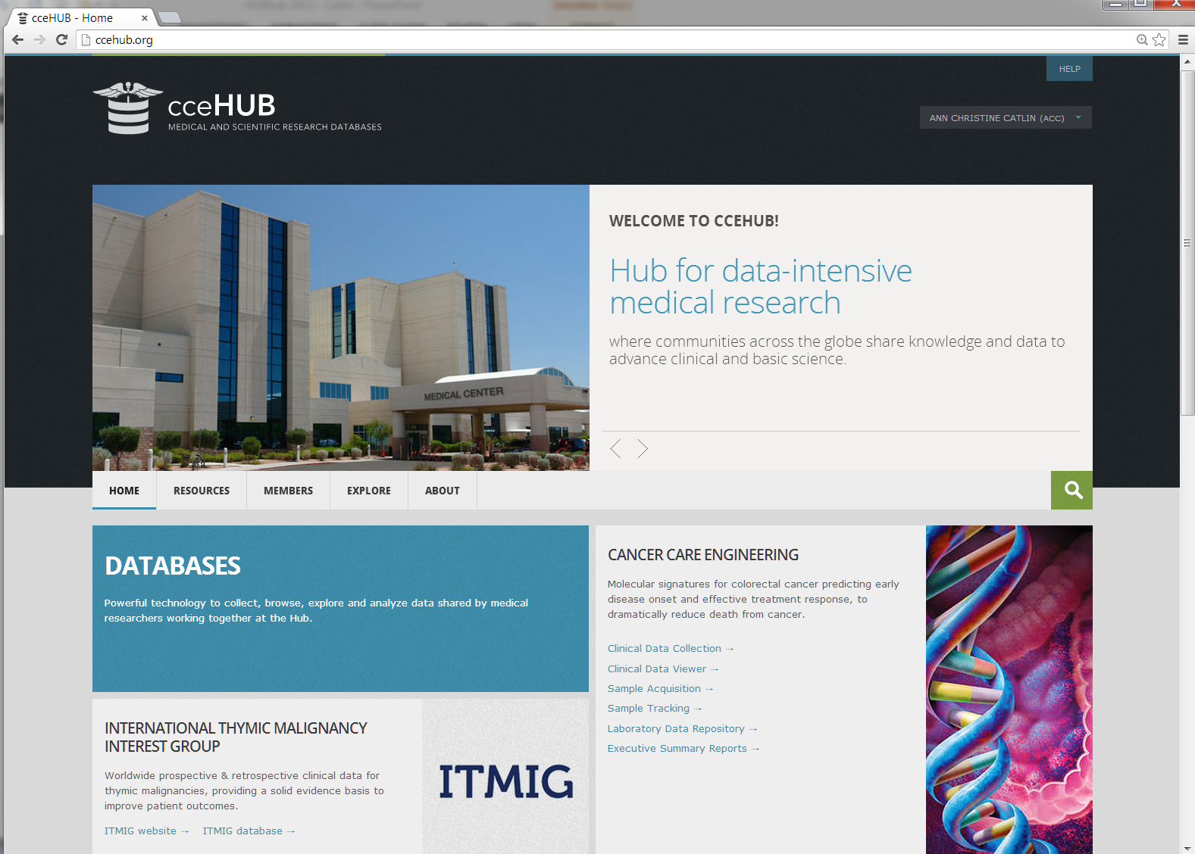
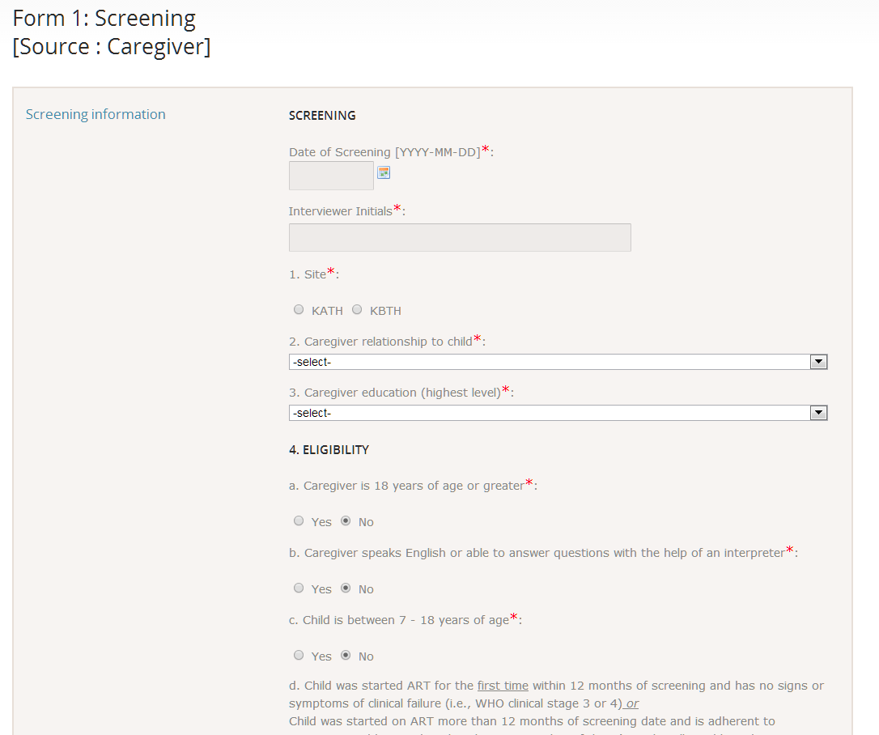
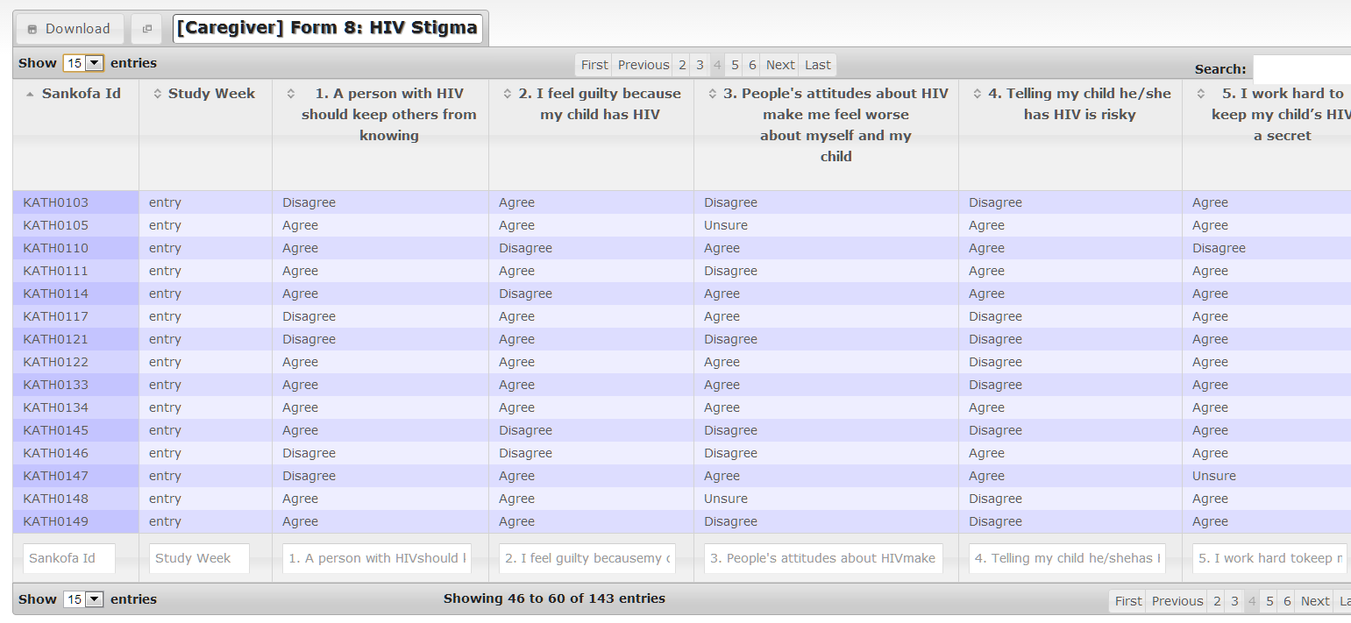
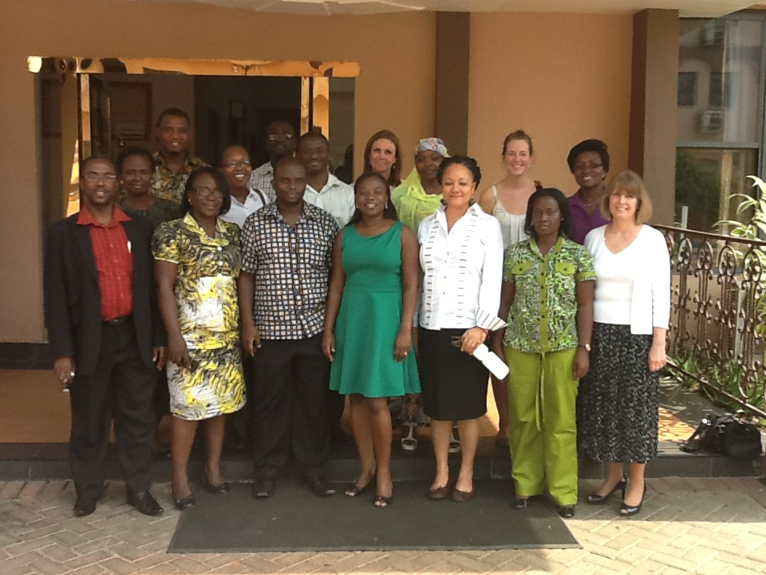
What is a HUB database?

Slide 5
What is a HUB database? (underneath)
“databases” component
configuration, access control, backup,
repository structure, applications
the building blocks
for Hub developers
to create
customized databases
on any Hub
“forms” component
“toolkit” for building & processing data collection forms (mywebform.php)
“dataviewer” component
presentation and exploration of data (mydatadefinition.php)
package
for all Hub users
to create
their own databases
on any Hub
“datastore” component
the whole package for data collection and exploration
“datastore lite” at projects
“lite” version of the whole package for data collection and exploration

Slide 6
Databases: Features & Time LINE
2009
cceHUB
Cancer Care Engineering
Collect clinical data
Track blood & tissue samples
Store laboratory analysis files
Browse, search, export data

Slide 7
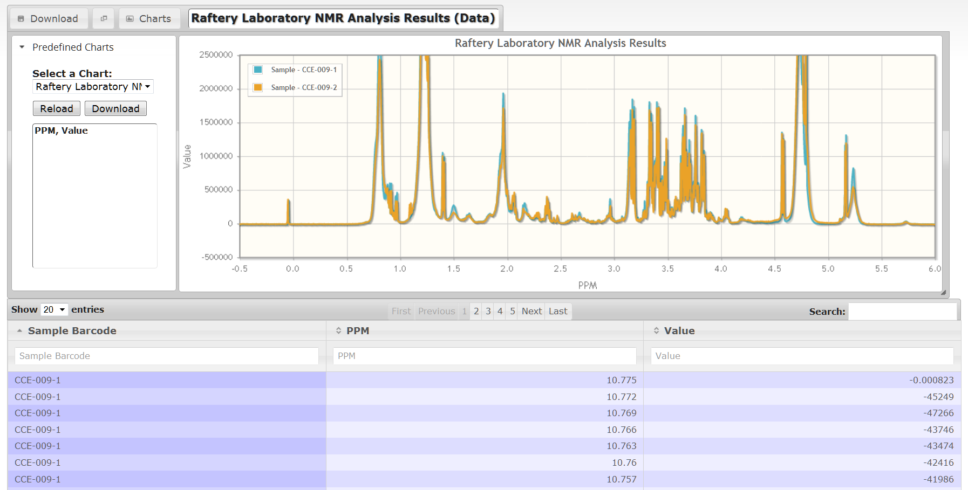
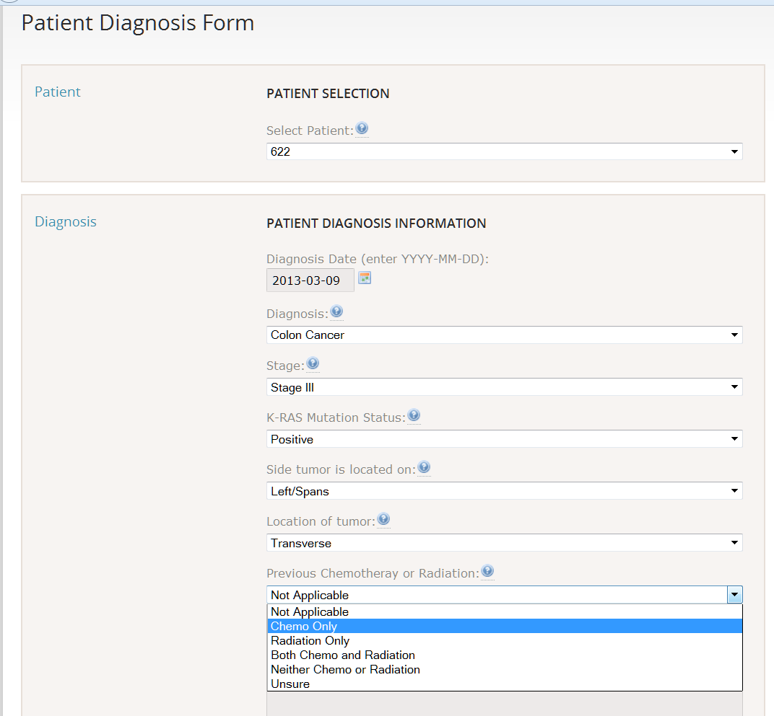
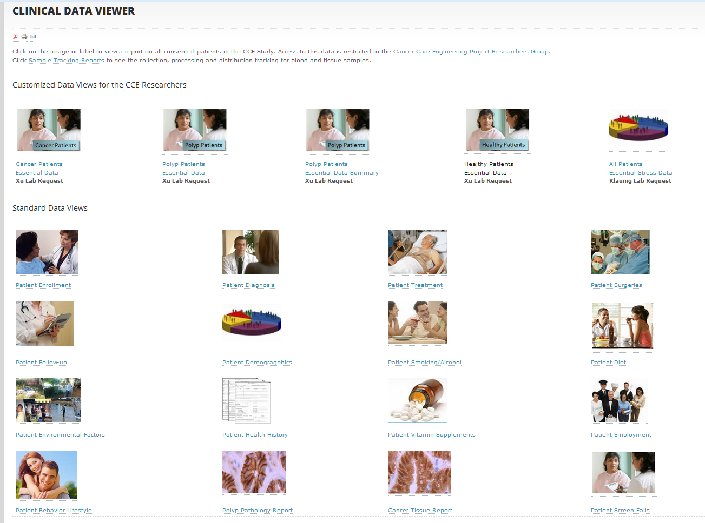
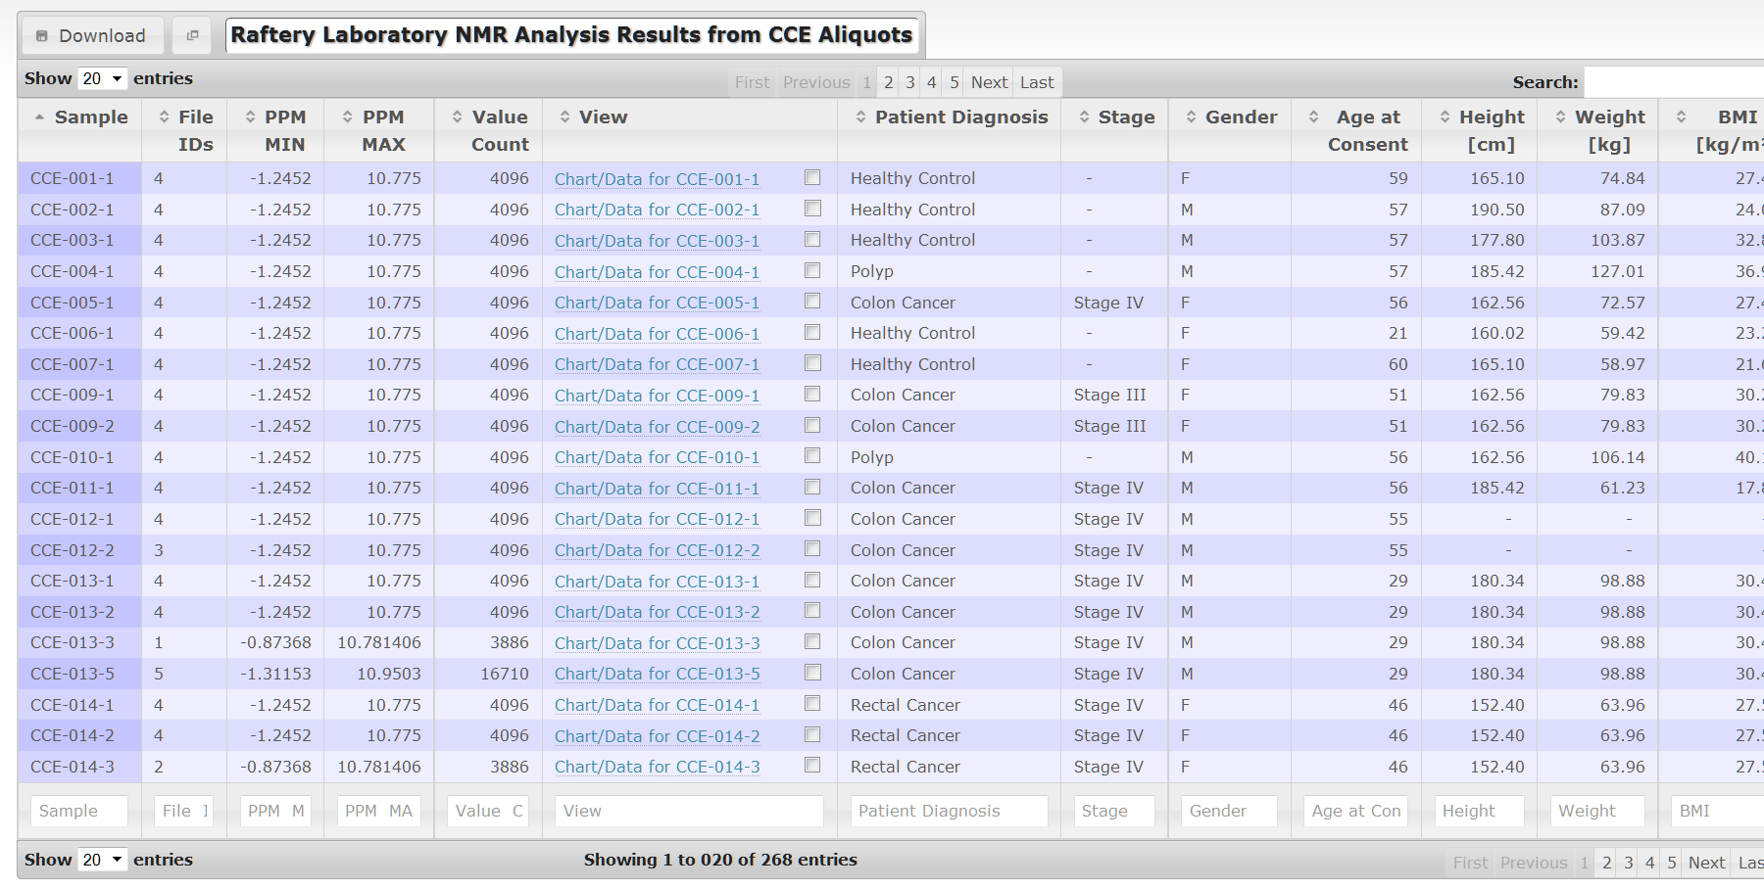
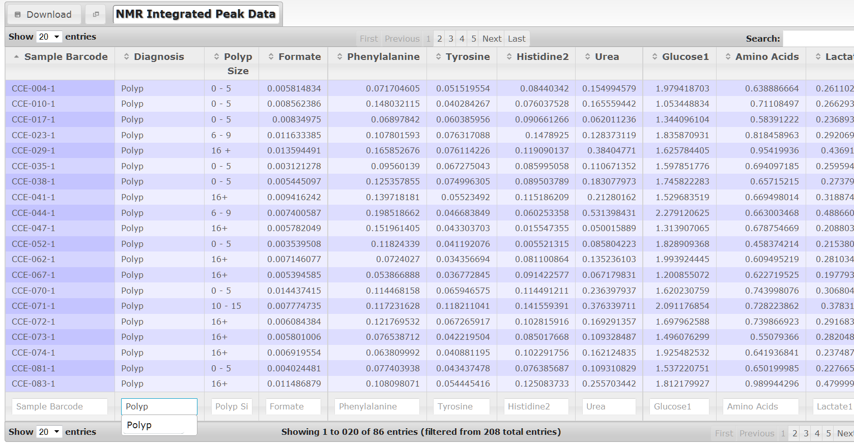
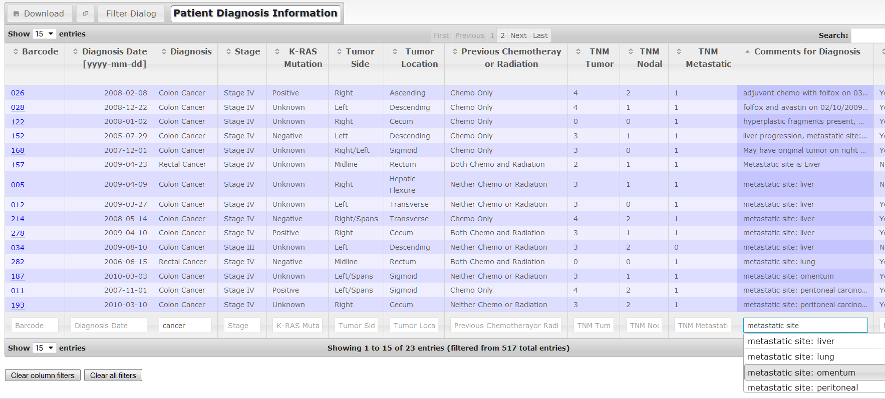
Cancer Care Engineering supporting data-intensive research

Slide 8
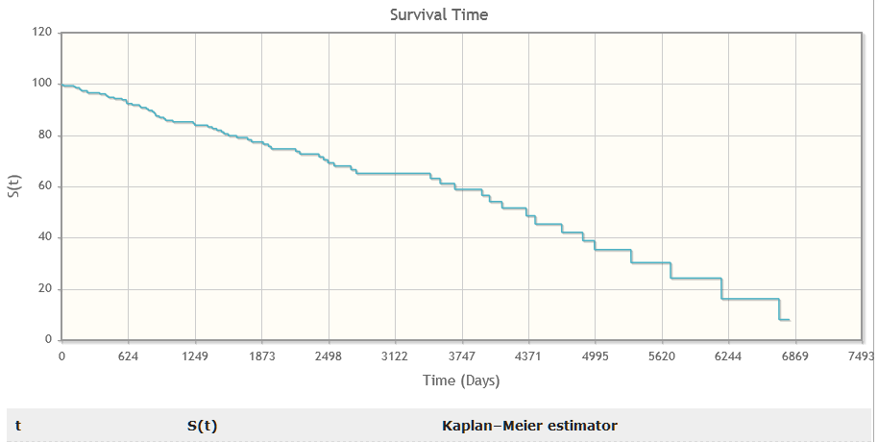
Databases: Features & Time LINE
2009
2010
Survival Time
Survival Time
cceHUB
first data Hub
5 databases
3 Hubs
Building custom databases
Generalizing the technology
DataView
Web forms toolkit
Spreadsheet databases
CCE Database
Data Collection
Data Tracking
Data Repository
Data Exploration

Slide 9
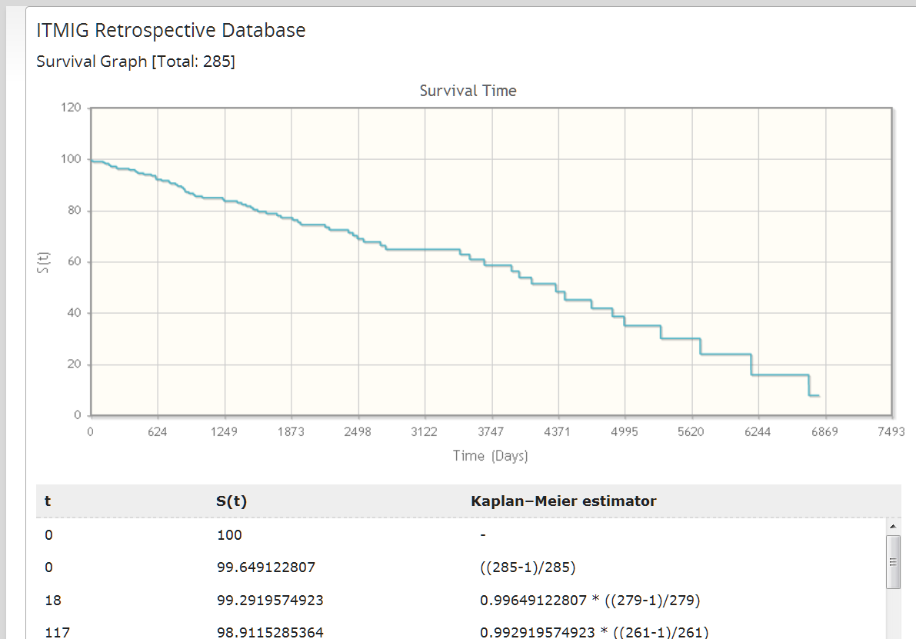
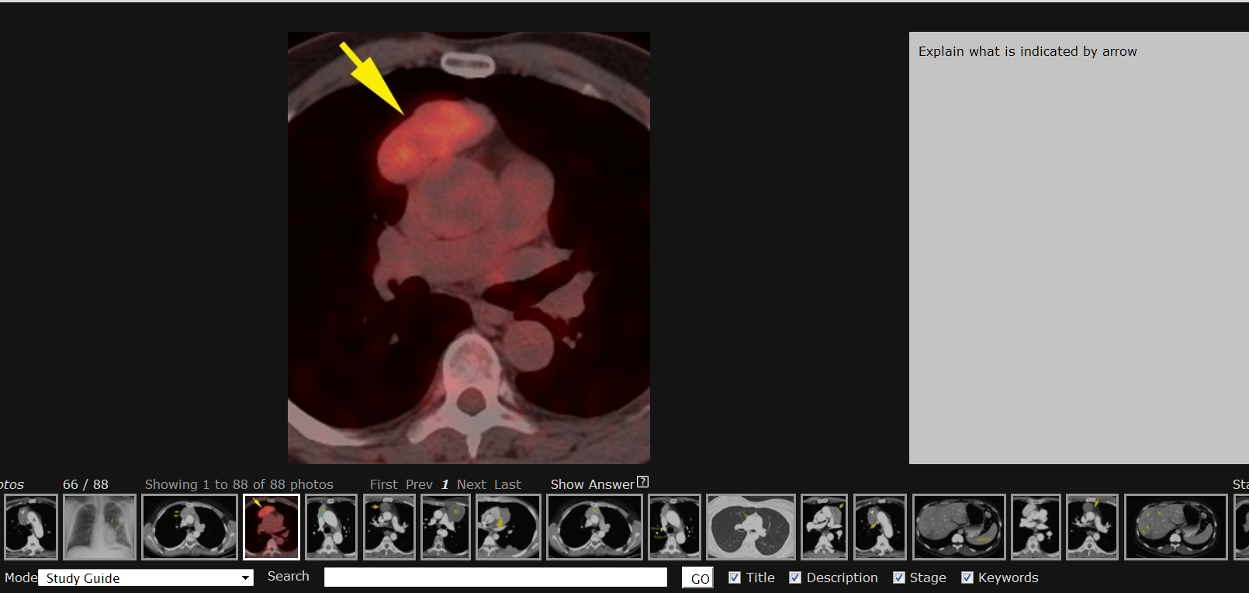
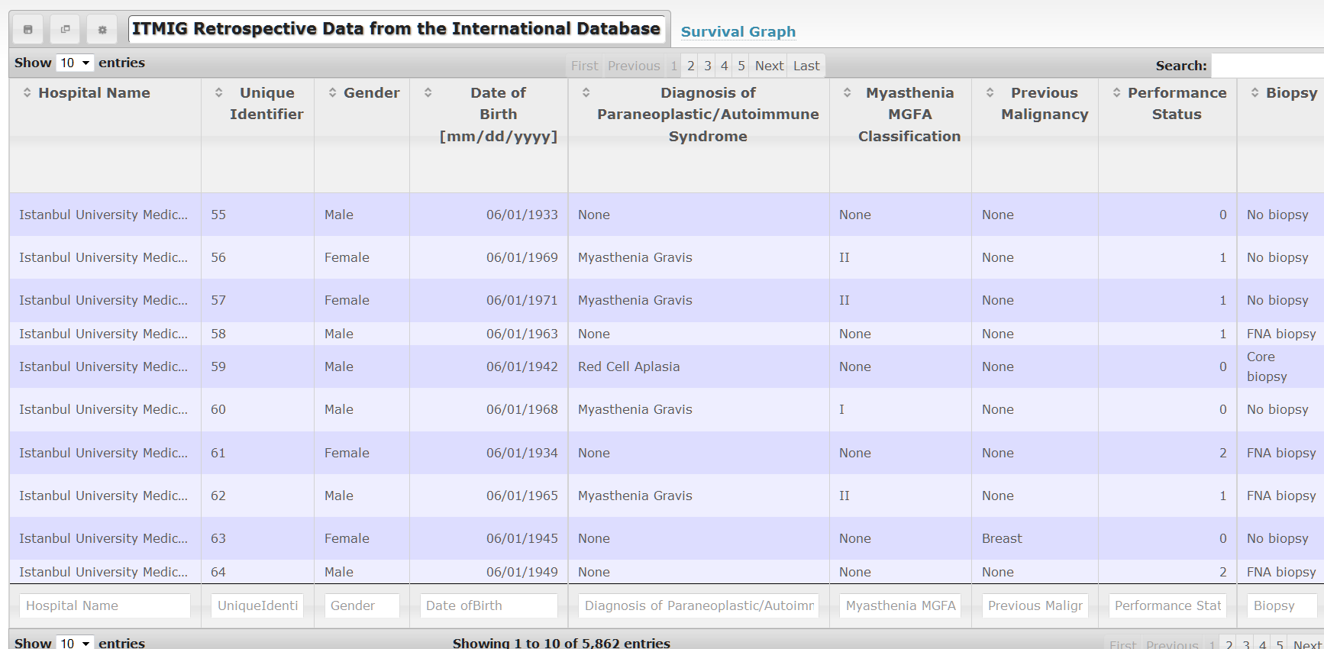
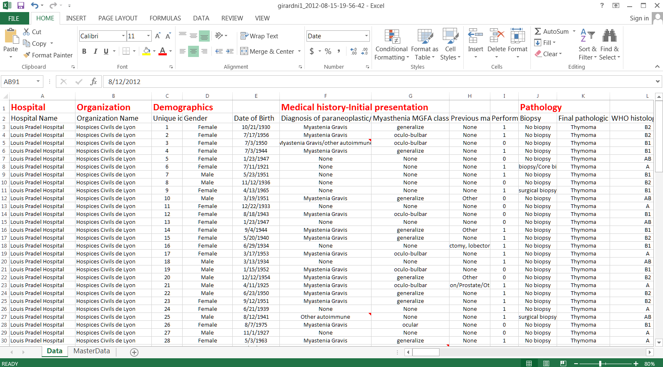
Thymic MalignaNCy international database for a rare cancer

Slide 10
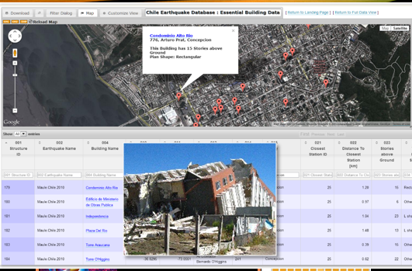
Databases: Features & Time LINE
2009
2010
2011
Survival Time
cceHUB
first data Hub
5 databases
3 Hubs
22 databases
6 Hubs
Building custom databases
Generalizing the technology
Data drill-down
Maps
Graphs
Computations
Export
Launching tools
Photo gallery
Access control
DataView
Web forms toolkit
Spreadsheet databases
CCE Database
Data Collection
Data Tracking
Data Repository
Data Exploration

Slide 11
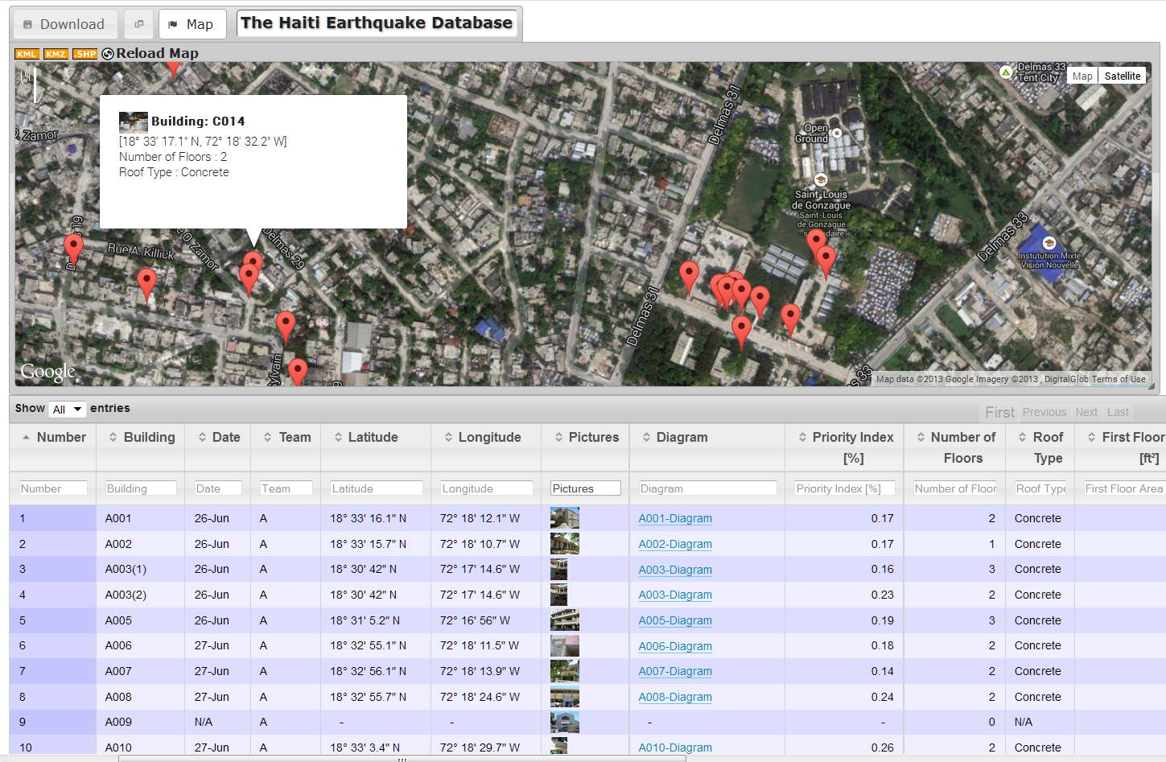
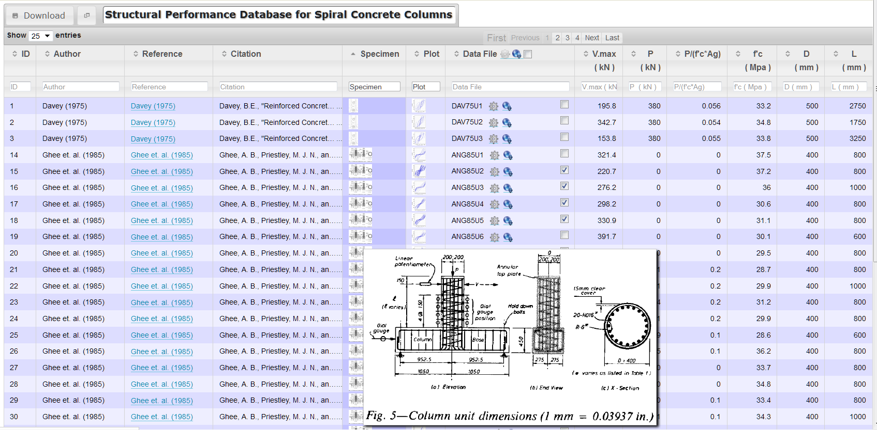
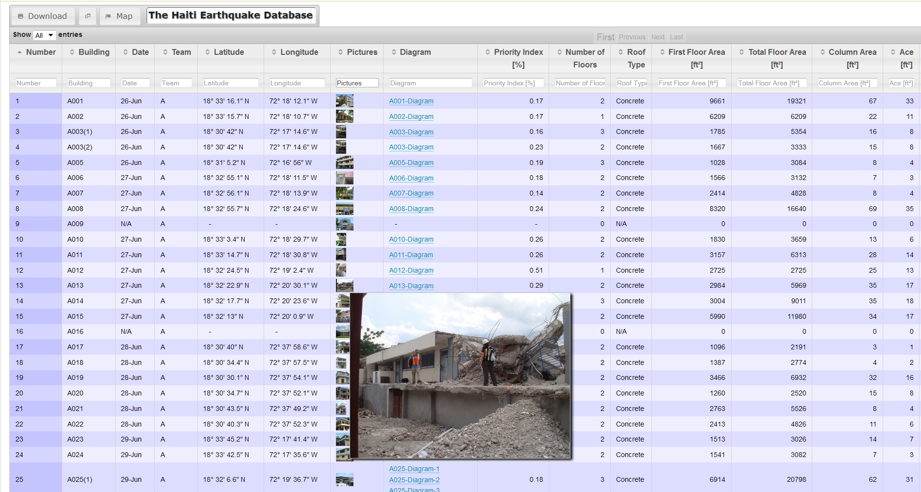
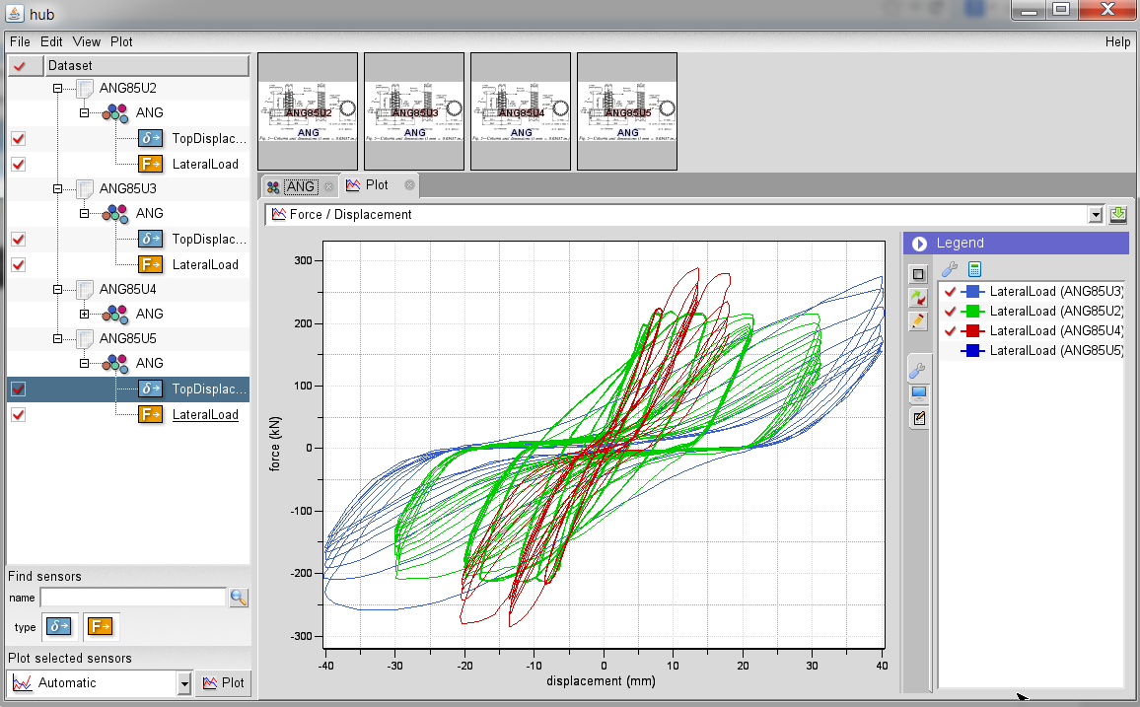
Disaster & Failure Studies databases for nist and NEES

Slide 12
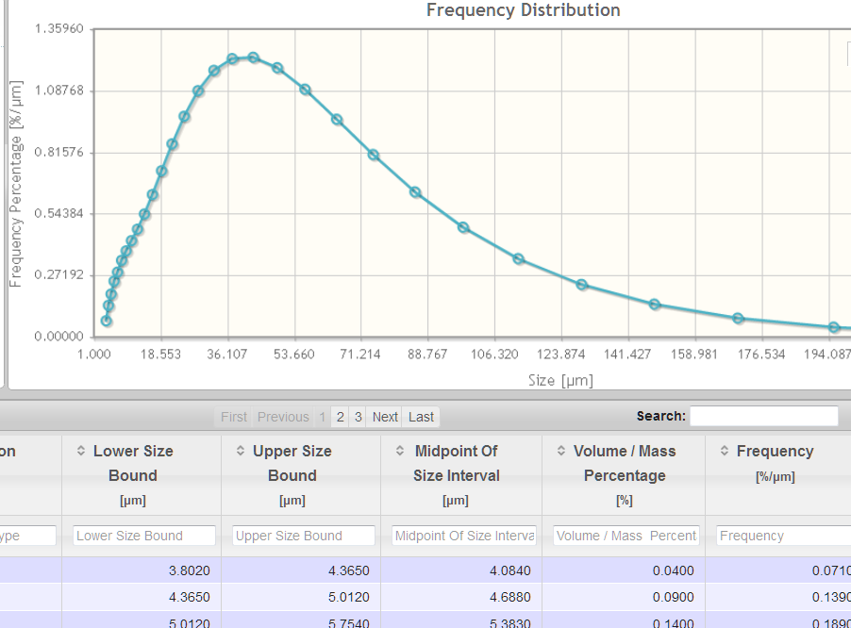
Databases: Features & Time LINE
2009
2010
2011
2012
Survival Time
cceHUB
first data Hub
5 databases
3 Hubs
22 databases
6 Hubs
30 databases
10 Hubs
Building custom databases
Generalizing the technology
Data drill-down
Maps
Graphs
Computations
Export
Launching tools
Photo gallery
Access control
DataView
Web forms toolkit
Spreadsheet databases
CCE Database
Data Collection
Data Tracking
Data Repository
Data Exploration

Slide 13
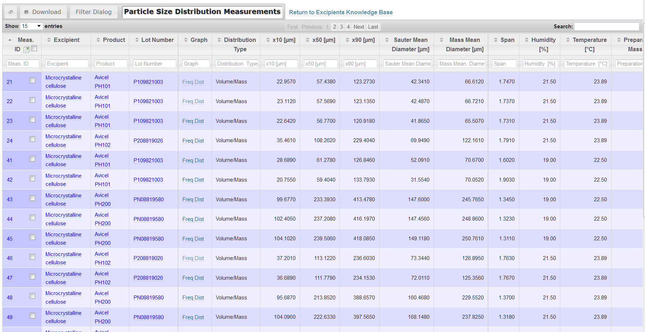
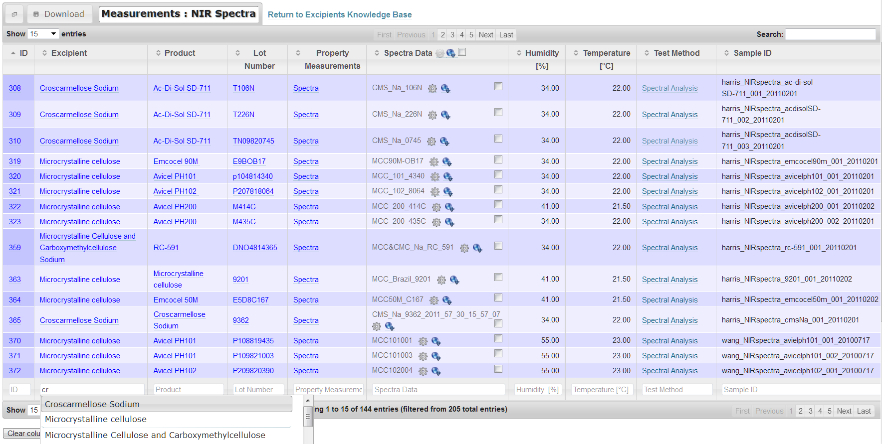
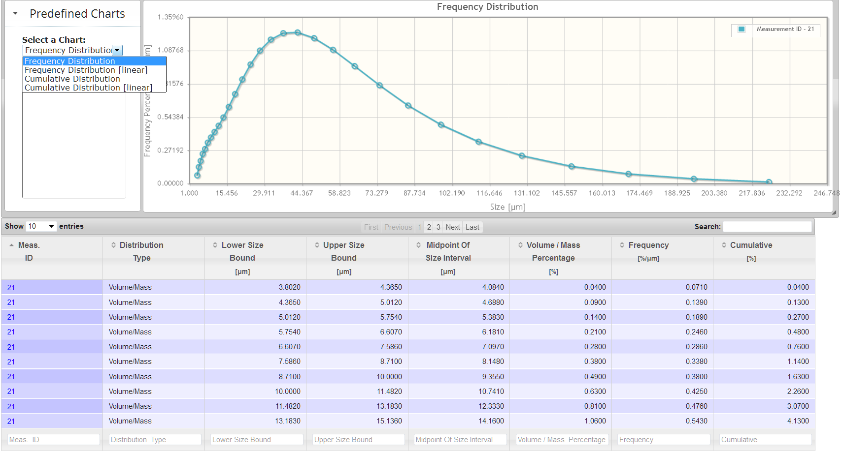
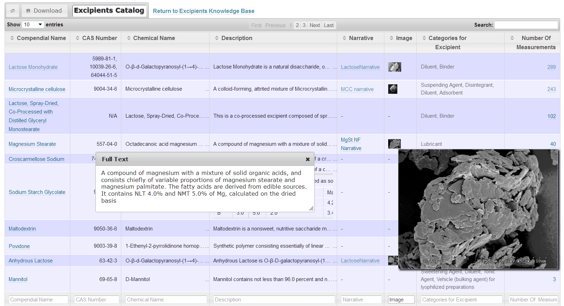
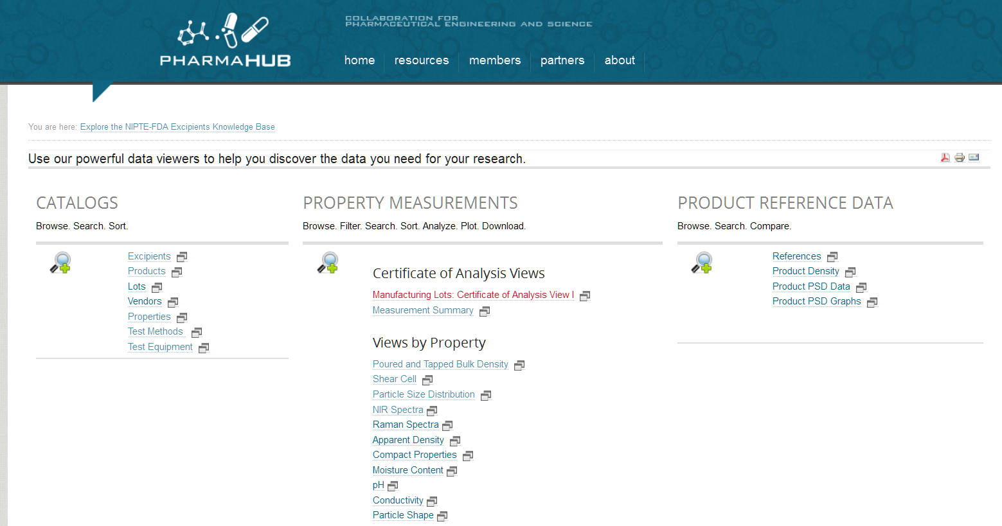
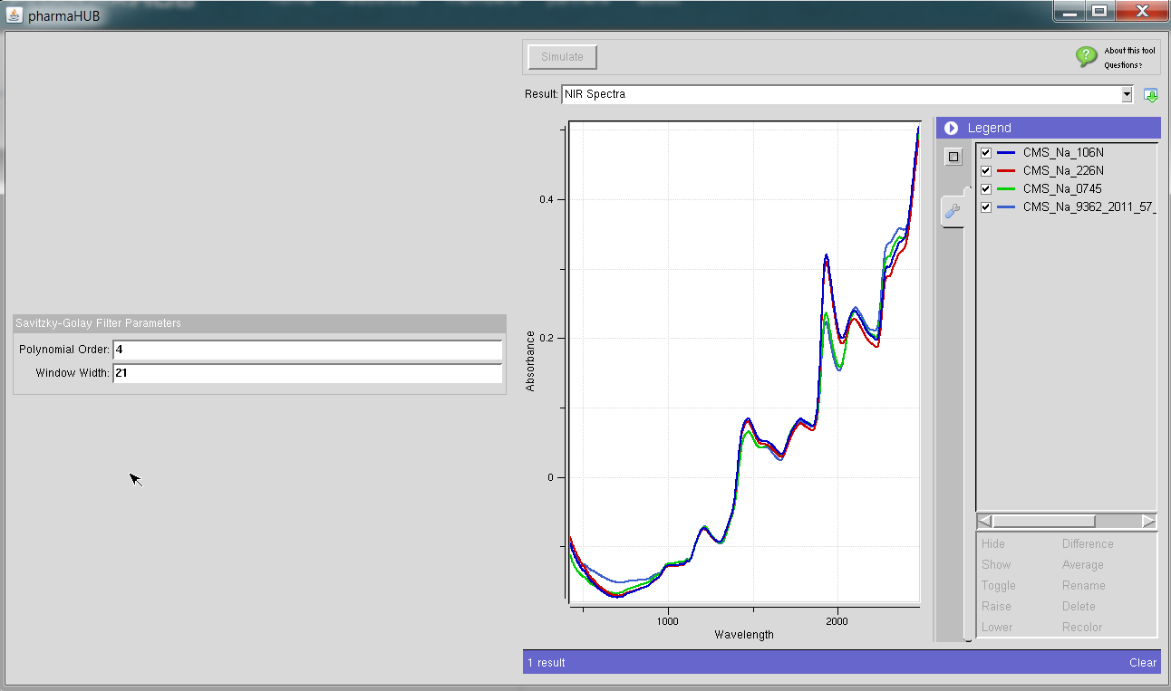
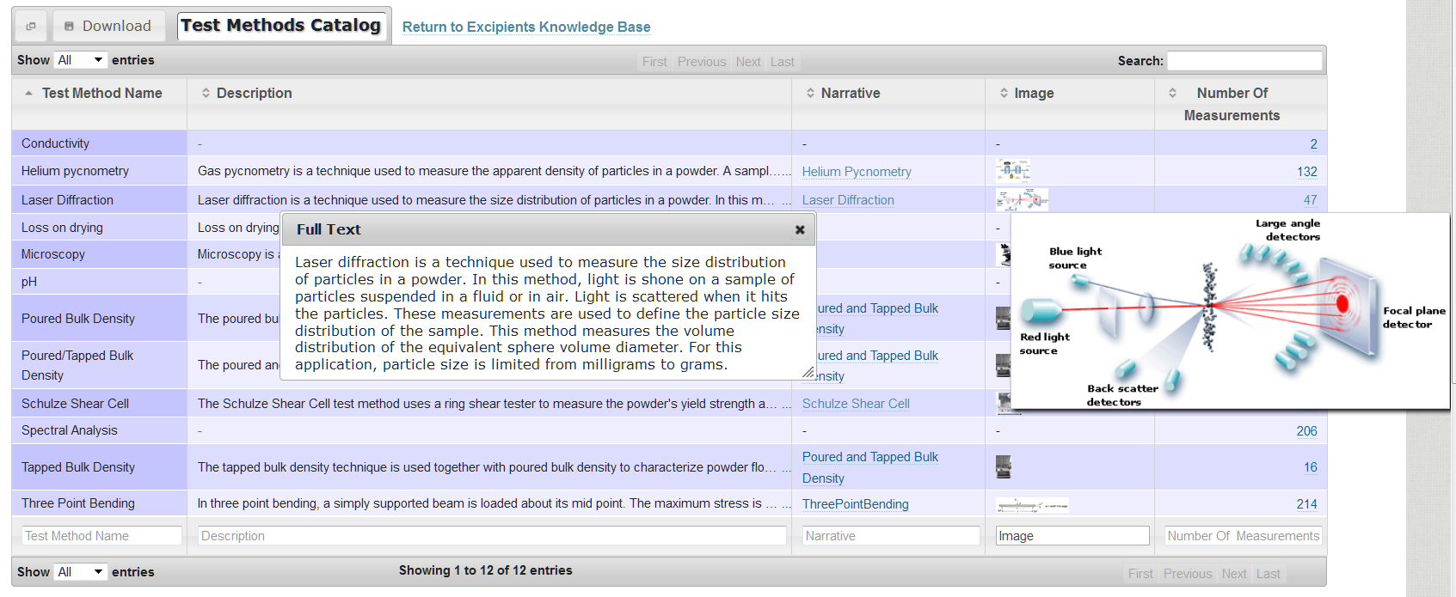
Pharmaceutical database excipients measurements, variability, QbD

Slide 14
Databases: Features & Time LINE
2009
2010
2011
2012
2013
Survival Time
cceHUB
first data Hub
5 databases
3 Hubs
22 databases
6 Hubs
30 databases
10 Hubs
Building custom databases
Generalizing the technology
Data drill-down
Maps
Graphs
Computations
Export
Launching tools
Photo gallery
Access control
DataView
Web forms toolkit
Spreadsheet databases
DataStore Lite DataStore
users can create their own Hub databases
CCE Database
Data Collection
Data Tracking
Data Repository
Data Exploration

Slide 15
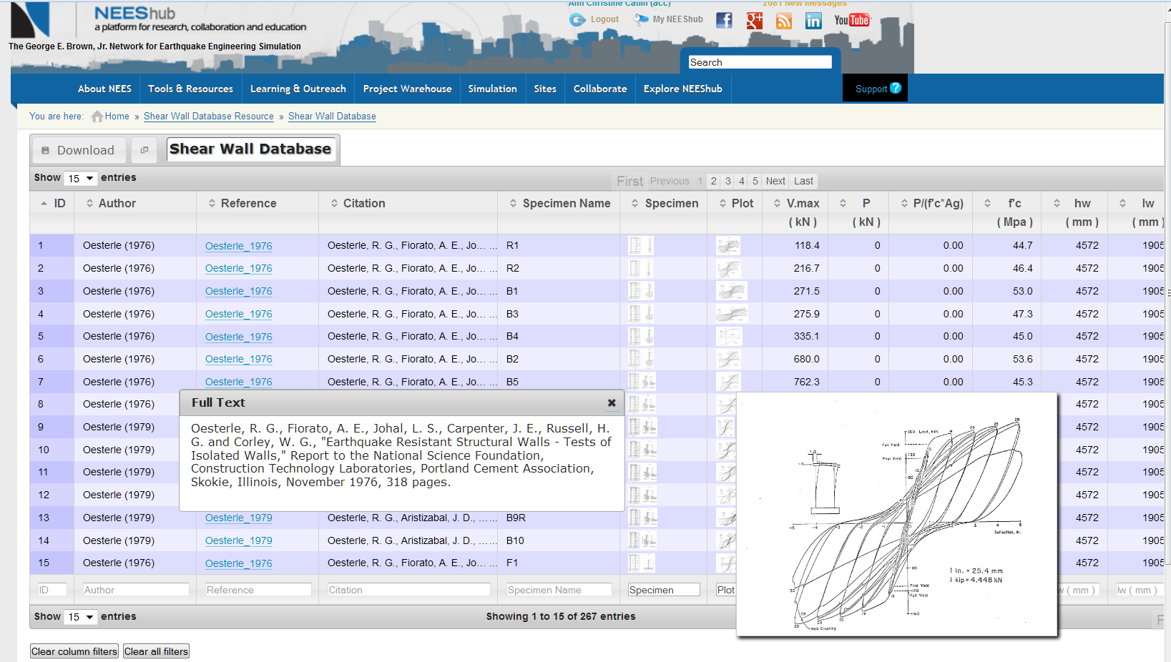
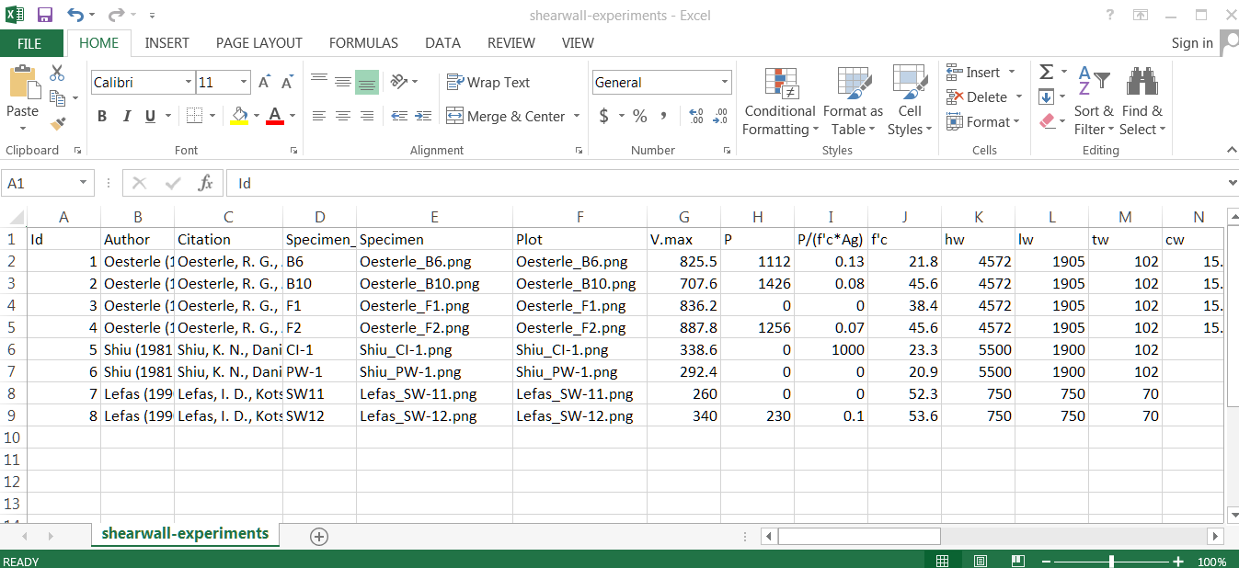
datastore creating your own database

