Slide 1
Using the HUB to Study Disaster Events
Eric Letvin
Director, Disaster and Failure Studies Program
Engineering Laboratory
National Institute of Standards and Technology
U.S. Department of Commerce

Slide 2
Problem Statement
A comprehensive archival repository of disaster and failure data does not currently exist. Data that are gathered during and after an event may be lost or inaccessible relatively soon after.
A repository is needed to preserve data to enable the study and analysis of the current event as well as future disaster events.

Slide 3
Repository Purpose
The repository will serve as a national archival database where NIST and other organizations can store the results of the study and analysis of disaster and failure events.
The results of these studies and analyses will lead to recommended improvements to codes, standards, practices and/or new knowledge.
By making these data available, NIST hopes to enable the efficient dissemination of data on disaster and failure events.

Slide 4
NIST Repository Workplan
Phase 1 – World Trade Center database
High level of interest in data collected
Goal of releasing before 10-year anniversary
Phase 2 – Chile earthquake and Joplin Tornado pilots
Phase 3 – Full scale implementation

Slide 5
Phase 1 – World Trade Center
Data previously released from NIST’s 7-year investigation on the collapses of three buildings at New York City’s World Trade Center
Over 94,000 photos and videos
Computer simulations
Complete set of technical reports
Repository created and managed by NIST
Website publically released in August 2011

Slide 6
Phase 2 – Chile Earthquake Pilot
Develop event-specific, web-based repository
Data-rich event that will also support the National Earthquake Hazards Reduction Program (NEHRP)
Opportunity to leverage with the Network for Earthquake Engineering Simulation (NEES)
NIST retained a contractor to assist with obtaining data previously collected by others (American Society of Civil Engineers - ASCE, Earthquake Engineering Research Institute - EERI, and Los Angeles Tall Buildings Council)
Release late 2013 on NIST’s website (NIST HUB)

Slide 7
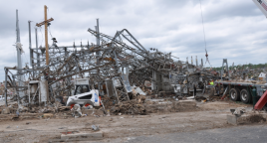
Phase 2 - Joplin Tornado Pilot
Supports NIST’s Technical Investigation of event
In development, to be released late 2013 on NIST HUB
Diverse data set
Structural drawings
Modeled tornado wind field
Geolocated data on Open Street Maps

Slide 8
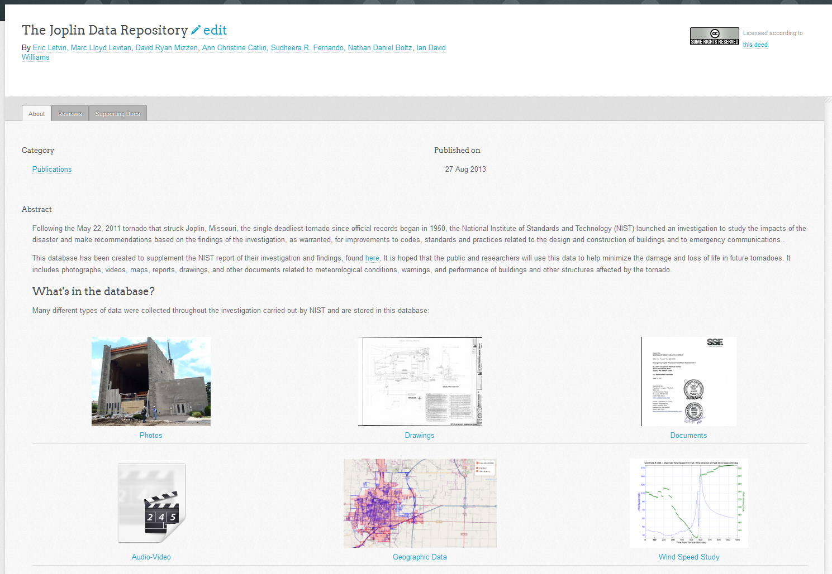
Phase 2 - Joplin Tornado Pilot

Slide 9
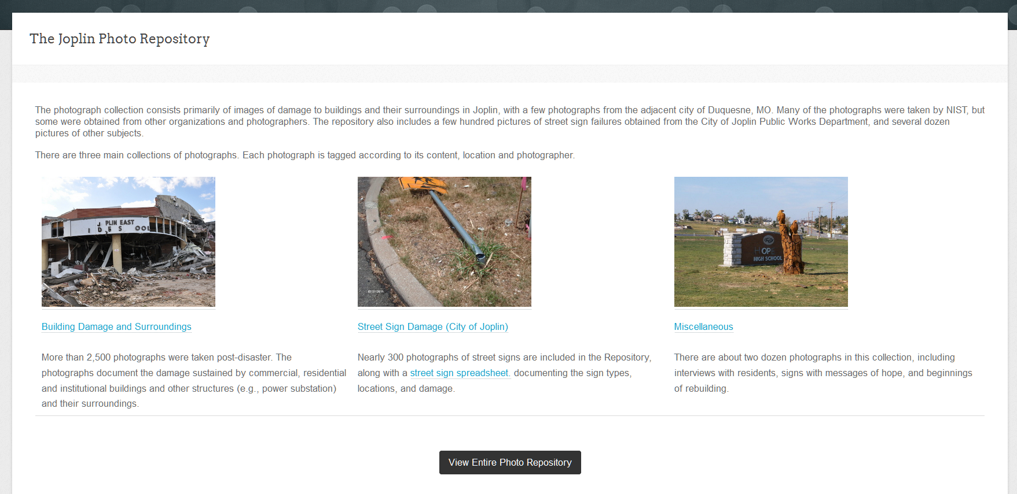
Phase 2 - Joplin Tornado Pilot

Slide 10
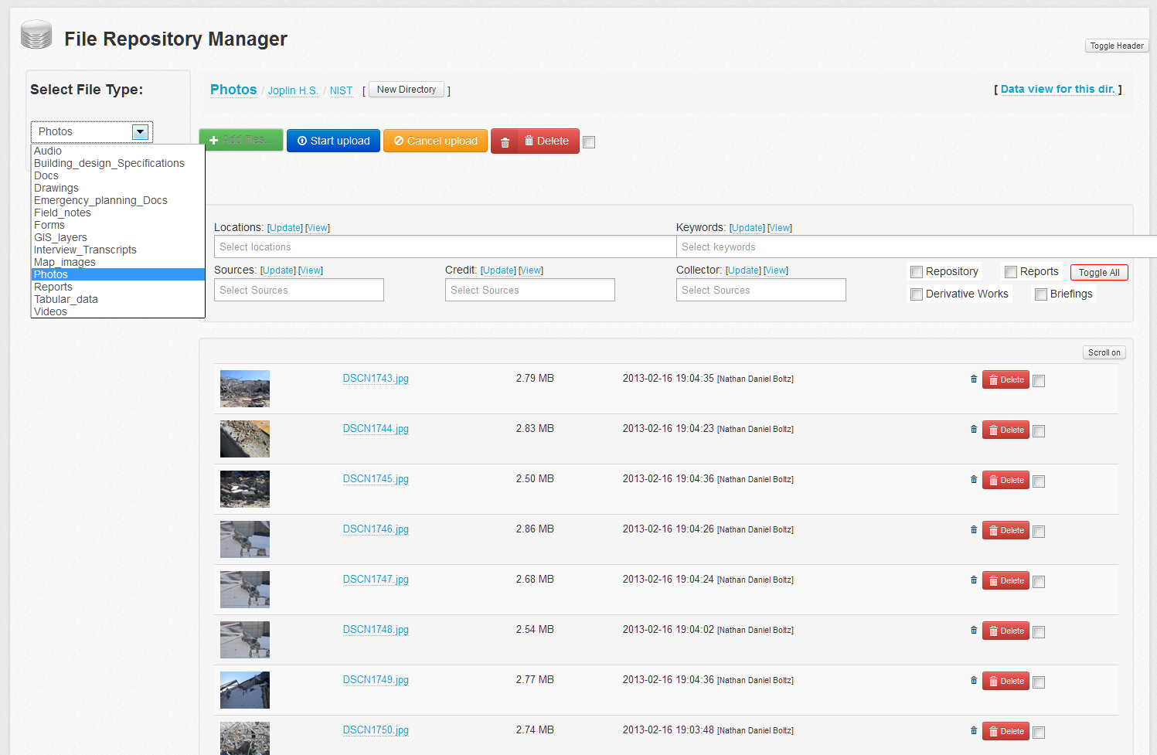
Phase 2 - Joplin Tornado Pilot

Slide 11
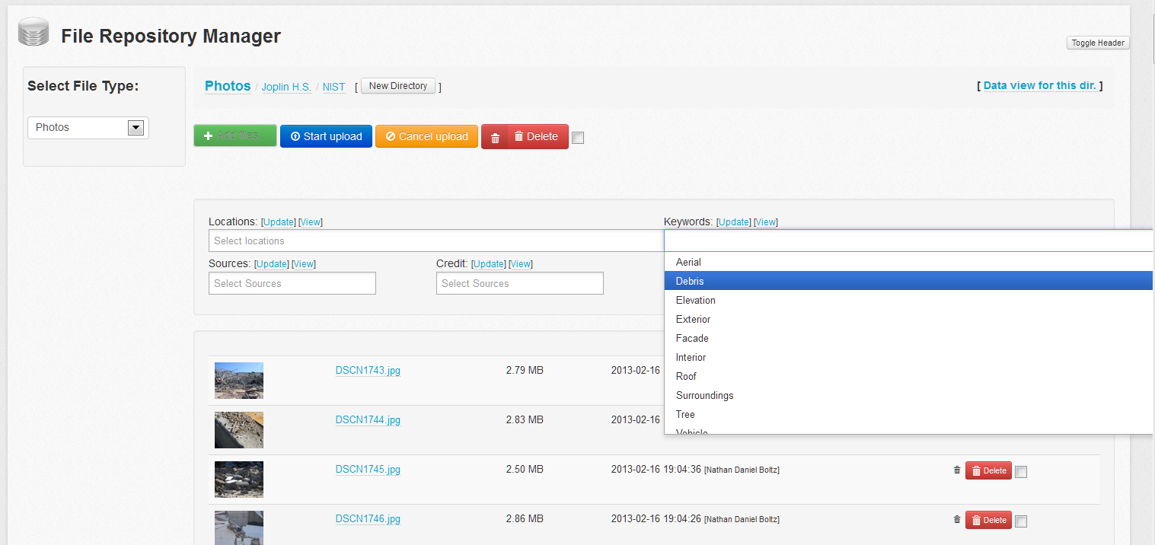
Phase 2 - Joplin Tornado Pilot

Slide 12
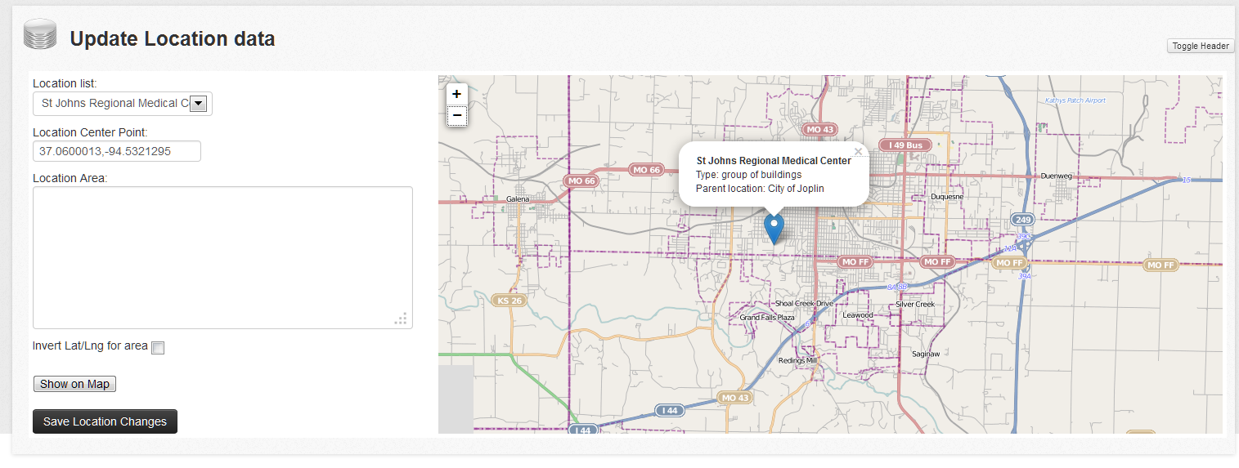
Phase 2 - Joplin Tornado Pilot

Slide 13
Phase 3 – Design Challenges
Criteria for activating repository (which hazard events)
Finalizing which types of data to be included
Set minimum requirements for data to be accepted by NIST for the repository (quality, data formats, legal/copyright/use)
Standardizing / optimizing data collection for each hazard type (earthquake, etc)
Creating standard taxonomy / ontology for each hazard type

Slide 14
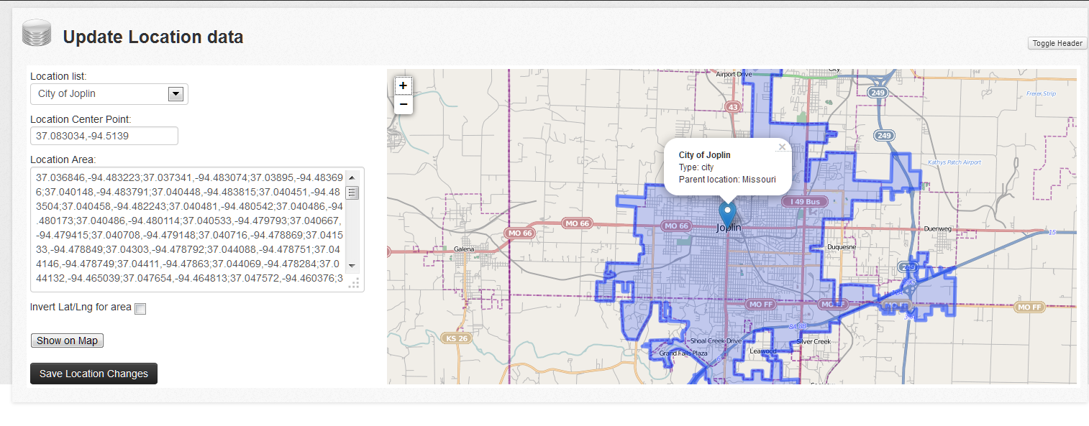
Phase 3 – Design Challenges
Geospatial enhancement of repository
Obtaining permissions from data source owners
Dealing with sensitive data collected that should not be released
Continued compliance with Federal Security Management Act of 2002 (FISMA)

Slide 15
Levels of Access – HUB Design at NIST
Unrestricted Public Access
(Data will be available for viewing and downloading without restriction on a publicly accessible website.)
Disaster and Failure Database
Team-Only Access
(Data collected by team are available only to the team for the purposes of the study.)
View-Only Access for Team
(Data that are reviewed by team but not collected and preserved by NIST.)
Not Part of Database

Slide 16
Phase 3 – Full-Scale Implementation
Finalize user requirements / create “proof of concept” document
Select operating platform
Develop cost estimate to maintain, update, operate and improve accessibility of the repository
Populate with selected high-impact historical and future events
Disseminate information to stakeholder / user community
Maintain ongoing communication with stakeholder / user community

Slide 17
Drawings Sensor Records Reports Photos Videos Audio Files Coordinates Test Results

Slide 19
