Slide 1
Customize the User Experience
Erich Huebner HUB Liaison, HUBzero® Platform for Scientific Collaboration
HUBbub 2013
Purdue University

Slide 2
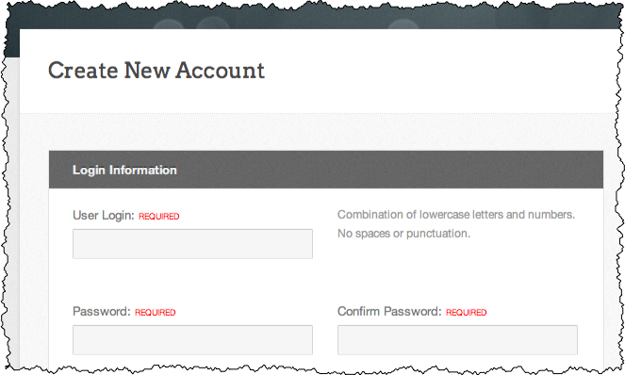
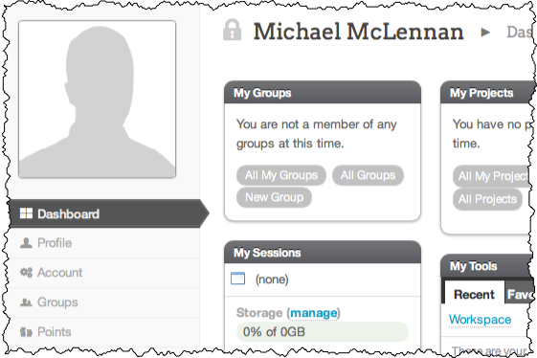
The User Experience
1
Register
2
Log in
3
Participate

Slide 3
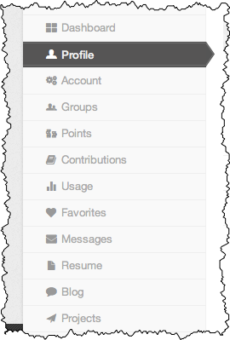
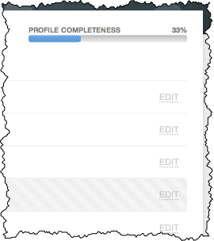
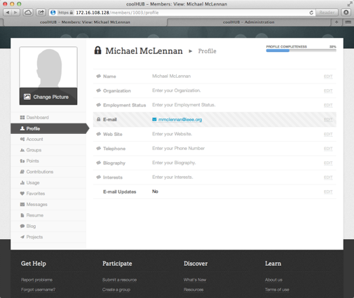
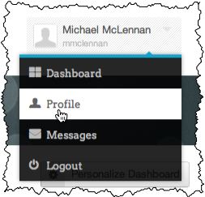
User Profiles
Configurable list of plug-ins
for various hub functions
Profile fields controlled by the
“Edit” column of user registration

Slide 4
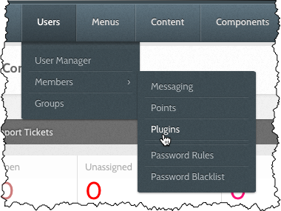
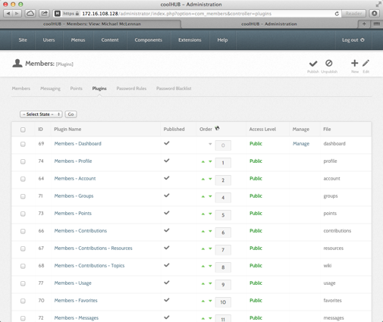
Configuring Profile Plug-ins
Turn off any plug-ins
that your users won’t need

Slide 5
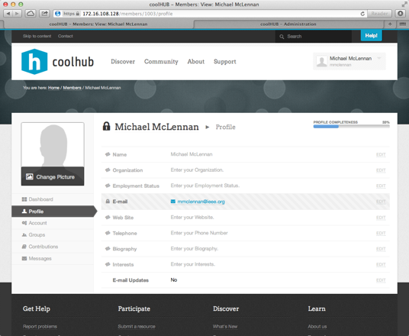
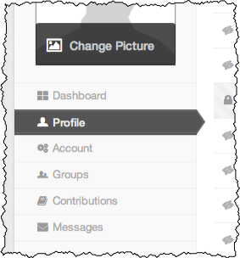
User Profiles
Dramatically
simpler!

Slide 6
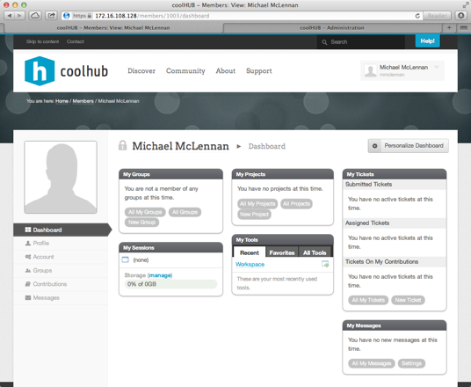
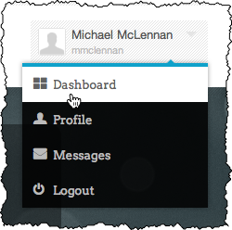
User Dashboard
Change the
default dashboard
configuration

Slide 7
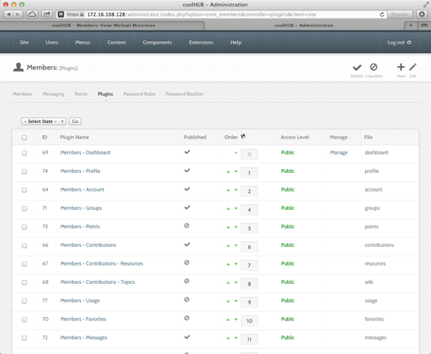
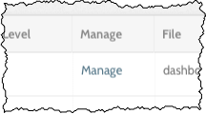
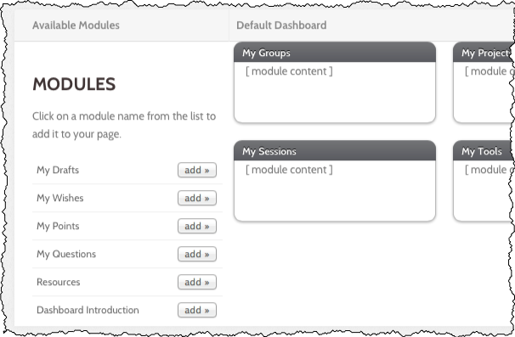
Changing the Default Dashboard
On the dashboard
plug-in, look for
the “manage” link
Drag and drop
to arrange modules
Click “add” to bring
in new modules

Slide 8
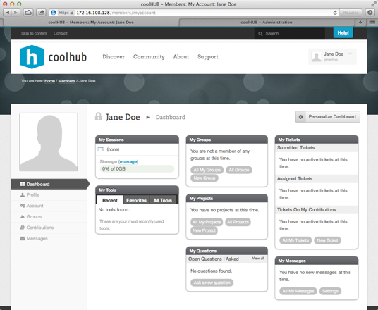
New Default Layout for Dashboard
New layout applies
only to new users

Slide 9
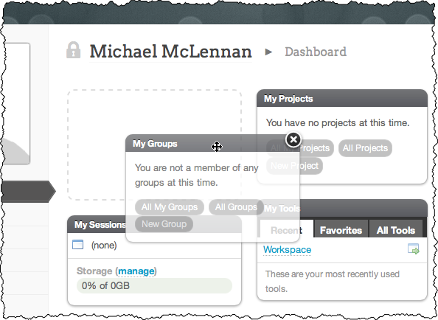
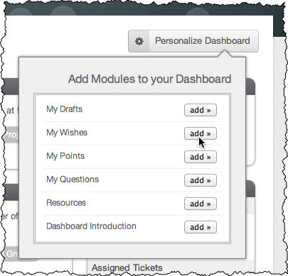
Users Can Further Customize
Click “add” to bring
in new modules
Drag and drop to arrange modules

