Slide 1
Configuring Your New Hub
Erich Huebner HUB Liaison, HUBzero® Platform for Scientific Collaboration
HUBbub 2013
Purdue University

Slide 2
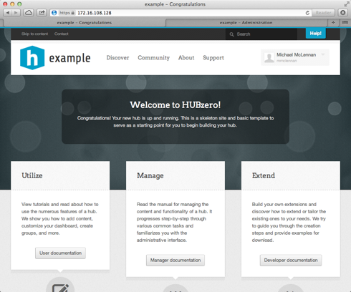
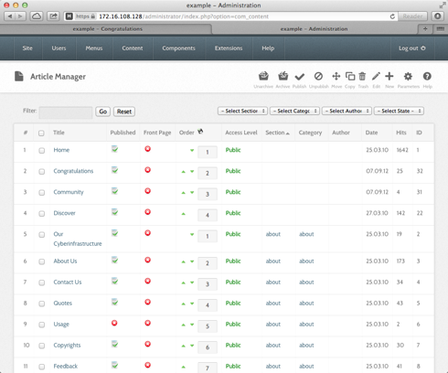
Two Sides
“Front End”
What end users see
“Back End”
What Hub Administrators see

Slide 3
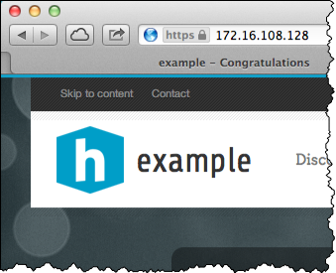
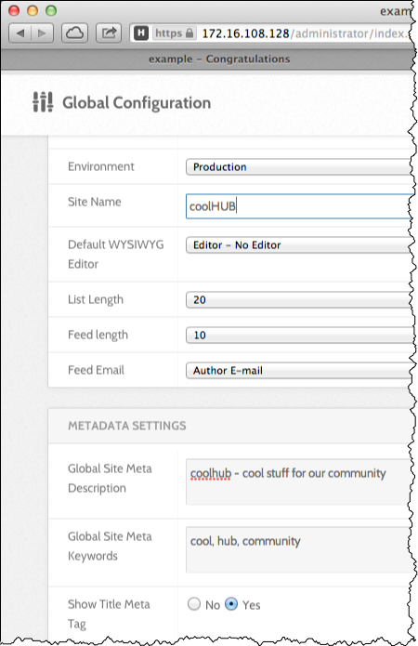
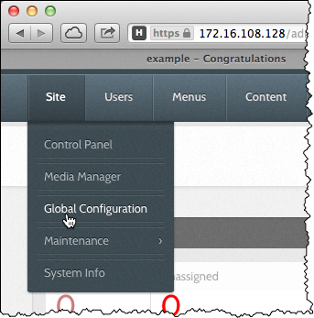
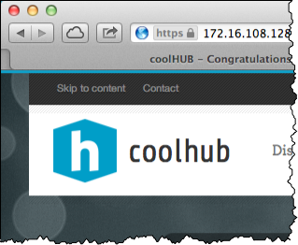
Change the hub name

Slide 4
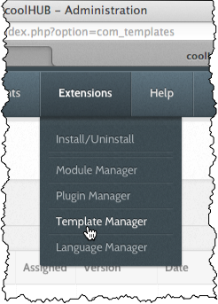
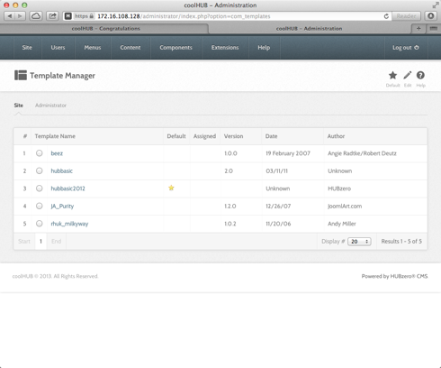
Change the hub style (template)
Choose another and save
Star marks
active template
List of installed templates

Slide 5
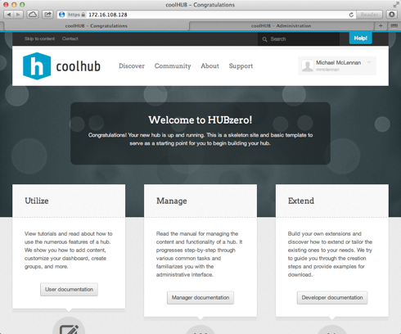
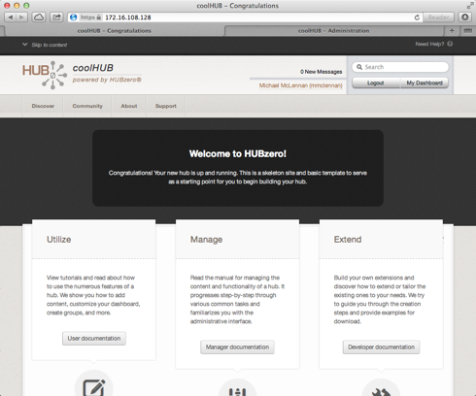
Same site, different templates
hubbasic2013
hubbasic
Create your own templates:
https://hubzero.org/documentation/

Slide 6
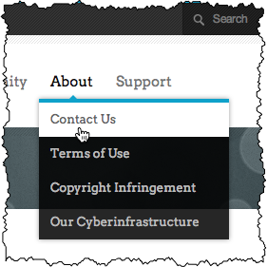
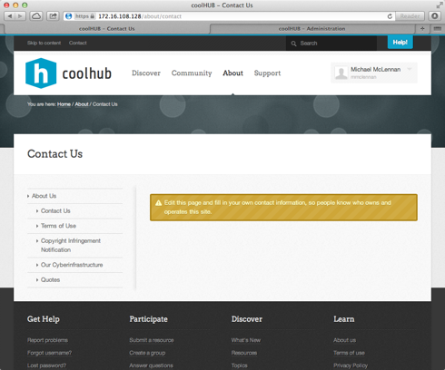
Changing “static” pages
See this page on the front end?

Slide 7
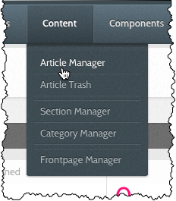
Changing “static” pages
Edit this page on the back end…

Slide 8
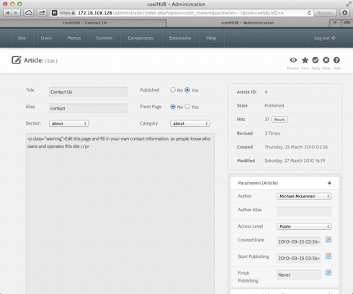
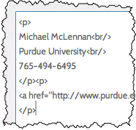
Changing “static” pages

Slide 9
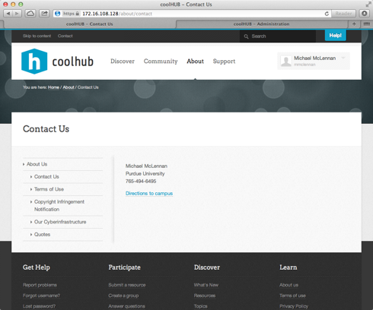
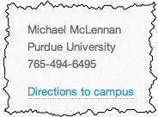
Changing “static” pages
Reload the page
on the front end
to see the effect

Slide 10
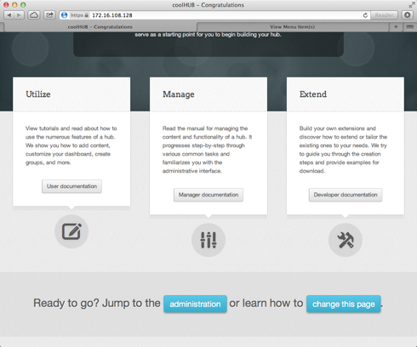
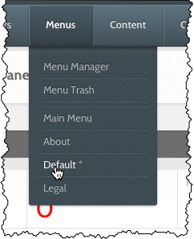
Change the front page
Don’t be fooled by various places
in the back end that say “front page.”
Here’s how it works…
See instructions about changing
the home page here here

Slide 11
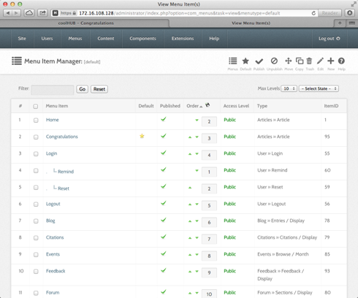
Change the front page
Star marks
current home page

Slide 12
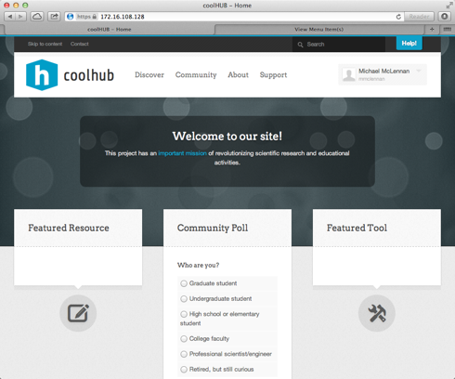
Change the front page
Front page is an
“article” with lots
of embedded
modules
“welcome” module
module position:
featureLeft
module position:
featureRight
module position:
featureMiddle

Slide 13
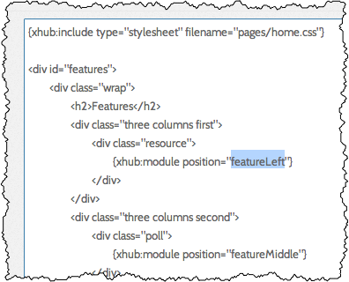
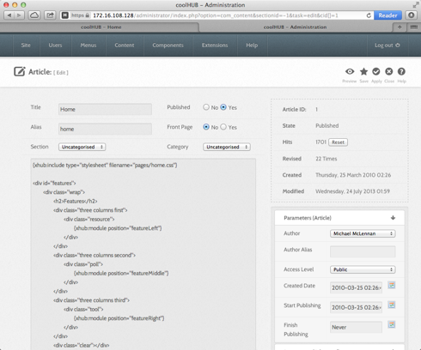
Front page is an “article”
hard-coded text
module position

Slide 14
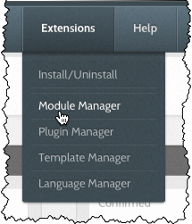
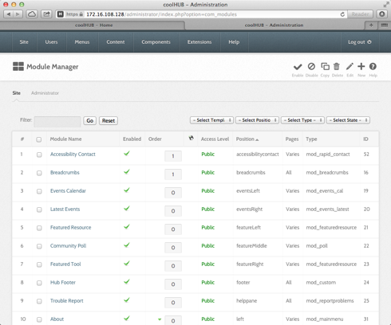
Exploring modules
Find the “welcome”
module on the
back end

Slide 15
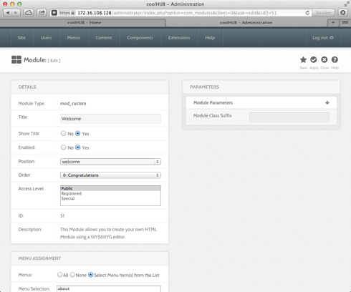
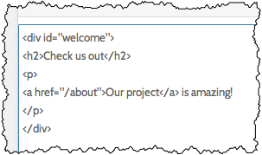
Edit the “welcome” text
Change the
module on the
back end…
…See the
change on the
front page

Slide 16
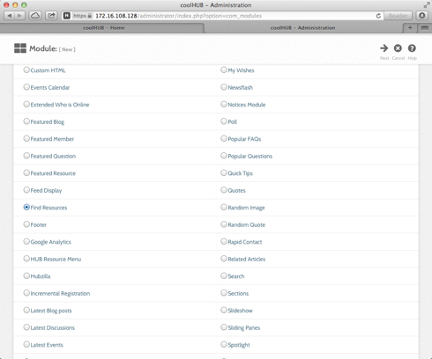
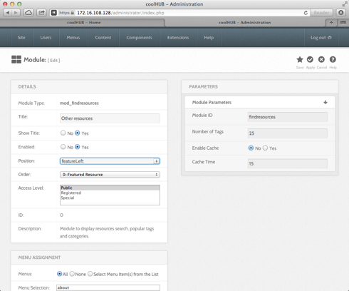
Create new modules
From the module manager…
Choose module
type
Edit module
properties
and position

Slide 17
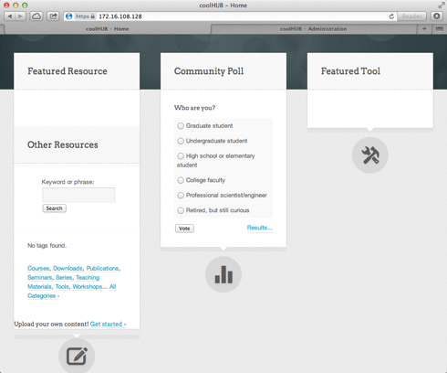
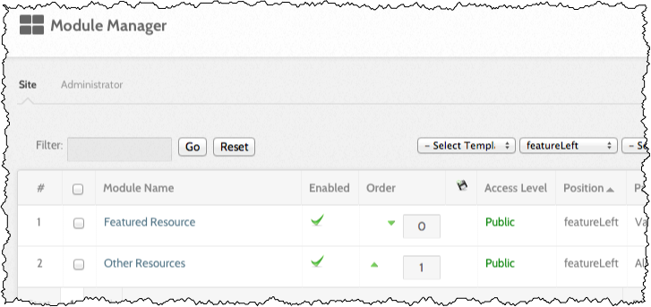
Create new modules
New module shows
up in “featureLeft”
position

