Slide 1
+
Power to the Masses
Carol Song carolxsong@purdue.edu
Hubbub 2013
September 5, 2013

Slide 2
Contributors
Rob Campbell, developer
Kevin (Feng) Chen, developer
Brian Raub, developer
Chris Thompson, developer
Steve Clark, HUBzero application dev
Ben Cotton, project coordination, docs
HUBzero team

Slide 3
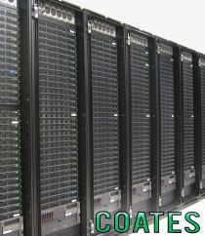
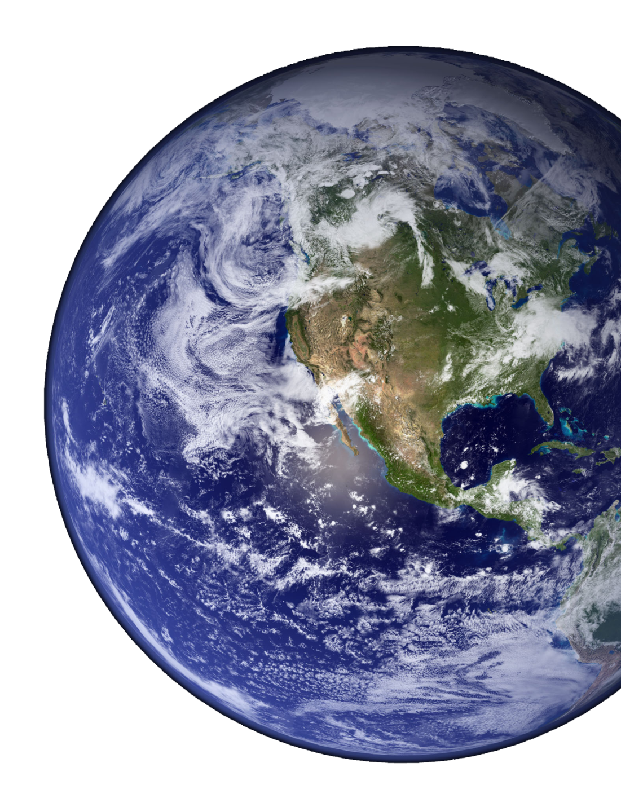
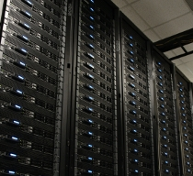
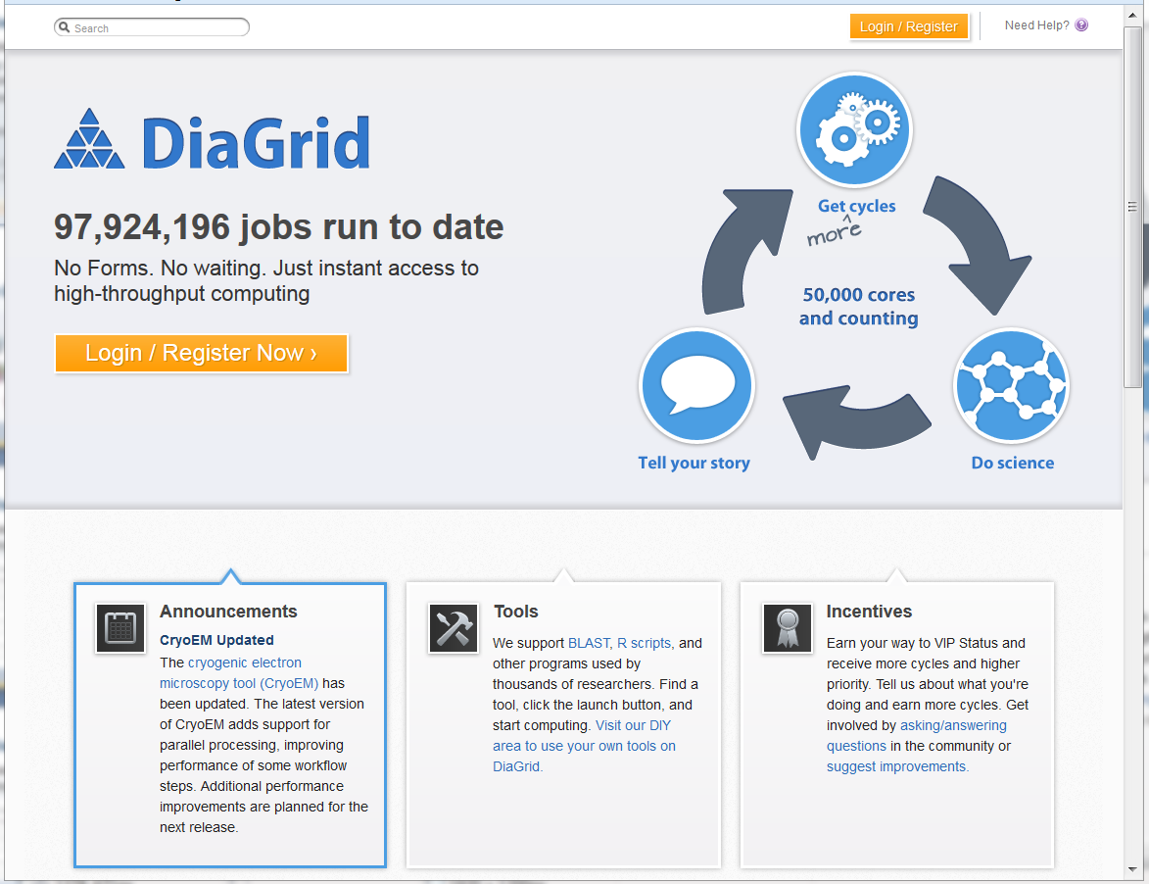
Overview
What is DiaGrid?
Building Communities
Supporting Science
Tools
BLASTer
SubmitR
CryoEM
Gromas
Future Tools

Slide 4
What is DiaGrid?
Notes:
4

Slide 5
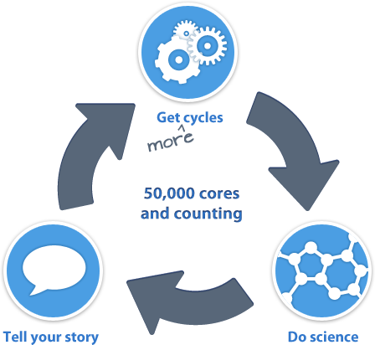
Diagrid.org

Slide 6
To users, DiaGrid is…..
Tools for science, easy to use, instant access, technical support, opportunity to help improve tools, ….
A hub for collaboration and community building
Scientific Software-as-a-Service with easy access to a vast set of computing resources.
A remotely accessible home for research.

Slide 7
To app developers, DiaGrid is …
A federation of 50,000+ cores from computing resources across multiple campuses & institutions.
A pipeline for the whole development process.
Managed deployment straight to users.
A support platform for communicating directly with end users.
Python
Data
Java
Results
R
C++
Science

Slide 8
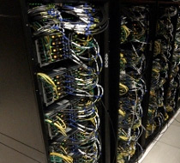
Hardware
Large high-throughput and distributed network of 50,000+ cores, available through HT Condor.
Utilizes spare cycles from:
Community clusters at Purdue
Steele, Coates, Rossmann, Hansen, & Carter
Campus lab workstations
Departmental desktop computers
More than 100 million jobs run to date!
Can also access HPC systems

Slide 9
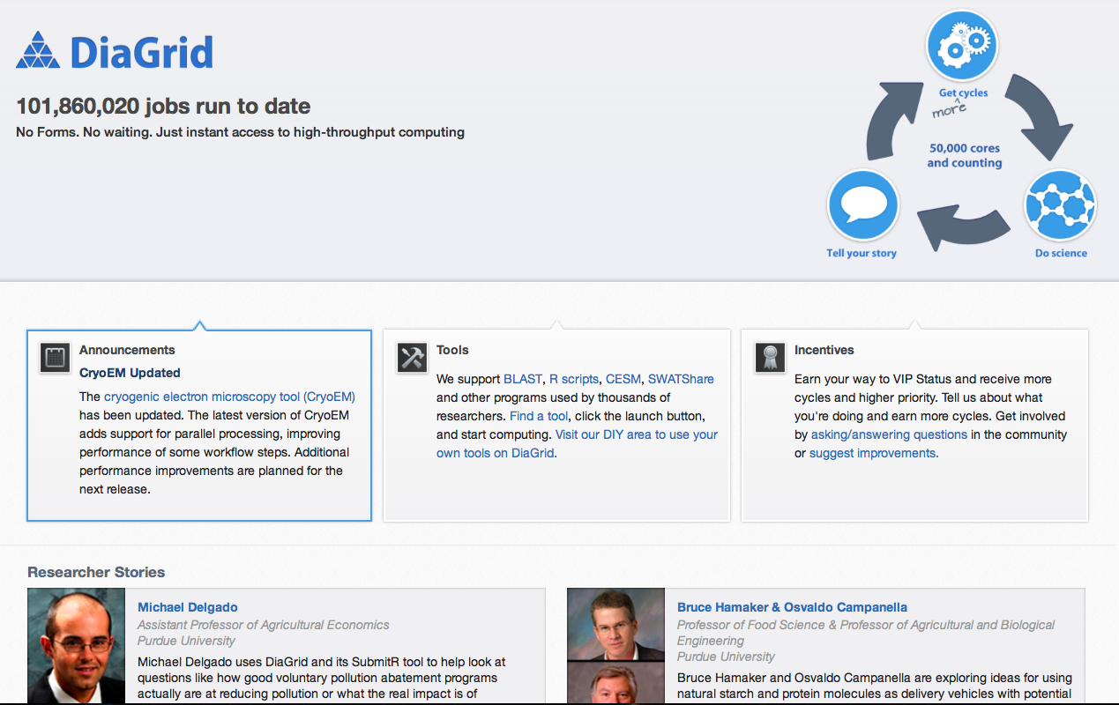
The web site: diagrid.org

Slide 10
Supporting Science
DiaGrid.org
The HUBzero team has created the “submit” shell command to abstract grid access for tool developers.
Tools run a subprocess through “submit” to handle all their grid computation needs.
Utilizes Pegasus engine for HT Condor on resources.
Selects apps for development based on user community needs (size of community, need for computing resources, potential to link with other tools)
Tool Session
Tool
Submit
Pegasus
HT Condor
CPU
CPU
CPU
CPU
CPU

Slide 11
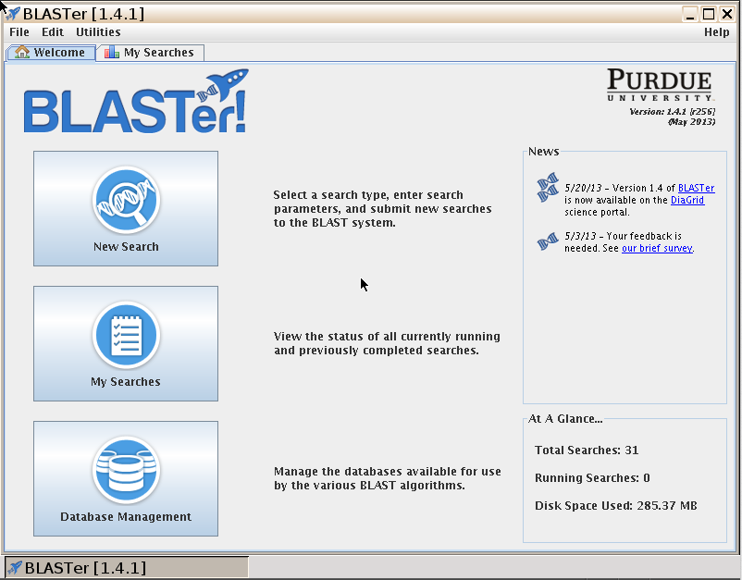
BLASTer

Slide 12
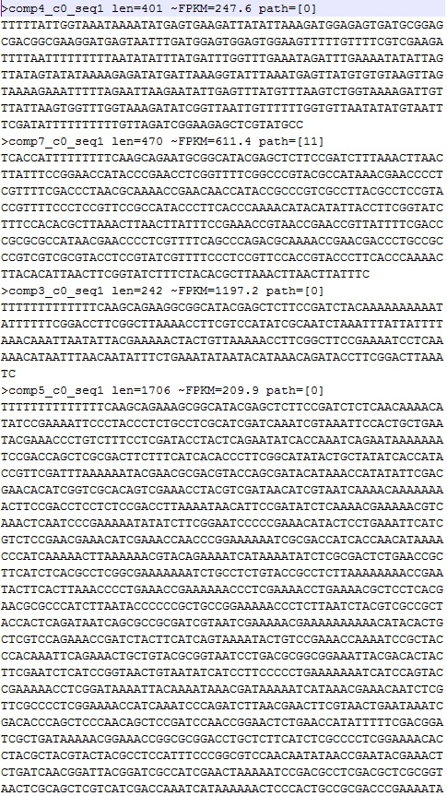
BLASTer
AGT
G
BLAST is a popular tool used throughout biology research to scan genomes for target sequences.
A search job can contain thousands of sequences.
Many users run long BLAST jobs for weeks on desktop workstations in their labs…
TGCGCATT
TGCGCATT
CGATT
FGCACT
TGCAT
C
Science

Slide 13
BLASTer
Each sequence is independent, making a great case for parallelization!
Input files are split into small chunks and fed to Condor jobs via the HUBzero “submit” system.
Submit
Pegasus
HT Condor
BLAST
DB

Slide 14
BLASTer
Splitting BLAST inputs for parallel HT Condor jobs like those used by BLASTer creates dramatic speed-up for most users.
Rick Westerman, bioinformatics specialist at Purdue, recently reported the following:
Sample | Sequences | Bases | N50 Length | Cluster Wall Time | HT Condor Wall Time
#1 | 43K | 16M | 439 | 5:20 | 2:40
#2 | 40K | 15M | 412 | 5:30 | 2:30
#3 | 105K | 49M | 479 | 7:15 | 3:30
#4 | 145K | 72M | 509 | 8:20 | 3:20

Slide 15
Solving problems for users
Speed up the searches
Use custom databases for searches
Manage data transfer
Track search history
Regular BLAST database update
BLAST code update
Post processing, link to other tools (BLAST2GO)
Manage storage
Share databases

Slide 16
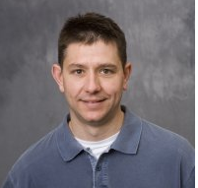
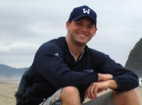
In the past 12 months, BLASTer
Completed 1.4 million search jobs (equivalent to searches of tens of millions of sequences against public and custom databases)
Consumed 800K CPU hours (HT Condor)
111 researchers used Blaster
Most of them are from domains that traditionally use desktops for computation.
Using Blaster to annotate assembly of gene sequences (50,534 contigs) from E51K Illumina in study of gene evolution
8 days in the lab → less than 3 hours on DiaGrid
J. Andrew DeWoody, Nick Marra, Forestry & Natural Resources

Slide 17
SubmitR

Slide 18
SubmitR
Users create scripts to run their simulations all the time.
A demand exists to run these jobs on the grid.
SubmitR solves this issue for the R language on DiaGrid.
R Scripts &
Inputs
Results &
Outputs
SubmitR
R Scripts &
Inputs
Results, logs,
etc… (.zip)

Slide 19
SubmitR
SubmitR supports a wide range of R scripts:
Single: one process
Parallel: multiple processes communicating with each other
Sweep: many isolated processes with different parameters, inputs, or both
R Scripts &
Inputs
Results &
Outputs
SubmitR
R Scripts &
Inputs
Results, logs,
etc… (.zip)

Slide 20
SubmitR
SubmitR already supports a wide range of R libraries:
And through the DiaGrid community features users can request more!
ElectroGraph
GWASExactHW
KernSmooth
MASS
Matrix
PBSmapping
base
boot
class
cluster
codetools
compiler
cubature
datasets
deldir
foreign
grDevices
graphics
grid
igraph
lattice
maptools
methods
mgcv
mvtnorm
ncf
nlme
nnet
np
parallel
plotrix
plyr
qtl
raster
rgdal
rgeos
rpart
snow
snowfall
sp
spatial
spatstat
splancs
splines
stats
stats4
stpp
stringr
survival
tcltk
tools
utils
…

Slide 21
SubmitR usage examples
Nutrition: (single, long running jobs)
Ingestive behavior research
Bioinformatics: (single, long running jobs)
Genome association and prediction
Agricultural Economics: (single and parallel jobs)
Distributed hydrological modeling
Effects of education on growth rates in developing countries
Consumer demand for hybrid cars
In past 12 months, ~7550 simulation runs, 45 users. Together with workspace, nearly 3M hours consumed by R codes.

Slide 22
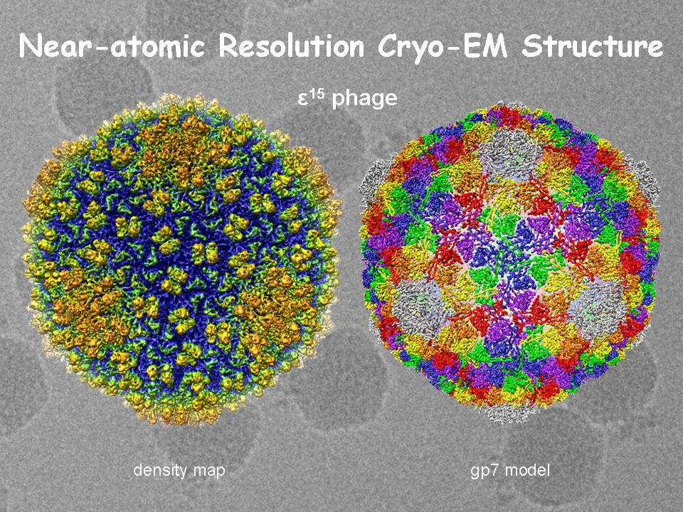
CryoEM
The analysis of images taken at cryogenic temperatures within an electron microscope can reveal much about the structure of microscopic objects.
Image processing is a good candidate for parallelization.
The first user developed tool for the DiaGrid portal.
DiaGrid staff utilized helping CryoEM authors split tasks for HT Condor then recombine with MPI for 3D visualization.

Slide 23
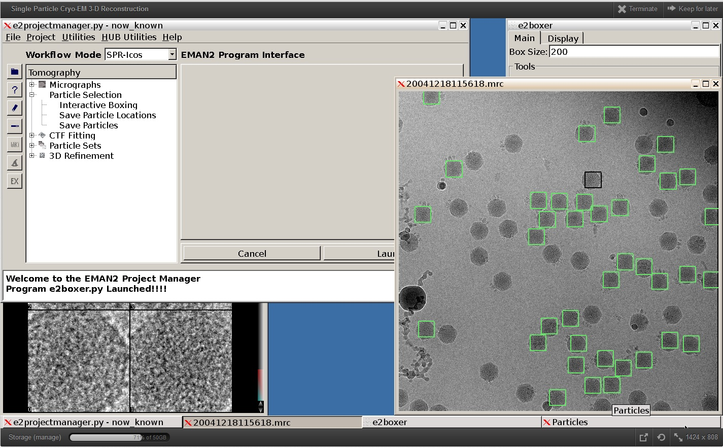
CryoEM

Slide 24
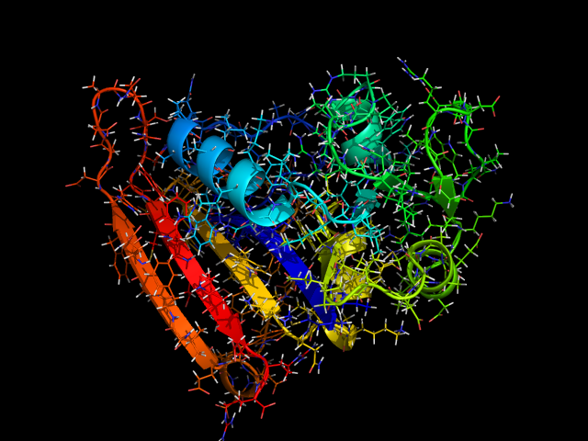
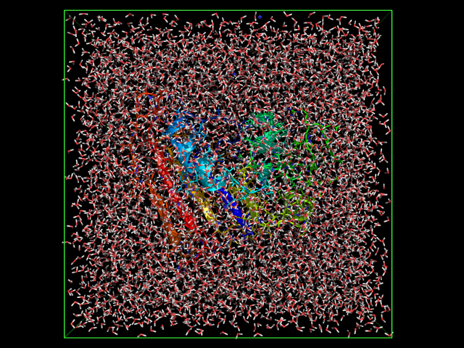
GROMACSIMUM
GROMACS is a molecular dynamics model with a large community of users in many scientific disciplines from chemistry, biology, medicine, physics, etc...
This project takes a popular open source GROMACS GUI, jSimMacs, and extends it with new features for high-performance computing.
First DiaGrid tool to actively modify and improve existing open source project.

Slide 25
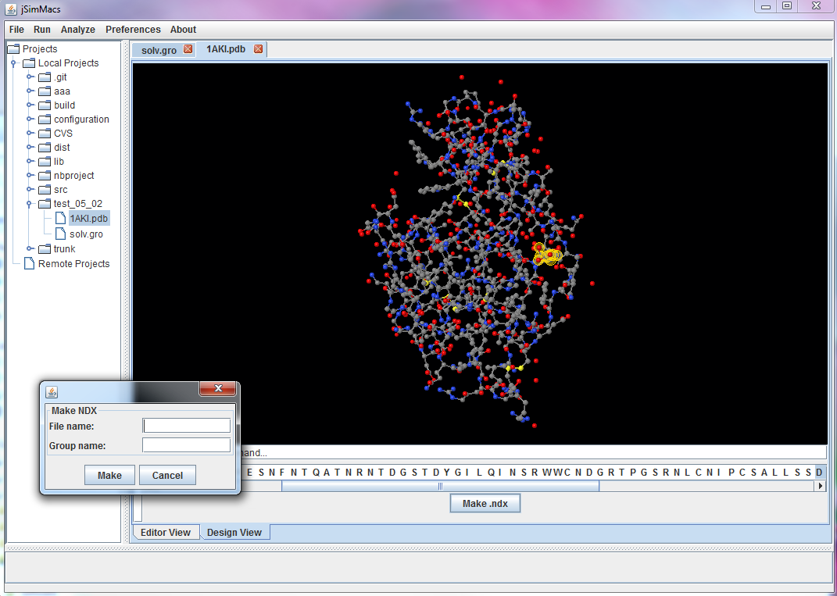
GROMACSIMUM

Slide 26
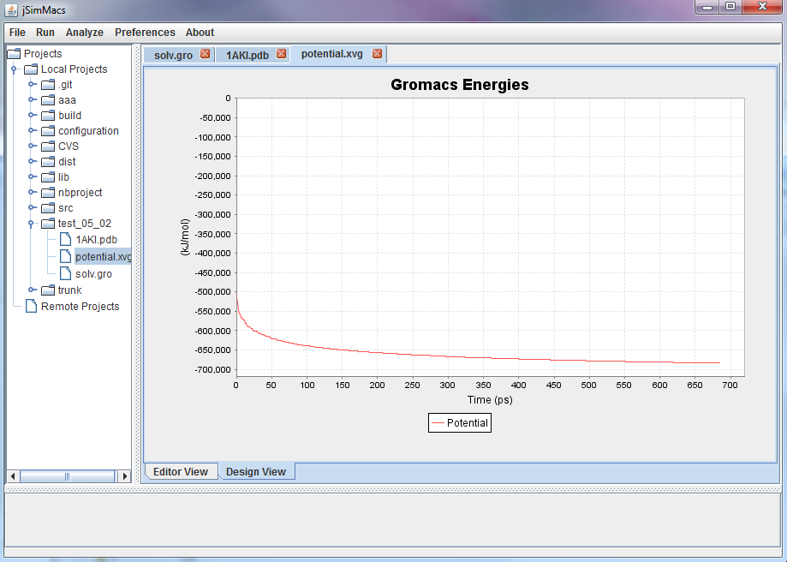
GROMACSIMUM

Slide 27
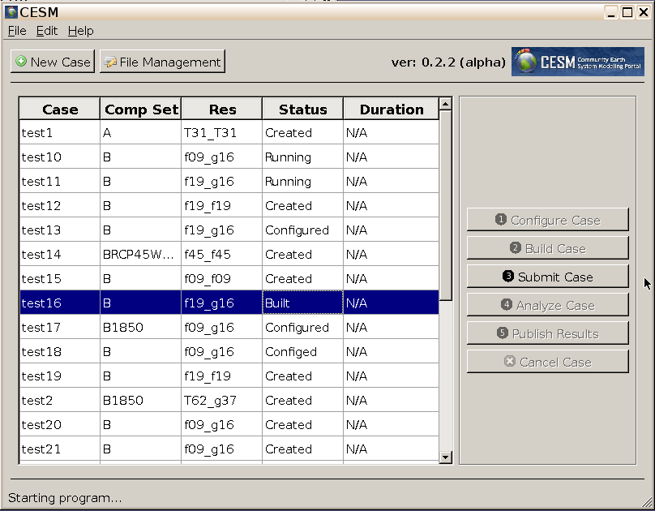
CESM
CESM is a global climate model coupling many aspects of Earth sciences research.
Purdue developed a CESM web gateway and designed it to support multiple interfaces.
This project will explore providing an alternate interface to the CESM gateway services from inside DiaGrid.

Slide 28
More apps!
More Applications that are:
for research or instruction
Requires high performance and/or high throughput computing
Solves workflow or ease­of­use problems
Tied to a computational resource or sufficiently portable as to be resource­agnostic
Not encumbered by license or patent restrictions
Multi­institution user community
Partnership
Contribute applications
Contribute unique resources

