Slide 1
Enabling computational modeling and geospatial data analysis through HUBzero
Venkatesh Merwade, Lan Zhao, Carol Song
Purdue University
Hubbub2013, September 2013

Slide 2
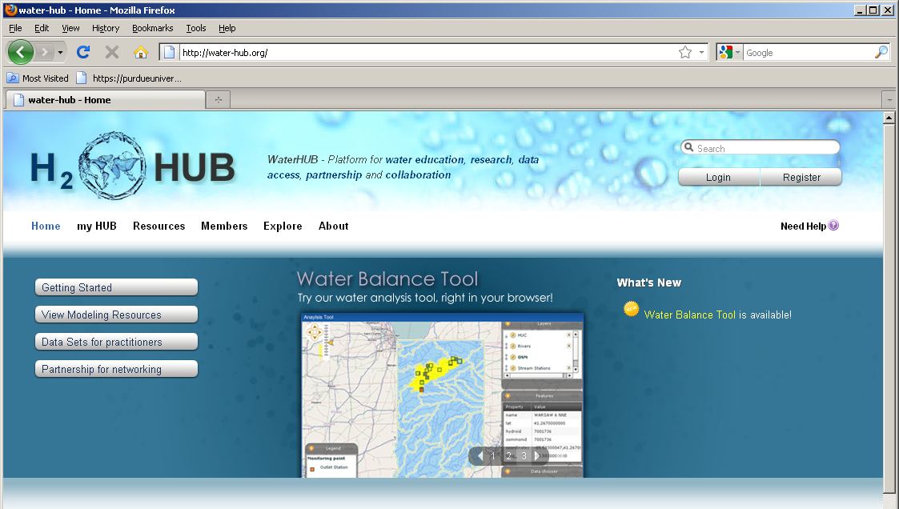
WaterHUB
Based on HUBzero technology at Purdue, WaterHUB uses open source packages to create an environment in which researchers, educators, and students can access tools and share information
Notes:
Waterhub has the following built-in tools:
Interactive simulation tools
Online presentations
Mechanism for uploading resources
Tool development area
Content tagging
Wikis and Blogs
User groups for private collaboration
User support area
Usage statistics
Feedback mechanisms
Right now waterhub is in development phase and is not available to the public. It will be available at water-hub.org in september. If anyone is interested in beta testing, please let us know, and we will send you the link.

Slide 3
SWATShare
One of the tools on WaterHUB
SWATShare enables
Searching for existing SWAT models on WaterHUB
Downloading of previously created SWAT models and their outputs by the community
Publishing and sharing of your own SWAT models with the community
Execution of single or multiple normal, sensitivity analysis and calibration runs
Visualization of outputs
Everything is enabled by using XSEDE resources
Notes:
Because of its interactive environment it enables the following

Slide 4
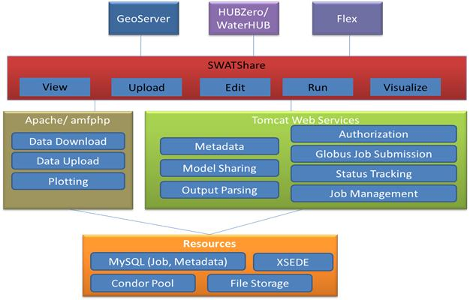
SWATShare Architecture

Slide 5
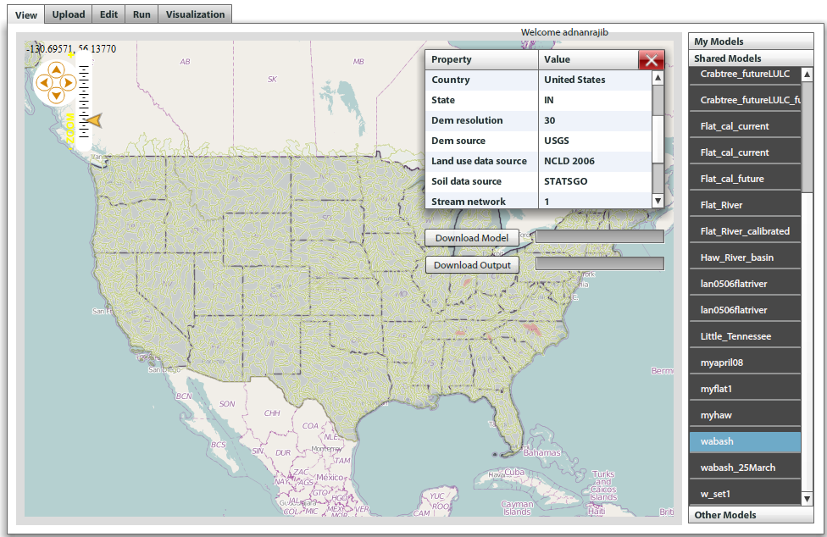
SWATShare User Interfaces
View
Users can download only their own model and a shared model with associated output files
The uploaded models are displayed in 3 groups
My Models: models that are uploaded by the current user
Shared Models: models that uploaded by other users, but are shared with all users
Other models: models that are uploaded by other users but not shared
Notes:
If a user clicks on a model in the list, the map view in the left panel will highlight the selected model and display its metadata as shown in the figure

Slide 6
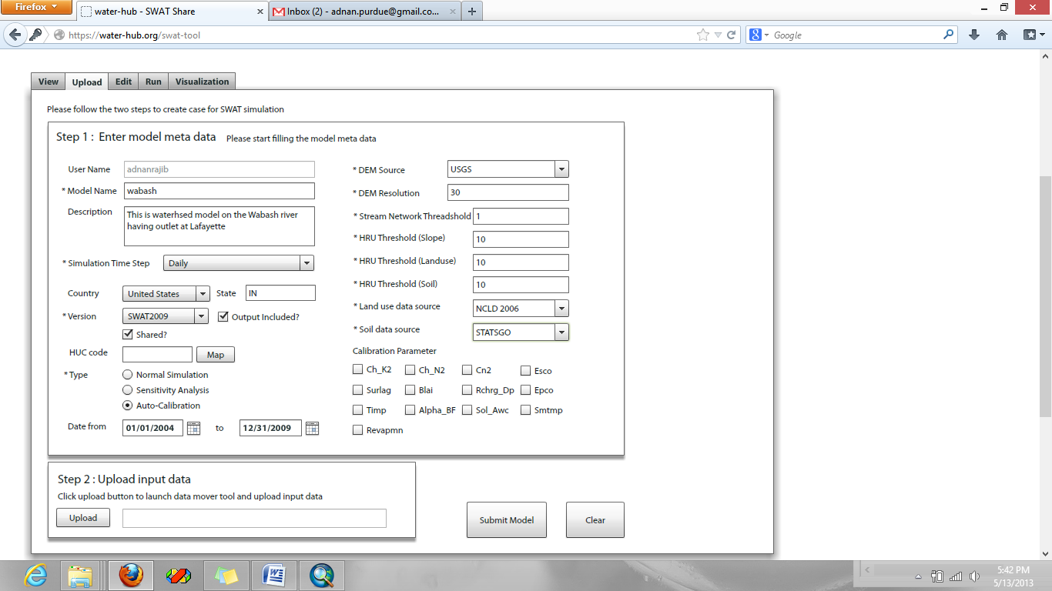
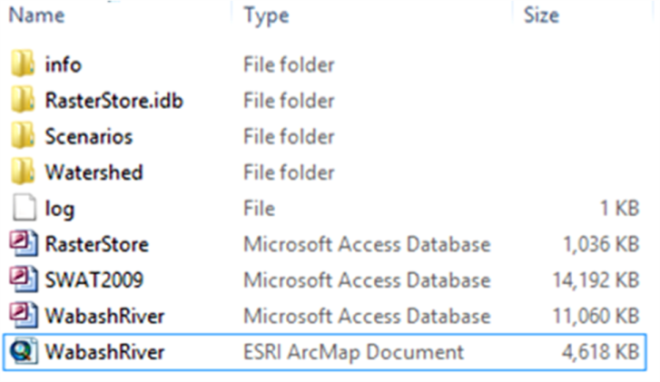
SWATShare User Interfaces
Upload
Contents of the zip folder
Notes:
Uploading of model into SWATShare involves a two-step procedure.
In the first step, a user has to enter the metadata associated with the model including model name and description, simulation time-step (daily/monthly) and duration, DEM source and resolution, stream network threshold (%), slope, landuse and soil threshold (%) for HRU definition, landuse and soil data source, as well as the SWAT version being used.
Out of all these met-info, (i) simulation time-step, (ii) duration, (iii) simulation type, these three are very sensitive for successful execution through SWATShare. They have to be exactly the same as in the master file file.cio of the original model getting uploaded. This is very important.
In the second step, the model is uploaded by clicking the ‘Upload’ button and browsing to the computer directory where the zip folder is located. The upload process is completed by selecting the “Submit Model” button.

Slide 7
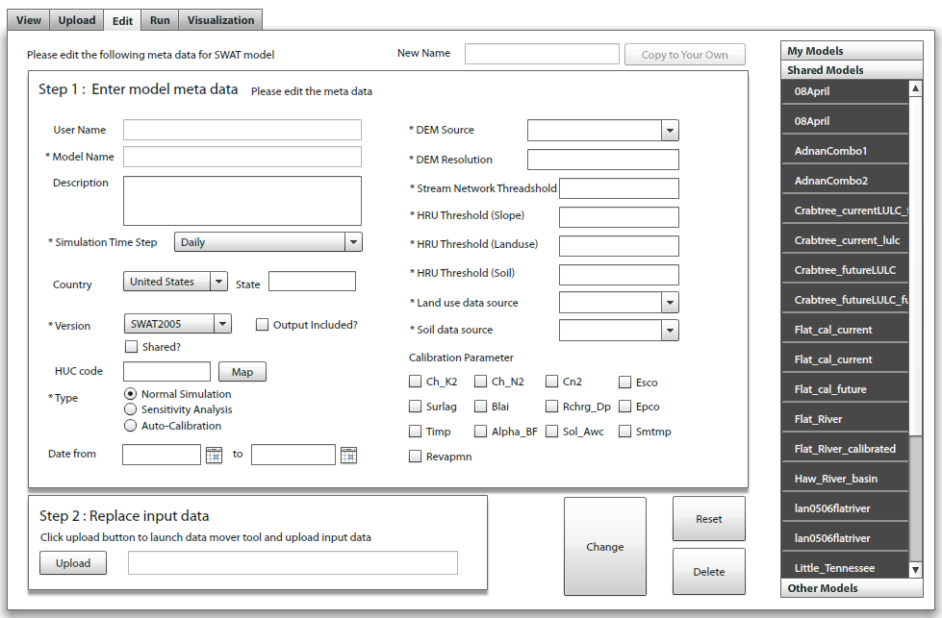
SWATShare User Interfaces
Edit
Select any model from My Model section. Related information will show up in left panel
Manually edit or replace information including the model input file. Click on Change
The Reset button will restore all the original information previously saved
Notes:
This is quite similar to the upload interface
This interface can only be used to update or replace information including the model file for an existing model in the system. When a model is selected in the right hand column, all the information related to the model will be displayed on the left hand side.
Generally, a user can only edit or modify model owned by him or her (from My Models section)

Slide 8
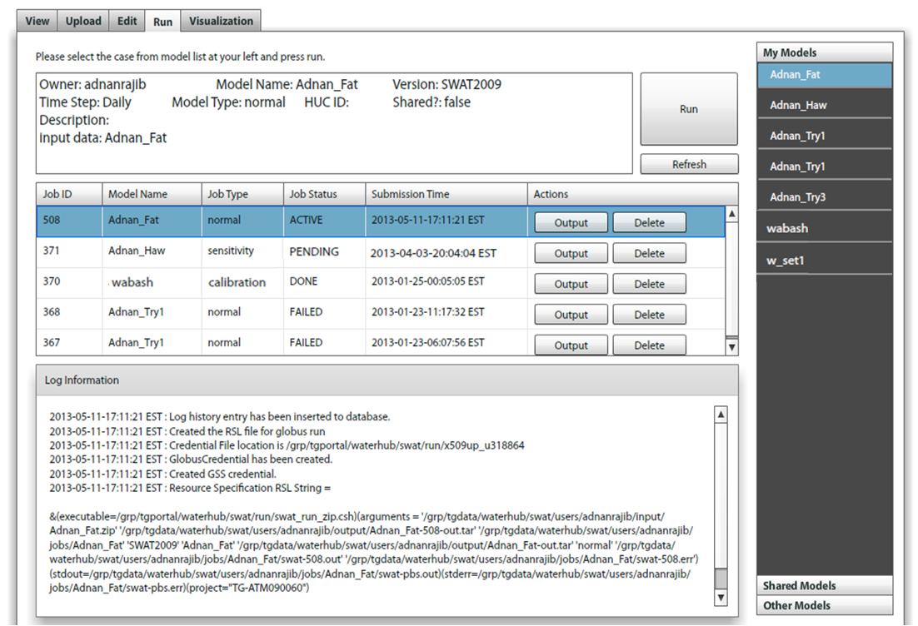
SWATShare User Interfaces
Run
Selecting a model and clicking the Run button will submit the model to run on one of the XSEDE clusters
A user can import a shared model, and run it in My Models section
SWATShare selects run option (normal/sensitivity/calibration) depending on model’s file.cio and information provided in the Upload interface

Slide 9
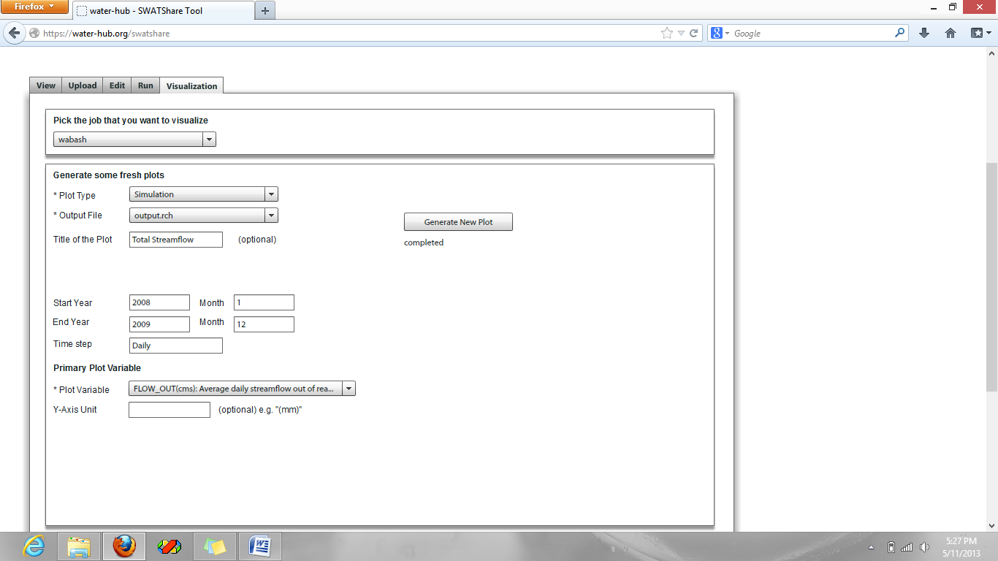
Visualization
Visualization for (i) output.std, (ii) output.sub and (iii) output.rch
One variable at a time needs to be selected to produce the visual plot
All plots in output.rch and output.sub correspond to outputs at the watershed outlet

Slide 10
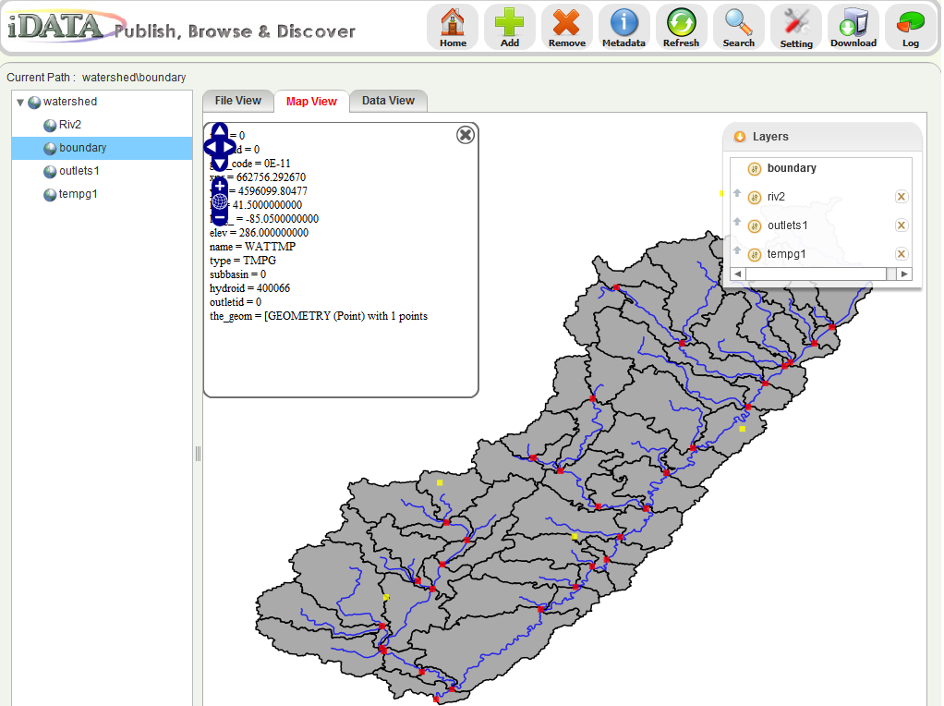
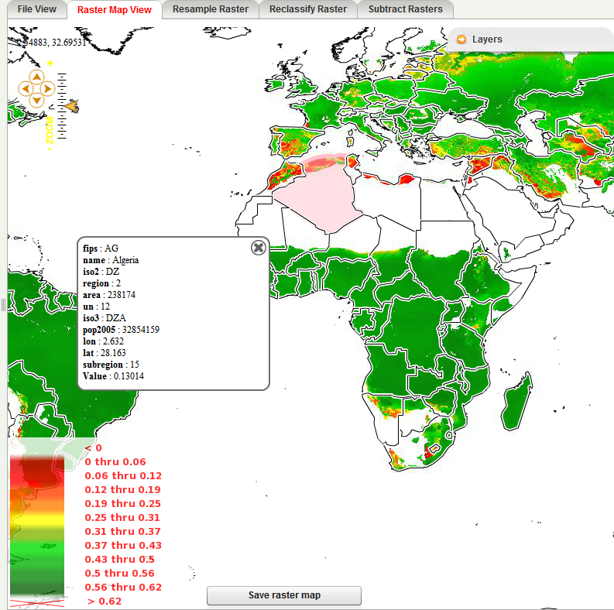
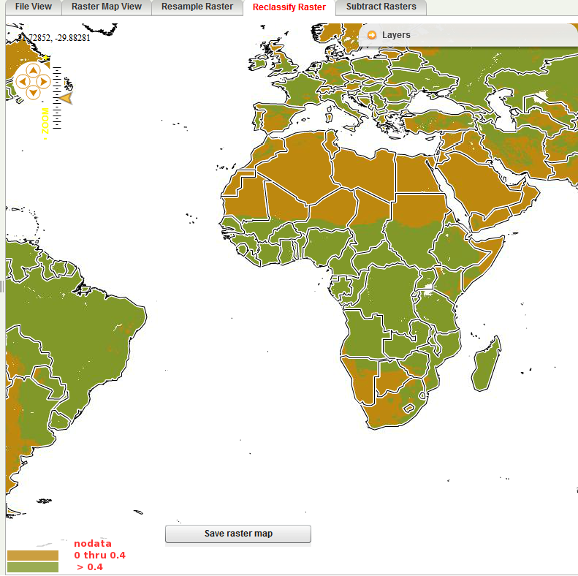
iData- A Community Geospatial Data Sharing Environment
Integrated data publishing, sharing, visualization, and processing for geospatial data collections
Notes:
Joomla component, deployable in any HUBzero-based environment
General-purpose data management framework supporting data collections of various types
Specific support for geospatal data types commonly used by geoscience and environmental science researchers
Available on drinet and geoshare hubs
Fig 1: shows shapefile visualization
Fig 2: shows raster data visualization
Fig 3: shows an example raster data processing service - reclassification

Slide 11
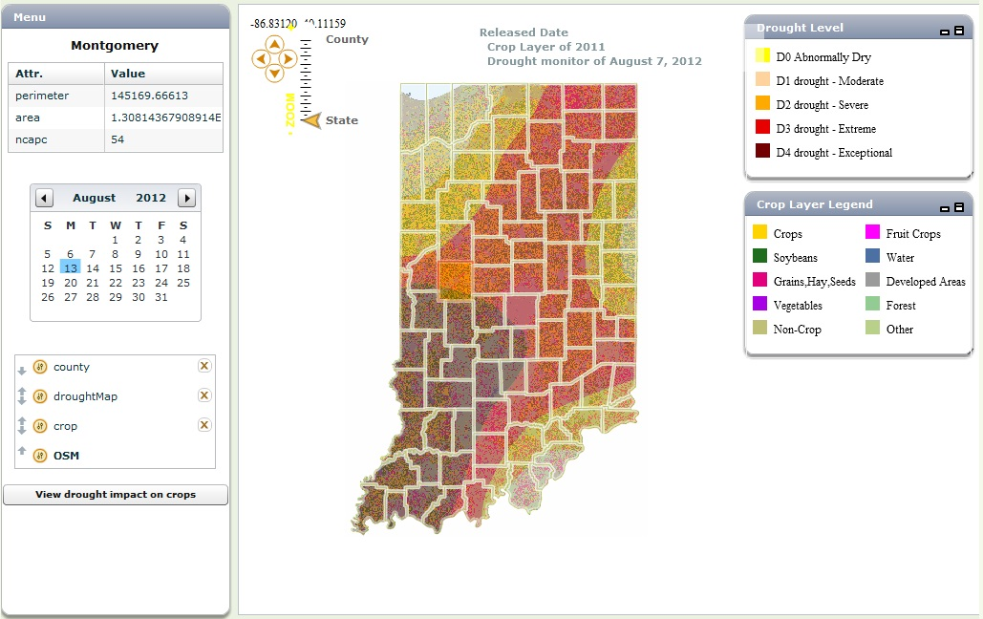
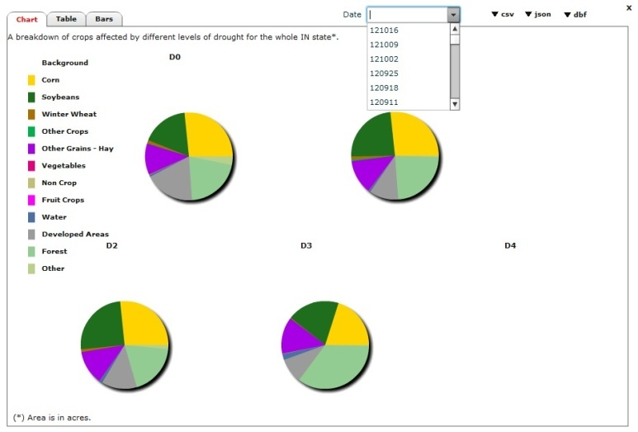
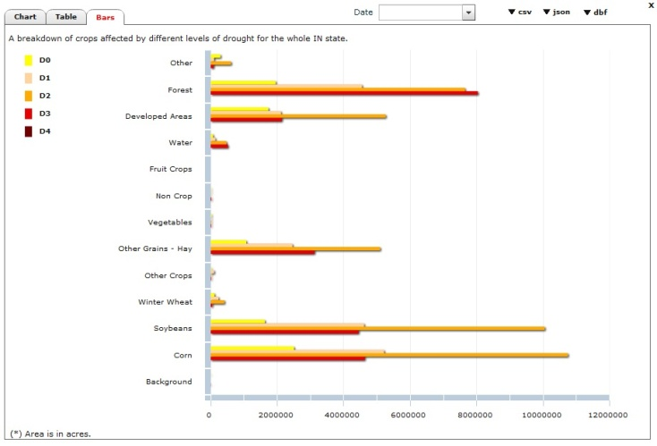
DRINET
Drought Impact Viewer
http://drinet.hubzero.org
Notes:
Drought impact viewer
Used by users to study the impact of drought on various types of crops by comparing the current yearly crop data published by USDA National Agricultural Statistics Service (NASS) and the weekly drought map published by the US drought monitor site.
The NASS crop map consists of 13 categories of crops and other land uses.
Users can also check the drought impact of a past date using a calendar control.
Overlay drought map with crops data layer
User may view the impact of drought for state and counties
Each pie chart shows the impacted crops under each drought level of the Indiana state

Slide 12
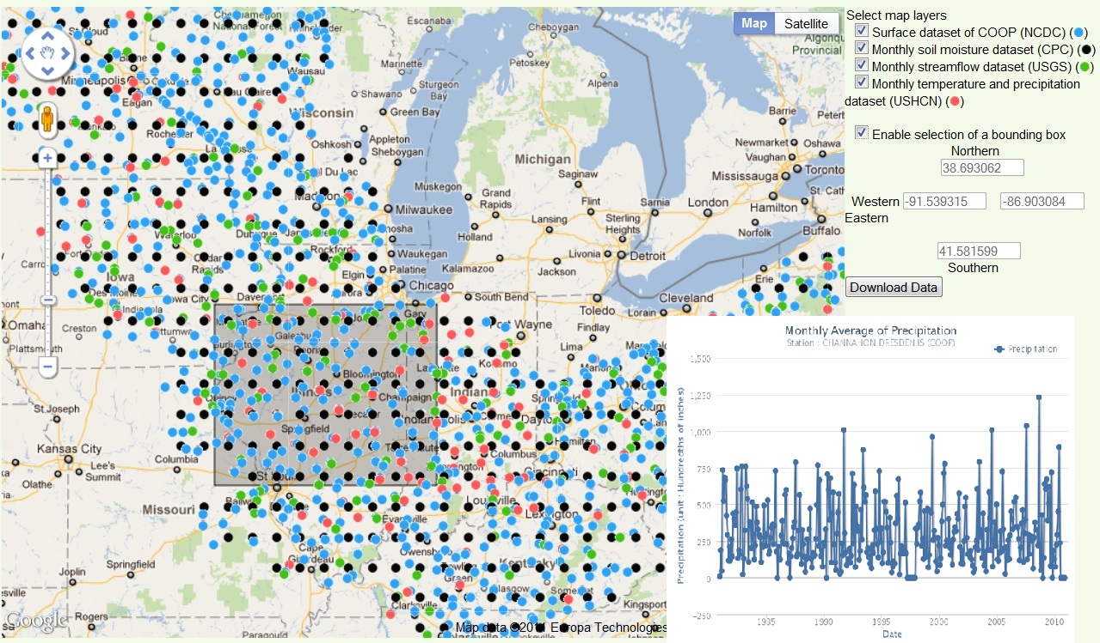
DRINET Tools
Upper Mississippi River and Ohio River Basin Data
Notes:
A tool to present temperature, precipitation, soil moisture, streamflow data.
Four layers representing stations and grid cell overplayed on map.
Data layers can be visible or hidden.
User may select a region and obtain the data for that region, or plot time series online.

Slide 13
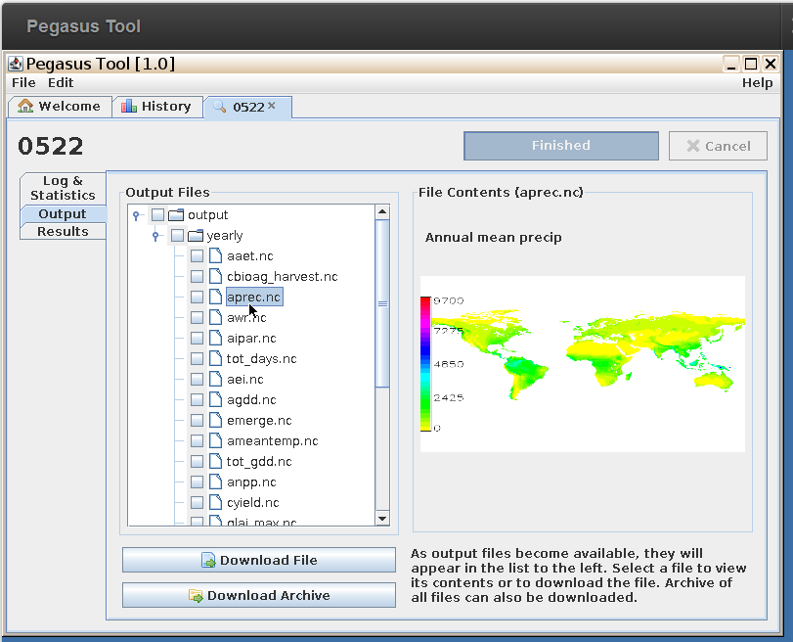
Pegasus
A hub tool deployed on geoshare hub
Configure, submit Pegasus crop model simulations to a cluster
Manage and visualize model output
http://geoshareproject.org

Slide 14
Maize production tool
A prototype system
Agriculture datasets for maize and climate variables
Weighted average module (GRASS and R)
Data processing, plotting, and download
Flex, Geoserver, GRASS, R, PHP

Slide 15
GABBS
A new project expected to start soon!
Develop geospatial data analysis and modeling building blocks for HUBzero
Data space supporting geospatial data processing, analysis and visualization
New Rappture geospatial APIs and renderers
Data services exposing APIs for the data space
Enable geospatial data driven workflows between data space and tool space
Notes:
Combining our experiences in developing geospatial data and modeling tools using hubzero, we will launch a new NSF-funded project called GABBS in September

Slide 16
Summary
Tools that support geospatial capabilities to enable simulation models are available for specific models
Geospaital data analysis tools to process and visualize geospatial data are created for several ongoing project
Efforts are underway to develop generic tools support computational modeling and geospatial capabilities within HUBZero to support geosciences applications

Slide 17
Thank you!
Contact:
Venkatesh Merwade – vmerwade@purdue.edu
http://web.ics.purdue.edu/~vmerwade

