Slide 1


pHUBpk: Pharmacokinetics on the pharmaHUB
Stephen D. Stamatis¹, Michael J. McLennan², and Lee E. Kirsch¹
HUBbub 2013
¹The University of Iowa College of Pharmacy
²Purdue University

Slide 2
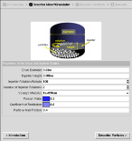
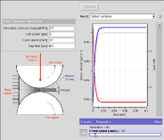
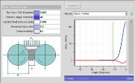
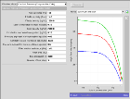
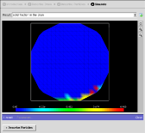
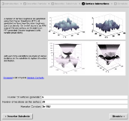
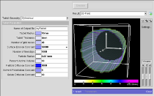
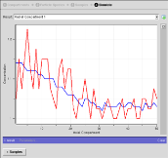

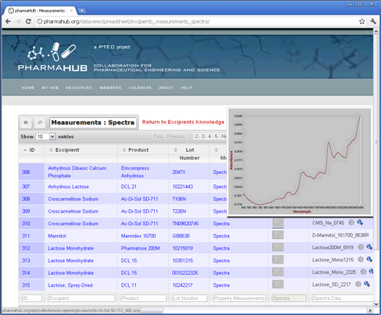
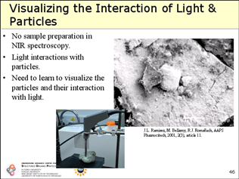
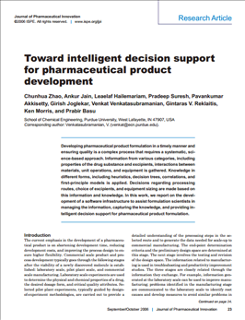
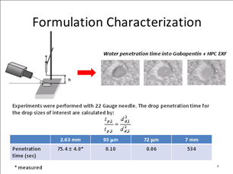
pharmaHUB
23,000
Users Worldwide
22 simulation tools
Collaboration for
Pharmaceutical
Engineering and Science
$1.9M NSF CDI award
Purdue University
Rutgers University
University of Iowa
NIPTE-FDA
Excipients
Knowledge Base
100 other

Slide 3
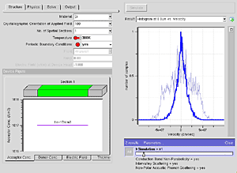
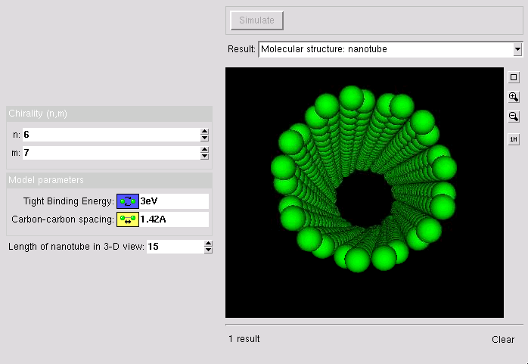
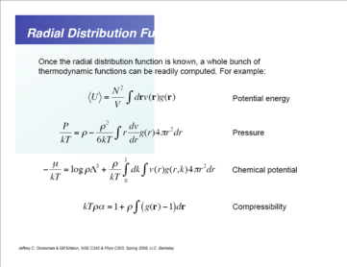
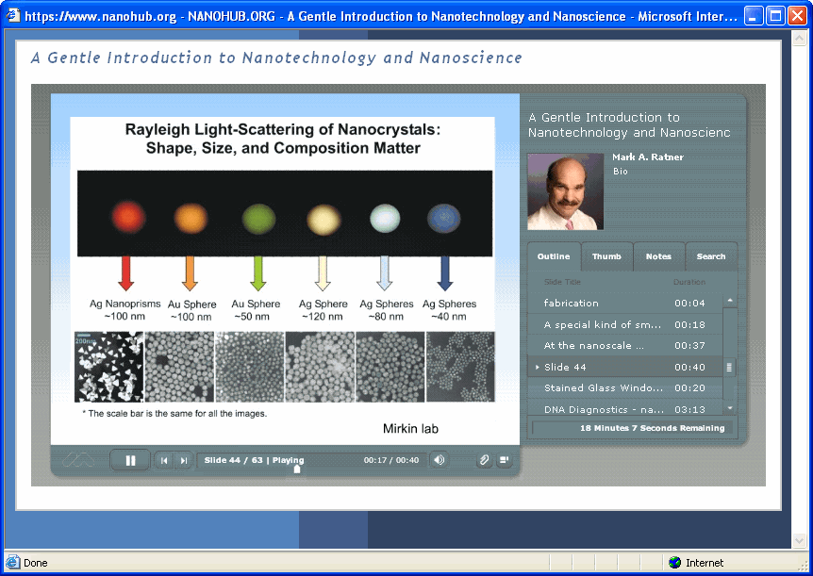
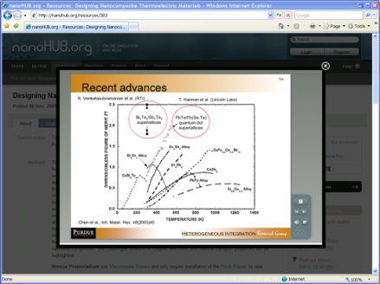
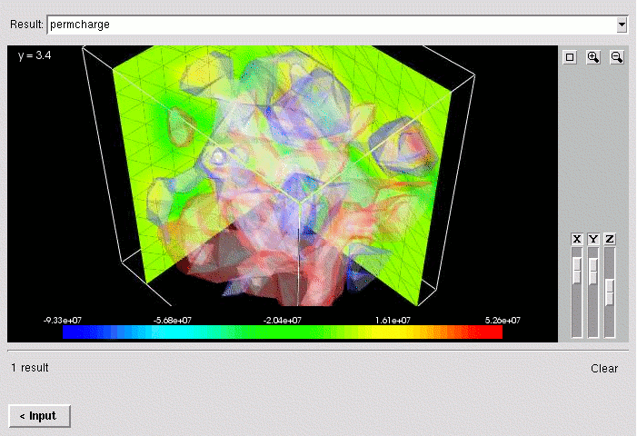
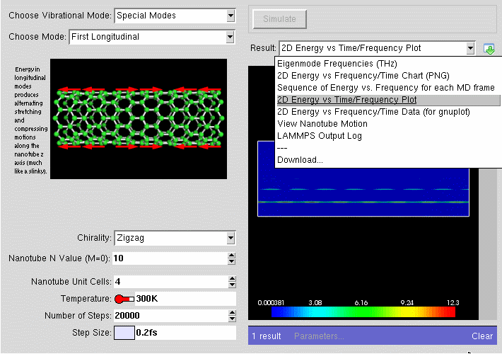
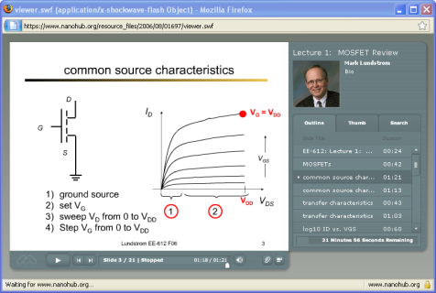

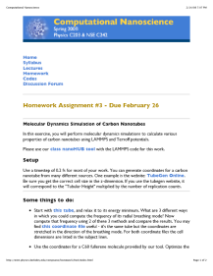









pharmaHUB Community
Tools
Tags
Supporting Resources
Crystallization
Particle Size Distribution
Dissolution
Research
Education
Reviews
Reviews

Slide 4
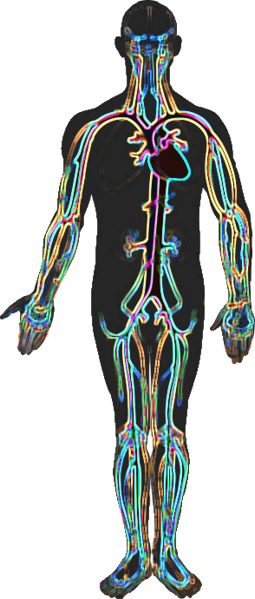
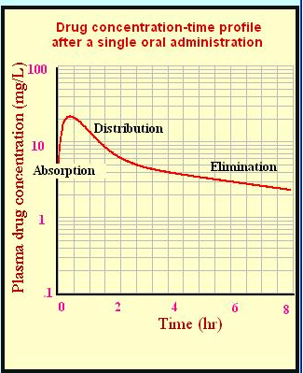
Pharmacokinetics
Loosely speaking: the study of what the body does to a drug
Absorption
Distribution
Metabolism
Excretion
Whole Body Physiologically Based Models provide a unique opportunity to learn about PK actively

Slide 5
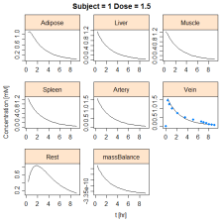
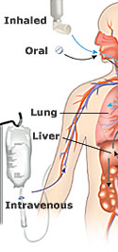
pHUBpk
Graphics
Drug
Library
WBPBPK
Calculator
Drug
Properties
Delivery
Mode
Patient
Properties
Lung
Non Eliminating Tissues
User
Inputs
Tables
Venous Blood
Arterial Blood
Kidney
Comp | Cmax | AUC
Adipose | 0.853 | 0.017
Bone | 0.0017 | 0.346
Brain | 0.0015 | 0.62
Kidney | 0.0242 | 0.483
Liver | 0.024 | 0.573
Lung | 0.0128 | 0.446
Muscle | 0.0072 | 0.63
Skin | 0.0044 | 0.291
GI/Portal Vein System
5
Liver
Patient
Library

Slide 6



Implementation
UDE
Substitutions at runtime
.R Driver
GUI
Tcl/Tk
UDE
Processed at runtime
Run Simulation
.inf
Data passed back to GUI for rendering
R
All code runs on the PharmaHUB

Slide 7
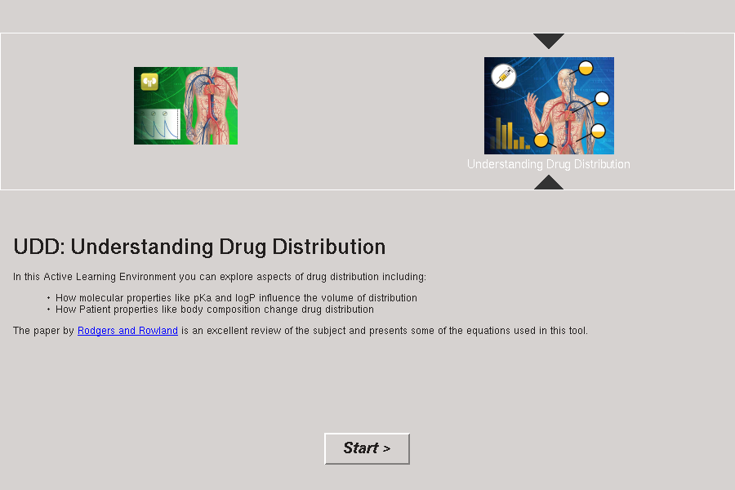

Slide 8
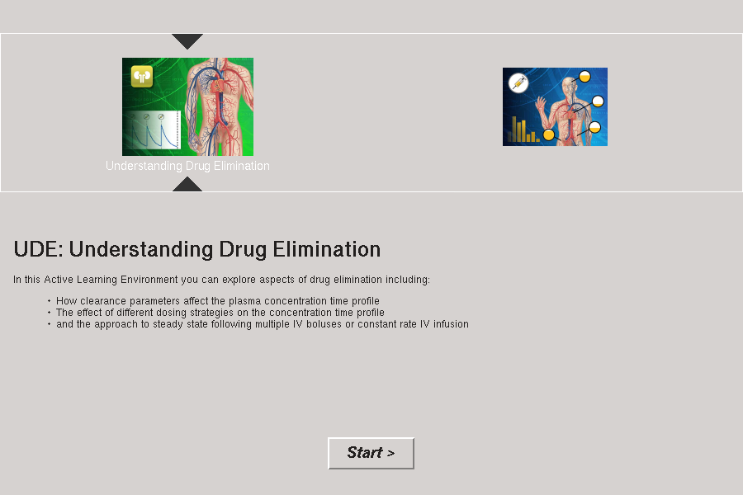

Slide 9
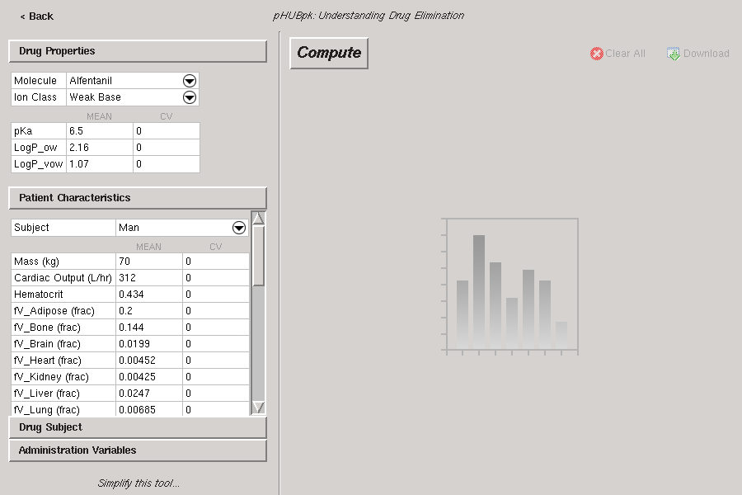

Slide 10
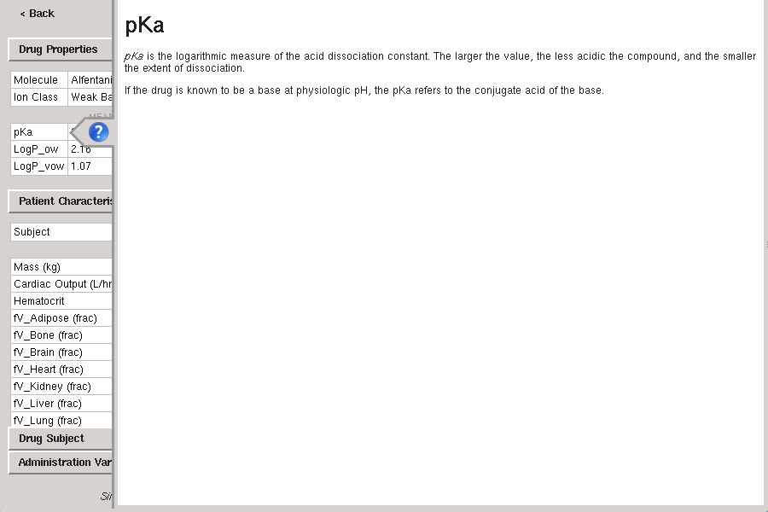

Slide 11
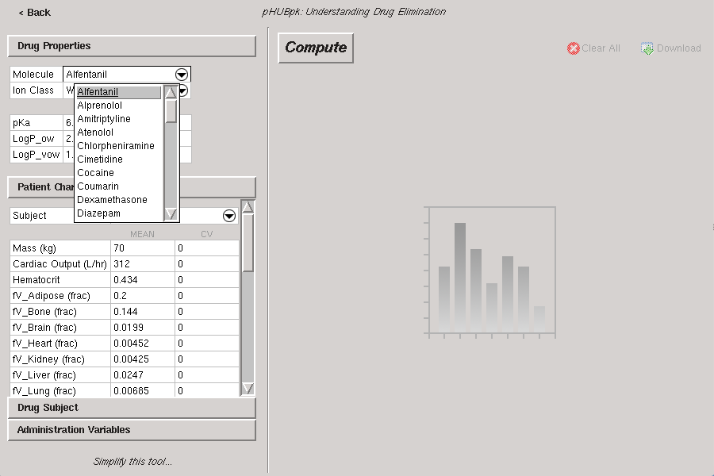

Slide 12
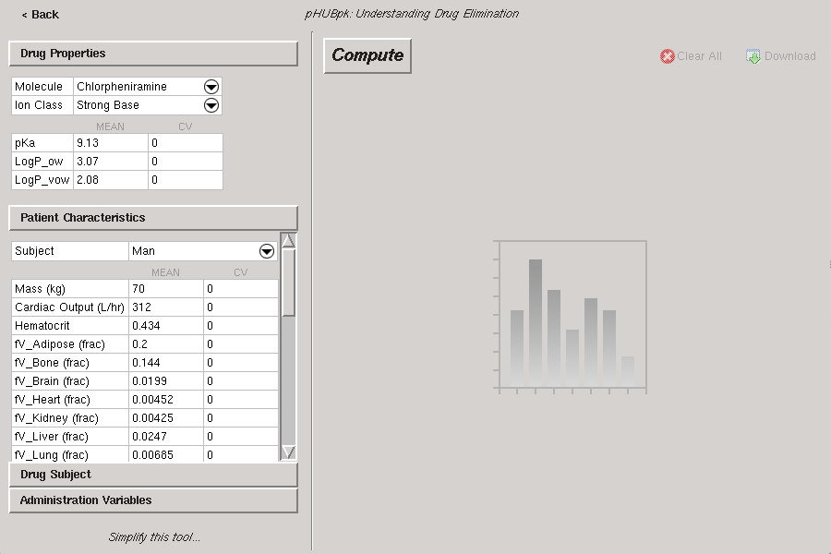

Slide 13
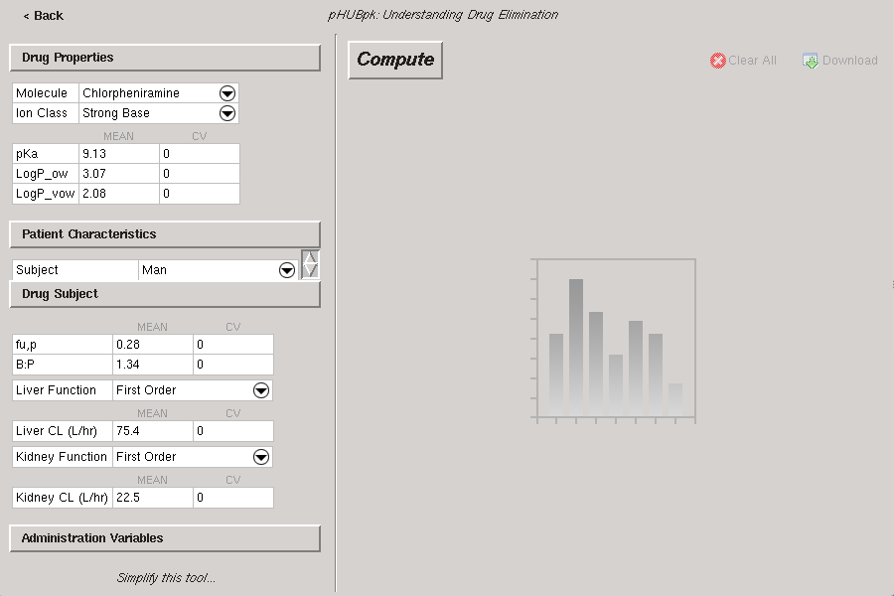

Slide 14
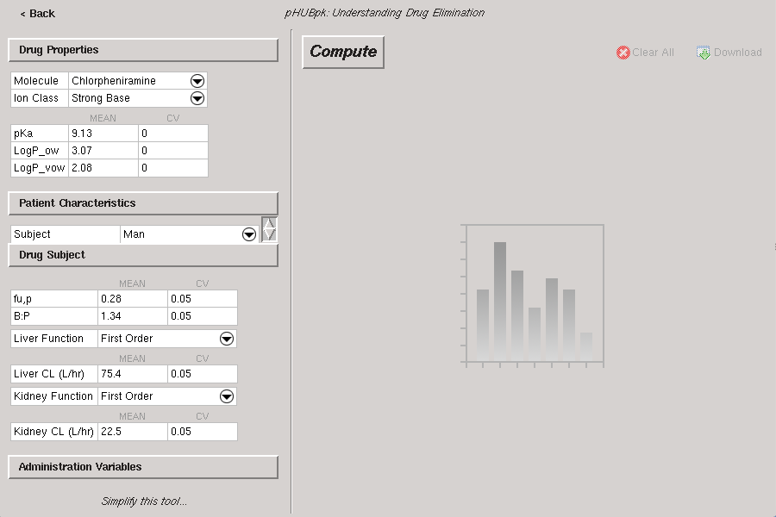

Slide 15
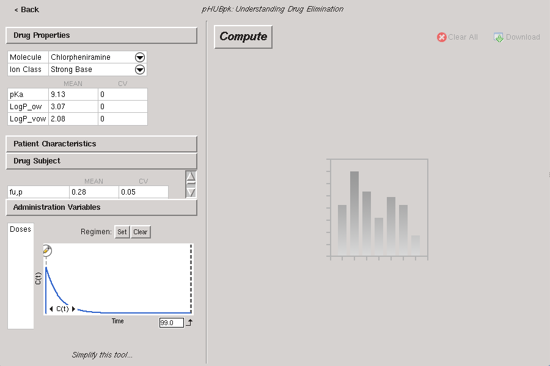

Slide 16
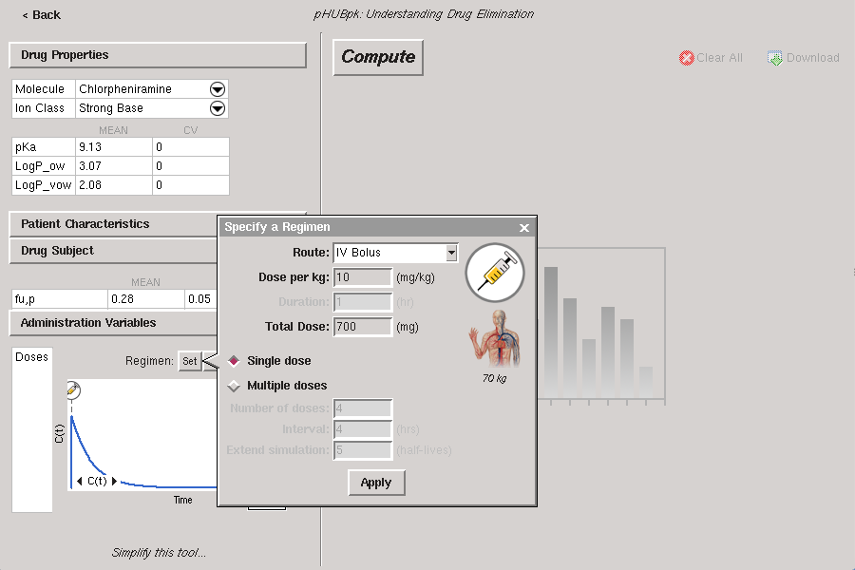

Slide 17
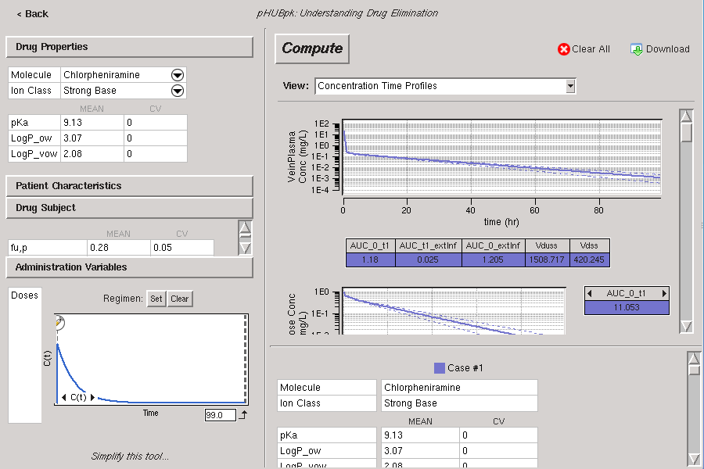

Slide 18
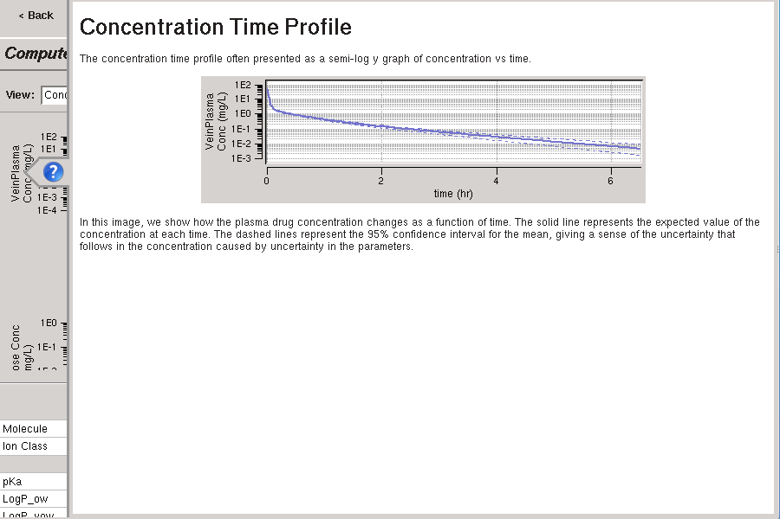

Slide 19
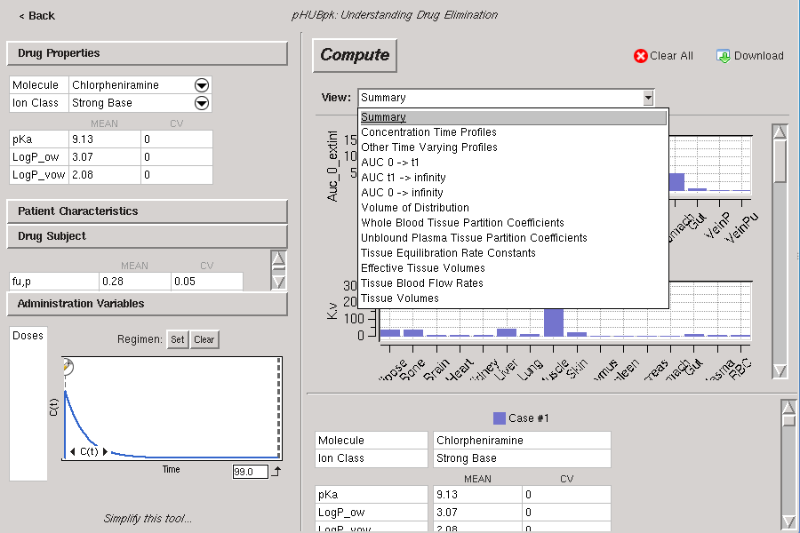

Slide 20
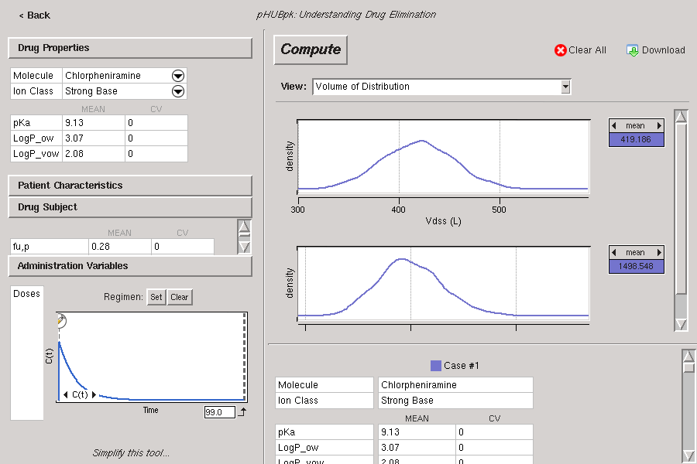

Slide 21
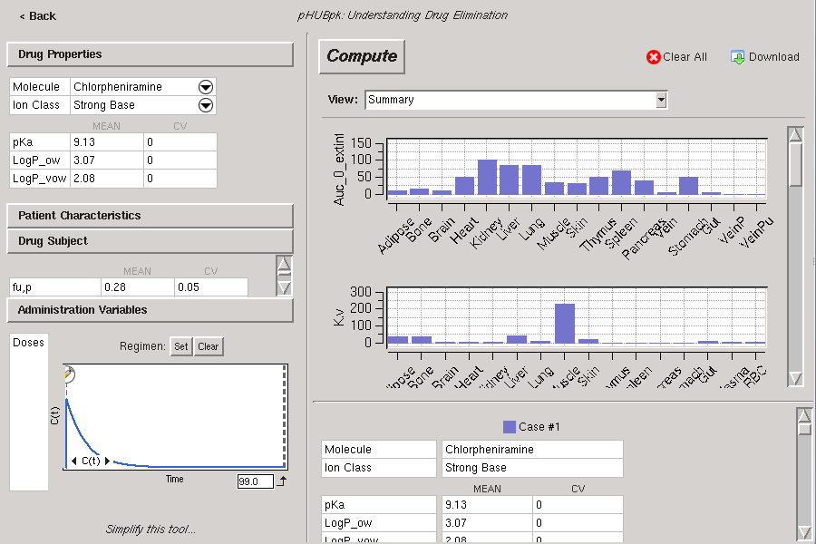

Slide 22
Case Comparison
To explore and discover how the various properties influence interface is interactive, we allow users to compare different cases
Cases can be different
  Drugs
  Subjects
  Regimens
We highlight the differences in the case browser

Slide 23
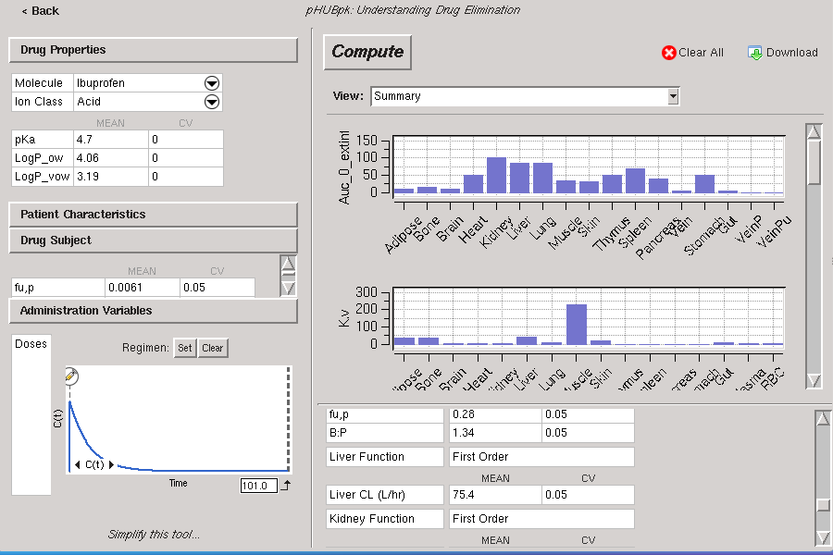

Slide 24
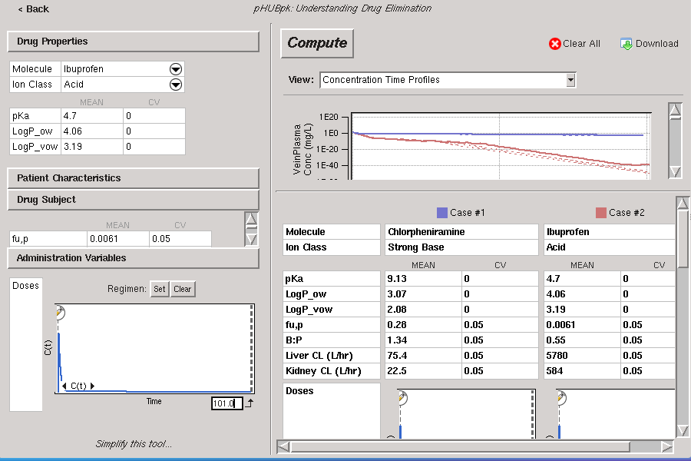

Slide 25
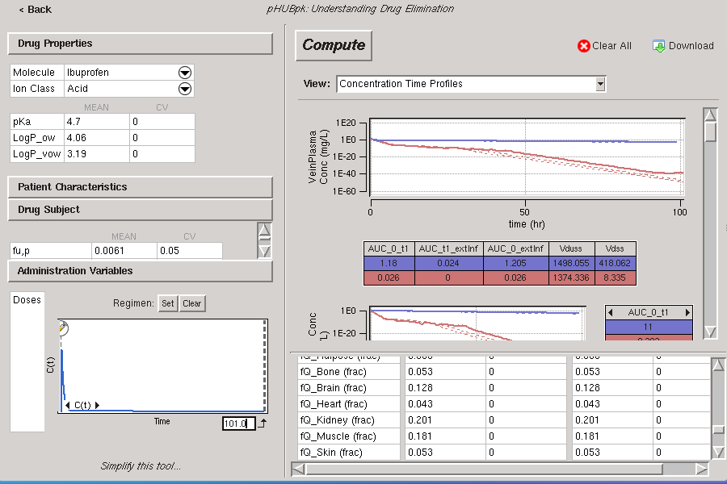

Slide 26
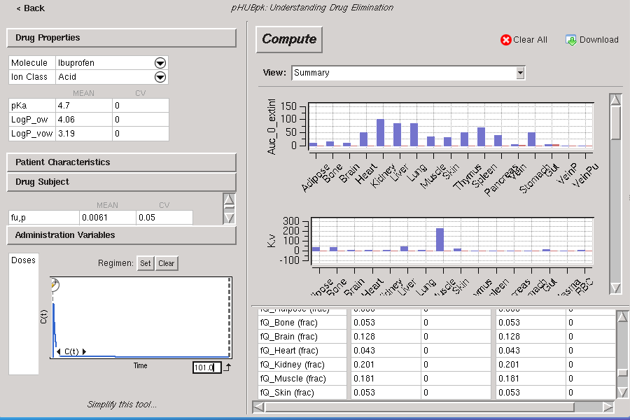

Slide 27
Wizards simplify
The input libraries contain all the relevant quantities
There is no need to show the default values to new users
Similarly, new users need not be overwhelmed with all of the output
Instructors can use a GUI to hide fields and output for simple laboratory class assignments

Slide 29
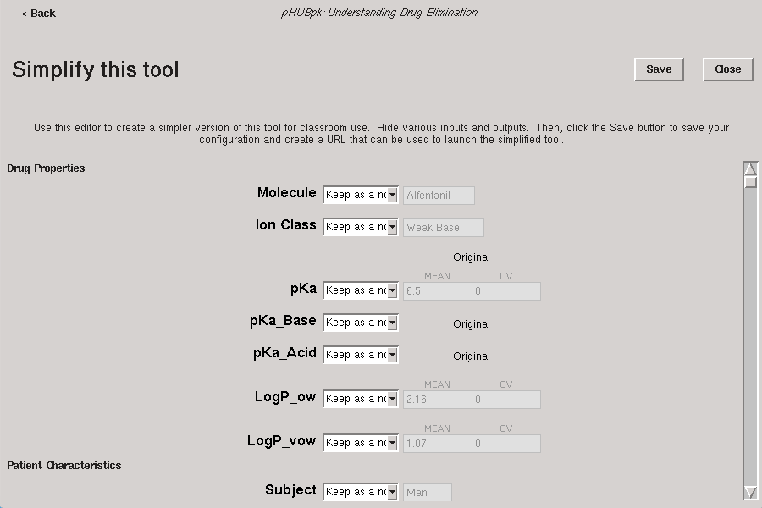

Slide 30
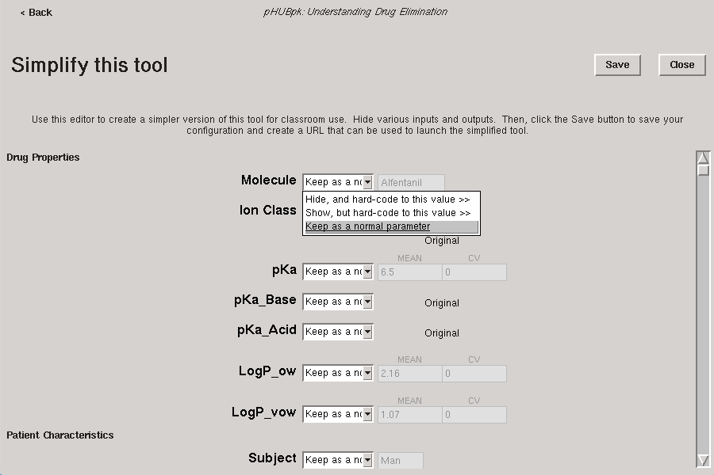

Slide 31
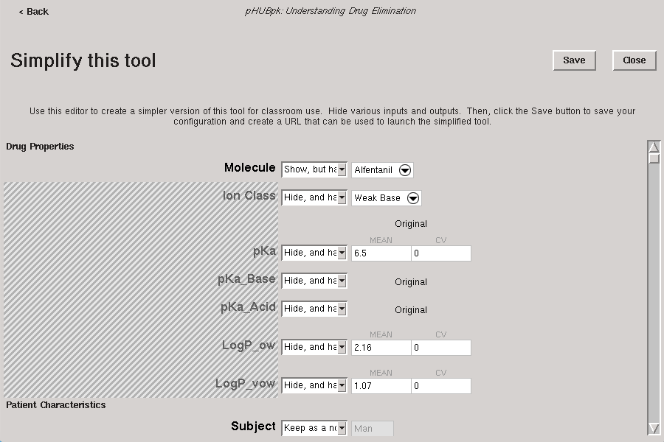

Slide 32
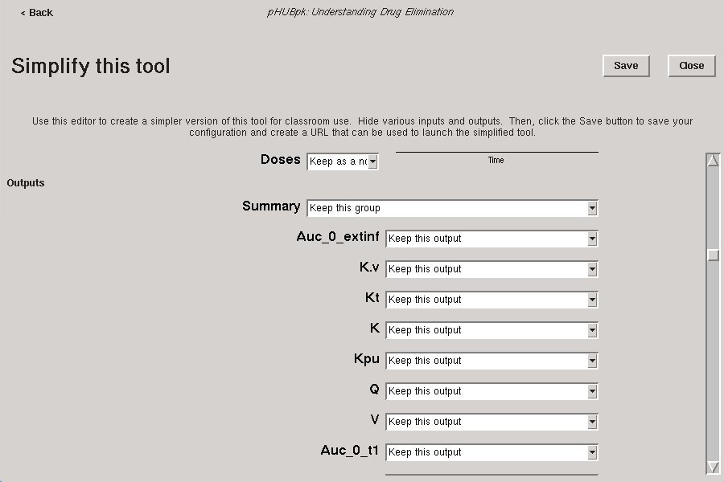

Slide 33
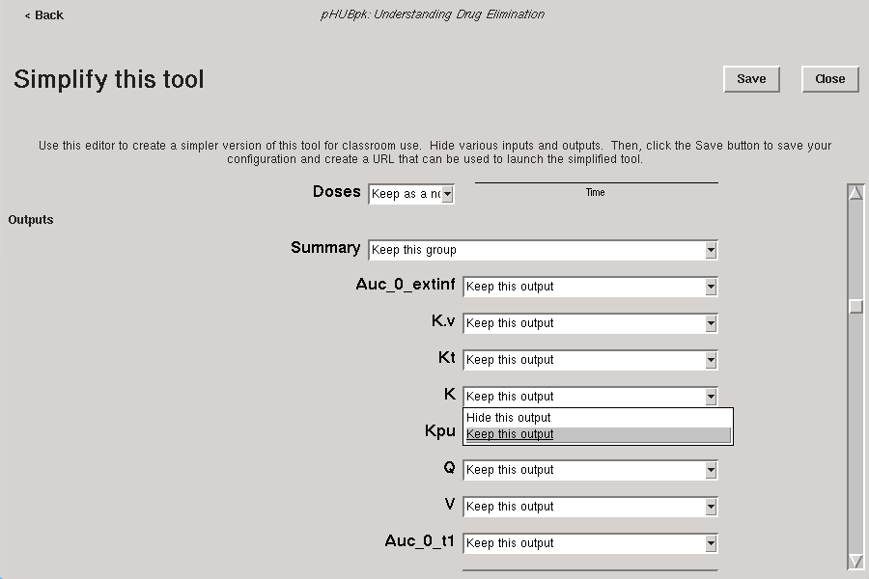

Slide 34
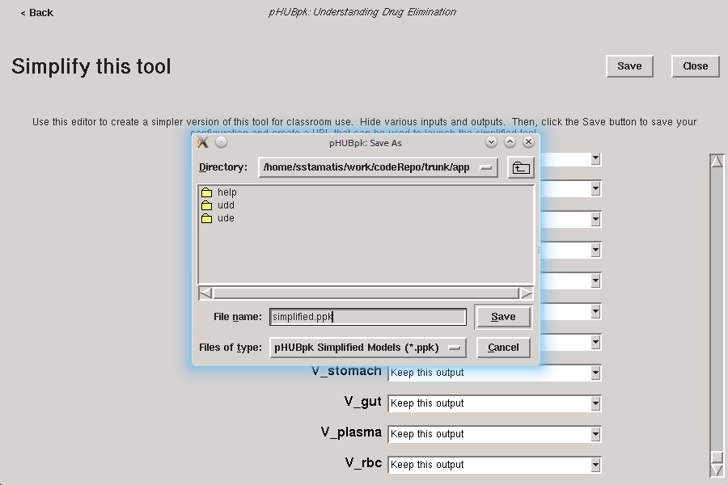

Slide 35


Slide 36


Slide 37


Slide 38
Summary
http://pharmaHUB.org
  No cost to users
  Community tools
pHUBpk
  A collection of active learning environments for pharmacokinetics
  Users discover trends with simulated empiricism

